Slide 1
Metagenomics
Quito, PUCE
2024-06
Manzanilla Vincent

Slide 2
Learning goals
Foundational skills to work with metagenomic data
Familiarity and practice with bioinformatics tools
Perspective and confidence to apply these skills in your own work
Empower you to ask and answer the questions you have of your own data

Slide 3
This course
Hands-on
Materials available during and after the course Github
Mix of lectures, tutorials and practice
Ask questions but if there is an error read the error message first
Learn from each other as well as instructors

Slide 4
The nature of data: sequencing of amplicons vs shotgun metagenomes
http://merenlab.org/momics
Notes:
The alternative approach is the shotgun metagenomics.

Slide 5
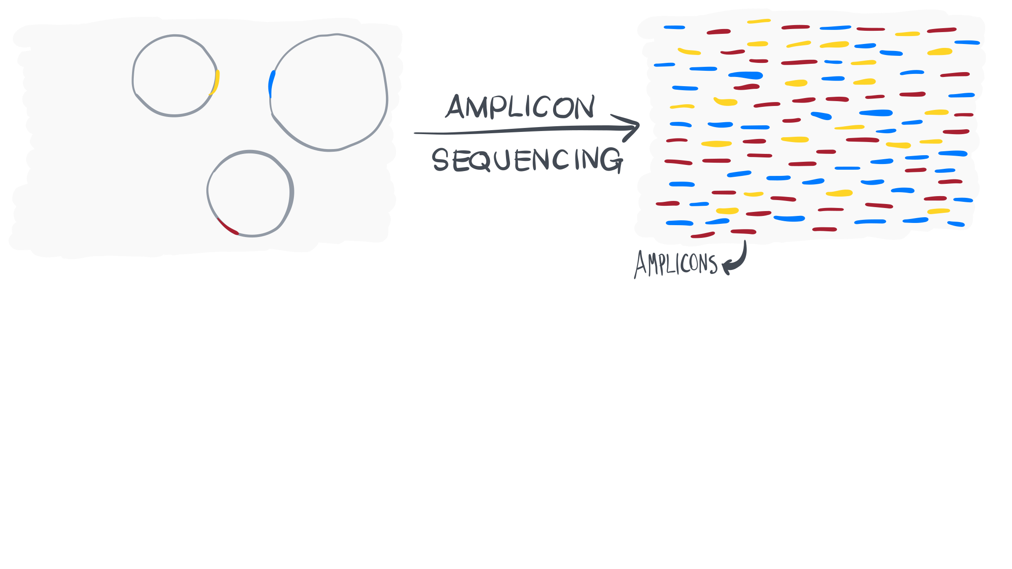
Notes:
The resulting dataset can be used to understand the taxonomic make up of an environment, and/or study the changes in microbial diversity as a function of environmental variables.
Although, universal primers used to amplify from 16S rRNA gene amplicon are not as universal as we would like to think. So it is likely that amplicon data will be missing information from,

Slide 6
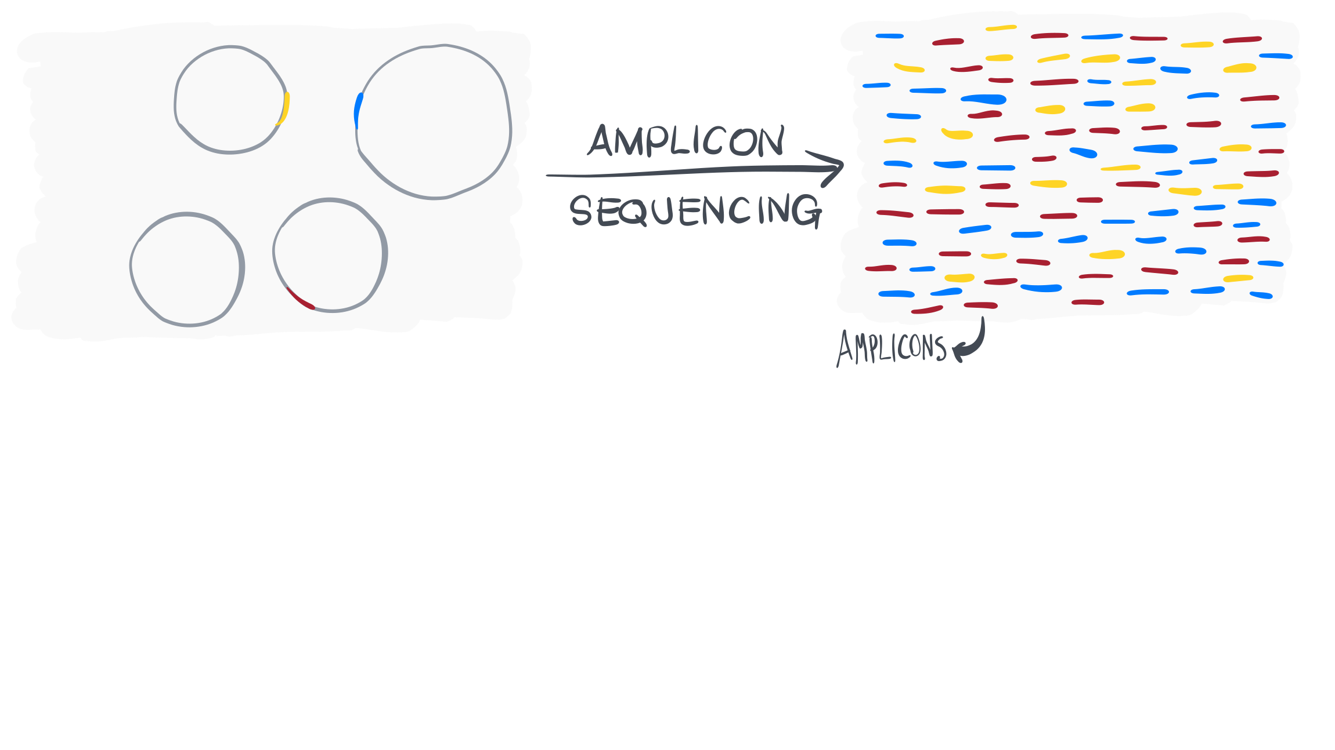
Notes:
Bacterial populations that our primers do not recognize,

Slide 7
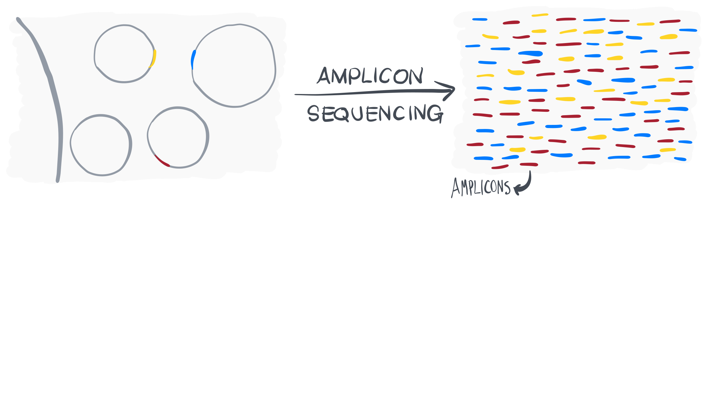
Notes:
Eukaryotic organisms, the ribosomal small subunit of which do not include 16S rRNA gene (but 18S rRNA gene),

Slide 8

Notes:
Plasmids,

Slide 9
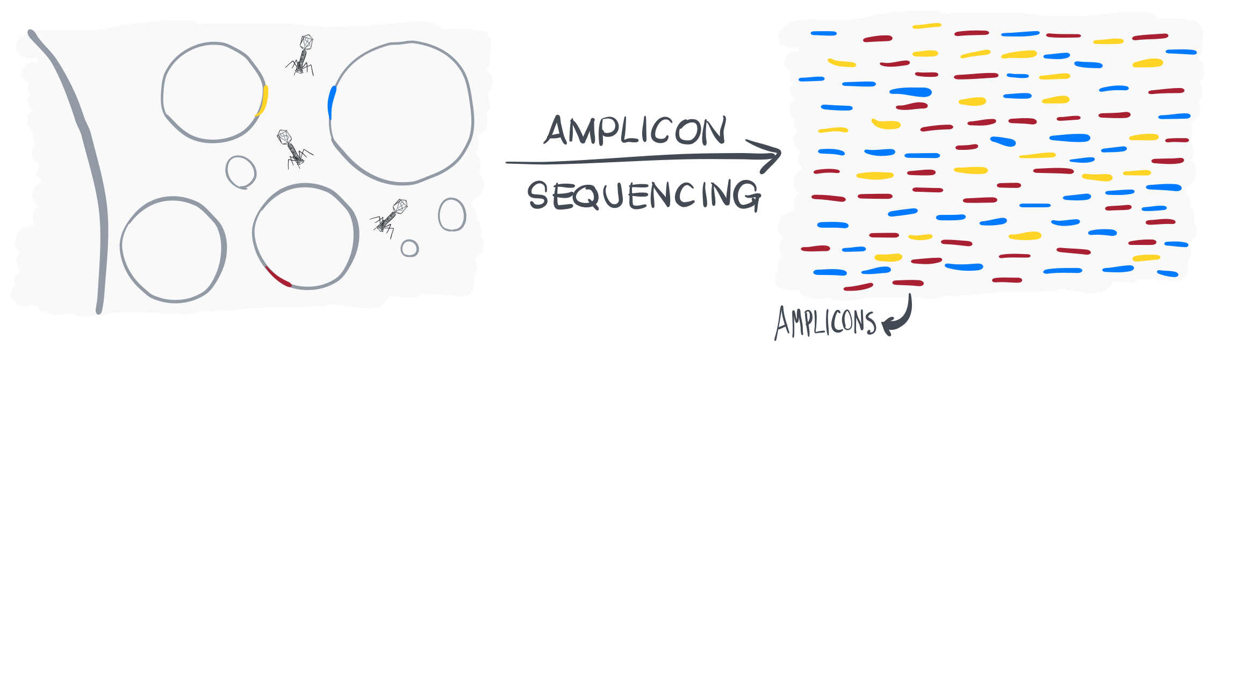
Notes:
And phages.
To what extent these genetic features of a given environment is critical to understand ecosystem functioning is a an important question. And the answer may differ from study to study.

Slide 10
The nature of data: sequencing of amplicons vs shotgun metagenomes
http://merenlab.org/momics
Notes:
The alternative approach is the shotgun metagenomics.

Slide 11
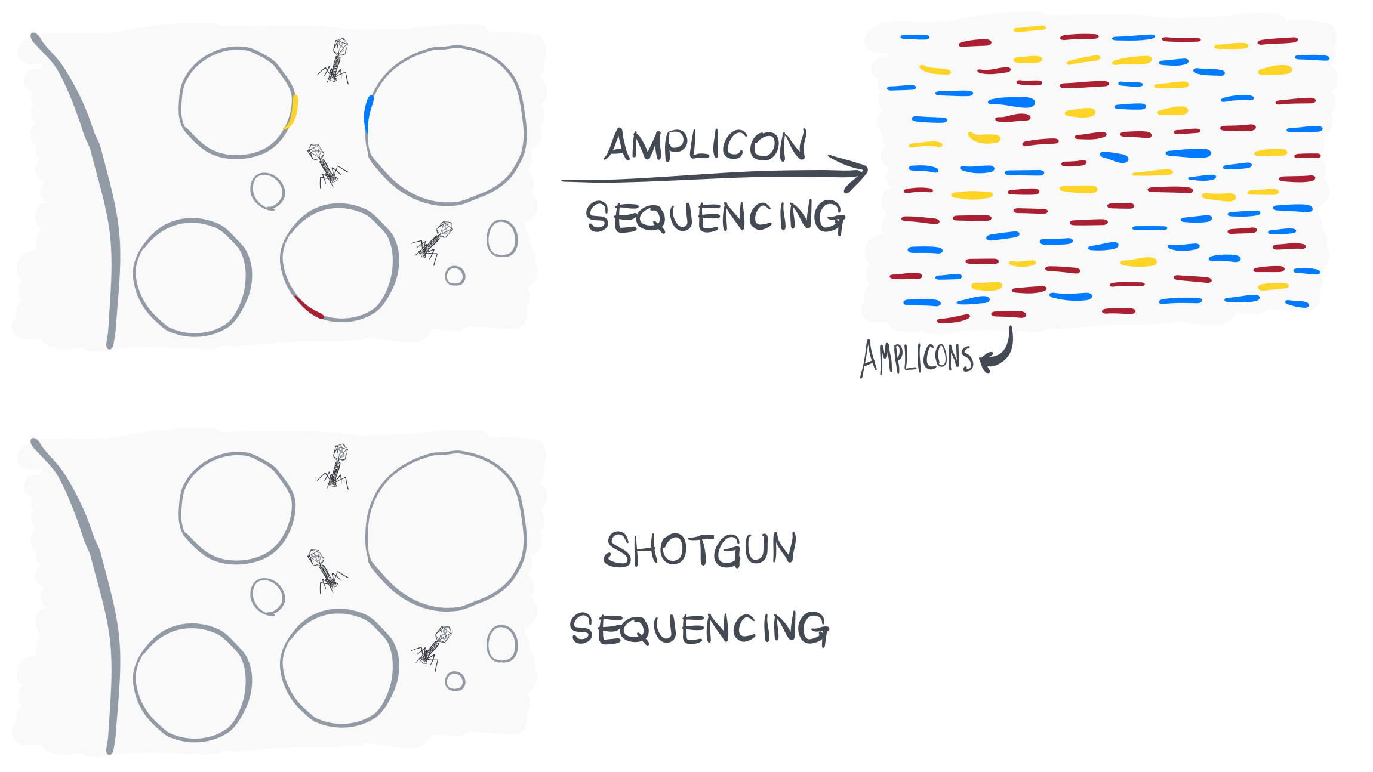

Slide 12
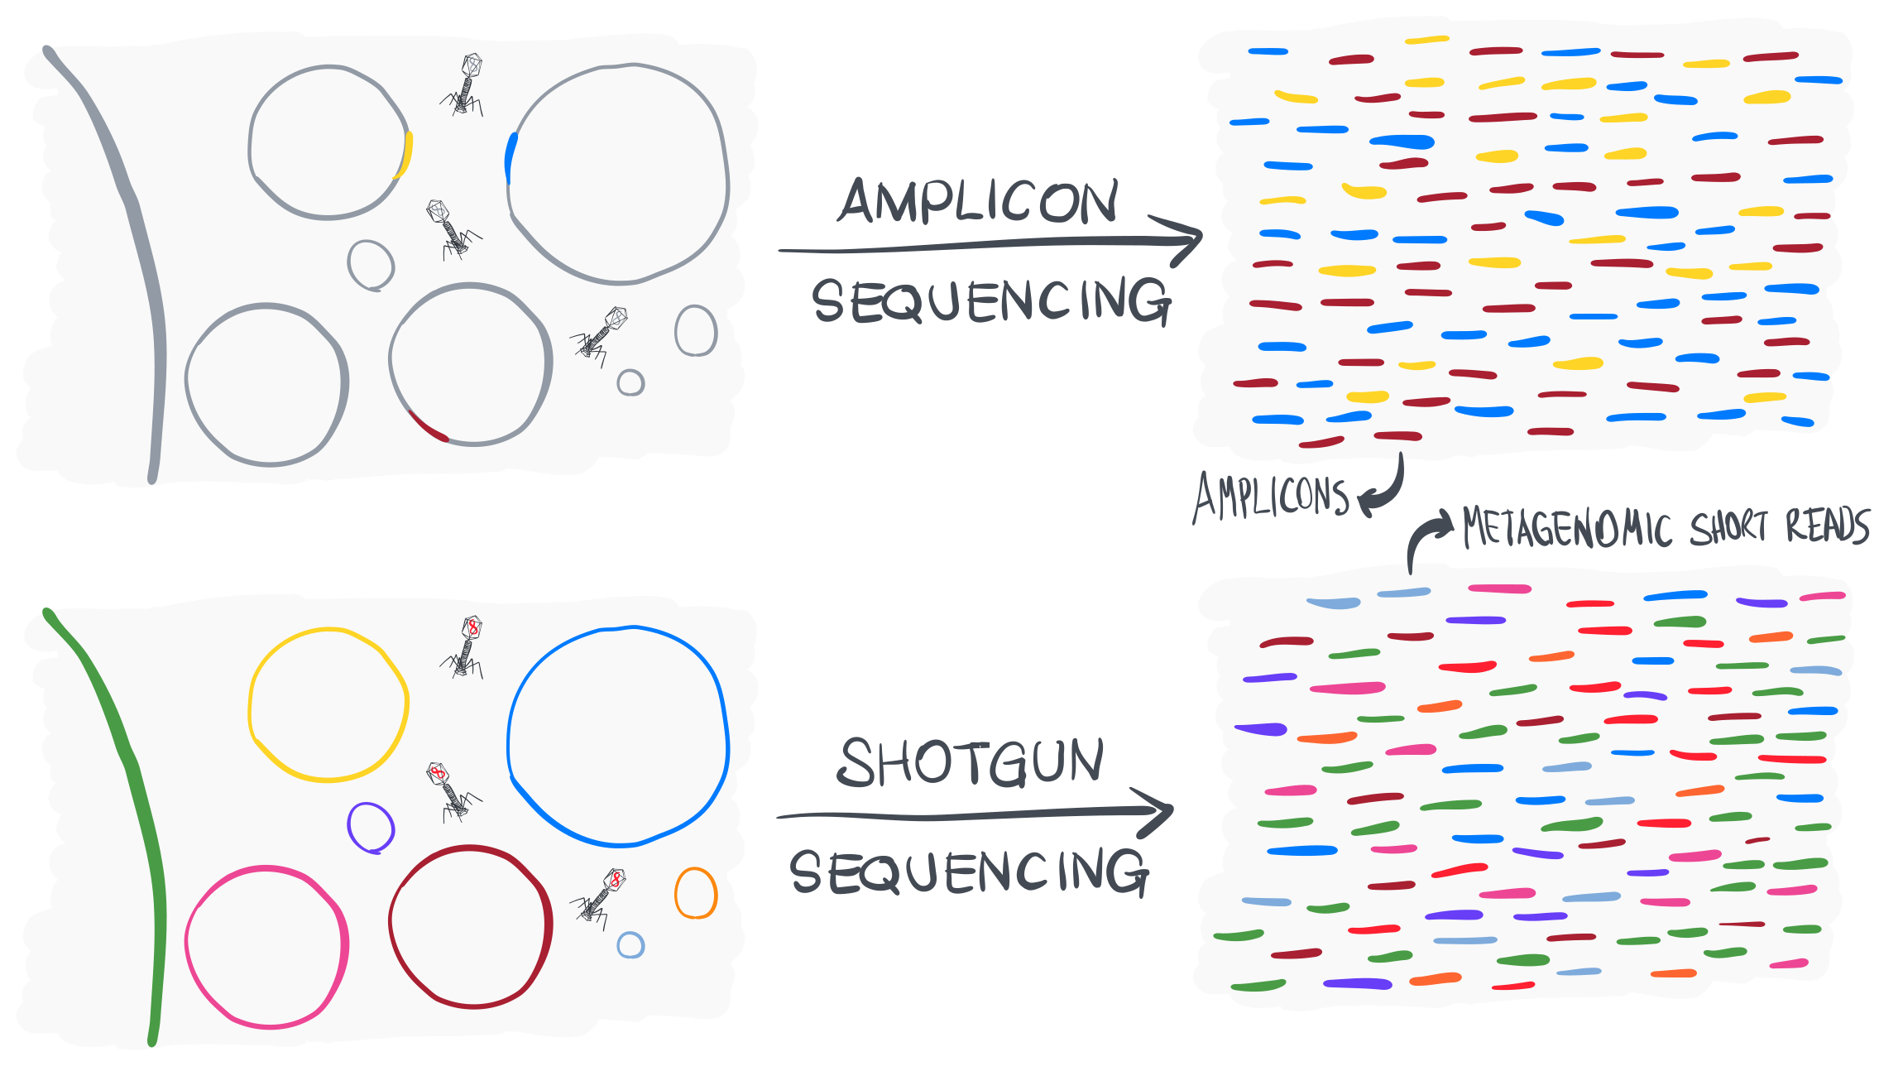

Slide 14
Amplicon
Amplicon easy, cheap
Limited information
Missing organisms
Very well establish protocols
Shotgun sequencing – Metagenomics short reads
80% to 90 % eukaryote genome
Information on all bacteria but also virus
Short reads - complex data but metagenomics short read recruitment
Very well established protocols
No limitation with the primers

Slide 16
Dataset for this course
A Wolbachia plasmid from Culex pipiens ovaries
Summary
We captured four wild mosquitoes in Southern France, and performed microsurgery to extract their ovaries (ouch),
After shotgun sequencing, we reconstructed de novo population genomes for Wolbachia, the endosymbiotic alphaproteobacterial genus of many arthropod and nematode species worldwide,
Identified a circular, extra-chromosomal element with hallmarks of a plasmid in the mobilome, and confirmed its occurrence and circular nature using PCR, Sanger sequencing, and long-read sequencing experiments,
Used publicly available mosquito metagenomes to show the occurrence and conservancy of the plasmid, and the diversity and richness of phages in individual mosquitoes.

Slide 17
Reconstructing high-quality microbial genomes from metagenomes (i.e., metagenome-assembled genomes, or MAGs)
Characterizing microdiversity within environmental populations our MAGs represented through single-nucleotide variants,
Using metapangenomics to investigate gene content of metagenome-assembled and reference genomes and its association with metagenomes,
Employing snakemake workflows to study complex datasets with many steps of analyses in a reproducible manner.

Slide 18
Schedule
Time | Monday | Tuesday | Wednesday | Thurday | Friday
Morning | Intro | MEGAN | Assembly Genome resolved metagenomics | Integrated multi-omics | MAG annotation
Lunch break
Afternoon | Read-based analysis | METAXA | Integrated multi-omics | Integrated multi-omics | MAG analysis

