Slide 1
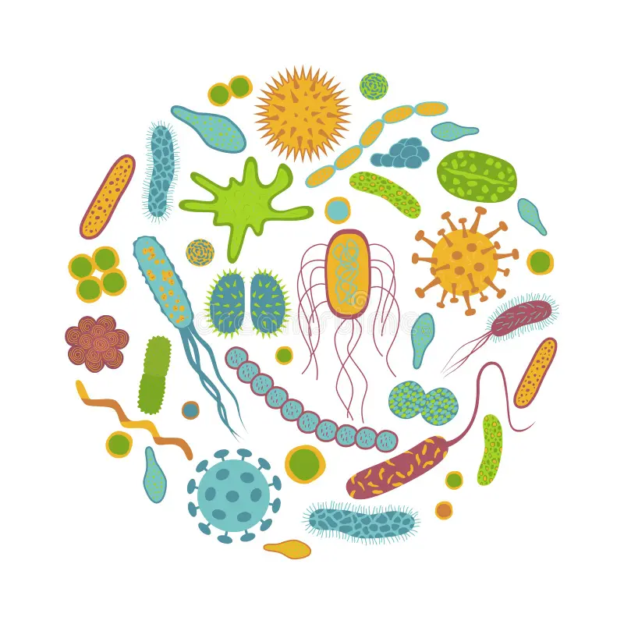


Introduction to Metagenomics
Vincent Manzanilla
Quito 06/2024

Slide 2
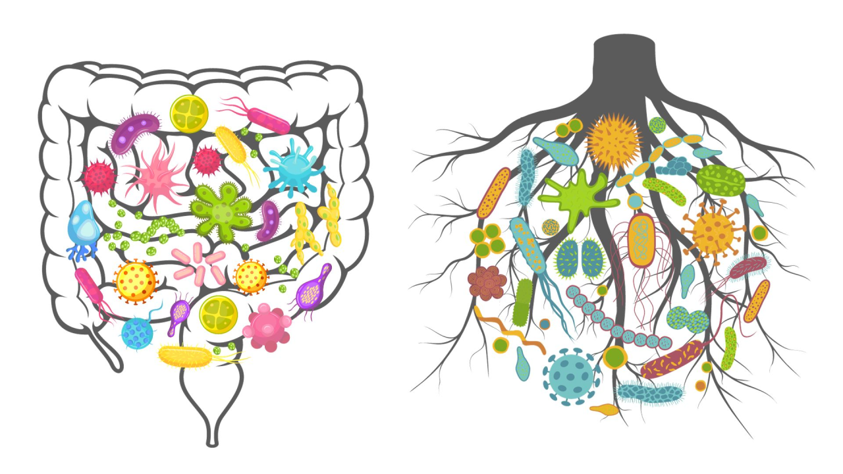
What is a microbiome?
The totality of microbes in a defined environment, especially their genomes and interactions with each other and surrounding environment.
A population of a single species/strain is a culture, extremely rare outside of lab, some infections
A microbiome is a mixed population of different microbial species (microbial ecosystem)
A mixed community is the norm!

Slide 3
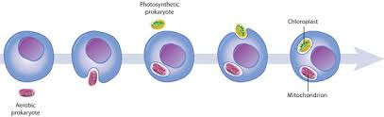
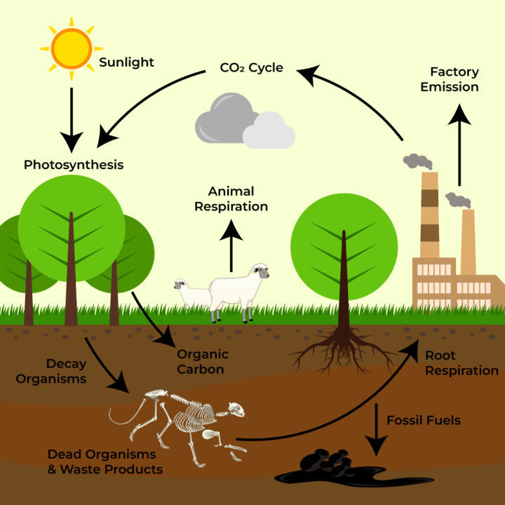
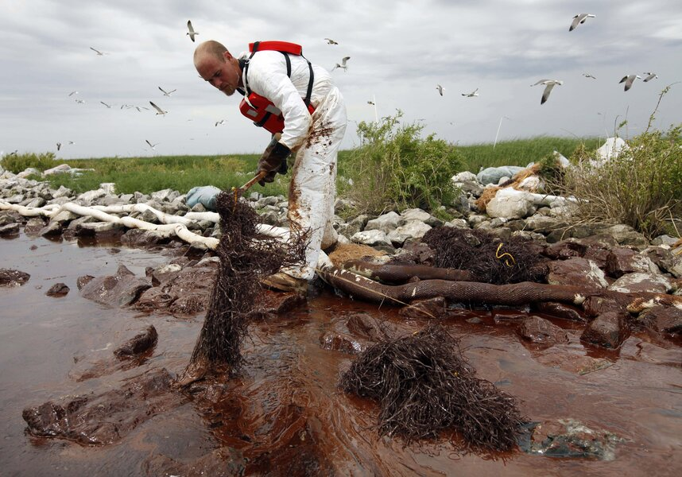
Why study microbiomes?
Environmental Science
- Critical elemental cycles (carbon, nitrogen, sulfur, iron, …)
- Pollution control, cleanup
- Ecology / Evolution (chloroplasts, mitochondria, symbiosis, competition, …)

Slide 4


Why study microbiomes?
Environmental Science
- Critical elemental cycles (carbon, nitrogen, sulfur, iron, …)
- Pollution control, cleanup
- Ecology / Evolution (chloroplasts, mitochondria, symbiosis, competition, …)
Industrial Applications
- Wastewater treatment (V. cholera, algal blooms, etc.)
- Bioprospecting (novel enzymes, compounds)
- Novel biosynthesis
- Fermentations: Consortia (yogurt) / wild (kombucha, Belgian ales

Slide 5

Why study microbiomes?
Human Health
- Protection from pathogens (e.g. Clostridium difficile)
- Cancer
- Absorption/Production of nutrients in the gut (obesity, T2D)
- Development/regulation of immune system, e.g. chronic diseases (T1D, RA, IBD, other autoimmune, UTIs, periodontitis, …)

Slide 6
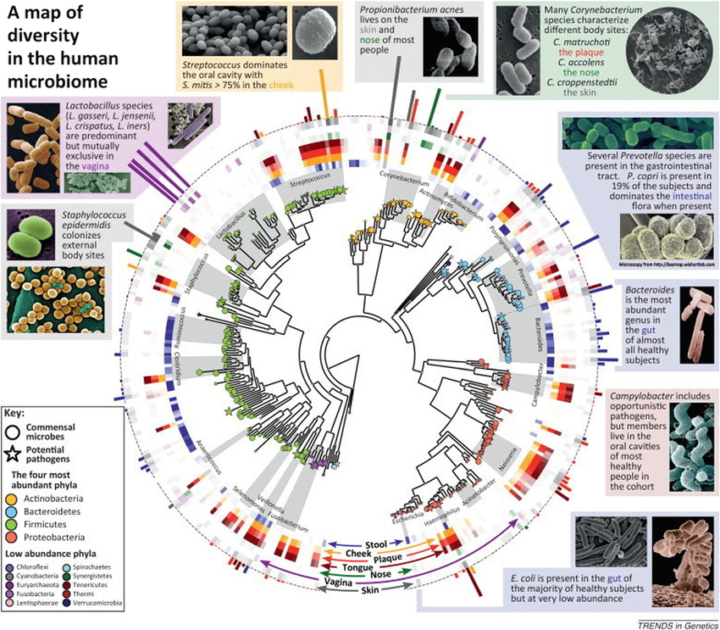

Slide 7
Who’s there?
(Taxonomic profiling)
What are they doing?
(Functional profiling)
What does it all mean?
(Statistical analysis)

Slide 8
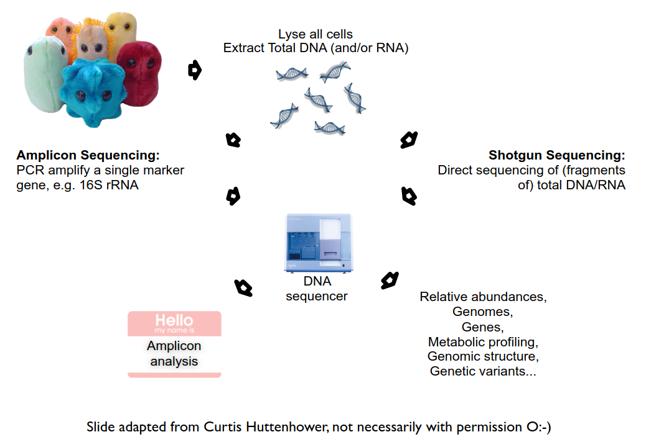
A summary of metagenomics technique

Slide 9
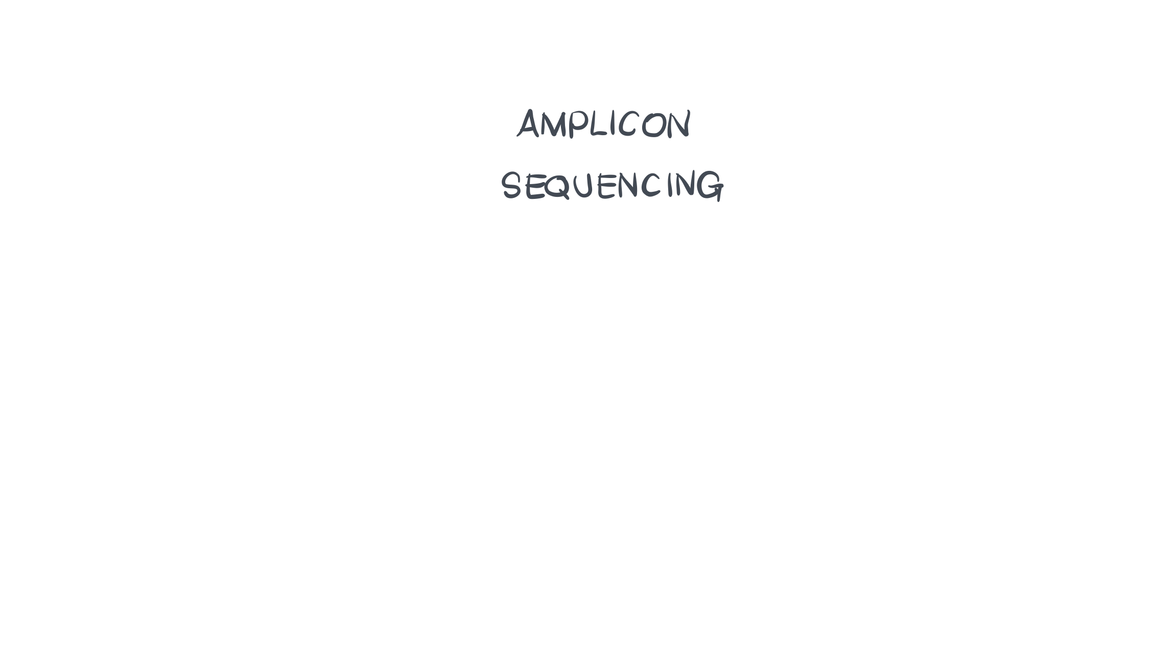
https://merenlab.org
Notes:
The main principle behind amplicon sequencing is the use of primers to ‘amplify’ sequences from evolutionarily homologous and short regions of genomes of interest.
Advantages of amplicon sequencing include the affordability of this strategy, well-established primers for many environments, and the tractability of the resulting data.

Slide 10
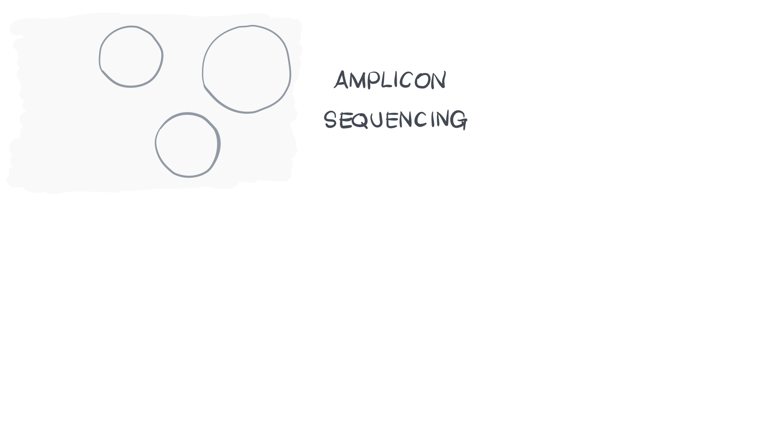
Notes:
If we are working with an environment with, say three different populations,

Slide 11
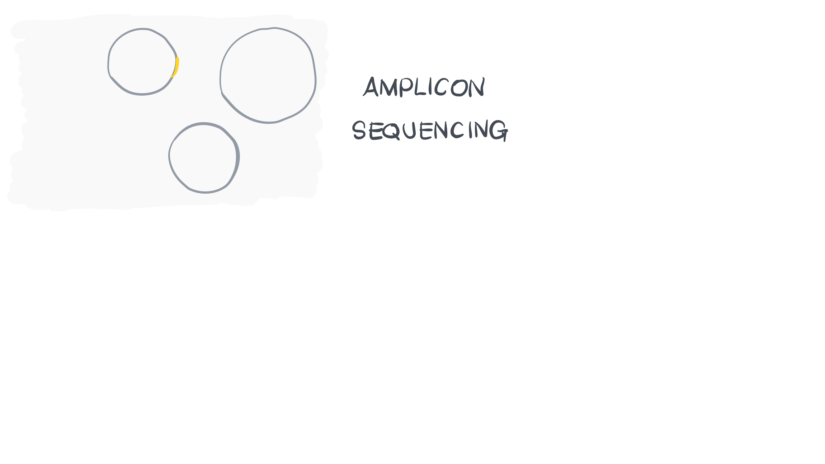
Notes:
Our primers will land and amplify reads from each of these populations.

Slide 12
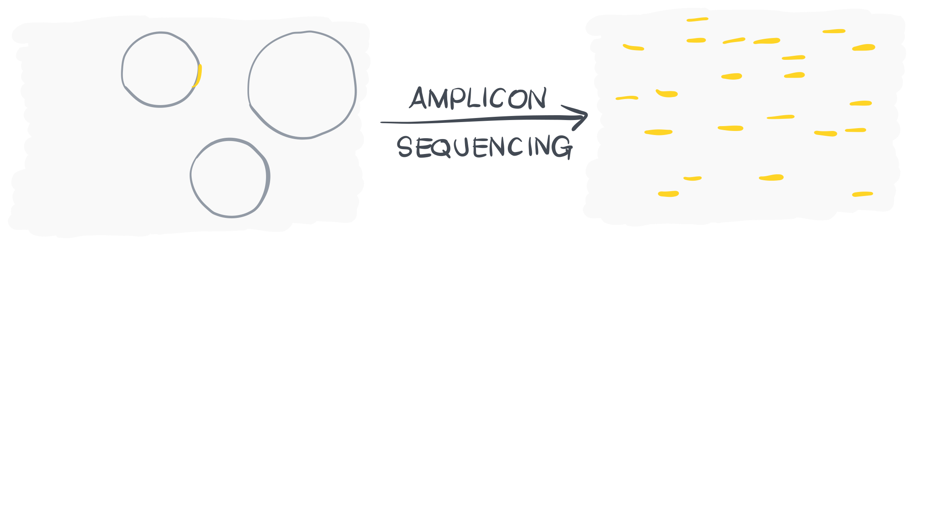

Slide 13
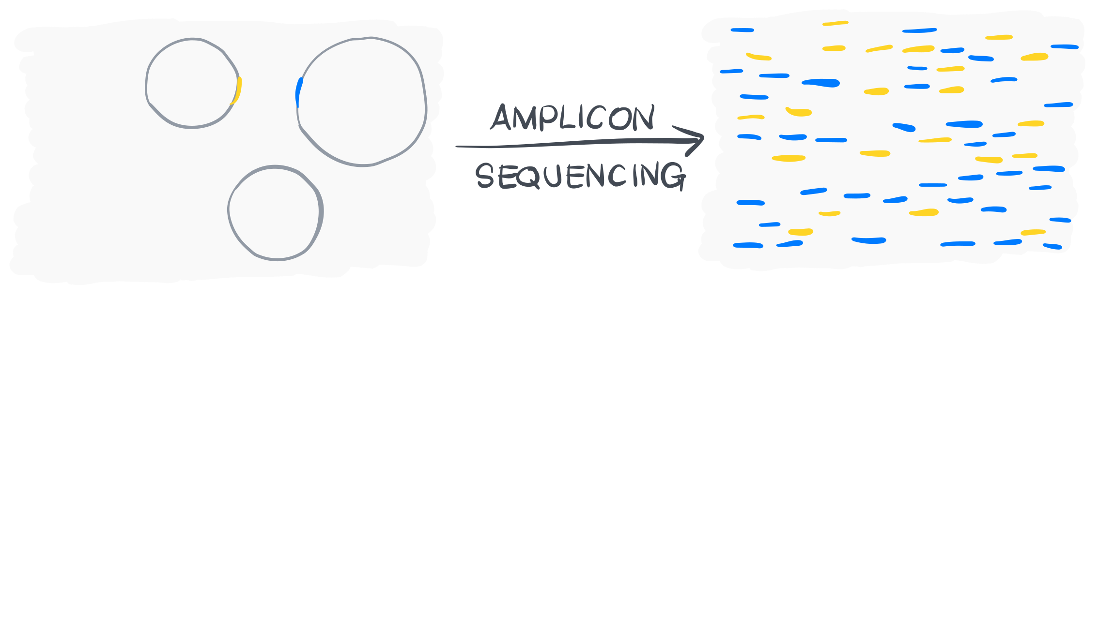

Slide 14
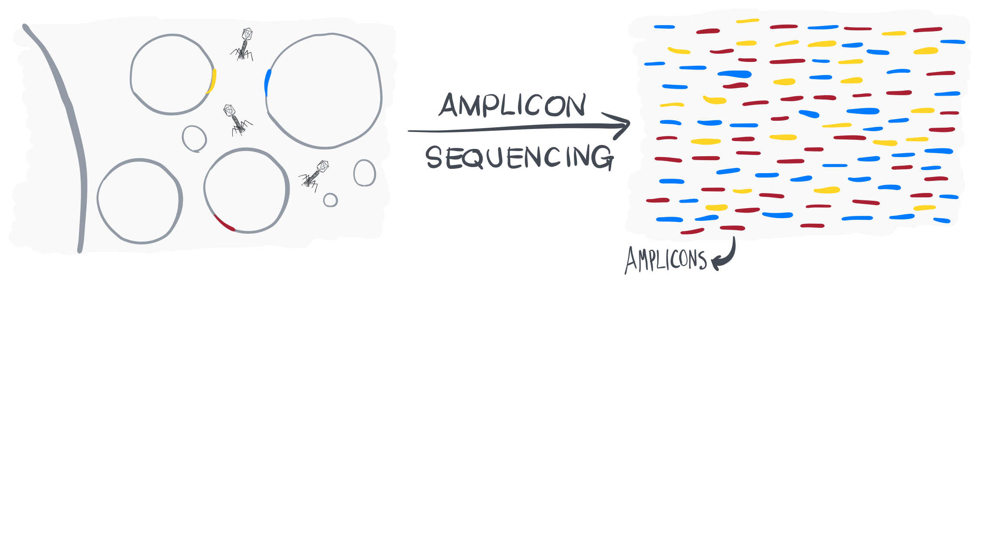
Notes:
And phages.
To what extent these genetic features of a given environment is critical to understand ecosystem functioning is a an important question. And the answer may differ from study to study.

Slide 15
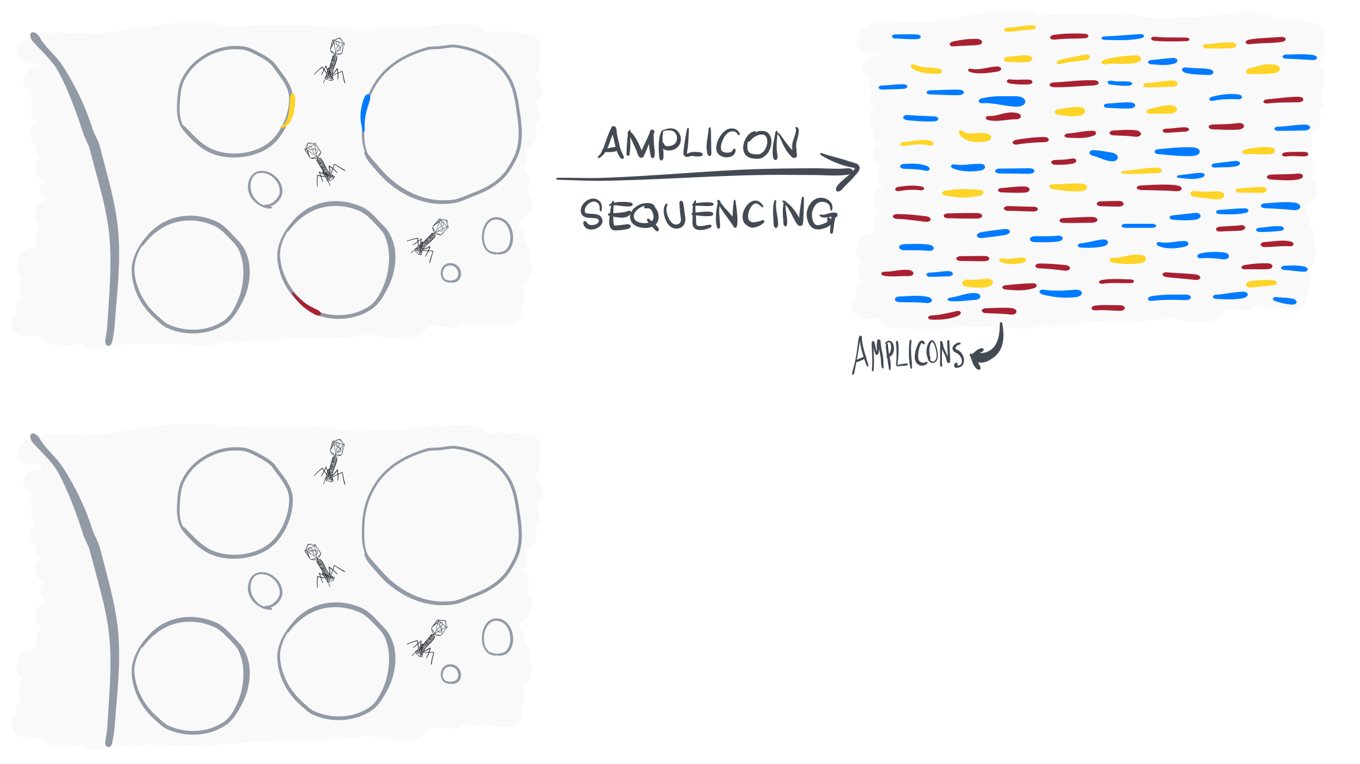

Slide 16
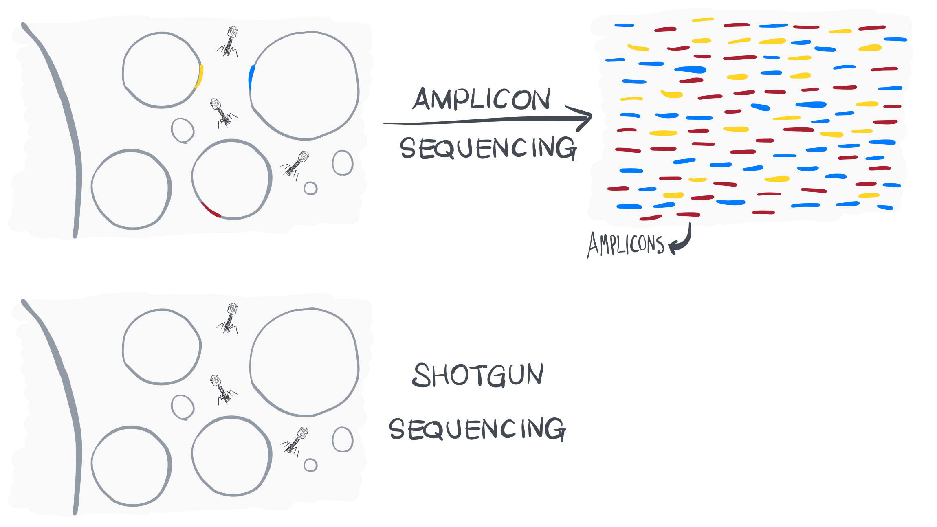

Slide 17
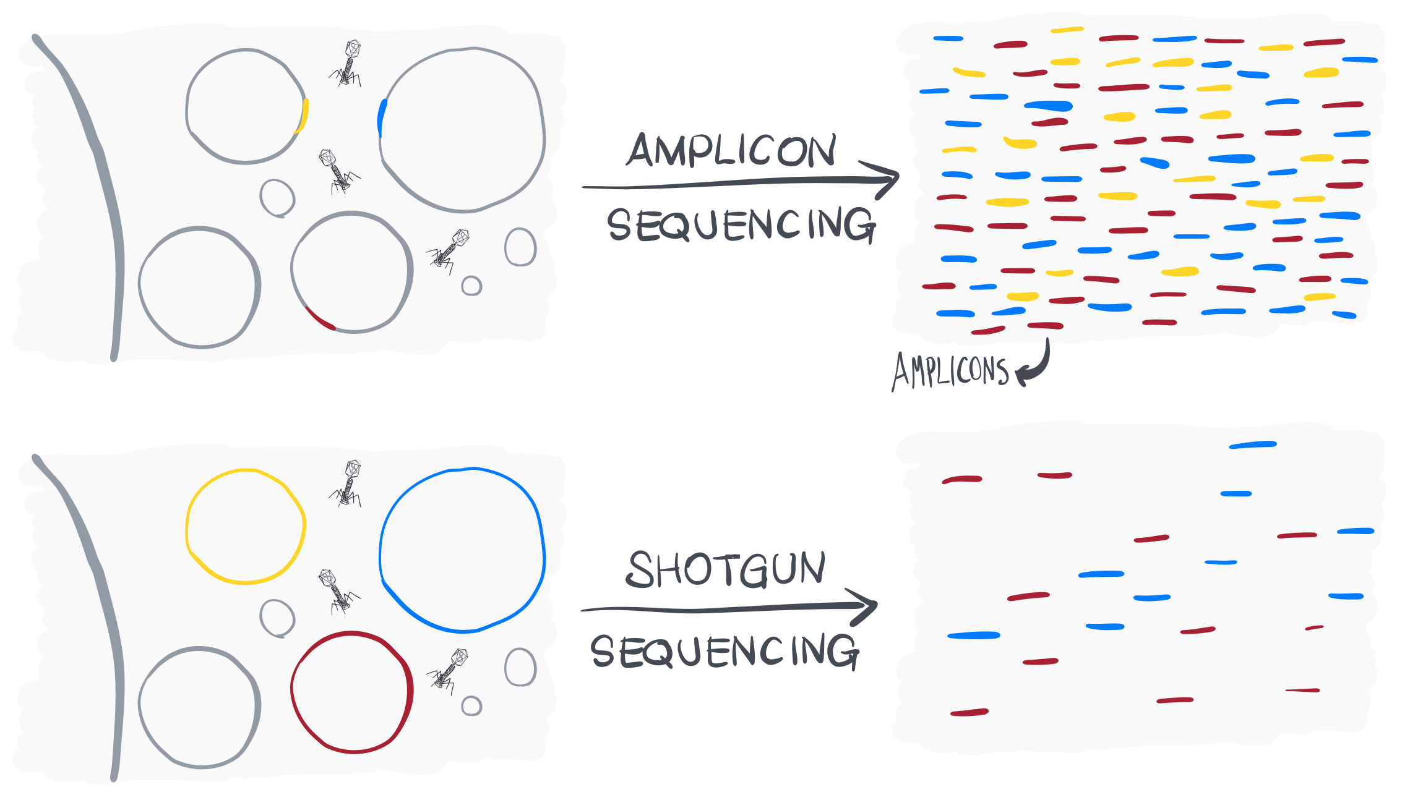

Slide 18
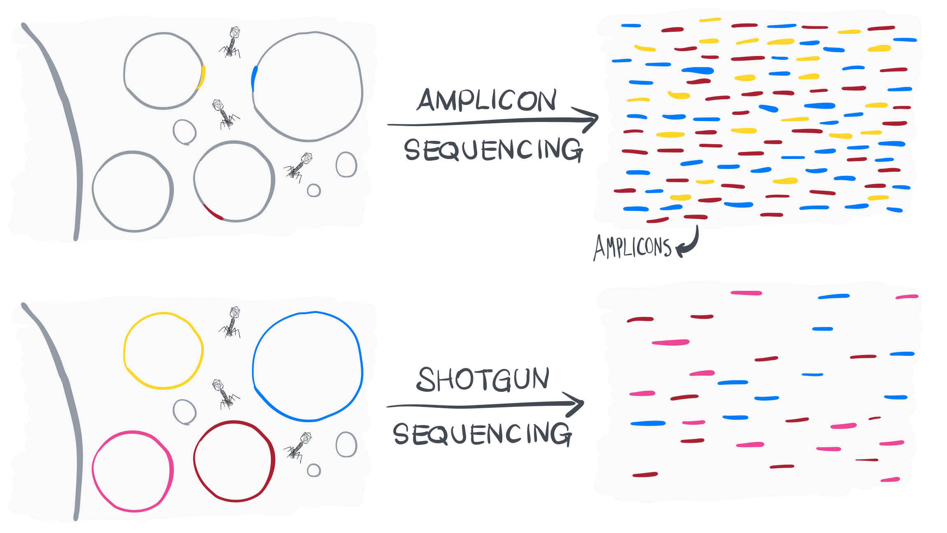

Slide 19
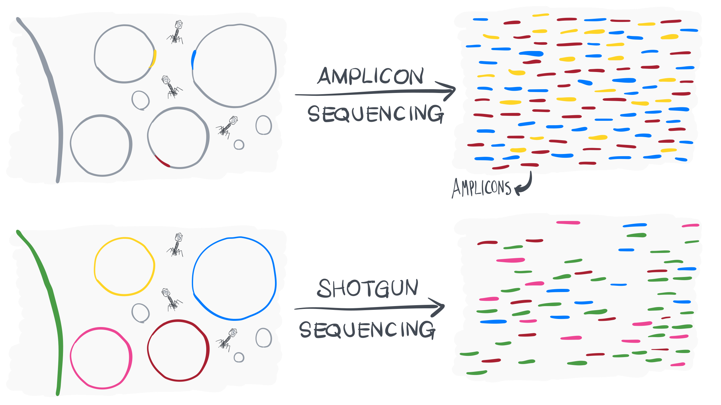

Slide 20
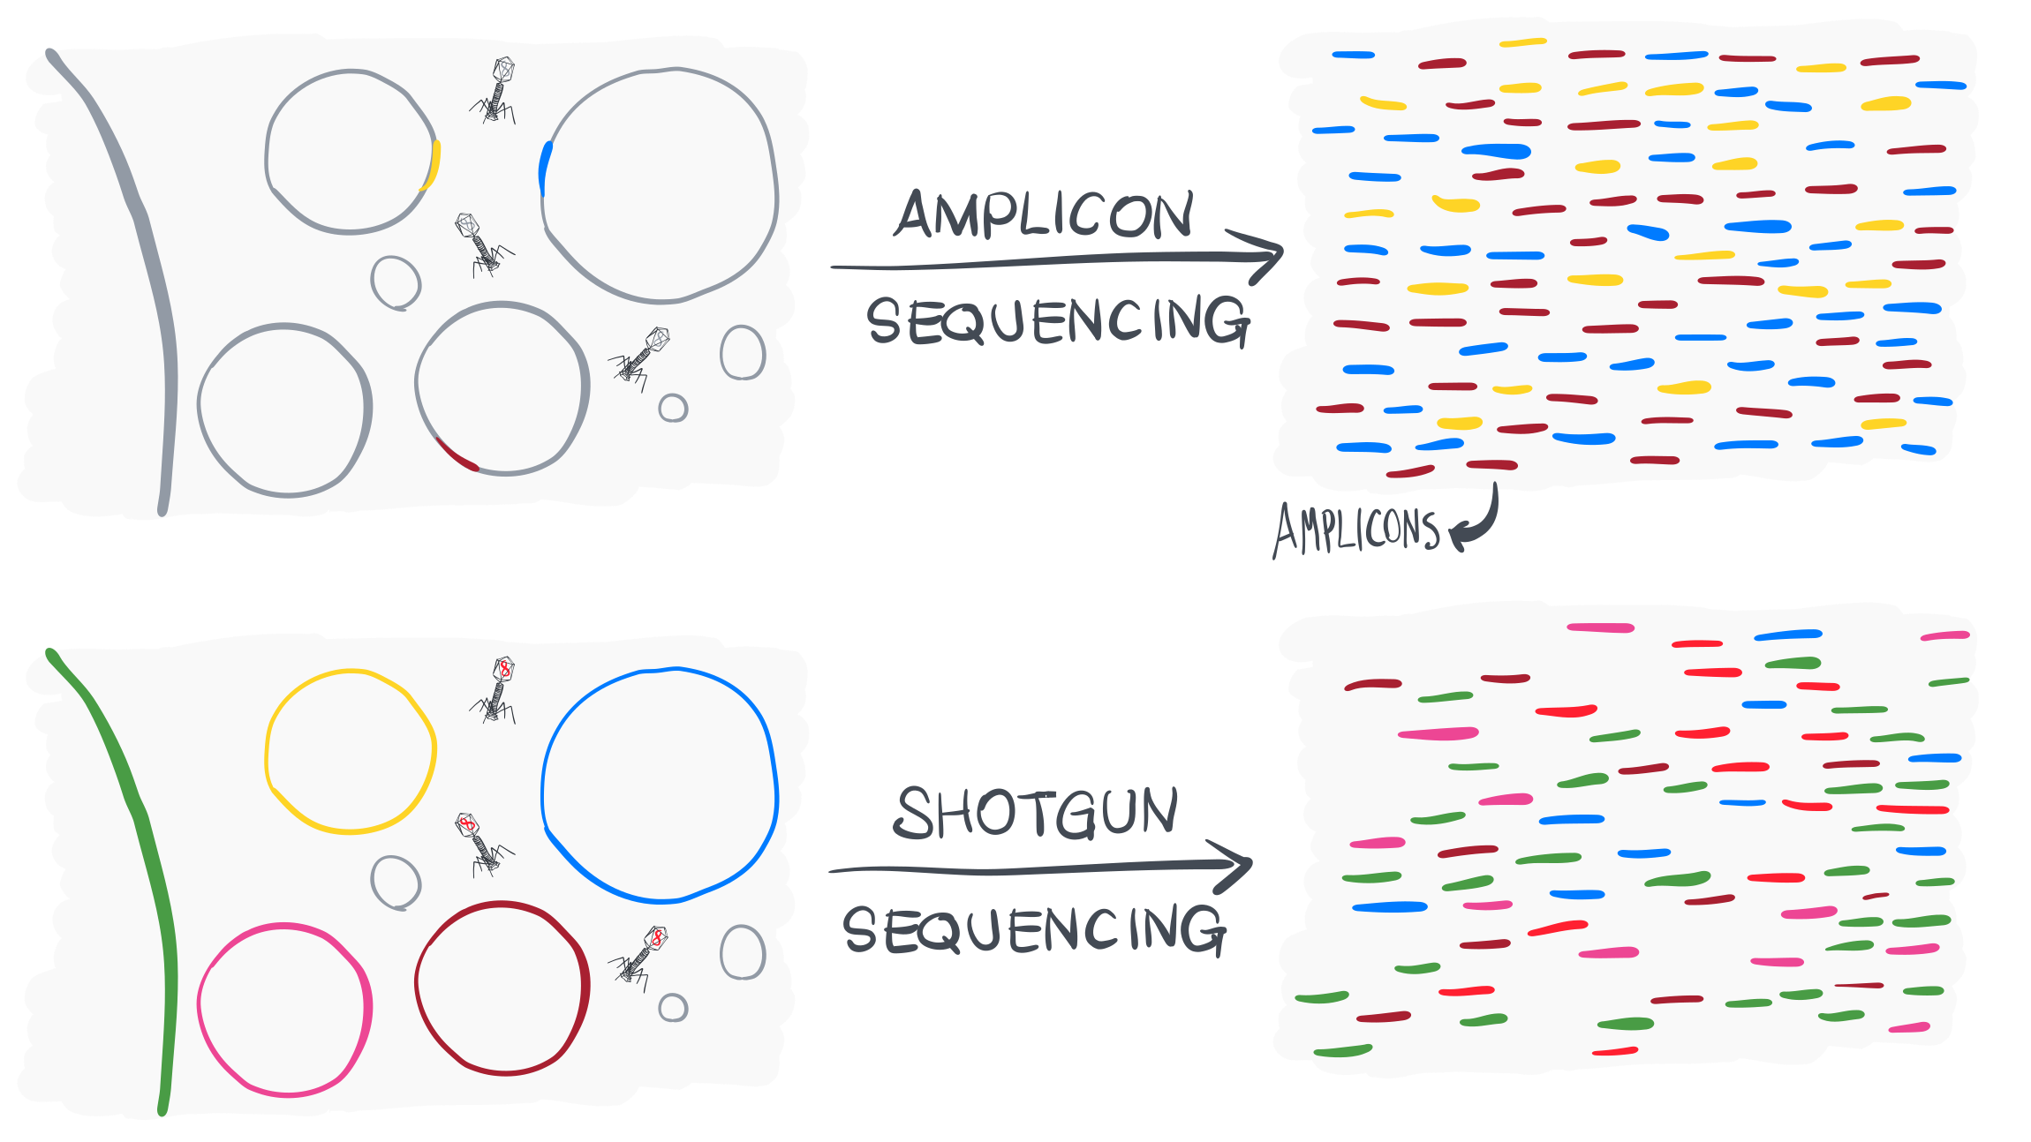

Slide 21
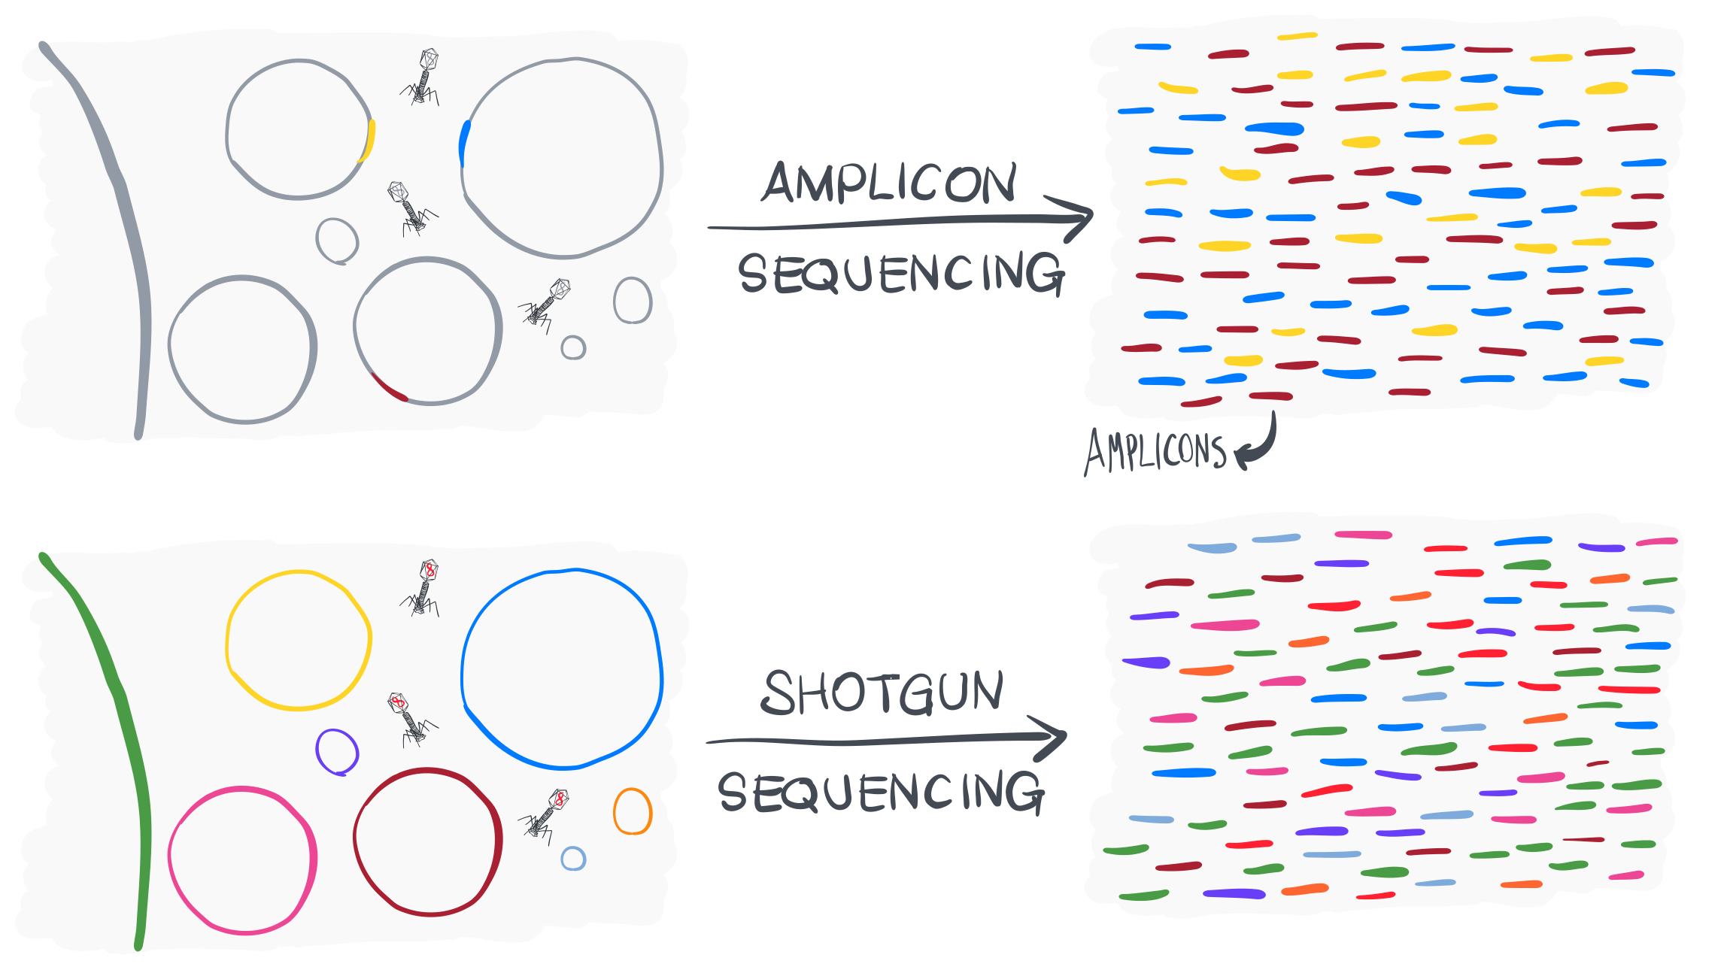

Slide 22


Slide 23
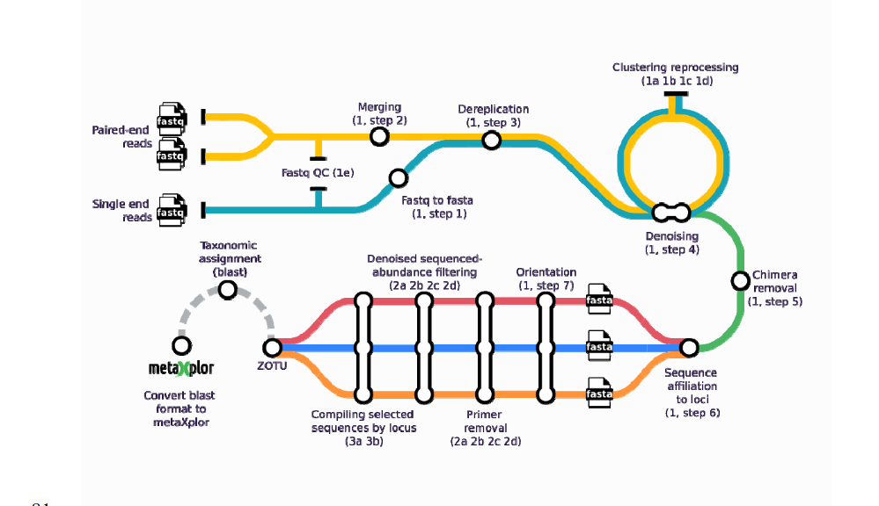
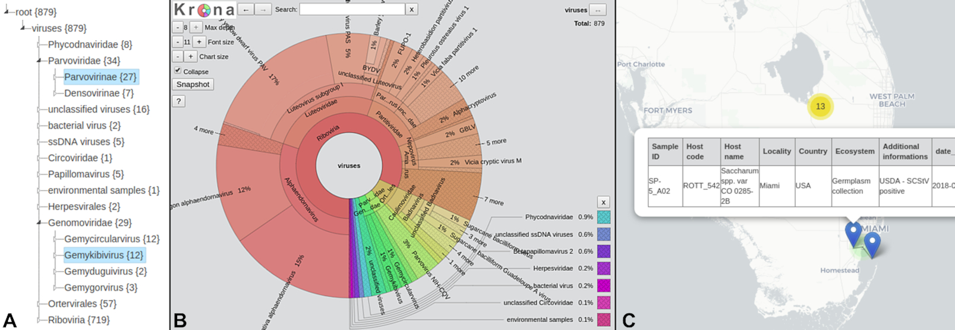
Amplicon sequencing
Cheap
Quick
Resolution to the genus level
Very good pipelines, Dada2, Quiime, Metaphlan, Vsearch (mbctools package)
Do not requires lots of CPU and RAM
mbctools: A User-Friendly Metabarcoding and Cross-Platform Pipeline for Analyzing Multiple Amplicon Sequencing Data across a Large Diversity of Organisms
https://doi.org/10.1101/2024.02.08.579441

Slide 24
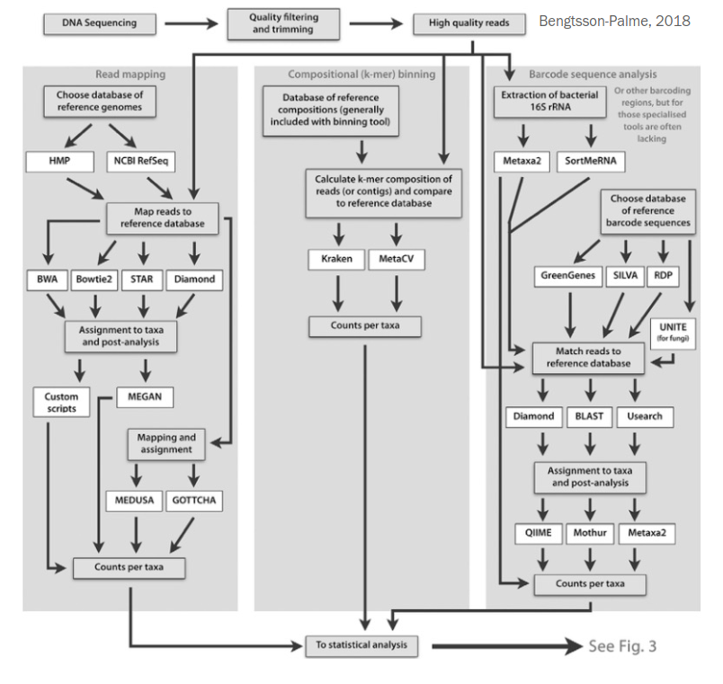
Shotgun sequencing – Read based
Read mapping and compositional binning
Analysis of all reads
Reference database of sequenced genomes
Mapping: slow, requires lots of
CPU and RAM
Compositional binning: faster
but less accurate

Slide 25
Shotgun sequencing – Read based
Read mapping and compositional binning
Analysis of all reads
Reference database of sequenced genomes
Mapping: slow, requires lots of
CPU and RAM
Compositional binning: faster
but less accurate

Slide 26
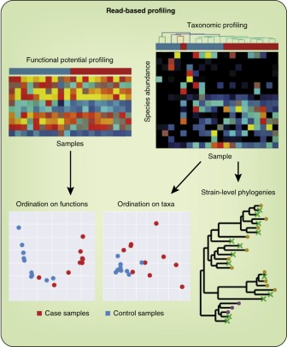
Read-based profiling
Fast
Quantitative
Can give interesting preliminary insights
Usually done as a ”quick-and-dirty” estimate prior to assembly
Quince et al 2017

Slide 27
Approaches to taxonomic profiling: how to choose?
Analysis of all reads suffer from limited databases of reference genomes
More suitable for environments that are better described (e.g. human gut)
Analysis of barcode genes suffer from lower resolution
• More suitable for environments with a high fraction of unknown microorganisms (e.g. soil)

Slide 28
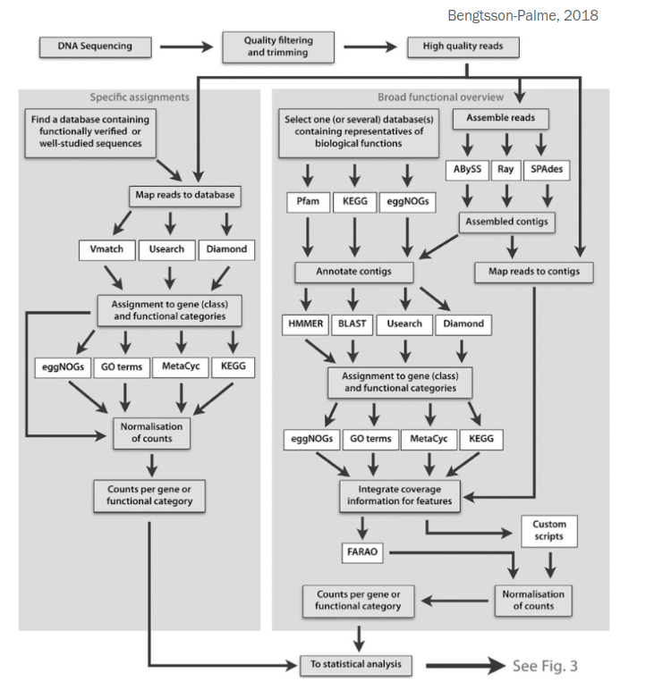
Approaches to functional profiling – genome resolved metagenomics
Broad versus specific profiling
Broad DBs: entire functional universe (e.g. KEGG, PFAM)
Specific DBs: focusing on one or few processes (e.g. CAZy, CARD)
CAZy is a database of Carbohydrate-Active enZYmes.
CARD = The Comprehensive Antibiotic Resistance Database

Slide 29
Approaches to functional profiling: how to choose?
Broad databases give an overview of the functional potential of microbial communities
Suitable for investigating major differences across environments
Specific databases are often highly curated and can give substrate-level information
Suitable for investigating e.g. gene variants across environments

Slide 30
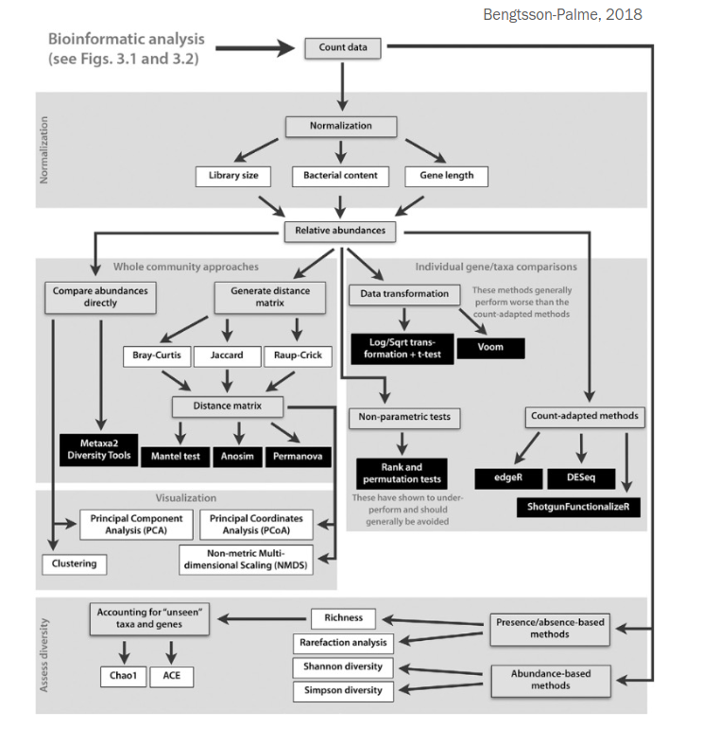
Making sense of read- based analyses
Comparative analyses
Statistics
Univariate (e.g. ANOVA of specific genes and taxa)
Multivariate (e.g. PERMANOVA, ordination/clustering, Mantel test)
Normalization!
Library size
Bacterial content

Slide 31
Making sense of read- based analyses
Comparative analyses
Statistics
Univariate (e.g. ANOVA of specific genes and taxa)
Multivariate (e.g. PERMANOVA, ordination/clustering, Mantel test)
Normalization!
Library size
Bacterial content

Slide 32
Pitfalls of read-based analyses
Curation level of the database
Are sequences verified experimentally to perform the expected function?
Comprehensiveness of the database
Both taxonomic- and functionally

Slide 33
Remember: always sanity check!
Especially for unexpected findings:
Redo with more strict thresholds
Redo with a different tool and database
Investigate other genes belonging to the same pathway

Slide 34
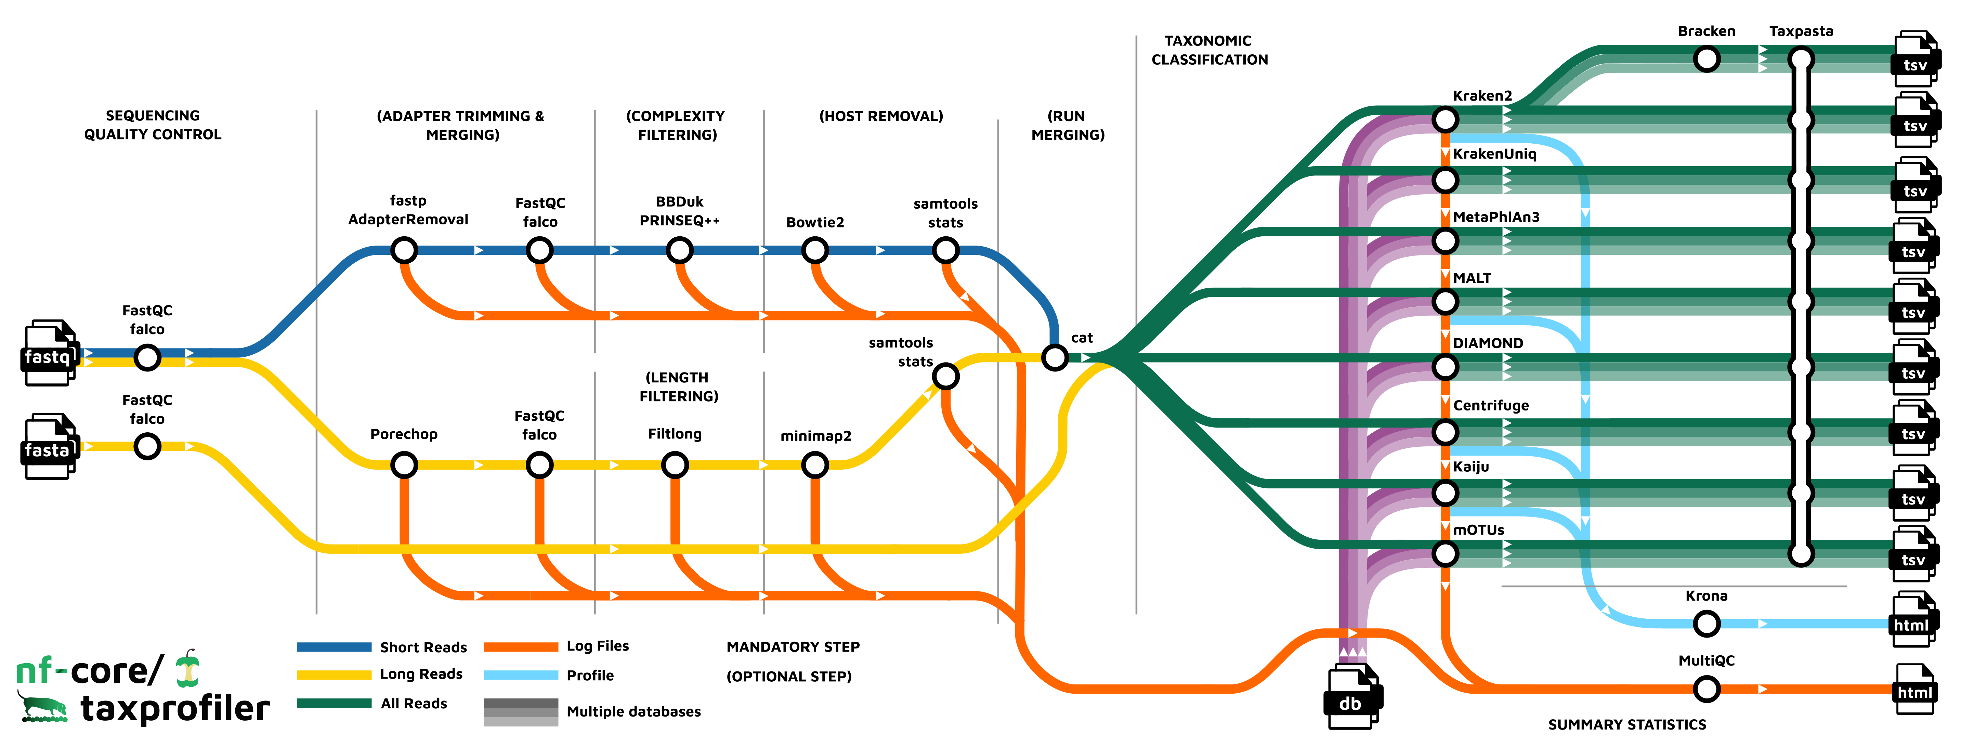
Pipeline: read-based analyses

Slide 35
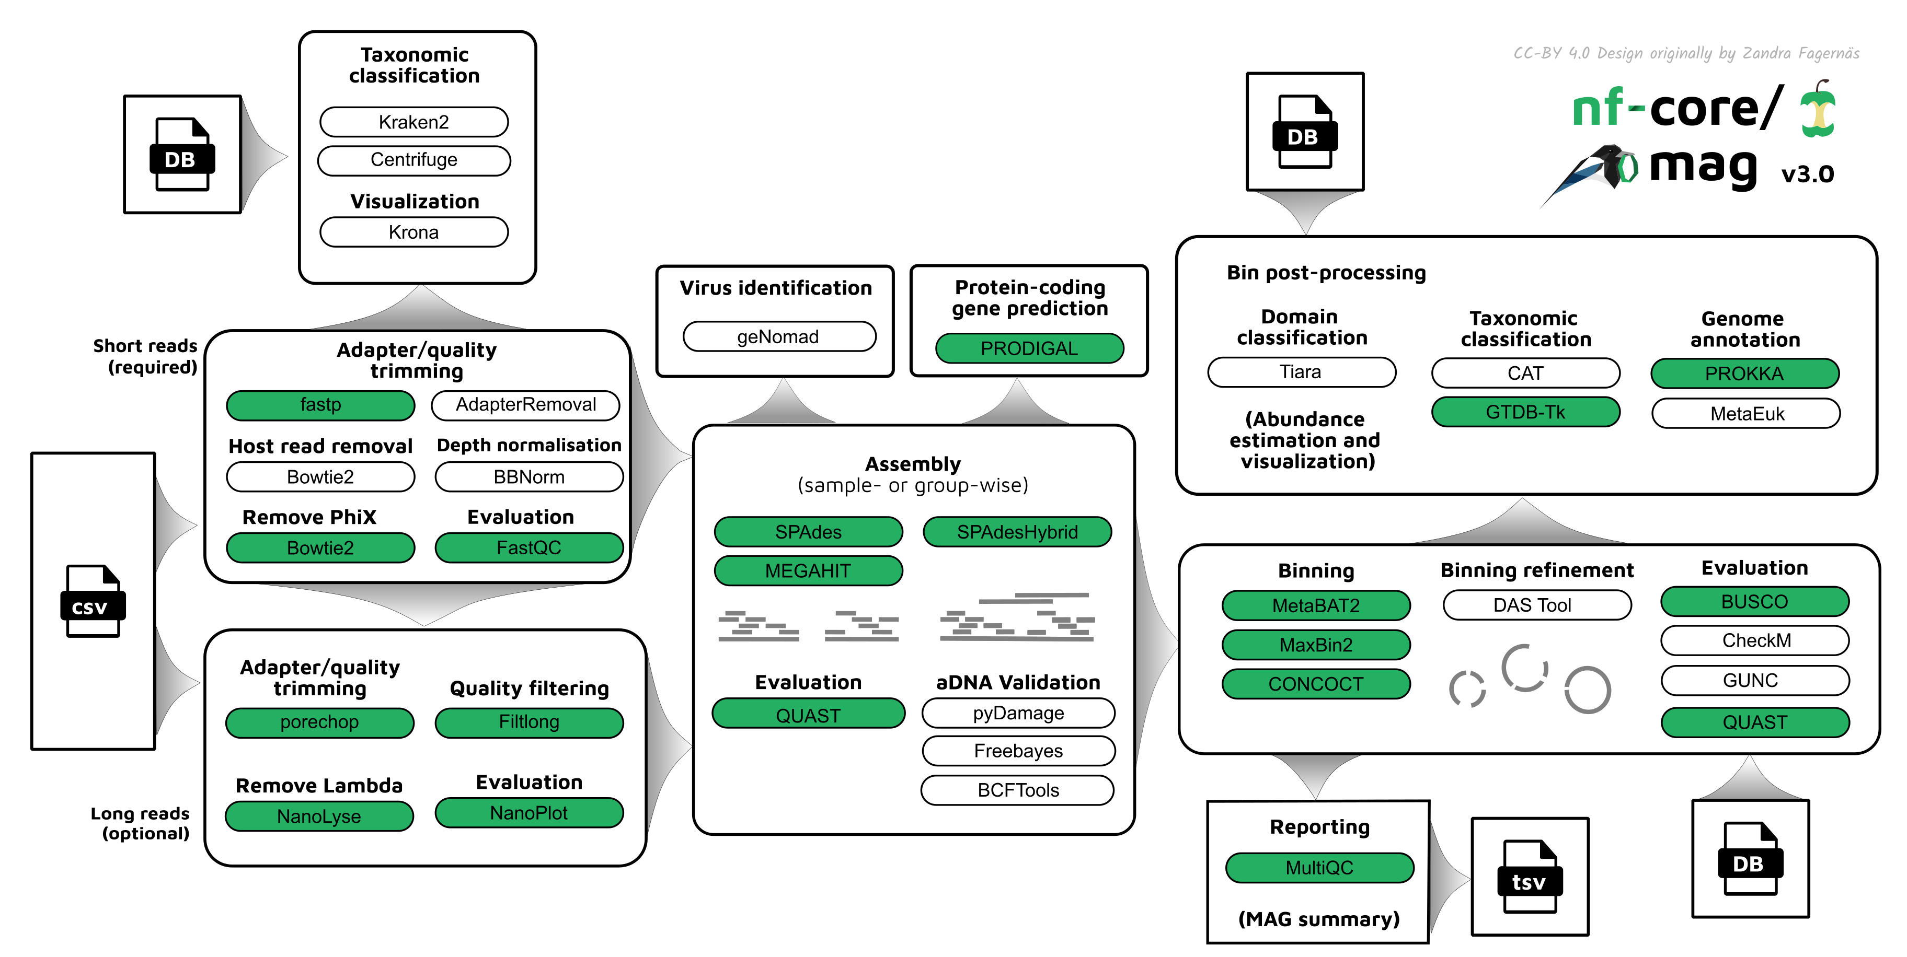
Pipeline : genome resolved metagenomics

Slide 36
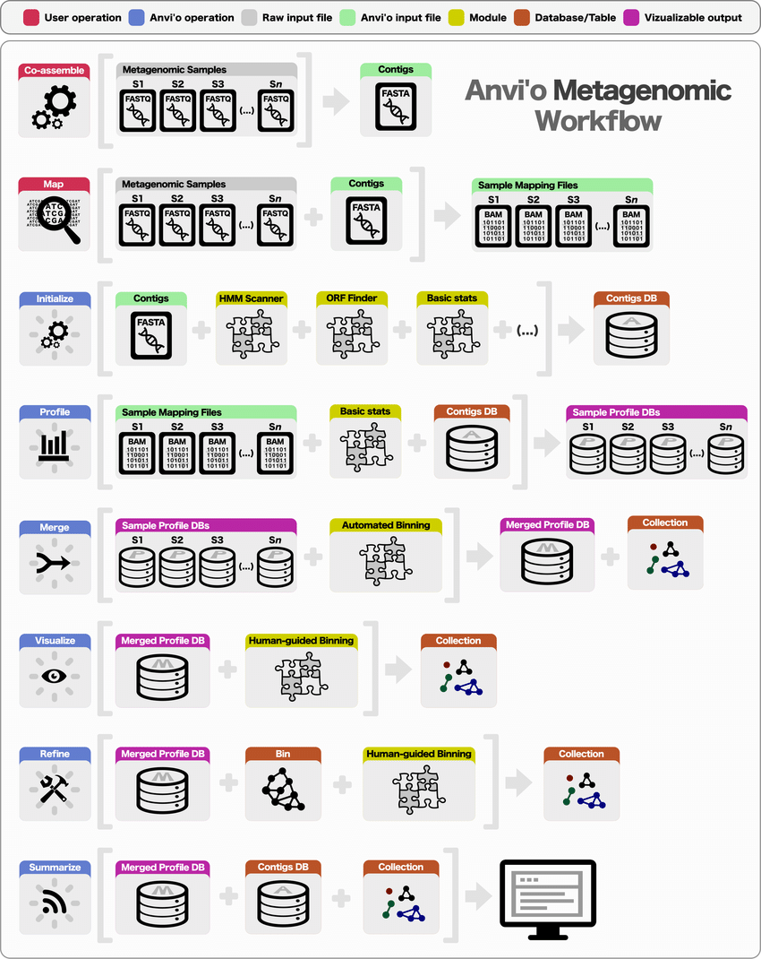
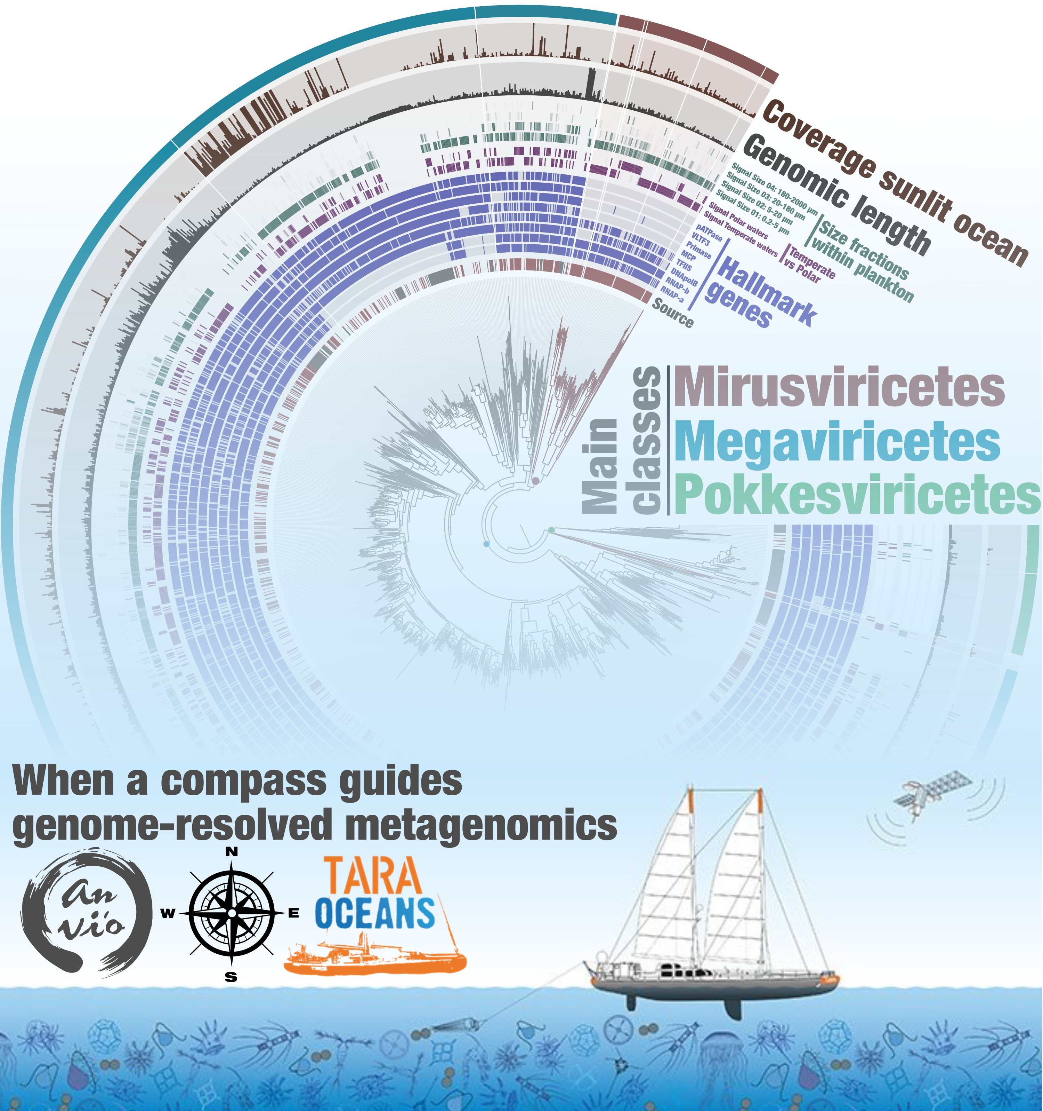

Pipeline : genome resolved metagenomics

