Slide 1
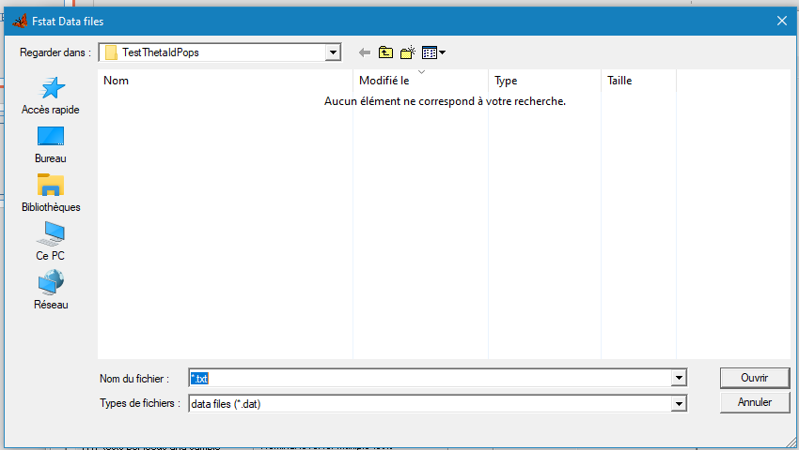
Data
Hierarchical
LD
Classic statistics
Amplification problems
Distances
Ne
Multivariate
Groups
Clonal
Help
Load
Manage
Import
Export
To Fstat
To HierFstat
To Genepop
Manage data
Exclude subsamples
Exclude loci
Recode alleles
Label for true missing data (blanks) (default is 999)
Label for unavailable data (Default is NA)
No data loaded

Slide 2
Data
Hierarchical
LD
Classic statistics
Amplification problems
Distances
Ne
Multivariate
Groups
Clonal
Help
F-stats
Choose levels
Testing
Testing (randomizations)
Levelx
Levely
Levelz
……...
LastLevel
Levelx
in
Levely
in
Levelz
in
……...
in
LastLevel
Choose levels
Levelx
Levely
Levelz
……...
LastLevel
Tested level
Within
Done
Randomization unit
Number of randomizations (100-)
Results are stored in MyData.pga
Done
OK
Change
Loaded data is MyData.txt

Slide 3


Data
Hierarchical
LD
Classic statistics
Amplification problems
Distances
Ne
Multivariate
Groups
Clonal
Help
Locus pairs
Multi-ocus
LD between each pair of loci
Multilocus LD
Keep loci with no allele at frequency above (1=all)
1
$\overline{rD}$ within each subsample
Shuffling of genotypes between the two loci (G-based)
$\overline{rD}$ over all subsamples
Number of randomizations (100-)
Shuffling of genotypes between the two loci (G-based)
For all locus pairs in each subsample
Number of randomizations (100-)
For all locus pairs over all subsamples
Done
Table of the number of time a locus is in significant LD and H_{T}
r_{GGD}
Done
Results are stored in MyData.pga
OK
Change
Loaded data is MyData.txt

Slide 4
Data
Hierarchical
LD
Classic statistics
Amplification problems
Distances
Ne
Multivariate
Groups
Clonal
Help
Define subpopulation units
Choose levels
Estimating and testing
Weir and Cockerham's estimators
Nei's statistics
Levelx
Levely
Levelz
……...
LastLevel
For each locus in each subsample
Over all loci in each subsample
For each locus over all subsamples
Over all loci and subsamples
H_{S}
Ignore subsamples with less than
5
individuals
f (F_{IS})
H_{o}
H_{T}
General statistics
G_{ST}
Alleles frequencies
For each locus
Over all loci
For each subsample pair
Over all subsamples
Genotypic frequencies
θ (F_{ST})
Normalized FST
Number of alleles
F_{ST}'
Allelic richness
G_{ST}"
Number of blanks (999)
F (F_{IT})
For each locus
Over all loci
Number of NA's
Done
Bootstraps
Testing for local panmixia (f based)
Over loci
Number (100 to 10000)
Randomizing alleles between individuals within subsamples
For each subsample and each locus
Number (100-)
Over subsamples
Number (100 to 10000)
For locus over all subsamples
Number (100-)
Over alleles
Number (100 to 10000)
Jackknives over loci
Testing for subdivision (G-based) randomizing
In each subsample
Individuals between subsamples
Number (100-)
Over all subsamples
Complete genotypes between subsamples
Number (100-)
Results are stored in MyData.pga
Testing for global panmixia (F based) randomizing
OK
Change
Alleles between subsamples
Number (100-)
Done
Loaded data is MyData.txt

