Slide 1
emoBERT-HDBSCAN emotion-based serious tweets detection
Team reviewer 2:
Vincent Michael Sutanto (2111434) – Liu Chang (2111313)
(Equal contributions.)
https://github.com/vincentmichael089/sociocom-BERTHDBSCAN-seriousness

Slide 2
Problem Definition
We define that a tweet is considered as serious if one of the following conditions are met:
The tweet contains news headline (sports, political views, economics, etc.).
The tweet contains urgent information regarding natural disaster events (earthquake, fire, flood, etc.).

Slide 3
Why using Emotions?
We have data but no labels == Clustering! But ….
Using BERT as feature extractor may introduce problem when combined with density-based clustering algorithm: 768 features introduce overhead to algorithm like DBSCAN or HDBSCAN
In the other hand, using emotion features can alleviate this problem (with trade-off of course): Smaller feature-size while still maintaining informations of what’s the writer thinks/feels¹
This research used eight different emotions proposed by Putchik²

Slide 4
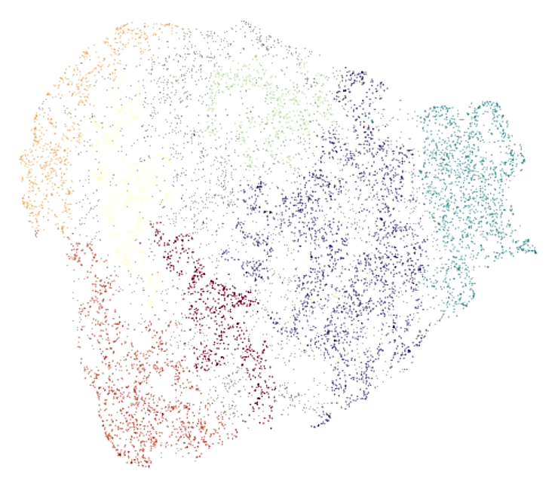
emoBERT-HDBSCAN
BERT Regressor
+ ReLU
HDBSCAN
Clusters
Joy: 0.25
Anger: 1
Tweet
こんな天気でも、富士山ばっちり（^人^） 北鎌倉駅近くの絶景ポイントです。
………….
Trust: 0.7

Slide 5
emoBERT BERT-Based emotion extractor
We fine-tune a pretrained BERT (cl-tohoku/bert-base-japanese-v2) with the WRIME Dataset³, a Dataset containing tweets and its respective emotions from 4-different individuals.
Our model shares similarity with Emotion Analysis of Writers and Readers of Japanese Tweets on Vaccinations (Ramos et al., 2022)⁴ but with additional ReLU layer to avoid negative output
BERT Regressor
+ ReLU
Joy: 0.25
Anger: 1
こんな天気でも、富士山ばっちり
………….
Trust: 0.7

Slide 6
emoBERT BERT-Based emotion extractor
The model was fine-tuned as follows:
Epochs = 50
Batch Size = 16
Adam Optimizer (epsilon: 1e-9; betas: 0.9, 0.98)
Learning Rate 0.0001 with 1000 steps warm-up and cosine LR decay
Mean-squared Error Loss
The performance of our model is similar enough to Ramos et al., 2022⁴, and we use the model to generate emotions to the provided tweets
Table 1. Mean-squared errors for WRIME test split
Model | Joy | Sadness | Antcpation | Surprise | Anger | Fear | Disgust | Trust | Overall
Writer Emotions
BERT⁴ | 0.658 | 0.688 | 0.746 | 0.542 | 0.486 | 0.462 | 0.664 | 0.400 | 0.581
BERT+ ReLU (Our) | 0.614 | 0.706 | 0.809 | 0.482 | 0.613 | 0.468 | 0.701 | 0.333 | 0.591
Reader Emotions
BERT⁴ | 0.192 | 0.178 | 0.211 | 0.139 | 0.032 | 0.147 | 0.123 | 0.029 | 0.131
BERT+ ReLU (Our) | 0.204 | 0.186 | 0.209 | 0.151 | 0.037 | 0.144 | 0.122 | 0.042 | 0.137

Slide 7
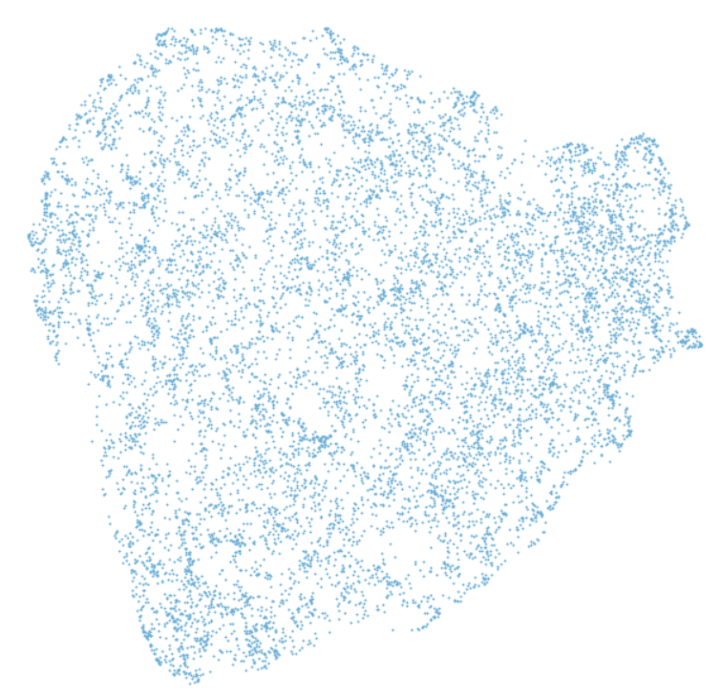
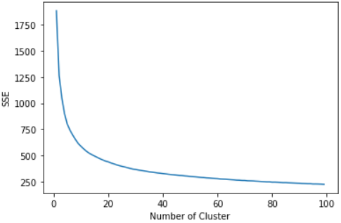
HDBSCAN Density-based Clustering algorithm
We use HDBSCAN to clusters the tweets’ emotion features. But WHY?
The data is sparse, which means using point-based clustering method may not be optimal
Using Kmeans and elbow criterion
didn’t produce any elbow at all!

Slide 8
HDBSCAN Density-based Clustering algorithm
From HDBSCAN we got 7 clusters, which we will analyze if it is “Serious” or “Not Serious”
However, due to the nature of HDBSCAN, some of data points won’t belong to any class (only 75.42% are labelled)

Slide 9
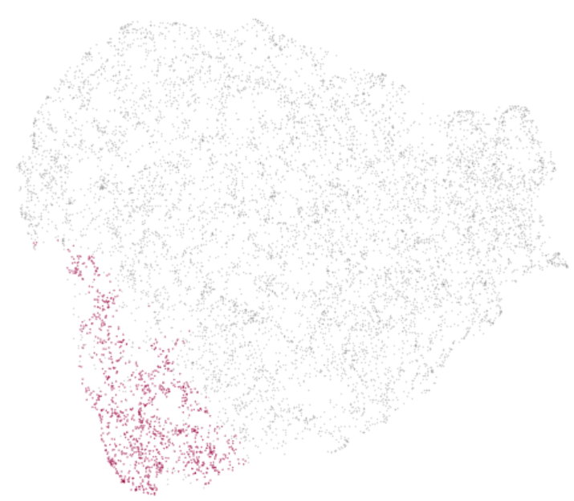
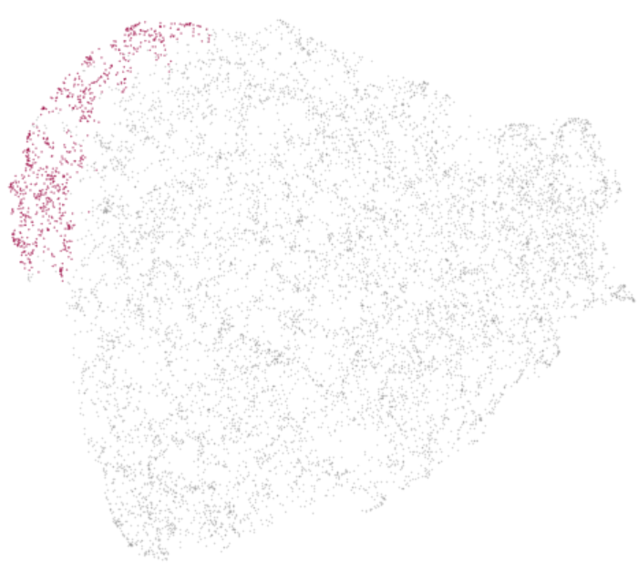
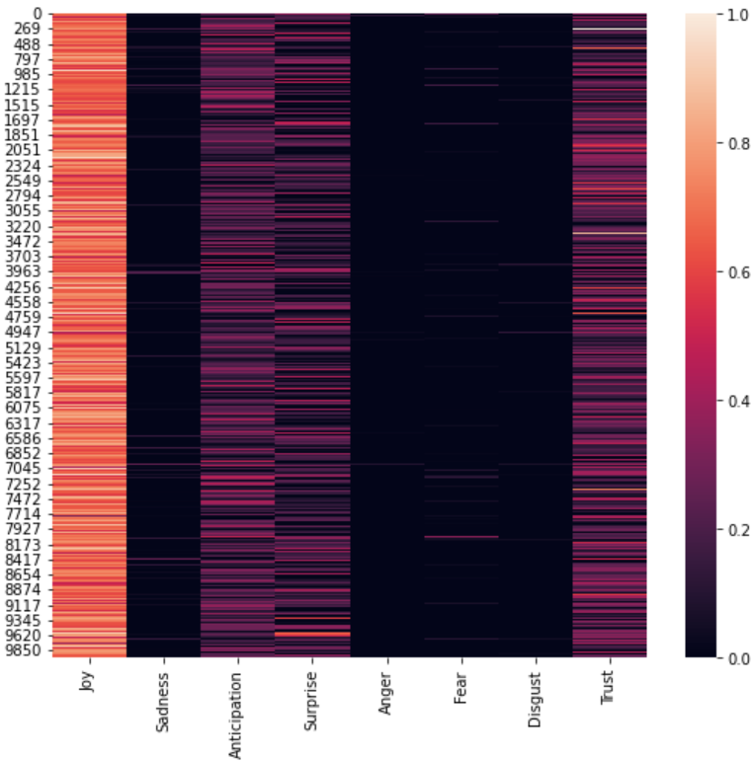
Cluster 1
Characteristics:
Super strong Joy
Moderate Anticipation, Surprise, and Trust
Tweet samples:
富士山いつ見ても感動する＊ そしてもうすぐ夢の国☆*:.｡. o(≧▽≦)o .｡.:*☆ ... Mt.Fuji Impressed every time I see it * And soon the land of dreams ☆*:.｡.o(≧▽≦)o.｡.:*☆ ...
「仲良しメンバーと駅でばったり集合！3人で楽しくご通勤ー♪ え？これから温泉？梓ずるいMeet up at the station with good friends! The three of us have fun commuting♪ Eh? Hot springs from now on? Cunning
USER] ゆいから飛んだよ (๑･ิټ･ิ๑)めちゃめちゃ元気っす！＼(^o^)／おりんわ？428 [USER] Yui flew away (๑･icټ･ic๑) I'm so energetic! ＼(^o^)／ Orinwa?
Conclusion:
This cluster consists of normal daily life tweets, so we consider this cluster as NOT SERIOUS

Slide 10
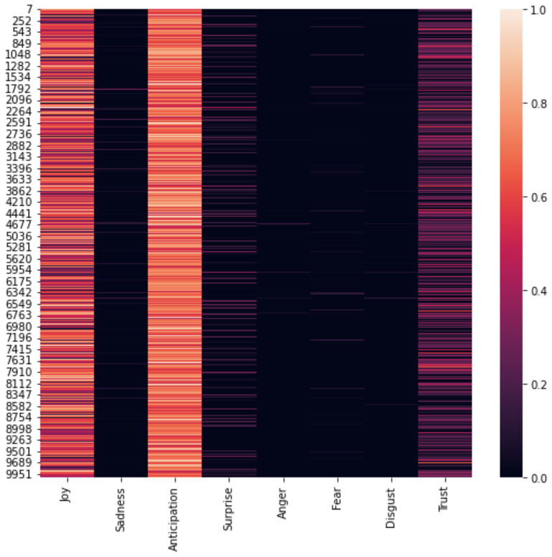
Cluster 2
Characteristics:
Super strong Joy and Anticipation
Moderate Trust
Weak Surprise
Tweet samples:
[USER] いいテスト勉強たい。涙でテスト用紙濡らしたら単位もらえる！[USER] I want to study for a good test. If you wet the test paper with tears, you can get credits!
春から学園大行くこと決まりました(^-^)v 学園大の人よろしく! I've decided to go to Gakuen University from spring (^-^)v Greetings from Gakuen University!
10日から夏休みっ！さあ どこに行こうか～西か東。。北か南か。。旅に出よう(^_^) Summer vacation starts on the 10th! Now where should she go~ west or east. . north or south . Let's go on a trip (^_^)
Conclusion:
This cluster consists of normal daily life tweets, so we consider this cluster as NOT SERIOUS

Slide 11
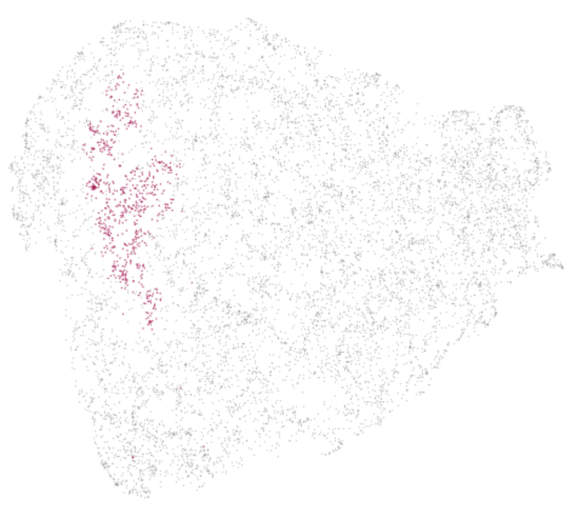
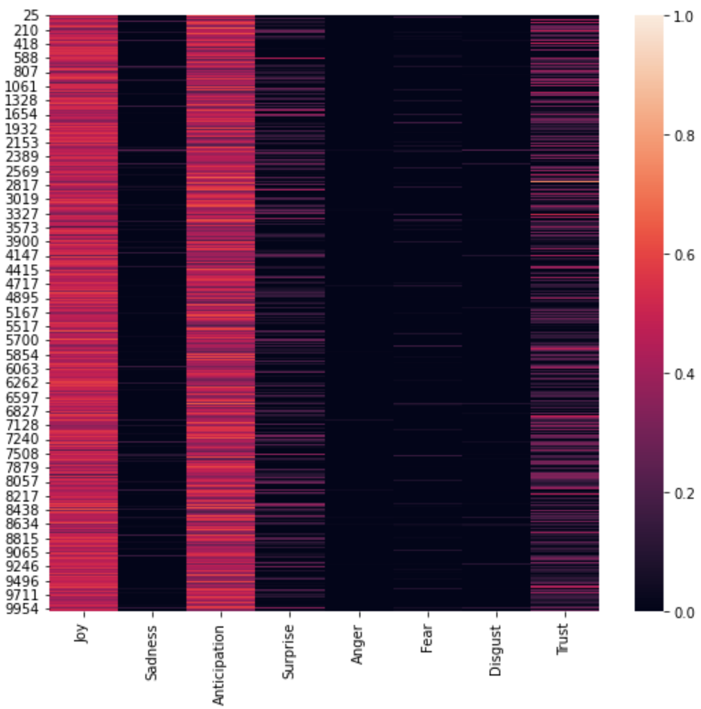
Cluster 3
Characteristics:
Strong Joy and Anticipation
Moderate Trust
Weak Surprise
Tweet samples:
明日は同期の結婚式ですわ。 今月はあと二件オメデタですわ。 平和ですね。Tomorrow is my classmate's wedding. I have two more to come this month. Peaceful, isn't it?
楽しかったー！明日からバレンタインの催事がんばろ(T_T)いっこに依存するのは、そろそろ卒業... It was fun! Starting tomorrow, I'll do my best at the Valentine's event (T_T).
ソフトボールのフリーバッティングで、やっと一球当たりました(^-^;来週は2球当てるぞ(^o^)/ I finally hit one ball in the softball free batting (^-^; I'll hit two next week (^o^)/
Conclusion:
This cluster consists of normal daily life tweets so we consider this cluster as NOT SERIOUS. Additionally, we notice that the user are expecting something in the future.

Slide 12
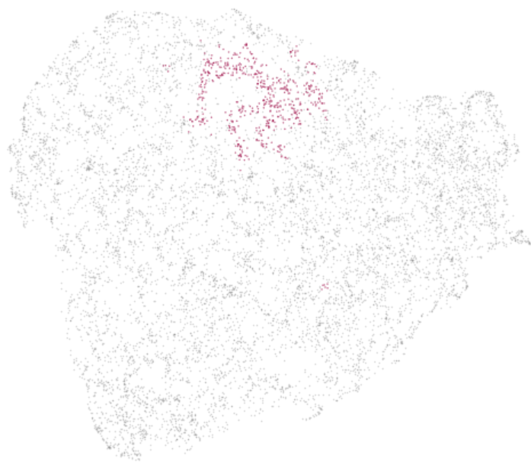
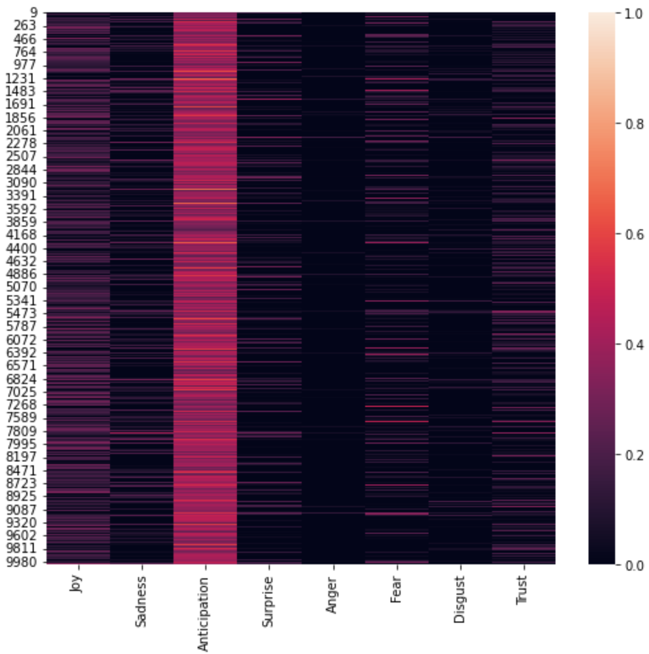
Cluster 4
Characteristics:
Strong Anticipation
Weak Joy, Sadness, Surprise, Fear, and Trust
Tweet samples: S
[USER] 今日は、ありがとうございます。今後ともよろしくお願いします。o(^▽^)o[USER] Thank you for your time today. I look forward to working with you. o(^▽^)o
昨日に引き続き今日もラーメンなう。静岡伊駄天の特つけ麺醤油大盛卵トッピング。 [URL] Continuing from yesterday, let's have ramen again today. Shizuoka Itaten's special tsukemen soy sauce topped with a large egg. [URL]
3日まで出掛けるので‥2011年は大変お世話になりました！2012年もよろしくね♥I'll be out until the 3rd, so thank you very much for your help in 2011! Happy new year 2012♥
Conclusion:
This 4 filled with someone expressed their gratitude / being on certain places, so we consider this cluster as NOT SERIOUS

Slide 13
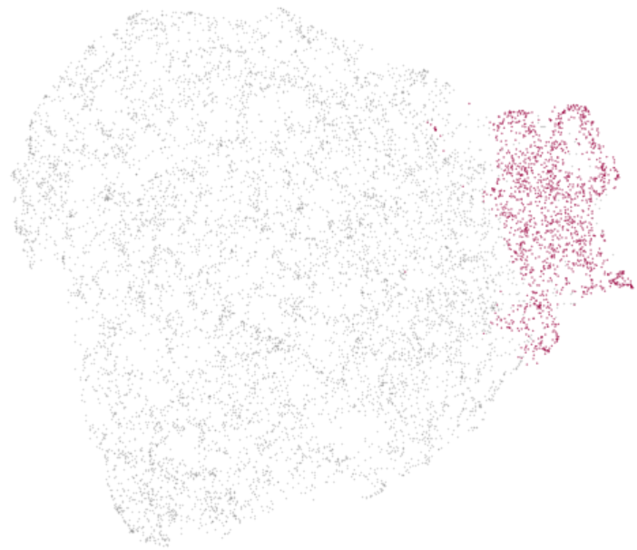
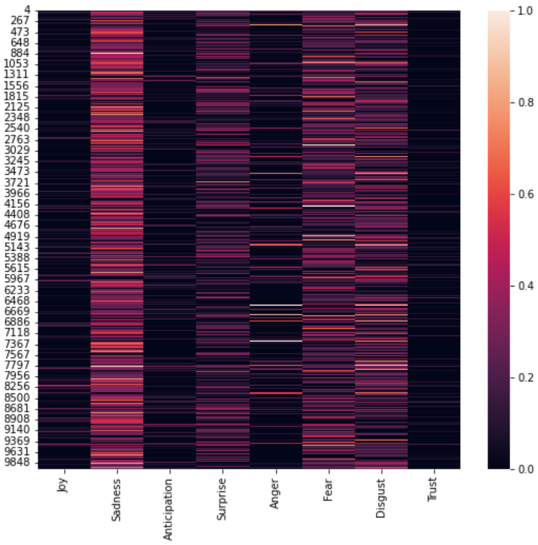
Cluster 5
Characteristics:
Strong Sadness
Moderate Fear, Disgust, and Surprise
Weak Joy, Anticipation, Anger
Tweet samples:
国の出先機関廃止反対宣伝：政府は国が果たすべき責任をすべて地方（国民）に押し付けようとしてい... Propaganda against the abolition of national branch offices: The government is trying to impose all the responsibilities that the national government should fulfill on local governments (citizens)...
☆☆☆地震速報【第1報】2時52分17秒に宮城県沖で震度1(M3.7)の地震が発生。震源の深... ☆☆☆Earthquake Early Warning [1st Report] At 02:52:17, an earthquake with a seismic intensity of 1 (M3.7) occurred off the coast of Miyagi Prefecture. Depth of the epicenter...
jishin RT[USER] 【気象庁情報】07日02時10分頃 岐阜県美濃東部近辺(N3... jishin RT[USER] [Japan Meteorological Agency Information] Around 02:10 on the 7th Around the eastern part of Mino, Gifu Prefecture (N3...
Conclusion: This cluster do also have some unserious tweets, we can find tweets about disaster event notifications, politicst, propaganda etc in this cluster, so we consider that this cluster is SOMEWHAT SERIOUS

Slide 14
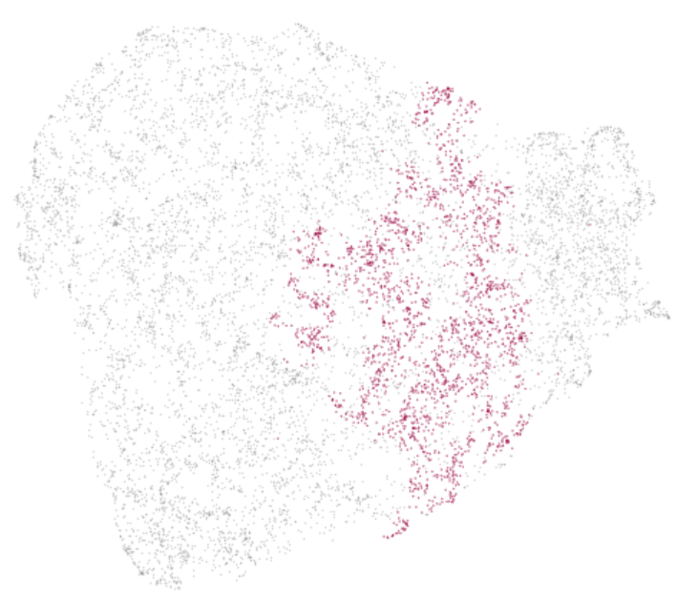
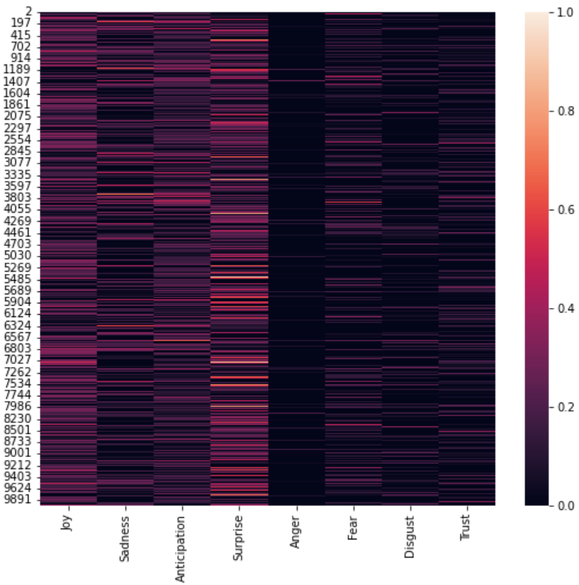
Cluster 6
Characteristics:
Moderate Joy, Sadness, Anticipation, Surprise
Weak Fear, Disgust, Trust
Tweet samples:
藤丸にいるよ！ なんか3時から売る物に並んでる(⌒▽⌒) とっても長い列だよ～ん [URL] I'm in Fujimaru! I've been lining up to sell something since 3:00 (⌒▽⌒) It's a really long line [URL]
今さらながらの初詣 (@ 西新井大師 (總持寺) w/ 3 others) [URL] Hatsumode (@ Nishiarai Daishi (Sojiji) w/ 3 others) [URL]
市民向けクリスマスの集いに参加 (@ カトリック 河原町教会) [URL] Participated in a Christmas gathering for citizens (@ Catholic Kawaramachi Church) [URL]
Conclusion: Cluster 6 represents someone who post their feelings about certain location, so we consider this cluster as NOT SERIOUS

Slide 15
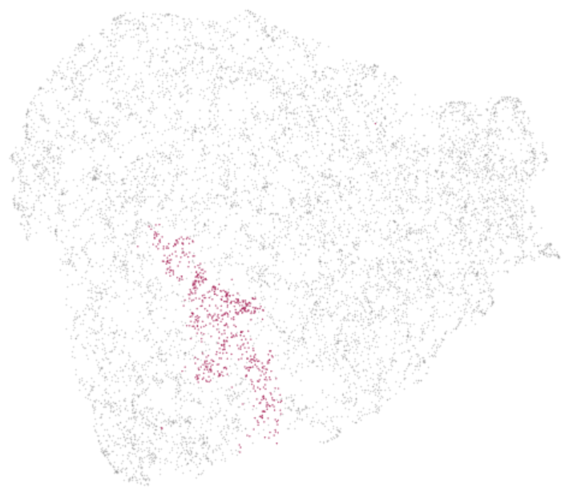
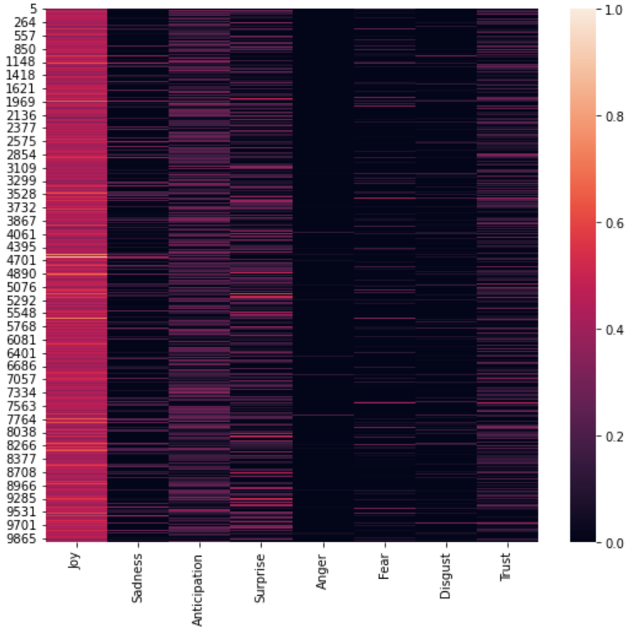
Cluster 7
Characteristics:
Strong Joy
Moderate Anticipation, Surprise
Weak Sadness, Fear, Trust
Tweet samples:
[USER] ちょうど今ぼっち居酒屋で酔っ払いナウ(*'ω’*)w [USER] Just got drunk at a bar now (*'ω’*)w
トロサーモン炙り丼を食した (@ 若狭屋 秋葉原店) [pic]: [URL] I ate a bowl of grilled fatty salmon (@ Wakasaya Akihabara) [pic]: [URL]
こんな天気でも、富士山ばっちり（^人^） 北鎌倉駅近くの絶景ポイントです。Even in this kind of weather, Mt. Fuji is perfect (^People^) This is a scenic point near Kita-Kamakura Station. [URL]
Conclusion: Cluster 7 represents users that expressing their happiness towards something, , so we consider this cluster as NOT SERIOUS

Slide 16
Conclusion
Out of 7 clusters produced by our model, only one cluster is detected to have what we define as “SERIOUS”.
Relying solely on emotions seems to be somewhat ineffective, as within the “SERIOUS” cluster, we still can find tweets that we considered as “NOT SERIOUS”
For future works, we recommend discriminative approach instead, such as fine-tuning the BERT with news / political text.

Slide 17
Thank you, QnA time!
References:
Text-based emotion detection: Advances, challenges, and opportunities (Acheampong et al., 2020) https://doi.org/10.1002/eng2.12189
A general psychoevolutionary theory of emotion (Putchik, 1980)
WRIME: A New Dataset for Emotional Intensity Estimation with Subjective and Objective Annotations (Kajiwara et al., 2021) https://aclanthology.org/2021.naacl-main.169/
Emotion Analysis of Writers and Readers of Japanese Tweets on Vaccinations (Ramos et al., 2022) https://aclanthology.org/2022.wassa-1.10/
https://github.com/vincentmichael089/sociocom-BERTHDBSCAN-seriousness

Slide 18
Appendix Emotion Level
8 emotions used in this research (Joy Sadness Anticipation Surprise Anger Fear Disgust Trust) is selected is scaled based on WRIME: A New Dataset for Emotional Intensity Estimation with Subjective and Objective Annotations (Kajiwara et al., 2021), and the explanation of the level is as follows:
3: annotators fully agree with the label given.
2: annotators can find the relevance between the post and label.
1: annotators hardly find the relevance between the post and label.
0: annotators do not think the annotator seriously engaged for this post.

Slide 19
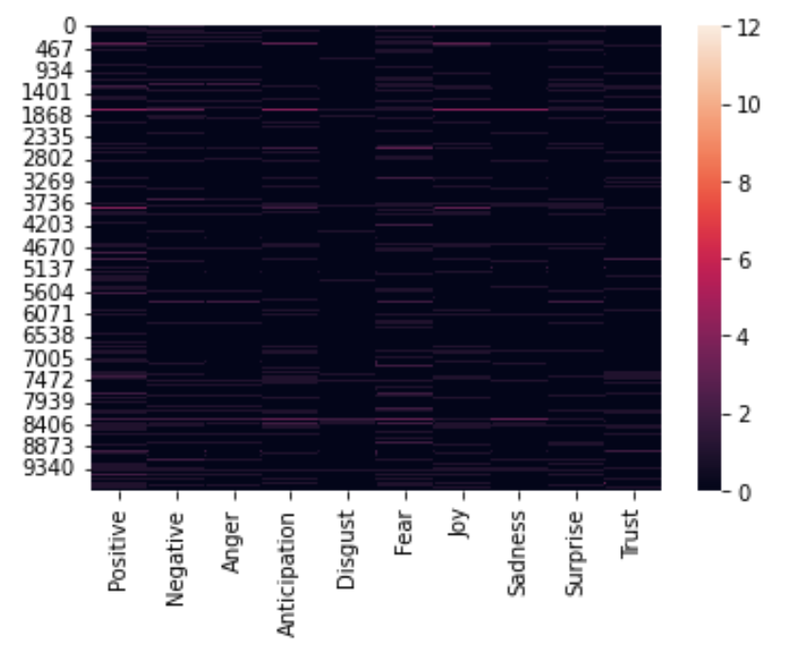
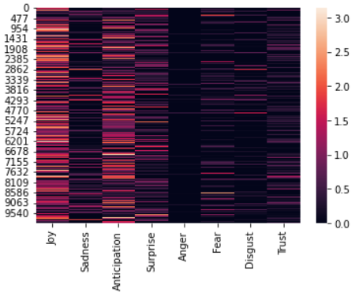
Appendix Dictionary-based emotion
We tried to use the NRC Word-Emotion Association Lexicon* , however the emotion of the tweets is insignificant compared to BERT-generated…
…so we ditched the idea.
Dict. based
BERT-based
Crowdsourcing a Word-Emotion Association Lexicon (Saif Mohammad and Peter Turney, 2013) https://arxiv.org/abs/1308.6297

Slide 20
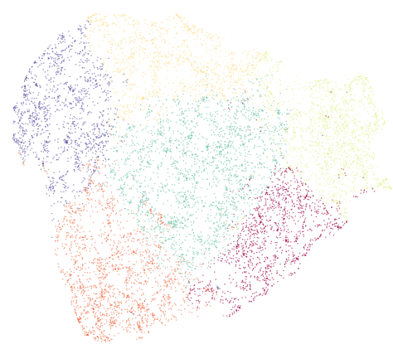
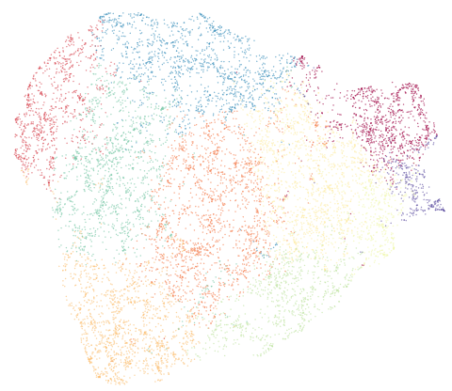
Appendix Dictionary-based emotion
Clustering result with K-Means shows how the clusters seems unreliable and increasing K would only divide bigger cluster to smaller one
K = 6
K = 10

