Slide 1
BGP – Part 2 and Multicast
CS 168 – Fall 2017 – Section 13

Slide 2
Last Section ☹
Course evaluations!
Help us make the course better and be better TAs!
You should have received an email titled “Student Course Evaluations”
Also on https://course-evaluations.berkeley.edu
Just a few minutes…

Slide 3
Agenda
BGP Basics
Business Relationship among ASes
Basic Messages in BGP
Route attributes
Policy Oscillation
Gao-Rexford Policy
Multicasting
DVMRP
Core-Based Trees

Slide 4
Types of ASes
Stub: only sends/receives traffic on behalf of its users
companies, universities, etc.
Transit: carries traffic on behalf of other ASes
Global ISPs (Tier 1):
Don’t buy service from other ISPs
Fully connected (if n global ISPs, 1+2+…+n-1 connections)
Regional ISPs (Tier 2): buy service from global ISPs
Local ISPs (Tier 3): buy service from global or regional ISPs
What’s the relationship between AS and ISP?
AS is a superset of ISP
All ISPs are ASes, but not all ASes are ISPs
E.g. UC Berkeley is not an ISP but it is an AS

Slide 5
Business Relationship among ASes
Two ASes will connect to each other only if they have business relationship
Business relationship types:
Customer-Provider
If A is B’s customer (B is A’s provider), B carries A’s traffic for a fee
Peers
If A and B are peers, they carry each other’s traffic for free
For a global ISP (Tier 1), what role/roles can it have?
Global ISP can be a provider to Tier 2 or Tier 3
Or a peer to other global ISP
But not a customer!

Slide 6

Business Relationship Restrictions
The graph of peering relations can be cyclic
The peer of my peer can also be my peer
For example, global ISPs all peer with each other
The graph of customer-provider relations must be acyclic

Slide 7
Basic Messages in BGP
Open: establishes BGP session using TCP
Notification: report unusual conditions
Update:
Format <IP prefix: route attributes>
Inform neighbors of new routes (announcements)
Inform neighbors of old routes that are no longer active (withdrawal)
Keepalive:
Inform neighbors that this BGP session is still alive
What’s this?
Notes:
route attributes describe property of the route like ASPATH, LOCALPREF, etc.

Slide 8
Selection/Export Revisited
If you are an AS:
Route Selection
for a particular IP prefix, you may receive routes from multiple ASes all of which are valid
determines how you choose which of those valid routes to use (where you send your traffic).
Route Export
determines which ASes will receive your route
so that they can later select your route and send traffic to you.
Routes in selection/export decisions are described using attributes

Slide 9
BGP Route Attributes
Local attributes
ASes keep them private
Not included in eBGP route announcements
E.g. LOCAL_PREF
Nonlocal attributes:
propagated with eBGP route announcements
E.g. AS_PATH
Many standardized attributes, but we only cover a few

Slide 10
BGP Route Attributes Continued …
AS_PATH (nonlocal attribute, mandatory)
Insert ASN of traversed AS to BGP’s path vector in reverse order
The fewer ASes traversed, the better
Berkeley
(25)
Amazon exports its route using eBGP with attribute AS_PATH {16, 56}
Google exports its route using eBGP with attribute AS_PATH {16, 56, 10}
Comcast
(16)
Amazon
(56)
Google
(10)
Notes:
Multi-Exit Discriminator

Slide 11
BGP Route Attributes Continued …
LOCAL_PREF (local attribute)
Propagated through iBGP
Used to choose different AS paths
Default preference 100
The higher the value, the more preferred
Highest priority among all other attributes
How AS prefer customers to peers to providers
Default 100
AS_PATH | LOCAL_PREF
{16, 56}
{16, 56, 10} | 120
{16} | 50
{16, 56, 10, 5} | 200
Pick Highest
Berkeley kept all paths to some IP prefix in Comcast’s AS (ASN 16)
Notes:
Multi-Exit Discriminator

Slide 12
BGP Route Attributes Continued …
MED (nonlocal attribute)
Used when ASes are connected via 2 or more links
Allows AS to inform its immediate neighbors of its preferred entry points
The lower the value, the more preferred
Default 100
AS_PATH | LOCAL_PREF | MED
{16, 56} |  | 20
{16, 10} | 100 | 5
{16, 35} | 50 | 15
Same local preferences
Same # of ASes traversed
Pick Lowest
Notes:
Multi-Exit Discriminator

Slide 13
BGP Route Attributes Continued …
IGP cost (local attribute)
Used for hot-potato routing (AS wants to get rid of the packet ASAP)
minimize use of my network bandwidth (“hot potato”)
may conflict with MED (the route may not be preferred)
Notes:
Multi-Exit Discriminator

Slide 14
Route Selection in Priority Order
Priority | Rule | Remarks
1 | LOCAL PREF | Pick highest LOCAL PREF
2 | ASPATH | Pick shortest ASPATH length
3 | MED | Lowest MED preferred
4 | eBGP > iBGP | Did AS learn route via eBGP (preferred) or iBGP?
5 | iBGP path | Lowest IGP cost to next hop (egress router)
6 | Router ID | Smallest next-hop router’s IP address as tie-breaker
Notes:
Multi-Exit Discriminator

Slide 15
Serious problems coming with BGP policies…
Notes:
Multi-Exit Discriminator

Slide 16
Policy Oscillation
Each node prefers route through neighbor over direct route.
1
Suppose initially each node only knows the shortest path to 0 (green arrow).
1 prefers reaching 0 through 2 or 3
2 prefers reaching 0 through 1 or 3
3 prefers reaching 0 through 1 or 2
0
1 knows 1→0
2 knows 2→0
3 knows 3→0
2
3

Slide 17
Policy Oscillation 1
Each node prefers route through neighbor over direct route.
1
Suppose initially each node only knows the shortest path to 0 (green arrow).
1 prefers reaching 0 through 2 or 3
2 prefers reaching 0 through 1 or 3
3 prefers reaching 0 through 1 or 2
0
1 knows 1→0
2 knows 2→0
3 knows 3→0
2
3
1 advertises its path to 0 to 2: 1->0

Slide 18
Policy Oscillation 2
Each node prefers route through neighbor over direct route.
1
Suppose initially each node only knows the shortest path to 0 (green arrow).
1 prefers reaching 0 through 2 or 3
2 prefers reaching 0 through 1 or 3
3 prefers reaching 0 through 1 or 2
0
1 knows 1→0
2 knows 2→0
3 knows 3→0
2
3
3 advertise its path of 0 to 1: 3->0

Slide 19
Policy Oscillation 3
Each node prefers route through neighbor over direct route.
1
Suppose initially each node only knows the shortest path to 0 (green arrow).
1 prefers reaching 0 through 2 or 3
2 prefers reaching 0 through 1 or 3
3 prefers reaching 0 through 1 or 2
0
1 knows 1→0
2 knows 2→0
3 knows 3→0
2
3
1 withdraws its path of 0 to 2: 1->0 (because 1 now takes 1->3->0)

Slide 20
Policy Oscillation 4
Each node prefers route through neighbor over direct route.
1
Suppose initially each node only knows the shortest path to 0 (green arrow).
1 prefers reaching 0 through 2 or 3
2 prefers reaching 0 through 1 or 3
3 prefers reaching 0 through 1 or 2
0
1 knows 1→0
2 knows 2→0
3 knows 3→0
2
3
2 now advertises its path of 0 to 3: 2->0
(3 would take it as it favors its neighbor)

Slide 21
Policy Oscillation 5
Each node prefers route through neighbor over direct route.
1
Suppose initially each node only knows the shortest path to 0 (green arrow).
1 prefers reaching 0 through 2 or 3
2 prefers reaching 0 through 1 or 3
3 prefers reaching 0 through 1 or 2
0
1 knows 1→0
2 knows 2→0
3 knows 3→0
2
3
3 now withdraws its path of 0 to 1: 3->0

Slide 22
Policy Oscillation 6
Each node prefers route through neighbor over direct route.
1
Suppose initially each node only knows the shortest path to 0 (green arrow).
1 prefers reaching 0 through 2 or 3
2 prefers reaching 0 through 1 or 3
3 prefers reaching 0 through 1 or 2
0
1 knows 1→0
2 knows 2→0
3 knows 3→0
2
3
1 again advertise its path of 0 to 2: 1->0

Slide 23
Policy Oscillation 7
Each node prefers route through neighbor over direct route.
1
Suppose initially each node only knows the shortest path to 0 (green arrow).
1 prefers reaching 0 through 2 or 3
2 prefers reaching 0 through 1 or 3
3 prefers reaching 0 through 1 or 2
0
1 knows 1→0
2 knows 2→0
3 knows 3→0
Back to where we started!
2
3
2 withdraws its path of 0 to 3: 2->0

Slide 24
Why doesn’t this happen in reality?
Gao-Rexford

Slide 25
Gao-Rexford Policy
You already saw the Gao-Rexford policy in last section’s worksheet (in the disguise of Game of Thrones)
Destination prefix advertised by… | Export route to…
Customer | Everyone (providers, peers, other customers)
Peer | Customers
Provider | Customers
Notes:
Multi-Exit Discriminator

Slide 26
Gao-Rexford Policy Continued
Green arrow is where you learn the route
Orange arrows are where you export the route
With Gao-Rexford
The AS policy graph is a DAG
Routes are “valley free”/”single-peaked”
providers
peers
customers
Notes:
Multi-Exit Discriminator

Slide 27
Gao-Rexford avoids Policy Oscillation
Example shown before did not use Gao-Rexford (why?)
1, 2, and 3 are peers
0 is the provider to 1, 2, and 3
Peers don’t advertise route learned from providers to each other
i.e. 1 would never advertise 1->0 (learned from 1’s provider 0) to 2 (1’s peer)
1
0
2
3
Destination prefix advertised by… | Export route to…
Peer | Customers

Slide 28


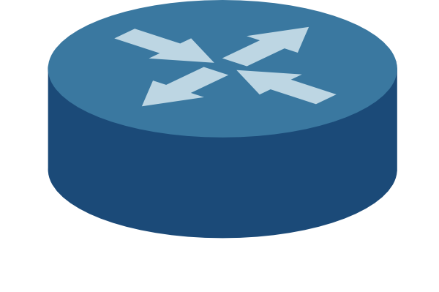

Multicasting: Motivation
Many users want to access the same stream simultaneously
E.g. Olympic Opening Ceremony
Normal connections are Unicast
Each host receives a separate copy of the stream
...

Slide 29

Multicasting: Motivation
Unicast
Each host receives a separate copy of the stream
Here, 4x the bandwidth required!
Could be millions…
Huge strain on the network
...

Slide 30
Multicasting: Motivation
Multicast to the rescue!
Single packet can be sent to multiple hosts
Routers copy the packets as they forward them to hosts
...

Slide 31
Multicast
Multicast connections are represented by groups
Hosts join a group w/ address G
Sender sends to destination address G
Multicast can exist on multiple layers
L2: Ethernet Multicast
L3: IP Multicast
App Layer: Application Multicast
Won’t talk about this…

Slide 32
L2 Multicast
Multicasting within a subnet
Group: MAC Address G
Normally, host NICs (network interface cards) listen for packets sent to
Their own MAC address
broadcast address ff:ff:ff:ff:ff:ff
Join group G:
The host’s NIC will also listen to the multicast address G
Send to G:
Packet is treated as a broadcast

Slide 33
L2 Multicast
Limited to a single subnet
Requires broadcast on subnet
State:
Only host NICs keep state
which groups they have joined

Slide 34
L3 Multicast
Multicasting across different networks
224.0.0.0/4 IP block is reserved for multicast groups
Starting with 1110...
Open group membership
Any host can join the group
By sending IGMP message
Any host can send to the group
Even nonmembers (Mistake!)

Slide 35
L3 Multicast Implementations
Types of IP multicast:
Intra-domain
Source Specific Tree
DVMRP
Shared Tree
Core Based Trees
Single-Sender
Inter-domain
Very difficult, not covered...

Slide 36
DVMRP
Distance Vector Multicast Routing Protocol
Leverages the routes formed by standard distance vector routing
DV routing gives us:
Shortest paths from all sources to a destination
(Destination based)
If we flip those routes:
Shortest paths from a source to all destinations
This gives us a shortest-paths tree for every sender to its receivers
Packets are sent along this tree

Slide 37
DVMRP
When hosts join the group:
Send IGMP message
“I want to join group G”
Routers learn which of their children are in the group
When a host sends data to the group:
Packets are flooded on the tree
Reverse of unicast paths towards that host

Slide 38
DVMRP: Pruning
When a host wants to leave the group, it sends an IGMP prune message
“I am not part of this group”
Router knows not to send to that host
If a router has no children in the group
Sends a prune message to parent routers
Once all prunes have been sent:
Result is a tree that connects a source S to all receivers in the group

Slide 39
DVMRP: State
DVMRP requires:
O(Sources x Groups)
For every group:
There exists a tree for every source to all destinations
How to improve scaling?
Core-based Trees!

Slide 40
Core-Based Trees
For each group G, a core is chosen
Called a “rendezvous point”
The tree is built from all members to that core
Requires:
each member knows the location of the core in advance

Slide 41
Establishing Shared Tree
Group members: M1, M2, M3
core
M1
M2
M3
control (join) messages

Slide 42
Use Shared Tree for Delivery
Group members: M1, M2, M3
M1 sends data
core
M1
M2
M3
control (join) messages
data

Slide 43
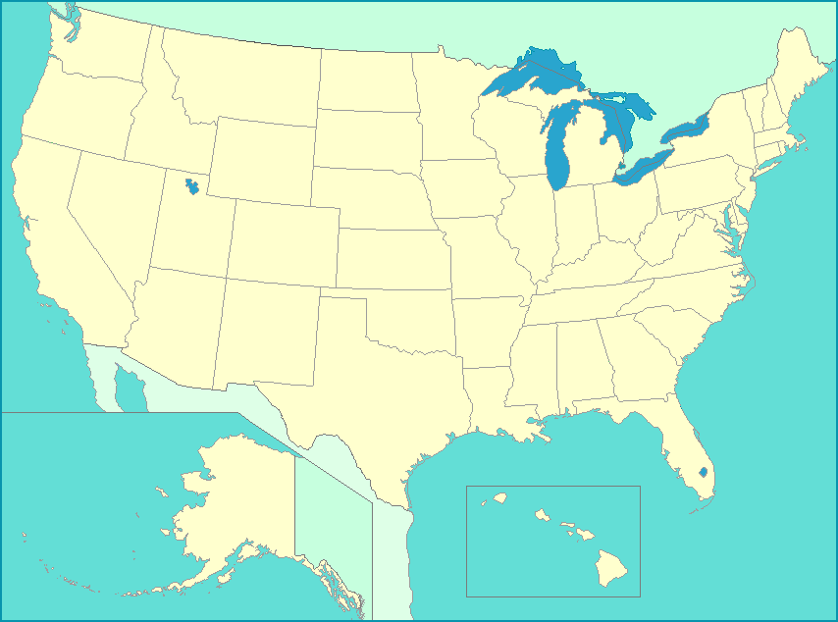
Core Performance
Core location is crucial to performance
If chosen poorly, connections could waste lot more time/bandwidth
M1
core
M2
M3

Slide 44
CBT: State
CBT requires:
O(Groups)
One tree per group
Shortest paths to the core

Slide 45


Multicast Today
Intradomain (within an AS)
Used in special enterprises
Stock exchanges
Corporate video conferencing
Interdomain
Original vision of millions watching a live broadcast
Never realized…
Too difficult to scale

Slide 46
Worksheet

