Slide 1
Distance-Vector Routing
CS 168 – Fall 2017 – Section 4

Slide 2
Agenda
Application
Transport
Network (L3)
Distance-Vector Routing
Network
Datalink
Physical

Slide 3
Distance-Vector Key Points
Scalable
Unlike link-state, routers don’t need global network topology
Distributed
Routers communicate with neighbors to compute routes
Minimizes Distance
Avoids loops and minimizes “cost,” not necessarily physical distance

Slide 4
Distance-Vector Routing
Each router…
Has a “vector” of distances to each destination
Also keeps track of next-hop router for each destination
Uses its own outgoing link costs to compute its initial vector
Initial State
A | B | C
0, A | 2, B | 9, C
A | B | C | D
9, A | 1, B | 0, C | 16, D
9
A
C
2
1
16
B
D
7
A | B | C | D
2, A | 0, B | 1, C | 7,D
B | C | D
7, B | 16, C | 0, D

Slide 5
Two Components of Distance-Vector
Protocol
Each router floods its vector to neighbors when helpful
Algorithm
- Upon receiving a vector from a neighbor, each router uses Bellman-Ford to update its own vector

Slide 6
Protocol
Each router advertises its vector to all of its neighbors
Whenever any distance to a destination changes in its vector
- Including when it builds its initial vector
2. Periodically
- Helps with consistency among neighbors

Slide 7
Protocol Example
Since each router just built its initial vector, each of them advertises its vector by flooding
Only A is shown here, but B,C,D do the same
A | B | C | D
9, A | 1, B | 0, C | 16, D
A | B | C
0, A | 2, B | 9, C
9
A
C
2
1
16
B
D
7
B | C | D
7, B | 16, C | 0, D
A | B | C | D
2, A | 0, B | 1, C | 7,D

Slide 8
Algorithm
Upon receiving a vector from its neighbor, a router:
Learns about new destinations
Uses Bellman-Ford to update its vector
for d in destinations:
minCost, nextHop = ∞, None
for n in neighbors:
c = cost of link to n
a = advertised distance from n to d
if a + c < minCost:
minCost = a + c
nextHop = n
vector[d] = (minCost, nextHop)
Flood vector if any entry changed!

Slide 9
Distance-Vector Walkthrough
Continuing the example from earlier
Let’s consider just router A for now
All routers initially flood their vectors
A | B | C
0, A | 2, B | 9, C
A | B | C | D
9, A | 1, B | 0, C | 16, D
9
A
C
2
1
16
B
D
7
B | C | D
7, B | 16, C | 0, D
A | B | C | D
2, A | 0, B | 1, C | 7,D

Slide 10
Walkthrough
9
A
C
2
1
16
B
D
Initially, A doesn’t know either of its neighbors’
vectors
7
A’s Perspective
B’s vector
?
C’s vector
?
A’s vector
A | B | C
0, A | 2, B | 9, C
A

Slide 11
Walkthrough
9
A
C
2
1
16
B
D
A receives B’s vector
- Learns about D
Using Bellman-Ford, updates its entries for dests C and D
- Floods new vector to neighbors
7
B’s vector
A | B | C | D
2, A | 0, B | 1, C | 7,D
B’s vector
A | B | C | D
2, A | 0, B | 1, C | 7,D
C’s vector
?
C’s vector
?
A | B | C
0, A | 2, B | 9, C
A | B | C | D
0, A | 2, B | 3, B | 9, B
A’s vector
A’s vector
A
A

Slide 12
Walkthrough
9
A
C
2
1
16
B
D
7
A receives C’s vector
Using Bellman-Ford, realizes it has no updated distances
- Does not flood vector to neighbors
B’s vector
A | B | C | D
2, A | 0, B | 1, C | 7,D
B’s vector
A | B | C | D
2, A | 0, B | 1, C | 7,D
C’s vector
A | B | C | D
9, A | 1, B | 0, C | 16, D
C’s vector
A | B | C | D
9, A | 1, B | 0, C | 16, D
A | B | C | D
0, A | 2, B | 3, B | 9, B
A | B | C | D
0, A | 2, B | 3, B | 9, B
A’s vector
A’s vector
A
A

Slide 13
Walkthrough
Eventually all vectors will converge
Routers still send periodic updates to deal with network changes
A | B | C | D
0, A | 2, B | 3, B | 9,B
A | B | C | D
3, B | 1, B | 0, C | 8, B
9
A
C
2
1
16
B
D
7
A | B | C | D
9, B | 7, B | 8, B | 0,D
A | B | C | D
2, B | 0, B | 1, B | 7,B

Slide 14
Special Case 1: Poison Reverse
A realizes C is its first hop router to D, as well as to C…
A changes its distance to D and C to infinity
Sends this modified vector to C
A | B | C | D
0, A | 2,B | 2, C | ∞
2
A | B | C | D
0, A | 2, B | 2,C | 4, C
A
C
2
2
B
D
D

Slide 15
Special Case 2: Split Horizon
Split horizon is the same as poison reverse, except…
In split horizon, A does not advertise its distance to D and C at all when sending its vector to C
Similarly, A does not advertise its distance to B when sending its vector to B
A | B
0,A | 2,B
A | C | D
0,A | 2,C | 4,C
2
A
C
2
2
B
D

Slide 16
Special Case 3: Route Poisoning
When a link between A and C goes down and they can no longer reach each other…
A advertises infinity for dest C, and vice versa
A also advertises infinity to D because A uses C to get to D (same with C to B)
A | B | C | D
∞ | ∞ | 0, C | 2, D
A | B | C | D
0, A | 2,B | ∞ | ∞
A
C
2
2
B
D
D

Slide 17
Combinations of Strategies
Route Poisoning + Poison Reverse
Efficient updates
Split Horizon + Poisoning
Only split horizon means full update required on link going down
Only poisoning means have to explicitly send poison for every route don’t have

Slide 18
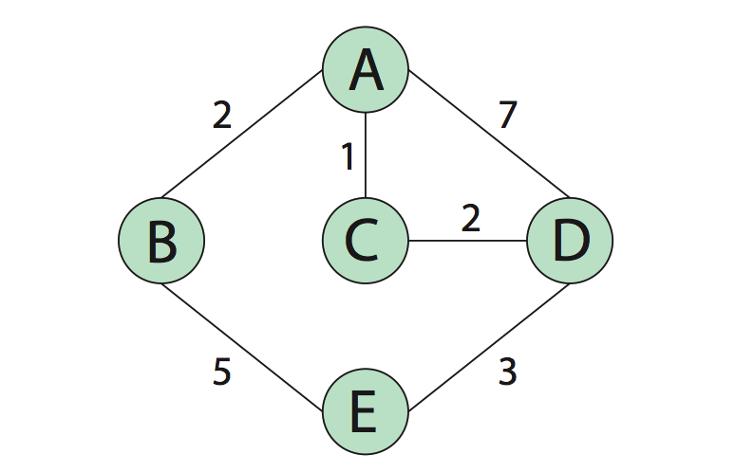
Diagram for Q1

Slide 19
LOST Session
(Lost and Overwhelmed Student's Turnabout) ☺
Safe space for students who feel like they have lost contact with the class and need help reconnecting with one or more of the basic concepts
320 Soda, Friday 5-6 PM
We encourage checking it out if you’re feeling on shaky ground!

