Slide 1
CS 168 Addressing
Fall 2017
Scott Shenker
CS168.io

Slide 2

Ssssshhhhhhhhhhhhhhh

Slide 3
Questions about Routing
When router A tells router B about A’s route to B:
What does Split Horizon tell us to do?
What does Poison Reverse tell us to do?
What the @#$@# do we care?
B does not need a route to B!
We don’t care how you handle this case….

Slide 4
Fundamentals of Addressing

Slide 5
Have covered everything but addresses!
4-bit
Version
4-bit
Header
Length
8-bit
Type of Service
(TOS)
16-bit Total Length (Bytes)
16-bit Identification
3-bit
Flags
13-bit Fragment Offset
8-bit Time to
Live (TTL)
8-bit Protocol
16-bit Header Checksum
32-bit Source IP Address
32-bit Destination IP Address
Options (if any)
Payload

Slide 6
Current IP Addressing
Reflects series of necessary hacks
Necessary to survive, but not pretty…
No one would design such a system from scratch
But before walking through the shame that is today’s IP addressing, we first try to design it from scratch….

Slide 7
Use of Addresses
Used by routers to forward packets to destination
Functions as “locator”
You can use this to forward packets to destination
Sometimes also used as identifier (subtle)
Must let destination know packet was for them
I know what my address is
Might let destination know who packet is from
This address tells me who you are (not typical)
Typically addresses are mostly locators
Contains information about how to reach host

Slide 8
Forwarding vs Routing
Routing: “control plane”
Computing paths the packets will follow
Distributed protocol leads to state at each router
Can be done slowly (tens of milliseconds)
But must scale to size of network!
Forwarding: “data plane”
Directing a data packet to an outgoing link
Individual router using routing state
Must be done quickly (micro or nano seconds)

Slide 9
Two Requirements for Addressing
Scalable routing
How much state must be exchanged to create paths
Some addressing schemes require more than others
Efficient forwarding
How big is the forwarding table?
How quickly can you locate items in table?
Some addressing schemes make this easier than others

Slide 10
One Additional Requirement
Host must be able to recognize packet is for them
They should be able to tell that sender meant for that packet to reach them
This is a subtle issue….but important
Think of this as the end-to-end check on routing!

Slide 11
Recognizing Packets are for Me
Address can contain something intrinsic to me
Functions somewhat as identifier
I know my current address
Can recognize that incoming packet is using that address
Layers handle this differently:
L2 addresses are “intrinsic”
L3 addresses are assigned (and ephemeral)

Slide 12
Layer 2 Addressing
Typically uses MAC addresses
Unique numbers burned into interface cards
Random string of bits
No location information
Local area networks route on these “flat” addresses
Separate routing entry for each host
Works nicely with learning switches and STP
Routes set up “on-demand”

Slide 13
How Does This Meet Requirements?
Scalable routing
Routing is done by learning switches
Can scale to size of L2 networks
Efficient forwarding
Exact match lookup on MAC addresses
Only need table for “active” hosts
Host must be able to recognize packet is for them
MAC address does this perfectly
Conclusion: scaling limited by table size (# hosts)

Slide 14
How Would You Scale L2?
If your L2 network were too big to have separate entries for every host, how would you scale it?
Must use MAC address as part of address
Only way host knows that the packet is for them
But how do you avoid having separate routing entries (in switches) for every host?

Slide 15
DIY Scalable L2 Routing/Addressing
Take three minutes
Talk to your neighbors
Requirement for solution:
Scales to large networks
Internal switch routing tables relatively small and stable
Not updated for every host movement
No separate entry for every host
But first-hop switch might have other information based on learning or other protocol

Slide 16
Solution
Run standard routing algorithm between switches
Internal routing tables know how to reach switches
Don’t know anything about hosts
When host sends packet
First-hop router adds tag to destination address
Which switch should this be delivered to (if not known, flood)
First-hop router adds tag to source address
Telling everyone that this host is located at this switch
All internal forwarding done on switch address
Smaller number, very stable
But last switch delivers to individual host

Slide 17
This Is A Learning Solution
But here routers learn where someone is
To which switch is it attached?
But already have a route to that location
Routing tables are precomputed to reach switches
And learning only happens at edge
They learn switch where packet’s source resides
Traditional L2 switches only learn a local direction
And require spanning trees to ensure that the resulting paths reach the destination….

Slide 18
Addressing
Addresses are of form: Switch : Host
All internal forwarding done on switch addresses
Fewer in number (than hosts)
Very stable
Mapping between hosts and switches
Learned as in normal L2 (or some other mechanism)
Information only kept at edge
Hosts know that packet is for them (MAC address)
Don’t need to know which switch they are at

Slide 19
Status
Several protocols (SPB, Trill) are adopting this approach
Driven mainly by need to avoid spanning tree, not size of routing tables

Slide 20
How Do We Extend This to L3?
Must extend to entire world!
Routing tables cannot have entry for every switch
Cannot flood when you don’t know where someone is!

Slide 21
DIY Scalable L3 Routing/Addressing
Take three minutes
Talk to your neighbors
Requirement for solution:
Scales to global networks
No flooding
Won’t embarrass you when you present idea to class

Slide 22
One Solution
Use addresses of the form: Network : Host
Routers know how to reach all networks in world
Routers ignore Host part of address
Hosts can recognize when packets are for them (Host)
Each network knows how to reach local hosts
E.g., using L2
A lookup mechanism allows hosts to know where every host is (i.e., which network to send to)
This was the original IP addressing scheme

Slide 23
What Do I Mean By “Network”
In the original IP addressing scheme…
Network meant an L2 network (“subnet”)
There are too many of them now to scale
Will return to this later….

Slide 24
Two Key Aspects of Solutions
Aggregation
Mapping between identifier and locator

Slide 25
Aggregation
Aggregation: Single forwarding entry used for many individual hosts
Examples:
Scaled L2: Aggregate was “switch”
L3: Aggregate was “network”
Advantages: fewer entries and more stable
Don’t need to keep state on individual hosts
Aggregate doesn’t move around much

Slide 26
Name/Identifier to Location Mapping
Scaled L2: used learning to map host to switch
Or other mechanisms
L3: uses DNS (not yet covered)
Use “name” as identifier
Get back IP address as locator

Slide 27
Where Are We?
Have a sensible addressing scheme for scaling L2
Use MAC addresses for host addressing
But forward based on destination switch addresses
We have a sensible addressing scheme for L3
Use Network:Host addressing
Routers Forward on Network field

Slide 28
How Do These Fit Together?
When sending packet from A to B….
A sends over L2 network to router
Using MAC address of router and L2 forwarding
Series of routers carry packets to B’s L2 network
Looking at network portion of IP address
B’s L2 network delivers packet to B
Using B’s MAC address and L2 forwarding
How do you find out about B’s MAC address?
ARP (to be covered later)

Slide 29
Hierarchical Structure
The Internet is an “inter-network”
Used to connect networks together, not hosts
Forms a natural two-level hierarchy:
WAN delivers to the right LAN
LAN delivers to the right host
host
host
...
host
host
host
...
host
LAN 1
LAN 2
router
router
router
WAN
WAN
LAN = Local Area Network (L2)
WAN = Wide Area Network (L3)

Slide 30
Two Universal Tricks in CS
When you need more flexibility, you add…
A layer of indirection
When you need more scalability, you impose…
A hierarchical structure

Slide 31
Hierarchical Addressing in U.S. Mail
Addressing in the U.S. mail
Zip code: 94704
Street: Center Street
Building on street: 1947
Location in building: Suite 600
Name of occupant: Scott Shenker
Forwarding the U.S. mail
Deliver letter to the post office in the zip code
Assign letter to mailperson covering the street
Drop letter into mailbox for the building/room
Give letter to the appropriate person
???

Slide 32
Quick Review
Original IP addressing: Network : Host
Elegant, but perhaps not sufficiently scalable
How would you make it more scalable?

Slide 33
Extending The L3 Solution
If too many networks, then could add layer:
AS : Network : Host
AS = Autonomous System (often your ISP)
Network might be L2 network within AS
Can add additional levels of hierarchy (e.g., region)
And can do flat routing at each level
Address can be both locator (prefix) and identifier (suffix)

Slide 34
Implementing This Design
Could have had extra address layers as IP options
Routers always forward on visible part of address
Until you reach that address (AS/Network/..)
When arrive in a AS/Network you pop address
Bringing the next address to the top
Elegant design, completely compatible with IP

Slide 35
But that’s not what happened
Rather than reusing the lesson of hierarchy, L3 addressing has turned into a mess
Rest is a story of how a good design turned bad
To understand, we need to dive into details...

Slide 36
Gory Details of Addressing

Slide 37
IP Addresses (IPv4)
Unique 32-bit number associated with an interface
on a host, on a router, … connect to ports, links, etc.
Association can be long-term or short-term
Use dotted-quad notation, e.g., 12.34.158.5:
12
34
158
5
00001100
00100010
10011110
00000101

Slide 38
Examples
80.19.240.51
What address is this?
How would you represent 68.115.183.7?
01010000
00010011
11110000
00110011
01000100
01110011
10110111
00000111

Slide 39
Original Internet Addresses
First eight bits: network address (/8)
Slash notation indicates network address
Last 24 bits: host address
Assumed 256 networks were more than enough!

Slide 40
Nice Features
Transit routers looked at what portion of address?
Network
That portion of address space was flat
No need for hierarchy with 256 entries
Rest of address only relevant on host’s network
But did not provide for enough networks
Ubiquity of ethernet not foreseen

Slide 41
Next Design: Classful Addressing
Class A: if first byte in [0..127] ⇒ assume /8 (top bit = 0)
Very large blocks (e.g., MIT has 18.0.0.0/8)
Class B: first byte in [128..191] ⇒ assume /16 (top bits = 10)
Large blocks (e.g,. UCB has 128.32.0.0/16)
Class C: [192..223] ⇒ assume /24 (top bits = 110)
Small blocks (e.g., ICIR has 192.150.187.0/24)
(My house used to have a /25)
0*******
********
********
********
126 nets
~16M hosts
~16K nets
~65K hosts
10******
********
********
********
~2M nets
254 hosts
110*****
********
********
********

Slide 42
Classful Addressing (cont’d)
Class D: [224..239] (top bits 1110)
Multicast groups
Class E: [240..255] (top bits 11110)
Reserved for future use
1110****
********
********
********
Multicast
11110***
********
********
********
Experimental
Nice feature of design:
First bits tell you which is network address

Slide 43
What is wrong with classful?
Only comes in 3 sizes
Routers may need state for many class C’s (/24s)
Wasted address space

Slide 44
Today’s Addressing: CIDR
CIDR = Classless Interdomain Routing
Flexible division between network and host addresses
Must specify both address and mask
Clarifies where boundary between addresses lies
Classful addressing communicate this with first few bits
CIDR requires explicit mask
Mask carried in routing algorithm
Not implicitly carried in address

Slide 45
Hierarchical Addressing
Prefix is network address: suffix is host address
12.34.158.0/23 is a 23-bit prefix with 2⁹ addresses
Terminology: “Slash 23”
12
34
158
5
00001100
00100010
10011110
00000101
Network (23 bits)
Host (9 bits)

Slide 46
IP Address and a 23-bit Subnet Mask
Address
12
34
158
5
00001100
00100010
10011110
00000101
11111111
11111111
11111110
00000000
Mask
255
255
254
0

Slide 47
CIDR Addressing
Use two 32-bit numbers to represent a network.
Network number = IP address + Mask
IP Net Address : 12.4.0.0 IP Mask: 255.254.0.0
Address
00001100
00000100
00000000
00000000
Mask
11111111
11111110
00000000
00000000
Network Prefix
for hosts
Written as 12.4.0.0/15 or 12.4/15

Slide 48
Classful vs. Classless addresses
Example: an organization needs 500 addresses.
A single class C address not enough (254 hosts).
Instead a class B address is allocated. (~65K hosts)
That’s overkill, a huge waste!
CIDR allows an arbitrary prefix-suffix boundary
Hence, organization allocated a single /23 address (equivalent of 2 class C’s)
Maximum waste: 50%

Slide 49
How Do Prefixes Help?
Number nearby hosts with same prefix
1.2.3.0/24 on the left LAN
5.6.7.0/24 on the right LAN
1.2.3.4
1.2.3.7
1.2.3.156
5.6.7.8
5.6.7.9
5.6.7.212
host
host
...
host
host
host
...
host
LAN 1
LAN 2
router
router
router
WAN
WAN
1.2.3.0/24
5.6.7.0/24
forwarding table
Notes:
What are the routing entries?

Slide 50
Easy to Add New Hosts
No need to update the routers
E.g., adding a new host 5.6.7.213 on the right
Doesn’t require adding a new forwarding entry
1.2.3.4
1.2.3.7
1.2.3.156
5.6.7.8
5.6.7.9
5.6.7.212
host
host
...
host
host
host
...
host
LAN 1
LAN 2
router
router
router
host
WAN
WAN
5.6.7.213
1.2.3.0/24
5.6.7.0/24
forwarding table

Slide 51
“Subnet” Terminology
Think of LANs as special case of “subnets”
Subnet is region without routers containing addresses within the “subnet mask”, could be a link, or LAN
Area with same network address
Textbook has an operational definition of subnet
Remove all interfaces from hosts, routers
The regions that remain connected are subnets
Subnets are the lowest level of aggregation
No routers needed within a subnet
But you might have switches (L2)

Slide 52
Aggregation
All of this is about aggregation
In our earlier designs we had fixed aggregation:
All L2 addresses attached to the same router
All L3 addresses with the same network address
What about with CIDR?
Aggregation is much more fluid!
A single entry in one router might be two separate entries in the next router:
12.0.0.0/8 turns into 12.0.0.0/9 and 12.128.0.0/9
Aggregation is a local decision, not global….

Slide 53
Aggregating at a Router
Group of contig. addresses require same forwarding
Contiguous so they share the same routing entry
This allows you to do lookup over smaller table
Works better when aggregates are fairly stable
And is more possible when address allocation is reasonable (i.e., if you spread addresses around randomly, aggregation is less likely)

Slide 54
CIDR: Hierarchal Address Allocation
Prefixes are key to Internet scalability
Addresses allocated in contiguous chunks (prefixes)
Routing protocols and packet forwarding based on prefixes
Recursively break down chunks as get closer to host
12.0.0.0/15
12.3.0.0/22
:
:
:
12.2.0.0/16
12.3.4.0/24
12.3.0.0/16
:
:
:
:
12.3.254.0/23
12.0.0.0/8
12.253.0.0/19
12.253.32.0/19
12.253.64.0/19
12.253.0.0/16
:
12.253.64.108/30
12.253.96.0/18
12.253.128.0/17

Slide 55
Allocation Done Hierarchically
Internet Corporation for Assigned Names and Numbers (ICANN) gives large blocks to…
Regional Internet Registries, such as the American Registry for Internet Names (ARIN), which give blocks to…
Large institutions (ISPs), which give addresses to…
Individuals and smaller institutions
FAKE Example:
ICANN ➔ ARIN ➔ AT&T ➔ UCB ➔ EECS

Slide 56
FAKE Example in More Detail
ICANN gives ARIN several /8s
ARIN gives AT&T one /8, 12.0/8
Network Prefix: 00001100
AT&T gives UCB a /16, 12.197/16
Network Prefix: 0000110011000101
UCB gives EECS a /24, 12.197.45/24
Network Prefix: 000011001100010100101101
EECS gives me a specific address 12.197.45.23
Address: 00001100110001010010110100010111

Slide 57
Why Is Aggregation Nontrivial?
Mobility: laptops, cellphones, etc.
Not really….Dynamic address assignment
Multihoming: Many entities have two or more ISPs
Institutional renumbering hard

Slide 58
IP addressing → scalable routing?
Hierarchical address allocation only helps routing scalability if allocation matches topological hierarchy

Slide 59
Scalability: Address Aggregation
Provider is given 201.10.0.0/21 (201.10.0.x .. 201.10.7.x)
Provider
201.10.0.0/22
201.10.4.0/24
201.10.5.0/24
201.10.6.0/23
Routers in the rest of the Internet just need to know how to reach 201.10.0.0/21. The provider can direct the IP packets to the appropriate customer.

Slide 60
Aggregation Not Always Possible
201.10.0.0/21
Provider 1
Provider 2
201.10.0.0/22
201.10.4.0/24
201.10.5.0/24
201.10.6.0/23
Multi-homed customer with 201.10.6.0/23 has two providers. Other parts of the Internet need to know how to reach these destinations through both providers.
⇒ /23 route must be globally visible

Slide 61
IP addressing → scalable routing?
a.c.*.* is this way
a.b.*.* is this way
France Telecom
AT&T a.0.0.0/8
LBL a.b.0.0/16
UCB a.c.0.0/16

Slide 62
IP addressing → scalable routing?
Can add new hosts/networks without updating
the routing entries at France Telecom
a.*.*.* is this way
France Telecom
AT&T a.0.0.0/8
foo.com a.d.0.0/16
LBL a.b.0.0/16
UCB a.c.0.0/16

Slide 63
IP addressing → scalable routing?
ESNet must maintain routing entries for both a.*.*.* and a.c.*.*
AT&T a.0.0.0/8
ESNet
LBL a.b.0.0/16
UCB a.c.0.0/16

Slide 64
IP addressing → scalable routing?
Hierarchical address allocation helps routing scalability if allocation matches topological hierarchy
Problem: may not be able to aggregate addresses for “multi-homed” networks
Two competing forces in scalable routing
aggregation reduces number of routing entries
multi-homing increases number of entries

Slide 65
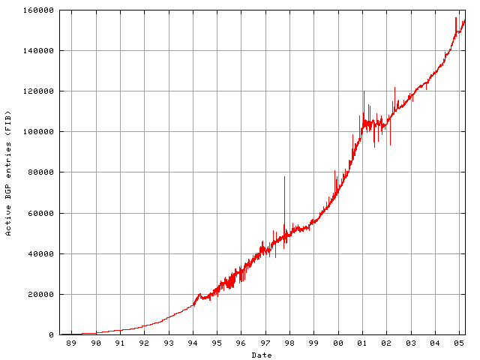
Growth in Routed Prefixes (1989-2005)
Dot-com implosion; Internet bubble bursts
Advent of CIDR allows aggregation: linear growth
Initial growth super-linear; no aggregation
Back in business
Internet boom: multihoming drives superlinear growth

Slide 66
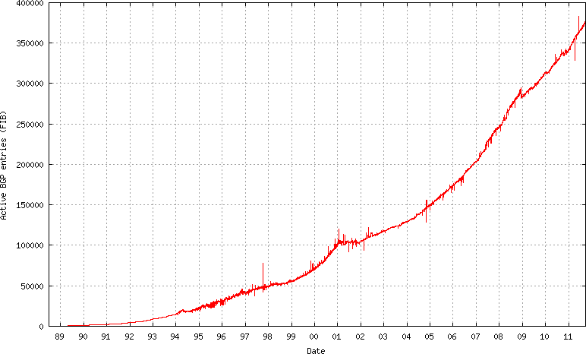
Same Table, Extended to Present
Linear growth
Superlinear growth
What Happened Here?
Stock Market
Crash of 2008

Slide 67
Summary of Addressing
Hierarchical addressing
Critical for scalable system
Don’t require everyone to know everyone else
Reduces amount of updating when something changes
Non-uniform hierarchy
Useful for heterogeneous networks of different sizes
Class-based addressing was far too coarse
Classless InterDomain Routing (CIDR) more flexible
But how do you forward on these addresses?

Slide 68
Challenge
How do you keep table small even with holes in aggregation?
For next time….

