Slide 1
CS 168 Congestion Control
Fall 2017
Scott Shenker
CS168.io

Slide 2

Ssssshhhhhhhhhhhhhhh

Slide 3
TCP Congestion Control
Notes:
Deceptively complicated….

Slide 4
Who Takes Care of Congestion?
Network?
End hosts?
Both?

Slide 5
TCP’s Answer
End hosts adjust sending rate
Based on implicit feedback from network
Implicit: router drops packets because its buffer overflows, not because it is trying to send message
Later I might discuss various methods for explicit feedback where router purposely tells hosts about congestion
Hosts probe network to test level of congestion
Speed up when no congestion (i.e., no packet drops)
Slow down when congestion (i.e., packet drops)
Notes:
REPEAT

Slide 6
Drawbacks
Suboptimal (always above or below optimal point)
Relies on end system cooperation
Messy dynamics
All end systems adjusting at the same time
Large, complicated dynamical system
Miraculous it works at all!
Ignores economics
Who should get the bandwidth?

Slide 7
Some History: TCP in the 1980s
Sending rate only limited by flow control (RWND)
Dropped packets → senders (repeatedly!) retransmit
Led to “congestion collapse” in Oct. 1986
Throughput on the NSF network dropped from 32Kbits/s to 40bits/sec
“Fixed” by Van Jacobson’s development of TCP’s congestion control (CC) algorithms

Slide 8
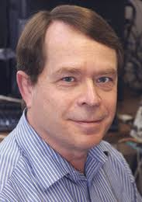
Van Jacobson
Leader of the networking research group at LBL
Many contributions to the early TCP/IP stack
Most notably congestion control
Creator of many widely used network tools
Traceroute, tcpdump, pathchar, Berkeley Packet Filter
Later Chief Scientist at Cisco, then Fellow at PARC
Now a member of the Borg (I mean Google)

Slide 9
Jacobson’s Approach
Extend TCP’s existing window-based protocol but adapt the window size in response to congestion
A pragmatic and effective solution
Required no upgrades to routers or applications!
Patch of a few lines of code to TCP implementations
Extensively researched and improved upon
Especially now with datacenters and cloud services

Slide 10
All These Windows…
Congestion Window: CWND
How many bytes can be sent without overflowing routers
Computed by the sender using congestion control algorithm
Flow control window: AdvertisedWindow (RWND)
How many bytes can be sent without overflowing receiver’s buffers
Determined by the receiver and reported to the sender
Sender-side window = minimum{CWND, RWND}
Assume for this lecture that RWND >> CWND

Slide 11
Note
This lecture will talk about CWND in units of MSS
(Recall MSS: Maximum Segment Size, the amount of payload data in a TCP packet)
This is only for pedagogical purposes
Keep in mind that real implementations maintain CWND in bytes

Slide 12
Basics of TCP Congestion Control
Congestion window (CWND)
Maximum # of unacknowledged bytes to have in flight
Rate ~ CWND/RTT
Adapting the congestion window
Increase upon lack of congestion: optimistic exploration
Decrease upon detecting congestion
But how do you detect congestion?

Slide 13
Detecting Congestion
Network could tell source (ICMP Source Quench)
Risky, because during times of overload the signal itself could be dropped (and add to congestion)!
Packet delays go up (knee of load-delay curve)
Tricky: noisy signal (delay often varies considerably)
Packet loss
Fail-safe signal that TCP already has to detect
Complication: non-congestive loss (checksum errors)
Complication: reordered packets look like congestion

Slide 14
Not All Losses the Same
Duplicate ACKs: isolated loss
Still getting ACKs
Timeout: possible disaster
Not enough dupacks
Must have suffered several losses

Slide 15
How to Adjust CWND?
Consequences of over-sized window much worse than having an under-sized window
Over-sized window: packets dropped and retransmitted
Under-sized window: somewhat lower throughput
Approach:
Gentle increase when uncongested (exploration)
Rapid decrease when congested

Slide 16
How do you adjust CWND?
Upon receipt of an ACK (assume for single MSS)
Upon receipt of a 3rd DupACK?
Upon a timeout?
Design it yourself!

Slide 17
Some Possible Answers
Option #1:
ACK: CWND → 2 CWND
3rd DupACK: CWND → CWND/2
Timeout: CWND → CWND/2
Option #2:
ACK: CWND → CWND + 1 MSS
3rd DupACK: CWND → CWND - 2 MSS
Timeout: CWND → CWND/2
Many other answers. What do you think?
And why?

Slide 18
Additive Increase, Mult. Dec.: AIMD
Additive increase
On success of last window of data, increase by one MSS
That is, if W packets in a row have been ACKed, I can increase W by one
i.e., +1/W per ACK
Multiplicative decrease
On loss of packet detected by dupacks, divide congestion window in half
Notes:
REPEAT

Slide 19
AIMD
ACK: CWND → CWND + 1/CWND
(when CWND measured in MSSs)
CWND → CWND + MSSx[MSS/CWND] (in bytes)
NOTE: after a full window, CWND increases by 1 MSS
Thus, CWND increases by 1 MSS per RTT
3rd DupACK: CWND → CWND/2
Special case ofTimeout: CWND → 1 MSS

Slide 20
Leads to the TCP “Sawtooth”
Window
Loss
halved
t
Notes:
Picture not realistic!!

Slide 21
Any Questions?

Slide 22
Slow-Start
In what follows refer to cwnd in units of MSS

Slide 23
AIMD Starts Too Slowly!
Need to start with a small CWND to avoid overloading the network.
Window
It could take a long time to get started!
t

Slide 24
Bandwidth Discovery with Slow Start
Goal: estimate available bandwidth
start slow (for safety)
but ramp up quickly (for efficiency)
Consider
RTT = 100ms, MSS=1000bytes
Window size to fill 1Mbps of BW = 12.5 packets
Window size to fill 1Gbps = 12,500 packets
With just AIMD, it takes 12500 RTTS to get to this window size!
~21 minutes!

Slide 25
“Slow Start” Phase
Start with a small congestion window
Initially, CWND is 1 MSS
So, initial sending rate is MSS/RTT
That could be pretty wasteful
Might be much less than the actual bandwidth
Linear increase takes a long time to accelerate
Slow-start phase (actually “fast start”)
Sender starts at a slow rate (hence the name)
… but increases exponentially until first loss
Notes:
MSS vs MTU??

Slide 26
Slow Start in Action
Double CWND per round-trip time
Simple implementation:
on each ack, CWND += MSS
1
2
3
4
8
Src
D
A
D
D
A
A
D
D
D
D
A
A
A
A
Dest

Slide 27
Slow Start and the TCP Sawtooth
Window
Loss
Exponential “slow start”
t
Why is it called slow-start? Because TCP originally had
no congestion control mechanism. The source would just start by sending a whole window’s worth of data.

Slide 28
Slow-Start vs. AIMD
When does a sender stop Slow-Start and start Additive Increase?
Introduce a “slow start threshold” (ssthresh)
Initialized to a large value
On timeout, ssthresh = CWND/2
When CWND > ssthresh, sender switches from slow-start to AIMD-style increase

Slide 29
Time Outs
In what follows refer to cwnd in units of MSS

Slide 30
Loss Detected by Timeout
Sender starts a timer that runs for RTO seconds
Restart timer whenever ack for new data arrives
If timer expires:
Set SSTHRESH ← CWND / 2 (“Slow-Start Threshold”)
Set CWND ← 1 (MSS)
Retransmit first lost packet
Execute Slow Start until CWND > SSTHRESH
After which switch to Additive Increase

Slide 31
Summary of Decrease
Cut CWND half on loss detected by dupacks
“fast retransmit”
Cut CWND all the way to 1 (MSS) on timeout
Set ssthresh to cwnd/2
Never drop CWND below 1 (MSS)

Slide 32
Summary of Increase
“Slow-start”: increase cwnd by 1 (MSS) for each ack
Leave slow-start regime when either:
cwnd > SSThresh
Packet drop detected by dupacks
Enter AIMD regime
Increase by 1 (MSS) for each window’s worth of acked data

Slide 33
Why AIMD?
In what follows refer to cwnd in units of MSS

Slide 34
Reality Of Congestion Control
1Gbps
1Gbps
600Mbps
Congestion control is a resource allocation problem involving many flows, many links, and complicated global dynamics

Slide 35
Problem is too complicated….
Goal:
Avoid overloading links, but don’t waste bandwidth
Must do so in the presence of
Many competing flows
Dynamic conditions (flows arriving, leaving)
Complicated topology
Limited visibility
How do you think about such a problem?

Slide 36
Modularity is not just for design….
It is a lesson in how to think!
Break problems into subproblems
Gain insight into the subproblems,
And hope that union solves real problem

Slide 37
Three Congestion Control Challenges
Single flow adjusting to bottleneck bandwidth
Without any a priori knowledge
Could be a Gbps link; could be a modem
Single flow adjusting to variations in bandwidth
When bandwidth decreases, must lower sending rate
When bandwidth increases, must increase sending rate
Multiple flows sharing the bandwidth
Must avoid overloading network
And share bandwidth “fairly” among the flows

Slide 38
Problem #1: Single Flow, Fixed BW
Slow start is pretty good at this….
Identifies fixed BW within factor of two
And does so in logarithmic time
...no need to discuss further

Slide 39
Problem #2: Single Flow, Varying BW
Want to track available bandwidth
Oscillate around its current value
If you never send more than your current rate, you won’t know if more bandwidth is available
Possible variations: (in terms of change per RTT)
Multiplicative increase or decrease:
cwnd → cwnd * / a
Additive increase or decrease:
cwnd → cwnd +- b

Slide 40
Four alternatives
AIAD: gentle increase, gentle decrease
AIMD: gentle increase, drastic decrease
MIAD: drastic increase, gentle decrease
too many losses: eliminate
MIMD: drastic increase and decrease
Notes:
What do you think about these options?
Which one is obviously bad?
What do you think about the other ones?

Slide 41
Problem #3: Multiple Flows
Want steady state to be “fair”
Many notions of fairness, but here just require two identical flows to end up with the same bandwidth
This eliminates MIMD and AIAD
As we shall see…
AIMD is the only remaining solution!
Not really, but close enough….

Slide 42
Buffer and Window Dynamics
A
B
x
C = 50 pkts/RTT
No congestion → x increases
Congestion → x decreases

Slide 43
Simple Model of Congestion Control
Two users
rates x₁ and x₂
Congestion when x₁+x₂ > 1
Unused capacity when x₁+x₂ < 1
Fair when x₁ =x₂
1
Efficiency line (x₁+x₂ = 1)
Fairness line (x₁ =x₂)
User 2’s rate (x₂)
congested →
← inefficient
User 1’s rate (x₁)
1

Slide 44
Example
1
fairness
line
Efficient: x₁+x₂=1
Fair
Congested: x₁+x₂=1.2
(0.7, 0.5)
User 2: x₂
(0.2, 0.5)
(0.5, 0.5)
congested →
Inefficient: x₁+x₂=0.7
(0.7, 0.3)
← inefficient
Efficient: x₁+x₂=1
Not fair
efficiency
line
User 1: x₁
1

Slide 45
AIAD
Increase: x + a_{I}
Decrease: x - a_{D}
Does not converge to fairness
fairness
line
(x₁-a_{D}+a_{I}), x₂-a_{D}+a_{I}))
(x₁,x₂)
User 2: x₂
(x₁-a_{D},x₂-a_{D})
congested →
← inefficient
efficiency
line
User 1: x₁

Slide 46
AIAD Sharing Dynamics
x₁
A
B
x₂
D
E

Slide 47
AIAD Sequence of Values
X1 = 1, X2 = 3, capacity can handle total = 5
Increase: add 2 Decrease: subtract 1
First window successful:
X1 → 3, X2 → 5
Second window has drops:
X1 → 2, X2 → 4
Third window has drops:
X1 → 1, X2 → 3
…

Slide 48
MIMD
Increase: x*b_{I}
Decrease: x*b_{D}
Does not converge to fairness
fairness
line
(x₁,x₂)
(b_{I}b_{D}x₁, b_{I}b_{D}x₂)
User 2: x₂
(b_{d}x₁,b_{d}x₂)
congested →
← inefficient
efficiency
line
User 1: x₁

Slide 49
MIMD Sharing Dynamics
x₁
A
B
x₂
D
E

Slide 50
AIMD
Increase: x+a_{I}
Decrease: x*b_{D}
Converges to fairness
fairness
line
(x₁,x₂)
(b_{D}x₁+a_{I}, b_{D}x₂+a_{I})
User 2: x₂
(b_{D}x₁,b_{D}x₂)
congested →
← inefficient
efficiency
line
User 1: x₁

Slide 51
AIMD Sharing Dynamics
x₁
A
B
x₂
50 pkts/sec
D
E
Rates equalize → fair share

Slide 52
Is MIAD Fair?
X1 = 1, X2 = 3, capacity can handle total = 5
Increase: x2 Decrease: subtract 1
First window successful:
X1 → 2, X2 → 6
Second window has drops:
X1 → 1, X2 → 5
Third window has drops:
X1 → 0, X2 → 4
Fourth window successful:
X1 → 0, X2 → 8
X1 pegged at 0! MIAD maximally unfair

Slide 53
Answer to Why AIMD?
AIMD is only reasonable choice that is “fair”
Out of the four options
AIAD, MIMD: not fair
MIAD: too much congestion, and maximally unfair
AIMD: fair and reasonable congestion

Slide 54
Any Questions?

Slide 55
TCP Congestion Control Details
In what follows refer to cwnd in units of MSS

Slide 56
Implementation
State at sender
CWND (initialized to a small constant)
ssthresh (initialized to a large constant)
dupACKcount
[timer, as before]
Events at sender
ACK (new data)
dupACK (duplicate ACK for old data)
Timeout
What about receiver? Just send ACKs upon arrival

Slide 57
Event: ACK (new data)
If in slow start
CWND += 1
CWND packets per RTT
Hence after one RTT with no drops: CWND = 2xCWND

Slide 58
Event: ACK (new data)
If CWND ≤ ssthresh
CWND += 1
Else
CWND = CWND + 1/CWND
Slow start phase
“Congestion Avoidance” phase (additive increase)
CWND packets per RTT
Hence after one RTT with no drops: CWND = CWND + 1

Slide 59
Event: TimeOut
On Timeout
ssthresh ← CWND/2
CWND ← 1

Slide 60
Event: dupACK
dupACKcount ++
If dupACKcount = 3 /* fast retransmit */
ssthresh = CWND/2
CWND = CWND/2
Remains in congestion
avoidance after fast retransmission…

Slide 61
Time Diagram
Window
Timeout
SSThresh
Set to Here
Fast Retransmission
Slow start in operation until it reaches half of previous CWND, I.e., SSTHRESH
t
Slow-start restart: Go back to CWND of 1 MSS, but take advantage of knowing the previous value of CWND.
Notes:
ASK!

Slide 62
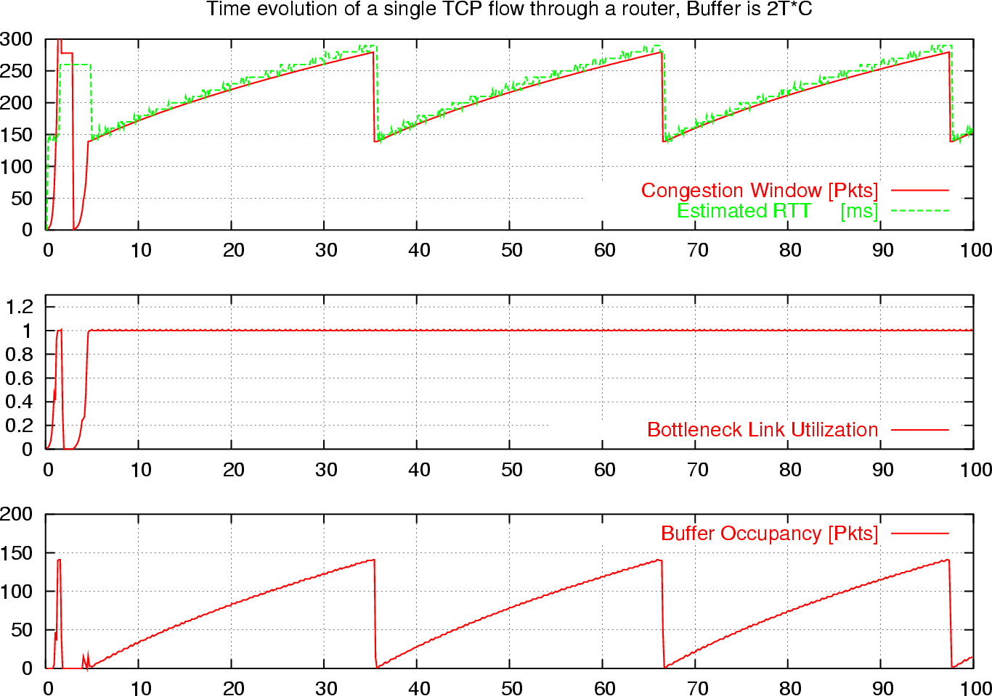
What is really looks like…
Notes:
Why?????

Slide 63
Components of TCP
Slow-Start: ramp up quickly
Congestion Avoidance: probe bandwidth gently
AIMD
Tractable version:
CWND ← FLOOR[CWND/2] on loss
CWND ← CWND+1/FLOOR[CWND]

Slide 64
One Final Phase: Fast Recovery
The problem: congestion avoidance too slow in recovering from an isolated loss
This last feature improves performance, but is not conceptually important

Slide 65
Example
Consider a TCP connection with:
CWND=10 packets
Last ACK was for packet # 101
i.e., receiver expecting next packet to have seq. no. 101
10 packets [101, 102, 103,…, 110] are in flight
Packet 101 is dropped
What ACKs do they generate?
And how does the sender respond?

Slide 66
Timeline
ACK 101 (due to 102) cwnd=10 dupACK#1 (no xmit)
ACK 101 (due to 103) cwnd=10 dupACK#2 (no xmit)
ACK 101 (due to 104) cwnd=10 dupACK#3 (no xmit)
RETRANSMIT 101 ssthresh=5 cwnd= 5
ACK 101 (due to 105) cwnd=5 (no xmit)
ACK 101 (due to 106) cwnd=5 (no xmit)
ACK 101 (due to 107) cwnd=5 (no xmit)
ACK 101 (due to 108) cwnd=5 (no xmit)
ACK 101 (due to 109) cwnd=5 (no xmit)
ACK 101 (due to 110) cwnd=5 (no xmit)
ACK 111 (due to 101) ⬅ only now can we transmit new packets
Plus no packets in flight so no ACKs for another RTT
Note that you do not
restart dupACK counter
on same packet!

Slide 67
Solution: Fast Recovery
Idea: Grant the sender temporary “credit” for each dupACK so as to keep packets in flight (each ACK due to arriving pkt)
If dupACKcount = 3
ssthresh = cwnd/2
cwnd = ssthresh + 3
While in fast recovery
cwnd = cwnd + 1 for each additional duplicate ACK
Exit fast recovery after receiving new ACK
set cwnd = ssthresh (which had been set to cwnd/2 after loss)

Slide 68
Example
Consider a TCP connection with:
CWND=10 packets
Last ACK was for packet # 101
i.e., receiver expecting next packet to have seq. no. 101
10 packets [101, 102, 103,…, 110] are in flight
Packet 101 is dropped

Slide 69
Timeline
ACK 101 (due to 102) cwnd=10 dup#1
ACK 101 (due to 103) cwnd=10 dup#2
ACK 101 (due to 104) cwnd=10 dup#3
REXMIT 101 ssthresh=5 cwnd= 8 (5+3)
ACK 101 (due to 105) cwnd= 9 (no xmit)
ACK 101 (due to 106) cwnd=10 (no xmit)
ACK 101 (due to 107) cwnd=11 (xmit 111)
ACK 101 (due to 108) cwnd=12 (xmit 112)
ACK 101 (due to 109) cwnd=13 (xmit 113)
ACK 101 (due to 110) cwnd=14 (xmit 114)
ACK 111 (due to 101) cwnd = 5 (xmit 115) ⬅ exiting fast recovery
Packets 111-114 already in flight (and now sending 115)
ACK 112 (due to 111) cwnd = 5 + 1/5 ← back in congestion avoidance

Slide 70
TCP “Phases”
Slow-start
Enter on timeout
Leave when CWND > sshresh (to Cong. Avoid.)
The > only applies here….
Congestion Avoidance
Leave when timeout
Fast Recovery
Enter when dupACK=3
Leave when New ACK or Timeout

Slide 71
TCP State Machine
timeout
slow start
congstn. avoid.
new ACK
dupACK
cwnd > ssthresh
timeout
dupACK
new ACK
timeout
new ACK
dupACK=3
dupACK=3
fast recovery
dupACK

Slide 72
TCP State Machine
timeout
slow start
congstn. avoid.
new ACK
dupACK
cwnd > ssthresh
timeout
dupACK
new ACK
timeout
new ACK
dupACK=3
dupACK=3
fast recovery
dupACK

Slide 73
TCP State Machine
timeout
slow start
congstn. avoid.
new ACK
dupACK
cwnd > ssthresh
timeout
dupACK
new ACK
timeout
new ACK
dupACK=3
dupACK=3
fast recovery
dupACK

Slide 74
TCP State Machine
timeout
slow start
congstn. avoid.
new ACK
dupACK
cwnd > ssthresh
timeout
dupACK
new ACK
timeout
new ACK
dupACK=3
dupACK=3
fast recovery
dupACK

Slide 75
Comment from last time
You leave Slow-Start only when CWND > ssthresh
But you remain in congestion avoidance even when CWND ≤ ssthresh

Slide 76
TCP Flavors
TCP-Tahoe
CWND =1 on triple dupACK
TCP-Reno
CWND =1 on timeout
CWND = CWND/2 on triple dupack
TCP-newReno
TCP-Reno + improved fast recovery
TCP-SACK
incorporates selective acknowledgements
Our default assumption

Slide 77
Interoperability
How can all these algorithms coexist? Don’t we need a single, uniform standard?
What happens if I’m using Reno and you are using Tahoe, and we try to communicate?
What happens if I’m using Tahoe and you are using SACK?

Slide 78
Any Questions?

