Slide 1
CS 168 More Congestion Control
Fall 2017
Scott Shenker
CS168.io

Slide 2

Ssssshhhhhhhhhhhhhhh

Slide 3
TCP Congestion Control Details
In what follows refer to cwnd in units of MSS

Slide 4
Implementation
State at sender
CWND (initialized to a small constant)
ssthresh (initialized to a large constant)
dupACKcount
[timer, as before]
Events at sender
ACK (new data)
dupACK (duplicate ACK for old data)
Timeout
What about receiver? Just send ACKs upon arrival
In reality receivers can “delay ACKs”, but we ignore that

Slide 5
Event: ACK (new data)
If in slow start
CWND += 1
CWND packets per RTT
Hence after one RTT with no drops: CWND = 2xCWND

Slide 6
Event: ACK (new data)
If in slow start
CWND += 1
Else
CWND = CWND + 1/CWND
Slow start phase
“Congestion Avoidance” phase (additive increase)
CWND packets per RTT
Hence after one RTT with no drops: CWND = CWND + 1

Slide 7
Event: TimeOut
On Timeout
ssthresh ← CWND/2
CWND ← 1

Slide 8
Event: dupACK
dupACKcount ++
If dupACKcount = 3 /* fast retransmit */
ssthresh = CWND/2
CWND = CWND/2 (but never less than 1)
Remains in congestion
avoidance after fast retransmission…

Slide 9
Components of TCP
Slow-Start: ramp up quickly
Congestion Avoidance: probe bandwidth gently
AIMD
Tractable version:
CWND ← FLOOR[CWND/2] on loss
CWND ← CWND+1/FLOOR[CWND]

Slide 10
Time Diagram
Window
Timeout
SSThresh
Set to Here
Fast Retransmission
Slow start in operation until it reaches half of previous CWND, I.e., SSTHRESH
t
Slow-start restart: Go back to CWND of 1 MSS, but take advantage of knowing the previous value of CWND.
Notes:
ASK!

Slide 11
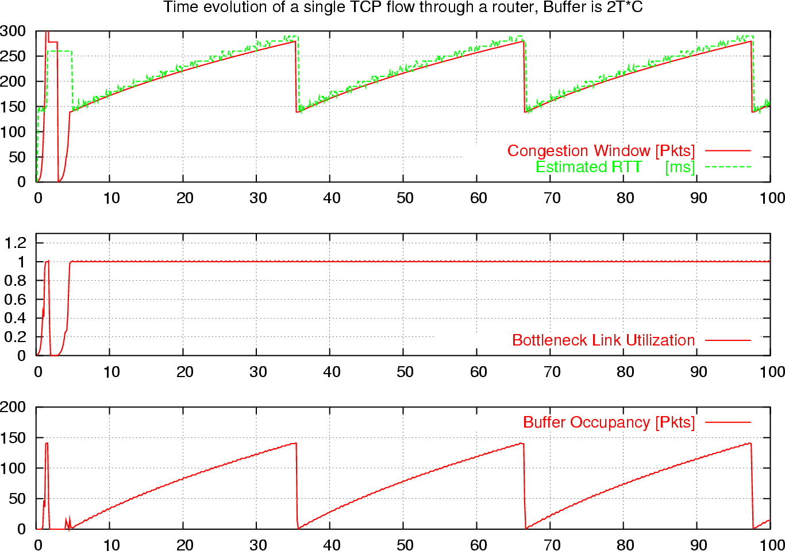
What is really looks like…
Notes:
Why?????

Slide 12
Why Is Dividing By 2 Not Bad?
To “fill the pipe” we need CWND ≥ B x RTT
Assuming path has single bottleneck of bandwidth B
But RTT is made up of two pieces:
Latency: round-trip latency RTL (which is RTT_{min})
Queueing: Q/B (where Q is bytes in queue)
There are many queues, but assume only queue is at bottleneck
RTT_{min} = RTL RTT_{max} = RTL + Q_{max}/B
Minimal CWND to fill pipe: B RTT_{min}
Max CWND that does not overflow buffer B RTT_{max}

Slide 13
Rule of thumb for buffer sizing:
Set max queue size Q_{max} to be B x RTL
So then RTT_{max} = RTL + Q_{max}/B = 2RTL
When you drop packet, queue is full, at RTT_{max}
So CWND = B RTT_{max} = 2 B RTL
When you decrease by ½, then CWND = BRTL
Which is still big enough to fill pipe!

Slide 14
Look at the Buffer
Notes:
Why?????

Slide 15
In Real Life
Things are much more complicated!
Many simultaneous flows
Queues don’t fill and empty quite so easily
ACK-smashing and other effects
….but the rule of thumb still works pretty well

Slide 16
Any Questions?

Slide 17
One Final Phase: Fast Recovery
The problem: congestion avoidance too slow in recovering from an isolated loss
This last feature improves performance, but is not conceptually important

Slide 18
Example
Consider a TCP connection with:
CWND=10 packets
Last ACK was for packet # 101
i.e., receiver expecting next packet to have seq. no. 101
10 packets [101, 102, 103,…, 110] are in flight
Packet 101 is dropped
What ACKs do they generate?
And how does the sender respond?

Slide 19
Timeline
ACK 101 (due to 102) cwnd=10 dupACK#1 (no xmit)
ACK 101 (due to 103) cwnd=10 dupACK#2 (no xmit)
ACK 101 (due to 104) cwnd=10 dupACK#3 (no xmit)
RETRANSMIT 101 ssthresh=5 cwnd= 5
ACK 101 (due to 105) cwnd=5 (no xmit)
ACK 101 (due to 106) cwnd=5 (no xmit)
ACK 101 (due to 107) cwnd=5 (no xmit)
ACK 101 (due to 108) cwnd=5 (no xmit)
ACK 101 (due to 109) cwnd=5 (no xmit)
ACK 101 (due to 110) cwnd=5 (no xmit)
ACK 111 (due to 101) ⬅ only now can we transmit new packets
Plus no packets in flight so no ACKs for another RTT
Note that you do not
restart dupACK counter
on same packet!

Slide 20
Two Questions
Do you understand the problem?
Have to wait a long time before sending again
When you finally send, you have to send full window
How would you fix it?

Slide 21
Solution: Fast Recovery
Idea: Grant the sender temporary “credit” for each dupACK so as to keep packets in flight (each ACK due to arriving pkt)
If dupACKcount = 3
ssthresh = cwnd/2
cwnd = ssthresh + 3
While in fast recovery
cwnd = cwnd + 1 for each additional duplicate ACK
Exit fast recovery after receiving new ACK
set cwnd = ssthresh (which had been set to cwnd/2 after loss)

Slide 22
Example
Consider a TCP connection with:
CWND=10 packets
Last ACK was for packet # 101
i.e., receiver expecting next packet to have seq. no. 101
10 packets [101, 102, 103,…, 110] are in flight
Packet 101 is dropped

Slide 23
Timeline
ACK 101 (due to 102) cwnd=10 dup#1
ACK 101 (due to 103) cwnd=10 dup#2
ACK 101 (due to 104) cwnd=10 dup#3
REXMIT 101 ssthresh=5 cwnd= 8 (5+3)
ACK 101 (due to 105) cwnd= 9 (no xmit)
ACK 101 (due to 106) cwnd=10 (no xmit)
ACK 101 (due to 107) cwnd=11 (xmit 111)
ACK 101 (due to 108) cwnd=12 (xmit 112)
ACK 101 (due to 109) cwnd=13 (xmit 113)
ACK 101 (due to 110) cwnd=14 (xmit 114)
ACK 111 (due to 101) cwnd = 5 (xmit 115) ⬅ exiting fast recovery
Packets 111-114 already in flight (and now sending 115)
ACK 112 (due to 111) cwnd = 5 + 1/5 ← back in congestion avoidance

Slide 24
TCP “Phases”
Slow-start
Enter on timeout
Leave when CWND > sshresh (to Cong. Avoid.)
Congestion Avoidance
Leave when timeout
Fast Recovery
Enter when dupACK=3
Leave when New ACK or Timeout

Slide 25
TCP State Machine
timeout
slow start
congstn. avoid.
new ACK
dupACK
cwnd > ssthresh
timeout
dupACK
new ACK
timeout
new ACK
dupACK=3
dupACK=3
fast recovery
dupACK

Slide 26
TCP State Machine
timeout
slow start
congstn. avoid.
new ACK
dupACK
cwnd > ssthresh
timeout
dupACK
new ACK
timeout
new ACK
dupACK=3
dupACK=3
fast recovery
dupACK

Slide 27
TCP State Machine
timeout
slow start
congstn. avoid.
new ACK
dupACK
cwnd > ssthresh
timeout
dupACK
new ACK
timeout
new ACK
dupACK=3
dupACK=3
fast recovery
dupACK

Slide 28
TCP State Machine
timeout
slow start
congstn. avoid.
new ACK
dupACK
cwnd > ssthresh
timeout
dupACK
new ACK
timeout
new ACK
dupACK=3
dupACK=3
fast recovery
dupACK

Slide 29
Note
You leave Slow-Start only when CWND > ssthresh
But you remain in congestion avoidance even when CWND = ssthresh
When CWND < ssthresh, you are in Slow-Start
When CWND > ssthresh, you are in Cong. Av.
When CWND = ssthresh, it depends….

Slide 30
TCP Flavors
TCP-Tahoe
CWND =1 on triple dupACK
TCP-Reno
CWND =1 on timeout
CWND = CWND/2 on triple dupack
TCP-newReno
TCP-Reno + improved fast recovery
TCP-SACK
incorporates selective acknowledgements
Our default assumption

Slide 31
Interoperability
How can all these algorithms coexist? Don’t we need a single, uniform standard?
What happens if I’m using Reno and you are using Tahoe, and we try to communicate?
What happens if I’m using Tahoe and you are using SACK?

Slide 32
Throughput Equation
In what follows refer to cwnd in units of MSS

Slide 33
What throughput results from this?
Congestion control determines window size
Window size determines throughput (W/RTT)
So what throughput does TCP produce?
Depends on:
RTT
Drop rate p
….

Slide 34
Calculation on Simple Model
Assume loss occurs whenever cwnd reaches W
And detected by duplicate ACKs
Window: W/2, W/2+1, W/2+2, …W, W/2, …
W/2 RTTs, then drop, then repeat
Average throughput: .75W(MSS/RTT)
One packet dropped out of (W/2)*(3W/4)
Packet drop rate p = (8/3) W⁻²
Throughput = (MSS/RTT) sqrt(3/2p)
Don’t worry about slight inaccuracies in calculation!
Notes:
Do this yourself

Slide 35
A Simple Model for TCP Throughput
cwnd
Loss
½ W_{max} RTTs between drops
A
Avg. ¾ W_{max} packets per RTTs
1
time
RTT

Slide 36
A Simple Model for TCP Throughput
cwnd
Loss
½ W_{max} RTTs between drops
A
Avg. ¾ W_{max} packets per RTTs
time

Slide 37
Why Care About TCP Eqtn?
It tells you about the asymptotic behavior of TCP
At low drop rates (or high speeds)
You can use it (and similar eqtns) to see how design changes impact asymptotic behavior
Does changing additive constant change power law?
Does changing multiplicative constant change power law?
What would change the power law?

Slide 38
Some implications
Flows get throughput inversely proportional to RTT
Fairness issue?
One can dispense with TCP and just match eqtn:
Equation-based congestion control
Measure drop percentage p, and set rate accordingly
Useful for streaming applications

Slide 39
A Critical Analysis of TCP

Slide 40
The Many Failings of TCP CC
Cumulative ACKs are stupid
Fills up queues (large delays)
Depends on losses (noncongestive losses)
Does not scale to high-speed
Produces irregular saw-tooth behavior
Depends on RTT (unfair)
Takes a long time to reach steady state
Easy to cheat
Relies on homogeneity for performance/fairness

Slide 41
(1) Cumulative ACK Stupidity
When we have cumulative ACKs, we must:
Guess which data has arrived
Play games with CWND to send additional packets
TCP SACK:
Selective Acknowledgements
Think: complete listing of all received packets
Would remove need for “fast recovery”
Could design very simple CC algorithm
Just slow-start, congestion avoidance, fast-retransmit
Much more robust to drops (almost never time out)

Slide 42
(2) TCP fills up queues
TCP only slows down when queues fill up
Means that delays are large for everyone
And many packets are dropped when buffer fills
Not always, but it does tend to increase packet drops
Alternative: Random Early Drop (LBL)
Drop packets on purpose before queue is full
This was a very clever idea….

Slide 43
Random Early Drop (or Detection)
Measure avg queue size A with exp. weighting
Avg: Allows short bursts of packets without over-reacting
Drop probability is a function of A
No drops if A is very small
Low drop rate for moderate A’s
Drop everything if A is too big
Drop probability applied to incoming packets
Intuition: link is fully utilized well before buffer is full

Slide 44
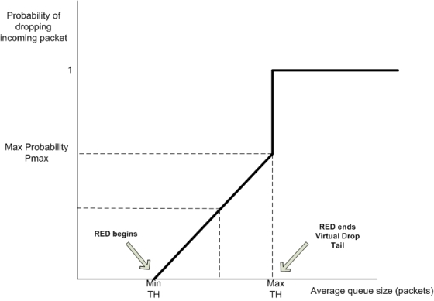
RED Dropping Probability

Slide 45
Advantages of RED
Keeps queues smaller, while allowing bursts
Just using small buffers in routers can’t do the latter
Reduces synchronization between flows
Not all flows are dropping packets at once
Increases/decreases are more gentle
Now being used to reduce buffer-bloat
“buffer-bloat”: experiencing large delays
Try uploading large file from home…
Notes:
…

Slide 46
Why Isn’t RED Fair?
RED gives all flows roughly the same drop rate
The TCP equation gives the following
Resulting throughputs depend on RTT…
I had a competing proposal called FQ
More on that later

Slide 47
History of RED
RED proposed (Floyd and Jacobson)
Huge support from research community
Operators find it hard to configure, see few advantages
Adaptive RED (Floyd)
Self-configuring version of RED. Largely ignored.
CoDel (Nichols and Jacobson)
Cleaner self-configuring version of RED.
Lots of press (bufferbloat)
Implementors adopt FQ-CoDel
Karma’s a bitch!

Slide 48
(3) Non-congestion-related Losses?
Can use Explicit Congestion Notification (ECN)
Bit in IP packet header (actually two)
TCP receiver returns this bit in ACK
When RED router would drop, it sets bit instead
Congestion semantics of bit exactly like that of drop
Advantages:
Doesn’t confuse corruption with congestion
Doesn’t confuse recovery with rate adjustment

Slide 49
(4) Does AIMD work at high speed?
Throughput = (MSS/RTT) sqrt(3/2p)
Assume that RTT = 100ms, MSS=1500bytes
What value of p is required to go 100Gbps?
Roughly 2 x 10⁻¹²
How long between drops?
Roughly 16.6 hours
How much data has been sent in this time?
Roughly 6 petabits
These are not practical numbers!

Slide 50
Adapting TCP to High Speed
One approach:
Let AIMD “constants” depend on CWND
At very high speeds,
Increase CWND by more than MSS in a RTT
Decrease CWND by less than ½ after a loss
We will discuss other approaches later…

Slide 51
High-Speed TCP Proposal (Floyd)
Bandwidth | AvgCwnd (pkts) | Increase a(w) | Decrease b(w)
1.5 Mbps | 12.5 | 1 | 0.50
10 Mbps | 83 | 1 | 0.50
100 Mbps | 833 | 6 | 0.35
1 Gbps | 8333 | 26 | 0.22
10 Gbps | 83333 | 70 | 0.10

Slide 52
High-Speed TCP

Slide 53
This changes the TCP Equation
Throughput ~ p^{-.8} (rather than p^{-.5})
Packet drops every tens of seconds
To achieve high throughput:
Don’t need such a tiny drop rate…
Can ramp up more quickly
How can this coexist with normal TCP?
Only invoke new parameters at large window sizes
Competes fairly with normal TCP at normal speeds

Slide 54
(5) Sawtooth Behavior Uneven
TCP throughput is “choppy”
Repeated swings between W/2 to W
Some apps would prefer sending at a steady rate
e.g., streaming apps
A solution: “Equation-Based Congestion Control”
Ditch TCP’s increase/decrease rules and just follow the equation
Measure drop percentage p, and set rate accordingly
Following the TCP equation ensures we’re “TCP friendly”
i.e., use no more than TCP does in similar setting

Slide 55
These Problems Are All Solved
With published and often standardized solutions
TCP-SACK
RED (and its many variants)
ECN
High-Speed TCP
Equation-based congestion control (EBCC)
Datagram congestion control protocol (DCCP)
Some widely used, others not….

Slide 56
Any Questions?

Slide 57
(6) Bias Against Long RTTs
Flows get throughput inversely proportional to RTT
TCP unfair in the face of heterogeneous RTTs!
A1
B1
100ms
200ms
A2
bottleneck
link
B2

Slide 58
Possible Solutions?
Make additive constant proportional to RTT
But people don’t really care about this….

Slide 59
(7) How do short flows fare?
50% of flows have < 1500B to send; 80% < 100KB
Short flows are slowed down by slow-start
It takes several round-trips to send 8 packets!
Handshake, CWND=1, CWND=2, CWND=4, CWND=8
Too few packets to trigger dupACKs
Isolated loss may lead to timeouts
At typical timeout values of ~500ms…
...might severely impact flow completion time

Slide 60
Possible Solutions?
Larger initial window?
Google proposed moving from ~4KB to ~15KB
Covers ≈90% of HTTP Web
Decreases delay by ~5%
Recursively cautious congestion control (RC3)
Run normal TCP at normal priority
Send aggressively at lower priorities
With a limit on each priority level
Ramps up to full speed immediately, no harm to others
I failed at providing better QoS; this exploits worse QoS!

Slide 61
(8) Cheating
TCP was designed assuming a cooperative world
No attempt was made to prevent cheating
Many ways to cheat, will present three

Slide 62
Cheating #1: ACK-splitting (Rcvr)
Sender
Receiver
Round-
Trip
Time
(RTT)
Data 1:1461
Rule: grow window by one
full-sized packet for each
valid ACK received
Send M (distinct) ACKs for one packet
Growth factor proportional
to M
What’s the fix?
ACK 486
ACK 973
ACK 1461
Data 1461:2921
Data 2921:4381
Data 4381:5841
Data 5841:7301

Slide 63
10 line change to Linux TCP
(Courtesy of
Stefan Savage)

Slide 64
Cheating #2: Increasing CWND Faster
y
C
x increases by 2 per RTT
y increases by 1 per RTT
Limit rates:
x = 2y
x

Slide 65
Cheating #3: Open Many Connections
x
A
B
y
D
E
Assume
A starts 10 connections to B
D starts 1 connection to E
Each connection gets about the same throughput
Then A gets 10 times more throughput than D

Slide 66
Cheating
Either sender or receiver can independently cheat!
Why hasn’t Internet suffered congestion collapse yet?
Individuals don’t hack TCP (not worth it)
Companies need to avoid TCP wars
How can we prevent cheating?
Verify TCP implementations?
Controlling end points is hopeless!
So what should we do?

