Slide 1
CS 168 The End of Architecture and the Beginning of Design
Fall 2017
Scott Shenker
CS168.io

Slide 2

Ssssshhhhhhhhhhhhhhh

Slide 3
Agenda For Today
Internet design goals:
What were the designers trying to accomplish?
The last discussion of “architecture” for a while
Organization of course
Why the Internet is layered but this course is not
The design of routing algorithms
Just a brief taste of Internet design
Learning from 40 beanbags!

Slide 4
Internet Design Goals

Slide 5
David Clark
Wrote a paper in 1988 that tried to capture why the Internet turned out as it did
In particular, it described an ordered list of priorities that informed the design
What do you think those priorities were?

Slide 6
The Anti-Telephony Network!
These goals quite different from phone network
It is easy to trivialize these differences as just reservation vs best-effort
Differences are more subtle than people assume
And it makes for a more interesting paper..

Slide 7
Internet Design Goals (Clark ‘88)
Connect existing networks (Kahn’s stated goal)
Robust in face of failures
Support multiple types of delivery services
Accommodate a variety of networks
Allow distributed management
Easy host attachment
Cost effective
Allow resource accountability
Notes:
Not telephone, point by point.

Slide 8
This is Not the Phone Network!
Connect existing networks (Kahn’s stated goal)
Robust in face of failures
Support multiple types of delivery services
Accommodate a variety of networks
Allow distributed management
Easy host attachment
Cost effective
Allow resource accountability

Slide 9
#1 Connect Existing Networks
Wanted single protocol that could be used to connect any pair of (existing) networks
The Internet Protocol (IP) is that unifying protocol
All (existing) networks must be able to implement it
This is why we have the “narrow waist” of IP
This is where the need for best effort arose….
And this is where circuit switching died
Why?
Notes:
CS can do PS
PS cannot to CS

Slide 10
#2 Robust
Def’n A: As long as network is not partitioned, two hosts should be able to communicate (eventually)
Must eventually recover from failures
Def’n B: Failures should never interfere with endpoint (i.e., application) semantics
Must always isolate endpoints from failures
A: Very successful, not clear how relevant now
Availability more important than recovering from disaster
B: This notion of robustness is underappreciated
Key to modularity of Internet

Slide 11
The Internet Architecture
Layer | Scope | Granularity | Where | Unique?
Application | Host | Data | Host | No
Reliability | Global | Data | Host | No
Network | Global | Packets | Network | Yes
Link | Local | Packets | Network | No
Physical | Local | Bits | Network | No

Slide 12
The Telephony Architecture
Layer | Scope | Granularity | Where | Unique?
Application | Host | Data | Network And Host | No
Reliability | Global | Data | Network | No
Network | Global | Packets | Network | Yes
Link | Local | Packets | Network | No
Physical | Local | Bits | Network | No

Slide 13
What Is Wrong With This?
Violates E2E principle: reliability via network
And puts application logic in network
As a result:
Endpoint semantics at risk when network fails
So design is not “robust” according to Clark (B)
These are crucial differences

Slide 14
#3 Types of Delivery Services
Use of the term “delivery services” already implied an application-neutral network
Built lowest common denominator service
Allow end-based protocols to provide better service
For instance, turn unreliable service into reliable service
Example: recognition that TCP wasn’t needed (or wanted) by some applications
Separated TCP from IP, and introduced UDP
But this isn’t as obvious as it seems….

Slide 15
The paradox of the Internet’s design
The goal is to support many applications
These applications have different requirements
Shouldn’t the Internet support them all?
That is, provide a service the satisfies all of them
By meeting the most stringent requirements

Slide 16
What service should Internet support?
Strict delay bounds?
Some applications require them
Guaranteed delivery?
Some applications are sensitive to packet drops
No applications mind getting good service
Why not require Internet support all these guarantees?
This is what I would have done, if they asked me
And I would have been tragically wrong…why?

Slide 17
Important life lessons
(1) People (or applications)
Don’t always need what they think they need
Almost never need what we think they need
(2) Flexibility often more important than performance
But typically only in hindsight!
Example: cell phones vs landlines
(3) Architect for flexibility, engineer for performance
Flexibility ensures longevity
Performance requirements are ephemeral

Slide 18
Applying lessons to Internet
Requiring performance guarantees would limit variety of networks that could attach to Internet
Many applications don’t need these guarantees
And those that do?
Well, they don’t either (usually)
Tremendous ability to mask drops, delays
And ISPs can work hard to deliver good service without changing the architecture
Through good engineering and provisioning

Slide 19
Bottom Line
The choice of packet switching service is not as obvious as it might seem today
Reservation-based service was more obvious choice
Great vision on the part of the Internet designers
To see past so-called “requirements”…
…and envision a future where application agility minimizes the need for perfect infrastructure
And lucky that they were focused on applications that did not need great service (file transfer, email)

Slide 20
Questions?

Slide 21
#4 Variety of Networks
Incredibly successful!
Minimal requirements on networks
No need for reliability, in-order, fixed size packets, etc.
A result of aiming for lowest common denominator
IP over everything
Then: ARPANET, X.25, DARPA satellite network..
Now: ATM, SONET, WDM, WiFi, new radio technologies, …

Slide 22
#5 Decentralized Management
Both a curse and a blessing
Important for easy deployment
Makes management hard today
Recent efforts have improved management of individual networks
But no attempt to manage the Internet as a whole….

Slide 23
#6 Host Attachment
Clark observes that cost of host attachment may have been higher because hosts had to be smart
But the administrative cost of adding hosts is very low, which is probably more important
Plug-and-play kind of behavior….
And now most hosts are smart for other reasons
So the cost is actually minimal….

Slide 24
#7 Cost Effective
Cheaper than circuit switching at low end
More expensive than circuit switching at high end
Not a bad compromise:
Cheap where it counts (low-end)
More expensive for those who can pay….

Slide 25
#8 Resource Accountability
Failure!

Slide 26
Internet Motto
We reject kings, presidents, and voting. We believe in rough consensus and running code.”
David Clark

Slide 27
Real Goals
Build something that works!
Connect existing networks
Robust in face of failures
Support multiple types of delivery services
Accommodate a variety of networks
Allow distributed management
Easy host attachment
Cost effective
Allow resource accountability

Slide 28
Questions to think about….
What priorities would a commercial design have?
Probably focus on high-revenue applications
What would the resulting design look like?
Probably bake some of the application into the network
As in the phone network
What goals are missing from this list?
Suggestions?

Slide 29
Some of the missing issues
Security
Resilience to attacks (denial-of-service)
Endpoint security
Tracking down misbehaving users
Privacy
Availability
Resource sharing (fairness, etc.)
ISP-level concerns
Technical issues of interconnection and internal management
Economic issues of interconnection
Value flow (who should get paid for these bits?)

Slide 30
Questions?

Slide 31
Organization of Course

Slide 32
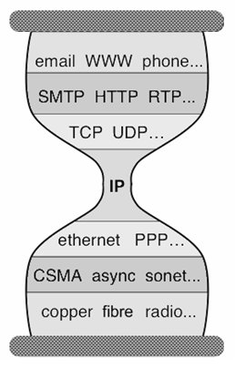
Five Layers
Applications
…built on…
Reliable (or unreliable) transport
…built on…
Best-effort global packet delivery
…built on…
Best-effort local packet delivery
…built on…
Physical transfer of bits

Slide 33
Traditional Courses
Cover each layer in order (as in our textbook)
Philosophies differ as to top-down vs bottom-up
I prefer to focus on the distinctions between
General architectural considerations
Fundamental intellectual challenges
Design/implementation choices in today’s Internet
Special topics…
We will next address fundamental challenges
Later will discuss current designs in each layer

Slide 34
From Architecture to Design

Slide 35
Which of these tasks are hard?
Application: not a fundamental challenge
Not general, and not necessarily hard
Reliable transport: a fundamental challenge
General, and difficult
Global and local packet delivery:
Local and global packet delivery both require routing
This is a general and difficult challenge
Physical transfer: not a fundamental challenge
Not general, and not conceptually difficult

Slide 36
Two Fundamental Challenges
Routing: guiding packets from source to destination
Reliable delivery: building a reliable transport service on top of best-effort delivery
Other pieces required to build operational networks
Naming, addressing, congestion control,….
We will get to those later in the course
But these two are inherent and hard
Routing: next few lectures
Reliable transport: lecture after that

Slide 37
Questions?

Slide 38
A Few Preliminaries
Network Topologies
Forwarding

Slide 39
Example of Network Graph
Router with 6 attached links
Router with 4 attached links

Slide 40
Three Kinds of Routers
Edge: Connected to end hosts
Border: Connected to routers in another network
Core/backbone: Connected to other internal routers

Slide 41
A Variety of Networks
ISPs: carriers
Backbone
Edge (connecting to customers)
Border (to other ISPs)
Enterprises: companies, universities
Core
Edge (connecting to hosts)
Border (to outside)
Datacenters: massive collections of machines
Aggregation and Core
Top-of-Rack (connecting to hosts)
Border (to outside)

Slide 42
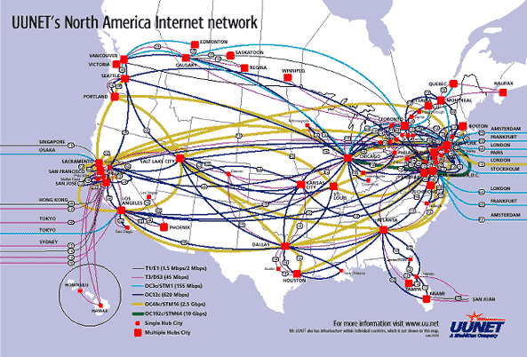
UUNET’s North American Network
Notes:
Very irregular

Slide 43
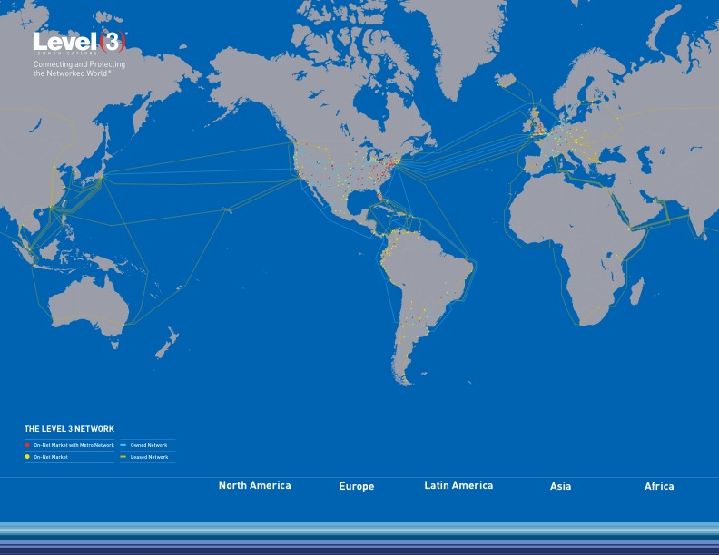
Level3’s Global Network

Slide 44
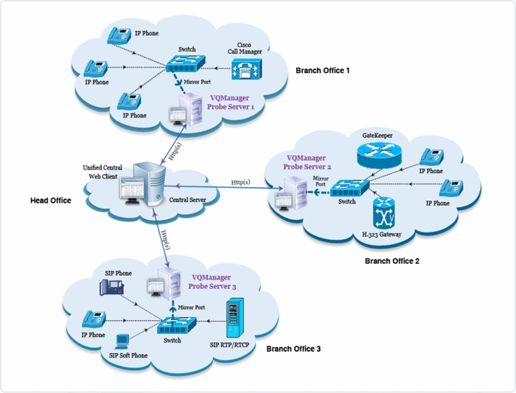
Enterprise Network
Notes:
Not very detailed, couldn’t get a better one….

Slide 45
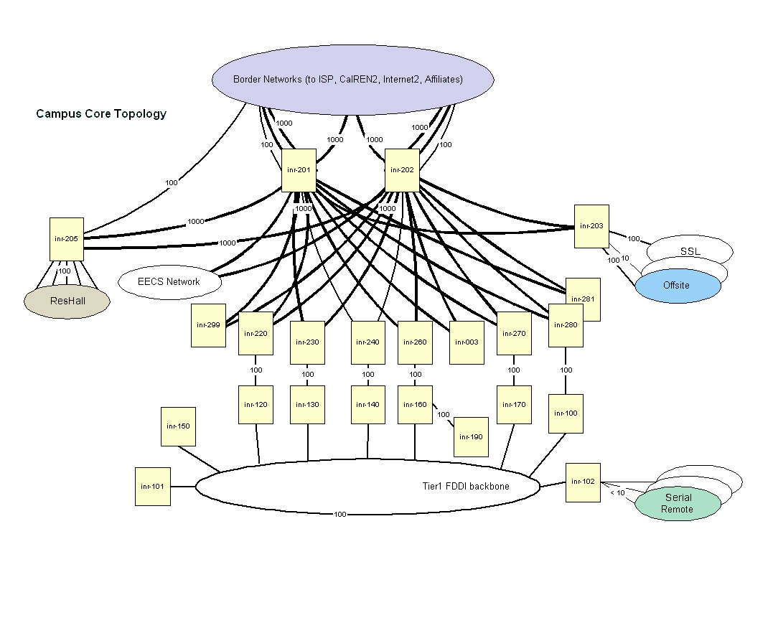
Berkeley’s Campus Network

Slide 46
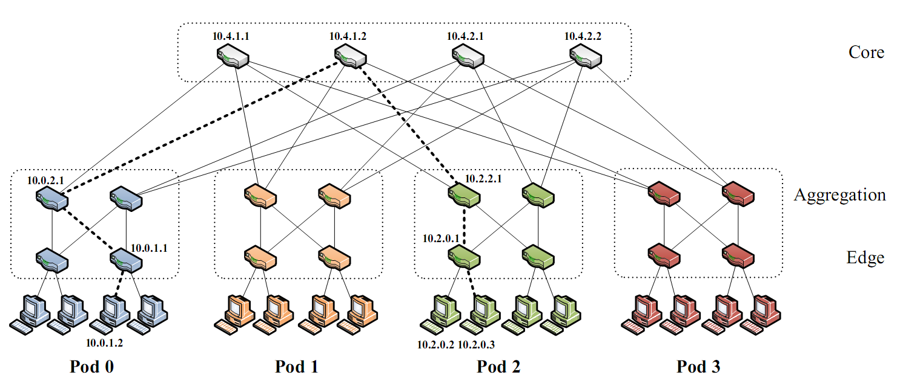
Partial Datacenter Network
Notes:
Only a part of the network, but the takeaway is that the network is very regular, involving levels of hierarchy.

Slide 47
Forwarding

Slide 48
Animation of Forwarding
to UCB
to MIT
switch#4
switch#2
Forwarding Table
111010010
MIT
Destination | Next Hop
UCB | switch#4
UW | switch#5
MIT | switch#2
NYU | switch#3
switch#5
to UW
to NYU
switch#3

Slide 49
The Key Forwarding Step
to UCB
to MIT
switch#4
switch#2
111010010
MIT
Forwarding Table
Destination | Next Hop
UCB | switch#4
UW | switch#5
MIT | switch#2
NYU | switch#3
switch#1
switch#5
to UW
to NYU
switch#3

Slide 50
Forwarding
The act of forwarding in a router:
Read address from packet’s header
Search routing state for correct output port
Send (within router) to correct output port
Forwarding is a local process within a router

Slide 51
Routing
Routing is what computes the routing state
Also called forwarding state
This is inherently a global process
How can you know where to send packets without knowing what the overall network looks like?

Slide 52
Destination | Next Hop
UCB | switch#1
UW | switch#1
MIT | switch#6
NYU | switch#1
to UCB
to MIT
switch#4
switch#2
Forwarding Table
111010010
MIT
Destination | Next Hop
UCB | switch#4
UW | switch#5
MIT | switch#2
NYU | switch#3
Destination | Next Hop
UCB | switch#1
UW | switch#1
MIT | switch#1
NYU | switch#1
switch#1
to UW
switch#5
to NYU
switch#3

Slide 53
Local vs Global View of State
Local routing state is table in a single router
By itself, the state in a single router can’t be evaluated
It must be evaluated in terms of the global context
Global state is collection of tables in all routers
Global state determines which paths packets take
(Will discuss later where this routing state comes from)

Slide 54
“Valid” Routing State
Global routing state is “valid” if it produces forwarding decisions that always deliver packets to their destinations
Valid is my terminology, not standard
Goal of routing protocols: compute valid state
How can you do that?
Focus on next few lectures…at an abstract level
Notes:
What could go wrong?

Slide 55
Nature of Forwarding Decisions
Switches and routers make the following mapping:
Header + Routing Table ➔ OutgoingPort
Most do so in single transmission time
Forwarding decisions must be simple
Assume forwarding decisions are deterministic
Packets with same header always routed to same port
Decisions based on packet header:
Destination Address, Source Address, etc.

Slide 56
Forwarding Decision Dependencies
Must depend on destination
Could also depend on :
Source: requires n² state
Input port: not clear what this buys you
Other header information: ignore for now
We will focus only on destination-based routing
But first consider the alternative

Slide 57
Source/Destination-Based Routing
Paths from two different sources (to same destination) can be very different

Slide 58
Destination-Based Routing
Paths from two different sources (to same destination) must coincide once they overlap
Notes:
Why coincide?

Slide 59
Destination-Based Routing
Paths to same destination never cross
Once paths to destination meet, they never split
Set of paths to destination create a “delivery tree”
Must cover every node exactly once
Only one outgoing arrow at each node
All nodes have path to destination
Produces Spanning Tree rooted at destination
Notes:
You all know what a spanning tree is?

Slide 60
A “Delivery Tree” for a Destination

Slide 61
Assume Destination-Based Routing
For rest of lecture (and course)…..

Slide 62
The Crucial Routing Question
How do you create these directed delivery trees?
One for each destination
Describes the paths from all sources to that destination
Each tree must
Span all hosts (because each can send a packet)
And converge on the destination
There are many approaches to routing….
They differ in fundamental ways
We will discuss some of them on Thursday
But today....

Slide 63
Design Exercise: Invent Routing
Your Job: design a way to compute routes
It must be possible to implement in the network

Slide 64
Design Exercise: How This Works
Talk to people around you
After a few minutes, I will call on a few groups….
Point of exercise not to get the “right answer”!
I want you to think about the problem first

Slide 65
And now for something completely different….

Slide 66
We Will Learn By Doing!
I need 40 volunteers
If you haven’t participated, this is your chance!

Slide 67
The Task
Do not look at sheet of paper until I say so
You will have five minutes to complete this task
Each sheet says:
You are node X You are connected to nodes Y,Z
Your job: find route from source (node 1) to destination (node 40) in five minutes

Slide 68
Context
I have done this exercise for the past few years
Last year’s class failed miserably… twice!
These miserable failures are now your TAs
Your task: make them look bad!

Slide 69
Ground Rules
You may not:
Leave your seat (but you can stand)
Pass your sheet of paper
Let anyone copy your sheet of paper
You may:
Ask nearby friends for advice
Shout to other participants (anything you want)
Curse your instructor (sotto voce)
You must: Try

Slide 70
Go!

Slide 71
Ssssshhhhhhhhhhhhhhh

Slide 72
Postmortem
What went right?
What went wrong?
What did you learn?

Slide 73
Next Lecture
Principled way to think about routing
A few basic paradigms for routing

