Slide 1
Announcements
No Lecture this Thursday
Study instead
Midterm this Thursday 10/4 at 7 PM
See Piazza for rooms
Homework 6: Probability and Bayes Nets
Due Monday 10/17 at 11:59pm
Project 3: MDPs and Reinforcement Learning
Due Friday 10/14 at 5pm

Slide 2

Our Status in CS188
We’re done with Part I: Search and Planning!
We’ve seen how AI methods can solve problems in:
Search
Constraint Satisfaction Problems
Games
Markov Decision Problems
Reinforcement Learning

Slide 3
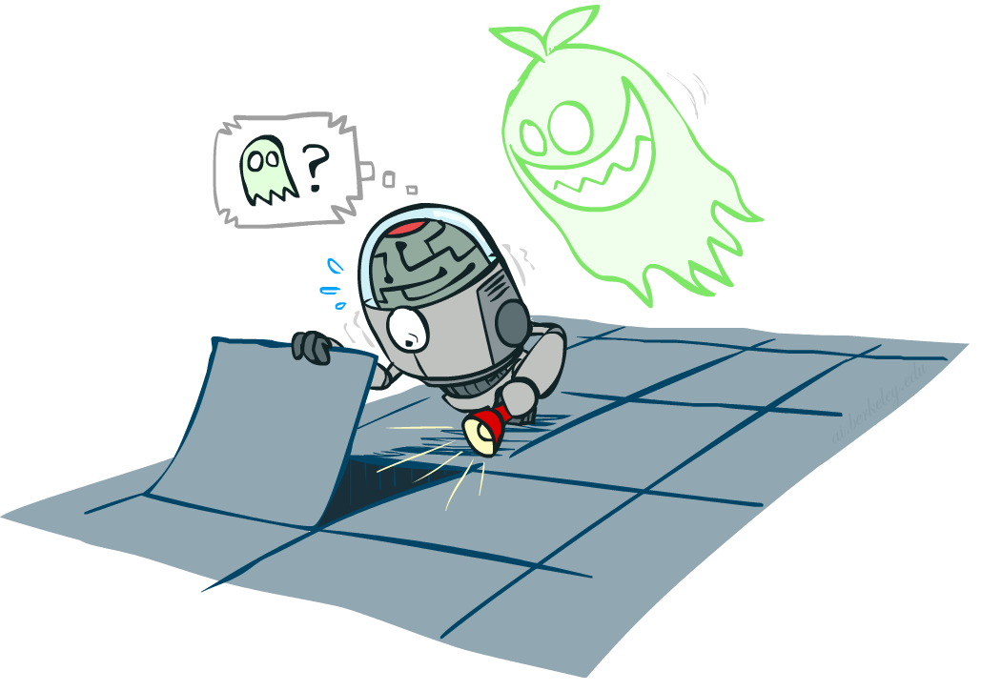
Our Status in CS188
Next up:
Part II: Probabilistic Reasoning
Diagnosis
Speech recognition
Tracking objects
Robot mapping
Genetics
Error correcting codes
… lots more!
Part III: Machine Learning
Notes:
PREP NOTE: Watch this
Reference AI winter --- logic (exceptions, etc. + so much knowledge --- can learn)
Diagnosis: temperature, blood pressure, types of pain → disease
Speech: temporal signal of pressure variation → words and sentences
Tracking objects: e.g. helicopter you saw in last lecture, combines gps data with accelerometers, gyros and magnetic compass to infer its position and orientation using probabilistic reasoning
Robot mapping: turns out if you put a camera on the helicopter, it would not only be able to fly upside down, but also build a map of the environment!
Genetics: discovery of gene interactions from gene expression data
Error correcting codes: which we use on pretty much all our digital communication lines. They ensure that even in the presence of noise (which is everywhere) we can communicate reliably.
OK: how do we collect all that knowledge in general? --- Part III
Good news: We are going to learn about the tools that got us out of AI winter
The other news: It’s going to get very mathematical! Total shift in gears compared to what we have looked at before.
And yet other news: Time for a fresh start --- which might help if you fell behind in the past weeks.

Slide 4
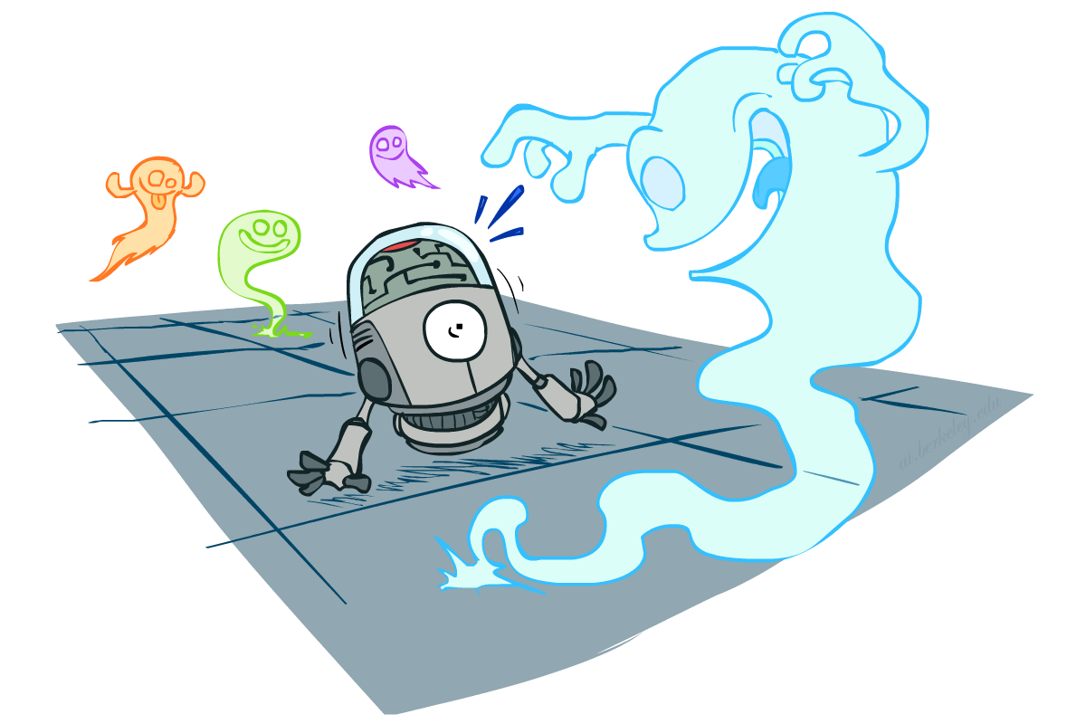
CS 188: Artificial Intelligence
Probability Review
Instructors: Adam Janin, Josh Hug -- University of California, Berkeley
[These slides created by Dan Klein, Pieter Abbeel, Anca Dragan, Josh Hug for CS188 Intro to AI at UC Berkeley. All CS188 materials available at http://ai.berkeley.edu.]
Notes:
Please retain proper attribution, including the reference to ai.berkeley.edu. Thanks!

Slide 5
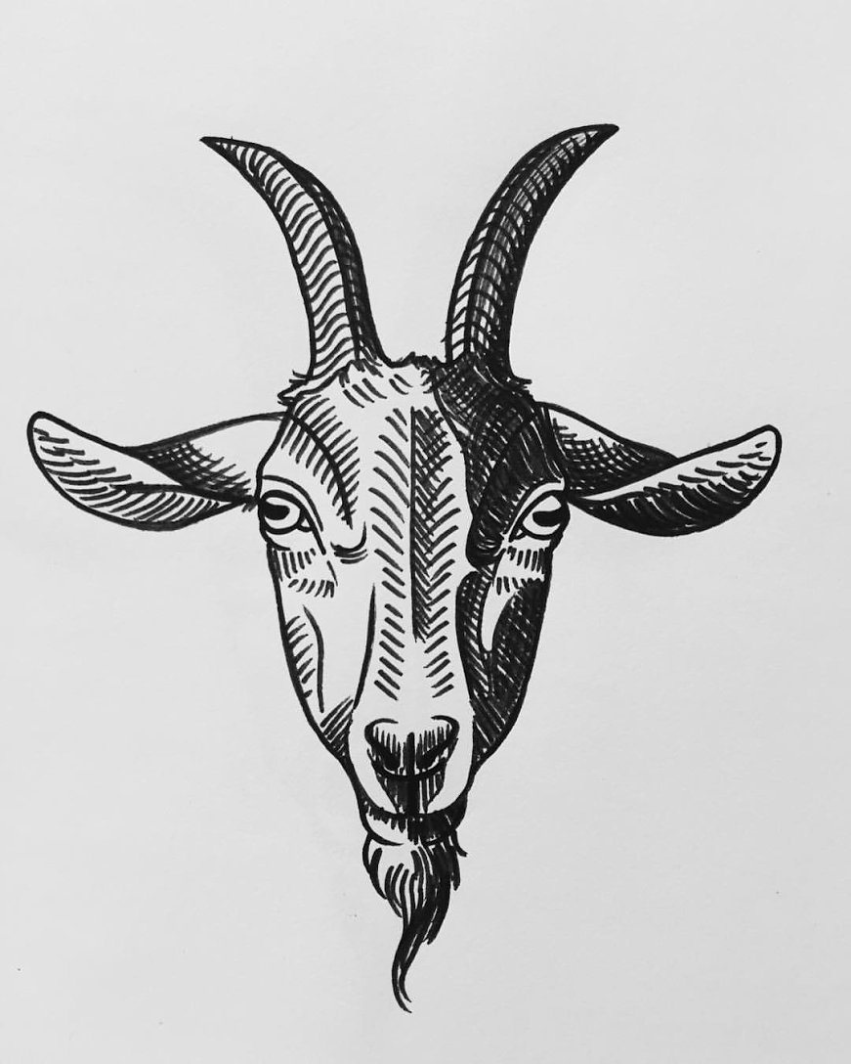
Values of States
Recall (?): Inference with Bayes’ Rule
Example: Diagnostic probability from causal probability:
Example:
M: meningitis, S: stiff neck
From the information above, what is the chance that you have meningitis assuming your neck is stiff, i.e. P(+m | +s)
In theory, you learned all this in CS70, and we’ll be reviewing it today. Give it a shot and see how you do.
Example
givens

Slide 6

Today
Probability
Random Variables
Joint and Marginal Distributions
Conditional Distribution
Product Rule, Chain Rule, Bayes’ Rule
Inference
Independence
You’ll need all this stuff A LOT for the next few weeks, so make sure you go over it now!
Notes:
Like “sort this list” or “add these two numbers”

Slide 7
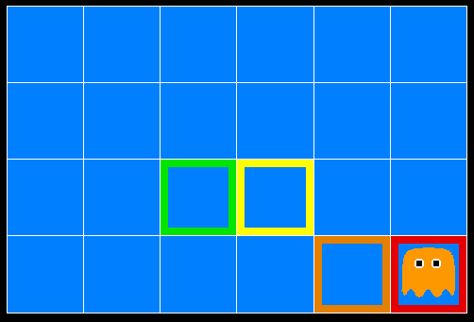
Inference in Ghostbusters
A ghost is in the grid somewhere
Sensor readings tell how close a square is to the ghost
On the ghost: red
1 or 2 away: orange
3 or 4 away: yellow
5+ away: green
Sensors are noisy, but we know P(Color | Distance)
P(red | 3) | P(orange | 3) | P(yellow | 3) | P(green | 3)
0.05 | 0.15 | 0.5 | 0.3
[Demo: Ghostbuster – no probability (L12D1) ]

Slide 8
Demo Ghostbusters – No probability

Slide 9
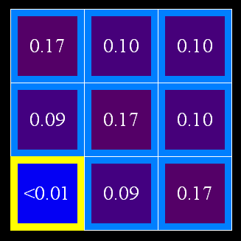
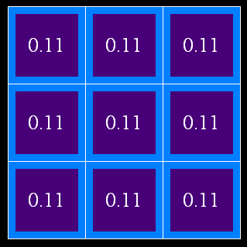

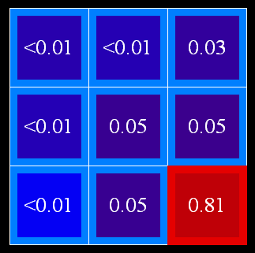
Uncertainty
General situation:
Observed variables (evidence): Agent knows certain things about the state of the world (e.g., sensor readings or symptoms)
Unobserved variables: Agent needs to reason about other aspects (e.g. where an object is or what disease is present)
Model: Agent knows something about how the known variables relate to the unknown variables
Probabilistic reasoning gives us a framework for managing our beliefs and knowledge

Slide 10
Random Variables
A random variable is some aspect of the world about which we (may) have uncertainty
R = Is it raining?
T = Is it hot or cold?
D = How long will it take to drive to work?
L = Where is the ghost?
We denote random variables with capital letters
Like variables in a CSP, random variables have domains
R in {true, false} (often write as {+r, -r})
T in {hot, cold}
D in [0, ∞)
L in possible locations, maybe {(0,0), (0,1), …}

Slide 11
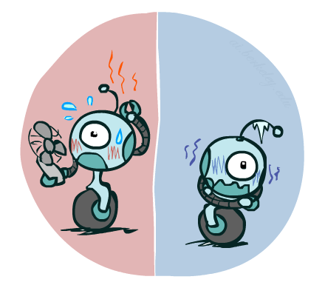

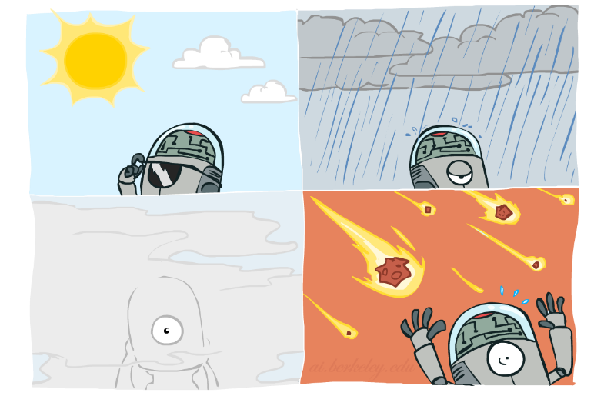

Probability Distributions
Associate a probability with each value
Temperature:
Weather:
W | P
sun | 0.6
rain | 0.1
fog | 0.3
meteor | 0.0
T | P
hot | 0.5
cold | 0.5

Slide 12


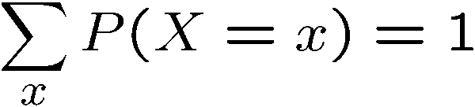
Probability Distributions
Unobserved random variables have distributions
A distribution is a TABLE of probabilities of values
A probability (lower case value) is a single number
Must have: and
Shorthand notation:
OK if all domain entries are unique
T | P
hot | 0.5
cold | 0.5
W | P
sun | 0.6
rain | 0.1
fog | 0.3
meteor | 0.0

Slide 13




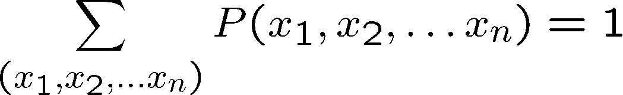
Joint Distributions
A joint distribution over a set of random variables:
specifies a real number for each assignment (or outcome):
Must obey:
Size of distribution if n variables with domain sizes d?
For all but the smallest distributions, impractical to write out!
T | W | P
hot | sun | 0.4
hot | rain | 0.1
cold | sun | 0.2
cold | rain | 0.3

Slide 14


Probabilistic Models
Distribution over T,W
A probabilistic model is a joint distribution over a set of random variables
Probabilistic models:
(Random) variables with domains
Assignments are called outcomes
Joint distributions: say whether assignments (outcomes) are likely
Normalized: sum to 1.0
Ideally: only certain variables directly interact
Constraint satisfaction problems:
Variables with domains
Constraints: state whether assignments are possible
Ideally: only certain variables directly interact
T | W | P
hot | sun | 0.4
hot | rain | 0.1
cold | sun | 0.2
cold | rain | 0.3
Constraint over T,W
T | W | P
hot | sun | T
hot | rain | F
cold | sun | F
cold | rain | T

Slide 15
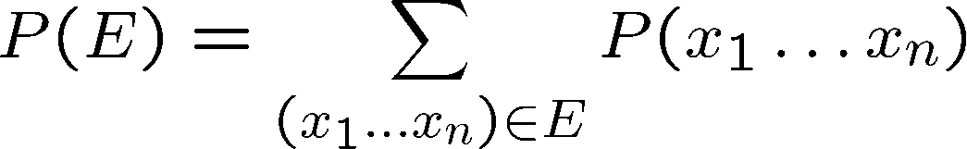
Events
An event is a set E of outcomes
From a joint distribution, we can calculate the probability of any event
Probability that it’s hot AND sunny? P(hot, sun)
Probability that it’s hot? P(hot)
Probability that it’s hot OR sunny? P(hot or sun)
Typically, the events we care about are partial assignments, like P(T=hot)
T | W | P
hot | sun | 0.4
hot | rain | 0.1
cold | sun | 0.2
cold | rain | 0.3

Slide 16

Values of States
Events
P(+dog, +cat) ?
P(+dog) ?
P(-cat OR +dog) ?
$$P(D, C)$$
D | C | P
+dog | +cat | 0.2
+dog | -cat | 0.3
-dog | +cat | 0.4
-dog | -cat | 0.1
Notes:
Less trivial?

Slide 17
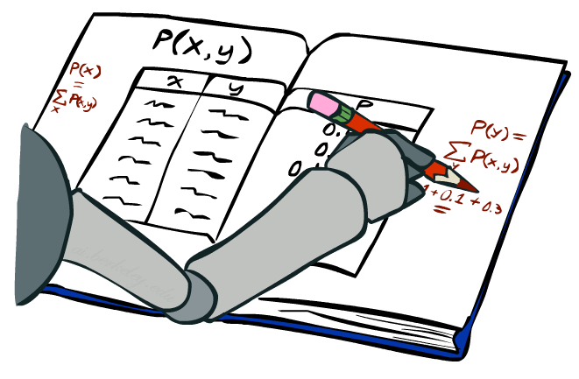
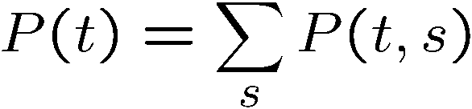
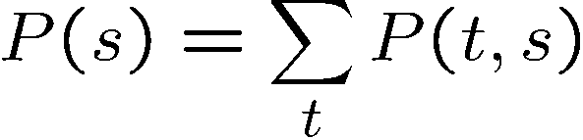
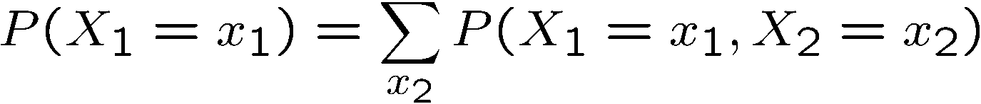
Marginal Distributions
Marginal distributions are sub-tables which eliminate variables
Marginalization (summing out): Combine collapsed rows by adding
T | P
hot | 0.5
cold | 0.5
T | W | P
hot | sun | 0.4
hot | rain | 0.1
cold | sun | 0.2
cold | rain | 0.3
W | P
sun | 0.6
rain | 0.4

Slide 18



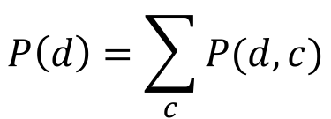
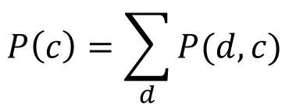
Values of States
Marginal Distributions
$$P(D)$$
$$P(D, C)$$
D | P
+dog
-dog
D | C | P
+dog | +cat | 0.2
+dog | -cat | 0.3
-dog | +cat | 0.4
-dog | -cat | 0.1
$$P\left(d\right)=\sum_{c}{P(d, c)}$$
$$P(C)$$
C | P
+cat
-cat
$$P\left(c\right)=\sum_{d}{P(d, c)}$$
Notes:
PREP NOTE: BORING NUMBERS

Slide 19
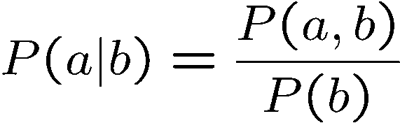
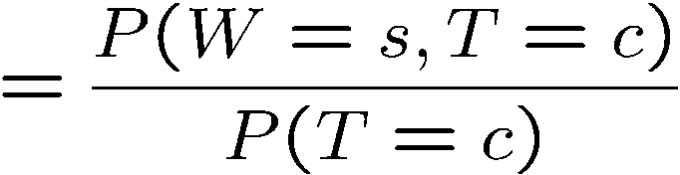
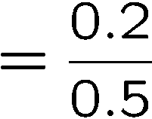



Conditional Probabilities
A simple relation between joint and conditional probabilities
In fact, this is taken as the definition of a conditional probability
P(a,b)
P(a)
P(b)
T | W | P
hot | sun | 0.4
hot | rain | 0.1
cold | sun | 0.2
cold | rain | 0.3

Slide 20
Values of States
Conditional Probabilities
P(+dog | +cat) ?
P(-dog | +cat) ?
P(-cat | +dog) ?
$$P(D, C)$$
D | C | P
+dog | +cat | 0.2
+dog | -cat | 0.3
-dog | +cat | 0.4
-dog | -cat | 0.1
Notes:
Less trivial?

Slide 21



Conditional Distributions
Conditional distributions are probability distributions over some variables given fixed values of others
Conditional Distributions
Joint Distribution
W | P
sun | 0.8
rain | 0.2
T | W | P
hot | sun | 0.4
hot | rain | 0.1
cold | sun | 0.2
cold | rain | 0.3
W | P
sun | 0.4
rain | 0.6

Slide 22
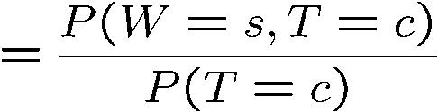

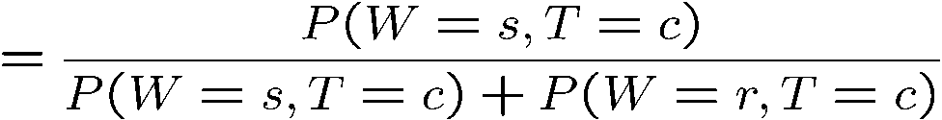
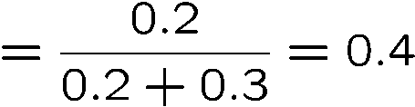

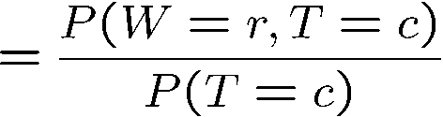

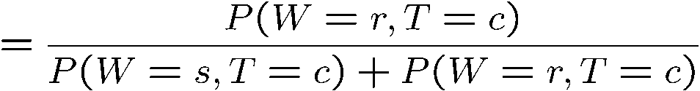
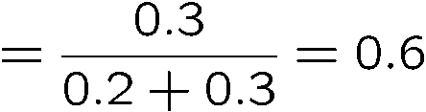
Conditional Distributions (Tedious)
T | W | P
hot | sun | 0.4
hot | rain | 0.1
cold | sun | 0.2
cold | rain | 0.3
W | P
sun | 0.4
rain | 0.6

Slide 23








Conditional Distributions via Normalization Trick
SELECT the joint probabilities matching the evidence
NORMALIZE the selection
(make it sum to one)
T | W | P
hot | sun | 0.4
hot | rain | 0.1
cold | sun | 0.2
cold | rain | 0.3
T | W | P
cold | sun | 0.2
cold | rain | 0.3
W | P
sun | 0.4
rain | 0.6

Slide 24
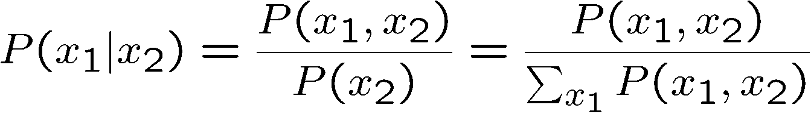
Normalization Trick
SELECT the joint probabilities matching the evidence
NORMALIZE the selection
(make it sum to one)
T | W | P
hot | sun | 0.4
hot | rain | 0.1
cold | sun | 0.2
cold | rain | 0.3
T | W | P
cold | sun | 0.2
cold | rain | 0.3
W | P
sun | 0.4
rain | 0.6
Why does this work? Sum of selection is P(evidence)! (P(T=c), here)

Slide 25

Values of States
Normalization Trick
P(D | C=-cat) ?
$$P(D, C)$$
SELECT the joint probabilities matching the evidence
NORMALIZE the selection
(make it sum to one)
D | Y | P
+dog | +cat | 0.2
+dog | -cat | 0.3
-dog | +cat | 0.4
-dog | -cat | 0.1

Slide 26
To Normalize
(Dictionary) To bring or restore to a normal condition
Procedure:
Step 1: Compute Z = sum over all entries
Step 2: Divide every entry by Z
Example 1
All entries sum to ONE
Example 2
W | P
sun | 0.2
rain | 0.3
Normalize
W | P
sun | 0.4
rain | 0.6
T | W | P
hot | sun | 20
hot | rain | 5
cold | sun | 10
cold | rain | 15
T | W | P
hot | sun | 0.4
hot | rain | 0.1
cold | sun | 0.2
cold | rain | 0.3
Normalize
Z = 0.5
Z = 50

Slide 27

Probabilistic Inference
Probabilistic inference: compute a desired probability from other known probabilities (e.g. conditional from joint)
We generally compute conditional probabilities
P(on time | no reported accidents) = 0.90
These represent the agent’s beliefs given the evidence
Probabilities change with new evidence:
P(on time | no accidents, 5 a.m.) = 0.95
P(on time | no accidents, 5 a.m., raining) = 0.80
Observing new evidence causes beliefs to be updated

Slide 28





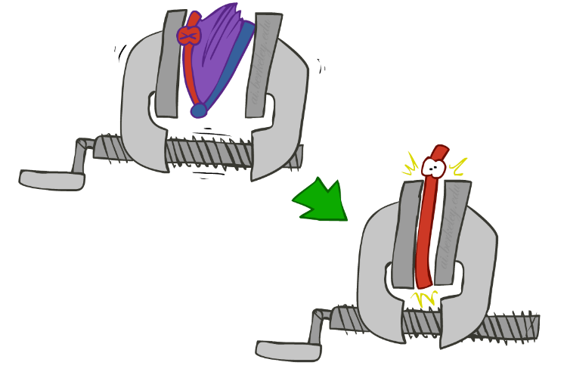
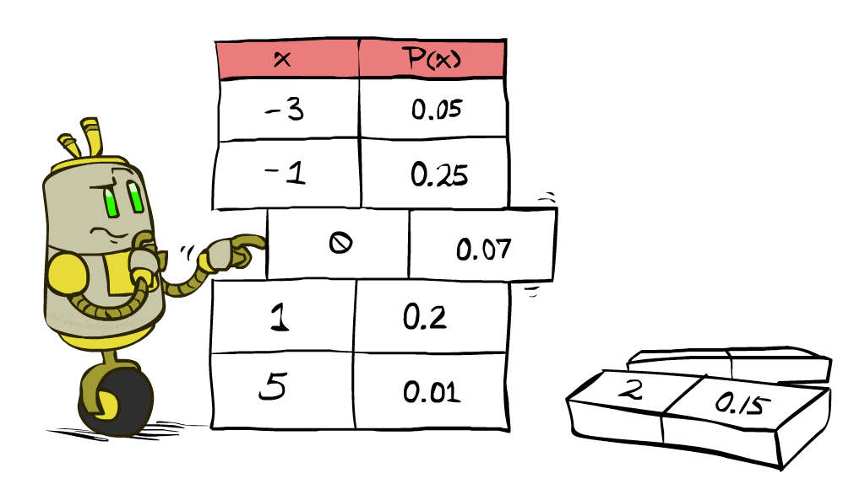


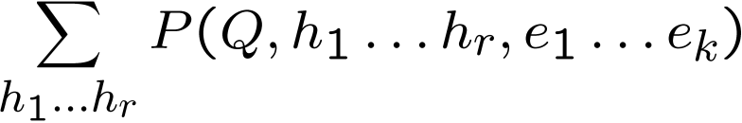
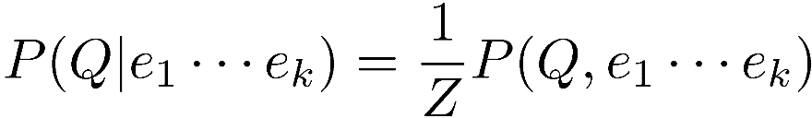
Inference by Enumeration
* Works fine with multiple query variables, too
General case:
Evidence variables:
Query* variable:
Hidden variables:
We want:
All variables
Step 1: Select the entries consistent with the evidence
Step 2: Sum out H to get joint of Query and evidence
Step 3: Normalize

Slide 29
Inference by Enumeration
P(W)?
P(W | winter)?
P(W | winter, hot)?
S | T | W | P
summer | hot | sun | 0.30
summer | hot | rain | 0.05
summer | cold | sun | 0.10
summer | cold | rain | 0.05
winter | hot | sun | 0.10
winter | hot | rain | 0.05
winter | cold | sun | 0.15
winter | cold | rain | 0.20

Slide 30
Inference by Enumeration
Obvious problems:
Worst-case time complexity O(d^{n})
Space complexity O(d^{n}) to store the joint distribution

Slide 31
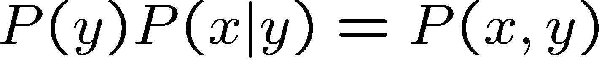
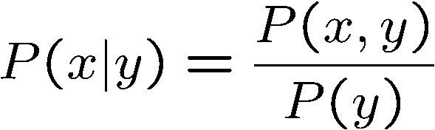
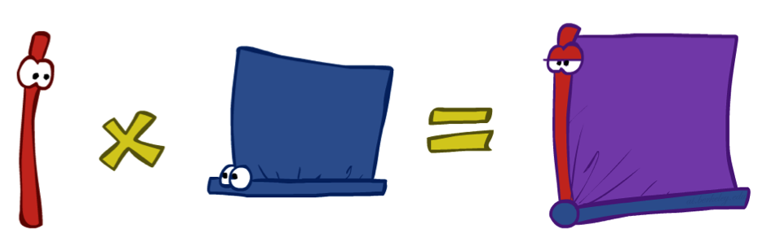
The Product Rule
Sometimes have conditional distributions but want the joint

Slide 32


The Product Rule
Example:
D | W | P
wet | sun | 0.1
dry | sun | 0.9
wet | rain | 0.7
dry | rain | 0.3
D | W | P
wet | sun | 0.08
dry | sun | 0.72
wet | rain | 0.14
dry | rain | 0.06
R | P
sun | 0.8
rain | 0.2

Slide 33
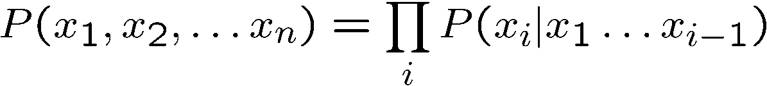
The Chain Rule
More generally, can always write any joint distribution as an incremental product of conditional distributions
By induction, we can chain this along infinitely many times.

Slide 34
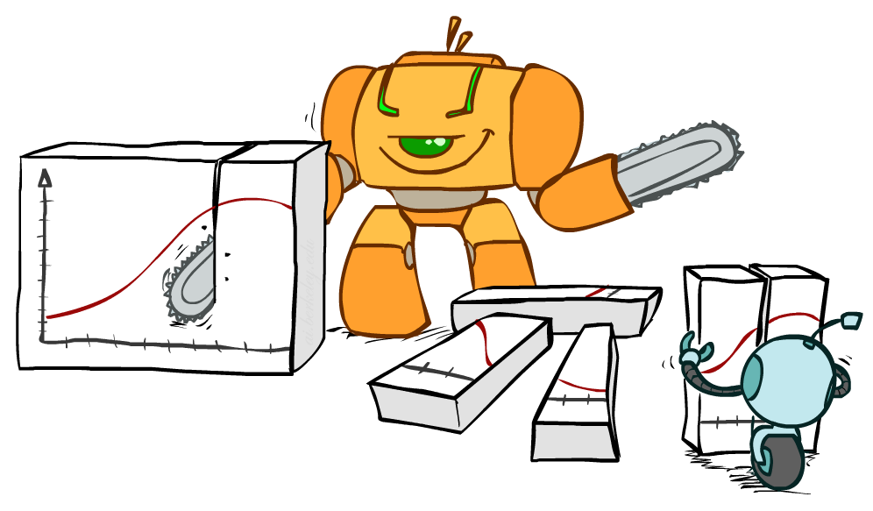
Bayes Rule

Slide 35


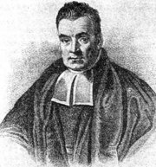
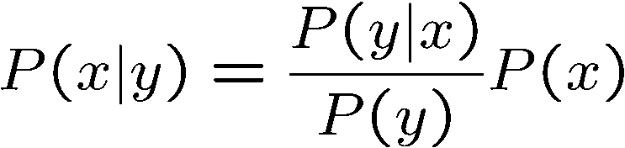
Bayes’ Rule
Two ways to factor a joint distribution over two variables:
Dividing, we get:
Why is this at all helpful?
Lets us build one conditional from its reverse
Often one conditional is tricky but the other one is simple
Foundation of many systems we’ll see later (e.g. ASR, MT)
In the running for most important AI equation!
That’s my rule!
Notes:
Automated Speech Recognition and Machine Translation

Slide 36


Bayes Rule Example
$$P(S|A)$$
Given:
What is P(sister | howl) ?
$$P(A)$$
S | A | P
howl | sister | 0.05
hello | sister | 0.95
howl | wolf | 1 - 10⁻⁶
hello | Wolf | 10⁻⁶
A | P
wolf | 0.01
sister | 0.99

Slide 37
Values of States
Bayes Rule
Given:
What is P(W | dry) ?
D | W | P
wet | sun | 0.1
dry | sun | 0.9
wet | rain | 0.7
dry | rain | 0.3
R | P
sun | 0.8
rain | 0.2

Slide 38
Values of States
Recall: Inference with Bayes’ Rule
Example: Diagnostic probability from causal probability:
Example:
M: meningitis, S: stiff neck
From the information above, what is the chance that you have meningitis assuming your neck is stiff, i.e. P(+m | +s)
Will probably still be tricky!
Example
givens

Slide 39
Inference with Bayes’ Rule
Example: Diagnostic probability from causal probability:
Example:
M: meningitis, S: stiff neck
Note: posterior probability of meningitis still very small
Note: you should still get stiff necks checked out! Why?
Example
givens

Slide 40


Ghostbusters, Revisited
Let’s say we have two distributions:
Prior distribution over ghost location: P(G)
Let’s say this is uniform
Sensor reading model: P(R | G)
Given: we know what our sensors do
R = reading color measured at (1,1)
E.g. P(R = yellow | G=(1,1)) = 0.1
We can calculate the posterior distribution P(G|r) over ghost locations given a reading using Bayes’ rule:
[Demo: Ghostbuster – with probability (L12D2) ]

Slide 41
Demo Ghostbusters with Probability

Slide 42
Next Time: Bayes’ Nets

