Slide 1
CS188 Announcements (1)
Piazza used for class communication.
Waitlist
We’re trying to make the class bigger. We’ll let you know.
Project 0
Ungraded, but will be used to see if waitlisted people are still active.
Due tomorrow 5pm.
Math self test
Ungraded. If you’re unfamiliar with material, you may have trouble in 2nd half of the course.
Notes:
Mostly reminders. Waitlist: Instructors can’t help.

Slide 2
CS188 Announcements (2)
Homework 1
Out this week. See edge.edx.org "Course” tab.
Due Sept 6 midnight (local time).
Sections this week only
Try to go to assigned section.
Exam practice sections will be “overflow” standard section.
Exam schedule
Thu Oct 6 7-9pm, and Tue Nov 8 7-9pm
Makeup 8am the next morning. See Piazza post.

Slide 3
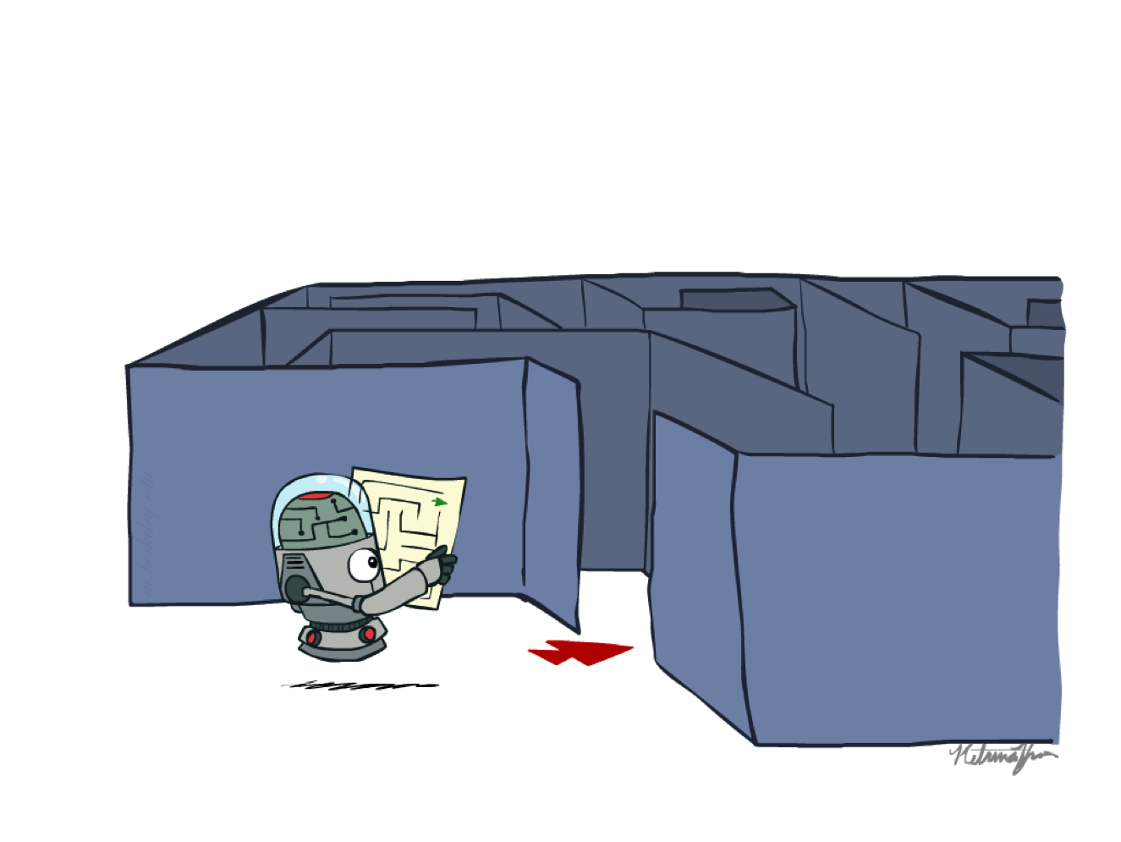
CS 188: Artificial Intelligence
Search
Instructors: Josh Hug and Adam Janin
University of California, Berkeley
[These slides were created by Dan Klein and Pieter Abbeel for CS188 Intro to AI at UC Berkeley (ai.berkeley.edu).]
Notes:
Please retain proper attribution, including the reference to ai.berkeley.edu. Thanks!
Introduce self again.
Build agents that plans ahead. Act rationally.

Slide 4
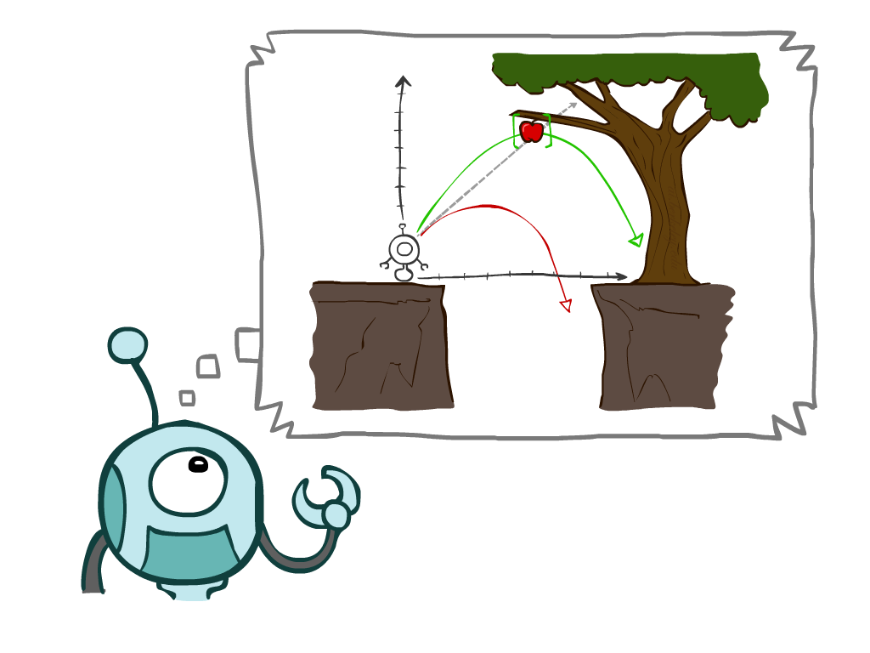
Today
Agents that Plan Ahead
Search Problems
Uninformed Search Methods
Depth-First Search
Breadth-First Search
Uniform-Cost Search
Notes:
Many you have seen before.
Unified formalism leading to A* search (search guided by heuristic)

Slide 5
Agents that Plan
Notes:
Why agents plan? If/then code. Hard to do.

Slide 6

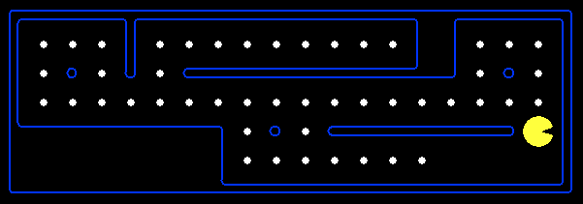
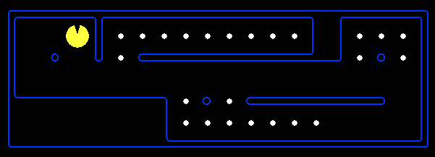
Reflex Agents
Reflex agents:
Choose action based on current percept (and maybe memory)
May have memory or a model of the world’s current state
Do not consider the future consequences of their actions
Consider how the world IS
Can a reflex agent be rational?
[Demo: reflex optimal (L2D1)]
[Demo: reflex optimal (L2D2)]
Notes:
Do something crazy. Move to apple. Hard coded vs. automatic planning.
Reflex – lookup from state to action.
Examples: blinking your eye (not using your entire thinking capabilities), vacuum cleaner moving towards nearest dirt

Slide 7
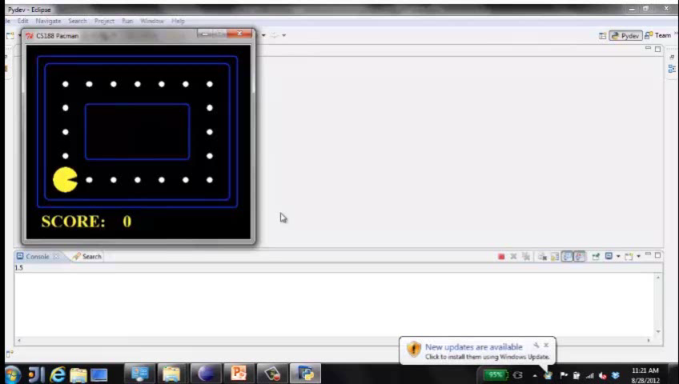
Video of Demo Reflex Optimal
Notes:
L2D1
Move in the direction of the nearest uneaten dot.
Can be rational.

Slide 8
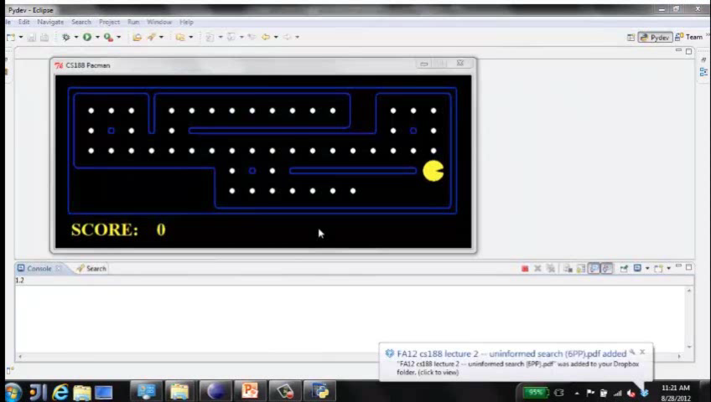
Video of Demo Reflex Odd
Notes:
L2D2
NO planning. Wall between you and nearest dot?
Reflex agents not generally optimal, but they can be depending on circumstance.
Optimality is not defined by algorithm, but by rational behavior.

Slide 9
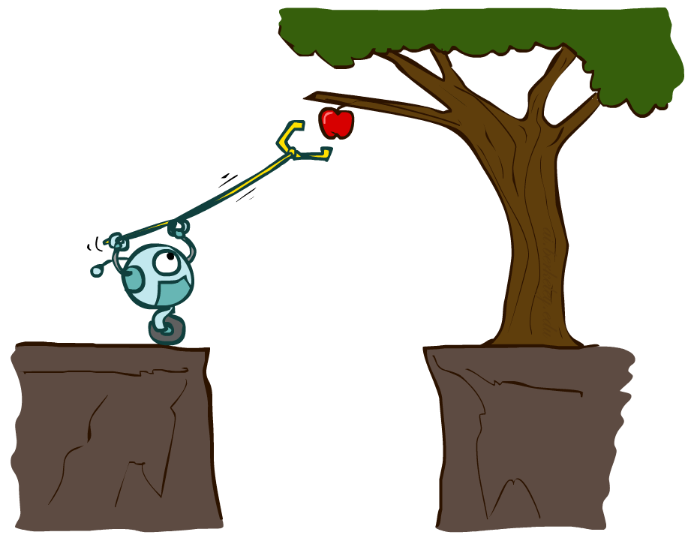
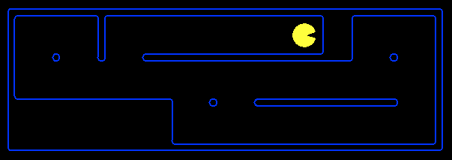
Planning Agents
Planning agents:
Ask “what if”
Decisions based on (hypothesized) consequences of actions
Must have a model of how the world evolves in response to actions
Must formulate a goal (test)
Consider how the world WOULD BE
Optimal vs. complete planning
Planning vs. replanning
[Demo: re-planning (L2D3)]
[Demo: mastermind (L2D4)]
Notes:
Simulate many games, execute one. Doesn’t do it in the world, does it in the model.
Consequences of action.
Complete – a solution; optimal – best

Slide 10
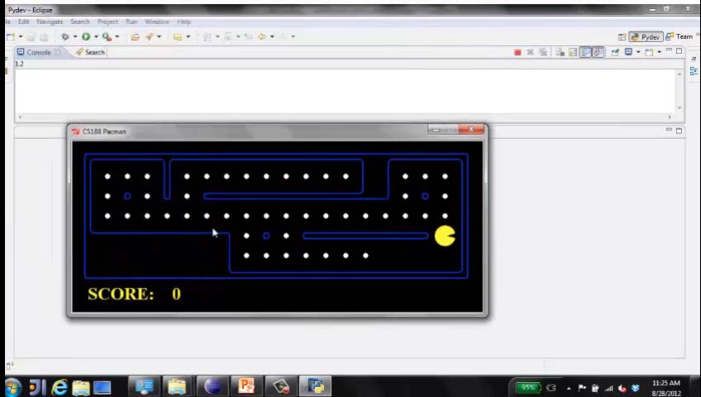
Video of Demo Replanning
Notes:
L2D3, replanning. Figure out how to get to next dot. Clears board; non-optimal. Fast.

Slide 11
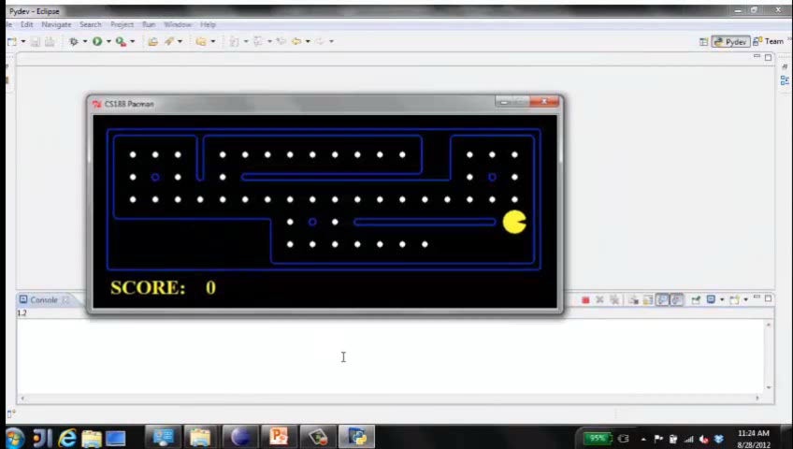
Video of Demo Mastermind
Notes:
L2D4, mastermind. Thinking, thinking, thinking…
Not just clear NEXT dot, but all dots.
Dead end last. Optimal.

Slide 12

Search Problems
Notes:
How do we formalize a search problem?

Slide 13

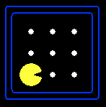





Search Problems
A search problem consists of:
A state space
A successor function
(with actions, costs)
A start state and a goal test
A solution is a sequence of actions (a plan) which transforms the start state to a goal state
“N”, 1.0
“E”, 1.0
Notes:
Abstraction. Useful for later topics.
Goal test – sometimes more than one state that satisfies having achieved the goal, for example, “eat all the dots”

Slide 14

Search Problems Are Models
Notes:
Models aren’t perfect.
Too detailed, you can’t solve.
Not detailed enough, doesn’t solve.

Slide 15
Example: Traveling in Romania
State space:
Cities
Successor function:
Roads: Go to adjacent city with cost = distance
Start state:
Arad
Goal test:
Is state == Bucharest?
Solution?
Notes:
Traffic, gas, accidents, time of day, etc.
Bit of art figuring out state space, etc.

Slide 16
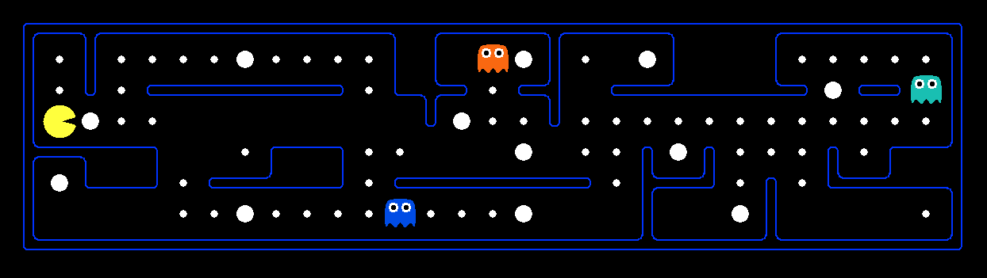
What’s in a State Space?
The world state includes every last detail of the environment
A search state keeps only the details needed for planning (abstraction)
Problem: Pathing
States: (x,y) location
Actions: NSEW
Successor: update location only
Goal test: is (x,y)=END
Problem: Eat-All-Dots
States: {(x,y), dot booleans}
Actions: NSEW
Successor: update location and possibly a dot boolean
Goal test: dots all false
Notes:
Wrong example for “eat-all-dots”: (x, y, dot count). Need bool.
World >= State
Walls? Part of successor.

Slide 17
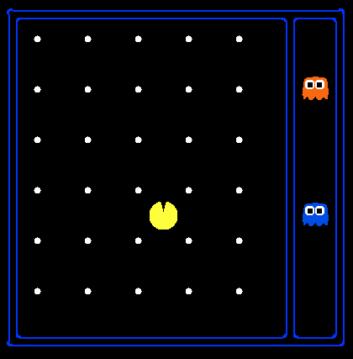
State Space Sizes?
World state:
Agent positions: 120
Food count: 30
Ghost positions: 12
Agent facing: NSEW
How many
World states?
120x(2³⁰)x(12²)x4
States for pathing?
120
States for eat-all-dots?
120x(2³⁰)
Notes:
12x10 grid

Slide 18
Quiz: Safe Passage
Problem: eat all dots while keeping the ghosts perma-scared
What does the state space have to specify?
(agent position, dot booleans, power pellet booleans, remaining scared time)
Notes:
Eat power pellets. Ignore ghost reset. What do you need in state space?
Do you need ghost positions?
What’s in the state vs. successor function?

Slide 19
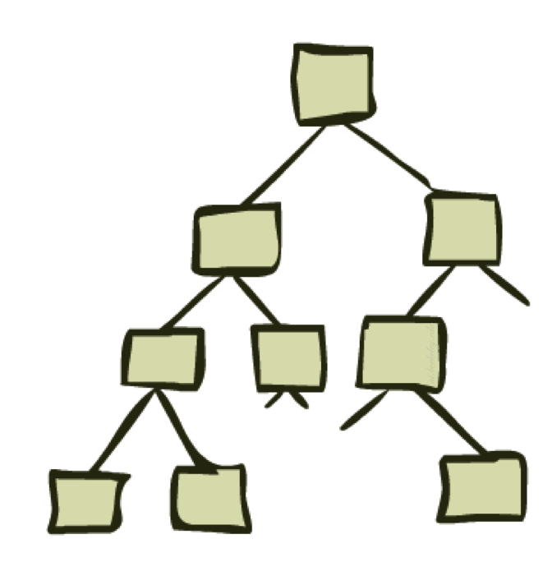
State Space Graphs and Search Trees
Notes:
~30 minutes
Solving only uses state space, successor, etc. Not power pellets, dots, etc.

Slide 20
State Space Graphs
State space graph: A mathematical representation of a search problem
Nodes are (abstracted) world configurations
Arcs represent successors (action results)
The goal test is a set of goal nodes (maybe only one)
In a state space graph, each state occurs only once!
We can rarely build this full graph in memory (it’s too big), but it’s a useful idea
Notes:
ASR: every possible pronunciation of every possible sentence. Huge.

Slide 21
State Space Graphs
State space graph: A mathematical representation of a search problem
Nodes are (abstracted) world configurations
Arcs represent successors (action results)
The goal test is a set of goal nodes (maybe only one)
In a search graph, each state occurs only once!
We can rarely build this full graph in memory (it’s too big), but it’s a useful idea
a
G
b
c
e
d
f
S
h
p
q
r
Tiny search graph for a tiny search problem
Notes:
For these slides. Abstract. How to move from state to state.
Find solution without writing it down.

Slide 22
Search Trees
This is now / start
“N”, 1.0
“E”, 1.0
Possible futures
A search tree:
A “what if” tree of plans and their outcomes
The start state is the root node
Children correspond to successors
Nodes show states, but correspond to PLANS that achieve those states
For most problems, we can never actually build the whole tree
Notes:
Different plans that achieve the same state, will be different nodes in the tree.
Every plan in the tree.
Search ignores most of the tree.

Slide 23
State Space Graphs vs. Search Trees
State Space Graph
Each NODE in in the search tree is an entire PATH in the state space graph.
Search Tree
S
a
G
d
e
p
b
c
q
b
c
e
h
r
d
e
f
a
a
h
r
p
q
f
S
h
We construct both on demand – and we construct as little as possible.
p
q
f
q
c
G
p
q
r
q
c
G
a
a

Slide 24

Quiz: State Space Graphs vs. Search Trees
Consider this 4-state graph:
How big is its search tree (from S)?
a
S
G
b
Important: Lots of repeated structure in the search tree!
Notes:
MISSING ANIMATION

Slide 25
Quiz: State Space Graphs vs. Search Trees
Consider this 4-state graph:
How big is its search tree (from S)?
a
S
G
b

Slide 26
Quiz: State Space Graphs vs. Search Trees
Consider this 4-state graph:
How big is its search tree (from S)?
a
s
a
b
S
G
b
G
a
G
b
a
G
b
G
…
…
Important: Lots of repeated structure in the search tree!
Notes:
Graph is only 4, tree is infinite!

Slide 27
Tree Search
Notes:
That’s the abstraction. Now talk about algorithm.

Slide 28
Search Example: Romania

Slide 29
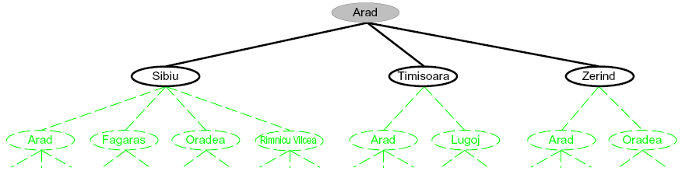
Searching with a Search Tree
Search:
Expand out potential plans (tree nodes)
Maintain a fringe of partial plans under consideration
Try to expand as few tree nodes as possible
Notes:
Haven’t constructed green stuff yet.
Build downward.

Slide 30
General Tree Search
Important ideas:
Fringe
Expansion
Exploration strategy
Main question: which fringe nodes to explore?
Notes:
Pseudo-code. General algorithm. Some details specific to later topics, notably A*.

Slide 31
Example: Tree Search
a
G
b
c
d
e
f
S
h
p
q
r
Notes:
Tiny example. Here’s the state graph. Walk through tree search.
Left: show tree. Not typically stored, but implicit.
Right: fringe. Key data structure.

Slide 32
Example: Tree Search
a
G
b
c
e
d
e
d
f
f
S
h
p
r
q
r
S
s
s → d
s → e
s → p
s → d → b
s → d → c
s → d → e
s → d → e → h
s → d → e → r
s → d → e → r → f
s → d → e → r → f → c
s → d → e → r → f → G
d
e
p
b
c
e
h
r
q
a
a
h
r
p
q
f
p
q
f
q
c
G
q
c
G
a
a
Notes:
For example, strategy is arbitrary.
S D E R F G
Don’t return until G removed. Not when G added. Important later.

Slide 33
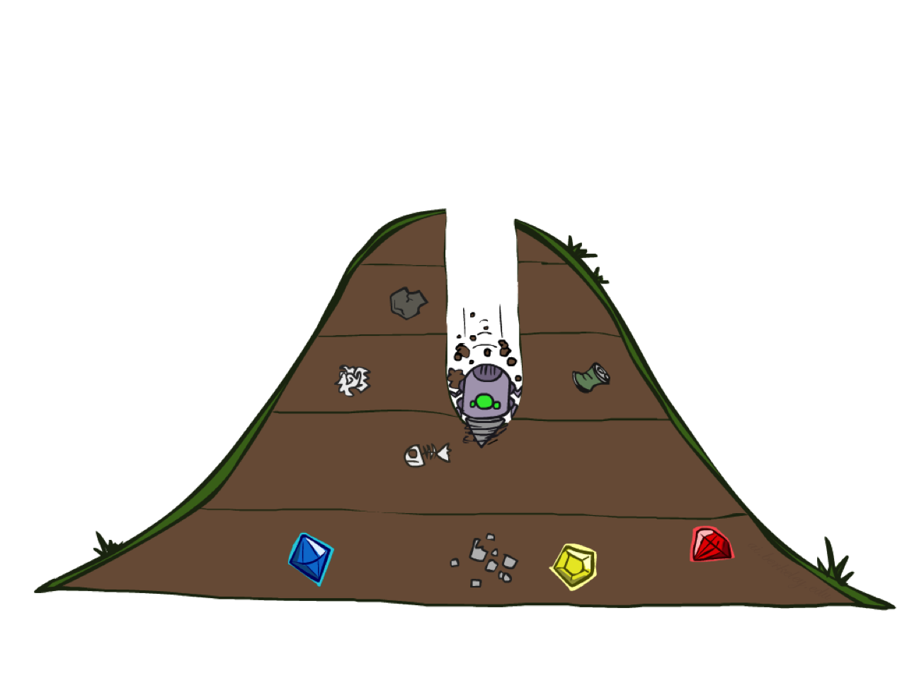
Depth-First Search
Notes:
That was generic. Now specific strategy – dfs
Go deep!
Exponentially large at the bottom.

Slide 34
Depth-First Search
Strategy: expand a deepest node first
Implementation: Fringe is a LIFO stack
a
G
a
c
b
c
b
e
d
e
d
f
f
S
h
h
p
p
r
q
r
q
S
d
e
p
b
c
e
h
r
q
a
a
h
r
p
q
f
p
q
f
q
c
G
q
c
G
a
a
Notes:
S D B A C A E H P Q
Ties alphabetically in this case.

Slide 35
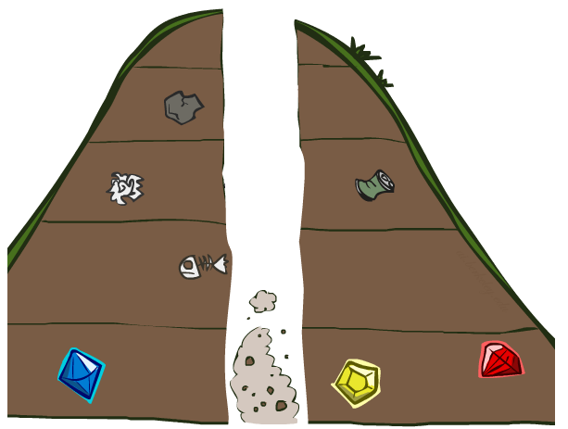
Search Algorithm Properties

Slide 36
Search Algorithm Properties
Complete: Guaranteed to find a solution if one exists?
Optimal: Guaranteed to find the least cost path?
Time complexity?
Space complexity?
Cartoon of search tree:
b is the branching factor
m is the maximum depth
solutions at various depths
Number of nodes in entire tree?
1 + b + b² + …. b^{m} = O(b^{m})
1 node
b
…
b nodes
b² nodes
m tiers
b^{m} nodes
Notes:
Questions about search algoirthms.
Simple cartoony case – assume each node is state space connects to exactly b other nodes.
Since doing bound estimation, we’re correct as long as fewer than b.
Infinite?

Slide 37
Depth-First Search (DFS) Properties
What nodes DFS expand?
Some left prefix of the tree.
Could process the whole tree!
If m is finite, takes time O(b^{m})
How much space does the fringe take?
Only has siblings on path to root, so O(bm)
Is it complete?
m could be infinite, so only if we prevent cycles (more later)
Is it optimal?
No, it finds the “leftmost” solution, regardless of depth or cost
1 node
b
…
b nodes
b² nodes
m tiers
b^{m} nodes
Notes:
Process whole tree if goal is lower right.
Space: At each level, children of one node at most on fringe, so b. Times number of layers m. (Small!)

