Slide 1
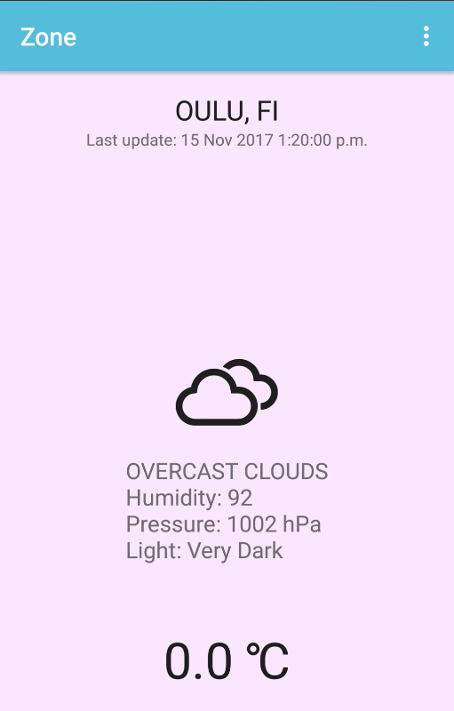
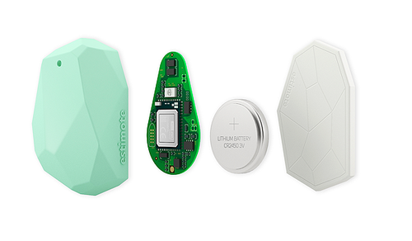
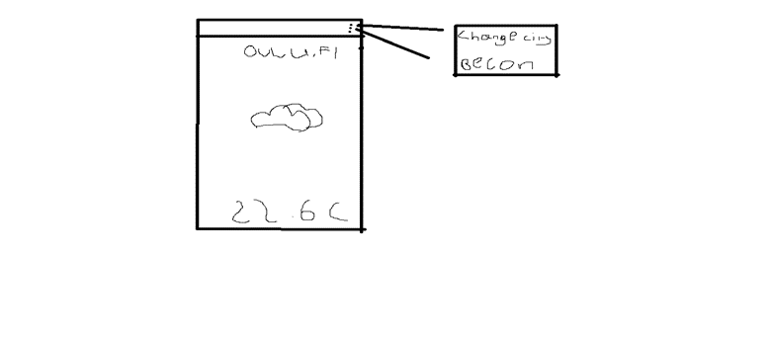
Designing and Implementing an Embedded Systems Application - Zone
Ronan O’Byrne, Vincent Ogbe
School of Engineering and Natural Recources, Information Technology, EDDIT Double Degree Programme
Introduction
The subject of this project was to design and develop an application that uses the functionality of Estimote Beacons. The lecturer provided us with two Estimote Beacons to use in the project. Our goal was to create a real-time weather app that uses the data from beacon such as temperature and light. The app also used an online weather API to give future weather predictions.
FIGURE 1. Design of the beacon
Estimote Beacon
The Estimote Beacon is capable of reading real time telemetric data such as temperature, if the beacon is moving and the current light level. This data can then be recorded to the Estimote Cloud. Applications keys are also saved in the Estimote Cloud. The Estimote SDK is used to create embedded mobile apps that use the sensors. The beacon contains a battery that cannot be replaced.
Methods
The main goal of this project was to create a weather app that we called Zone. To do this we had to read in real-time weather data from an online API and use the data from the beacons embedded sensors. We decided not to use a template as we had many issues running the provided ones and we instead created out own project from scratch using the Java language and Android Studio.
FIGURE 2. Prototype of the home screen
Results
We created the system that we had tried to make with minimal consecions made. The app uses the beacons sensor to read and display data. We somewhat overestimated the limitations of the beacons in their current state. The app will notify the user of the current conditions when they pass by a beacon. When the app is opened the user will aslo be able to view real time weather preditions.
FIGURE 3. Final Home Screen
Conclusions
We believe that the project as a whole was a success. We created the app we wanted to make however there was some issues. We had expected to be able to retrieve data such as the beacons stored location however we could not find any way to do this through the Android SDK. Both members believe that they have learned a lot about both Android Studio, which they were not familiar with prior to this assignment, and the Estimote SDK.
References
http://openweathermap.org/appid
Project
Date of publication: 2017, November
Supervisor Pertti Heikkilä

