Slide 1
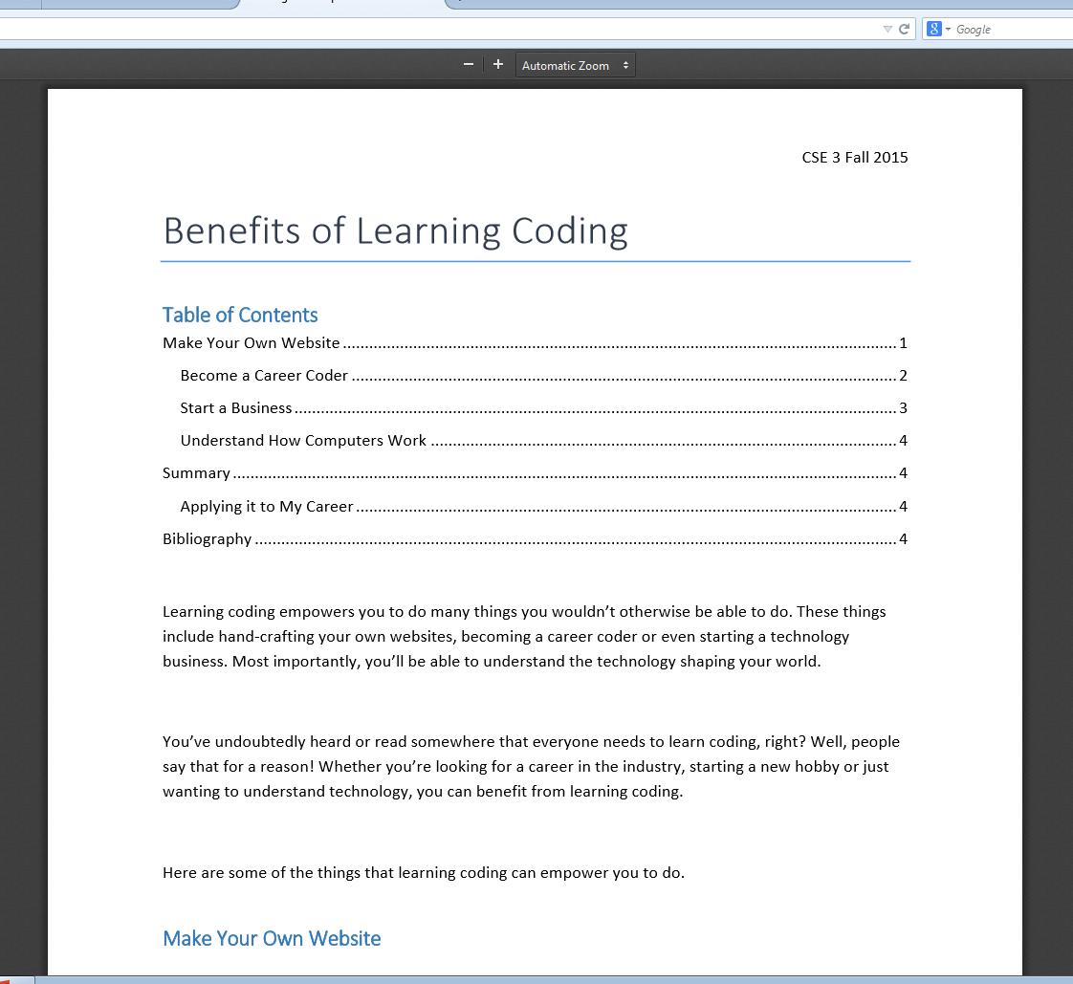
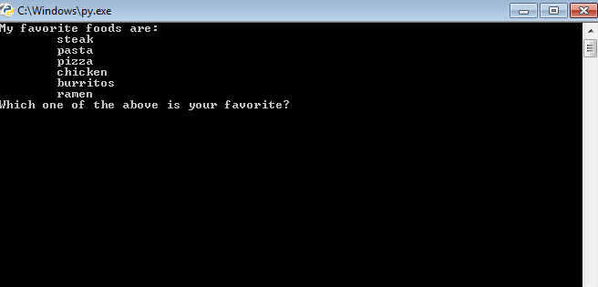
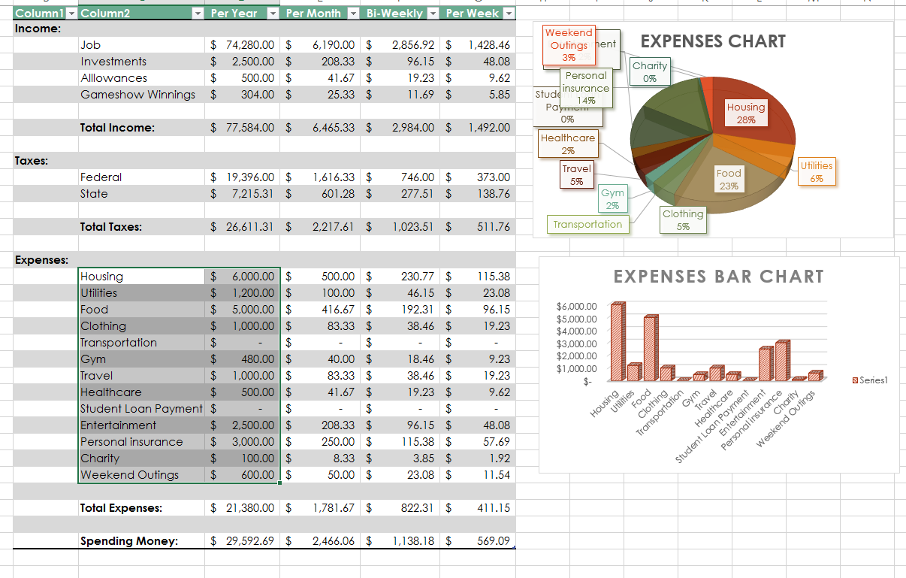
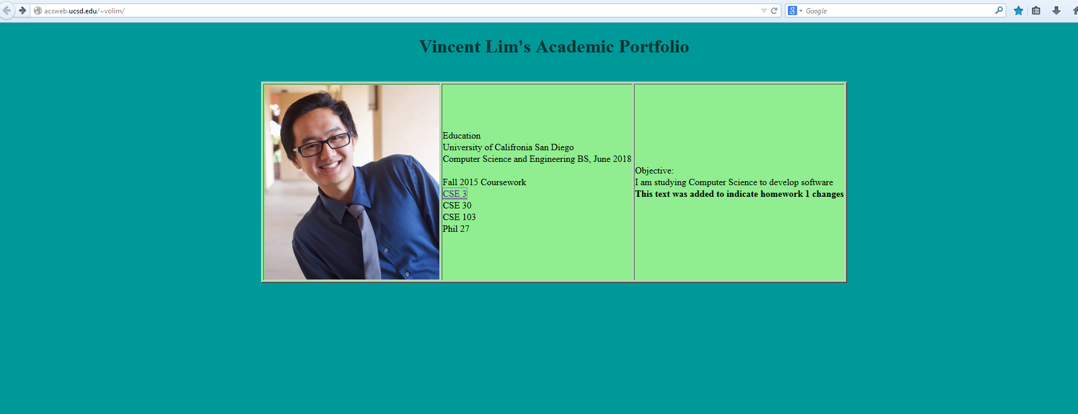
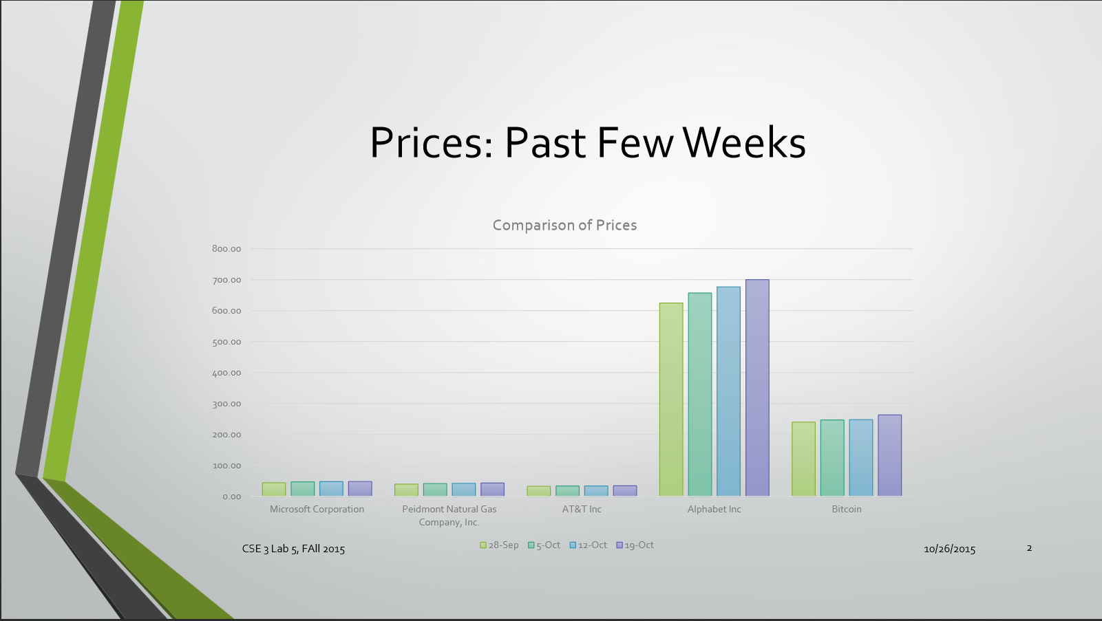
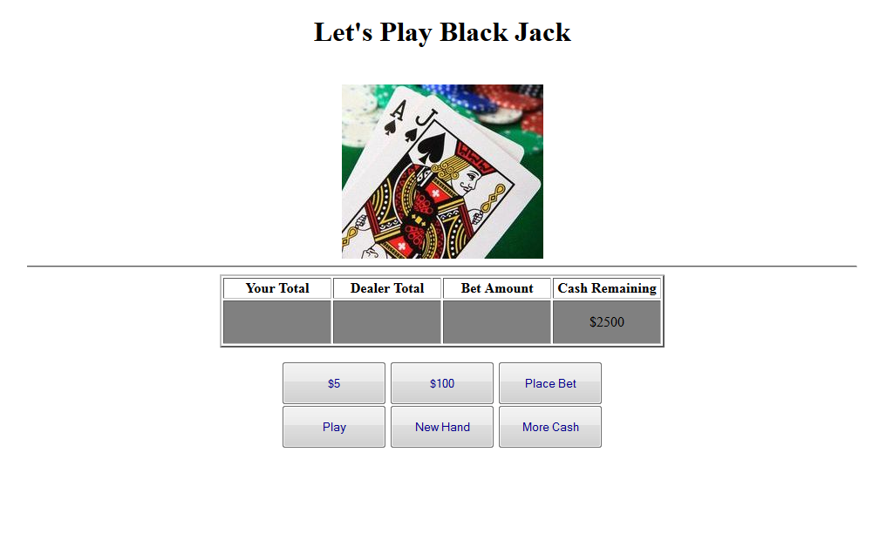
What is CSE 3?
By: Vincent Lim
Computation Thinking
Desktop Publishing (with MS Word)
IDLE (Integrated Development and Learning Environment) Programming with Python
Information Technology fluency aims to teach students about the applications of computer programs. The overall goal is to develop an understanding for information technology through working with various programs and programming (in HTML, Python, and Javascript).
Microsoft Word is a useful tool for documenting important/useful information.
You can do various formatting and styling in MS Word to make documents look aesthetically pleasing.
You can also publish these files onto the web
In order to understand how to make a website interactive, we had to learn Python as a stepping stone into learning JavaScript
This taught us basic programming tactics such as conditional statements and loops
We used PyCharm to learn Python at our own pace.
The result: an interactive program
Making Information Available to the World with HTML and Web Pages
Data Analysis and Visualization (with MS Excel)
We learned how to create web pages using HTML.
In order to put our web pages onto the web, we have to
Put a link so we can get to the page
Transfer the files using secure file transfer
Check if it worked!
Spreadsheets are often used to display large and confusing data as understandable graphs.
This is useful for visualizing financial information, large amounts of data (ex: students and gpa’s), and other types of numerical information
Graphs just look better than a spreadsheet, and they make information easier to interpret
Dynamic Webpage Programming with JavaScript
Presentation of Information (with MS PowerPoint)
A webpage with text is boring, so we learned how to make them interactive!
Using JavaScript, we gave the users options on what to do.
This makes websites more fun and let us do things like play BlackJack!

