Slide 1
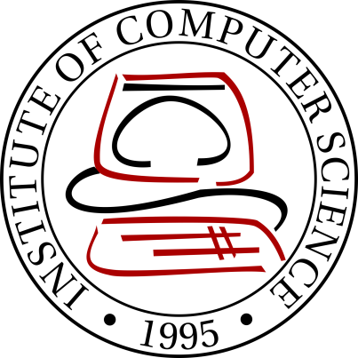

SkyLab
An extensible workflow web applicaton for HPC on the cloud
VINCENT PAUL L. CARPIO, KATRINA JOY M. ABRIOL-SANTOS, JOSEPH ANTHONY C. HERMOCILLA

Slide 2
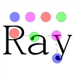
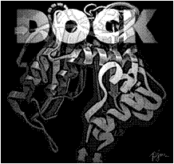



SkyLab
Molecular Docking
Sequence Alignment
De novo assembly
Materials Science
Quantum Chemistry

Slide 3
Background
Peak-Two Cloud (P2C)
vCluster
p2c-tools

Slide 4
Motivation
Using HPC applications require knowledge in terminal usage and scripting
Making it difficult for non-technical users (physicists, chemists, biologists) to use

Slide 5
Objectives
allow users to execute HPC tools via web interface
enable developers to easily extend it to support additional HPC tools
enable users to share their instantiated clusters
support displaying of results using third party tools

Slide 6
System Architecture

Slide 7
Bootup
Load tools
Search for toolsets in modules directory
Initialize cluster management
Start MPIThreadManager
Initialize task queues
Enqueue unfinished tasks to their respective cluster ‘s task queues
Spawn MPIThreads for each active cluster
Tasks are executed according to priority
Create or update toolset DB entries

Slide 8
Toolset
__init__.py
forms.py
executables.py
install.py
views.py
Contains tool classes extending P2CToolGeneric class
Contains Django form classes for subtools
Contains install_to_db function which creates/updates database entries related with the toolset/subtools
Contains Django views for subtools

Slide 9
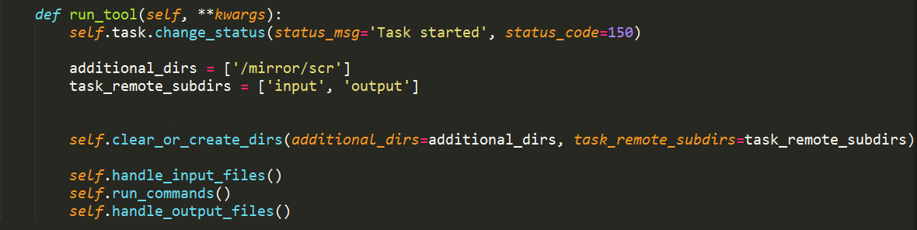
Toolset
run_tool method implementation for GAMESS

Slide 10
Results

Slide 11
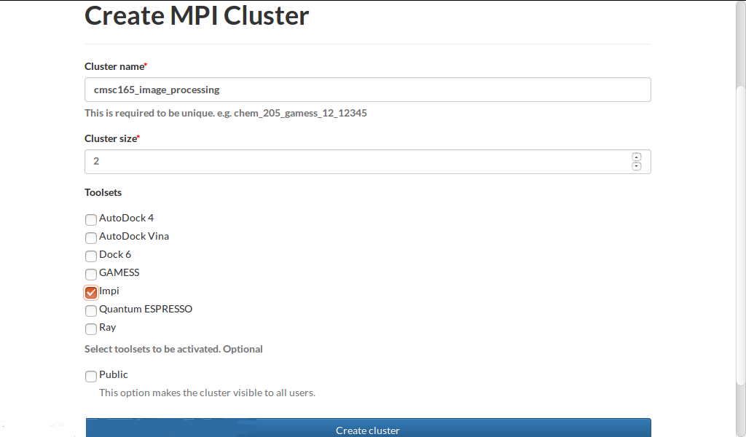
MPI cluster creation

Slide 12
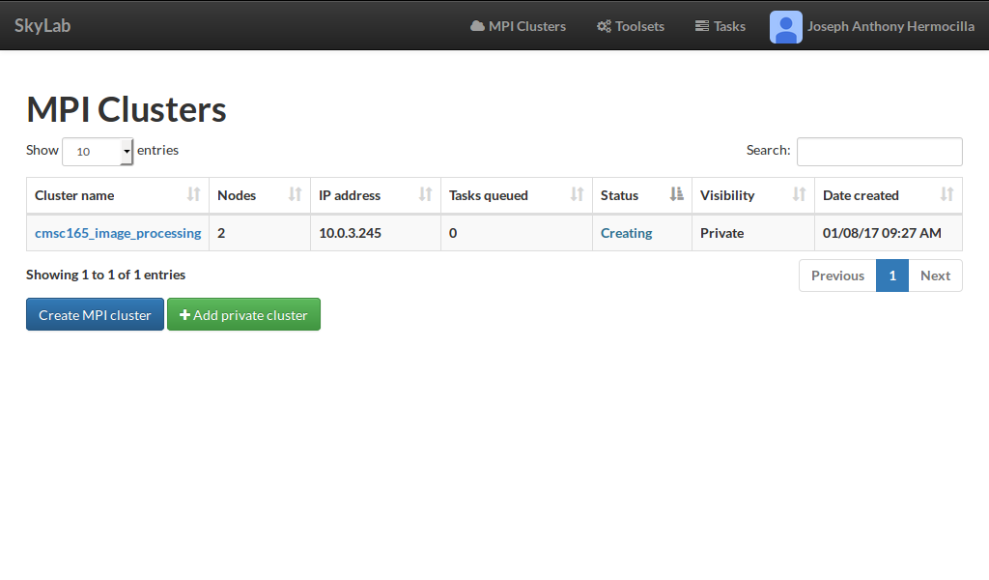
MPI cluster monitoring

Slide 13
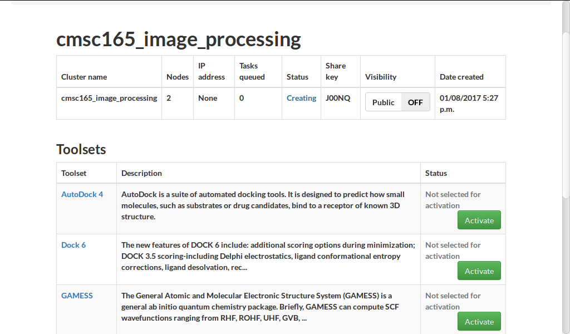
MPI cluster management

Slide 14
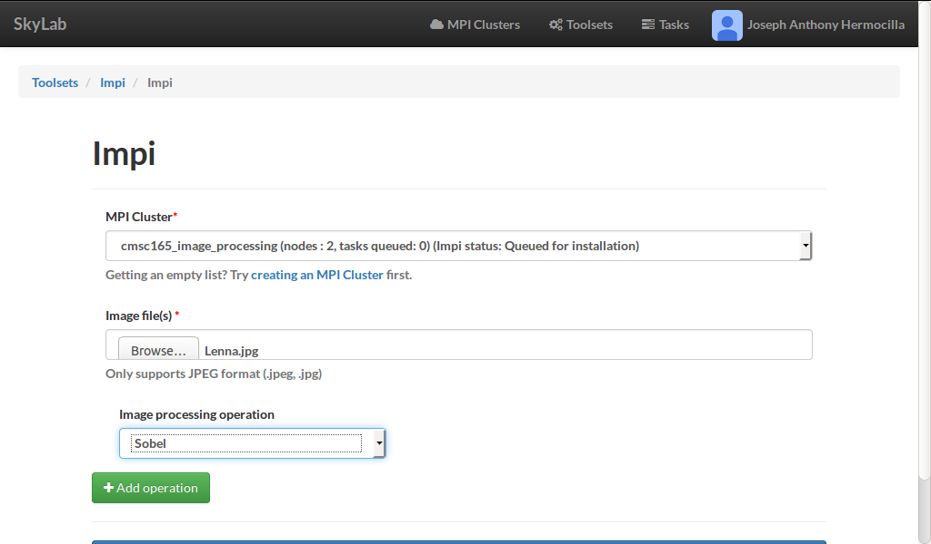
Task submission

Slide 15
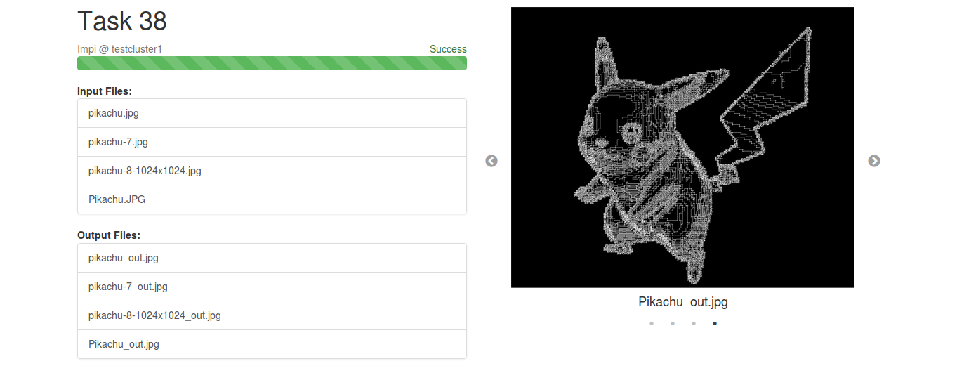
Task output

Slide 16
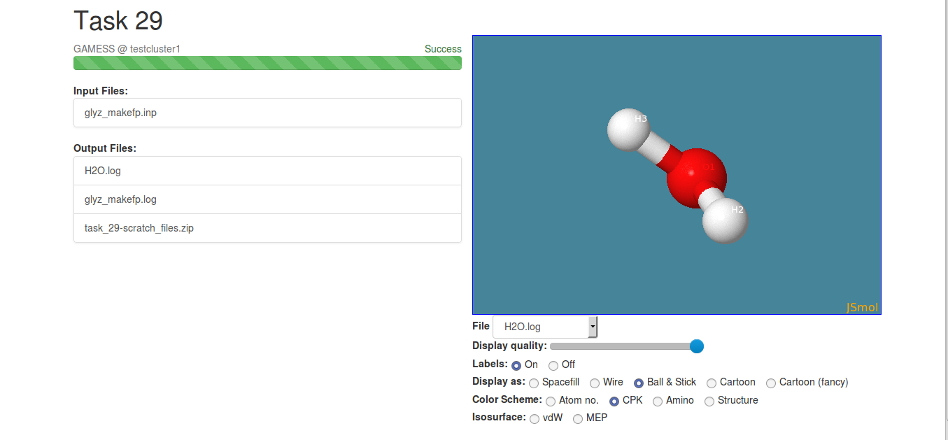
Task output

Slide 17
Evaluation

Slide 18
Summary
SkyLab is an extensible workflow web applicaton for HPC on the cloud
Via web interface, users are able to deploy MPI clusters and use them to run HPC tasks
Task output files are ready for download on task finish and are rendered with JSmol, if they are compatible
Test users found the system to be acceptable in terms of the criteria provided, in general

Slide 19
Acknowledgement
SkyLab is supported by the DOST-Accelerated Science and Technology Human Resource Development Program (DOST-ASTHRDP)
We would like to thank our collaborators who provided the use cases for the tools, Dr. Marlon Manalo (Chemistry), and Prof. Arian Jacildo (Bioinformatics)
Finally, we acknowledge the valuable comments by the reviewers

Slide 20
Github repository
https://github.com/srg-ics-uplb/SkyLab

Slide 21
Future Work
Support for additional use cases of current tools
Support for input file generation
Improved parameter checking and error handling
Support for customizable workflow design
Task scheduling and resource management algorithms

Slide 22
References
J. A. C. Hermocilla, “P2c: Towards scientific computing on private clouds,” in Proceedings of the National Conference on Information Technology Education (NCITE 2014), 2014, pp. 162–167.
R. M. Hanson, J. Prilusky, Z. Renjian, T. Nakane, and J. L. Sussman, “Jsmol and the next-generation web-based representation of 3d molecular tructure as applied to proteopedia,” Israel Journal of Chemistry, vol. 53, no. 3-4, pp. 207–216, 2013. [Online]. Available: http://.doi.org/10.1002/ijch.201300024

