Slide 1


SkyLab
An extensible workflow web applicaton for HPC on the cloud
VINCENT PAUL L. CARPIO, KATRINA JOY M. ABRIOL-SANTOS, JOSEPH ANTHONY C. HERMOCILLA

Slide 2
SkyLab
A web application that allows users to run HPC tools that utilize MPI via Peak-Two Cloud (P2C)
Allows users to deploy MPI clusters on-demand
Allows users to submit tasks for HPC tools, and download the resulting output files
Currently supported tools:
AutoDock4, AutoDock Vina, DOCK 6, Quantum ESPRESSO, GAMESS, Ray, IMPI

Slide 3
Outline
Background
Motivation
Objectives
System Architecture
Results
Summary

Slide 4
Background
Peak-Two Cloud (P2C)
Openstack-based private cloud on top of commodity hardware targeted for scientific and high-performance computing
vCluster
Tool for automatic configuration and deployment of MPI cluster on demand
p2c-tools
Utility for configuring tools with MPI clusters

Slide 5
Motivation
Using HPC applications require knowledge in terminal usage and scripting
This makes it difficult for non-technical users (physicists, chemists, biologists) to use

Slide 6
Objectives
allow users to execute HPC tools via web interface;
enable developers to easily extend it to support additional HPC tools;
enable users to share their instantiated clusters; and
support displaying of results using third party tools

Slide 7
System Architecture

Slide 8
Bootup
Load tools
Search for toolsets in modules directory
Initialize cluster management
Start MPIThreadManager
Initialize task queues
Enqueue unfinished tasks to their respective cluster ‘s task queues
Spawn MPIThreads for each active cluster
Initialize event listeners
Tasks are executed according to priority
Create or update toolset DB entries

Slide 9
Toolset
__init__.py
forms.py
executables.py
install.py
views.py
Contains tool classes extending P2CToolGeneric class
Contains Django form classes for subtools
Contains install_to_db function which creates/updates database entries related with the toolset/subtools
Contains Django views for subtools

Slide 10
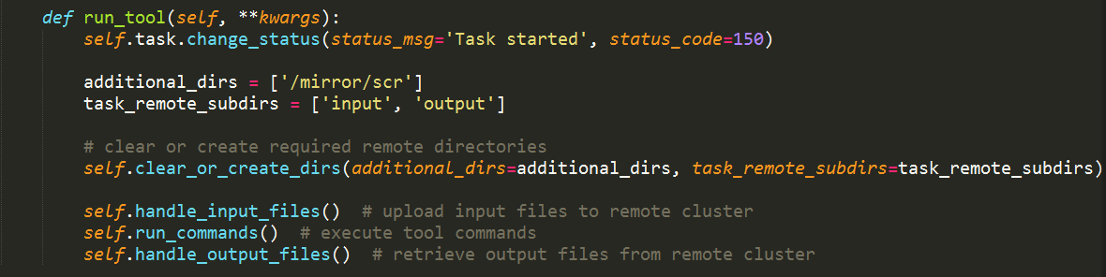
Toolset
run_tool method implementation for GAMESS

Slide 11
Results

Slide 12
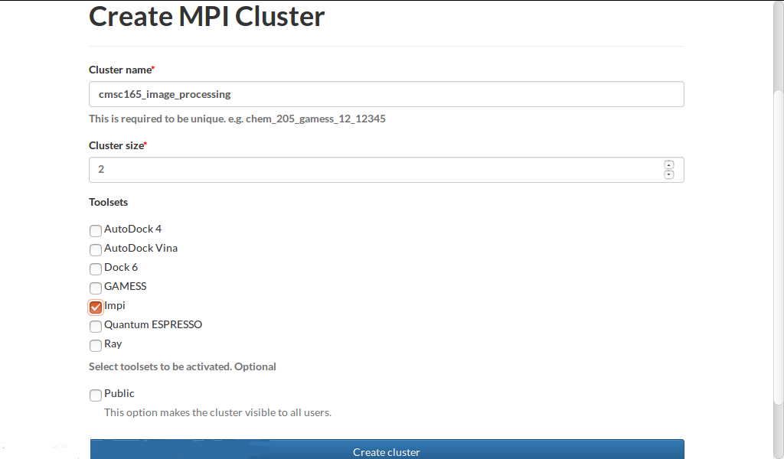
MPI cluster creation
Form specifying cluster parameters

Slide 13
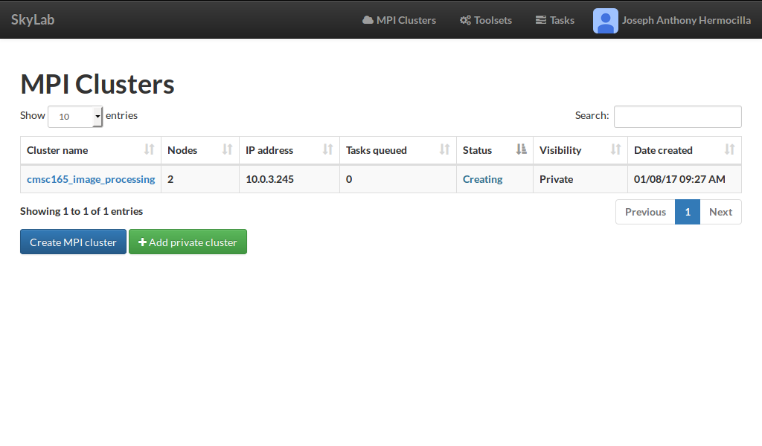
MPI cluster monitoring
List view of clusters visible to the user

Slide 14
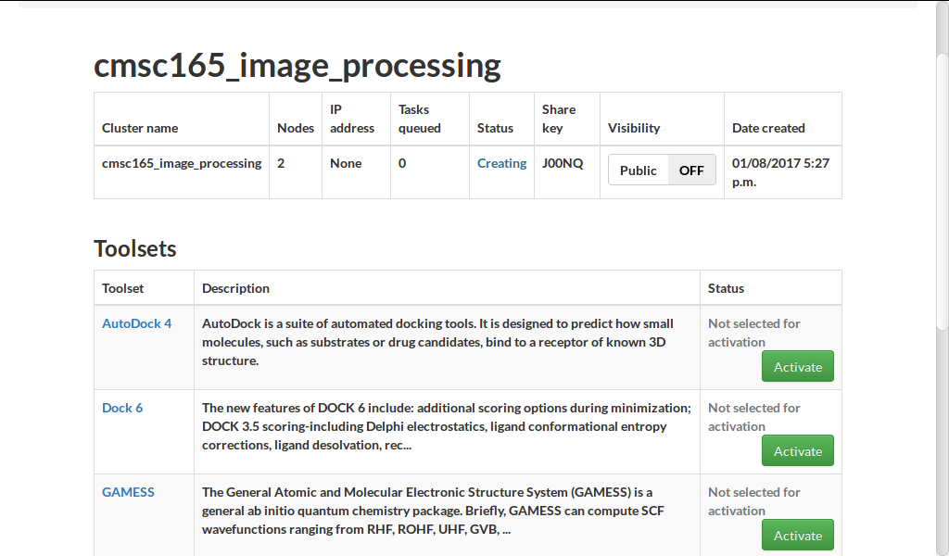
MPI cluster management
Detail view of an MPI cluster on SkyLab

Slide 15
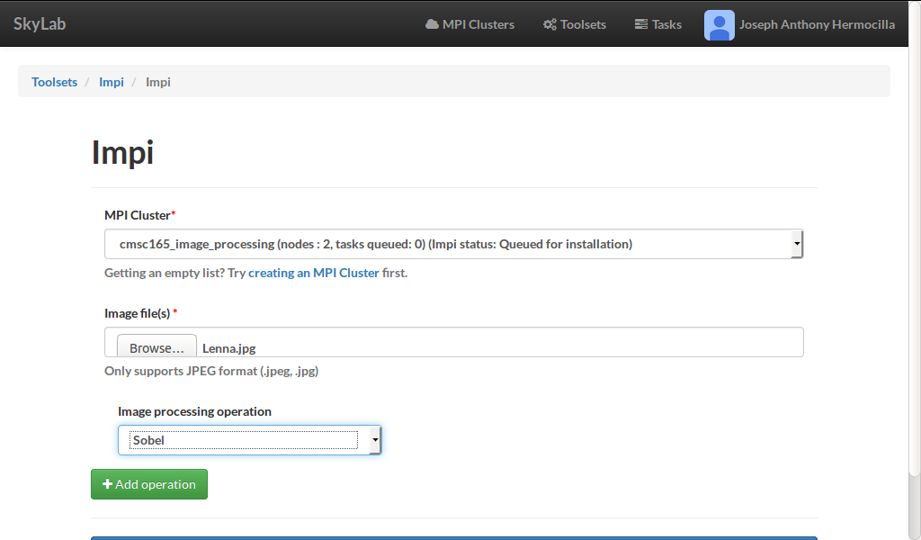
Task submission
IMPI task submission form

Slide 16
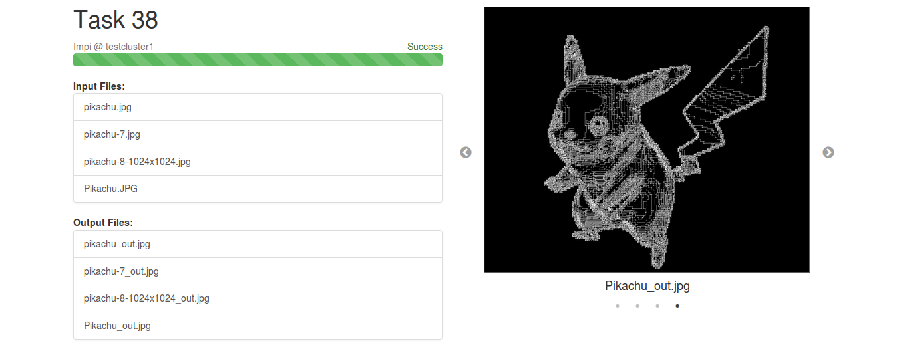
Task output
Sample output of IMPI Task

Slide 17
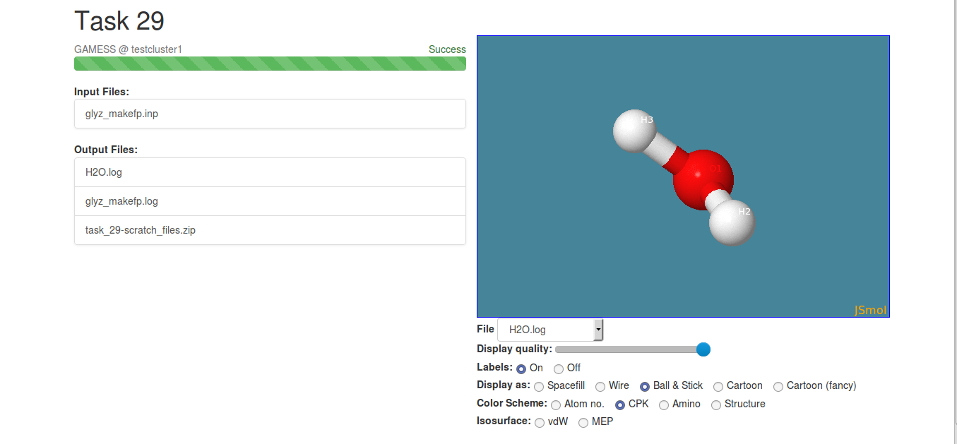
Task output
Sample output of GAMESS task rendered with JSmol

Slide 18
Evaluation

Slide 19
Summary
SkyLab is an extensible workflow web applicaton for HPC on the cloud
Via web interface, users are able to deploy MPI clusters and use them to run HPC tasks
Task output files are ready for download on task finish and are rendered with JSmol, if they are compatible
Test users found the system to be acceptable in terms of the criteria provided, in general

Slide 20
Acknowledgement
SkyLab is supported by the DOST-Accelerated Science and Technology Human Resource Development Program (DOST-ASTHRDP)
We would like to thank our collaborators who provided the use cases for the tools, Dr. Marlon Manalo (Chemistry), and Prof. Arian Jacildo (Bioinformatics)
Finally, we acknowledge the valuable comments by the reviewers

Slide 21
Github repository
https://github.com/srg-ics-uplb/SkyLab

Slide 22
Future Work
Support for additional use cases of current tools
Support for input file generation
Improved parameter checking and error handling
Support for custom workflow design
Task scheduling and resource management algorithms

Slide 23
References
J. A. C. Hermocilla, “P2c: Towards scientific computing on private clouds,” in Proceedings of the National Conference on Information Technology Education (NCITE 2014), 2014, pp. 162–167.
R. M. Hanson, J. Prilusky, Z. Renjian, T. Nakane, and J. L. Sussman, “Jsmol and the next-generation web-based representation of 3d molecular tructure as applied to proteopedia,” Israel Journal of Chemistry, vol. 53, no. 3-4, pp. 207–216, 2013. [Online]. Available: http://.doi.org/10.1002/ijch.201300024

