Slide 1

On the Onset of Collective Particle Motion in the Knudsen Regime
Vincent Carpenter, Hubert Klahr, Niclas Schneider, Gerhard Wurm
Notes:
For my master’s thesis, I worked with Wlad Lyra to implement an efficient self-gravity solver, in polar coordinates, in the Pencil Code.
Over the course of this presentation, I’ll attempt to communicate what that means, why we did it, how we did it, and how well we did.

Slide 2
Experiment: I was there!
Notes:
The convolution product is an operation that acts on two fields and produces a third. Mathematically, it can be defined like so.
Note that one field in the integrand is a function of the integration variables, while the other is a function of the difference between the integration variables and coordinates which are fixed with respect to the integration.
Visually, we can think of it like this: we hold one field stationary, and move the other one such that it is centered on a particular location; we can then compute the convolution product at that location by performing a pointwise sum of the overlapping areas of the fields.
Note here that, in order to compute the value of the convolution product at all points, we would need to shift the kernel to every point in the stationary field and perform a seperate pointwise sum. If both of these fields are defined on N points, this will require N^2 operations, and will quickly become extremely time consuming.
-> Enter the convolution theorem, which tells us that the Fourier transform of a convolution product is equal to the pointwise sum of the Fourier transforms of the individual fields.
-> This means that we can compute a convolution product by taking the inverse Fourier transform of the pointwise product of the Fourier transforms of our fields. And while that is more of a mouthful, and might seem more convoluted, if we have access to FFT algorithms it actually scales as NlogN, which is must faster than N^2 very quickly.

Slide 3
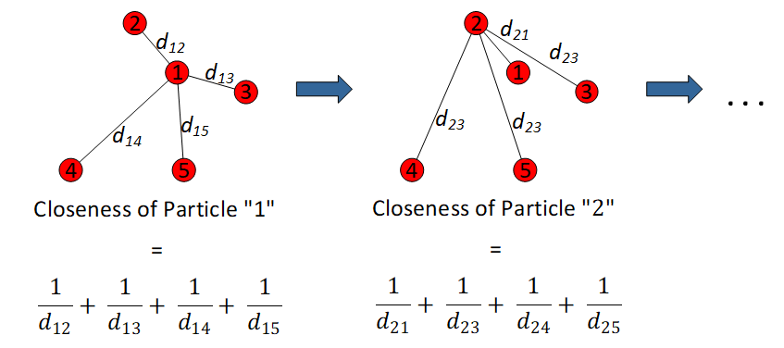
Experiment: Closeness
Schneider+, in review
Notes:
The convolution product is an operation that acts on two fields and produces a third. Mathematically, it can be defined like so.
Note that one field in the integrand is a function of the integration variables, while the other is a function of the difference between the integration variables and coordinates which are fixed with respect to the integration.
Visually, we can think of it like this: we hold one field stationary, and move the other one such that it is centered on a particular location; we can then compute the convolution product at that location by performing a pointwise sum of the overlapping areas of the fields.
Note here that, in order to compute the value of the convolution product at all points, we would need to shift the kernel to every point in the stationary field and perform a seperate pointwise sum. If both of these fields are defined on N points, this will require N^2 operations, and will quickly become extremely time consuming.
-> Enter the convolution theorem, which tells us that the Fourier transform of a convolution product is equal to the pointwise sum of the Fourier transforms of the individual fields.
-> This means that we can compute a convolution product by taking the inverse Fourier transform of the pointwise product of the Fourier transforms of our fields. And while that is more of a mouthful, and might seem more convoluted, if we have access to FFT algorithms it actually scales as NlogN, which is must faster than N^2 very quickly.

Slide 4
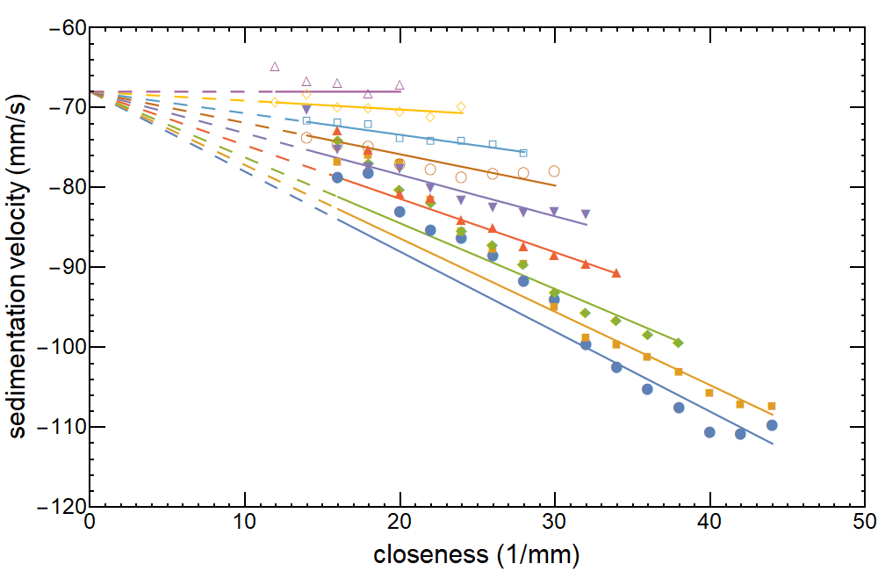
Experiment: Fast Sedimentation
Schneider+, in review
Notes:
The convolution product is an operation that acts on two fields and produces a third. Mathematically, it can be defined like so.
Note that one field in the integrand is a function of the integration variables, while the other is a function of the difference between the integration variables and coordinates which are fixed with respect to the integration.
Visually, we can think of it like this: we hold one field stationary, and move the other one such that it is centered on a particular location; we can then compute the convolution product at that location by performing a pointwise sum of the overlapping areas of the fields.
Note here that, in order to compute the value of the convolution product at all points, we would need to shift the kernel to every point in the stationary field and perform a seperate pointwise sum. If both of these fields are defined on N points, this will require N^2 operations, and will quickly become extremely time consuming.
-> Enter the convolution theorem, which tells us that the Fourier transform of a convolution product is equal to the pointwise sum of the Fourier transforms of the individual fields.
-> This means that we can compute a convolution product by taking the inverse Fourier transform of the pointwise product of the Fourier transforms of our fields. And while that is more of a mouthful, and might seem more convoluted, if we have access to FFT algorithms it actually scales as NlogN, which is must faster than N^2 very quickly.

Slide 5
Experiment: Fast Sedimentation
ε_{d}~0.07±.01
Increasing time, decreasing ε_{d}
ε_{d}~0.15±.02
Schneider+, in review
Notes:
The convolution product is an operation that acts on two fields and produces a third. Mathematically, it can be defined like so.
Note that one field in the integrand is a function of the integration variables, while the other is a function of the difference between the integration variables and coordinates which are fixed with respect to the integration.
Visually, we can think of it like this: we hold one field stationary, and move the other one such that it is centered on a particular location; we can then compute the convolution product at that location by performing a pointwise sum of the overlapping areas of the fields.
Note here that, in order to compute the value of the convolution product at all points, we would need to shift the kernel to every point in the stationary field and perform a seperate pointwise sum. If both of these fields are defined on N points, this will require N^2 operations, and will quickly become extremely time consuming.
-> Enter the convolution theorem, which tells us that the Fourier transform of a convolution product is equal to the pointwise sum of the Fourier transforms of the individual fields.
-> This means that we can compute a convolution product by taking the inverse Fourier transform of the pointwise product of the Fourier transforms of our fields. And while that is more of a mouthful, and might seem more convoluted, if we have access to FFT algorithms it actually scales as NlogN, which is must faster than N^2 very quickly.

Slide 6
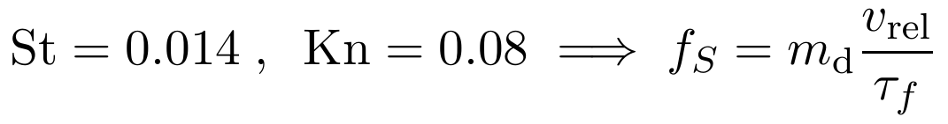
Back Reaction
Knudsen regime:

Slide 7
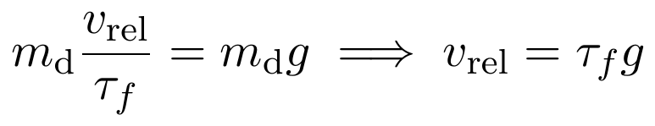
Back Reaction
Knudsen regime:
Terminal speed:

Slide 8
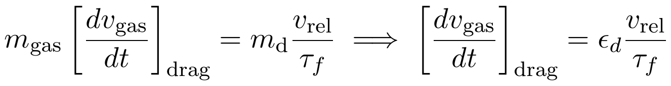
Back Reaction
Knudsen regime:
Terminal speed:
Back reaction:

Slide 9

Back Reaction
Knudsen regime:
Terminal speed:
Back reaction:
Particle group: more particles, larger region (ε_{d}, closeness)
altered gas velocity

Slide 10
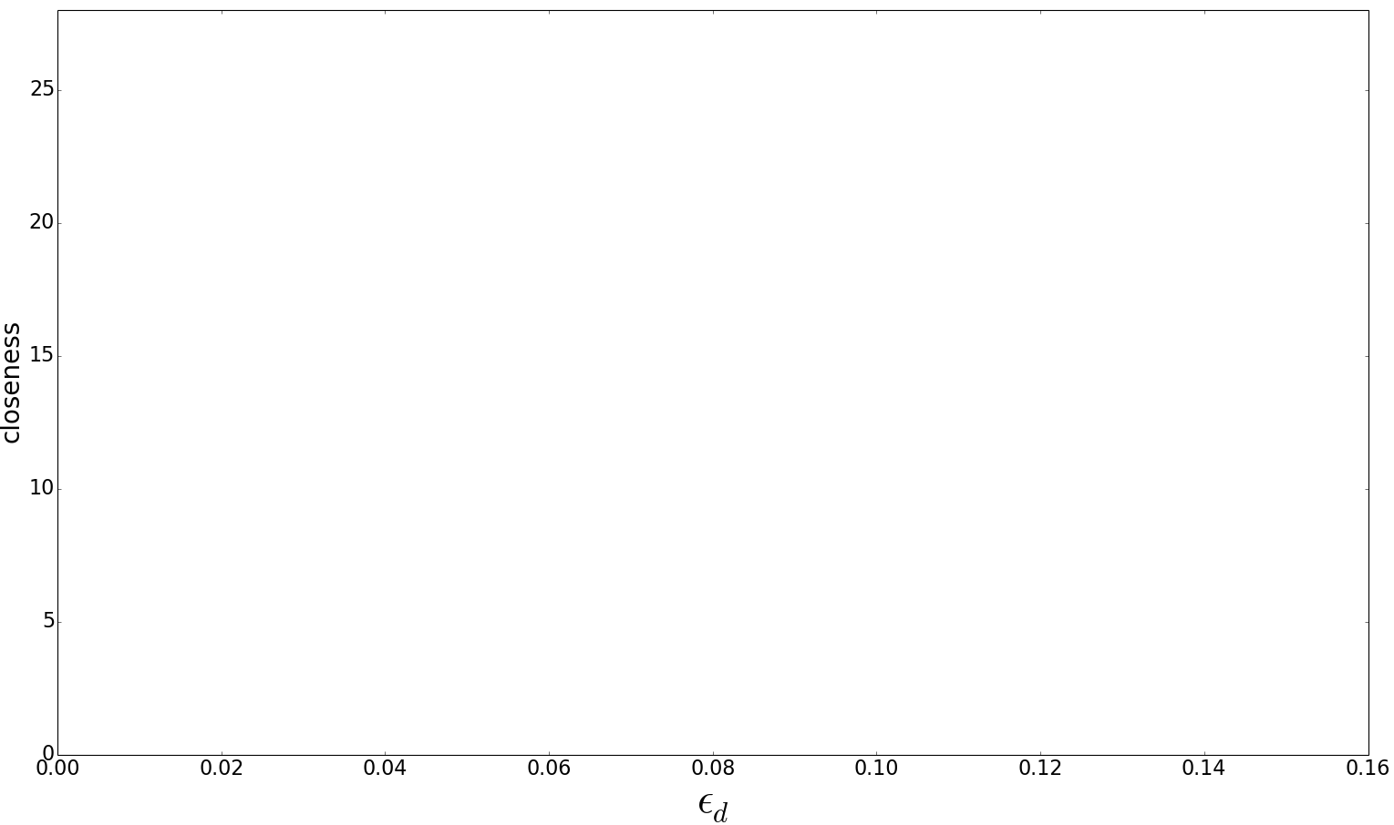
Simulations

Slide 11
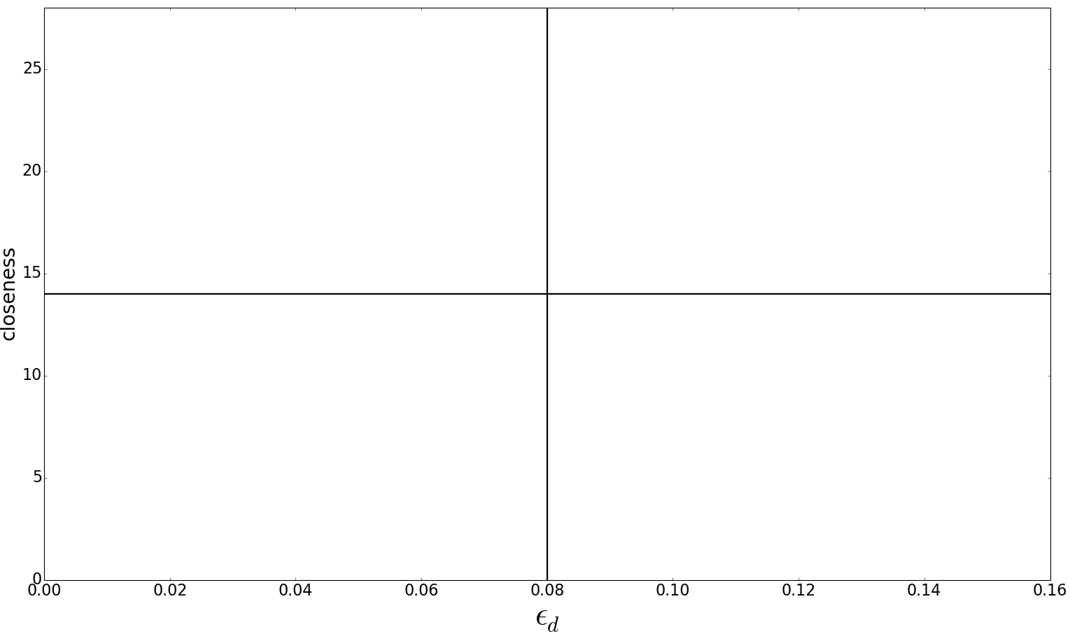
Simulations

Slide 12
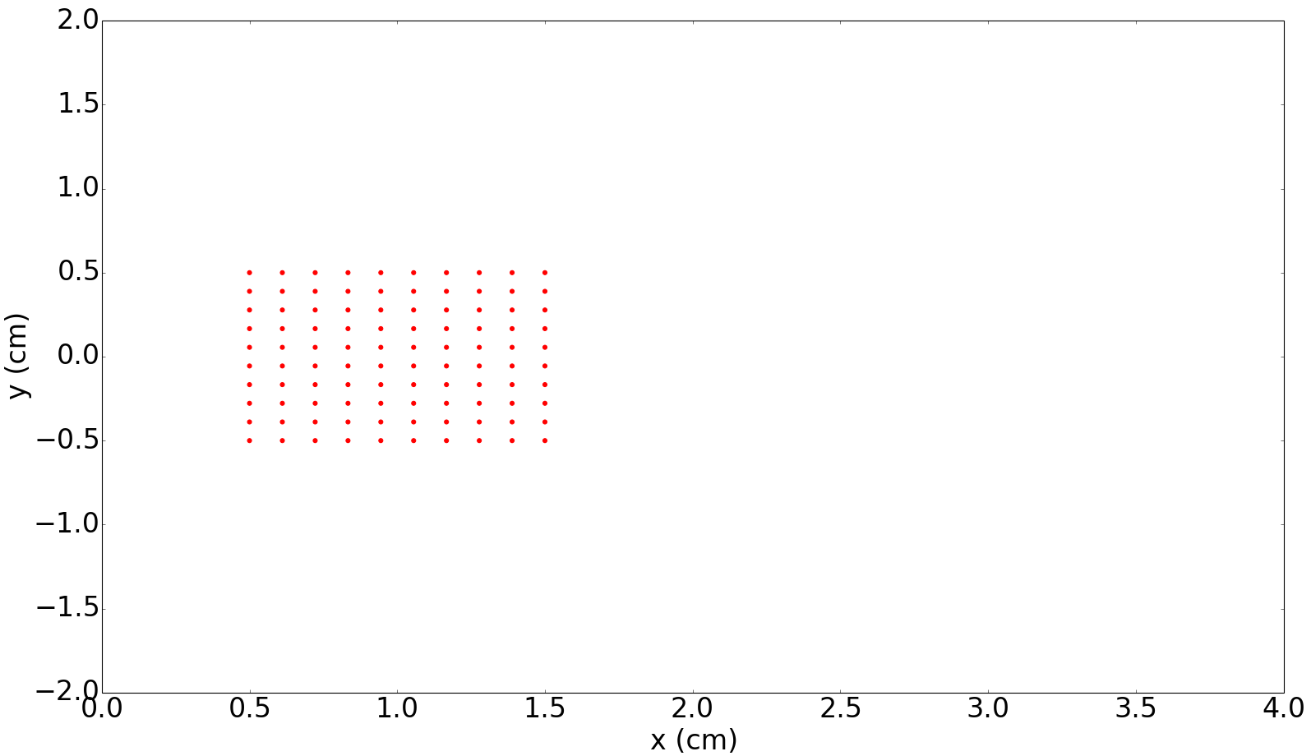
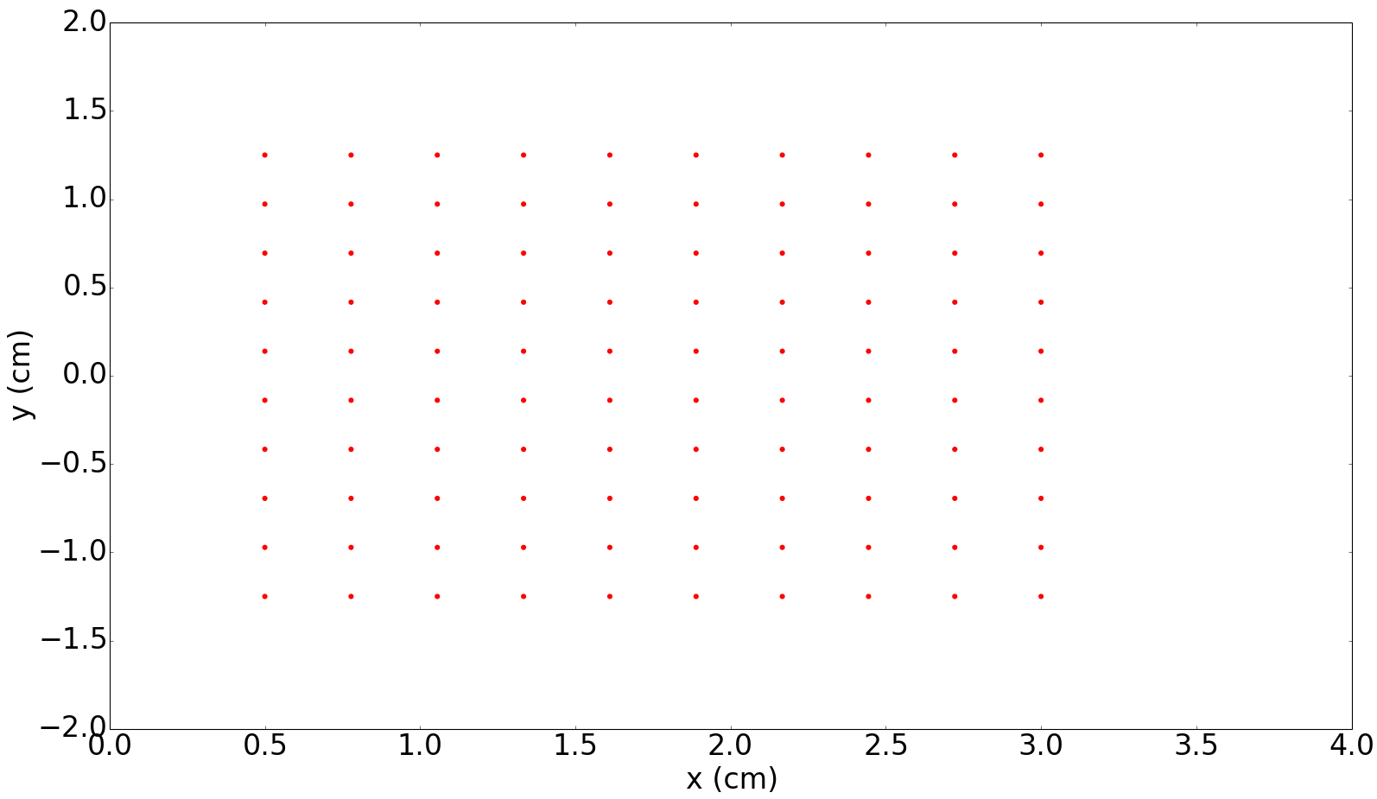
Simulations

Slide 13
In the Future
Make the simulations work
Implement variable density box, explore parameter space more thoroughly
3D simulations
Replicate gas velocity profile of experiment

Slide 14
In the Future
Karsten Dittrich

Slide 15
fin

Slide 16
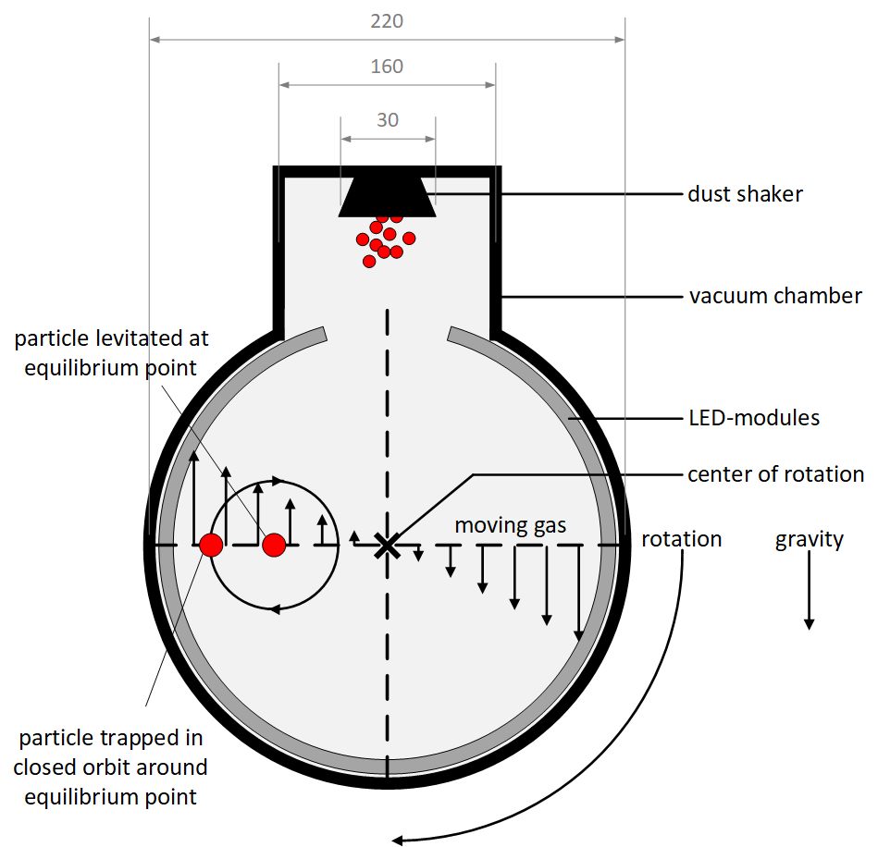
Experiment: Chamber Setup
Plain air
Evacuated to 950 ± 100 Pa
Uniform temperature (~300 K), density (~150 g/cm³)
Solid body rotation velocity profile, Ω = Ω_{chamber} = 0.336 Hz
Constant gravity, g ~ 981 cm/s²
Notes:
The convolution product is an operation that acts on two fields and produces a third. Mathematically, it can be defined like so.
Note that one field in the integrand is a function of the integration variables, while the other is a function of the difference between the integration variables and coordinates which are fixed with respect to the integration.
Visually, we can think of it like this: we hold one field stationary, and move the other one such that it is centered on a particular location; we can then compute the convolution product at that location by performing a pointwise sum of the overlapping areas of the fields.
Note here that, in order to compute the value of the convolution product at all points, we would need to shift the kernel to every point in the stationary field and perform a seperate pointwise sum. If both of these fields are defined on N points, this will require N^2 operations, and will quickly become extremely time consuming.
-> Enter the convolution theorem, which tells us that the Fourier transform of a convolution product is equal to the pointwise sum of the Fourier transforms of the individual fields.
-> This means that we can compute a convolution product by taking the inverse Fourier transform of the pointwise product of the Fourier transforms of our fields. And while that is more of a mouthful, and might seem more convoluted, if we have access to FFT algorithms it actually scales as NlogN, which is must faster than N^2 very quickly.

Slide 17
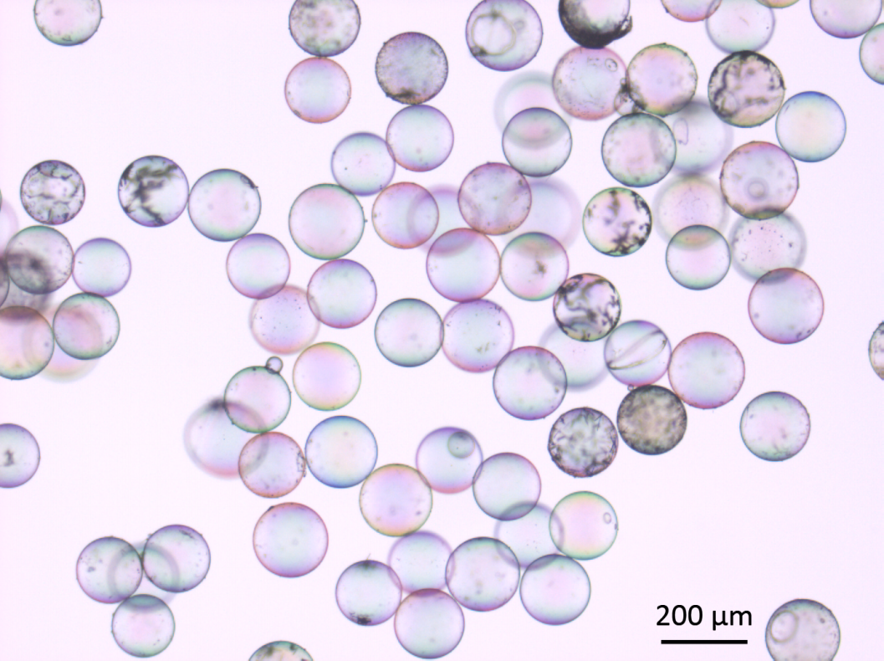
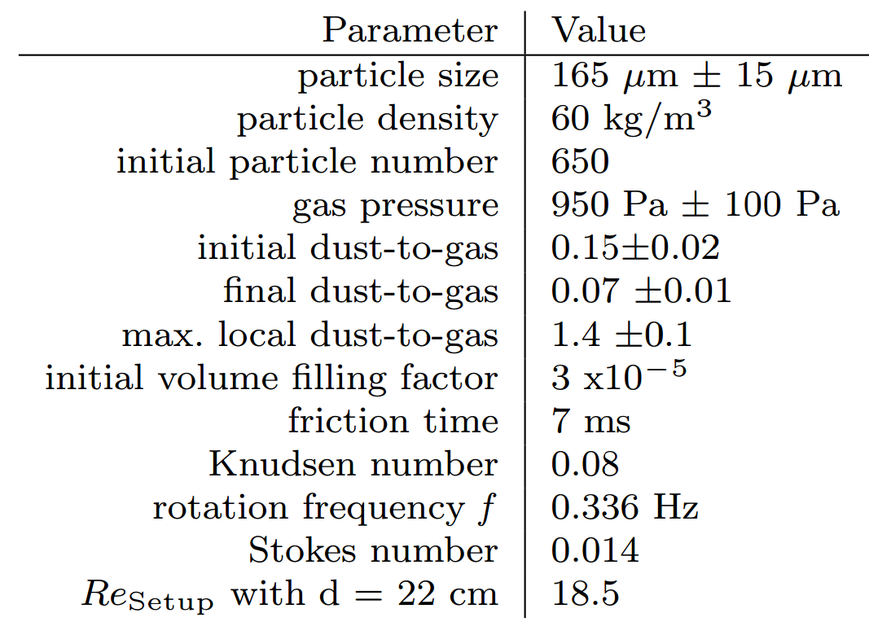
Experiment: Particles
Notes:
The convolution product is an operation that acts on two fields and produces a third. Mathematically, it can be defined like so.
Note that one field in the integrand is a function of the integration variables, while the other is a function of the difference between the integration variables and coordinates which are fixed with respect to the integration.
Visually, we can think of it like this: we hold one field stationary, and move the other one such that it is centered on a particular location; we can then compute the convolution product at that location by performing a pointwise sum of the overlapping areas of the fields.
Note here that, in order to compute the value of the convolution product at all points, we would need to shift the kernel to every point in the stationary field and perform a seperate pointwise sum. If both of these fields are defined on N points, this will require N^2 operations, and will quickly become extremely time consuming.
-> Enter the convolution theorem, which tells us that the Fourier transform of a convolution product is equal to the pointwise sum of the Fourier transforms of the individual fields.
-> This means that we can compute a convolution product by taking the inverse Fourier transform of the pointwise product of the Fourier transforms of our fields. And while that is more of a mouthful, and might seem more convoluted, if we have access to FFT algorithms it actually scales as NlogN, which is must faster than N^2 very quickly.

