Slide 1
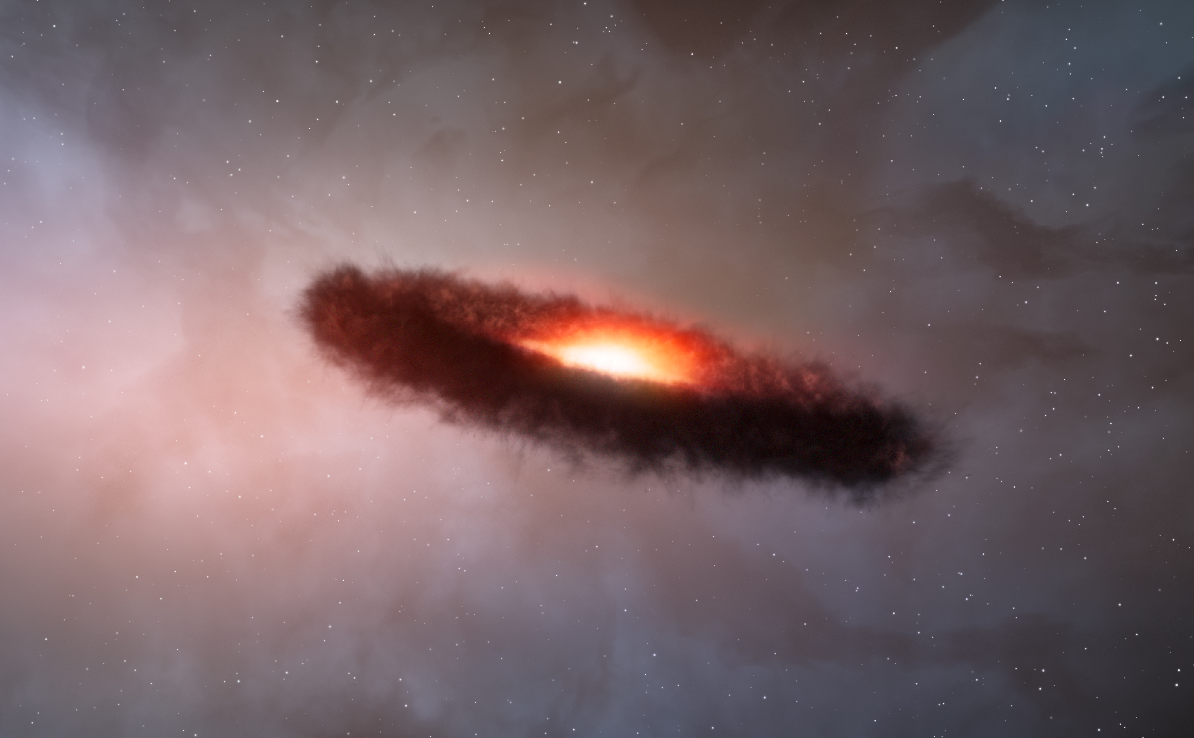
Simulations of the Onset of Collective Motion of Sedimenting Particles
Vincent Carpenter, MPIA, Heidelberg
with Hubert Klahr, Niclas Schneider, Gerhard Wurm

Slide 2
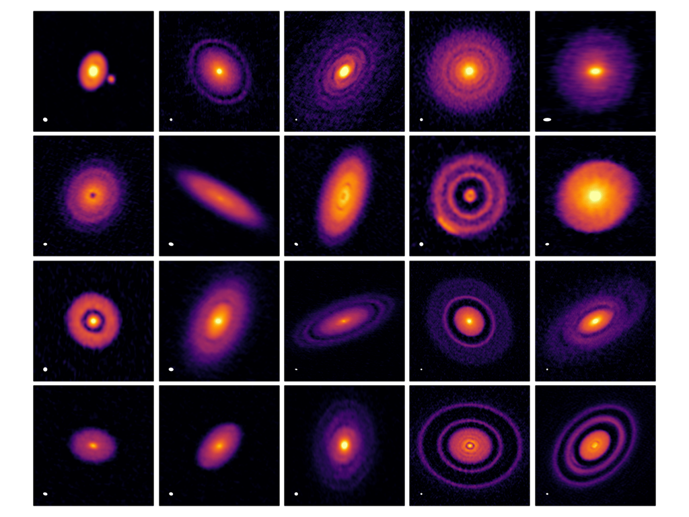

Introduction
DSHARP
Notes:
This meeting collects theorists, observers, and experimentalists together. We clearly have a lot to learn from each other, and need to cooperate to do our science.
The experiment that Niclas just talked about before me presents an excellent opportunity for theorists and experimentalists to collaborate. In the dust dynamics theory community, each group potentially has different codes and different results, and we often validate our simulations by comparing our models to each other; however, this process takes a long time and doesn’t guarantee that our results are actually physical. We can and do compare to observations of dusty disks, and this is of course useful, but there is limited information about dust dynamics that we can get from such snap shots.
Niclas and Gerhard’s experiment, on the other, provides a wealth of detailed information about dust dynamics in the laboratory, in real time, and therefore allows an excellent opportunity to benchmark simulations against an actual physical set up, and provide more and stronger constraints on our code’s treatment of solid-fluid coupling.
If we could demonstrate good agreement between simulations and these experiments, we could gain a lot of confidence that our code results reflect realistic behavior.
[mention something about helping experimentalists? Code results can direct?

Slide 3
Introduction
vs
Notes:
This meeting collects theorists, observers, and experimentalists together. We clearly have a lot to learn from each other, and need to cooperate to do our science.
The experiment that Niclas just talked about before me presents an excellent opportunity for theorists and experimentalists to collaborate. In the dust dynamics theory community, each group potentially has different codes and different results, and we often validate our simulations by comparing our models to each other; however, this process takes a long time and doesn’t guarantee that our results are actually physical. We can and do compare to observations of dusty disks, and this is of course useful, but there is limited information about dust dynamics that we can get from such snap shots.
Niclas and Gerhard’s experiment, on the other, provides a wealth of detailed information about dust dynamics in the laboratory, in real time, and therefore allows an excellent opportunity to benchmark simulations against an actual physical set up, and provide more and stronger constraints on our code’s treatment of solid-fluid coupling.
If we could demonstrate good agreement between simulations and these experiments, we could gain a lot of confidence that our code results reflect realistic behavior.
[mention something about helping experimentalists? Code results can direct?

Slide 4
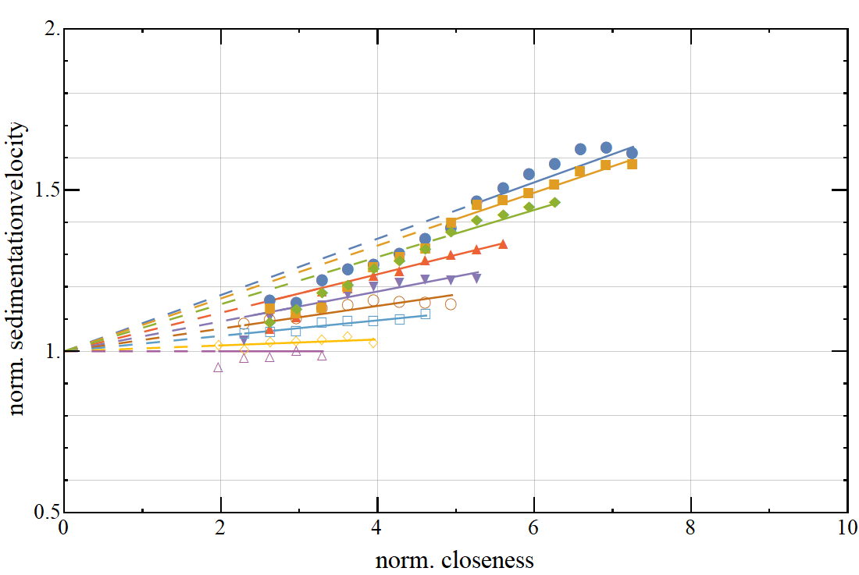
Experiment
Schneider+ 2019
Notes:
And this is exactly what Hubert and I have been working on! I won’t spend too long talking about the experiment, since Niclas already covered it; however, I will highlight one particular result that Hubert and I have targeted to attempt to replicate:
This plot shows the relationship between sedimentation velocity of the particles and their closeness to each other, as a function of the average dust to gas ratio in the chamber.
[This result should be replicable using simulations that are a good deal simpler than the experiment itself]

Slide 5
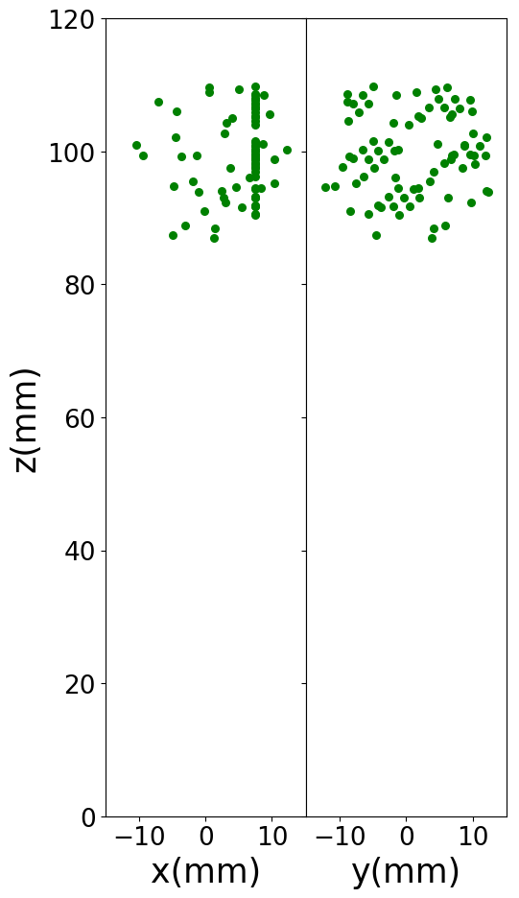
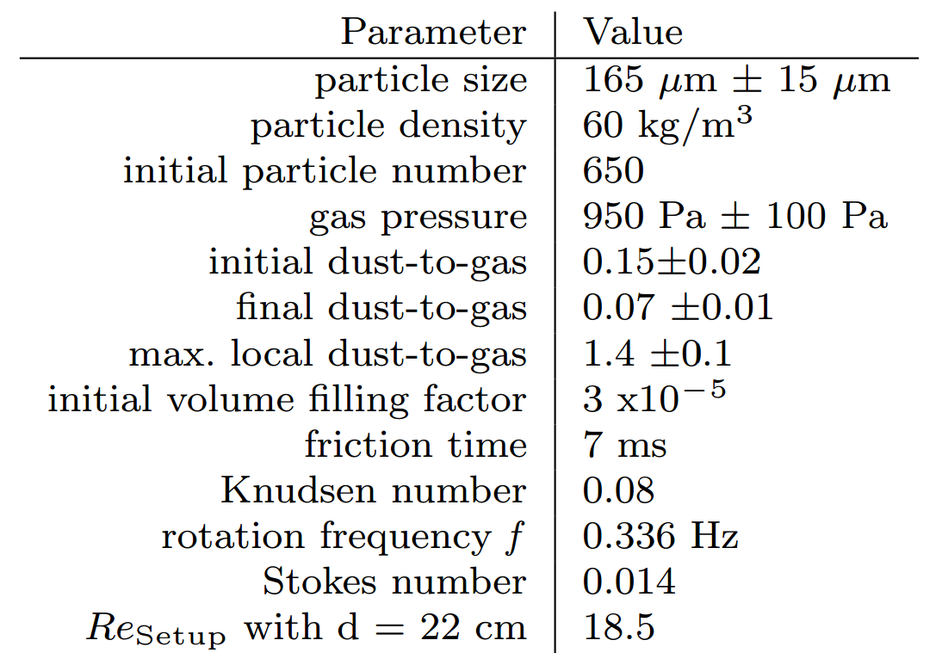
Simulations
Notes:
[empty single simulation view at left] In order to try to replicate this result, we set up hydrodynamics simulations with Lagrangian particles using the Pencil Code. We initialize 80 particles at rest [show particles], and evenly distributed in a spherical volume, at the top of a box of gas with uniform density and temperature, and also initially at rest, with particle and gas properties chosen to match the experiments as closely as possible [show table of properties, Schneider et al 2019]. The particles experience a constant, uniform gravitational force downward [draw arrow?], and interact with the gas via drag forces with back reaction [draw something for this?].
[get rid of talbes/arrows/etc, add other simulation views, along with approximate average closeness/local epsilon values] By varying the size of the spherical volume in which the particles start, we can adjust the initial average closeness and local dust to gas ratio of the group, in order to explore what impact this has on their motion.

Slide 6
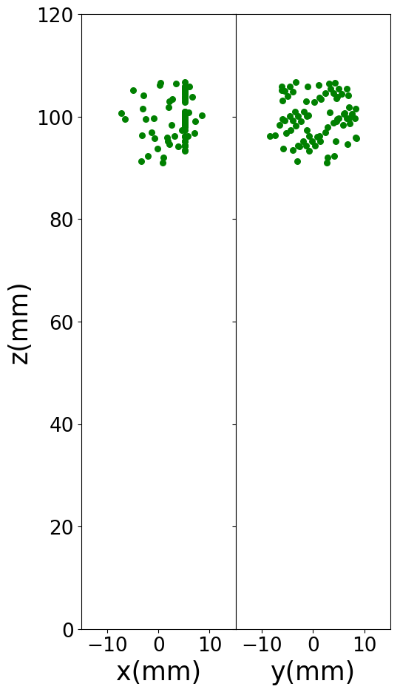
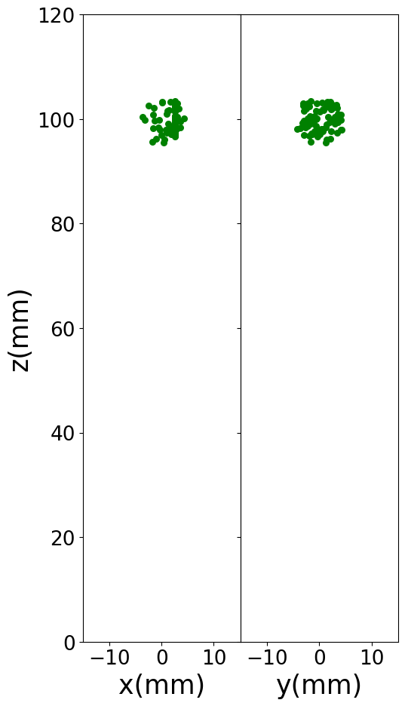
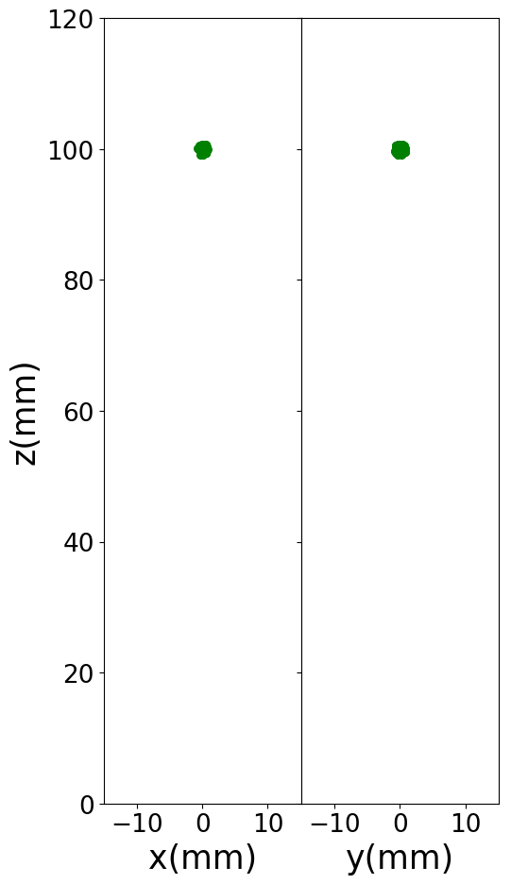
Simulations
mean closeness ~ 8
mean closeness ~ 12
mean closeness ~ 23
mean closeness ~ 116
Notes:
[empty single simulation view at left] In order to try to replicate this result, we set up hydrodynamics simulations with Lagrangian particles using the Pencil Code. We initialize 80 particles at rest [show particles], and evenly distributed in a spherical volume, at the top of a box of gas with uniform density and temperature, and also initially at rest, with particle and gas properties chosen to match the experiments as closely as possible [show table of properties, Schneider et al 2019]. The particles experience a constant, uniform gravitational force downward [draw arrow?], and interact with the gas via drag forces with back reaction [draw something for this?].
[get rid of talbes/arrows/etc, add other simulation views, along with approximate average closeness/local epsilon values] By varying the size of the spherical volume in which the particles start, we can adjust the initial average closeness and local dust to gas ratio of the group, in order to explore what impact this has on their motion.

Slide 7
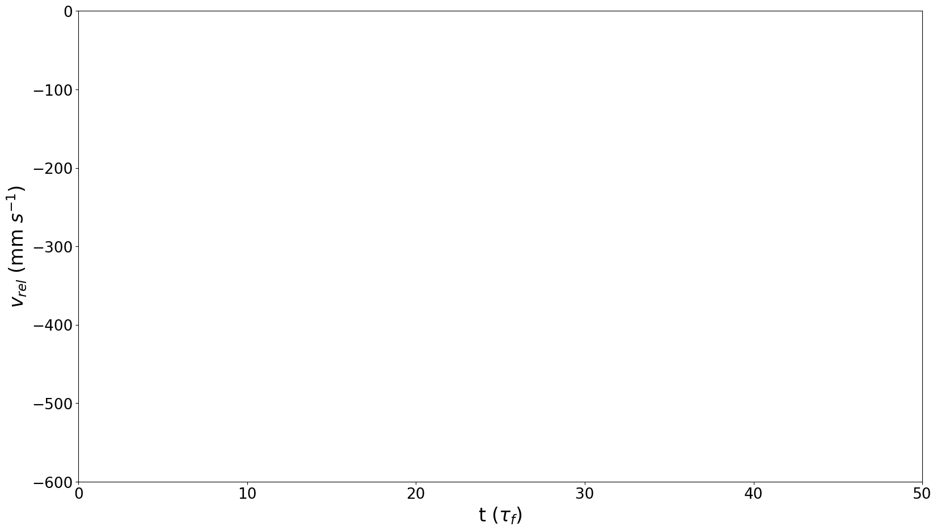
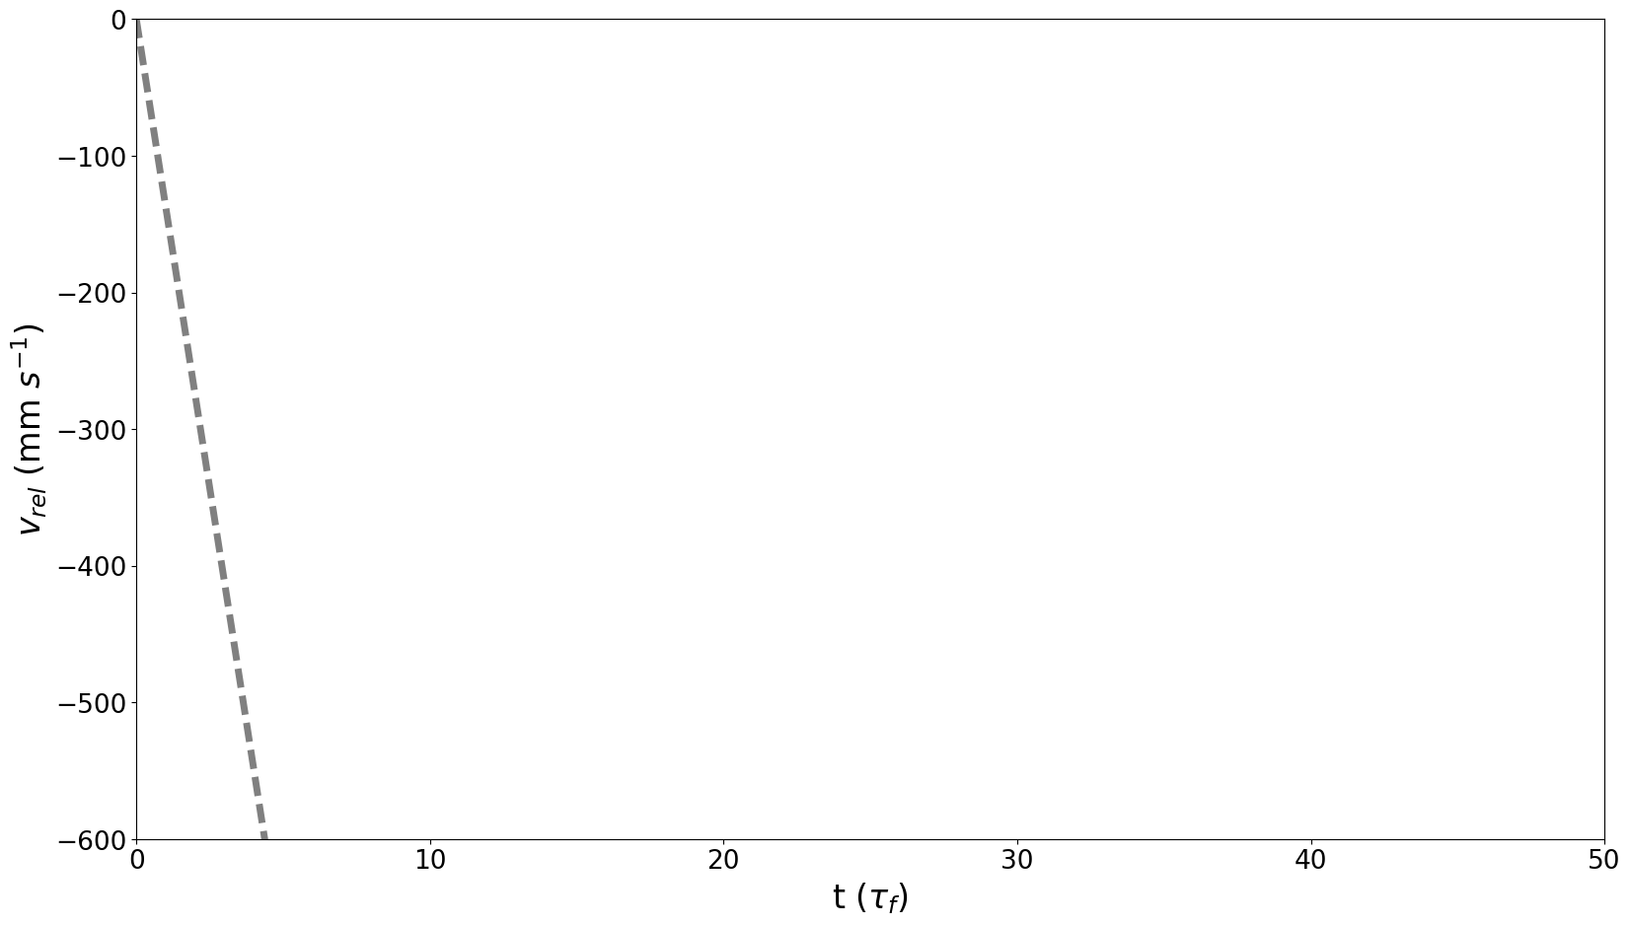
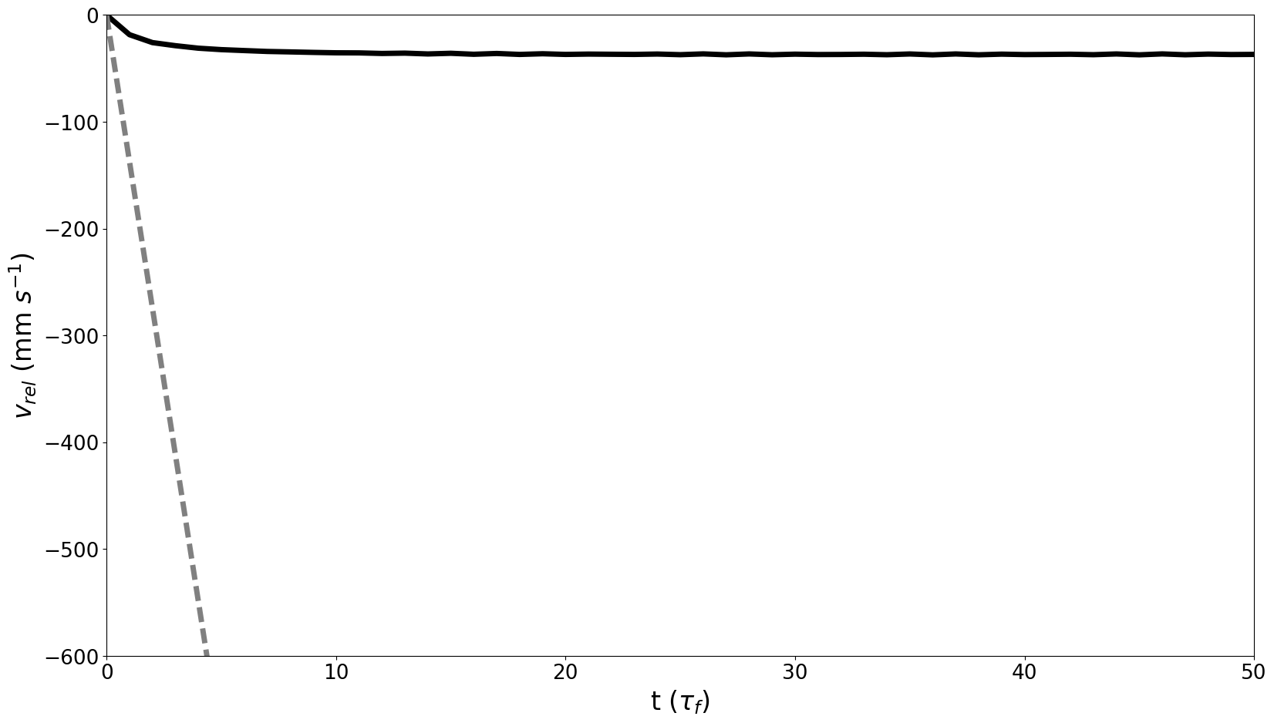
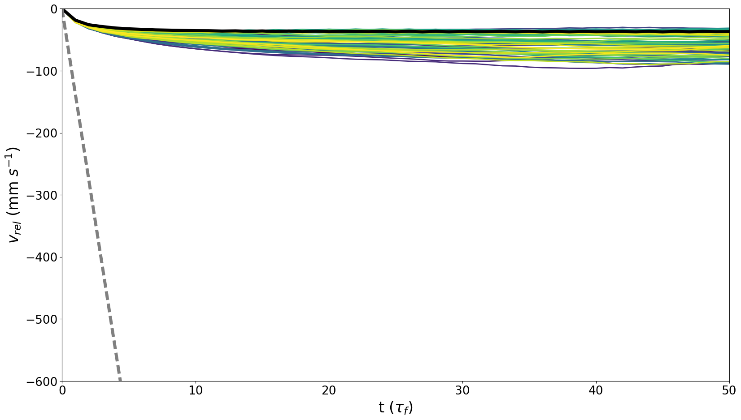
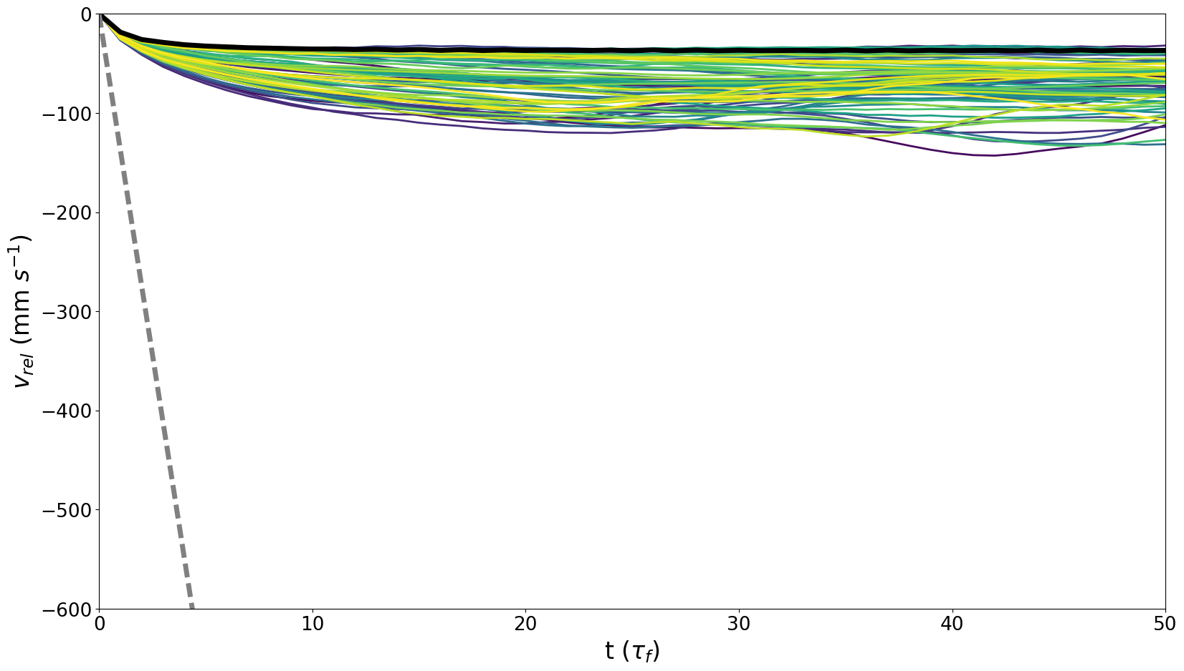
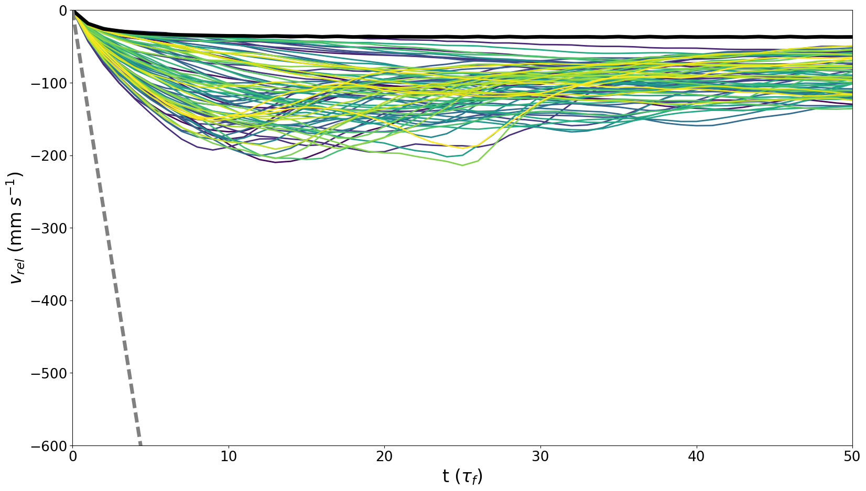
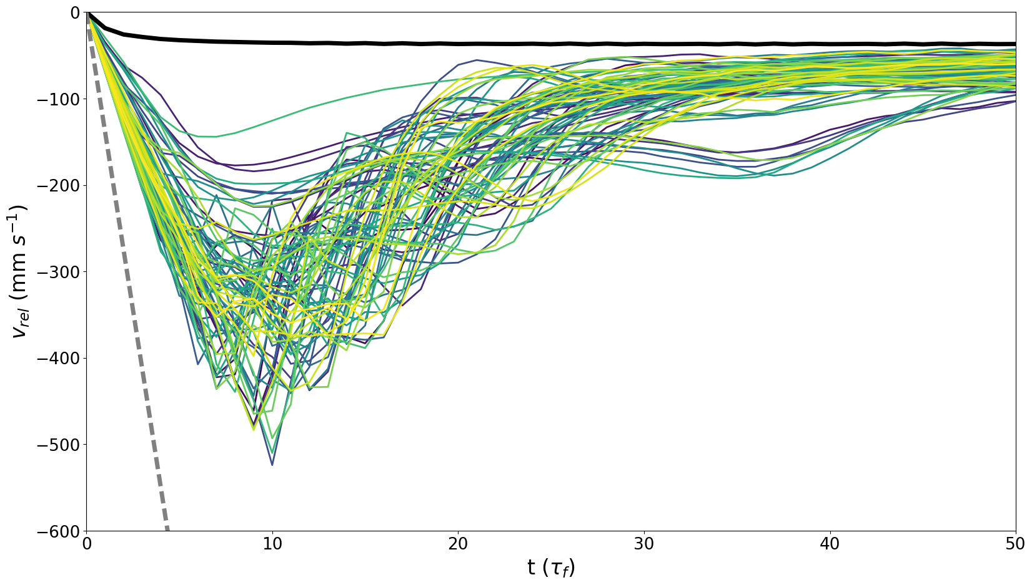
Results
Notes:
[empty single simulation view at left] In order to try to replicate this result, we set up hydrodynamics simulations with Lagrangian particles using the Pencil Code. We initialize 80 particles at rest [show particles], and evenly distributed in a spherical volume, at the top of a box of gas with uniform density and temperature, and also initially at rest, with particle and gas properties chosen to match the experiments as closely as possible [show table of properties, Schneider et al 2019]. The particles experience a constant, uniform gravitational force downward [draw arrow?], and interact with the gas via drag forces with back reaction [draw something for this?].
[get rid of talbes/arrows/etc, add other simulation views, along with approximate average closeness/local epsilon values] By varying the size of the spherical volume in which the particles start, we can adjust the initial average closeness and local dust to gas ratio of the group, in order to explore what impact this has on their motion.

Slide 8
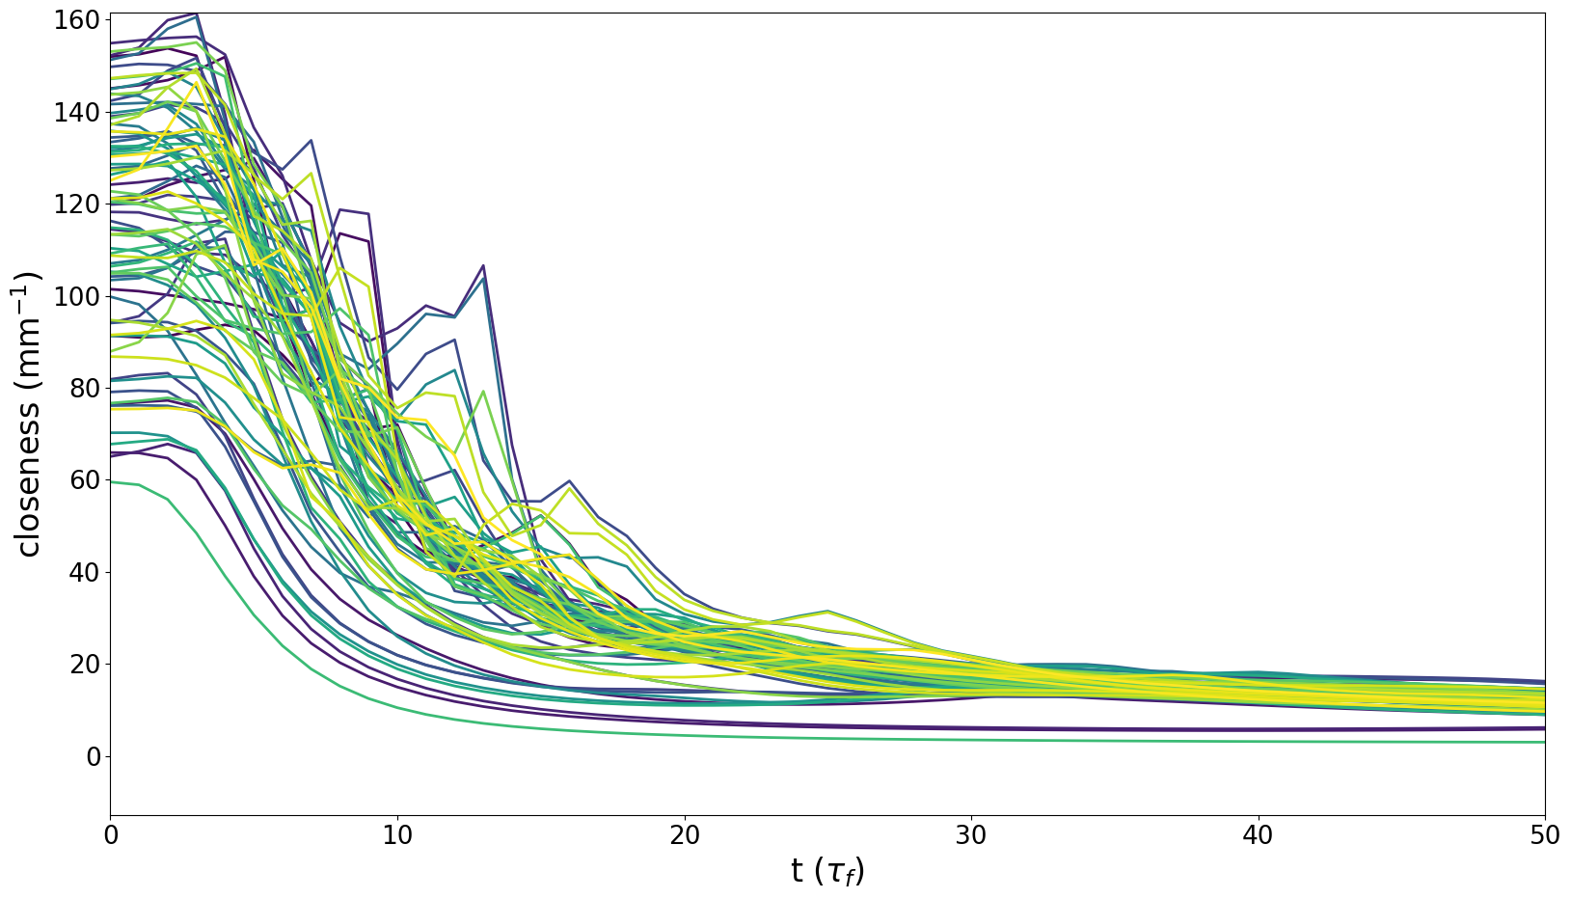
Results
Notes:
[empty single simulation view at left] In order to try to replicate this result, we set up hydrodynamics simulations with Lagrangian particles using the Pencil Code. We initialize 80 particles at rest [show particles], and evenly distributed in a spherical volume, at the top of a box of gas with uniform density and temperature, and also initially at rest, with particle and gas properties chosen to match the experiments as closely as possible [show table of properties, Schneider et al 2019]. The particles experience a constant, uniform gravitational force downward [draw arrow?], and interact with the gas via drag forces with back reaction [draw something for this?].
[get rid of talbes/arrows/etc, add other simulation views, along with approximate average closeness/local epsilon values] By varying the size of the spherical volume in which the particles start, we can adjust the initial average closeness and local dust to gas ratio of the group, in order to explore what impact this has on their motion.

Slide 9
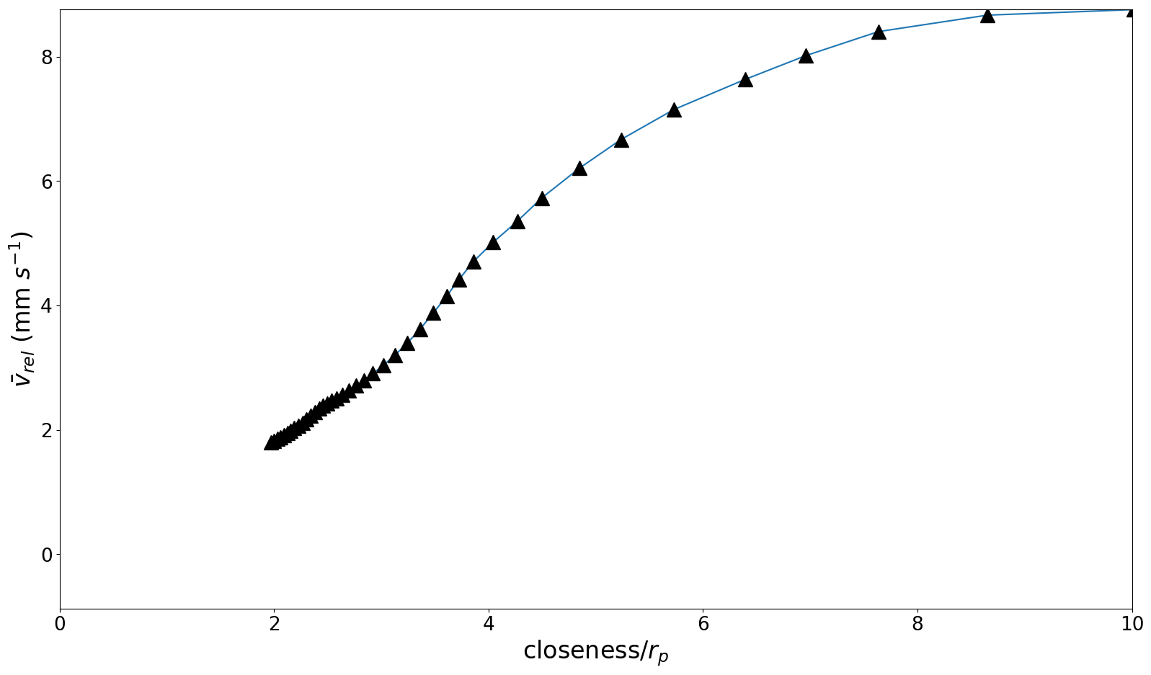
Results
Notes:
[empty single simulation view at left] In order to try to replicate this result, we set up hydrodynamics simulations with Lagrangian particles using the Pencil Code. We initialize 80 particles at rest [show particles], and evenly distributed in a spherical volume, at the top of a box of gas with uniform density and temperature, and also initially at rest, with particle and gas properties chosen to match the experiments as closely as possible [show table of properties, Schneider et al 2019]. The particles experience a constant, uniform gravitational force downward [draw arrow?], and interact with the gas via drag forces with back reaction [draw something for this?].
[get rid of talbes/arrows/etc, add other simulation views, along with approximate average closeness/local epsilon values] By varying the size of the spherical volume in which the particles start, we can adjust the initial average closeness and local dust to gas ratio of the group, in order to explore what impact this has on their motion.

Slide 10
Conclusions
Notes:
That journey looks something like this.

