Slide 1
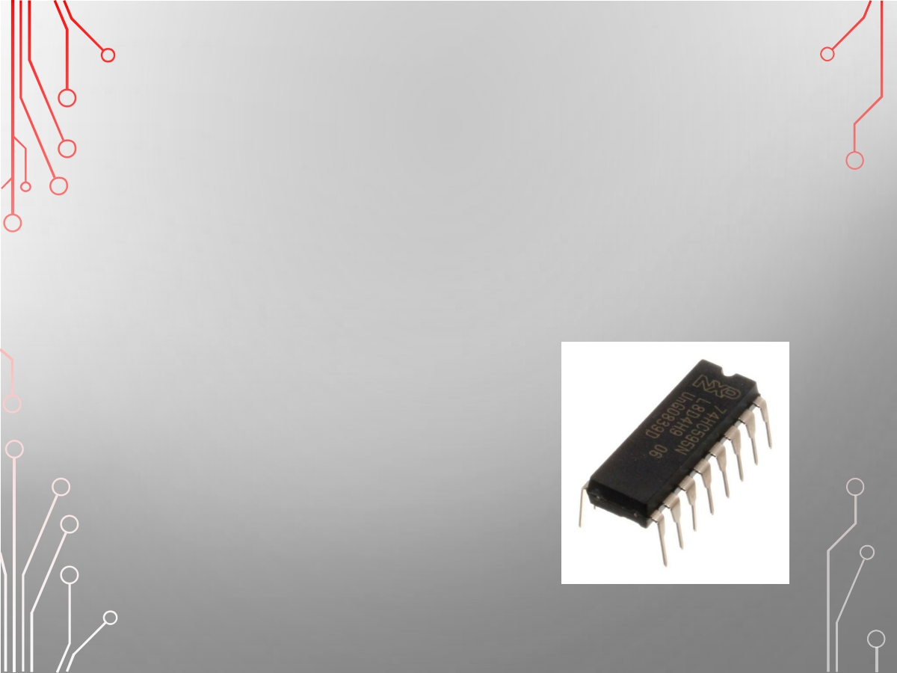
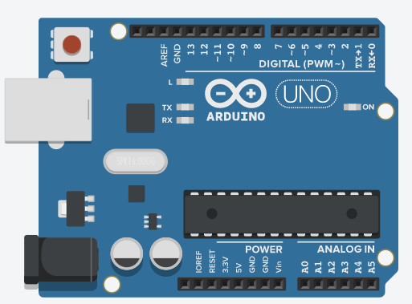
Arduino

Slide 2

講義網址
https://github.com/vincenttang1227/Arduino/raw/master/Arduino/arduino.pptx

Slide 3
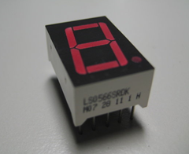
七段數字顯示器

Slide 4
七段數字顯示器(共陽)
• 七段顯示器（英語：Seven-segment display）為常用 顯示數字的電子元件。因為藉由七個發光二極體以不同組合來顯示數字，所以稱為「七劃管」、「七段數碼管」、「七段顯示器」，由於所有燈管全亮時所表
示的是「8」，所以又稱「8字管」、「8字顯示器」。
• 多數七段顯示器還會在右下角附加一個表示小數點的
燈管，因此也稱八段管。

Slide 5
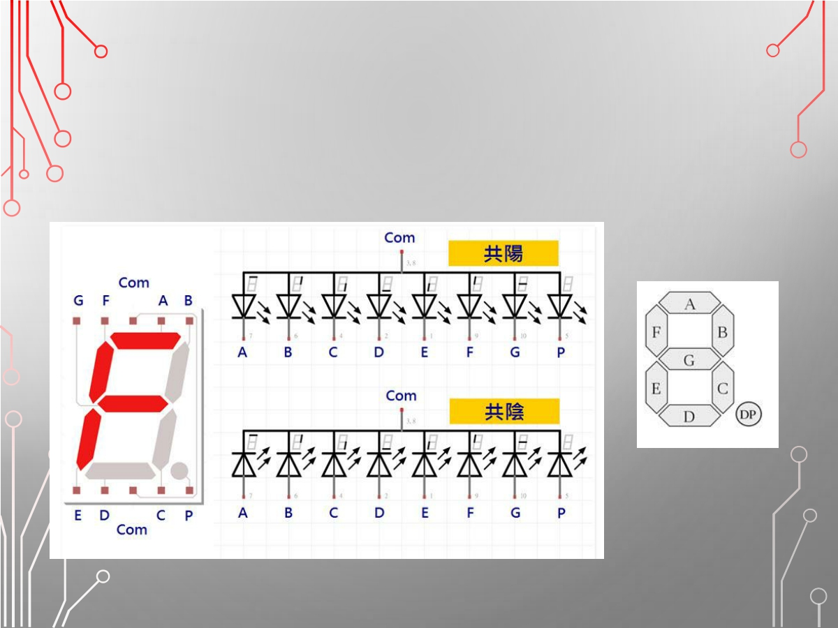
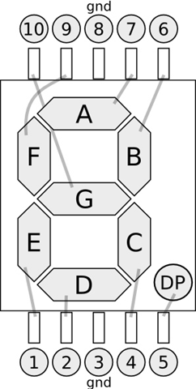
七段數字腳位及排列
⑧⑦ ②③
5V
5V
⑥⑤ ④⑨

Slide 6
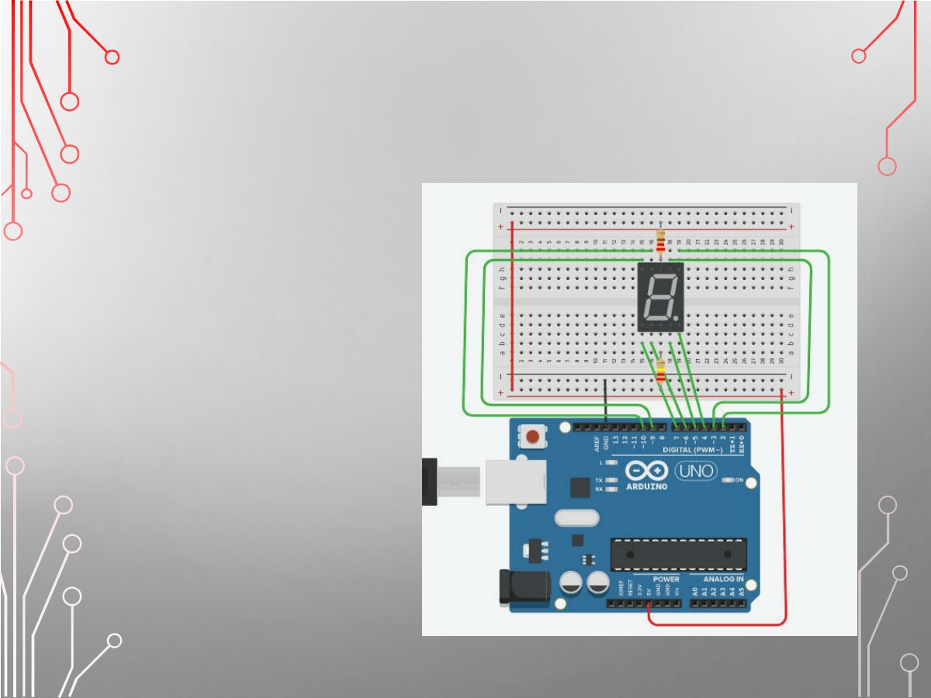
實作：七段數字顯示器
材料
• ARDUINO UNO
• 面包板
• 220Ω電阻 2個
• 七段數字顯示器

Slide 7
數字代碼表
0 – 0000001
1 – 1001111
2 – 0010010
3 – 0000110
4 – 1001100
5 – 0100100
6 – 0100000
7 – 0001111
8 – 0000000
9 – 0000100

Slide 8
Ex1：
int X[10][8] =
{
{0, 0, 0, 0, 0, 0, 1, 0}, //0
{1, 0, 0, 1, 1, 1, 1, 0}, //1
{0, 0, 1, 0, 0, 1, 0, 0}, //2
{0, 0, 0, 0, 1, 1, 0, 0}, //3
{1, 0, 0, 1, 1, 0, 0, 0}, //4
{0, 1, 0, 0, 1, 0, 0, 0}, //5
{0, 1, 0, 0, 0, 0, 0, 0}, //6
{0, 0, 0, 1, 1, 1, 1, 0}, //7
{0, 0, 0, 0, 0, 0, 0, 0}, //8
{0, 0, 0, 0, 1, 0, 0, 0} //9
};
void setup()
{
for (int i = 2; i < 10; i++)
pinMode(i, OUTPUT);
}
void loop()
{
for (int i = 0; i < 10; i++)
{
for (int j = 2; j < 10; j++)
{
digitalWrite(j, X[i][j - 2]);
}
delay(1000);
}
}

Slide 9
void setup()
{
Serial.begin(9600);
for (int i = 2; i < 10; i++)
{
pinMode(i, OUTPUT);
}
}
void loop()
{
if (Serial.available() > 0)
{
num = Serial.parseInt();
num = constrain(num, 0, 9);
}
for (int i = 2; i < 10; i++)
{
digitalWrite(i, X[num][i - 2]);
}
delay(1000);
}
Ex2：
int num;
int X[10][8] =
{
{0, 0, 0, 0, 0, 0, 1, 0}, //0
{1, 0, 0, 1, 1, 1, 1, 0}, //1
{0, 0, 1, 0, 0, 1, 0, 0}, //2
{0, 0, 0, 0, 1, 1, 0, 0}, //3
{1, 0, 0, 1, 1, 0, 0, 0}, //4
{0, 1, 0, 0, 1, 0, 0, 0}, //5
{0, 1, 0, 0, 0, 0, 0, 0}, //6
{0, 0, 0, 1, 1, 1, 1, 0}, //7
{0, 0, 0, 0, 0, 0, 0, 0}, //8
{0, 0, 0, 0, 1, 0, 0, 0} //9
};

Slide 10
IC 74HC595

Slide 11
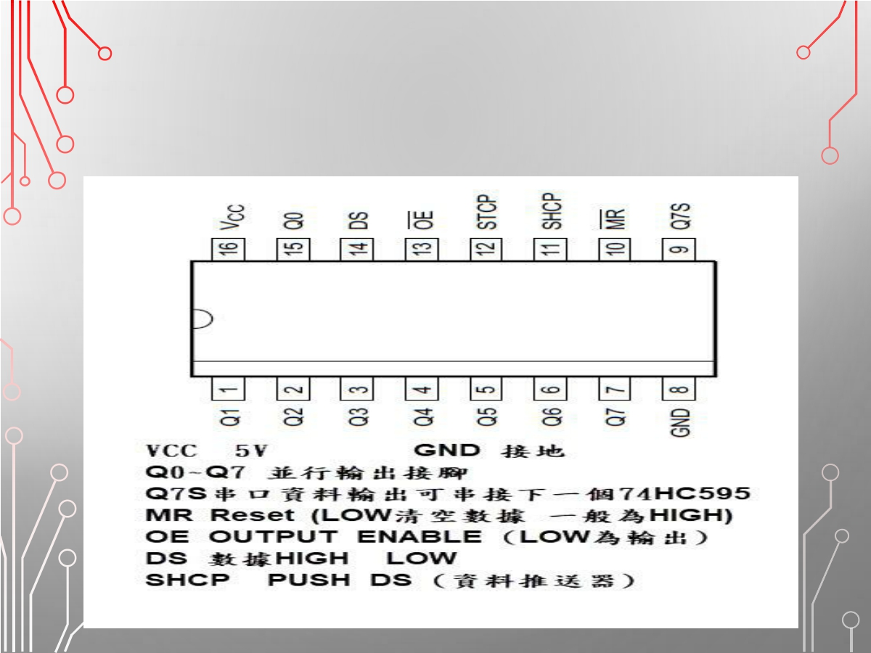
74HC595腳位介紹

Slide 12
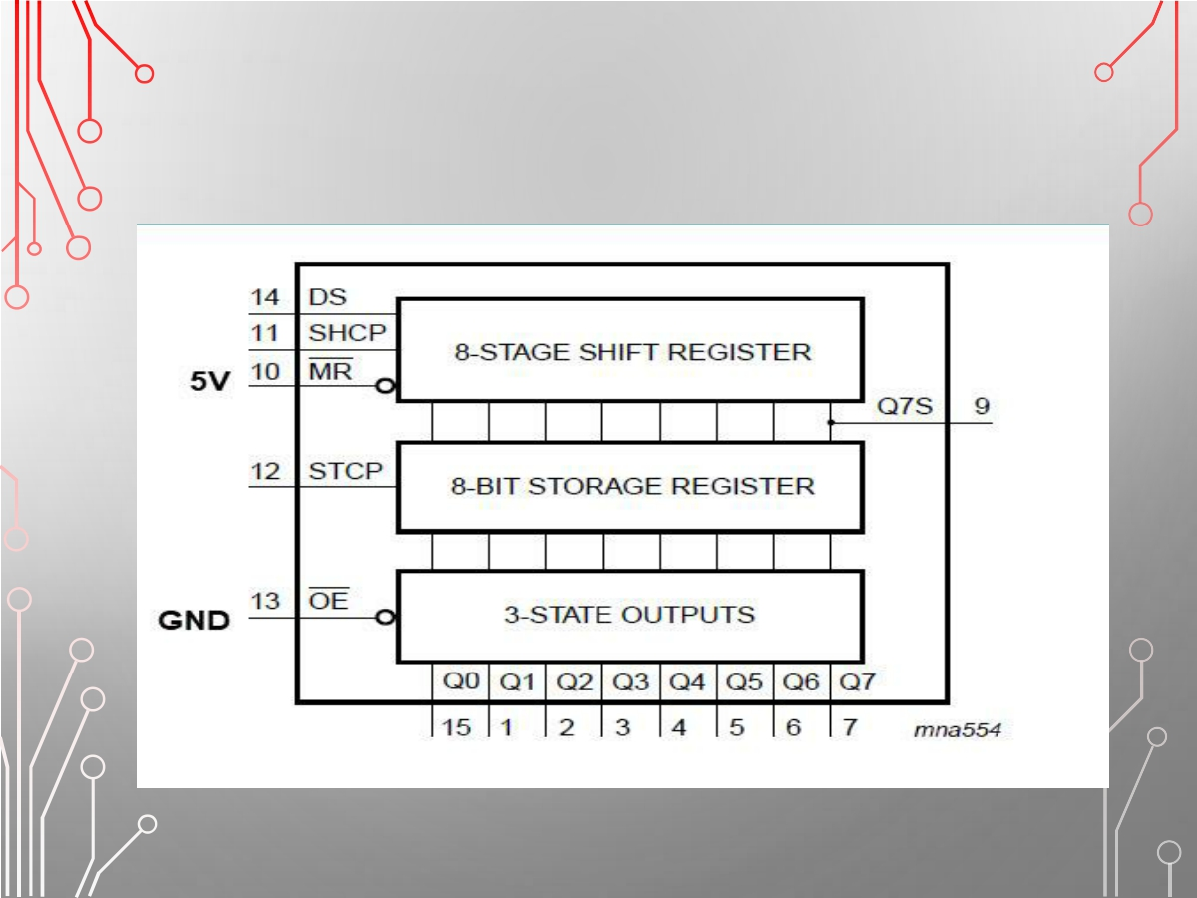
運作原理

Slide 13
實作:IC 74HC595
• Arduino UNO
• 面包板
• LED *8
• 220Ω *8
• 74HC595

Slide 14
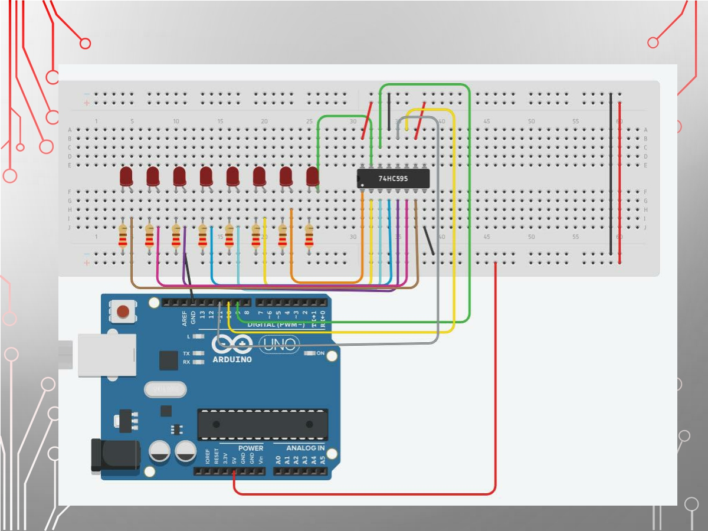

Slide 15
void pled()
{
digitalWrite(upload,LOW);
for(int i=0;i<8;i++)
{
digitalWrite(push,LOW);
digitalWrite(data,value[i]);
digitalWrite(push,HIGH);
}
digitalWrite(upload,HIGH);
}
void loop()
{
for(int i=0;i<8;i++)
{
value[i]=1;
pled();
delay(150);
value[i]=0;
}
}
Ex1：
int data=9;
int push=10;
int upload=11;
int value[8];
void setup() {
pinMode(data, OUTPUT); pinMode(push, OUTPUT); pinMode(upload, OUTPUT);
}

Slide 16
Ex2：
int data=9;
int push=10;
int upload=11;
int value[8];
void setup() {
pinMode(data, OUTPUT); pinMode(push, OUTPUT); pinMode(upload, OUTPUT);
}
void pled()
{
digitalWrite(upload,LOW);
for(int i=0;i<8;i++)
{
digitalWrite(push,LOW);
digitalWrite(data,value[i]);
digitalWrite(push,HIGH);
}
digitalWrite(upload,HIGH);
}

Slide 17
Ex2：
void loop()
{
for(int i=0;i<7;i++)
{
value[i]=1;
pled();
delay(150);
value[i]=0;
}
for (int i=7;i>=1;i--)
{
value[i]= 1;
pled();
delay(150);
value[i]=0;
}
}

Slide 18
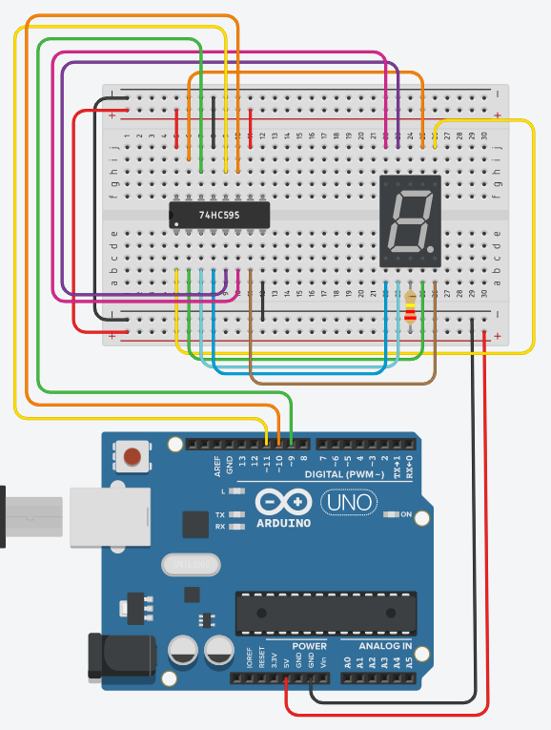

Slide 19
Ex3：
void setup()
{
Serial.begin(9600);
pinMode(data, OUTPUT);
pinMode(push, OUTPUT);
pinMode(upload, OUTPUT);
}
void pled()
{
digitalWrite(upload, LOW);
for (int i = 0; i < 8; i++)
{
digitalWrite(push, LOW);
digitalWrite(data, X[num][i]);
digitalWrite(push, HIGH);
}
digitalWrite(upload, HIGH);
}
int data = 9;
int push = 10;
int upload = 11;
int num = 0;
int X[10][8] =
{
{0, 0, 0, 0, 0, 0, 1, 0}, //0
{1, 0, 0, 1, 1, 1, 1, 0}, //1
{0, 0, 1, 0, 0, 1, 0, 0}, //2
{0, 0, 0, 0, 1, 1, 0, 0}, //3
{1, 0, 0, 1, 1, 0, 0, 0}, //4
{0, 1, 0, 0, 1, 0, 0, 0}, //5
{0, 1, 0, 0, 0, 0, 0, 0}, //6
{0, 0, 0, 1, 1, 1, 1, 0}, //7
{0, 0, 0, 0, 0, 0, 0, 0}, //8
{0, 0, 0, 0, 1, 0, 0, 0} //9
};

Slide 20
Ex3：
void loop()
{
if (Serial.available() > 0)
{
num = Serial.parseInt();
num = constrain(num, 0, 9);
}
pled(num);
delay(1000);
}

Slide 21
Ex3修正：
void pled()
{
digitalWrite(upload, LOW);
for (int i = 7; i > -1; i--)
{
digitalWrite(push, LOW);
digitalWrite(data, X[num][i]);
digitalWrite(push, HIGH);
}
digitalWrite(upload, HIGH);
}

