Slide 1
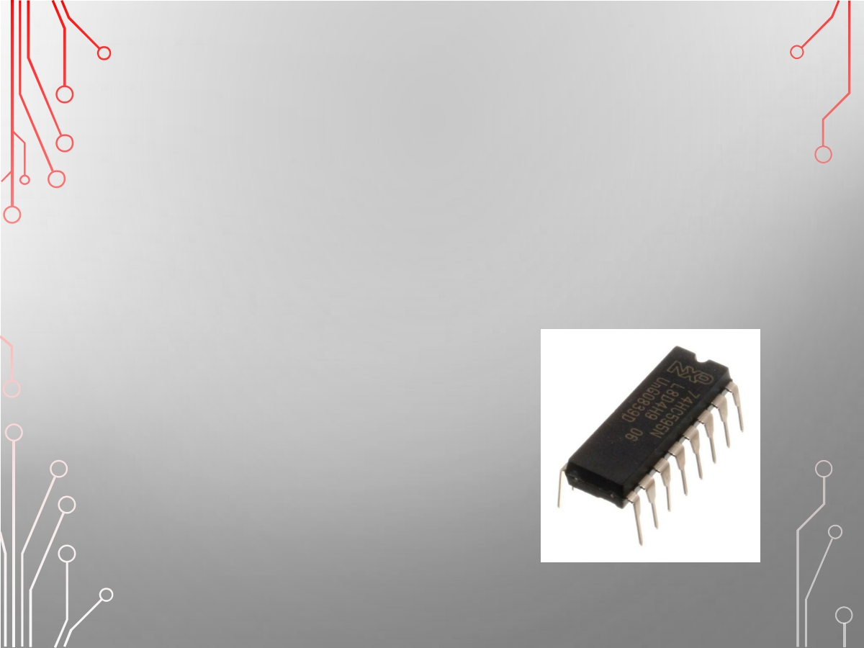
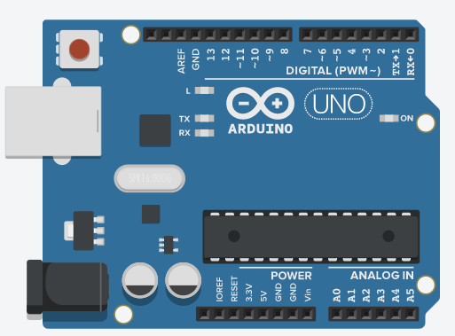
Arduino

Slide 2

講義網址
https://github.com/vincenttang1227/Arduino/raw/master/Arduino/arduino1.pptx

Slide 3
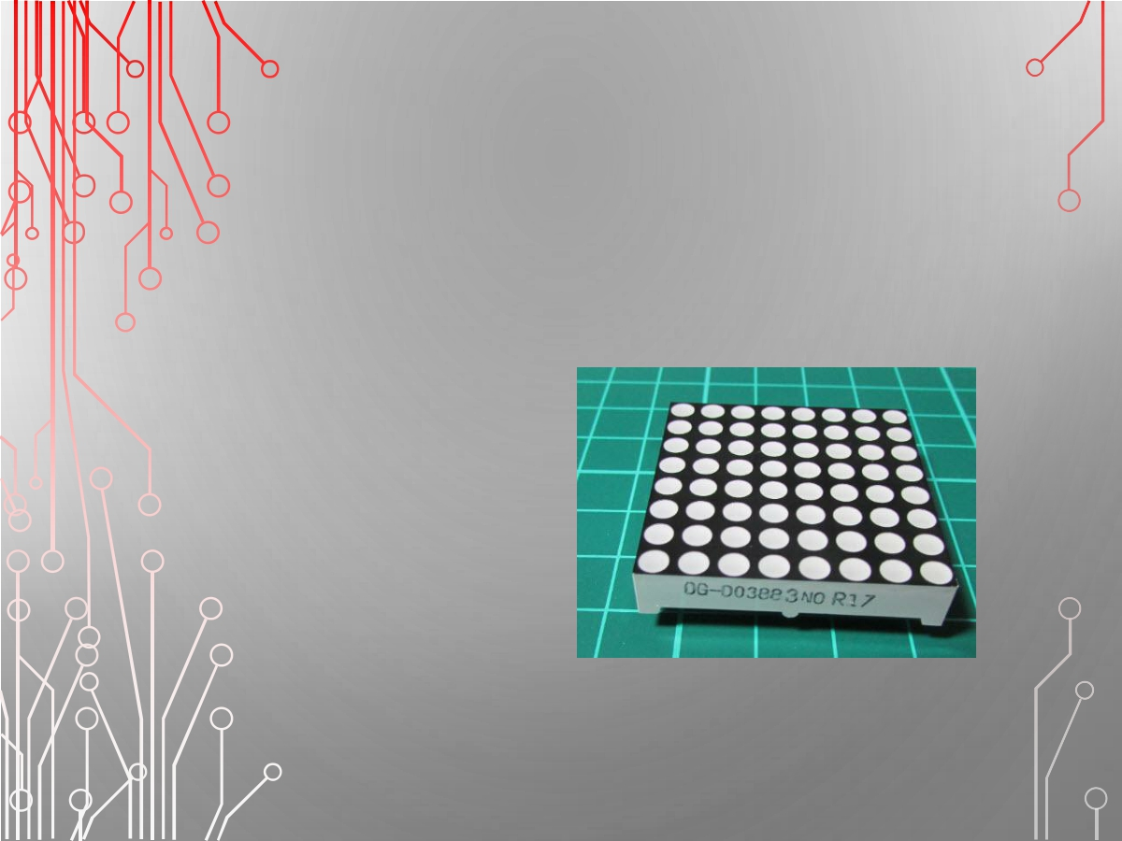
8X8 LED 點陣

Slide 4
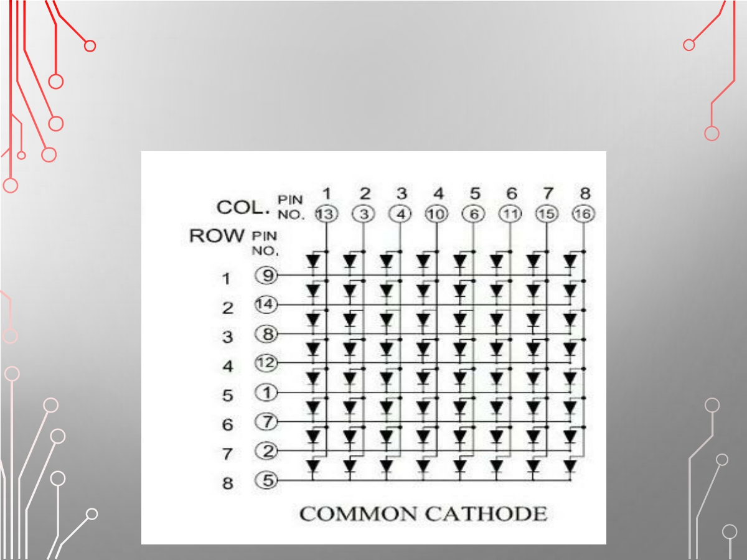
64顆LED組成

Slide 5
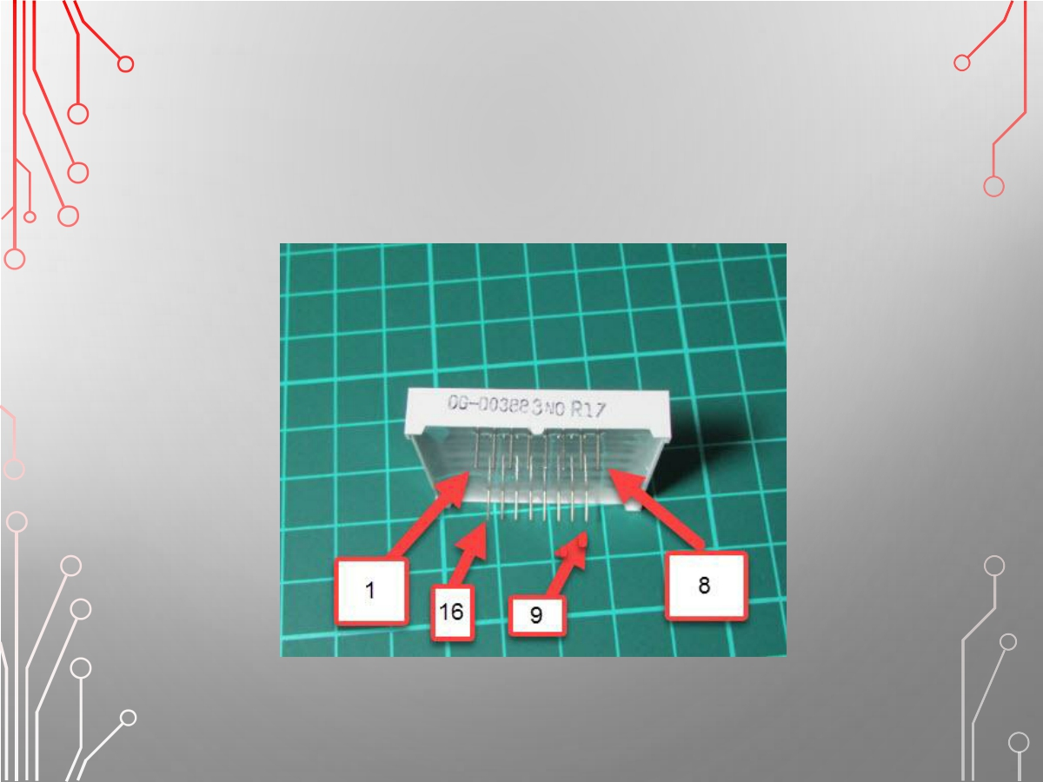
腳位定義

Slide 6
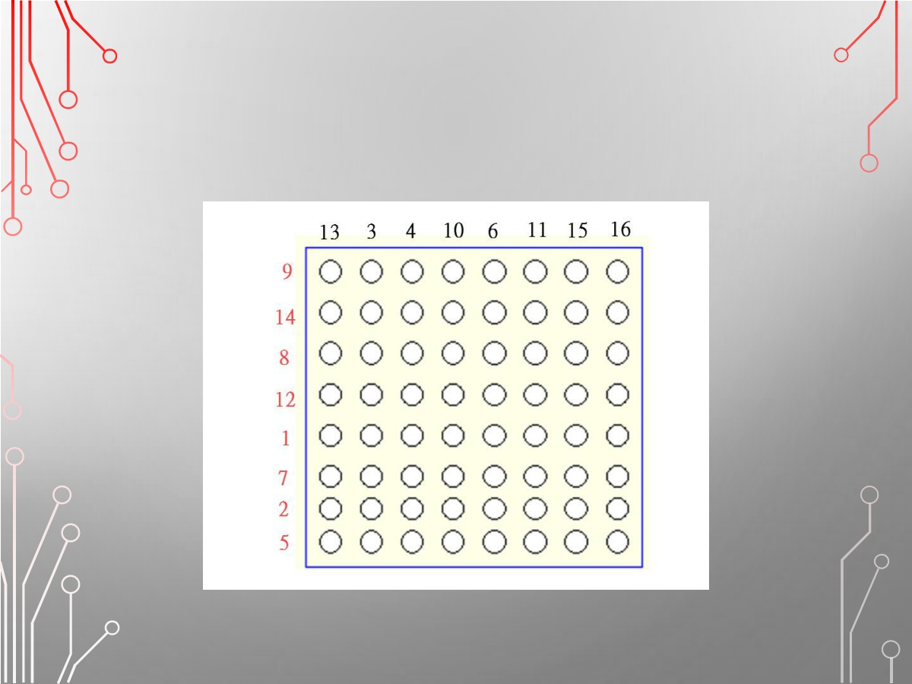
腳位對應圖

Slide 7
檢測8*8各腳位對應
• 利用杜邦線檢測8*8腳位是否與原規劃相同
• 並把各腳位的對應PIN列出來

Slide 8
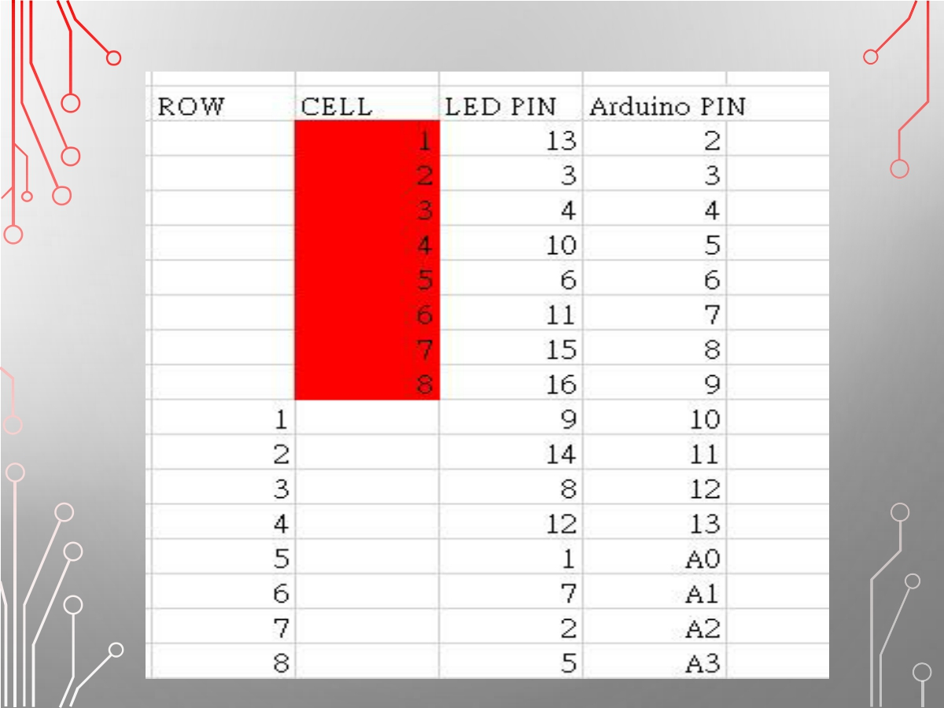

Slide 9
LED全亮測試
ROW 全HIGH
CELL 全LOW
void setup() {
for (int i = 2; i <= 18; i++) {
pinMode(i, OUTPUT);
}
}
void loop() {
for (int i = 2; i <= 9; i++)
{
digitalWrite(i, HIGH);
}
for (int i = 10; i <= 18; i++)
{
digitalWrite(i, LOW);
}
}

Slide 10
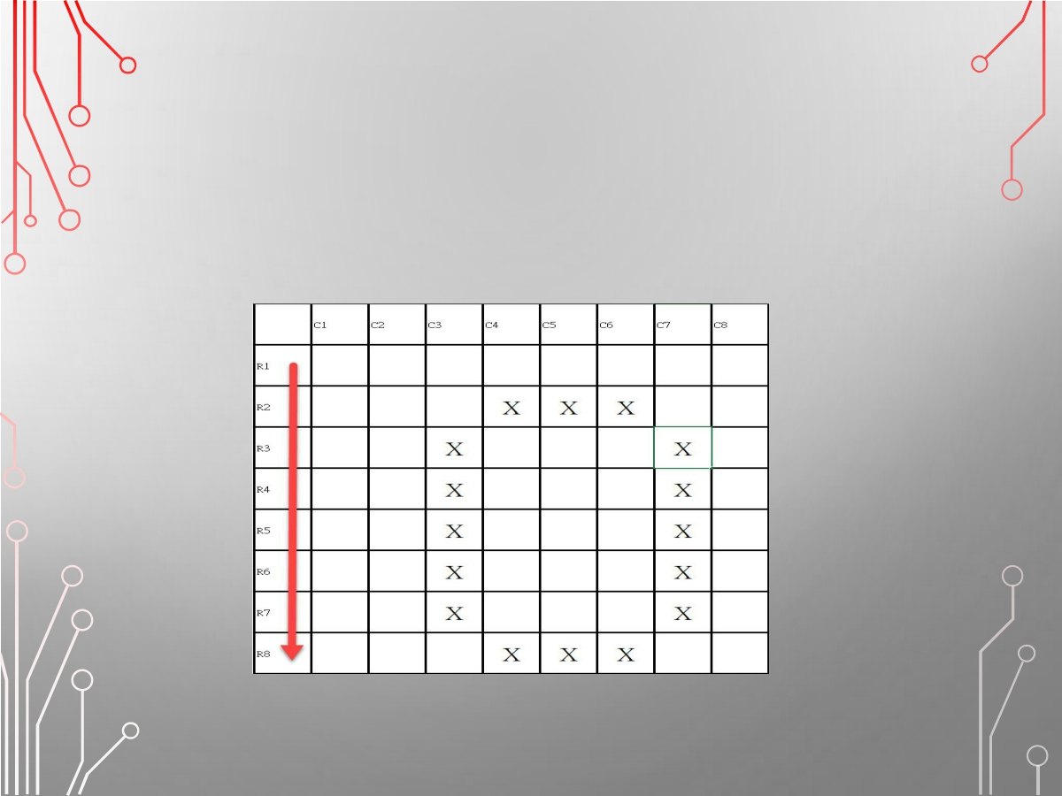
測試LED顯示數字零

Slide 11
使用陣列作出簡單數字
int ROW[8] = {10, 11, 12, 13, A0,A1,A2, A3}; int CEL[8] = {2, 3, 4, 5, 6, 7, 8, 9};

Slide 12
數字0的二維陣列
int X0[8][8] = {
{0, 1, 1, 1, 1, 1, 1, 0}, {0, 1, 0, 0, 0, 0, 1, 0}, {0, 1, 0, 0, 0, 0, 1, 0}, {0, 1, 0, 0, 0, 0, 1, 0}, {0, 1, 0, 0, 0, 0, 1, 0}, {0, 1, 0, 0, 0, 0, 1, 0}, {0, 1, 0, 0, 0, 0, 1, 0}, {0, 1, 1, 1, 1, 1, 1, 0}
};

Slide 13
使用陣列作出簡單數字：
int ROW[8] = {
10, 11, 12, 13, A0, A1, A2, A3 };
int CEL[8] = {
2, 3, 4, 5, 6, 7, 8, 9 };
int X0[8][8] = {
{0, 1, 1, 1, 1, 1, 1, 0}, {0, 1, 0, 0, 0, 0, 1, 0}, {0, 1, 0, 0, 0, 0, 1, 0}, {0, 1, 0, 0, 0, 0, 1, 0}, {0, 1, 0, 0, 0, 0, 1, 0}, {0, 1, 0, 0, 0, 0, 1, 0}, {0, 1, 0, 0, 0, 0, 1, 0}, {0, 1, 1, 1, 1, 1, 1, 0}
};
void setup() {
for (int i = 2; i <= 18; i++) {
pinMode(i, OUTPUT);
} }
void loop() {
for (int i = 0; i < 8; i++)
{
for (int j = 0; j < 8; j++) {
if (X0[i][j] == 1) {
digitalWrite(ROW[i], LOW);
digitalWrite(CEL[j], HIGH);
delay(1);
digitalWrite(CEL[j], LOW);
digitalWrite(ROW[i], HIGH);
} } } }

