Slide 1
A Virtual Router for Emulating Wireless Network Flow in Mobile Cloud
Vincent (Yukun) Zeng*, Bingqian Jiang
*Laboratory for Embedded & Networked Sensor Systems
Department of Computer Science and Engineering,
Texas A&M University, USA

Slide 2
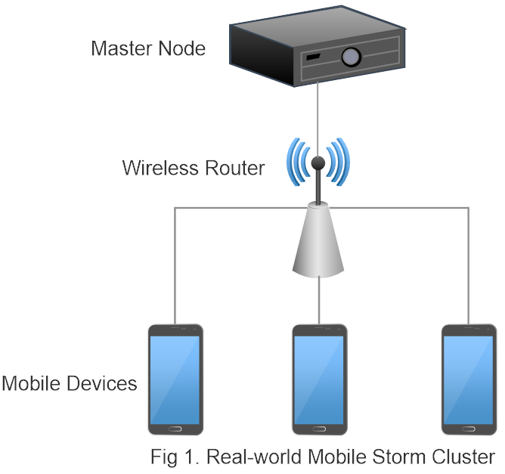
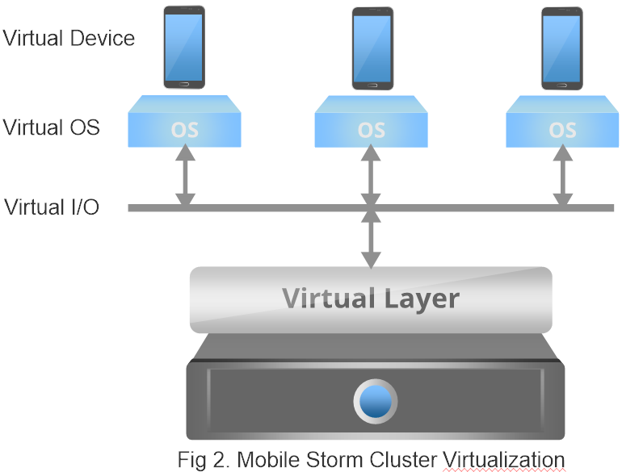
Brief Review
Physical Mobile Cloud
Unstable wireless connections
Virtualized Cluster
Virtual I/O or Wired Net->Stable&Fast Network
The Virtual Router Approach
Virtualization

Slide 3
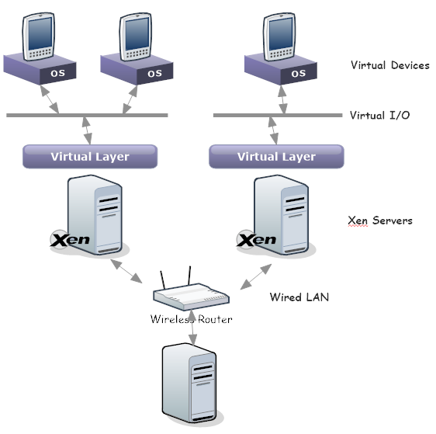
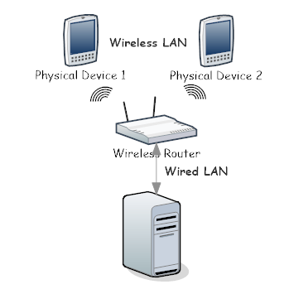
Mobile Cloud Architecture
Physical Mobile Cloud
Unstable wireless connections
Virtualized Cluster
Virtual I/O or Wired Net->Stable&Fast Network
The Virtual Router Approach

Slide 4
Experiment Methodologies
Metrics
Bandwidth
Packet Losses
Jitters
Traffic Categories in Mobile Cloud
Slave-to-Slave
Across XenServers
On the Same XenServer
Slave-to-Master
Master-to-Slave
Repeated Experiments with Increasing Transmitting Rate
Run in Virtualized Env
Run in Actual Env

Slide 5
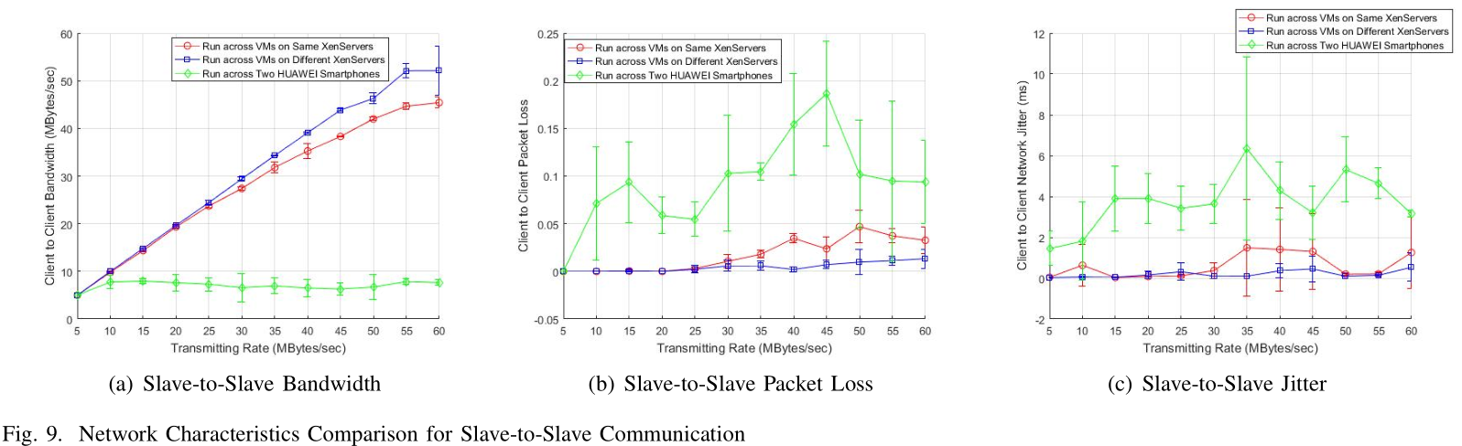
Preliminary Results
Maximum Bandwidth
Across Server: 52 Mbps
Same Server: 45 Mbps
Wireless: below 10 Mbps
Jitters and Packet Losses
High instability and latency in wireless link

Slide 6
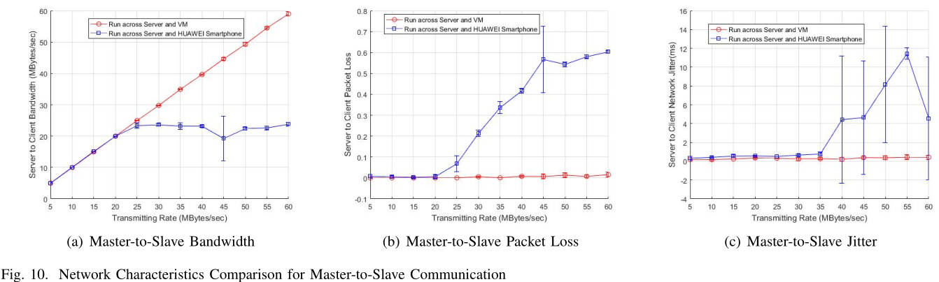
Preliminary Results
Maximum Bandwidth
VM: 60 Mbps
Wireless: below 25 Mbps (much higher than 2 device)
Jitters and Packet Losses
High instability
Too high, cannot explain precisely

Slide 7
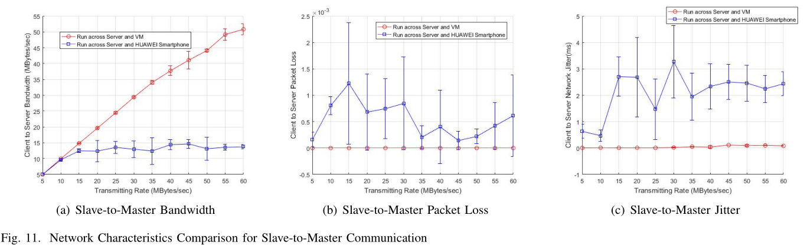
Preliminary Results
Maximum Bandwidth
VM: 50 Mbps
Wireless: below 15 Mbps (in between s-to-s and m-to-s)
Jitters and Packet Losses
Similar to Slave-to-Slave case
High instability and latency

Slide 8
Future Work
More Reliable Experiments
More runs to recognize the intrinsic wireless network performance pattern
Better experiment environment?
More metrics to better characterize the network
Bridge Wireless to Ethernet
To increase compatibility
Virtual Router
Emulate the network pattern

Slide 9
Thank You!
Q&A

