Slide 1
Getting Start with C coding under Linux

Slide 2
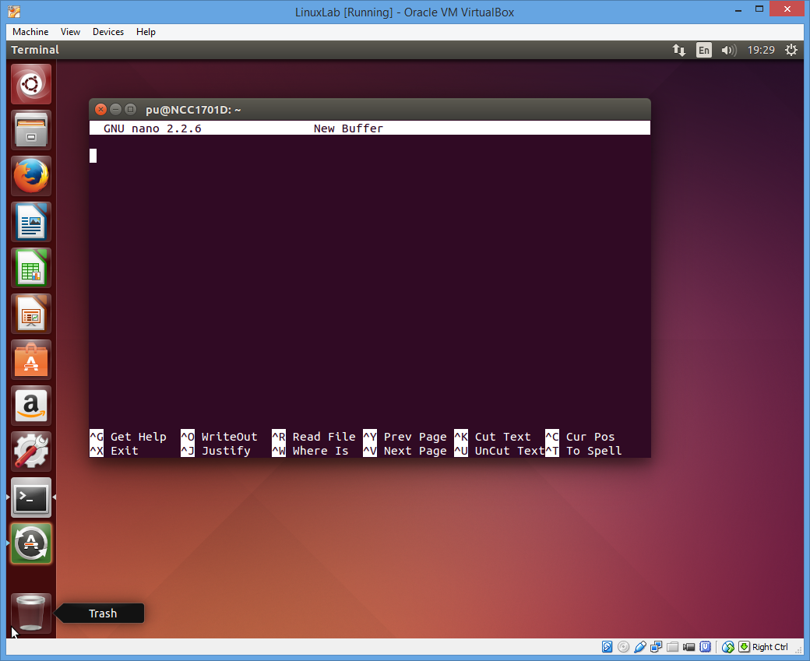
Using nano Editor
One of a very simple editor in Linux is call nano
$nano ; start nano editor
Using arrow key to move text around
Ctrl-G give a help to shortcut key
Ctrl-K = cut
Ctrl-U = paste

Slide 3
Hello world
Type this into nano
#include <stdio.h>
#include <stdlib.h>
int main(int argc, char **argv)
{
printf(“Hello World\n”);
}

Slide 4
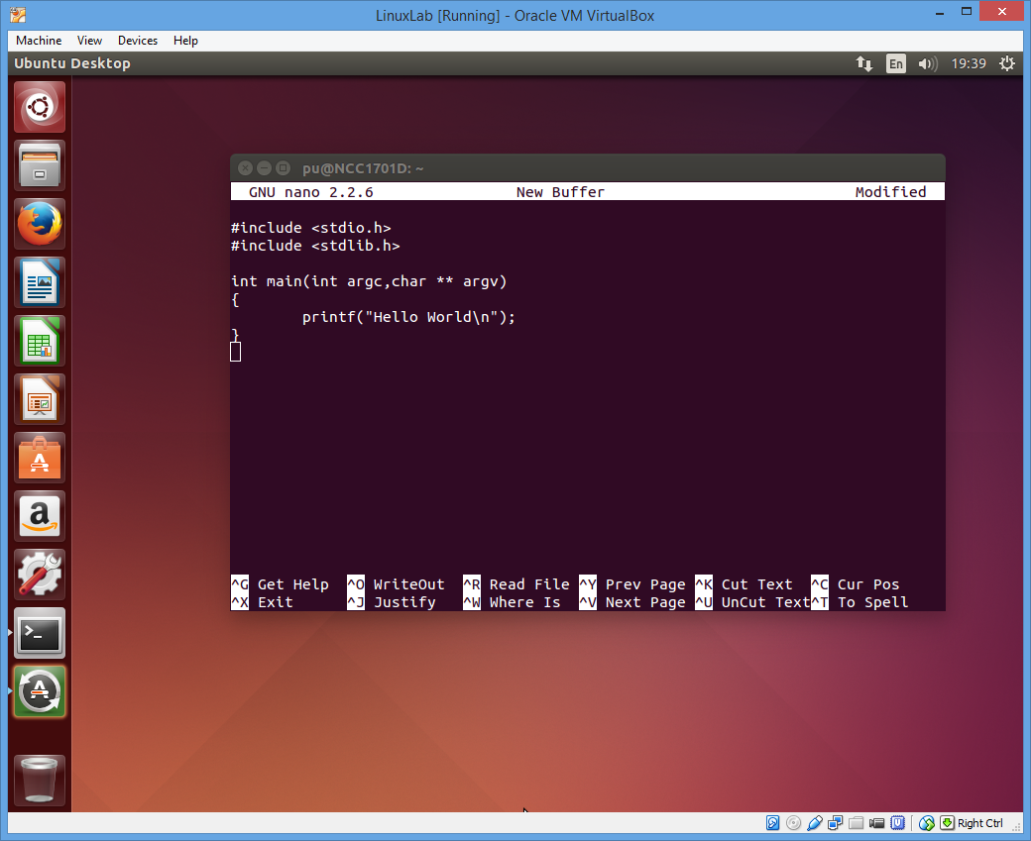
Saving file
In nano each text your edit is called “buffer”
To create file we need to save this buffer to disk
Using Ctrl-o
Enter filename
Press <enter>
Buffer is saved to disk
Ctrl-x to exit from nano
If buffer is not saved, fle name will be asked
If buffer is saved, nano will exit

Slide 5
Compiling c program using gcc
First check whether the file saved is there. Using
$ls hello.c
Compile program using gcc
$gcc –o hello hello.c
Running program
$../hello

Slide 6
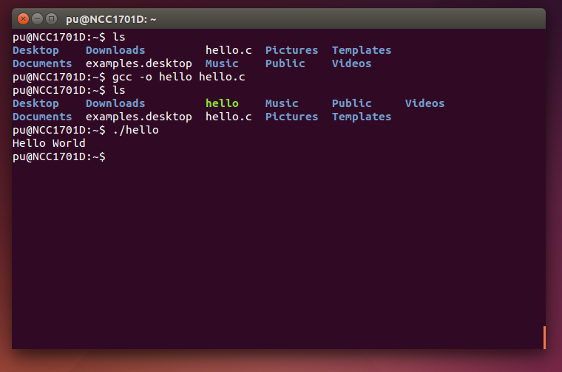

Slide 7
Make
In order to type command again Linux have a tool to help you create a complex code call make
Basic idea
Make is a utility running by calling $make
A control file called “Makefile” must be create to explain how to compile and link one or more source code together

Slide 8
Create a simple makefile
Create a file called Makefile using nano
$nano Makefile
hello : hello.c
gcc –o hello hello.c
Exit nano and save this to file named “Makefile”

Slide 9
How Make work
make works on Target
Target is built based on dependency
Dependency is described for each target
So make not only compile but also check the dependency of files Source→object→Executable
Executable must be newer than object
Object must be newer than source
If source is modified, new object and executable will be created

Slide 10
Exercise
// test1.c
#include <stdio.h>
int test1()
{
printf(“Here is test1\n”);
}
Create a file test1.c using nano
Modify hello.c as follow
Add new line to call test 1
// hello.c
#include <stdio.h>
#include <stdlib.h>
int main(int argc, char **argv)
{
printf(“Hello World\n”);
test1();
}

Slide 11
Exercise
Modify makefile as follow
Hello target is made by
2 objects: hello.o and test.o
Use gcc to create hello executable from hello.o and test1.o
Make is smart if only hello.c exist it will create hello.o by compiling hello.c→ hello.o
hello : hello.o test1.o
gcc –o hello hello.o test1.o

Slide 12
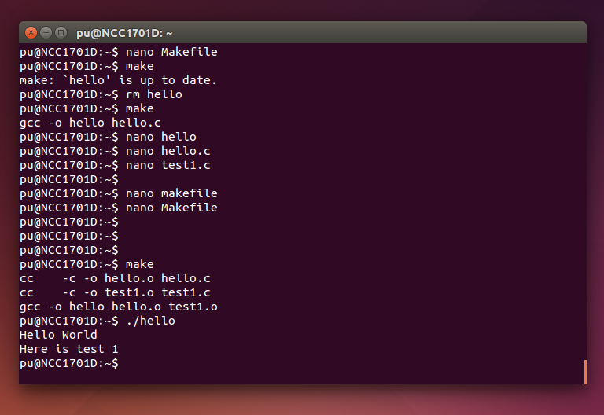

Slide 13
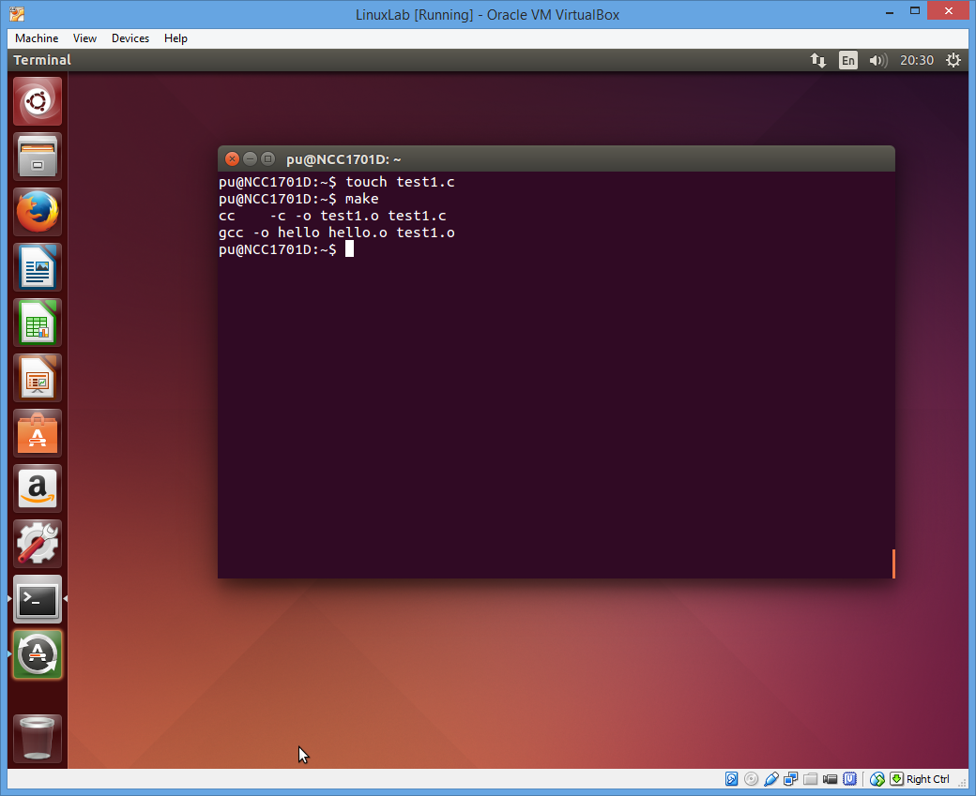
Exercise
If source is modified, each object and executable will be created
Try
$touch test1.c
$make
Make will recompile test1.c and link with hello.o to create executable file for hello

Slide 14
Macro
Macro can help making makefile shorter
# in the left most collumn mark this line a comment
# make file example
OBJ = hello.o test1.o
hello : $(OBJ)
gcc –o hello $(OBJ)

Slide 15
Explore further
Try to create a c project with multiple file like 5-6 files
Create make file and compile modified
Try more feature of nano
Try “VI” if you are brave enough

Slide 16
Reference
More on how to use nano
http://www.howtogeek.com/howto/42980/the-beginners-guide-to-nano-the-linux-command-line-text-editor/
Tutorial on Make
http://www.math.tau.ac.il/~danha/courses/software1/make-intro.html

Slide 17
End

