Slide 1
Module 3: VIM Text Editor

Slide 2
VI Text Editor
Editor based on standard UNIX
Advantage
Similar enough to vi
VI is ubiquitous on UNIX systems
Must use to recover a system (emacs usually is not available)
Suitable for programmer
Fully integrated with UNIX paradigm

Slide 3
Mode of Operation
Command mode – insert vi command, and ex command
Insert or replace mode – editing text
ESC key is used to switch between these two modes
i,a and so on
Command
Insert
Esc

Slide 4
Exercise: Start typing
At shell prompt type vi and enter to start vi
$vi
Press ESC to ensure that it is in the command mode
Press “i” to enter edit mode (insert)
Type
“A Quick brown fox jumps over the lazy dogs.”
Press “ESC” again
Press “:” to enter command
Type “w fox1.txt” ; this will save your text to file fox1.txt
Type “:” and “x” ; this will exit VI
Try
$cat fox1.txt ; you will see your text is in this file

Slide 5
Cursor movement
Cursor movement can be done only in command mode
Use arrow key to move cursor left,right,up, down
If you brave enough use this very primitive key to move cursor
H=Left L=Right J=down K=up

Slide 6
Insert or Replace Mode
a – insert after current cursor
i – insert before current cursor
A – insert at end of current line
I – insert at start of current line
R – replace at current cursor

Slide 7
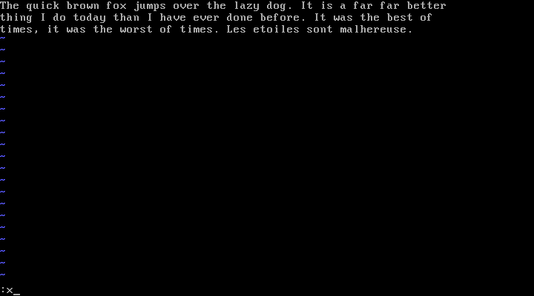
Save and Exit
:w [filename] – save file
:wq [filename] or :x [filename] – save and exit
:q – exit (after save)
:q! – exit without save

Slide 8
Moving around
G – end of file
gg – start of file
$ – end of current line
0 – start of current line
w – next word
b – previous word
n – repeats last regex search
ctrl + F page down
ctrl + B page up

Slide 9
Changing Text
x – delete a character under cursor
Delete n character using number before x; 3x = delete next 3 character
X – delete a character before cursor
Dd – delete a line
U – undo
J – join following line to current
. – redo

Slide 10
Cut, Copy, and Paste
Cut 1 Line use delete command dd
Copy 1 line use command yy
Paste using command p
For multiple lines
{number}Y – copy up to {number} lines
V{move} – highlight a text for cut or copy
:r {filename} insert text from filename to current positionj

Slide 11
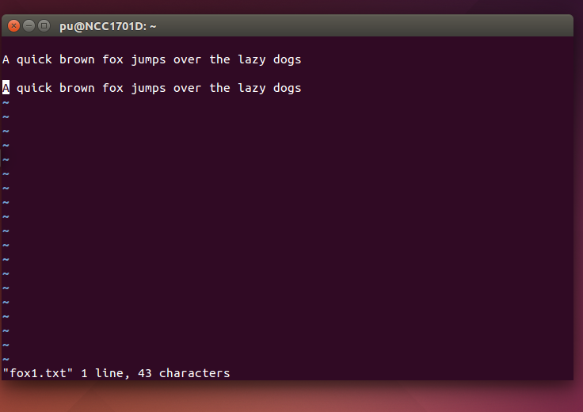
Example – Insert File
Try to insert fox1.txt into VI 2 times
Save the new buffer into file fox2.txt

Slide 12
Example – Cut, Copy, Paste
Go to the first line
gg
Copy 3 lines
3Y
Go to the last line
G
Paste it
p

Slide 13
Search and replace
/{pattern} – search text match pattern
/fox ; search for word fox
Press / will search for next one
n – go to next match pattern
:%s/pattern/text/g – search pattern then replace with text WITHOUT confirm
:%s/pattern/text/c – like above, but confirm each replacement

Slide 14
Replace Example
Try
:%s/fox/cock/g
Change all word fox to cock

Slide 15
The End

