Slide 1

The problem
A two way east-west road contains a narrow bridge with only one lane. An eastbound (or westbound) car can pass over the bridge only if there is no oncoming car on the bridge. Traffic may only cross the bridge in one direction at a time, and if there are ever more than 3 vehicles on the bridge at one time, it will collapse under their weight. In this system, each car is represented by one thread, which executes the procedure OneVehicle when it arrives at the bridge.
OneVehicle(Direction direc) {
ArriveBridge(direc);
CrossBridge(direc);
ExitBridge(direc);
}
Write the procedures ArriveBridge and ExitBridge.
ArriveBridge must not return until it safe for the car to cross the bridge in the given direction (it must guarantee that there will be no head-on collisions or bridge collapses).
ExitBridge is called to indicate that the caller has finished crossing the bridge; ExitBridge should take steps to let additional cars cross the bridge.
direc gives the direction in which the vehicle will cross the bridge

Slide 2
We want to use conditional variables but, before we discuss them, let’s go back to producer-consumer implemented with semaphores
Producer
wait "has space"
lock buffer
deposit
unlock buffer
signal "has items"
Consumer
wait "has items"
lock buffer
retrieve
unlock buffer
signal "has space"

Slide 3
binary semaphore mutex = 1
general semaphore has_items = 0
general semaphore has_space = N
Producer {
while (true) {
// Produce an item
wait(has_space)
wait(mutex)
// Add the item
signal(mutex)
signal(has_items)
}
}
Consumer {
while (true) {
wait(has_items)
wait(mutex)
// Retrieve an item
signal(mutex)
signal(has_space)
// Process or consume the item
}
}

Slide 4
What are the limitations?
It works only for counter-based synchronization, but a single semaphore count cannot directly represent a Boolean condition like
cars < 3 AND (cars == 0 OR current_direction == my_direction)
The condition is not explicit
  wait(has_space) suggests the meaning through the name, but it does not explicitly check while (count == max_size)
signal(has_space) increments the semaphore even if nobody is currently waiting. Also, Therefore, one accidental extra signal can create a false permit

Slide 5
Can we use locks?
Lock: token that can be held by 0 or 1 thread at a time
acquire: get the lock if the lock is free, wait otherwise
release: mark the lock as free (assumption: only how owns the lock calls release)
Notes:
The point here is that it could be nice, locks for specific conditions, until you do not get it, just sleep and wait

Slide 6
Let’s build prod/cons bounded buffer with locks (starting from scratch) – attempt 1
shared count = 0
shared max_size = N
Producer (repeat forever) {
01 // Produce an item
02 while (count == max_size) {}
03 // Add the item
04 count++;
}
Consumer (repeat forever) {
01 while (count == 0) {}
02 // Retrieve an item
03 count--;
04 // Consume the item
}
Notes:
Very first attempt, let’s agree that without locks it does not work

Slide 7

Let’s build prod/cons bounded buffer with locks (starting from scratch) – attempt 1
shared count = 0
shared max_size = N
2 Producers, P1 P2
N=20
… // here count=19
P1:02
P1:03
Context switch (P1 → P2)
P2: 02
P2: 03
P2: 04 (count is now 20)
Context switch (P2 → P1)
P1: 04 (count is now 21)
Producer (repeat forever) {
01 // Produce an item
02 while (count == max_size) {}
03 // Add the item
04 count++;
}
Consumer (repeat forever) {
01 while (count == 0) {}
02 // Retrieve an item
03 count--;
04 // Consume the item
}
Notes:
Very first attempt, let’s agree that without locks it does not work

Slide 8
Let’s build prod/cons bounded buffer with locks (starting from scratch) – attempt 2
shared count = 0
shared max_size = N
shared lock l
Producer (repeat forever) {
01 // Produce an item
02 acquire(l);
03 while (count == max_size) {}
04 // Add the item
05 count++;
06 release(l);
}
Consumer (repeat forever) {
01 acquire(l);
02 while (count == 0) {}
03 // Retrieve an item
04 count--;
05 release(l);
06 // Consume the item
}

Slide 9
Let’s build prod/cons bounded buffer with locks (starting from scratch) – attempt 2
shared count = 0
shared max_size = N
shared lock l
1 Producer, P1
1 Consumer, C1
N=20
Initially empty
C1: 01 // Game over
Producer (repeat forever) {
01 // Produce an item
02 acquire(l);
03 while (count == max_size) {}
04 // Add the item
05 count++;
06 release(l);
}
Consumer (repeat forever) {
01 acquire(l);
02 while (count == 0) {}
03 // Retrieve an item
04 count--;
05 release(l);
06 // Consume the item
}

Slide 10
Let’s build prod/cons bounded buffer with locks – attempt 3
shared count = 0
shared max_size = N
shared lock l
Producer (repeat forever) {
01 // Produce an item
02 acquire(l);
03 while (count == max_size) {
04 release(l);
05 acquire(l);
06 }
07 // Add the item
08 count++;
09 release(l);
}
Consumer (repeat forever) {
01 acquire(l);
02 while (count == 0) {
03 release(l);
04 acquire(l);
05 }
06 // Retrieve an item
07 count--;
08 release(l);
09 // Consume the item
}

Slide 11
Let’s build prod/cons bounded buffer with locks – attempt 3
It’s not guaranteed that the producer(s) / consumer(s) will make progress
What’s good: that both release the lock
What’s bad: that both wake up and try to get the lock independently of whether they can actually do their job
shared count = 0
shared max_size = N
shared lock l
Producer (repeat forever) {
01 // Produce an item
02 acquire(l);
03 while (count == max_size) {
04 release(l);
05 acquire(l);
06 }
07 // Add the item
08 count++;
09 release(l);
}
Consumer (repeat forever) {
01 acquire(l);
02 while (count == 0) {
03 release(l);
04 acquire(l);
05 }
06 // Retrieve an item
07 count--;
08 release(l);
09 // Consume the item
}

Slide 12
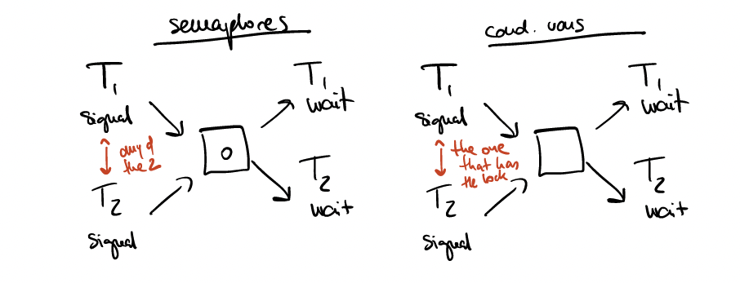
Condition variable: an object that you can use to wait for a condition to become true, associated with a lock.
cond_wait(condition, lock):
Release the lock.
The thread goes to sleep / enters the waiting queue.
Upon waking up, it reacquires the lock.
cond_signal(condition, lock):
If a thread is waiting on the condition, wake up one and give it the lock.
cond_broadcast(condition, lock):
Same as signal, except all waiting threads wake up.
Whoever calls these methods needs to hold the lock.
Fine-grained control over execution order.

Slide 13
Let’s build prod/cons bounded buffer with locks (starting from scratch) – attempt 4
shared count = 0
shared max_size = N
shared lock l
condition has_space
condition has_items
Producer (repeat forever) {
01 // Produce an item
02 acquire(l);
03 while (count == max_size) {
04 cond_wait(has_space, l);
05 }
06 // Add the item
07 count++;
08 cond_signal(has_items, l);
09 release(l);
}
Consumer (repeat forever) {
01 acquire(l);
02 while (count == 0) {
03 cond_wait(has_items, l);
04 }
05 // Retrieve an item
06 count--;
07 cond_signal(has_space, l);
08 release(l);
09 // Consume the item
}

Slide 14
The problem
A two way east-west road contains a narrow bridge with only one lane. An eastbound (or westbound) car can pass over the bridge only if there is no oncoming car on the bridge. Traffic may only cross the bridge in one direction at a time, and if there are ever more than 3 vehicles on the bridge at one time, it will collapse under their weight. In this system, each car is represented by one thread, which executes the procedure OneVehicle when it arrives at the bridge.
OneVehicle(Direction direc) {
ArriveBridge(direc);
CrossBridge(direc);
ExitBridge(direc);
}
Write the procedures ArriveBridge and ExitBridge.
ArriveBridge must not return until it safe for the car to cross the bridge in the given direction (it must guarantee that there will be no head-on collisions or bridge collapses).
ExitBridge is called to indicate that the caller has finished crossing the bridge; ExitBridge should take steps to let additional cars cross the bridge.
direc gives the direction in which the vehicle will cross the bridge

Slide 15
Constraints
0 <= cars <=3
All cars in the same direction
Bridge empty (cars==0) AND car wants in? OK
Bridge NOT(empty OR full) AND car in the same direction? OK
Synchronization shared variables:
  cars
  direction

Slide 16
shared variable cars = 0
shared Direction D = 0
lock bridge
waitingToGo[2]
ArriveBridge(Direction d) {
lock(bridge);
while (cars == 3 || (cars > 0 && D != d)) {
waitingToGo[d]++;
cond_wait(waitingToGo[d], bridge);
waitingToGo[d]--;
}
cars++;
D = d;
release(bridge);
}
ExitBridge(Direction d) {
lock(bridge);
cars--;
if (waitingToGo[d] > 0) {
cond_signal(waitingToGo[d], bridge);
} else if (cars == 0) {
cond_broadcast(waitingToGo[1 - d], bridge);
}
release(bridge);
}
Notes:
The reason we do cond_broadcast is that in the other direction up to 3 could travel immediately, so we just wake up all and if there are more than 3 it is still ok, they will go in order themselves

