Slide 1


Memory Management Operating Systems – EDA093/DIT401 Vincenzo Gulisano vincenzo.gulisano@chalmers.se

Slide 2
What to read (main textbook)
Chapter 3.1, 3.2, 3.7 (up to 3.7.1 - excluded) (extra facultative reading: 8.1-8.5 from Silberschatz Operating System Concepts)

Slide 3
Objective
Discuss how different types of memory are used
Discuss how information is continuously moved between “slow memory” and “fast memory” (accessed directly by the CPU)
Discuss how and why user/programmer/program view of memory and physical memory are kept separated
Notes:
Say this is a block of two lectures, VM later on continues on this

Slide 4
Agenda
Introduction
Base and limit registers
Logical/Virtual vs Physical addresses
Dynamic loading and linking optimizations [self reading]
Swapping
Memory allocation
Contiguous allocation
Segmentation
Paging

Slide 5
Agenda
Introduction
Base and limit registers
Logical/Virtual vs Physical addresses
Dynamic loading and linking optimizations [self reading]
Swapping
Memory allocation
Contiguous allocation
Segmentation
Paging

Slide 6
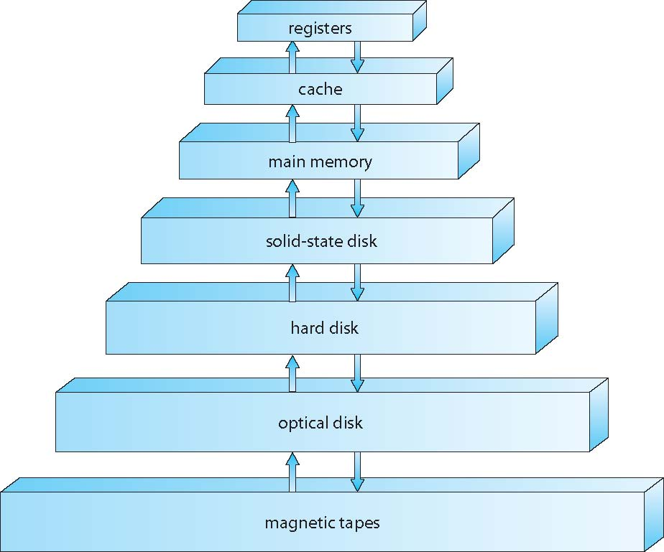
Background and basic hardware (I)
Goal of the OS: maximize CPU utilization → Run multiple processes concurrently / in parallel → Share memory!
We first have to move it up here!
1 cycle
Can be accessed directly by the CPU
Many cycles
If some data the CPU wants to access is here
Cannot be accessed directly by the CPU
Notes:
[click] The goal of the OS is to maximize CPU …
[click] As you most likely know, this is the organization of memory in our computers…
[click] Some memories can be accessed directly by the CPU
[click] Some are very fast
[click] Some take more time
[click] some others no
[click] Which means, if have data here and we want the CPU to access it, we first need to move it up here

Slide 7
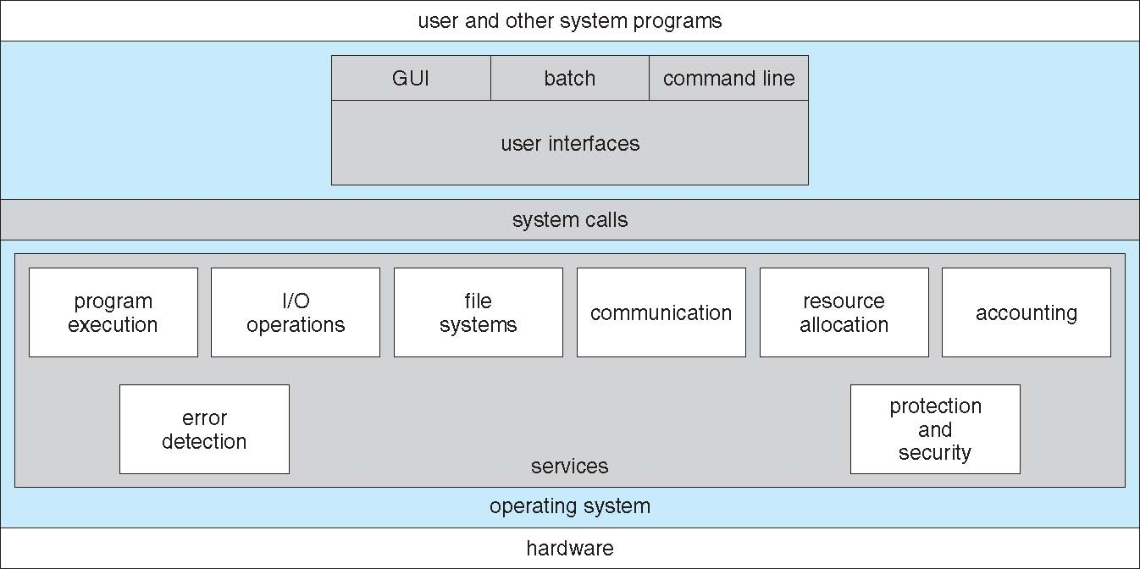
Background and basic hardware (II)
Need for fast CPU access to registers / caches and main memory? → hardware support without OS interaction
CHALLENGE: how to ensure correctness?
Notes:
[click] since we want to speed up operation, we can think of hardware support for the CPU to access registers / caches and main memory. But the challenge then is:

Slide 8
Agenda
Introduction
Base and limit registers
Logical/Virtual vs Physical addresses
Dynamic loading and linking optimizations [self reading]
Swapping
Memory allocation
Contiguous allocation
Segmentation
Paging

Slide 9
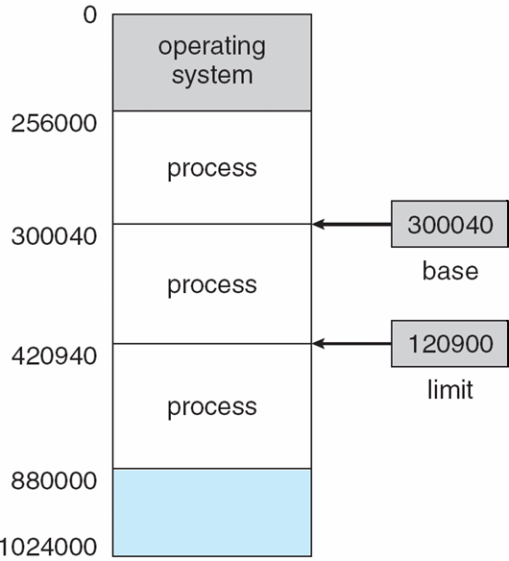
Base and Limit register (I)
For each process, the CPU maintains two registers:
Base register: first address that can be access by the process
Limit register: number of addresses (starting from the base register) that can be accessed by the process
Example: process A can only access addresses from 300040 to 420940
A
Notes:
[c] It works like this, we have two registers ….
[c] So for example, process A
[c] This show the how the CPU checks whether a trap should be sent
Possible question: is this for the cache, is it for the main memory or for both of them?

Slide 10
Base and Limit register (II)
Base and Limit register loaded by the OS using privileged instructions!

Slide 11
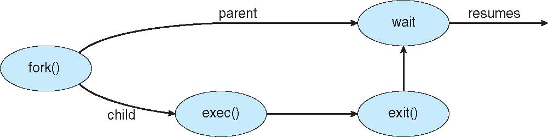
Base and Limit register (III)
The operating system can access the memory of the processes without restrictions.
We saw (at least) one example of this in the previous lectures, when?
Replace the memory of the process with the one of another process
Notes:
Exceptional case: dedicated hardware

Slide 12
Agenda
Introduction
Base and limit registers
Logical/Virtual vs Physical addresses
Dynamic loading and linking optimizations [self reading]
Swapping
Memory allocation
Contiguous allocation
Segmentation
Paging

Slide 13
Address binding
…
a = b + 2
…
Where do we store a?
Once we load it into memory, we know the address
As long as the program is not loaded in memory, we do not know the address
Notes:
[c] Suppose we write a program with this instruction, we are sayin we should store the value of b + 2 in a, somewhere in memory. Where exactly?
[c] While the program is on disk we don’t know
[c] once we load it in memory we do
Discussions always depend on what hardware we are thinking of / OS and programs... dedicated hardware we might know...

Slide 14
Logical/Virtual vs Physical address space (i)
Logical/Virtual address
…
a = b + 2
…
First address of the program 00000
Address of variable a 346
Physical address (main memory)
…
a = b + 2
…
First address of the program 14000
Address of variable a 14346
Notes:
[c] Each program sees its virtual addresses, starting in 0 (it is easier)
[c] But of course, once it runs in memory it will actually be allocated in a given region of the physical memory
here link back to question about addresses...

Slide 15
Logical/Virtual vs Physical address space (ii)
Address 346
Address 14346
Logical/Virtual address
physical address
How to convert between logical/virtual addresses to physical addresses?

Slide 16
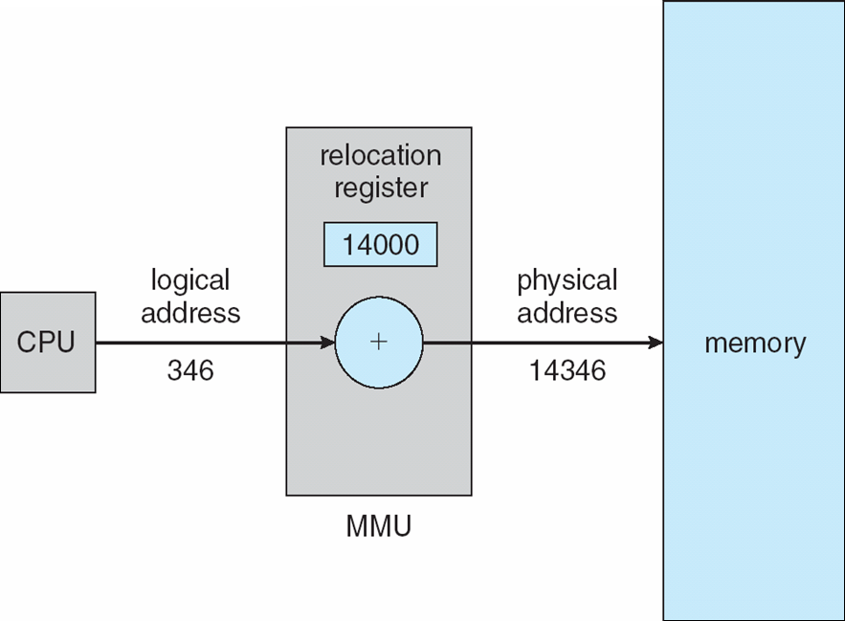
Memory-Management Unit (MMU) – Relocation Register
Logical/Virtual addresses [0,max]
Physical addresses [R+0,R+max]
Notes:
This is one way of doing it, using the relocation register. There can be other ways too, will see later

Slide 17
Agenda
Introduction
Base and limit registers
Logical/Virtual vs Physical addresses
Dynamic loading and linking optimizations [self reading]
Swapping
Memory allocation
Contiguous allocation
Segmentation
Paging

Slide 18
Optimizations – Dynamic loading
We assumed so far the entire program A is loaded
If A is large and parts of it are almost never used → slower to load
With dynamic loading, routines of a program can be loaded only when needed
A

Slide 19
Optimizations – Dynamic Linking (i)
Use library from
Program A
Program B
Program D
Program C
Static linking
A
B
C
D
D
D
D
Waste of disk
Waste of memory
Need to re-link if D changes

Slide 20
Optimizations – Dynamic Linking (ii)
Use library from
Program A
Program B
Program D
Program C
Dynamic linking
Stub for D
A
B
C
D
Better use of disk
Better use of memory
No need to re-link if D changes

Slide 21
Agenda
Introduction
Base and limit registers
Logical/Virtual vs Physical addresses
Dynamic loading and linking optimizations [self reading]
Swapping
Memory allocation
Contiguous allocation
Segmentation
Paging

Slide 22
Swapping (i)
Moving a process from memory to backing store
Why?
size(all logical addresses) > size(real physical memory)
Notes:
Question
Say also we will see more when we discuss Virtual Memory

Slide 23

Swapping (ii)
Basic idea:
Questions:
Which processes can we swap?
How much time does it take?
When does it make sense to use swapping?

Slide 24
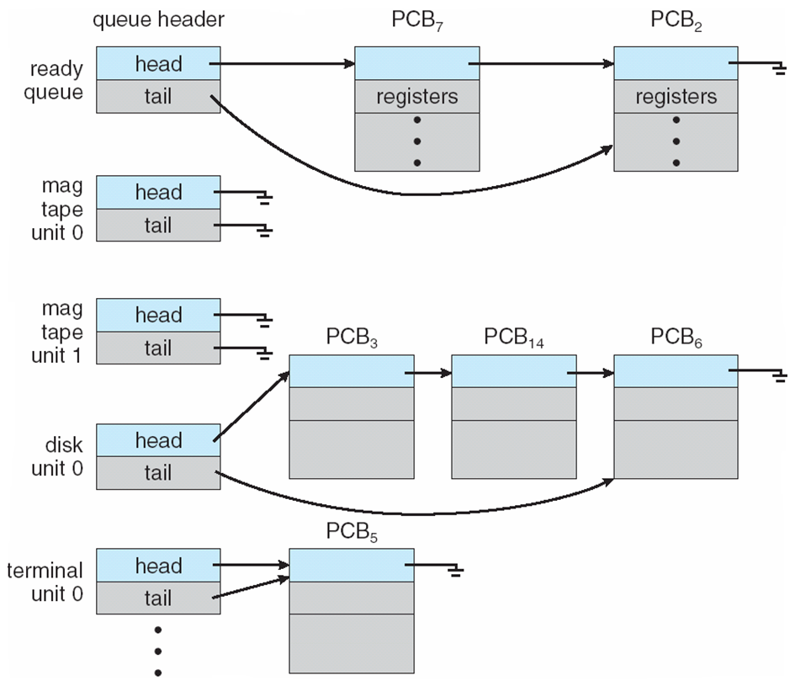
Swapping - Which processes can we swap?
Depends on the pending I/O…
Can the I/O results be buffered at the OS?
Notes:
make a drawing here

Slide 25
Swapping – How much time does it take?
Process in memory 100 MB
Disk transfer rate 50 MB/s
→ 100 MP / 50 MB/s = 2 seconds
→ Swap out + Swap in = 4 seconds
(Notice: being optimistic! Disk writes/reads might be requested by other processes, interrupts will occur in the meantime, etc…)
It is slow and expensive (because write/read to disks are slower and more expensive than memory ones)!

Slide 26
Swapping – When does it make sense to use it?
Not used “as it is”…
Modified versions are used in UNIX, Linux and Windows
Swapping is activated when free memory goes below a certain threshold
Swapping is activated when free memory goes above a certain threshold
Modified swapping (swap out / in only parts of the process) used in conjuction with Virtual Memory (next lecture…)

Slide 27
Agenda
Introduction
Base and limit registers
Logical/Virtual vs Physical addresses
Dynamic loading and linking optimizations [self reading]
Swapping
Memory allocation
Contiguous allocation
Segmentation
Paging

Slide 28

Memory allocation
Memory contains
The operating system itself
The users’ processes
Challenge: how to allocate memory efficiently?
We will see 3 cases
Contiguous allocation
Segmentation
Paging
Logical and physical memory more and more separated
Less fragmentation (better memory utilization)
Protection
Faster loading / swapping

Slide 29
Agenda
Introduction
Base and limit registers
Logical/Virtual vs Physical addresses
Dynamic loading and linking optimizations [self reading]
Swapping
Memory allocation
Contiguous allocation
Segmentation
Paging

Slide 30
Contiguous allocation
Operating system at the bottom
Processes one after the other (each process contiguous to the previous)
Notes:
Say similar things hold also for file systems

Slide 31

Contiguous allocation – memory protection
A

Slide 32
Contiguous allocation - limitations
When we terminate (or swap) a process
We create a hole
The OS needs to keep track of holes to reuse them later on for other processes
External fragmentation
sum(all holes size) > size(a new process) BUT size(of any hole) < size(a new process)
Notes:
drawing?

Slide 33
Contiguous allocation – which hole to assign to a new process?
First fit → allocate the first hole that is big enough
Best fit → allocate the smallest hole that is big enough
PROS: produces the smallest leftover hole
CONS: Search entire list (or keep list of holes sorted)
Worst fit → allocate the largest hole
PROS: produces the largest leftover hole
CONS: Search entire list (or keep list of holes sorted)
Notes:
We will see (also when discussing virtual memory / file systems) that the best strategy might depends on things we do not know yet (size of a process in this case)

Slide 34
Agenda
Introduction
Base and limit registers
Logical/Virtual vs Physical addresses
Dynamic loading and linking optimizations [self reading]
Swapping
Memory allocation
Contiguous allocation
Segmentation
Paging

Slide 35
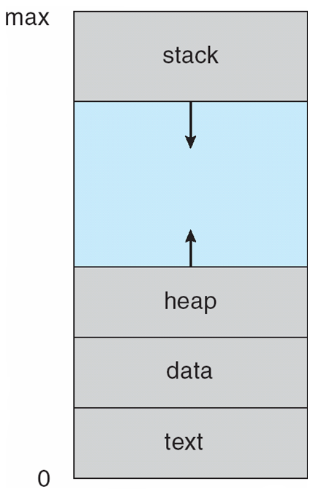
Segmentation (i)
So far we referred to the memory of a process as a single unidimensional space [0,max]
Nevertheless, from the programmer/program perspective:
Different parts have different meaning, and each should be “protected from others”
Different parts have different and variable size
A

Slide 36
Segmentation (ii)
With segmentation a memory position can be accessed not referring to its global position in [0,max] but rather as a pair <segment, position in the segment>
Segment 3
0
Easier to check if an access to a certain section is actually reaching a different section
Allows to have different permissions for the different segments!
Different parts of the process can be at different locations in the physical memory!
Read/write
n₃-1
n₂-1
Read/write
0
Segment 2
n₁-1
Read/write
0
Segment 1
n₀-1
Execute
0
Segment 0

Slide 37
Segmentation – segment table
Need to maintain extra information to link logical address space / segments to the physical memory

Slide 38
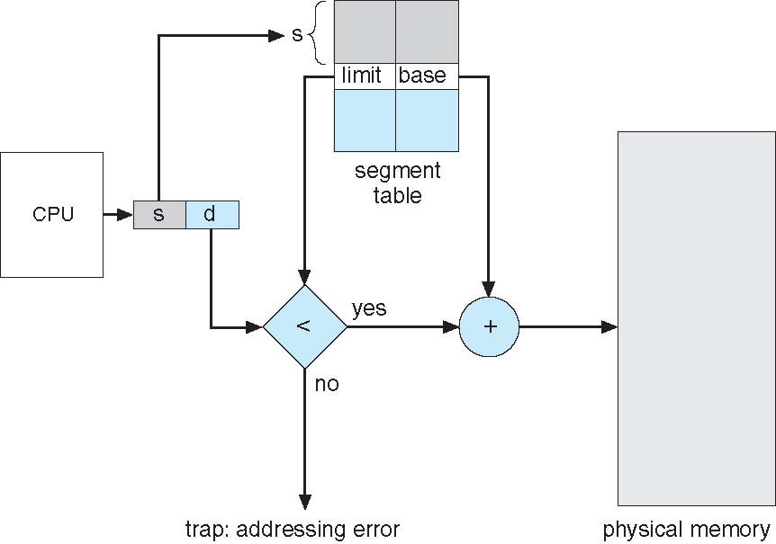
Segmentation – hardware support
Hardware is able to do this conversion automatically (and check whether the process is trying to access memory outside the segment)

Slide 39
Agenda
Introduction
Base and limit registers
Logical/Virtual vs Physical addresses
Dynamic loading and linking optimizations [self reading]
Swapping
Memory allocation
Contiguous allocation
Segmentation
Paging

Slide 40
Paging
Mechanism that allows for the physical address space of a process to be non-contiguous
Used in most modern OSes (from mainframes to smartphones)
Requires cooperation between OS and hardware (as common)

Slide 41


Paging – Basic idea
Split logical memory in pages
Split physical memory in frames
Keep a program (disk) organized in pages
Page size = Frame size!
How do we keep track of where each page is?

Slide 42
Paging – the page table
Page 0? Frame 1
Page 1? Frame 4
Page 2? Frame 3
Page 3? Frame 7

Slide 43
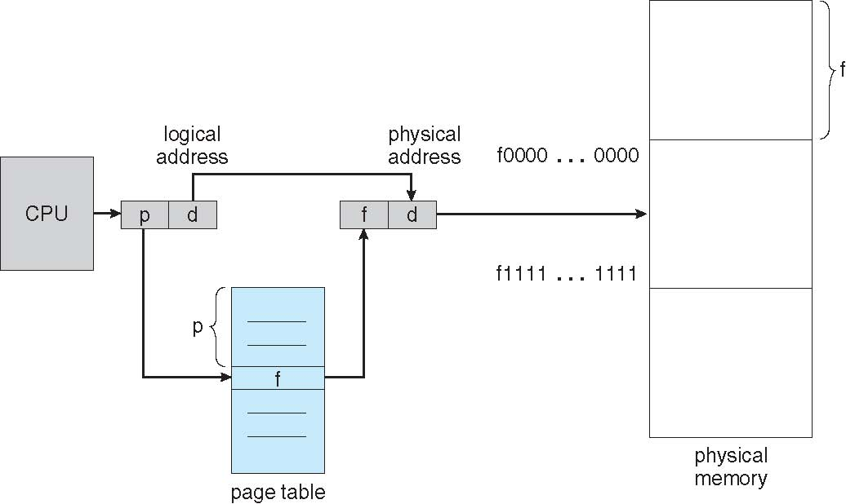
Paging – hardware support
How does the CPU know which page it should access?
Similarly to Segmentation, we can access physical memory specifying page + offset

Slide 44
Paging – from logical address to physical address (i)
If page/frame size is power of 2 → 2^{n}
If size of logical space is power of 2 → 2^{m}
Logical address (binary) 101101001110110
m-n page
n offset

Slide 45

Paging – from logical address to physical address (ii)
Page size = 2² bytes (n=2)
Size of logical space = 2⁴ bytes (m=4)
→ logical space = 4 pages
Physical address of logical address 7?
0 1 1 1
Frame 6 offset 3 → 6x4+3=27
page
1
offset
3

Slide 46
Paging - Fragmentation
No external fragmentation
Process needs a page? Can take any free frame
Internal fragmentation
Last frame assigned to a process’ page might be not full
On average, half frame is wasted for each process
Small pages → less fragmentation / more overhead (e.g., page table size)
Large pages → more fragmentation / less overhead

Slide 47
Questions

Slide 48
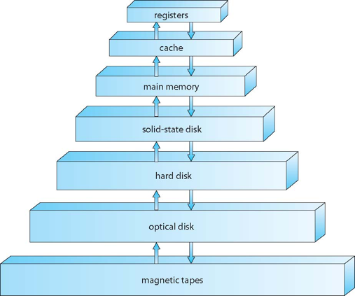
Which of these memories can be accessed directly by the CPU?30sec
Registers, cache and main memory
Registers, cache, main memory and disk (solid-state)
Registers, cache, main memory and disk (any)
Notes:
1

Slide 49
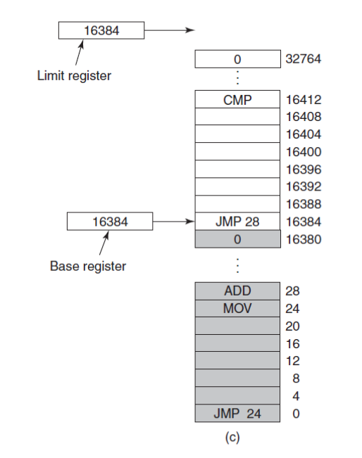
The base and limit registers in the figure contain the same value. Is it OK?
Yes, it is.
No, it is not.
Notes:
1

Slide 50
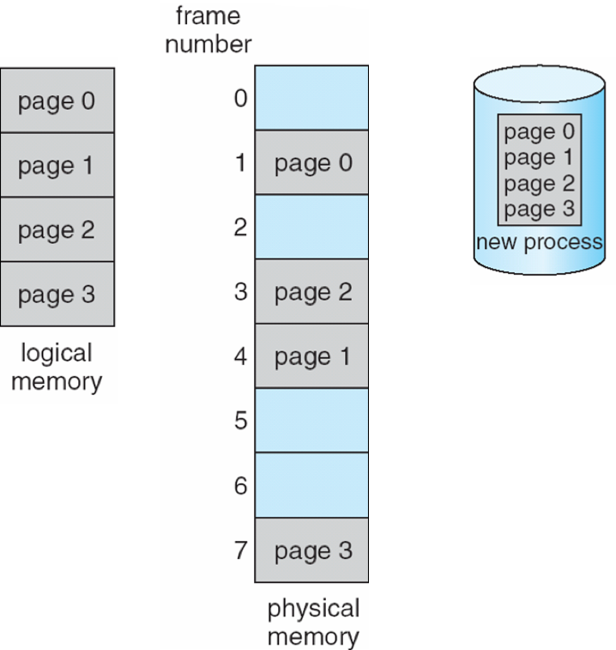
Paging suffers from...30sec
External fragmentation
Internal fragmentation
Does not suffer fragmentation
Notes:
2

Slide 51
Process p address space is 128K. There are 16K of physical memory available (page size is 1K).
The page table contains 128 entries
The page table contains 16 entries
The page table contains 8 entries
Notes:
1

Slide 52
Suppose a process P has size of 100 bytes. Compute (1) the number of wasted bytes caused by internal fragmentation if the page and frame sizes are set to 2^4 bytes and (2) the size of the page table.
Notes:
Page size = 16 bytes
Number of pages required = ceil(100/16) = 7
Wasted bytes because of internal fragmentation 16 –100%16 = 12 bytes
Page table = 7 * (8) = 56 bits

Slide 53
Assuming a 1 KB page size, what are the page numbers and offsets for the following address references (provided as decimal numbers):
2375
19366
30000
256
16385
Notes:
1 KB = 2^10
2375 → 0000100101000111
Page first 4 bits, page 2
Rest is offset, so 327

Slide 54
Consider the following segment table:
Segment Base Length
0 219 600
1 2300 14
2 90 100
3 1327 580
4 1352 96
Tell which physical address would be accessed for the following logical addresses
0,430
1,10
2,500
3,400
4,112
Notes:
219 + 430 = 649
2300 + 10 = 2310
illegal reference, trap to operating system
1327 + 400 = 1727
illegal reference, trap to operating system

