Slide 1


Security Operating Systems – EDA093/DIT401 Vincenzo Gulisano vincenzo.gulisano@chalmers.se
Notes:
Welcome to the lecture about Security in Operating Systems. [c]

Slide 2
Reading instructions
4th edition: Chapter 9, from the beginning until 9.4.1 (only the first paragraph of 9.4.1); 9.6 to 9.7.1 (only up to Data Execution Prevention - included); 9.9.3; The Sony Rootkit (starts at page 683, part of 9.9.5)
5th edition: Chapter 9, from 9.1 to 9.5.1 (included)
Notes:
You can find here the reading instructions for this lecture. Most of the material is covered in these slides, while other parts are for you to read directly from the book. [c]

Slide 3
Agenda
Introduction/Overview
Protection Domains
Access Control Lists
Capabilities
Authentication
Exploiting software bugs: buffer overflow attacks
Notes:
We are going to begin this lecture with an introduction and overview of what security is (in the context of Operating Systems), we will then cover the topic of Protection Domains and have a look at both Access Control Lists and Capabilities. We will then discuss Authentication and finally cover a very well-known way of exploiting software bugs: buffer overflow attacks. [c]

Slide 4
Agenda
Introduction/Overview
Protection Domains
Access Control Lists
Capabilities
Authentication
Exploiting software bugs: buffer overflow attacks
Notes:
Let’s start with our overview. [c]

Slide 5
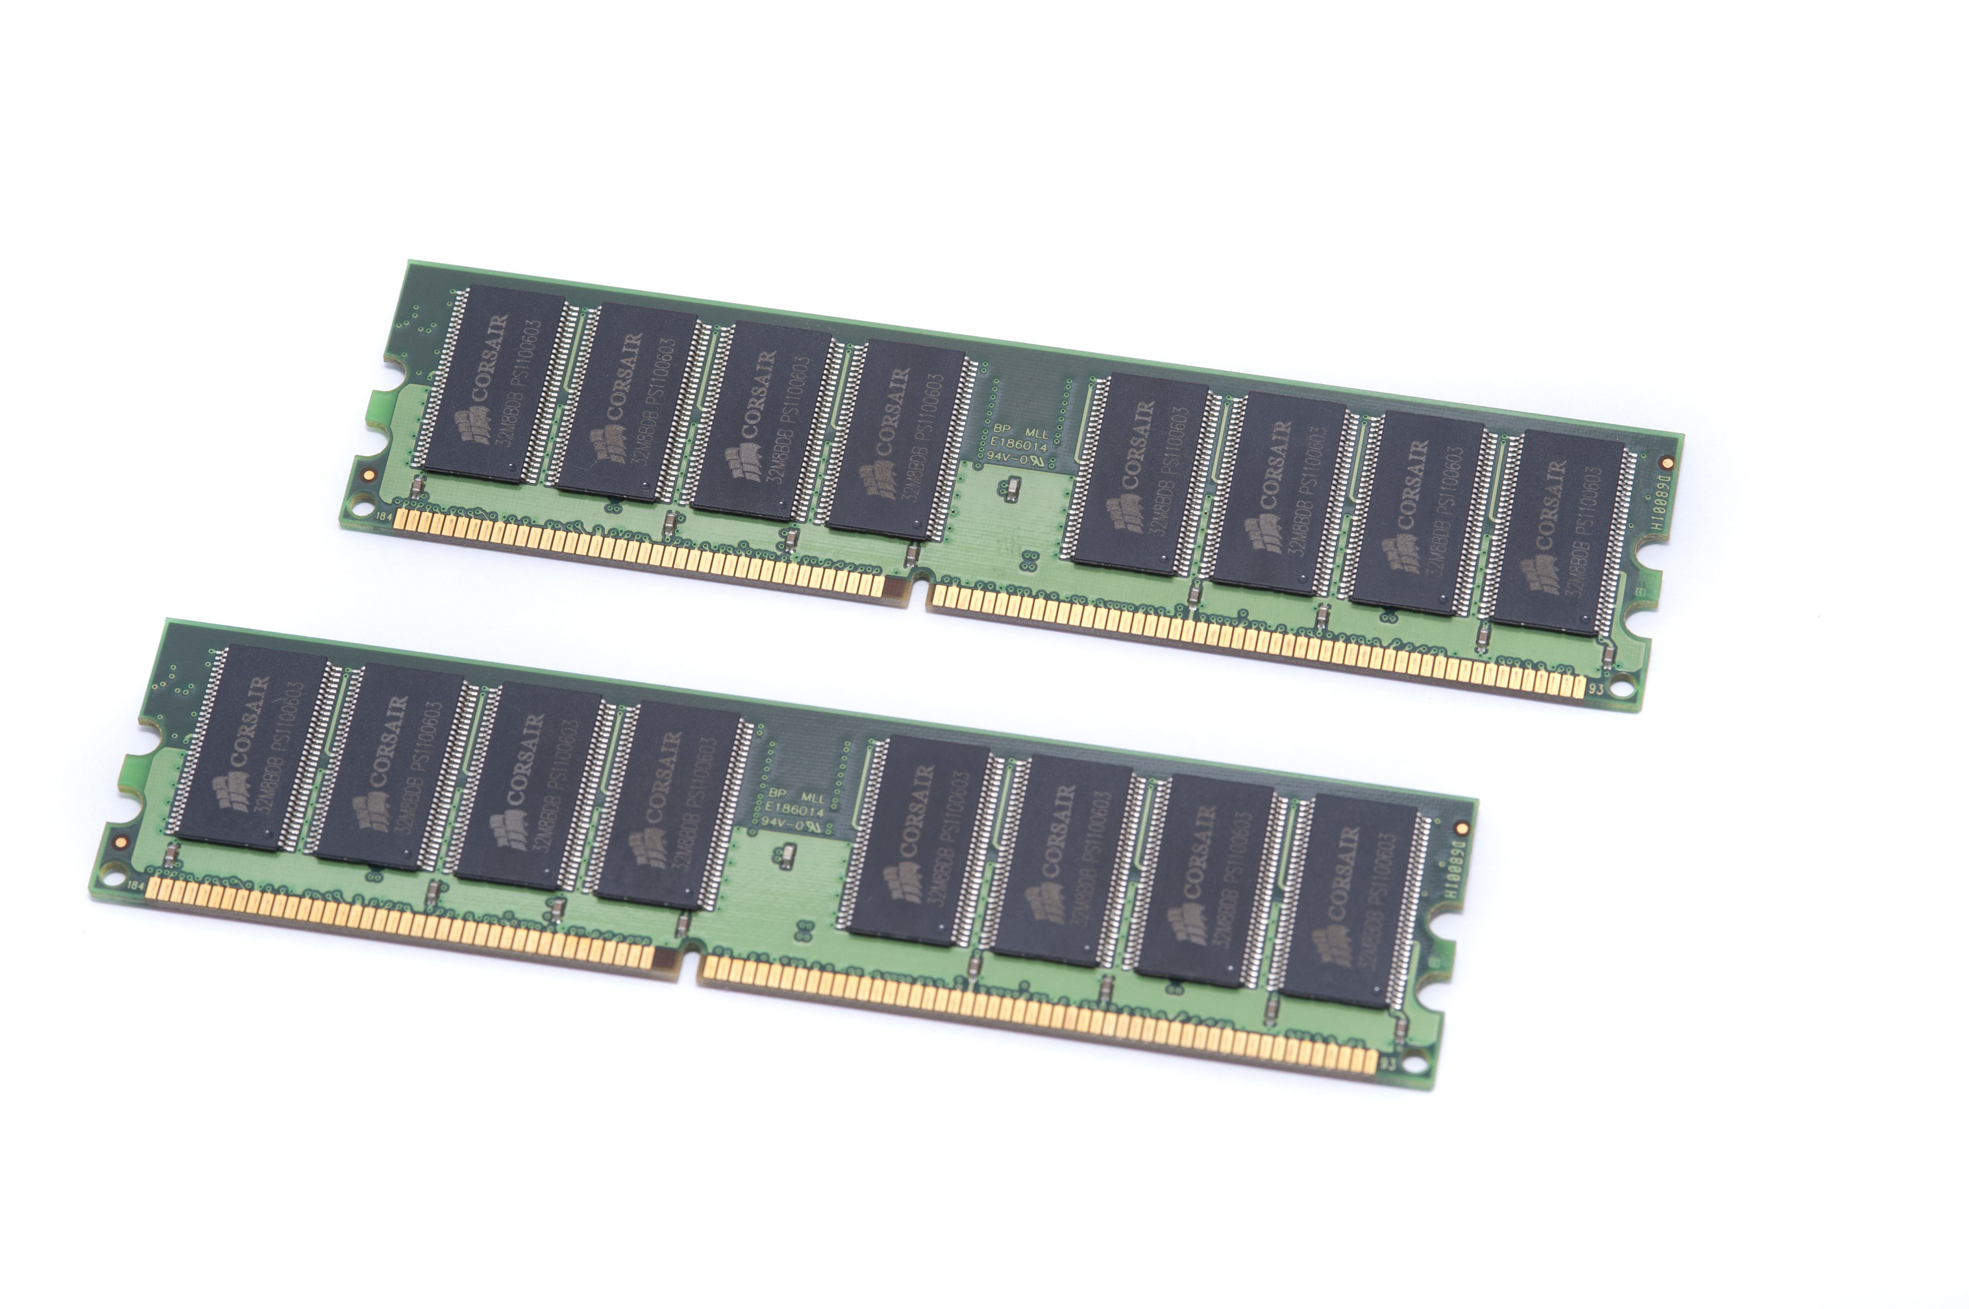


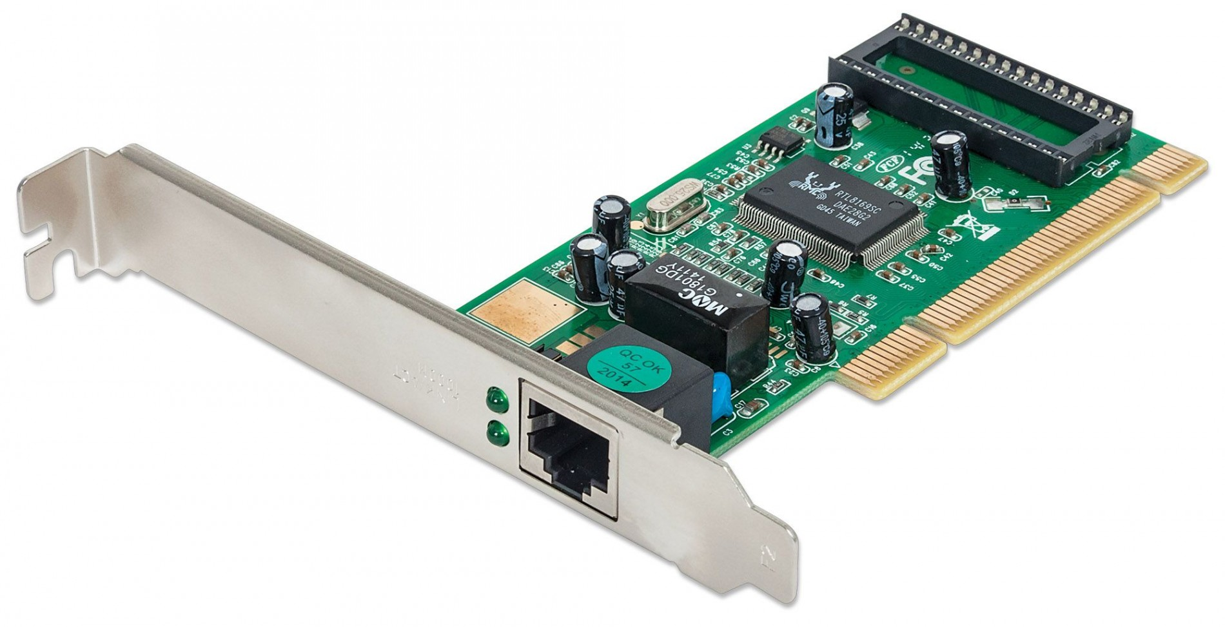
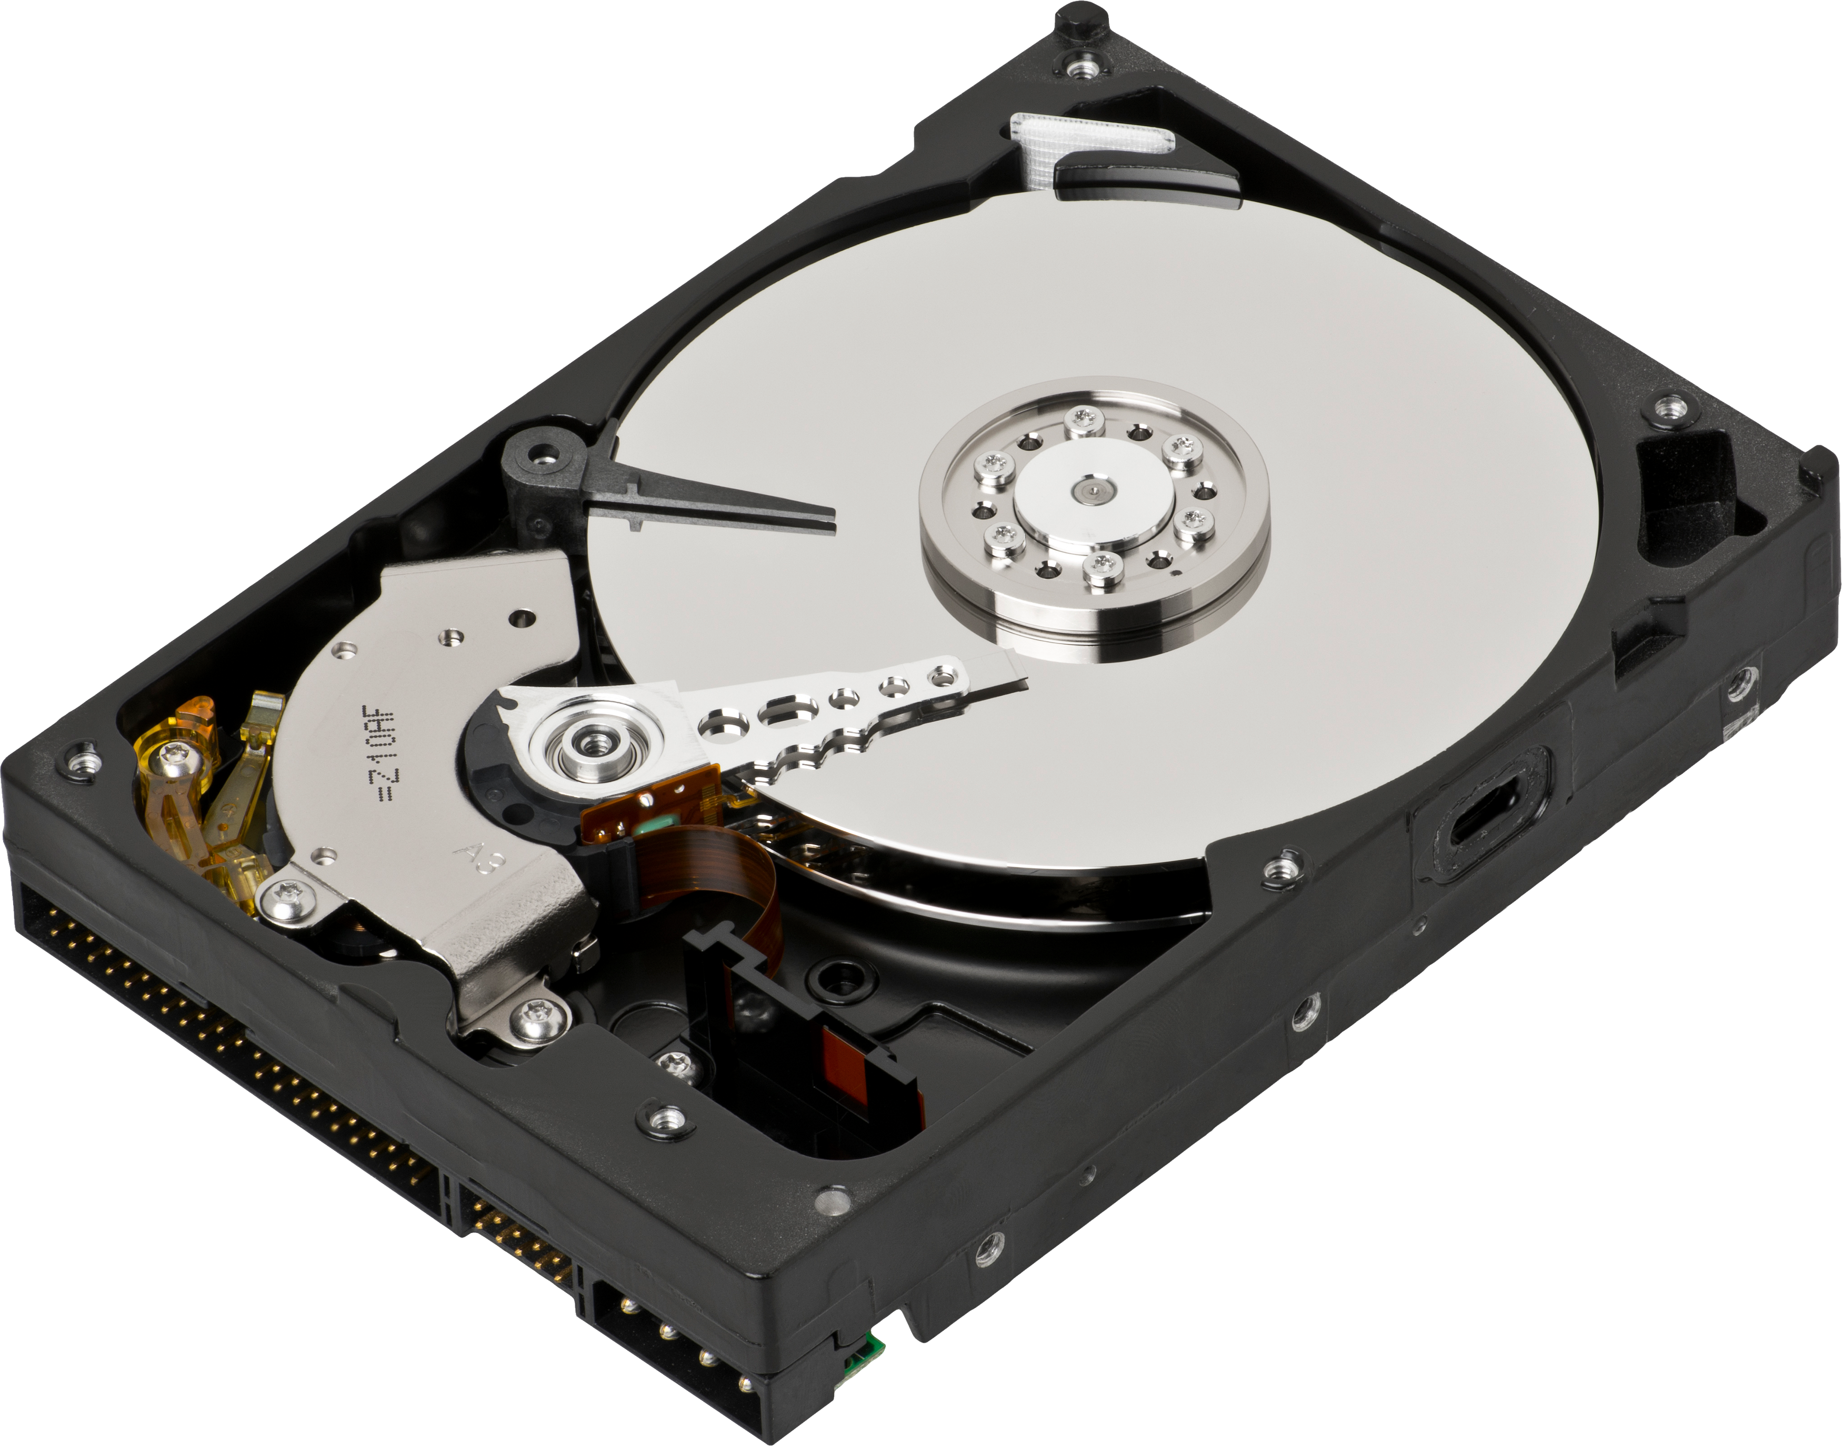
Important information:
your private one
commercial
legal
...
Attacker might want to:
read
modify/delete
prevent owner from accessing it
...
bugs are a way to reach such goals
Vulnerability = security bug
Exploit = bug-triggering input
Notes:
We all know that the information we access and store in our computer is being moved across different devices, like the disk, the main memory, the network card, and so on.
We also know that the operating system has a key role in deciding how this information is being moved.
[c] It is of course clear that part of this information is important and/or sensitive: your passwords, your credit card number, and so on
[c] and we can imagine attackers might be interested in accessing such information. Something important to notice here is that such wish to access information is not limited to reading the information, someone might want to alter it (to pretend you said something in a mail you did not) or just prevent you (the real owner of such information) from accessing it (so that you cannot recover all your files if you do not pay a ransom for them).
[c] Unfortunately for us, the software we use (including the operating system’s one) is full of bugs. Security bugs, called vulnerabilities, are often used by attackers to inject special input (exploit) that allows them, in a way or another, to fulfill their malicious intentions. [c]

Slide 6
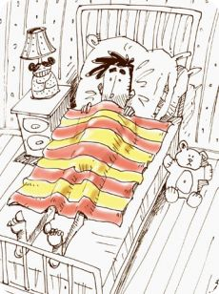
Features
email in which you can attach images and files
Simplicity and security
email offering only plain ASCII text
Notes:
At this point, it is important to realize that one additional trade-off we have in the context of Operating Systems is that of feature-rich software versus simple and secure software.
We tend to like systems with a lot of tools, gadgets, and features, but the truth is that the more of these we get, the higher the chances that a bug can be used against us.
[c] if you take the very simple example about mails, you probably agree with me that the possibility of sending images and files is something we prefer over [c] the possibility of sending only plain text.
But we have to acknowledge that it is hard for the attacker to gain control of a system through simple text, while it is significantly easier if executable files can be shared via mail. [c]

Slide 7
It’s complicated...
Attacks
Worm: freestanding program, propagates without user intervention
Virus: attaches to another file/program, propagates through user interaction
Trojan horse: malware disguised as legitimate software
DoS, DDoS, ...
Being victim of a security incident does not imply the attacker is after you/your data (e.g., botnets)
Focusing on the ones related to the OS
Security
OS
protection
Notes:
At this point, I want to stress that the topic of security is a very broad and complicated one, and this lecture does not aim at covering all aspects of it, of course.
[c] If we focus on the type of attacks and security threats that exist, we can list (among others), worms: freestanding programs that can propagate through various computers without user intervention, viruses, which on the other hand will attach to files and programs and will propagate depending on how users interact with infected files and programs, trojan horses, malware disguised as legitimate software, Denial of Service and Distributed Denial of Service attacks, and so on...
[c] if we focus on the concept of "victim", we must note that being a victim of a security incident does not imply the attacker is after you or your data, the attacker might be using you to achieve his or her goals
[c] In this lecture, we will only focus on some security aspects that concern the Operating System. [c]

Slide 8
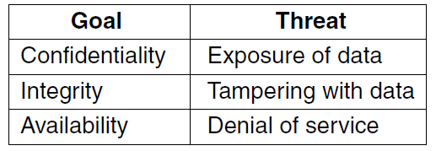
There exists of course more: authenticity, accountability, nonrepudiability, privacy, ...
Notes:
More concretely, we will focus on
confidentiality, which is about keeping secret data secret or ensuring data is accessed only by authorized people,
integrity, which is about ensuring data is modified only by authorized persons,
and availability, which is about ensuring no one can disturb the system and make it unusable.
[c] As you can imagine, these are not the only security aspects one can think about, but we will not cover additional ones. [c]

Slide 9
hackers
black hats
end up being used by ...
(dual use)
white hats
Develop security tools (nmap, port scanners, dsniff, ...)
Notes:
Something worth mentioning here is that we often hear the term hacker used to refer to malicious attackers.
In reality, a hacker only refers to someone with excellent programming skills. We can differentiate between [c] white hats, who try to attack a system and develop security tools to make such a system more secure, and [c] black hats, who on the other hand use the same tools (and hence the expression dual use) with malicious intentions. [c]

Slide 10
Attacks can be classified along different dimensions:
Attacks
passive (e.g., sniff network traffic and try to break encryption)
Active (take control of a browser and use it to execute code)
Protection mechanisms
Cryptography
Software hardening
And more... (e.g., Intel SGX, a set of security related instructions that allows user processes to have encrypted / isolated parts of memory, that cannot be access by other processes nor by the OS)
Notes:
It is also worth mentioning that attacks can be classified along different dimensions.
They could be differentiated between passive and active ones, for instance.
[c] In practice, there’s no silver bullet to handle all security aspects. We usually end up using a combination of various techniques, including cryptography, software hardening (which we will cover later), and even more (Intel SGX is an interesting example of a recent approach, which is currently a hot research topic). [c]

Slide 11
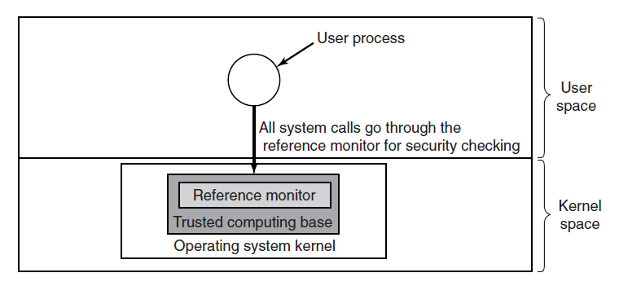
Trusted Computing Base (TCB)
hardware (except I/O that does not affect security), portion of kernel (process creation, process switching, memory management, file system, I/O) and user processes with root level
should be as small as possible
You always need a model:
what should be protected?
who can do what?
what is the power of the adversary?
Notes:
Security practitioners usually talk of trusted rather than secure systems. A trusted system is a system that has formally stated security requirements that it meets. For a system to be trusted, we usually need to identify the Trusted Computing Base, [c] so the portion of hardware, kernel, and user processes with root-level access that can affect security. [c] Such portion should be kept as small as possible, to make it easier to maintain it.
[c] Once we have our TCB, we need a model that specifies what should be protected, who can do what, and what type of adversary we can deal with (his/her power, basically) and make sure all system calls are checked by a so-called reference monitor before entering/operating in the TCB. [c]

Slide 12
Agenda
Introduction/Overview
Protection Domains
Access Control Lists
Capabilities
Authentication
Exploiting software bus: buffer overflow attacks
Notes:
Let’s move now to protection domains [c]

Slide 13
Protection domains
OBJECTS
CPU
memory page
file
semaphore
...
OPERATIONS
read
write
execute
up
down
...
PROCESSES
Process 1
Process 2
...
Notes:
We said that for building a trusted system, we need to have a clear understanding of what can be done and who can do it. We can ask ourselves: what does it mean to have a clear understanding of what can be done and who can do it?
To answer such a question, we can note that each system is composed of a set of objects (could be both hardware and software).
Each object can be manipulated through a set of operations, and such operations can take place within the execution of processes. [c]

Slide 14
Protection domains
Domain: set of <object, rights> pairs
Usually, a domain refers to 1 user, but it can be more general than that (e.g., groups)
Security works best when each domain has the minimum objects / privileges to do its work (POLA, Principle of Least Authority)
Notes:
A domain is a set of <object, rights> pairs that refer to one user or a group of users.
According to the Principle of Least Authority, security works best when each domain has the minimum objects/privileges required to perform a certain task. [c]

Slide 15
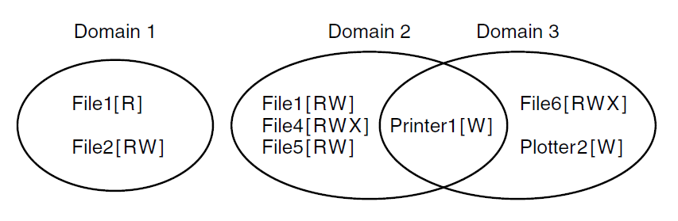
Protection domains
At each point in time, each process runs in some protection domain
Each process can in principle switch domain (depending on the system running it, of course...)
Unix: each process has UID and GID
Notes:
Here we have an example with three domains, each containing some objects and associated operations. As you can see, the same object (File 1 for instance) can be associated with different domains and with different operations. At the same time, the same object (Printer 1) can also exist with the same operation for multiple domains.
We assume that each process is executed in one protection domain and that the operating system could allow the process to switch between domains. In Unix, the domain of a process is given by the user id and the group id of the user that is currently logged in and running such a process. [c]

Slide 16
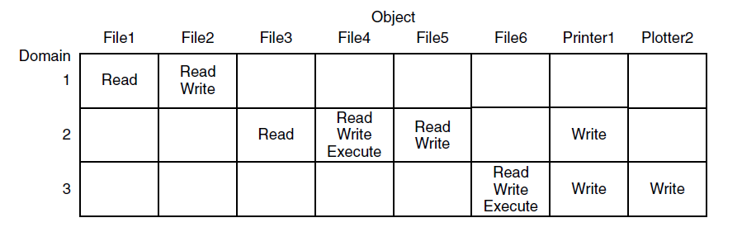
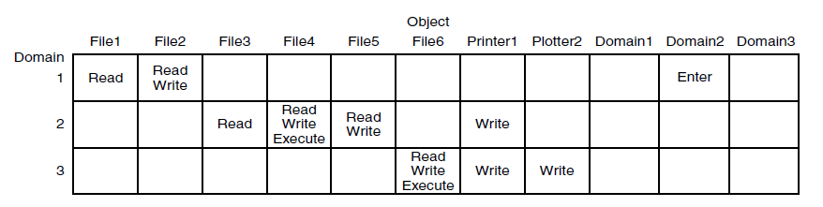
Figure 9-4. A protection matrix.
Access Control Lists
Capabilities
Figure 9-5. A protection matrix with domains as objects.
Notes:
If we now focus our attention on how to maintain the information about various domains, we realize we need to maintain a matrix like the one shown in these figures (the one at the bottom is an extension on the one on the top with domain-switching permissions too).
In practice, such a matrix would be sparse (most cells are empty), and storing it as a matrix is not efficient, we can go for either rows or columns. If we store information per column [c], we are then referring to Access Control Lists. If we do it per-row [c], we are referring to Capabilities. We will cover both in the following videos. [c]

Slide 17
Agenda
Introduction/Overview
Protection Domains
Access Control Lists
Capabilities
Authentication
Exploiting software bugs: buffer overflow attacks
Notes:
Let’s start discussing Access Control Lists [c]

Slide 18
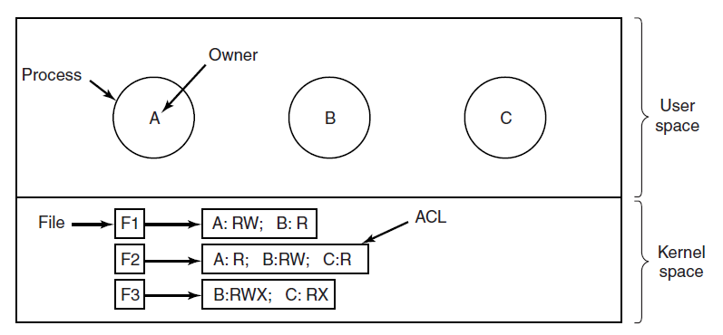
Access Control Lists
For simplicity, each domain = 1 user
RWX rights are common, but there could be more
rights might be per group of users, not an individual user
Could be stored as pairs (UID1,GID1):... (UID2,GID2):... – this models ROLES
Could include wildcards (UID1,*)
could be stored individual UID1:... UID2:... GID1:...
THESE ARE SCANNED IN ORDER, STOPPING AT THE FIRST THAT MATCHES!!!
Notes:
For simplicity, [c] let’s assume each user is associated with one domain and that all processes ran by the user belong to such domain.
In the example, we have a user A and his/her processes also belong to domain A.
We define one access control list per file. As the name suggests, it is a list, and [c] it is scanned in order, stopping at the first entry that matches.
If no rights are found for a given domain, then we assume such a domain as no rights associated with it.
[c] The entry can contain the usual permissions for reading (R) writing (W) and executing (X) but nothing prevents a system from defining more rights.
An important aspect here is how we implement such a system. More concretely, what are the specific elements we store in each entry?
[c] First, we can distinguish rights for individuals and for groups (the latter are useful when we want to apply the same rights to a set of individuals that share some features, e.g., students).
Then, we can store rights as pairs <UID,GID>. In this case, we refer to them as ROLES, since each set of rights is associated not only to a user but also to the group such user is representing (and one user could in principle be associated with multiple groups).
In such a case, we could also use wildcards, to define rights that apply to a user independently of each group (<UID,*>).
An alternative implementation is to store rights on a per-user / per-group basis. [c]
[Notice ACL are more powerful than standard Unix permissions]

Slide 19
<A,*>=(none)
Notes:
Revoking or granting permissions is simple using access control lists.
Let’s say we want to change the rights associated with user A so that user A can no longer do anything with file F1.
If we append to the ACL of F1 the pair <A,*>=(none) then this will be always the first entry matched for user A, and user A will thus have no rights for file F1.
Notice though we might want to clean and keep our access control list in order, to prevent it from ever-growing. [c]

Slide 20
Agenda
Introduction/Overview
Protection Domains
Access Control Lists
Capabilities
Authentication
Exploiting software bugs: buffer overflow attacks
Notes:
Let’s move now to capabilities. [c]

Slide 21
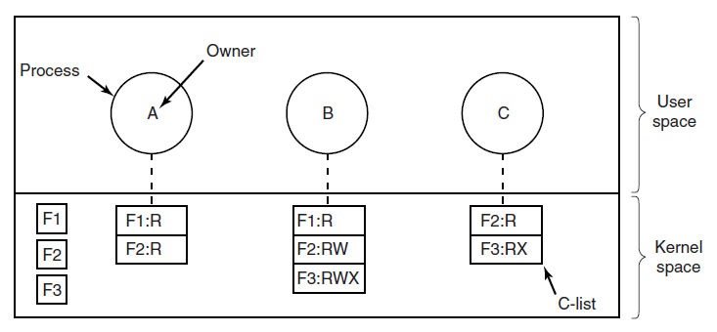
Capabilities
There can be other rights too: copy / remove/ destroy ...
The object contained in a capability list could be a pointer to another capability list (to facilitate the sharing of subdomains)
Notes:
In this case, we associate a list of permissions to each domain/process. Each entry in the list is a capability, a file (or another object), and the set of rights associated with it.
[c] since two domains can have part of their capabilities lists overlapping, they could use pointers to point to other lists hierarchically.
[c] Also in this case, we can have the common read, write, and execute rights, as well as other additional rights that are specific to a certain system or operating system. [c]

Slide 22

Capabilities
How to prevent a user from tampering/altering capabilities?
Tagged architecture: each word in memory has a special bit. If set, word contains a capability, and can only be changed in kernel mode
Keep C-lists in OS memory, user processes can point to them
Keep in user space and encrypt them so that users cannot modify them
If the user alters the Rights, the f() computed by the server / OS and the one in the capability will differ!
Figure 9-9. A cryptographically protected capability.
Notes:
We can ask ourselves: how to prevent a user from altering his/her capabilities?
[c] One way is to use a so-called tagged architecture. In this case, each word in memory (the word is the unit of data used by the processor) has a special bit (the tag) that, if set, indicates the word contains a capability and can only be changed when in kernel mode (i.e., by an OS process or a trusted process).
[c] A second way to go is to keep the capabilities lists in OS memory, so user processes can point to them but not alter them.
[c] Finally, a third way to go, which is particularly useful in distributed systems, is for user processes to prove their rights are indeed correct when using files maintained by remote servers. This techniques simplifies the sharing of files/rights in distributed systems.
Let’s assume we have a cryptographically secure one-way function f (it means from x we can compute y = f(x) but from y it is infeasible to find out x). In this case, when a file is created at the server, the server generates a random number (called check) and returns to the client the file id, the rights, and f(file id/Rights/Check), without giving the value of check back to the client but rather storing it locally. When the client wants to access the file, it shares the id, the rights, and the value of f. The server recomputes f taking the file id and rights from the client, but the check from its tables. If the values match, then the rights claimed by the client are correct and the request can be honored. [c]
here explain the example for Figure 9.9 in detail

Slide 23
Agenda
Introduction/Overview
Protection Domains
Access Control Lists
Capabilities
Authentication
Exploiting software bugs: buffer overflow attacks
Notes:
After discussing Access Control Lists and Capabilities, we can now move to a different topic, that of Authentication. [c]

Slide 24
Authentication
A secure system requires authentication
Need to know who the user is before enforcing a certain policy (which is user-specific)
Approaches:
something the user knows (password)
something the user has (a smart card)
something the user is (the owner of a certain fingerprint)
Notes:
Simply put, authentication is needed to be sure (to the extent possible) about who the user is before enforcing a certain policy.
This is because, as we saw, policies are user-specific.
There are different ways for a user to prove he/she is who he/she says: one option can be for the user to show that he/she knows something (like a password),
another to prove that he/she has something, or to prove that he/she is someone.
These methods can of course be used not only in isolation but also combined. [c]

Slide 25
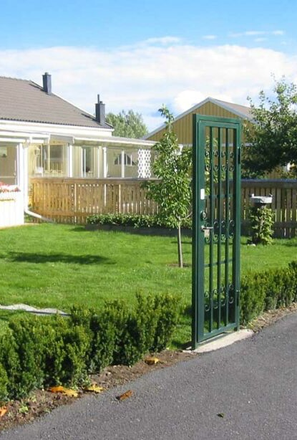
About passwords...
VERY BAD IDEAS:
store <user id, password> to check if the password of a user is correct
do not have the BIOS password-protected
Naïve mechanisms:
complain about the login name being wrong
show * while users are typing characters
weak passwords
default login/password → STUXNET!!!!
re-used passwords
Notes:
If we focus on passwords, which are the solution that is commonly adopted, we can agree on the fact that the following are all bad ideas (you can have a look at this by yourself).
A prominent example of why these are all bad ideas is the Stuxnet attack; you can search for it and will see how something critical has the Iranian nuclear program has been affected by one of these bad ideas. [c]

Slide 26
Unix authentication (alternative 1, not secure)
passwords are not stored, what is stored is <user id, result of encrypting a fixed block of data with the user password>
Easy to attack using dictionary attacks
Try all common passwords/combinations of words until one matches the encrypted set of characters associated with a user id → password found
Notes:
Once agreed that storing directly the password associated with each user is not a good idea, we can look at how authentication works in Unix.
A simple form of authentication (which is not adopted because it is not secure enough) is to store the result obtained when encrypting a fixed block of data with the user password rather than storing the password itself.
As we mentioned before, if we have a cryptographically secure one-way function f it means that from x we can compute y = f(x) but from y it is infeasible to find out x (which would be the password in this case).
Notice that, in this case, it is nonetheless possible to exploit dictionary attacks (simply put, to try all common passwords/combinations of words until one matches the encrypted set of characters).
Notice that if a match is found, all users having the same encryption result also have the same password. [c]

Slide 27
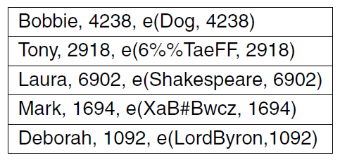
Unix authentication + n-bit salt
have unique random n-bit prefixes for each user
Now 1 dictionary is not enough, the attacker needs 2^n dictionaries --> unfeasible
Notes:
A variation to make Unix authentication more secure is that of using an additional n-bit salt (a random prefix of n bits) for each user password.
Assuming that the value is indeed random and cannot be found out by the attacker, this implies that each word in the dictionary should be tested with 2^n prefixes, which for large-enough n values becomes infeasible [c]

Slide 28
One-time passwords / one-way hash chain
Use hash function f with input and output having the same length
Choose a number n (how many passwords)
P₁ = f(f(f(f(s))))
P₂ = f(f(f(s)))
P_{i} = f(P_{i+1}) --> but you cannot find P_{i+1} from P_{i}
n of them
n-1 of them
Notes:
A different alternative is to use one-time passwords. In this case, an interesting example is that of one-way hash chain functions.
Supposing you have at your disposition a cryptographically secure one-way function (here simply called a hash function) for which the input and the output have the same length, and also supposing you want to use up to n one-time passwords,
you can compute [c] the first password (P1) applying the function n times, as shown in the slide.
[c] P2 can be computed applying the function n–1 times and, in general, [c] the i-th password can be computed applying the function over the (i+1)-th function.
That is, if you want to check that password i+1 is correct, you can check that its hash equals password i (but remember you cannot find password i+1 from password i). [c]
Seed (x0)
|
v f(x)
[x1] <--- f(x0)
|
v f(x)
[x2] <--- f(x1)
|
v f(x)
[x3] <--- f(x2)
|
v f(x)
[x4] <--- f(x3) (this one is stored/published)
The last step builds on authehtication assumption

Slide 29
One-time passwords / one-way hash chain
Server stores P₀ (which is f(P₁)) and value 1
First login, sends 1 to user, gets P₁, compares f(P₁) with P₀ and, if successful, stores P₁ and value 2
... can be repeated n times
Notes:
In this case, the server can store P0 and value 1.
When the user wants to connect, the server requests password 1, and to check if it is correct, it hashes it and compares it with the local one.
If they are the same, then the server can increase its value to 2 (it means next time it will ask the user to give password 2) and update its local password value to P1.
And this, of course, can be repeated up to n times.[c]

Slide 30
Challenge-Response authentication
Chose from a long list of questions
The user knows the answer, no need to “write it down somewhere”
Storage on server must be secure of course
Let the user choose an algorithm (e.g., x^2) and ask the user to compute the right answer
If an initial password/key k can be shared between user and server,
server shares r
both user and client compute f(r,k) and compare results – f can be known
--> with high computing power → complex f and large r/k → hard for the attacker to break
Notes:
As I mentioned before, there are several ways in which authentication can be performed. An alternative to passwords is that of challenge-response authentication.
A simple way to implement this is to choose as the secret to share the answer to a certain question, an answer that is known by the user but not by anyone else. This of course still requires the server-side storing to be secure! [c]
The user might also choose a certain algorithm and provide the output of such algorithm to the input provided by the server (in this case the algorithm cannot be trivial, otherwise the attacker can learn it easily) [c]
Finally, a way to go is also for the server and user to share an initial password k and for both to compute a certain function f over k and a value r shared by the server. If f is a complex function (and user/server have enough computational power to run it) and both and r and k are large enough, it might be infeasible for the attacker to recover k (even if f is known). [c]

Slide 31
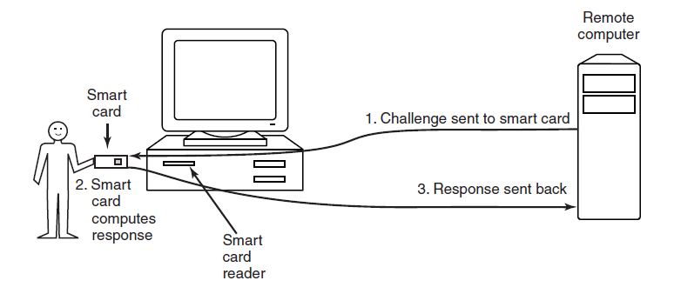
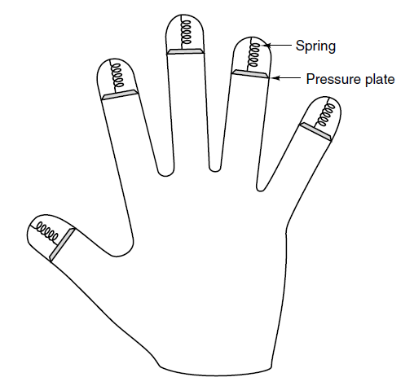
And more
Authentication using a physical object
Biometrics
Can be used in combination with passwords, of course (multiple techniques can be used at the same time)
account for variability
account for enough “distance” between users
Notes:
Other alternatives include authentication using physical objects such as smart cards and biometrics. [c]
In the case of biometrics, an important aspect to account for is variability, to have enough distance in the features between users while allowing some distance even for the same user (our face does not look always the same, to make a simple example) [c]
Of course, another important aspect is to realize many techniques can be used at the same time. [c]

Slide 32
About cards
Magnetic stripe cards
read only
can contain the user password
Chip cards
stored value cards
value in them can be updated
Smart cards
mount a small CPU
Can send messages/encrypting them in some cases
This can be useful to authorize payments when there’s no connectivity
Can run challenge-response authentication
Notes:
If we focus on cards, we can distinguish at least three types.
Magnetic stripe cards that contain read-only values (the password for instance),
chip cards that contain values that can be updated, and
Smart cards that also mount a small CPU and are also capable of participating in the check for authentication, for instance when using challenge-response authentication,
or by having the cards computing a small encrypted message (that could be helpful when buying something and having no connectivity) and then giving such token to the seller, who can give it later on to the bank to claim the money [c]

Slide 33
Agenda
Introduction/Overview
Protection Domains
Access Control Lists
Capabilities
Authentication
Exploiting software bugs: buffer overflow attacks
Notes:
Let’s move now to the last part of this lecture, focusing on bugs and how they can be exploited by adversaries.
In this case, we will focus on a specific type of attack, the buffer overflow attack. [c]

Slide 34
Exploiting software
Cracking passwords is only one way of course to gain control
Alternatives
drive-by-download: infect browser, have user download malicious content, malicious content downloads malware, ...
exploit bugs
OS have many...
Notes:
Before focusing on buffer overflow attacks, let me focus on some general considerations.
It should be clear that cracking a password is only one way to gain control from the attacker's perspective. There can be alternative ways, which even require fewer efforts in some cases.
One of them is to manage to trick the user into doing something that will harm him/her, and this could be done by infecting the browser, have users download malicious content, and so on...
The other is to exploit bugs, which are definitely there in Operating systems [c]

Slide 35
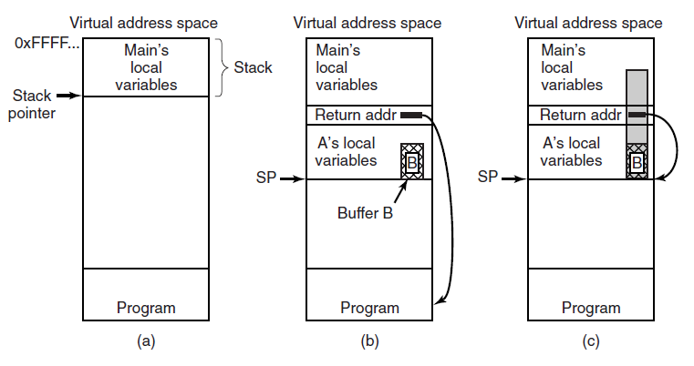
Buffer overflow attacks
Figure 9-21. (a) Situation when the main program is running. (b) After the procedure A has been called. (c) Buffer overflow shown in gray.
Notes:
Let’s focus now on buffer overflow attacks.
First, we need to know that the C programming language does not perform array bounds check. If we want to be sure we do not write in an array (a buffer of characters, for instance) something that is larger than the array itself, we need to do that explicitly.
Second, we need to remember that the stack of a process grows downwards, from the last address to smaller ones.
Let’s see now what is happening.
When we jump from the main function to a different function, we need to keep track of where we were, so that we can get back there once the function has completed its execution. We do this writing a return address.
After such a return address, we will have the various variables used by the function (A in the example).
Among these, we can have a buffer B.
If a malicious user is aware of this and also has the chance of giving back to the procedure A what should be written inside B, then it can give a longer input. This input can overwrite the return address.
In this case, the attacker can put a predefined value there, even pointing to an address within the input he/she just provided.
The code available there would then be executed next.
It turns out some system calls from the OS suffer from this bug. If the return address is changed to point to an injected code that starts a terminal, a malicious user can have access with full privileges to the computer (because the system call was being run by the operating system itself) [c]

Slide 36
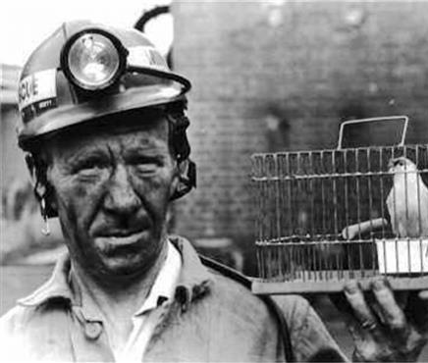
Possible defense: Stack Canaries
Just below the return address, add random canary value
When compiling a program, insert code that, upon return from a function, check if the canary value is still correct
Is it not? → return address has been modified WHP
NOTICE: stack canaries do not always work, check ”Avoiding Stack Canaries” in section 9.7
Notes:
A way to detect possible attacks (that is not 100% secure) is to use stack canaries.
In this case, just below the return address, we can add a random value and compile programs with special code that will stop the execution if such value is changed.
The idea is that when overflowing the buffer, the attacker will also change such random value, and the program will be able to detect this.
As I mention in the slide, you can check in the book how stack canaries can be avoided.[c]

Slide 37
Alternative defense strategy (not 100% secure either)
No-execute/NX bit (hardware)
hardware bit that ensures data segments are readable and modifiable, but not executable
Only text section can be executed
Code injection attacks do not work
Notes:
Alternative ways to go include the no-execute bit, which in this case is based on the hardware itself and used to specify portions of memory that cannot contain executable parts.
In this case, it is possible to prevent code injection attacks (because no code will be executed).

Slide 38
Questions

Slide 39
Consider the following protection matrix. Which statement is correct?
Domain | File 1 | File 2 | File 3
D1 | R | RW | -
D2 | - | R | W
D3 | RW | - | -
Each column corresponds to an access-control list, and each row corresponds to a capability list.
Each row corresponds to an access-control list, and each column corresponds to a capability list.
Neither representation corresponds to rows or columns of the matrix.
Notes:
1

Slide 40
Consider the following protection matrix
Domain | File 1 | File 2 | File 3 | File 4 | Printer 1 | Printer 2
D1 | R | - | - | - | W | -
D2 | RW | R | X | W | - | W
D3 | - | - | R | - | - | W
D4 | W | R | - | - | - | -
The administrator wants to determine everything that Domain 2 can access. Which representation requires inspecting a single list?
Access-control lists
Capability lists
Both
Notes:
2

Slide 41
Consider the following protection matrix
Assume that:
each nonempty cell is stored as one permission entry;
groups, wildcards, shared lists, and other compression mechanisms are not used; and
list metadata is ignored.
Which representation requires fewer permission entries?
Access-control lists
Capability lists
They require the same number
Domain | File 1 | File 2 | File 3 | File 4 | Printer
D1 | R | RW | - | X | -
D2 | W | - | R | - | RW
D3 | RX | - | - | W | R
D4 | - | X | RW | R | -
Notes:
3

Slide 42
Consider the following protection matrix
Domain | File 1 | File 2 | File 3 | File 4
D1 | - | - | R | -
D2 | R | - | W | -
D3 | - | W | RW | -
D4 | - | - | X | R
D5 | W | - | RX | -
The administrator wants to find and revoke all permissions on File 3. Which representation requires inspecting and updating a single list?
Access-control lists
Capability lists
Both
Notes:
1

Slide 43
An access-control list contains the following entries:
<A: R, B: R, C: R, D: RW, *: none>
Group G contains users A, B, C, and D. Which compact access-control list is equivalent to the original list for every user?
<G: R, D: RW, *: none>
<D: RW, G: R, *: none>
<G: RW, *: none>
Notes:
2

Slide 44
An access-control list contains the following entries:
<(A, *): R, (*, G1): RW, (*, *): none>
A process with UID=A and GID=G1 attempts to write to the object. Is the write operation permitted?
Yes
No
There is not enough information
Notes:
2

Slide 45
Assume that:
User A owns all three files;
folder permissions can be ignored; and
tool is a binary executable.
Consider the command trace
cat report.txt succeeds
printf 'x' >> report.txt fails
printf 'x' >> data.bin succeeds
./tool succeeds
cat tool fails
Which permission setup is consistent with the complete command trace?
Setup | report.txt | data.bin | tool
1 | r-- | rw- | --x
2 | rw- | r-- | r-w
3 | r-- | rw- | r-x
Notes:
1

