Slide 1


Operating Systems – EDA093/DIT401
Introduction to Operating Systems
Vincenzo Gulisano vincenzo.gulisano@chalmers.se

Slide 2
What to read (Main textbook)
Chapter 1
Especially: 1.1, 1.3, 1.6, 1.7

Slide 3
Agenda
What is an Operating System?
The event-driven (interrupt-driven) life of an OS
System calls (overview)
Dual-Mode and Multimode Operations
Operating system services
System calls (continued) and APIs [self reading]
System boot [self reading]
Operating system structures

Slide 4
Agenda
What is an Operating System?
The event-driven (interrupt-driven) life of an OS
System calls (overview)
Dual-Mode and Multimode Operations
Operating system services
System calls (continued) and APIs [self reading]
System boot [self reading]
Operating system structures

Slide 5

Components of a Computer System
Hardware – basic computing resources: CPU, memory, I/O devices
Operating system: what is that?
Application programs: Word processors, compilers, web browsers, database systems, video games
Users: People, machines, other computers
Notes:
Computer system can be divided into these 4 parts
OS sits in between hardware and applications / users
USER VIEW What it does depends on the user, single-user → Maximize ease of use multiple-users → resource utilization might be the goal
SYSTEM VIEW resource allocator
The ultimate goal is to run users’ applications while hiding the complexity of interfacing directly with the hardware

Slide 6
How can we define what an Operating System is and does?
Source: http://www.samsung.com/nz/consumer/home-appliances/washing-machines/front-loader/WW90H9600EW/SA
Source: http://www.amazon.com/Apple-MC916LL-Tablet-Black-Generation/dp/B0047DVWZS
Source: http://linustechtips.com/main/topic/50821-dell-contemplates-shipping-chinese-pcs-with-ubuntu-kylin-os-by-default/

Slide 7
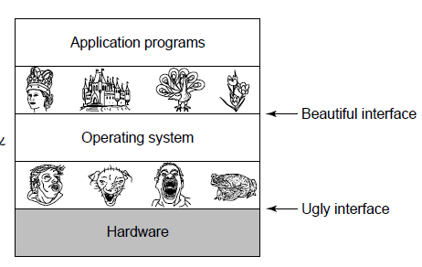
Operating System as Component of a Computer System
Provides a set of services to system users (collection of service programs)
Shield between the user and the hardware
Resource manager:
CPU(s)
memory and I/O devices
A control program
Controls execution of programs to prevent errors and improper use of the computer
Fig: Modern OS, A. Tanenbaum
Notes:
They always have a common role, and a kernel

Slide 8
Agenda
What is an Operating System?
The event-driven (interrupt-driven) life of an OS
System calls (overview)
Dual-Mode and Multimode Operations
Operating system services
System calls (continued) and APIs [self reading]
System boot [self reading]
Operating system structures

Slide 9
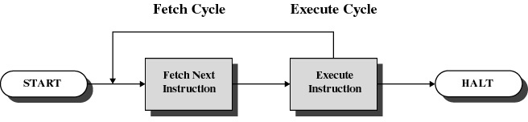
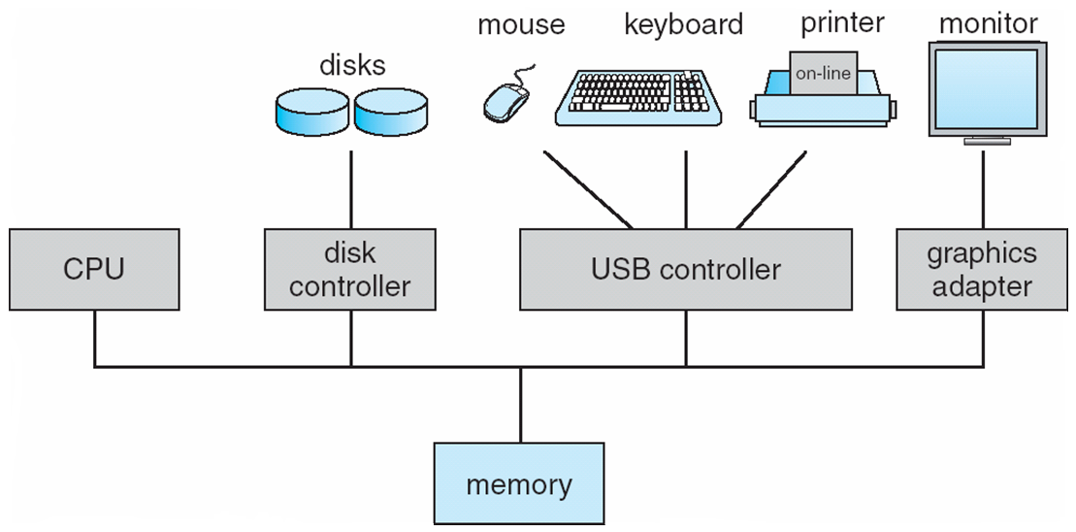
How does the OS manage devices and users?
Fig: Intro to OS, W. Stallings
Events (interrupts) mark the cycles of the OS!
Notes:
The basic cycle is pretty straightforward … but we have a lot of different devices and possibly multiple users / multiple programs running at the same time… so how does it work?
Events / interrupts mark the life cycles of an OS

Slide 10
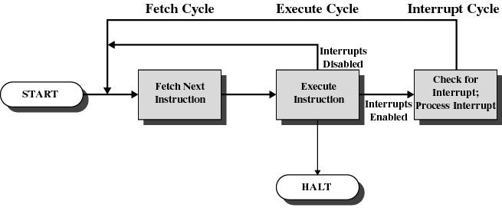
Events/interrupts are the basic “ticks” of the OS cycle
OS doing some work
Interrupt!
What’s happening?
Keystroke! Need to print a character on screen…
Doing that…
Going back to my previous work…
Interrupt!
What’s happening?
Byte copied to disk!
OK then copying another byte…
Interrupt!
…
Fig: Intro to OS, W. Stallings
Notes:
You can imagine that you of course need some dedicated hardware to do this… especially because you need to be fast!

Slide 11
Agenda
What is an Operating System?
The event-driven (interrupt-driven) life of an OS
System calls (overview)
Dual-Mode and Multimode Operations
Operating system services
System calls (continued) and APIs [self reading]
System boot [self reading]
Operating system structures

Slide 12
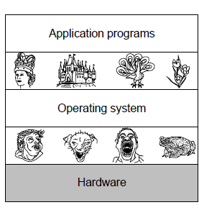
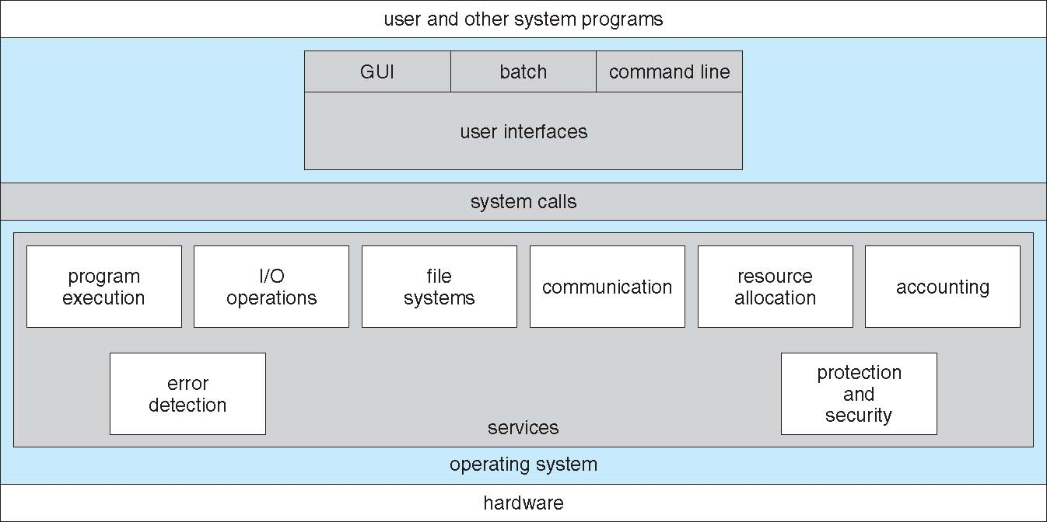
A deeper look at the OS…
→ Interrupts!!!
Fig: Modern OS, A. Tanenbaum
How does the OS allow users and programs to use and interface with the hardware and the resources of a computer?

Slide 13
Agenda
What is an Operating System?
The event-driven (interrupt-driven) life of an OS
System calls (overview)
Dual-Mode and Multimode Operations
Operating system services
System calls (continued) and APIs [self reading]
System boot [self reading]
Operating system structures

Slide 14
Wait a moment…
What if a program gets stuck in an infinite loop?
What if it alters the data of another program?
What if it modifies the operating system?

Slide 15
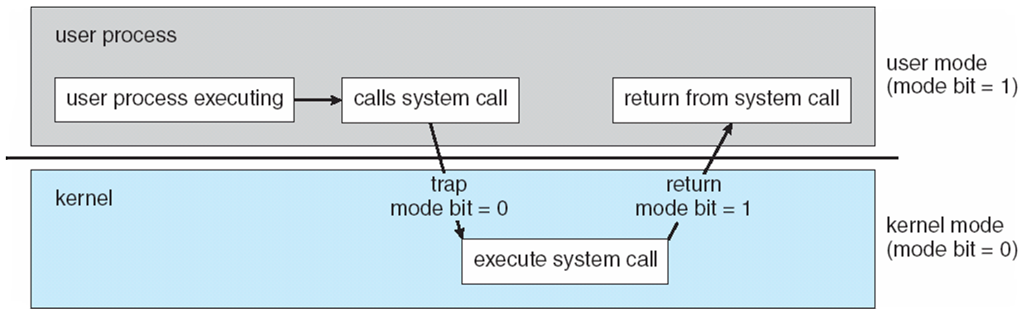
Dual-mode and Multimode Operations (I)
Two different modes: User mode / Kernel mode
A mode bit (hardware) differentiates between the two
Is it a privileged instruction what should be run next?
Can only execute in kernel mode (mode bit = 0)
Running a user program?
First switch the mode bit to 1… then run the code

Slide 16
Dual-mode and Multimode Operations (II)
More than 2 modes can exist
Example: to allow a Virtual Machine Manager (VMM) to execute more instructions than a user program
Example: Intel 64 CPUs allow for 4 privilege levels
If a user program tries to execute a privileged instruction
The hardware sends an interrupt to the OS (technically, a synchronous exception/trap that eventually leads to the OS)
The OS terminates the program (or does something else depending on the case)
Notes:
Trap is software, interrupt is hardware. exceptions/traps are synchronous with the current instruction, while hardware interrupts are asynchronous.
Yes. The operating system sets up the trap (and interrupt/exception) entry points at boot time. The hardware provides registers or tables (e.g., the IDT on x86, the trap vector base on RISC-V, the vector table on ARM) that the OS fills with the addresses of the handlers. This is done during boot, when only the OS kernel is executing and is trusted to configure the CPU correctly. After that, user processes cannot modify these entry points because updating them requires privileged instructions.

Slide 17
A special interrupt mechanism: the timer
When the OS decides to run a user program, how can it be sure the latter will generate an interrupt (in a reasonable amount of time)?
It can’t…
A timer can be used to periodically raise an interrupt to the OS
The OS can then take control

Slide 18
Question(s)
Can a user process change the mode bit to 0?
What happens if it tries?
But how does the CPU know if the code belongs to the user or the kernel?
Hardware defines which instructions are privileged. For each class of exception, the OS specifies which OS code to run
Turn on the hardware
Mode bit set to 1 before starting any user process. Any privileged instruction will trap attempted by a user process (some non-privileged too, if they do something they are not supposed to do)
No user process exists so far
Time
Firmware/bootloader perform predefined steps to load code into memory (code = the OS)
Complete loading of OS
Notes:
Examples of instructions that are privileged (defined by the hardware): LIDT Replace the interrupt descriptor table or HLT to halt the processor, which suspends the central processing unit (CPU) until the next external interrupt is fired. Notice also non-privileged instructions can fire an interrupt, for instance MOV to memory that does not belong to the process.

Slide 19
Agenda
What is an Operating System?
The event-driven (interrupt-driven) life of an OS
System calls (overview)
Dual-Mode and Multimode Operations
Operating system services
System calls (continued) and APIs [self reading]
System boot [self reading]
Operating system structures

Slide 20
What does the operating system provide?
Allow the user to interact with the system
Allow the user to access information (files and directories)

Slide 21
What does the operating system provide?
Allow programs to run, communicate with devices, access files and directories and communicate with one another

Slide 22
What does the operating system provide?
React when errors occur (e.g., a connection failure, attempt to access an illegal memory location)

Slide 23
What does the operating system provide?
Allow the system to operate efficiently, treat users fairly, and remain secure

Slide 24
Agenda
What is an Operating System?
The event-driven (interrupt-driven) life of an OS
System calls (overview)
Dual-Mode and Multimode Operations
Operating system services
System calls (continued) and APIs [self reading]
System boot [self reading]
Operating system structures

Slide 25
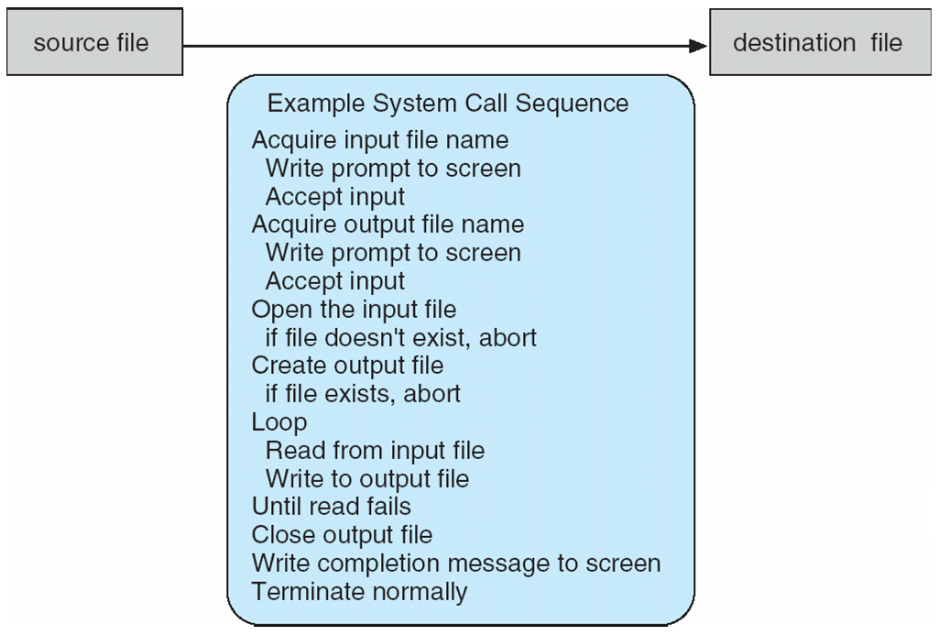
Let’s say we want to copy a file…
If a graphical menu is used to let the user pick a source file, many more system calls are needed (and I/O)
We could also decide to replace it (asking the user first)... More system calls!!!

Slide 26
Application Programming Interfaces (APIs)
APIs provide high-level combinations of low-level system calls
Reducing by some order of magnitude the number of calls to low-level system calls the user should otherwise handle (usually thousands of system calls per second are handled by the OS)
What are the advantages?
Portability
Simplicity

Slide 27
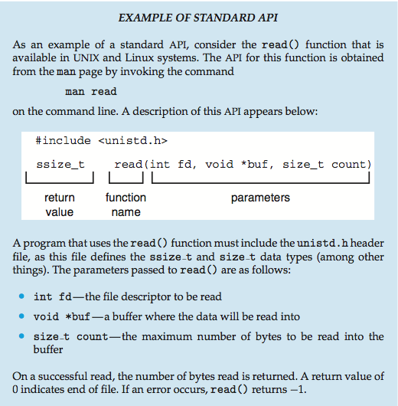
Sample API

Slide 28
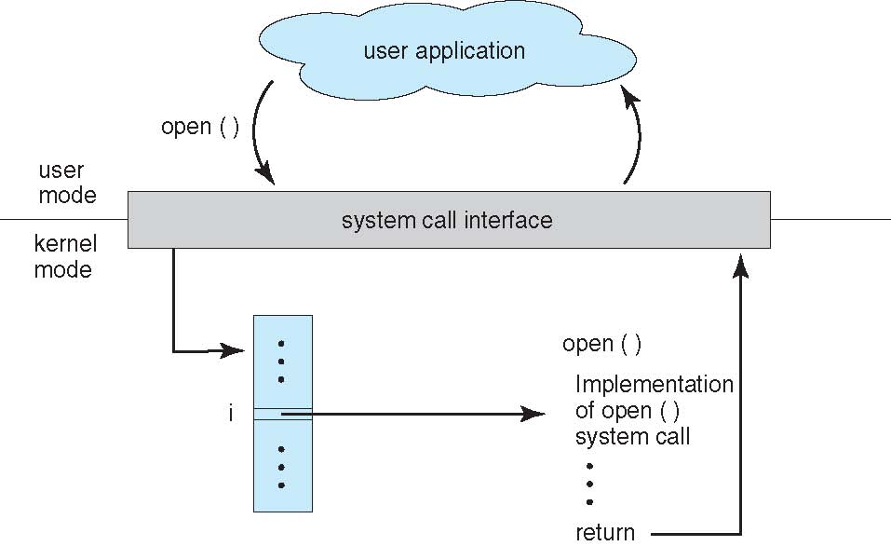
System call interface
Typically, a number is associated with each system call
The System-call interface maintains a table indexed according to these numbers
The system call interface invokes the intended system call in the OS kernel and returns status of the system call and any return values
The caller needs to know nothing about how the system call is implemented

Slide 29
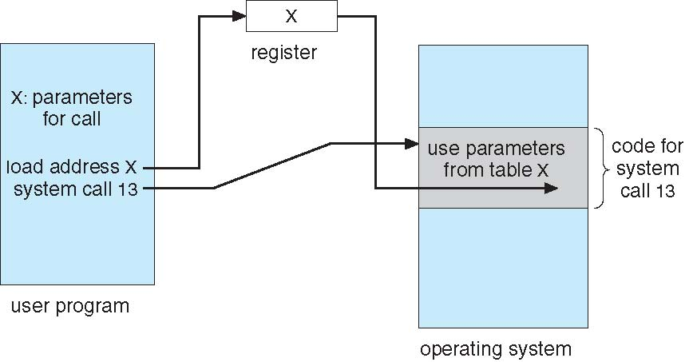
How are parameters passed to a system call?
Pass the parameters in registers
In some cases, there may be more parameters than registers
Parameters are stored in a block, or table, in memory, and the address of the block is passed as a parameter in a register
This approach is used by Linux and Solaris
Parameters are placed, or pushed, onto the stack by the program and popped off the stack by the operating system
Block and stack methods do not limit the number or length of parameters being passed

Slide 30
Types of system calls (I)
Process control
create process, terminate process
end, abort
load, execute
get process attributes, set process attributes
wait for time
wait event, signal event
allocate and free memory
Dump the memory if an error occurs
Debugger for finding bugs, single step execution
Locks for managing access to shared data between processes

Slide 31
Types of system calls (II)
File management
create file, delete file
open, close file
read, write, reposition
get and set file attributes
Device management
request device, release device
read, write, reposition
get device attributes, set device attributes
logically attach or detach devices

Slide 32
Types of system calls (III)
Information maintenance
get time or date, set time or date
get system data, set system data
get and set process, file, or device attributes
Communications
create, delete communication connection
send, receive messages if message passing model to host name or process name
From client to server
Shared-memory model: create and gain access to memory regions
transfer status information
attach and detach remote devices

Slide 33
Types of system calls (IV)
Protection
Control access to resources
Get and set permissions
Allow and deny user access

Slide 34
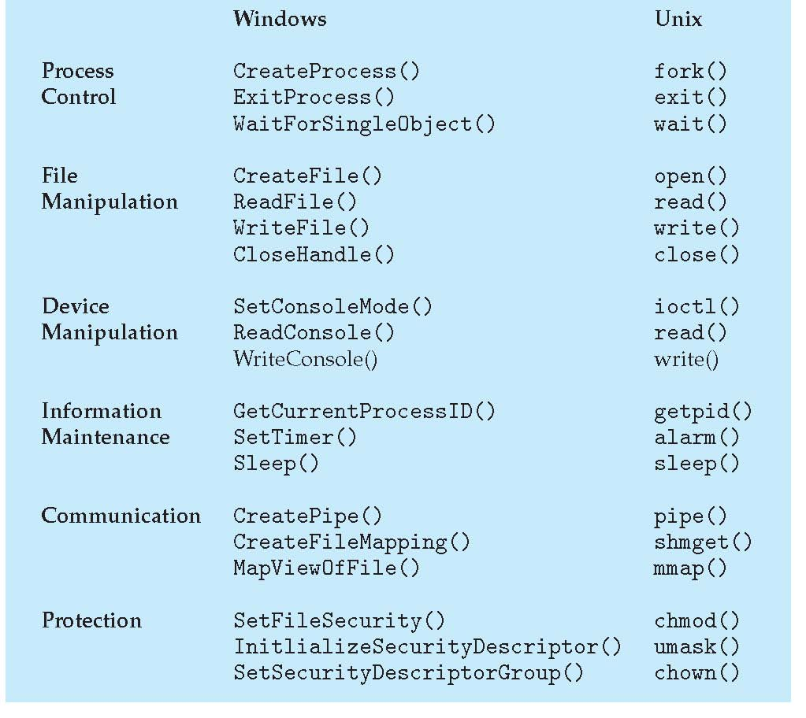
Some examples

Slide 35
Agenda
What is an Operating System?
The event-driven (interrupt-driven) life of an OS
System calls (overview)
Dual-Mode and Multimode Operations
Operating system services
System calls (continued) and APIs [self reading]
System boot [self reading]
Operating system structures

Slide 36
How does the computer know where / how to load the kernel at startup?
When the system is powered on, execution starts at a fixed memory location
Firmware ROM is used to hold the initial boot code
The operating system must be made available to the hardware so the hardware can start it
Small piece of code – bootstrap loader, stored in ROM or EEPROM, locates the kernel, loads it into memory, and starts it
Sometimes a two-step process is used where a boot block at fixed location is loaded by ROM code, which loads bootstrap loader from disk
A common bootstrap loader, GRUB, allows selection of a kernel from multiple disks, versions, kernel options
The kernel loads, and the system is then running

Slide 37
Agenda
What is an Operating System?
The event-driven (interrupt-driven) life of an OS
System calls (overview)
Dual-Mode and Multimode Operations
Operating system services
System calls (continued) and APIs [self reading]
System boot [self reading]
Operating system structures

Slide 38
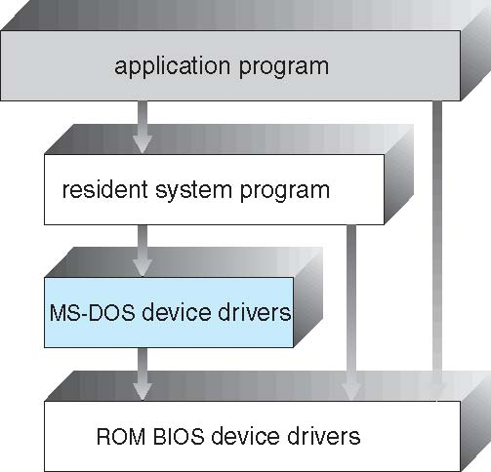
Operating System structure
Simple Structure
Monolithic structure
Designed for hardware without dual mode
Vulnerable to wrong/malicious code
Notes:
Say this is a sort of history
A monolithic operating system is one where the entire OS kernel runs in a single address space in kernel mode.
All core services—process management, memory management, file systems, device drivers, and system call handling—are implemented within the same large kernel. This design allows efficient function calls between components but makes the kernel large and less modular: a bug in any part (e.g., a driver) can crash the whole system.

Slide 39
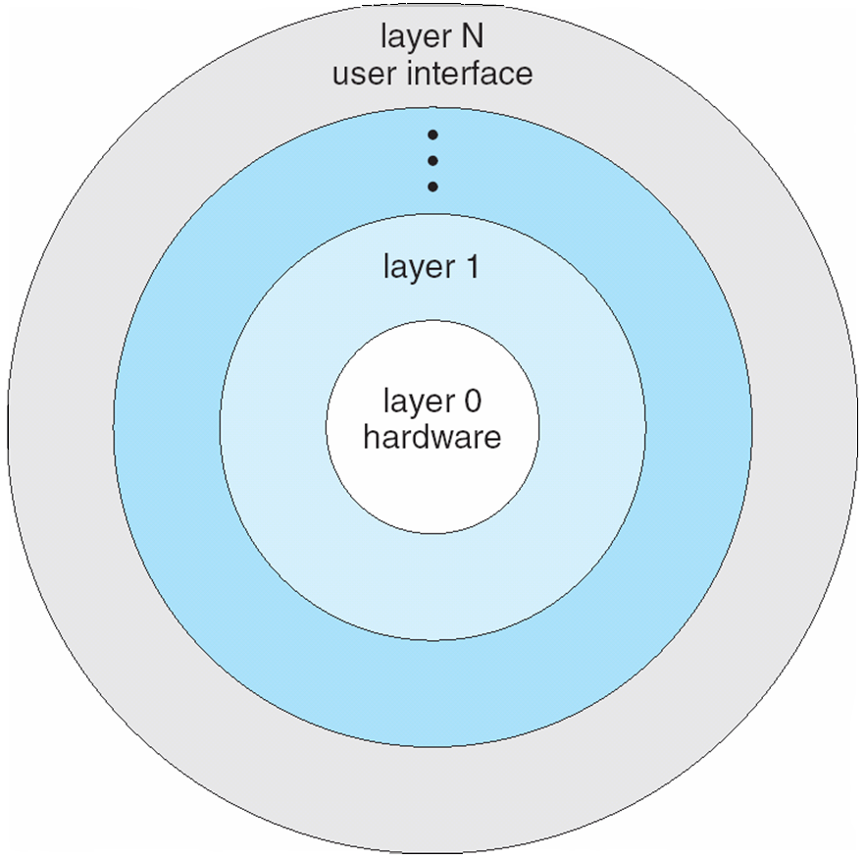
Operating System structure
Simple Structure
Layered Approach
Modular approach
Each layer maintains some data structures and a set of routines
Easier to debug
Problematic for “circular references”
Notes:
CPU scheduler above processes (info for deciding what to schedule)
BUT some processes could be above CPU
In a layered operating system, each layer is supposed to depend only on the services of the layer directly below it. A problematic circular reference occurs if two layers end up depending on each other.
Example:
Suppose the File System layer is above the Memory Management layer.
The File System layer calls memory management functions to allocate buffers for file data.
At the same time, the Memory Management layer is implemented using paging, and it tries to store its swap space inside regular files managed by the File System layer.

Slide 40
Operating System structure
Simple Structure
Layered Approach
Microkernels
Mach, one of the firsts modularized microkernels
Everything that is not essential → system-level or user-level program
Essential parts remain in the microkernel
Smaller
Makes sense if system-level/user-level programs can be updated frequently
More secure (most programs are now executed in user mode)
Might have lower performance

Slide 41
Operating System structure
Simple Structure
Layered Approach
Microkernels
Modules
Can be loaded in the kernel (at boot or on demand)
Unix-like (Solaris, Linux and Mac OS X) and Windows
Modules can be loaded without recompiling the kernel
Notes:
Modules are similar to microkernels, but modules are within the kernel

Slide 42
Operating System structure
Simple Structure
Layered Approach
Microkernels
Modules
Hybrid Systems
Mixing other structures
Usual case for modern operating systems

Slide 43
Hybrid systems – Mac OS X
Layered structure
This is for Objective-C programming (Mac OS X applications)
Memory management, RPCs and Interprocess communication, thread scheduling
Command-line interface, networking, file system
Notes:
BSD Berkeley Software Distribution (UNIX system)

Slide 44
Hybrid systems – iOS
Provides support for touchscreen devices

Slide 45
Hybrid systems – Android
Applications
“Java for Android” virtual machine
Linux kernel

