Slide 1


File Systems Operating Systems – EDA093/DIT401 Vincenzo Gulisano vincenzo.gulisano@chalmers.se

Slide 2
Reading instructions
Chapter 4.1 to 4.4
Please notice: UEFI only in 5th edition (4.3.1) but slides are enough (extra facultative reading: 10.1-10.3.6,10.4-10.6,11.1-11.2,11.4-11.5 from Silberschatz Operating System Concepts)

Slide 3
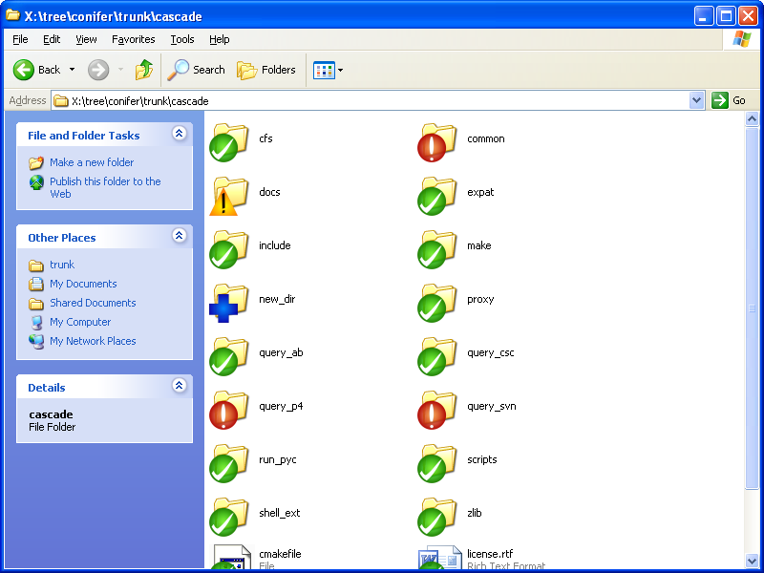
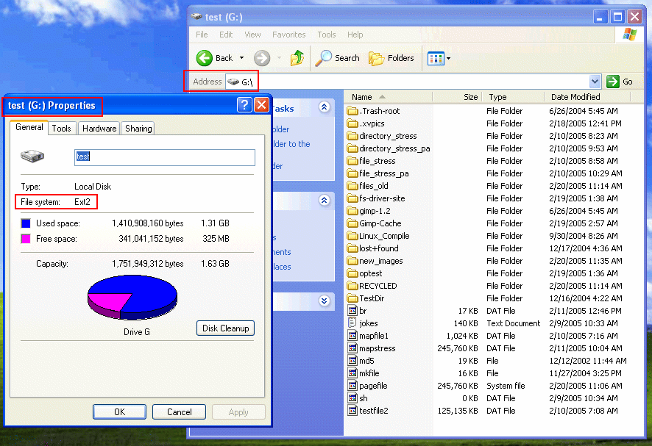
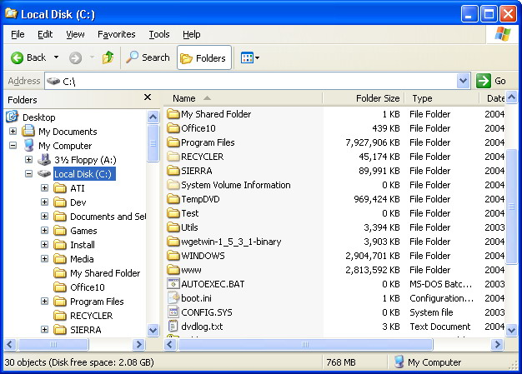
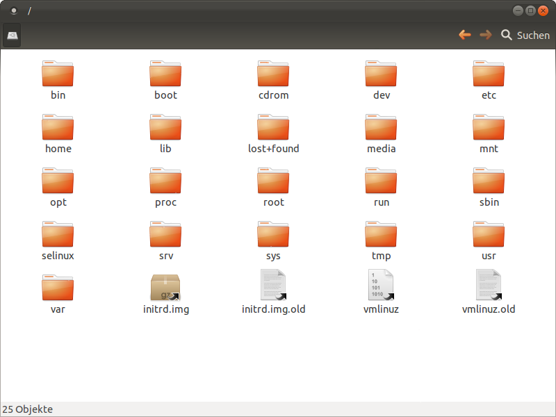
Which are the most visible aspects of a File System?
Files
Directories

Slide 4
Objectives
To explain the function of file systems
To describe the interfaces to file systems
To discuss file-system design tradeoffs, including access methods, file sharing, file locking, and directory structures
To explore file-system protection
To discuss block allocation and free-block algorithms and trade-offs

Slide 5
AGENDA
What extra information / overheads / interfaces does the OS need to provide file and directory abstractions to users?
File concept
Access methods
Disk structure
Directory structure (Self reading)
File-system structure
Allocation methods
Free-space management
File sharing and protection
How to we access files and which is the minimum unit we can read/write from secondary storage?
How is the physical disk organized in order to maintain 1 (or more) file systems?
How can we organize directories (and files) in a file system?
How is a file system organized in layers?
How do we know where each file is?
How do we know what portions of a file systems are free?
How do we share and protect files among different users?

Slide 6
AGENDA
What extra information / overheads / interfaces does the OS needs to provide file and directory abstractions to users?
File concept
Access methods
Disk structure
Directory structure (Self reading)
File-system structure
Allocation methods
Free-space management
File sharing and protection

Slide 7
File Concept
How are files:
Named
Structured
Protected
Accessed
…
Minimum allocation unit for the user
File system abstracts how they are mapped into secondary storage
Similarly to processes, files have contiguous logical address space (but not physical)
Different types: Data files (numeric, character, binary) and Program files
Contents defined by file’s creator! (Consider text file, source file, executable file)
Notes:
You should feel there are parallelism with processes and memory
And interdependencies (think about page size)
E.g., common Linux config:
Page size = 4096 bytes
Disk sector = 512 bytes
Filesystem block = 4096 bytes → Each page matches one FS block nicely.

Slide 8
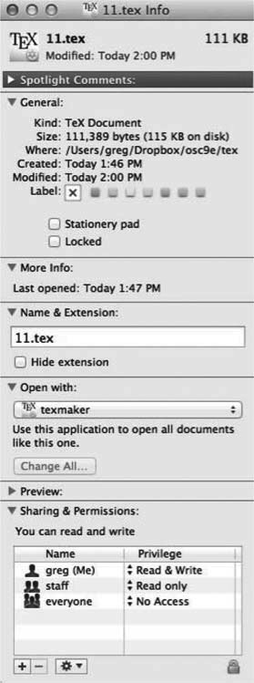
File Attributes
Name – only information kept in human-readable form
Identifier – unique tag (number) identifies file within file system
Type – needed for systems that support different types
Location – pointer to file location on device
Size – current file size
Protection – controls who can do reading, writing, executing
Time, date, and user identification – data for protection, security, and usage monitoring

Slide 9
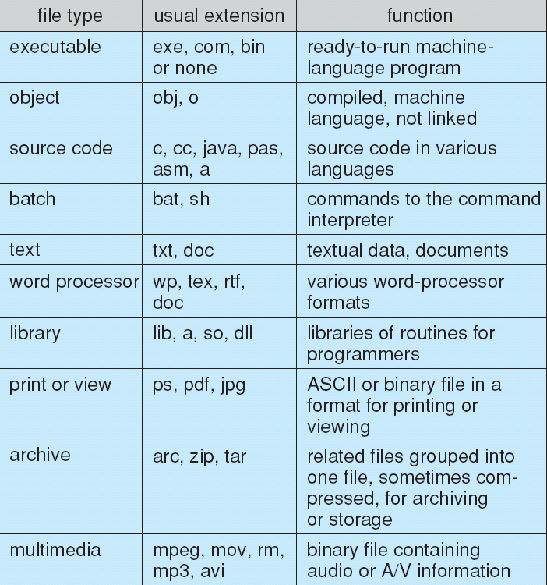
File Types – Name, Extension
Operating System, Processes and File System are dependent on each other
Extensions provide hints to the Operating System about which program to load in order to present the content to the user

Slide 10
Open Files
Providing a File System implies that the OS needs to maintain information. For instance, information about the open files:
Open-file table: tracks open files
File pointer: pointer to last read/write location, per process that has the file open
File-open count: counter of number of times a file is open – to allow removal of data from open-file table when last processes closes it
Disk location of the file: cache of data access information
Access rights: per-process access mode information
Some information is specific to a process
Some information is global, system-wide

Slide 11
File Operations
File is an abstract data type, we need ways to operate on them:
Create
Write – at write pointer location
Read – at read pointer location
Reposition within file - seek
Delete
Truncate
We can combine these basic operations into complex operations
Example:
Open(F_{i}) – search the directory structure on disk for entry F_{i}, and move the content of entry to memory
Close (F_{i}) – move the content of entry F_{i} in memory to directory structure on disk

Slide 12
System calls - Example program – 1/2
Fig. Tanenbaum, Modern Operating Systems

Slide 13
System calls - Example program – 2/2
Fig. Tanenbaum, Modern Operating Systems

Slide 14
AGENDA
File concept
Access methods
Disk structure
Directory structure (Self reading)
File-system structure
Allocation methods
Free-space management
File sharing and protection
How to we access files and which is the minimum unit we can read/write from secondary storage?

Slide 15
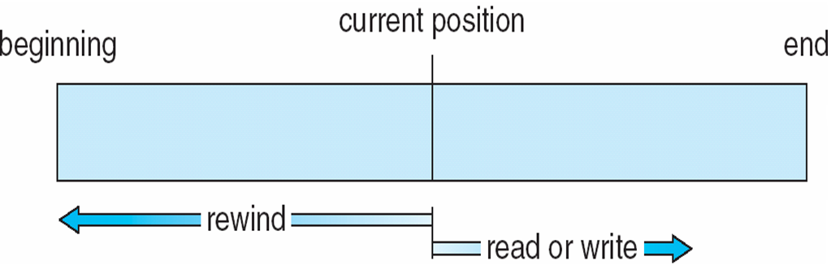
Access Methods
Sequential Access
read next
write next
reset
Direct Access – file is fixed length logical records
read n
write n
position to n
read next
write next
rewrite n
n = relative block number (0 being the beginning of the file)
Why do we read blocks and not just bytes?
Notes:
question

Slide 16
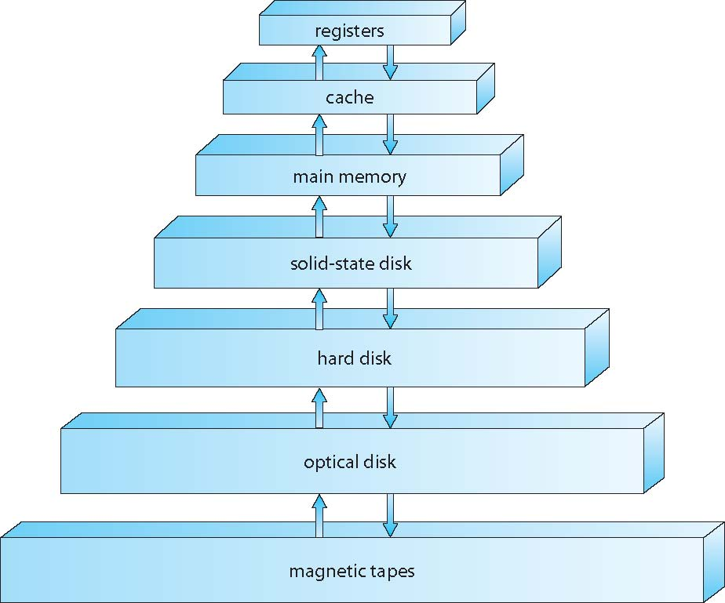
Reading / Writing blocks
I need the byte at position X from the disk!
System call…
Context switch…
Moving to waiting queue…
I/O disk…
Interrupts…
More context switch…
If we pay this price for each bytes it does not pay off…

Slide 17
Block Size 1/2
Which is the appropriate size of a block?
Large block
: Less blocks to read (➔faster reading)
: More wasted space if files are small
Small block
: Less space wasted
: More blocks to read (➔slower reading)

Slide 18
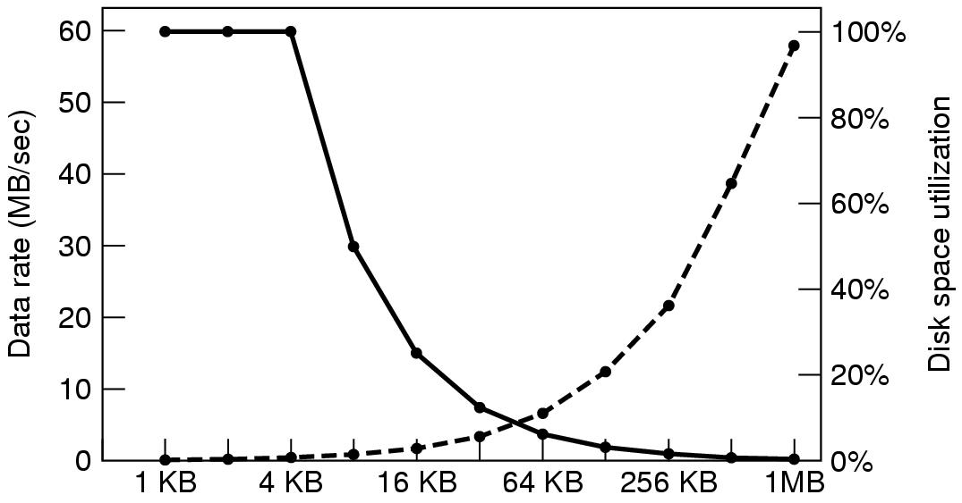

Block Size 2/2
Disk Space
Data Rate
Fig. Tanenbaum, Modern Operating Systems
Why is it so challenging to chose the right block size?
Notes:
don’t give hints, there’s a question later on

Slide 19
AGENDA
File concept
Access methods
Disk structure
Directory structure (Self reading)
File-system structure
Allocation methods
Free-space management
File sharing and protection
How is the physical disk organized in order to maintain 1 (or more) file systems?

Slide 20
File System layout on disk
Master Boot Record (MBR) – Legacy
GUID Partition Table (GPT), typically used with UEFI
Notes:
For disk layouts with one or more file systems, we will look at two boot and partitioning layouts: the Master Boot Record (MBR), an old legacy layout not much used today, and UEFI together with GPT, the GUID Partition Table, where GUID stands for Globally Unique Identifier.

Slide 21
File system layout – MBR/Legacy
Disk partitions: 1 (or more) independent file systems
Fig. Tanenbaum, Modern Operating Systems
The boot block is used to load the operating system of the partition
What there is after the boot block depends on the operating system. Superblock usually contains key information specific to each operating system.
Notes:
With the MBR layout, a disk can have different partitions, each containing an independent file system. Each partition begins with a boot block, which contains executable code that, once loaded into memory, can start the operating system associated with that partition, if the partition contains one OS. The blocks after the boot block depend on the specific file system in that partition.

Slide 22
File system layout – MBR/Legacy
Fig. Tanenbaum, Modern Operating Systems
MBR: Master Boot Record. Starts at sector 0 and is used to boot the computer. At the end, it contains the partition table.
Notes:
At the beginning of the disk, we have the Master Boot Record. The MBR is the first sector and contains both boot code and the partition table. When the machine starts, it loads the executable in the MBR, which reads the partition table and chooses which partition to use to load the OS, possibly asking the user.

Slide 23
File system layout – MBR/Legacy
Fig. Tanenbaum, Modern Operating Systems
Partition table: starting address and size of each partition.
One of the partitions is marked as active. Boot sequence:
Read the MBR
Locate the active partition
Read Boot block
Notes:
The partition table contains the addresses of the partitions. If one partition is marked as active, it is selected to load the operating system by reading that partition’s boot block.

Slide 24
Limitations of MBR
Limited
512 bytes must contain boot code and partition table, so booting often requires loading more code from disk
Only four primary partitions
Architecture dependent
Legacy BIOS starts in 16-bit real mode on start up
16-bit registers/instructions (Word size)
No paging
Max 2TB
32 bits for start address, 32 for size, sector of 512 bytes
2^32*512*10^-12=2.2 TB
Notes:
The MBR layout has been used for decades, especially when rotating disks were common in computers and laptops. It has several limitations. The MBR is limited to 512 bytes, including the partition table, so it often cannot contain all the code needed to boot and must load more code from another disk section. It also supports only up to four primary partitions. With legacy BIOS booting, execution starts in 16-bit real mode, using 16-bit registers and instructions, without paging, which is no longer how modern hardware normally works. Finally, given the bits used for the partition start address and size, and the assumed sector size, MBR can only handle partitions up to about 2 TB.

Slide 25
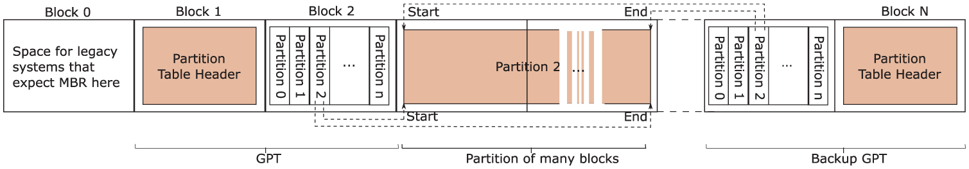
Unified Extensible Firmware Interface (UEFI)
Protective MBR for legacy tools
Notes:
Let's move now to the Unified Extensible Firmware Interface (UEFI), which is the common layout today, and which is more complex but offers richer features. The first block is still reserved for an MBR in case legacy tools expect it. This is called the protective MBR. It tells legacy MBR tools that the disk is occupied, so they do not treat the GPT disk as empty.

Slide 26
Unified Extensible Firmware Interface (UEFI)
GUID Partition Table
GUID stands for Globally Unique Identifier
Notes:
After that, block 1 contains the GPT header, followed by the GPT partition-entry array. The actual partitions follow after that.

Slide 27
Unified Extensible Firmware Interface (UEFI)
Notes:
At the end of the disk, there is a backup copy of the GPT. This backup contains a backup header and partition entries, so the partition table can be recovered if the primary GPT is damaged.

Slide 28
Unified Extensible Firmware Interface (UEFI)
UEFI firmware is powerful enough to read a specific partition, called EFI System Partition (ESP)
It’s one of the partitions
This is a proper file system with programs, configuration files
Can load and execute programs in a specific format (PE/COFF executables, usually with the .efi extension).
Notes:
One difference with MBR is that we are not only loading a small program that decides which operating system to load. Instead, there is a specific partition called the EFI System Partition, which contains a proper file system and executables. More concretely, UEFI loads .efi boot programs from the EFI System Partition.

Slide 29
AGENDA
File concept
Access methods
Disk structure
Directory structure (Self reading)
File-system structure
Allocation methods
Free-space management
File sharing and protection
How can we organize directories (and files) in a file system?

Slide 30
What should directories allow us to do?
Search for a file (or search all the files with a given extension)
Create a file
Delete a file
List a directory
Rename a file
Traverse the file system
Locate a file quickly
Provide convenient naming (Two users can have same name for different files)
logical grouping of files by properties, (e.g., all Java programs, all games, …)
The following is a list of common schemes for the logical structure of a directory

Slide 31
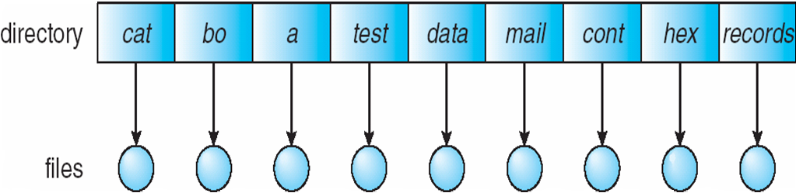
Single-Level Directory
A single directory for all users
Simple (good for small devices)
Easy to locate files
Different users / same file name?

Slide 32
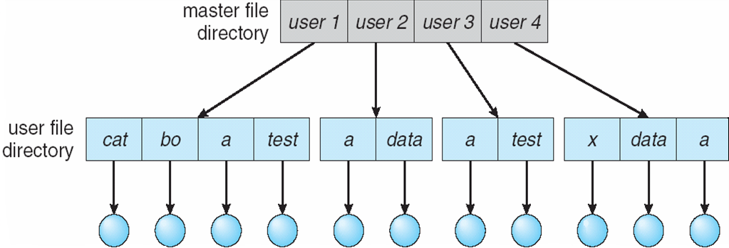
Two-Level Directory
Separate directory for each user
Same file for different users
Better searching
Will require a sort of login
Not convenient for large number of files
Will require a path name (the file name is not enough to access it)

Slide 33
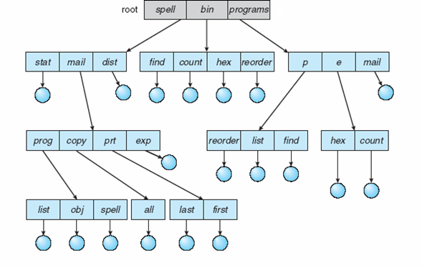
Tree-Structured Directories
Users decide how to organize their data
Even better searching
Arbitrary numbers of directories (in practice, each directory becomes a file…)
Introduces current directory
Introduces more operations on directories

Slide 34
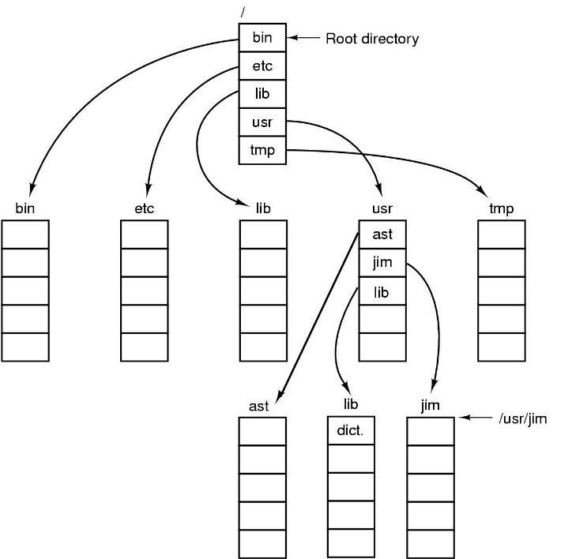
Path names
Absolute path name
Relative path name (given working directory)
absolute path name change working directory
cd /bin
ls .
ls ..
cd ../lib
cp ../usr/lib/hello.txt /tmp/hello.txt
list files of this folder (.)
list files of parent folder (.)
relative path name change working directory
relative path name absolute path name
Fig. Tanenbaum, Modern Operating Systems

Slide 35
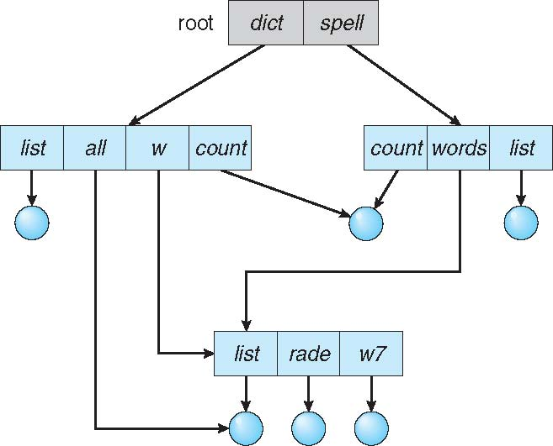
Acyclic-Graph Directories
Have shared subdirectories and files
In this case, we have a new type of file, the link (a pointer to an existing file)

Slide 36
Acyclic-Graph Directories bring trade-offs…
Suppose we are in spell/words and we delete list. Should we delete it from dict/w too?
Let’s say we remove it, should we update the links of other references or not?
Let’s say we remove it and update the links of other references, how do we know how many references we have?
Notes:
1 – yes… well depends, maybe w/list was created before or by another user
1 – no… well depends, maybe it was created by this user
2 – yes… but then the other folder might not notice at all
2 – no… other folders will notice, we will save time, but users will get an error
3 – we can keep track of them… extra info to maintain
3 – we can look for them… might take forever…

Slide 37
AGENDA
File concept
Access methods
Disk structure
Directory structure (Self reading)
File-system structure
Allocation methods
Free-space management
File sharing and protection
How is a file system organized in layers?

Slide 38
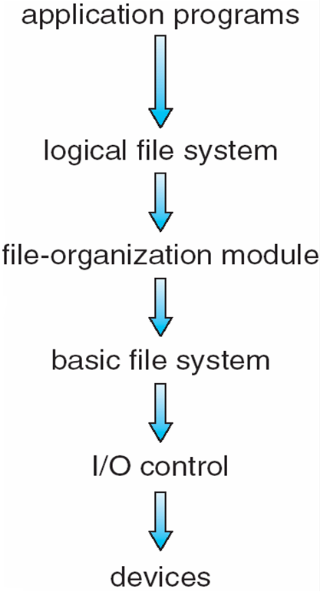
Layered File System
Manages metadata information Translates file name into file number, file handle, location by maintaining file control blocks (inodes in Unix) Directory management Protection
Understands files, logical address, and physical blocks Manages free space, disk allocation
Translates logical block # to physical block #
manages memory buffers and caches “retrieve block 123”
manage I/O devices at the I/O control layer “read drive1, cylinder 72, track 2, sector 10, into memory location 1060”

Slide 39
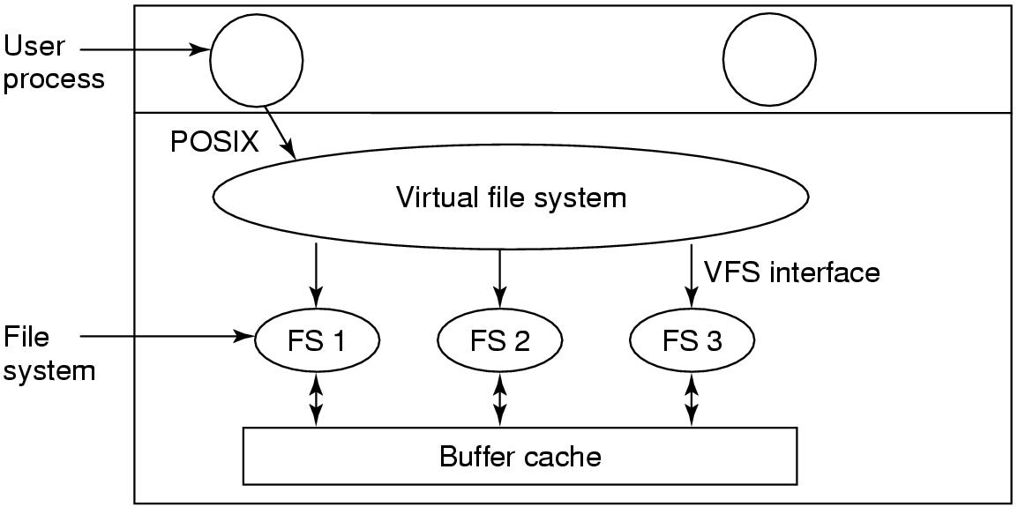
Virtual File Systems
Suppose a system has multiple partitions with different file systems, how can you integrate all of them?
Interface to the user
Interfaces to the different file systems
Fig. Tanenbaum, Modern Operating Systems

Slide 40
Implementing Files
Which file is this?
Contiguous allocation
Linked List allocation
FAT (File Allocation Table)
I-nodes (Index-nodes)
Disk block n

Slide 41
AGENDA
File concept
Access methods
Disk structure
Directory structure (Self reading)
File-system structure
Allocation methods
Free-space management
File sharing and protection
How do we know where each file is?

Slide 42
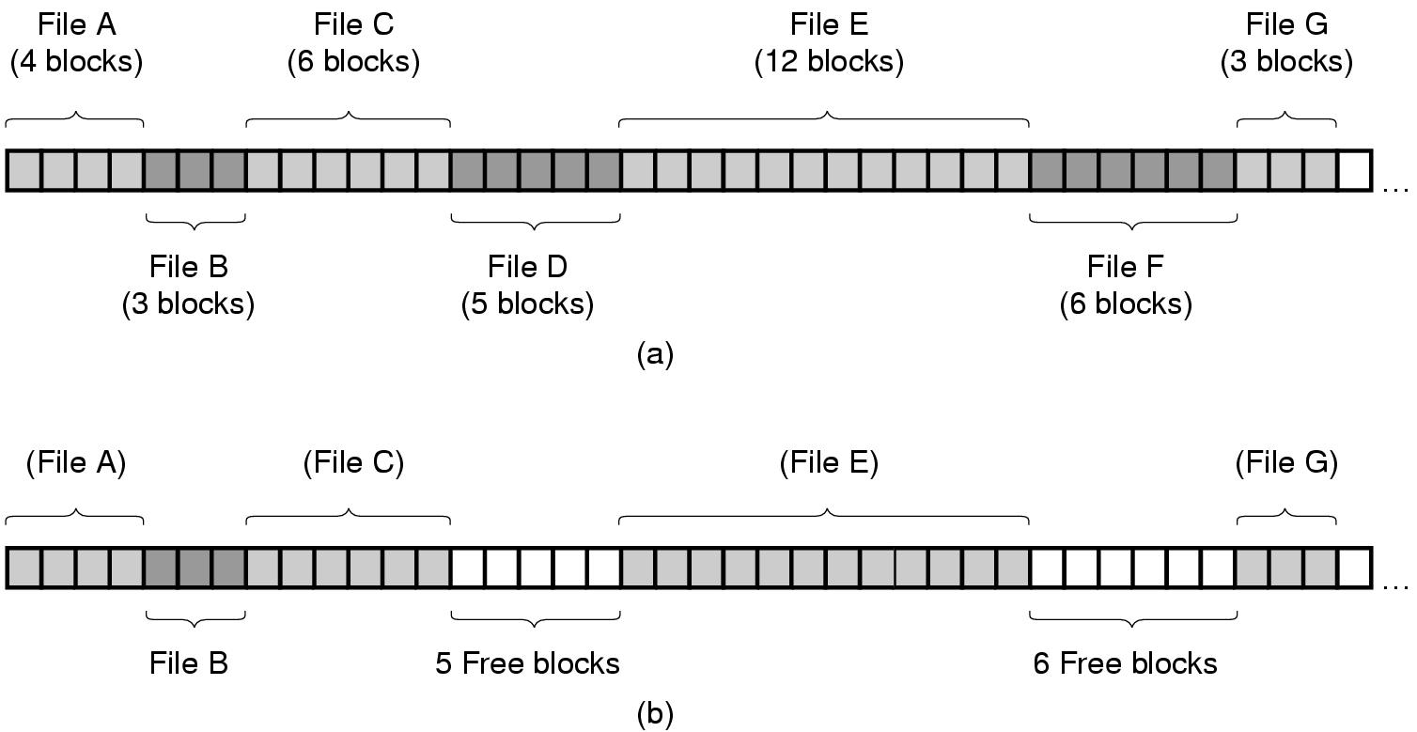
Contiguous allocation
Fig. Tanenbaum, Modern Operating Systems
Need to maintain 2 numbers per file (first address, number of blocks).
Read performance (single scan).
Fragmentation.
New file size required in advance.
In which support is contiguous allocation actually a good idea?

Slide 43
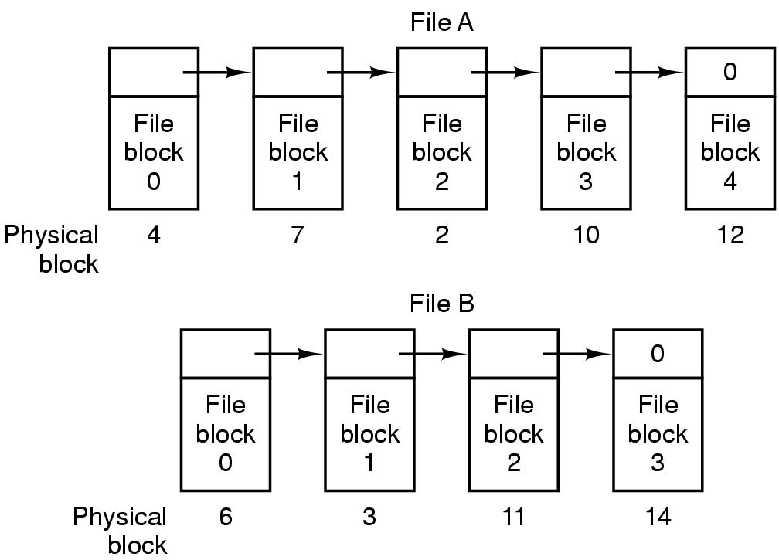
Linked List allocation
Fig. Tanenbaum, Modern Operating Systems
Need to maintain 1 number per file (first address).
Get block n?
Less space available per block.
Notes:
do you agree with me that the size we cannot use in the block depends on how many blocks in total we have? This depends on the size of the disk and the block size...

Slide 44
Linked List allocation using FAT
Disk: 40 GB
Block size: 1 KB Table entry: 3 B
How much memory?
40 x 1024 x 1024 blocks * 3 bytes/block
120 MB
Fig. Tanenbaum, Modern Operating Systems
When loaded in memory, disk blocks used only for data.
Faster random access.
Need to keep the table in memory.

Slide 45
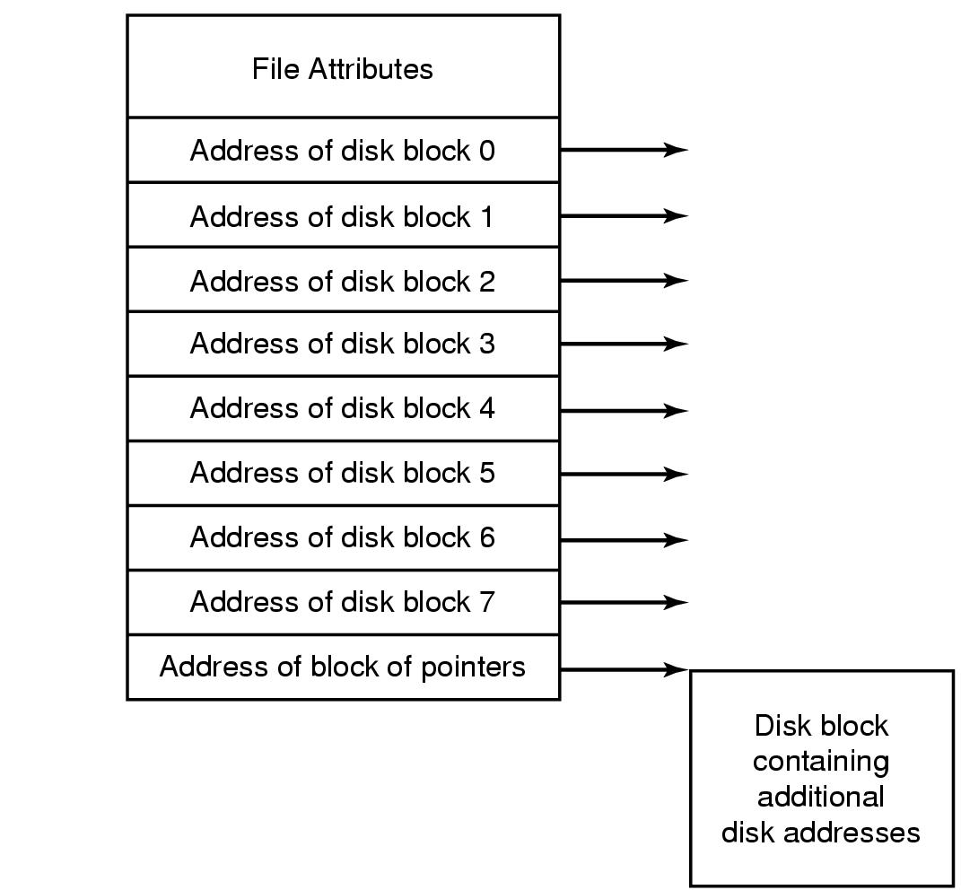
I-nodes
Fig. Tanenbaum, Modern Operating Systems
If loading I-nodes only for opened files → Less memory needed.
Memory needed proportional to the maximum number of open files.
Complex if file grows beyond number of addresses.

Slide 46
AGENDA
File concept
Access methods
Disk structure
Directory structure (Self reading)
File-system structure
Allocation methods
Free-space management
File sharing and protection
How do we know what portions of a file systems are free?

Slide 47
Keeping track of free blocks
Fig. Tanenbaum, Modern Operating Systems
Linked List
bitmap

Slide 48
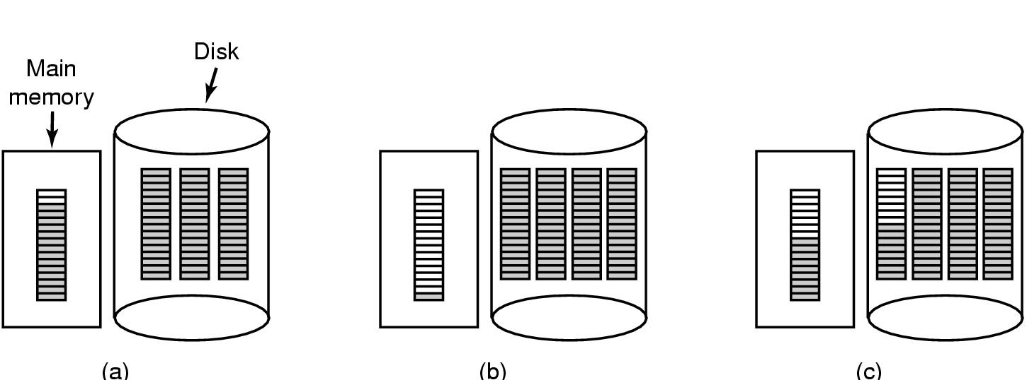
Keeping track of free blocks
Designing the right way of keeping free blocks is not trivial…
Linked List. Keep only 1 block of pointers to free blocks in memory, others are stored
Run out of free blocks? Read the following one from disk
New free blocks? Add them to block in memory, if full → store it.
Free temp file ( 3 blocks)
What if a program creates a lot of these temp files?
Create temp file ( 3 blocks)

Slide 49
AGENDA
File concept
Access methods
Disk structure
Directory structure (Self reading)
File-system structure
Allocation methods
Free-space management
File sharing and protection
How do we share and protect files among different users?

Slide 50
Protection
File owner/creator should be able to control:
what can be done
by whom
Types of access
Read
Write
Execute
Append
Delete
List

Slide 51
Access Lists and Groups
Mode of access: read, write, execute
Three classes of users on Unix / Linux
RWX
a) owner access 7 ⇒ 1 1 1 RWX
b) group access 6 ⇒ 1 1 0
RWX
c) public access 1 ⇒ 0 0 1
Ask manager to create a group (unique name), say G, and add some users to the group.
For a particular file (say game) or subdirectory, define an appropriate access.
owner
group
public
chmod
761
game
Attach a group to a file chgrp G game

Slide 52
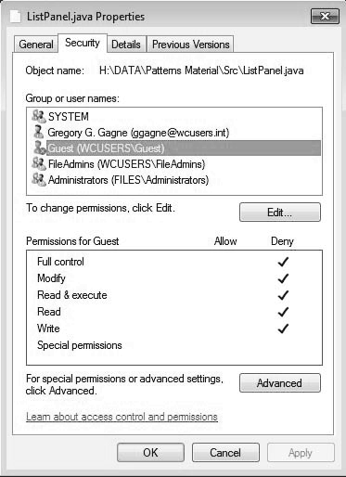
Windows 7 Access-Control List Management

Slide 53
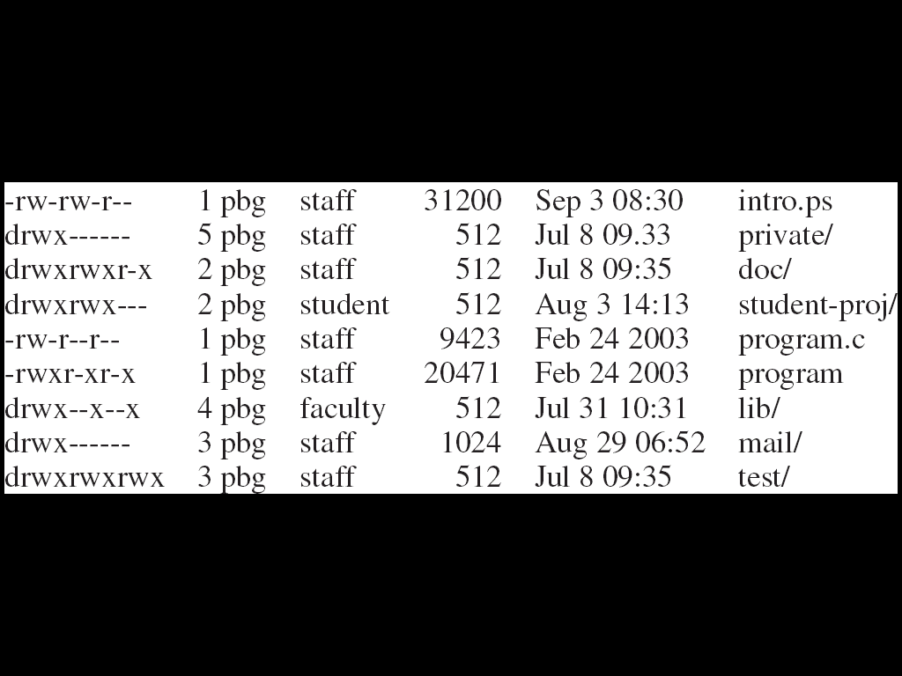
A Sample UNIX Directory Listing

Slide 54
Questions

Slide 55
Disk space utilization is most likely maximized by
decreasing the block size
increasing the block size
Notes:
1

Slide 56
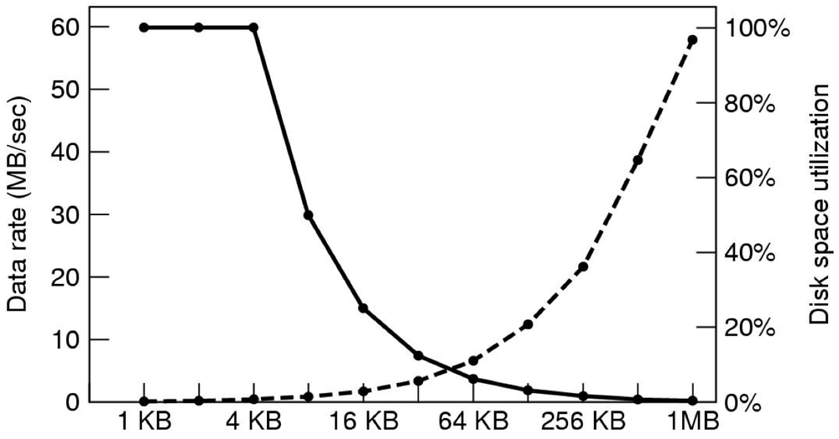
This figure shows...
rate goes up when internal frag. is small
hints about the average size of the files stored on disk
disk utilization must be sacrificed to speed up rate
Notes:
2

Slide 57
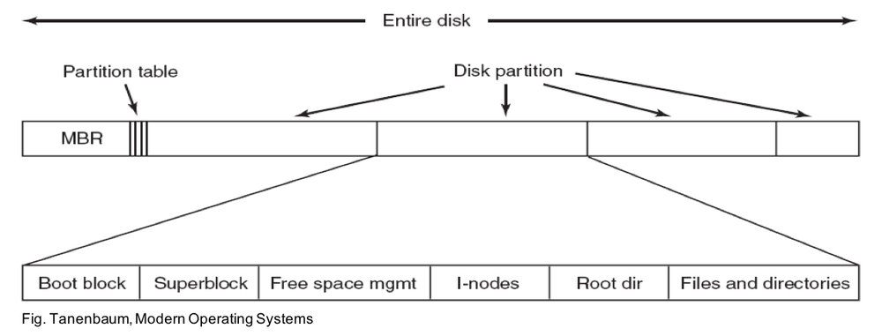
The part that is OS-specific is
MBR
Partition table
Boot block X
Free space management X
Notes:
3 4

Slide 58
Contiguous allocation for a disk leads to...
External fragmentation
Internal fragmentation
Both of them
Notes:
1

Slide 59
What requires more space to keep track of free blocks?
Linked list
Bitmap
who knows...
Notes:
3

Slide 60
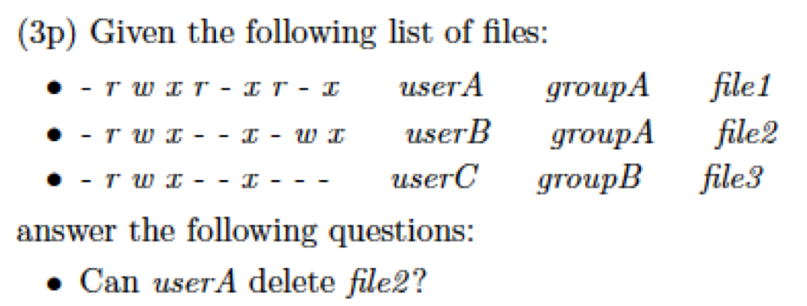
Yes
No
Who knows...
Notes:
3

Slide 61
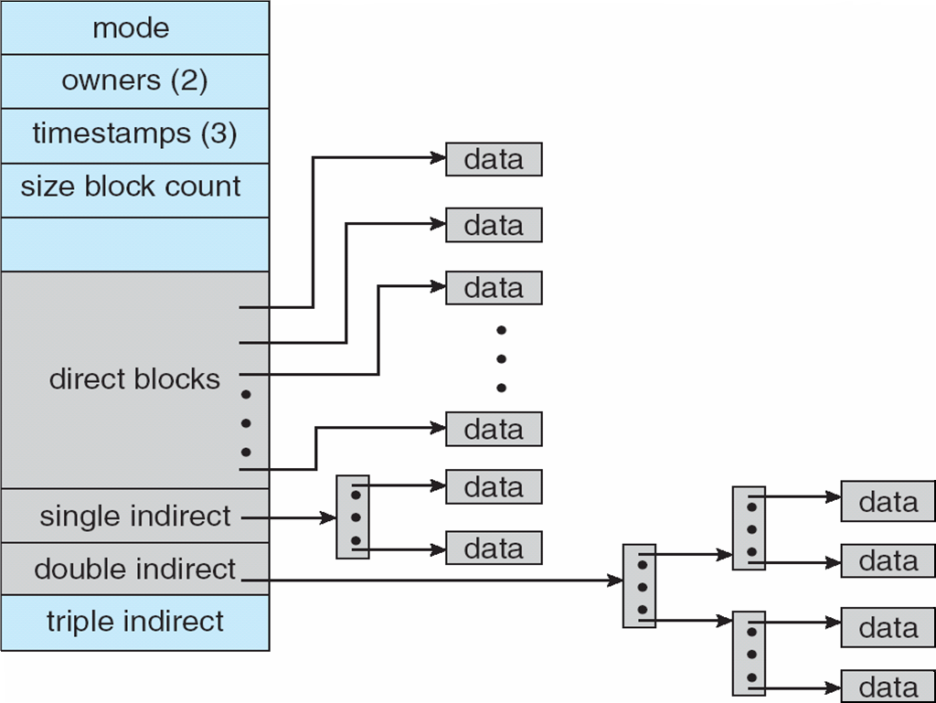
Consider a file system that uses i-nodes to represent files. Disk blocks are 8-KB in size and a pointer to a disk block requires 4 bytes. This file system has 12 direct disk blocks, plus single, double, and triple indirect disk blocks (as shown in the picture). What is the maximum size of a file that can be stored in this file system?
Notes:
(12 * 8 /KB/) + (2048 * 8 /KB) + (2048 * 2048 * 8 /KB/) + (2048 * 2048 * 2048 * 8 /KB) = 64 terabytes

Slide 62
What are the advantages of the variation of linked allocation that uses a FAT to chain together the blocks of a file?
Notes:
The advantage is that while accessing a block that is stored at the middle of a file, its location can be determined by chasing the pointers stored in the FAT as opposed to accessing all of the individual blocks of the file in a sequential manner to find the pointer to the target block. Typically, most of the FAT can be cached in memory and therefore the pointers can be determined with just memory accesses instead of having to access the disk blocks.

Slide 63
Consider a system where free space is kept in a free-space list. Suppose that the pointer to the free-space list is lost. Can the system reconstruct the free-space list? Explain your answer
Notes:
In order to reconstruct the free list, it would be necessary to perform “garbage collection.” This would entail searching the entire directory structure to determine which pages are already allocated to jobs. Those remaining unallocated pages could be relinked as the free-space list.

