Slide 1


I/O Systems Operating Systems – EDA093/DIT401 Vincenzo Gulisano vincenzo.gulisano@chalmers.se

Slide 2
Reading instructions
Chapter 5.1 to 5.3

Slide 3
Agenda
Introduction
I/O Hardware
Application I/O Interface
Kernel I/O Subsystem
Performance

Slide 4
Agenda
Introduction
I/O Hardware
Application I/O Interface
Kernel I/O Subsystem
Performance

Slide 5
Introduction
Main jobs of a computer: I/O & processing.
Role of OS: manage & control I/O operations & I/O devices.
OBJECTIVES:
Explore structure of an OS’s I/O subsystem
Principles & complexities of I/O hardware
Explain the performance aspects of I/O hardware & software.

Slide 6

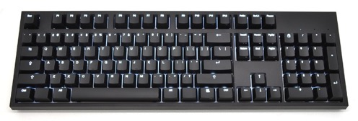
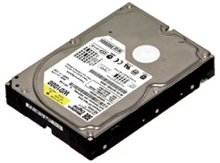

Introduction
I/O challenge: control as good as possible the devices of a given architecture
Why is it a challenge?
Variability of I/O devices (in their function & speed)
Varied methods are needed to control them.
Increasing standardization of software & hardware vs Increasing types of devices
Different details & oddities of devices
How does the OS address the challenge?
dedicated I/O subsystem in the kernel
device drivers that provide a device access interface to the I/O subsystem
Notes:
The challenge is how to control devices, since we have completely different types (each with different functions)
On one hand, we would like to increasing standardization, on the other we have increasing types of devices
In order to deal with different details / oddities the OS uses device drivers.

Slide 7
Agenda
Introduction
I/O Hardware
Application I/O Interface
Kernel I/O Subsystem
Performance

Slide 8
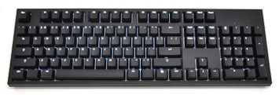

I/O Hardware
We have different types of hardware usually available in a computer:
Storage devices (disks)
Transmission devices (network cards)
Human-interface devices (screen, keyboard, mouse)
All of them exchange information by sending signals (via cable or air)
How do they communicate with the CPU, then?
Notes:
We have different types of hardware (now let’s focus on a standard computer…) we have storage devices (disks) / Transmission devices (network cards) and human-interface devices (screen / keyboard / mouse).
All of them exchange information sending signals (cable or air). So, the question is: how do they communicate?

Slide 9
I/O Hardware
Common concepts:
Port: the connection point (e.g., serial port)
Bus: a set of wires & a protocol that specifies a set of messages that can be sent on the wires.
Messages conveyed by patterns of electrical voltages with different timings.
Buses vary in signaling methods, speed, throughput & connection methods.
When device A plugs to device B and device B plugs to device C... We say A,B,C,… form a daisy chain
A daisy chain also operates as a bus
Notes:
Let’s introduce some common concepts. We have ports (the physical connection), we have bus (the communication channel). Notice that a set of devices plugged one on top of the other can also act as a bus, in this case we call it daisy chain.

Slide 10
Typical PC bus structure
Important concepts:
PCI bus: connects the processor-memory subsystem to the fast devices.
Expansion bus: connects relatively slow devices.
Controller: a collection of electronics that can operate a port, a bus or a device.
Example 1: Serial-port controller
A single chip (on the host) that controls the signals on the wires of a serial port.
Example 2: SCSI controller
Contains a processor, a microcode, private memory to process the SCSI protocol messages (e.g., disk drive a circuit board).
Notes:
When looking at the bus, we actually have different types of buses (PCI and expansion buses) and interfaces to specific types of devices (Controllers)
PCI : Peripheral Component Interconnect
SCSI: Small Computer System Interface

Slide 11
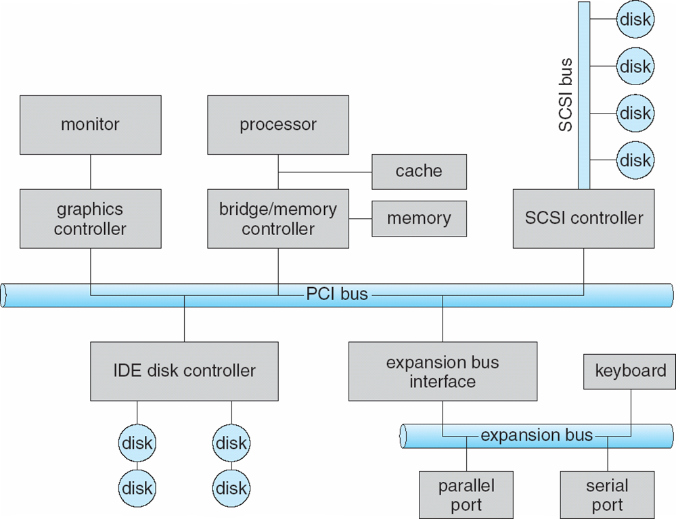
A typical PC Bus Structure
Notes:
So this is how it actually looks, you see we have controllers, we have the PCI bus and the expansion bus
IDE Integrated Drive Electronics
Say again each controller is a “small computer”

Slide 12
I/O Hardware
How can the processor give commands & data to a controller to accomplish a I/O transfer?
1st Way of Communication
Processor reads & writes bit patterns in the controllers’ registers.
Use of special I/O instructions that specify the transfer of a byte or word to an I/O port address.
I/O instruction triggers bus lines to select the proper device & move bits into or out of a device register.
2nd Way of Communication: Memory mapped I/O
Device-control registers are mapped into the address space of the processor.
CPU executes I/O requests using the standard data transfer instructions to read and write the device-control registers.
→ Some systems use both ways of communication.
Notes:
Now, let’s suppose the CPU wants to talk with the disk, how can they do this?
One way for the CPU is to use the registers of the controller, the CPU talks directly with the controller
The second one is to agree with the disk that a certain portion of memory is reserved for the disk and dedicated hardware can take care of sharing information.
Of course, we can have hybrid systems.

Slide 13
Processor reads & writes bit patterns in the controllers’ registers
RAM
CPU
I have dedicated channels
and dedicated instructions
depending on whether I want to write a byte in memory or
in a certain controller
SCSI Controller
SCSI Disk

Slide 14
Memory mapped I/O
RAM
CPU
motherboard
When I want to write a byte to a register of a certain controller I use a given address, but I do not really know (or care) how to differentiate a write to memory from a write to a controller
SCSI Controller
SCSI Disk
Notes:
This is simpler from the CPU perspective, and we can use dedicated hardware to do this… also better when we can have a lot of different devices…
THIS DOES NOT MEAN THE CPU IS READING FROM THE DISK DIRECTLY

Slide 15
Example of Memory mapped I/O: graphics controller
CPU
motherboard
Graphics controller
Graphics controller: has large memory-mapped region to hold screen contents.
Process sends output to the screen by writing data into the memory-mapped region.
Controller generates screen image based on the contents of the memory.

Slide 16
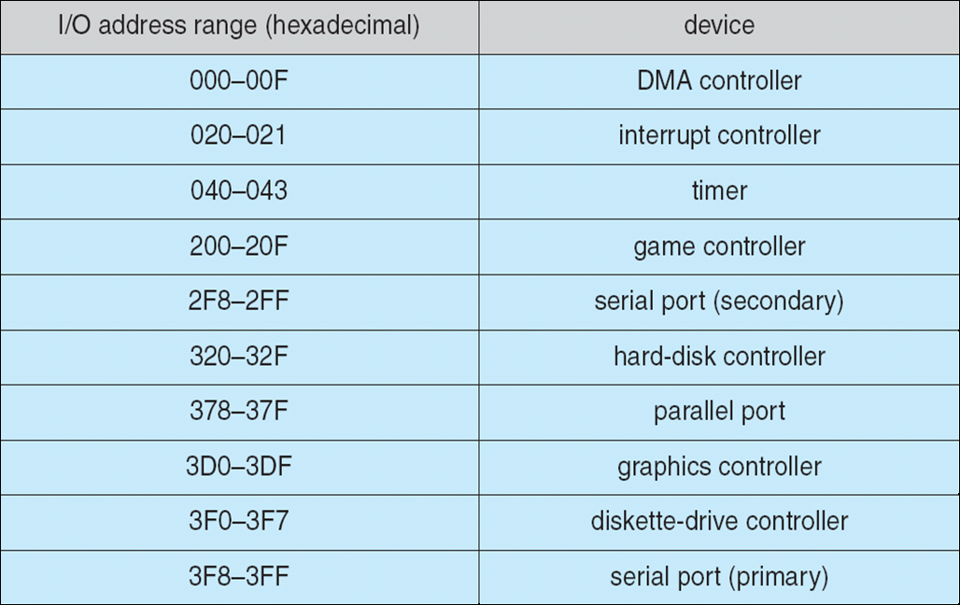
Device I/O Port Locations on PCs
Usual I/O port addresses for PCs
Notes:
The graphic controller example makes more sense before, then we can put the addresses…
When the CPU decides to write/read registers from devices / controllers there are fixed addresses representing fixed devices.

Slide 17
I/O Hardware
I/O port typically consists of:
Data-in register: is read by the host to get input (e.g. 1 to 4 bytes in size)
Data-out register: is written by the host to send output
Status register: contains bits that can be read by the host. Indicates states such as:
whether the current command has completed
whether a byte is available to be read
whether a device error has occurred
Control register: to start a command or to change the mode of a device.
Example 1: a certain bit in the control register of a serial port chooses between full-duplex & half-duplex communication.
Example 2: another bit sets the word length to 7 or 8 bits, Other bits select one of the speeds supported by the serial port
Notes:
Each I/O port usually consists of different registers: in / out / status and control
For example…

Slide 18
Interaction between host and controller
Complete interaction protocol between the host & a controller can be intricate.
busy-waiting / polling: the host is continuously trying to get access to the device via the controller
interrupt: the controller alerts the host when the device is available

Slide 19
Polling – Handshaking procedure
2 bits are used to coordinate the producer-consumer relationship between the controller & the host.
Controller indicates its state through the busy bit in the status register.
Host signals its wishes via the command-ready bit in the command register. Command ready bit: if it is set a command is available for the controller
busy-waiting / polling: it is a loop, reading the status register over and over until the busy bit becomes clear. Reasonable: If device controller & device are fast Inefficient: attempted repeatedly but device is busy.
In such cases: hardware controller should notify the CPU when the device becomes ready for service → this hardware mechanism is called interrupt.
Notes:
Now, let’s say the CPU wants to coordinate with a certain device and we can use the registers of the device (directly or memory mapped).
How can we interact with the device?
You should be familiar with the interrupt model, but there can be different ways in which we can do this, the first one is polling.
On one hand, the CPU can be actively checking if a device can be used (or is finished) on the other hand, it can wait for an interrupt

Slide 20
Interrupts
Basic mechanism
CPU hardware has a wire called interrupt request line
CPU senses the interrupt request line after executing every instruction.
If yes, CPU performs a save state & jumps to the interrupt handler routine at a fixed address in memory.
Interrupt handler (IH): What was the cause of the interrupt?
IH performs the necessary processing, performs state restore
… executes a return from interrupt instruction → return CPU to the execution state prior to the interrupt

Slide 21
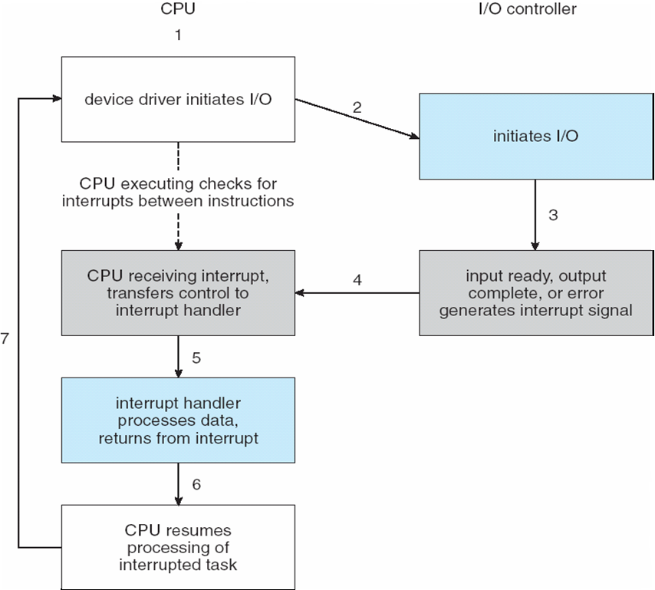
Interrupts

Slide 22
Interrupts - Dictionary
The device controller raises an interrupt
....by asserting a signal on the interrupt request line
CPU catches the interrupt
CPU dispatches it to the interrupt handler
Handler clears the interrupt by servicing the device
Notes:
Some dictionary about interrupts

Slide 23
Interrupts
Sophisticated Interrupt Handling
In a modern OS: we need sophisticated interrupt handling features
Ability to defer interrupt handling during critical processing
Efficient way to locate the proper interrupt handler for a device without asking all devices to see which one raised the interrupt
Multi-level interrupts so that the OS can distinguish between high & low level priority interrupts
In modern OS these provided by CPU & interrupt controller hardware

Slide 24
Interrupts
Two interrupt request lines:
Nonmaskable interrupt: reserved for events such as unrecoverable memory errors.
Maskable interrupt: can be turned off by CPU before the execution of critical instruction requests.
Interrupt mechanism accepts an address: a number that selects a specific interrupt-handling routine from a small set.
This address is an offset in a table called interrupt vector
This vector contains the memory addresses of specialized interrupt handlers.
Notes:
As we once mentioned, it might not be a good idea if the CPU gets interrupted continuously. For this reason, we actually have 2 types of interrupts (2 different lines)

Slide 25
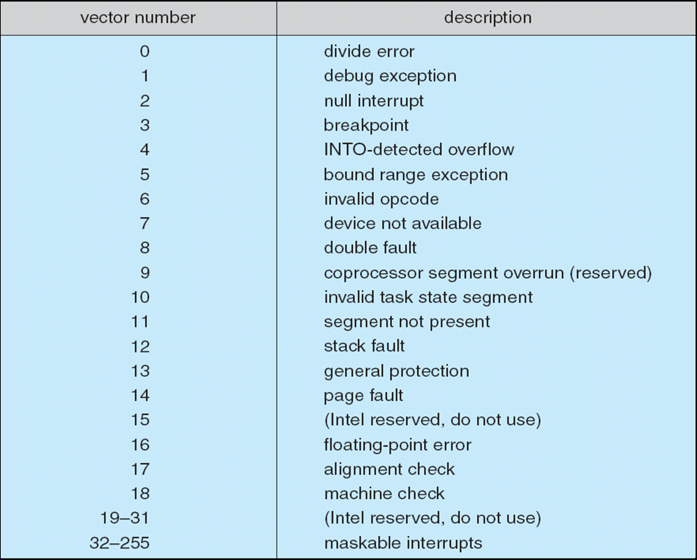
Interrupts – Intel Pentium processor event-vector table
nonmaskable
Notes:
As you can see in the nonmaskable ones we have some interrupts we should be familiar with at this point (like page fault for instance)
Example of maskerable is mouse click

Slide 26
Interrupts
OS & interrupts interaction
A modern OS interacts with the interrupt mechanism in several ways.
At boot time, probes the buses to see which devices are present and installs the corresponding interrupt handler.
During I/O, device controllers raise interrupts when they are ready for service. These interrupts may mean:
output has completed
input data are available
or a failure has been detected
Notes:
The OS interacts with the interrupt mechanism in several ways.
How do we load the routines for the different interrupts?
For instance at boot time…
UP TO HERE FOR KAHOOT

Slide 27
Direct Memory Access
Direct Memory Access
Devices with large transfer e.g. disk drive. Not a good idea to use an expensive general-purpose processor to watch status bits & feed data into a controller register → programmed I/O process.
Use instead DMA controller
Bypasses CPU to transfer data directly between I/O device & memory
DMA transfer
To initiate a DMA transfer, host writes a DMA command block into memory.
Block contains:
a pointer to the source of the transfer
a pointer to the destination of the transfer
a count of the number of bytes to be transferred.
Notes:
As we mentioned, we can have Direct Memory Access and this is also a way of reducing the interrupts that could “disturb” the CPU.
We can have dedicated hardware that “talks/interacts” with certain types of devices (the ones that usually transfer considerable amount of data)
Then, CPU writes address of the command block to the DMA controller

Slide 28
Direct Memory Access
Handshaking between DMA controller & device controller
Performed via a pair of wires: DMA request & DMA-acknowledge.
A word of data available for transfer → device controller places a signal on the DMA-request wire
DMA controller:
places the desired memory address on the memory-address wires.
places a signal on the DMA-acknowledge wire.
Device controller receives the DMA-acknowledge signal & transfers the word of data to memory & removes the DMA-request signal.

Slide 29
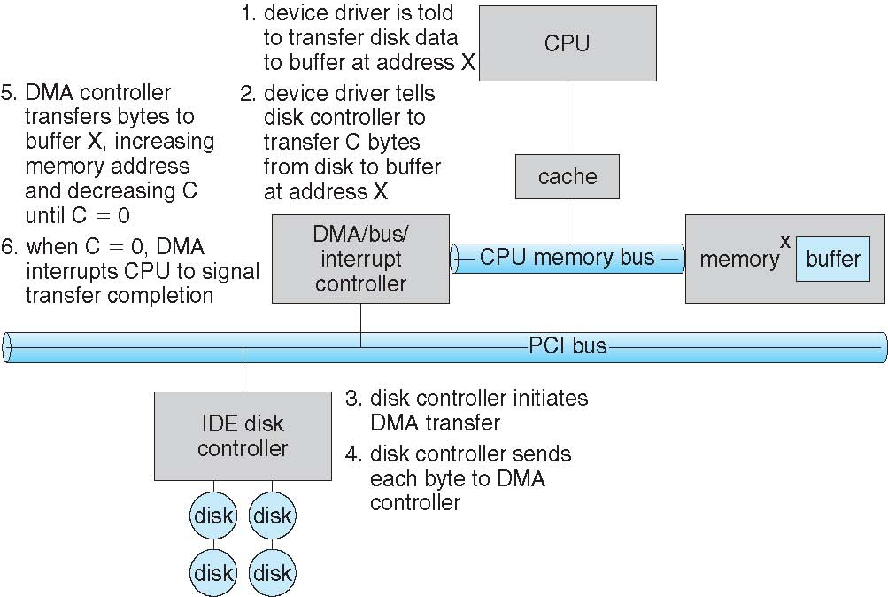
Six Step Process to Perform DMA Transfer
Notes:
Here the important thing is that this is done without the CPU

Slide 30
Agenda
Introduction
I/O Hardware
Application I/O Interface
Kernel I/O Subsystem
Performance

Slide 31
Application I/O Interface
Goals:
Abstract away the detailed differences in I/O devices by identifying a few general kinds.
Encapsulate device behaviors in general
Device-driver layer hides differences among I/O controllers from kernel.
Make I/O subsystem independent of the hardware:
Simplifies the job of the OS.
Benefits the hardware manufacturers
Attach peripherals without waiting for new support code
BUT: each type of OS has its own standards for the device-driver interface.

Slide 32
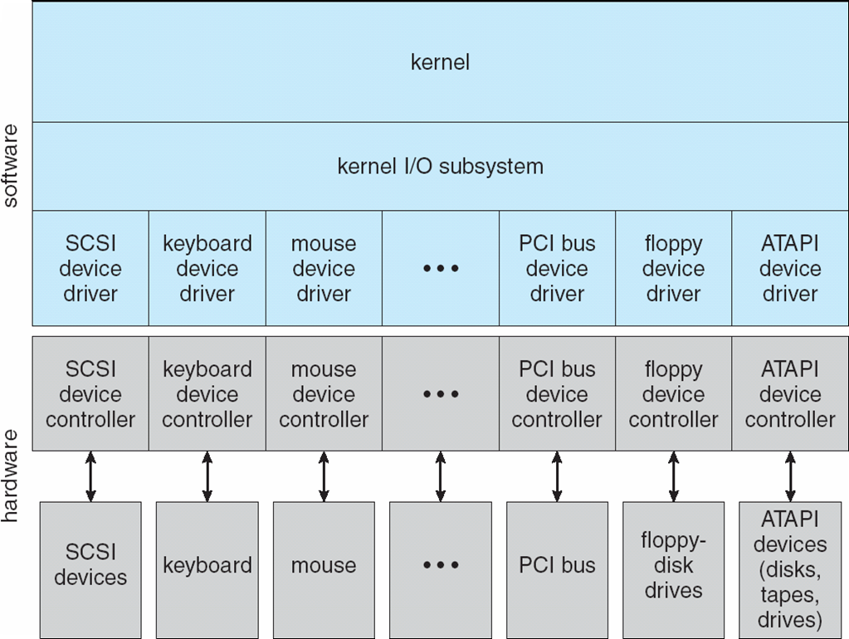
Application I/O Interface

Slide 33
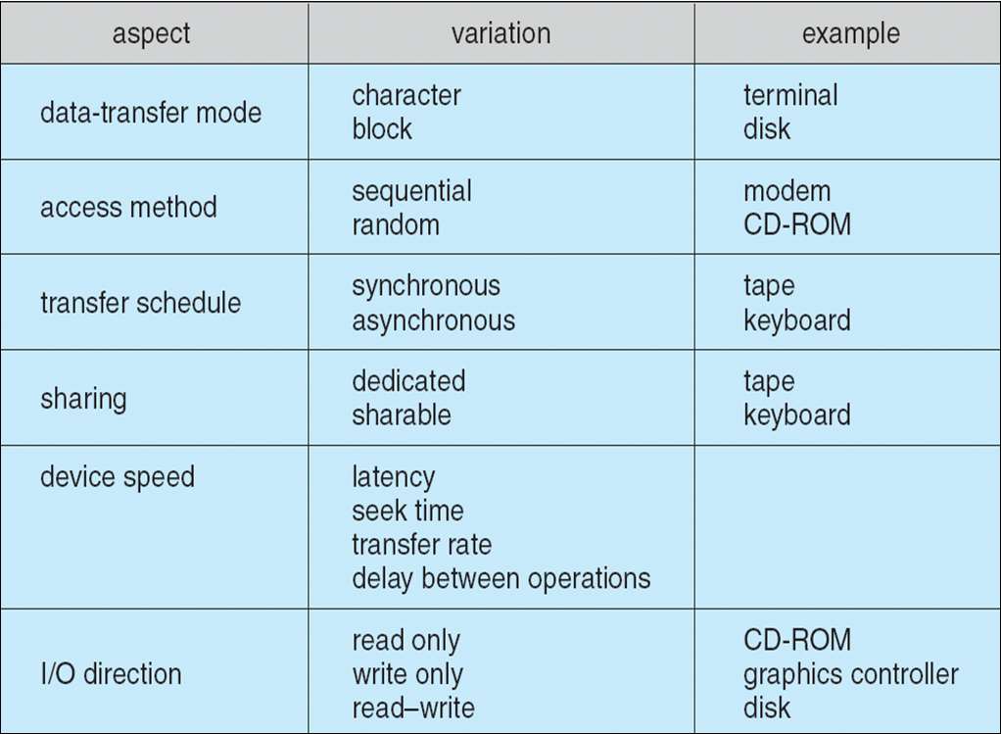
Application I/O Interface
Devices vary in many dimensions:
Character-stream or block: bytes one by one or blocks of bytes
Sequential or random access: fixed order or random
Synchronous or asynchronous: data transfers with predictable response times or not
Sharable or dedicated: used concurrently by several processes or not
Speed of operation: speeds range form a few bytes to gigabytes per sec
Read-write, read only or write only: some both directions, others not
Notes:
Why is it challenging?
Because we have a lot of different dimensions for each device
Let’s have a look at different interfaces we can have depending on the behavior / type of device

Slide 34
Block and Character Devices
Block devices include disk drives
Block-device interface all necessary aspects for accessing disk drives & other block-oriented devices
Commands include read(), write(), seek()
Memory-mapped file access possible
Character devices
Include keyboards, mouse, serial ports
Commands include get(), put()
Libraries layered on top allow line editing
Notes:
Each device will implement read write seek as it likes

Slide 35
Network Devices
Network Devices
Network I/O differs significantly form disks, the interface is not read(), write() and seek()
Unix & Windows include socket interface
System calls in the socket interface enable an application to
Create a socket
Connect to a remote socket
Socket Interface
Connect local socket to a remote address
Listen remote application to plug into the local socket
Send & receive packets over the connection
select() → return which sockets have a packet waiting to be received

Slide 36
Clocks & Timers
Give current time.
Give elapsed time.
Set a timer to trigger operation X at time T.
Programmable hardware interval timer: hardware to measure elapsed time & trigger operations
Example: wait a certain amount of time & then generate an interrupt Cancel operations preceding too slowly
Usual interrupt rate: between 18 & 60 ticks per sec.
Hardware clock constructed from a high-frequency counter.

Slide 37
Blocking & Nonblocking I/O
Blocking
Process suspended until I/O completed
Moved from run queue to wait queue
Later moved back to run queue & resumes
Easy to use & understand
Insufficient for some needs
Nonblocking
Example: a user interface that receives keyboard & mouse input while processing & displaying data on screen.
Implemented via multi-threading (a thread does the blocking part, another processes results)
Returns quickly with a return value indicating how many bytes were transferred.
Notes:
This is about system calls that can be provided by the OS
The difference lies in how the kernel and process interact during I/O operations — specifically when the process is allowed to continue execution relative to the I/O completion.
Here’s a concise breakdown:
Type Description Process behavior Example Blocking I/O The system call does not return until the I/O operation is fully complete. The process is put to sleep and cannot run until the data is ready or written. read(fd, buf, n) on a regular file — the process blocks until n bytes are read. Nonblocking I/O The system call returns immediately, even if the I/O cannot proceed. The process continues executing; it must poll or retry later to see if the I/O is done. Setting a socket to nonblocking (fcntl(fd, F_SETFL, O_NONBLOCK)) — read() returns EAGAIN if no data yet. Asynchronous I/O (AIO) The system call initiates the I/O and returns immediately. The kernel performs the I/O in the background and notifies the process upon completion (via signal, callback, or event). The process does not need to poll; it’s notified when I/O completes. POSIX aio_read(), Linux io_uring, Windows OVERLAPPED I/O.
Summary:
Blocking: process waits for completion.
Nonblocking: process checks repeatedly.
Asynchronous: kernel notifies when done.
In short: blocking waits, nonblocking polls, asynchronous is event-driven.

Slide 38
Blocking & Nonblocking I/O
Asynchronous
Process runs while I/O executes
Returns immediately without waiting for I/O to complete
Difficult to use
I/O subsystem signals process when I/O completed

Slide 39
Agenda
Introduction
I/O Hardware
Application I/O Interface
Kernel I/O Subsystem
Performance

Slide 40
Kernel I/O subsystem
Provides many services related to I/O, including:
I/O scheduling
Buffering / Caching / Spooling
Error handling
I/O protection

Slide 41
I/O Scheduling
Goal: schedule I/O requests in a good order before executing them
Improve overall performance
Share device access fairly among processes
Reduce the average waiting time for I/O to complete
Some OS maintain a wait queue of requests for each device
Some OS try fairness
Example
Application 1 needs a block near the end of a disk
Application 2 needs a block near the beginning
Application 3 needs a block near the middle of the disk
Best Scheduling: 2,3,1

Slide 42
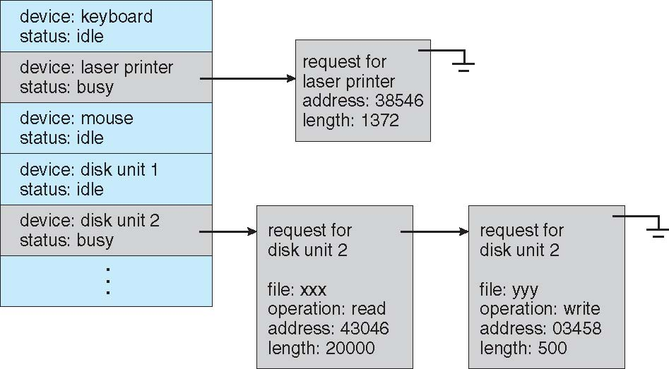
Device status table
When a kernel supports asynchronous I/O and might schedule requests in different orders, it must be able to keep track of many I/O requests

Slide 43
Buffering
Another way to improve performance → Use storage space in main memory or on disk via buffering, caching, spooling
Buffering
Buffer: memory area that stores data being transferred between two devices or between a device & an application.
Example:
File received via modem for storage on the hard disk.
Buffer created in main memory to accumulate the bytes received from the modem.
Buffer full → write data on the disk
Disk write not instantaneous: two buffers are needed → Double buffering

Slide 44
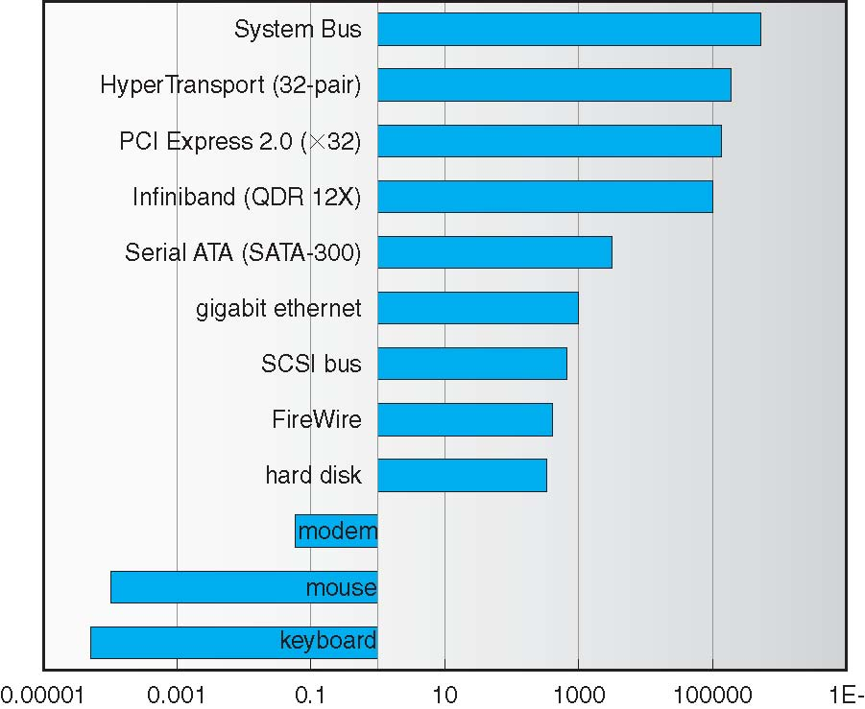
Buffering – Differences in device speeds
Enormous differences in device speeds for typical hardware!
Sun Enterprise 6000 device-transfer rates (logarithmic)

Slide 45
Caching – Spooling
Caching
Cache: holds a copy on faster storage of an item that resides elsewhere
Easier access → Key to performance
Spooling
Hold output for a device
If device can serve only one request at a time (e.g. printing) Devices that cannot accept interleaved data streams.

Slide 46
Error Handling
Error Handling
Devices and I/O transfers can fail in many ways.
Transient reasons: a network becomes overloaded
Permanent reasons: a disk controller becomes defective
OS can recover from disk read, device unavailable, transient write failures
Most return an error number or code when I/O request fails
System error logs hold problem reports

Slide 47
I/O Protection
Necessary: User access may attempt to disrupt normal operation via illegal I/O instructions.
All I/O instructions defined to be privileged → Users cannot issue them directly
To do I/O a user program executes a system call
OS checks if request is valid
If yes it is executed.
Memory mapped & I/O port memory locations must be protected
Notes:
Can say that this should sound familiar…
This is familiar, priviledged instructions are something related to I/O too… for protection / fairness and also for performance (indirectly)

Slide 48
Agenda
Introduction
I/O Hardware
Application I/O Interface
Kernel I/O Subsystem
Performance

Slide 49
Performance
I/O has major impact in system performance:
Why?
Places heavy demands on CPU to execute device driver
Schedule processes fairly & efficiently
Context switches due to interrupts
…

Slide 50
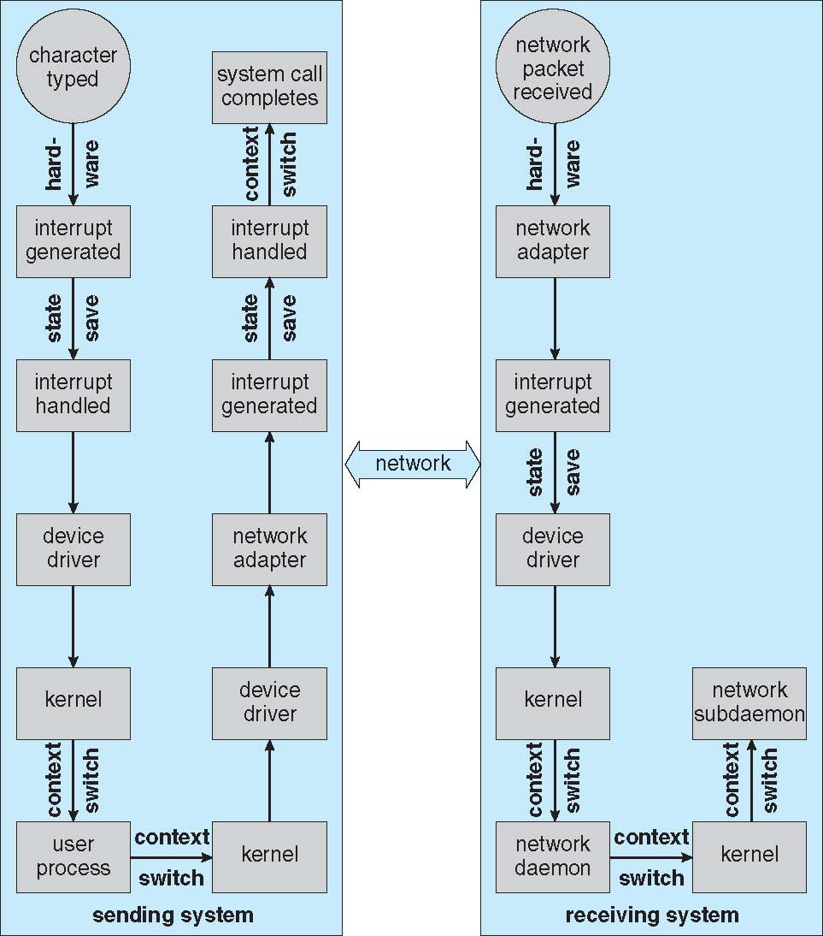
Example of performance: remote login

Slide 51
How to improve performance?
Reduce number of context switches
Reduce number of times data must be copied in memory (between device & application)
Reduce frequency of interrupts Use large transfers, smart controllers
Use DMA
Balance CPU, memory, bus and I/O performance for highest throughput

Slide 52
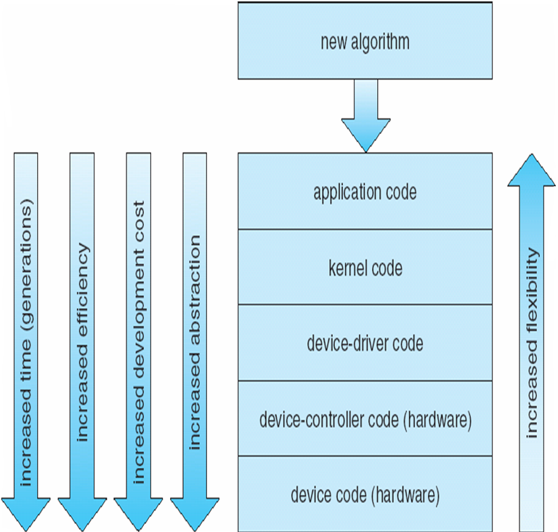
Performance
Notes:
Imagine what happens if you find a bug in the hardware
We can start with application code and then go into lower and lower levels… although it will always take more time and become more challenging (and dangerous in case of errors)

Slide 53
When using memory mapped I/O...
The same address can be shared for RAM and I/O device
The same address cannot be shared for RAM and I/O device
Notes:
2

Slide 54
The address of an interrupt is used to...
Detect if the interrupt is maskable or not
Find its interrupt-handling routine
Notes:
2

Slide 55
2 page faults interrupts can be served in parallel by the same interrupt-handling routine
Yes
No
Notes:
1

Slide 56
Direct memory access (DMA)...
reduces the number of interrupts
allows for data transfer without the need of interrupts
Notes:
1

Slide 57
A page fault could be directly handled by the MMU via DMA. What do you think?
why not?
not really...
Notes:
2

Slide 58
The I/O completion order for device D can differ from how PCBs are sorted in D waiting queue
Yes
no
Notes:
1

