Slide 1


Synchronization - Part 1 Operating Systems – EDA093/DIT401 Vincenzo Gulisano vincenzo.gulisano@chalmers.se

Slide 2
What to read (Main textbook) - Both for part 1 and part 2
Chapter 2.4.1-2.4.6, 6.1-6.2, 6.5-6.6, 6.7.3-6.7.4;
Quicker reading, for awareness, of sections 2.3.7-2.3.9, 2.3.11, 6.3

Slide 3
Agenda
Motivation
The Critical Section problem
Check-competition approach
The check-order / after-you approach
Peterson’s Algorithm
Synchronization and hardware support
Read-Modify-Write instructions
Semaphores
Other techniques
Notes:
Can connect back to scheduling of OS threads. Need to have them run concurrently and in parallel, and coarse grained is not really enough. We want to minimize the exclusive access to only the actual required part, how do we do it?
Then the actual example of what happens if you don’t

Slide 4
Agenda
Motivation
The Critical Section problem
Check-competition approach
The check-order / after-you approach
Peterson’s Algorithm
Synchronization and hardware support
Read-Modify-Write instructions
Semaphores
Other techniques
Notes:
Let’s start this lecture with some motivation

Slide 5
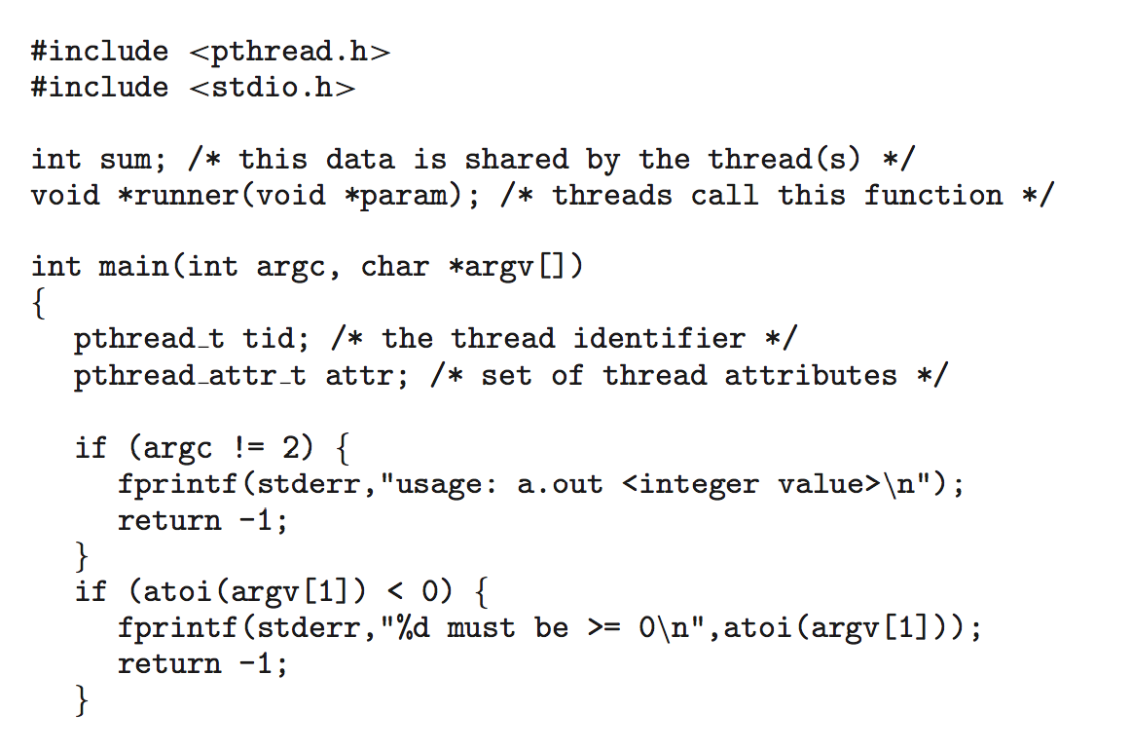
Previously on Operating Systems
Notes:
In our previous lecture about multithreaded processes, we saw that functions like pthread_join exist to help users coordinate the execution of threads that operate on shared memory.
In this lecture, we will discuss synchronization in more detail. Let’s start with an example.

Slide 6
On the need for proper synchronization: example
Setup
2 threads, A and B
Each has access to:
a local variable x
a shared variable S, initialized with value 20
A and B run in parallel, each on its core
A and B run 3 instructions to update S (see figure)
Consider the execution on the right:
Thread A
x ← S
x ← x + 50
S ← x
Thread B
x ← S
x ← x - 20
S ← x
Variable S
20
20
20
70
0
Time (in discrete steps)
Notes:
Let’s assume we have 2 threads, A and B. Each has a local variable x and a shared variable S. That is, A and B share the same S variable. S is initialized with value 20.
Let’s also assume A and B run in parallel, each on its core. Their code includes three instructions to update S.
Let’s look at the example.
[c] Each line represents an execution slot over time. We see that both A and B try to update S: A by adding 50 while B by subtracting 20.
In this example, A starts one slot before B. What is the problem with this execution? Since the access to S is not synchronized between A and B, A writes its update to S after B has read the previous value of S.
[c] Hence, rather than 20 + 50 - 20, the final value of S is in fact 20 - 20. If S represents your bank account balance, you see such behavior is extremely risky.
As we will elaborate next, what we are experiencing here is a race condition because of a critical section that is not accessed exclusively.

Slide 7
Question
Thread A
x ← S
x ← x + 50
S ← x
Thread B
x ← S
x ← x - 20
S ← x
Variable S
20
20
20
70
0
Here we say S takes values 20, 70 and then 0
What are the possible final values of S in this case?
Time (in discrete steps)
Thread A
x ← S
x ← x + 50
S ← x
Thread B
x ← S
x ← x - 20
S ← x
Variable S
20
…
…
…
?
Time (in discrete steps)
Notes:
Let’s assume we have 2 threads, A and B. Each has a local variable x and a shared variable S. That is, A and B share the same S variable. S is initialized with value 20.
Let’s also assume A and B run in parallel, each on its core. Their code includes three instructions to update S.
Let’s look at the example.
[c] Each line represents an execution slot over time. We see that both A and B try to update S: A by adding 50 while B by subtracting 20.
In this example, A starts one slot before B. What is the problem with this execution? Since the access to S is not synchronized between A and B, A writes its update to S after B has read the previous value of S.
[c] Hence, rather than 20 + 50 - 20, the final value of S is in fact 20 - 20. If S represents your bank account balance, you see such behavior is extremely risky.
As we will elaborate next, what we are experiencing here is a race condition because of a critical section that is not accessed exclusively.

Slide 8
Agenda
Motivation
The Critical Section problem
Check-competition approach
The check-order / after-you approach
Peterson’s Algorithm
Synchronization and hardware support
Read-Modify-Write instructions
Semaphores
Other techniques

Slide 9
The Critical-Section (aka Critical Region) Problem
Structure of process/thread P
Repeat
entry section
critical section
exit section
remainder section
Forever
n processes/threads competing
Assumptions:
atomic read/write
no process failures
n=2 in the initial examples
Notice: duration of the [remainder section] is unbounded
Problem formulation:
A solution must provide the entry and exit sections
It must ensure:
Mutual Exclusion. Only one process/thread at a time is allowed to execute in its critical section.
2. Progress (no deadlock/no livelock). If no process/thread is in its critical section and some is/are trying, some must enter its critical section in bounded time.
Fairness / Bounded Waiting / no starvation. Variety of formulations, e.g., FCFS; or bounded #bypasses, …
Notes:
Since we will look into whether 2 or more concurrent threads are correctly handling shared variables, let's introduce a system model for the critical section problem.
[c] From now on, we assume each of our threads looks like this:
we have a loop that runs forever (it's a model, of course it will stop in practice, but from the model perspective we do not assume anything about when it will stop)
inside the loop, we have a critical section, the one in which we read/write shared variables,
we assume shared variables are accessed with atomic read/write operations, so only one read or write operation can be performed at a time
before the critical section, we have an entry section, a statement/line/multiple lines whose execution implies the critical section can start: you can see the entry section as the portion in which the thread is trying to acquire a LOCK, its right to enter its critical section
after the critical section, we have an exit section, a statement/line/multiple lines whose execution implies the critical section is over: you can see the exit section as the portion in which the thread releases its LOCK, for someone else to enter their critical section
and a remainder section, basically the rest of the code in which we do not worry about reading/writing shared variables.
Notice that for simplicity we also assume threads' execution does not fail!
[c] Our goal of having 2 or more concurrent threads correctly handling shared variables can then be formulated as:
Define an entry and an exit section that ensure:
Mutual exclusion,
Progress (i.e., no deadlock/no livelock), and
Fairness (e.g., bounded waiting or no starvation).
Mutual exclusion means that only one thread at a time can execute its critical section.
Progress means that if no thread is in its critical section and one is/some are trying to enter their, then one must enter its critical section in bounded time.
Notice that we do not make any assumption about the duration of the reminder section of a thread. A thread can stay there for as long as it needs. The duration of the reminder section is NOT bounded in time.
Let's put also a temporary extra assumption for now: we only have 2 concurrent threads.
NOTES Atomic read/write -> it happens in its entirety
Some slides use the term “safety” later on. Is that mutual exclusion or more than that?
Deadlock: usual example with the chopsticks. Live lock: two people trying to pass in the corridor and not mananging

Slide 10
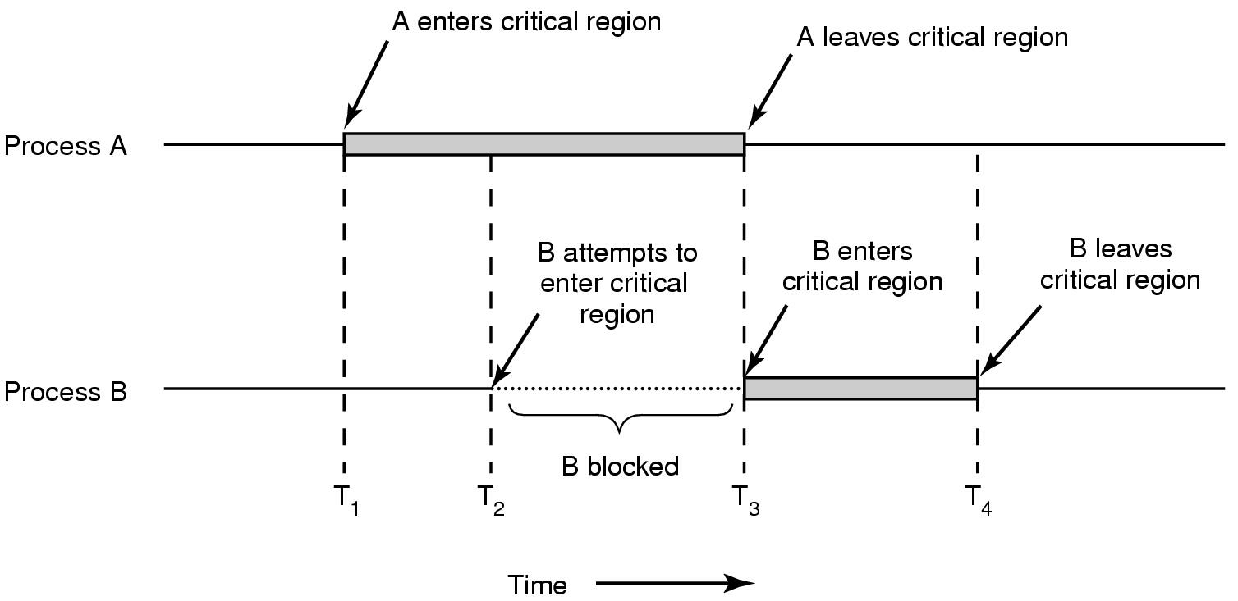
Critical section: desirable behavior
A enters or
irrevocably decides to enter critical region
/thread
B waits
/thread
Notes:
If we want to visualize such behavior it looks like this figure.
As you can see, only one thread at a time can enter the critical region. If a thread B tries to enter it when another thread A is in it, then B waits.

Slide 11

Beware!
Is a solution valid?
We are looking for formal answers
Can we find an example showing it is not? then it is NOT valid.
Can we show it is impossible to find such an example? Then it is valid.
An example showing it works is not sufficient
Notes:
What we are going to do next is to look at various ways of defining the entry and exit section and ask ourselves: does solution X ensure mutual exclusion, progress, and fairness?
We want formal correctness proofs. We cannot answer with "it looks like it does!" nor with "I tried running the code 1000000 times and it never broke, so I am confident it does".
To provide a formal answer, we are going to try to find one execution of the threads that breaks one of the properties. If we find it, then the solution is not valid (it breaks one of the desired properties). If we show such an execution does not exist, then the solution is valid.
Note That it runs and it works means nothing.

Slide 12
check-competition approach
Shared var flagA, flagB: boolean; // indicate A’s, B’s intention to enter; initially both false
Thread A // B is symmetric
repeat
while flagB == true do [nothing] //busywait
flagA ← true
[critical section]
flagA ← false
[remainder section]
forever
Notes:
Let's try to look at a specific (simple) example, which we refer to as check-completion.
Let's say the code of our 2 threads, A and B, looks like this.
They both share 2 boolean variables, flagA and flagB, initially set to false, which they use to indicate their intention to enter the critical section.
Here I show A's code. B's code is symmetric.
In its entry section, A waits as long as B's flag is true in a while loop.
This is called busywait because A is using CPU cycles to spin in a loop.
The loop ends when B sets its flag to false.
After that, A sets its flag to true, enters the critical section, and when the critical section is over sets its flag to false.
Is this solution to the critical section problem valid or not?
I strongly suggest you stop the video and try to reason and provide a formal answer.

Slide 13
check-competition: mutual exclusion property?
sees flagB == false and completes line 4
line 5
A
A in CS
B
B in CS
line 5
Time
Notes:
Now let's try to answer the question together.
That is, let's try to find an example showing one of the properties can be violated.
Can the property of mutual exclusion be violated?
For instance, can A enter its critical section while B is in its critical section?
Let's answer the question with the help of this drawing.
In this drawing, we see that A enters its critical section after B entered its own but before B exited it. Can this happen?.
To happen, sometime before entering its critical section [c] A needs to set its flag to true (that's what the code says).
And before that, [c] A needs to see that the value of flagB is false to exit the busywait while loop (again, that's what the code says).
Now let's focus on B. To enter its critical section, B needs to set flagB to true (that's what the code says).
Now we are at a critical point. In our example, if we assume B sets its flagB to true before A sees flagB's value is false [c], then it means in between these two events B completes its critical section, otherwise A cannot see flagB being false...
NOTES
What this slide is trying to show with the line 5 before the “sees flagb” for A is that if you place it there, then there can be another B in CS before the blue point and we are back to the same initial situation, so it’s about placing it after the first blue dot

Slide 14
check-competition: mutual exclusion property?
sees flagB == false and completes line 4
line 5
A
A in CS
B
B in CS
line 5
Time
sees flagA == false and completes line 4
Notes:
In the example we are studying, the point in which B sets flagB to true comes after A sees flagB value to be false.
So now we are left with one question: can B see flagA being false in between the time A sees flagB to be false and B sets flagB to true? [c]
The answer is yes because flagA is initially set to false and is also set to false every time A exits its critical section.
So, in the figure, the portion of time during which A has not yet entered its critical section is a period during which flagA's value is false.
We have found an example that breaks the mutual exclusion, which implies the code is NOT a solution to the critical section problem.

Slide 15

check-competition: mutual exclusion property?
sees flagB == false and completes line 4
line 5
A
A in CS
B
B in CS
line 5
Time
sees flagA == false and completes line 4
Notes:
Once you listen to this argumentation, you "digest" it and you understand it, you will probably agree that proving whether a solution to the critical problem is valid or not is very challenging. In all the following videos, I strongly suggest you stop and try to formally find out yourself whether a solution is correct or not!

Slide 16
Agenda
Motivation
The Critical Section problem
Check-competition approach
The check-order / after-you approach
Peterson’s Algorithm
Synchronization and hardware support
Read-Modify-Write instructions
Semaphores
Other techniques

Slide 17
check-order (after-you) approach
Shared var turn: (idA..idB) // initially e.g. idA // indicates whose turn it is to enter CS
Thread A // B is symmetric
repeat
while turn ≠ idA do [nothing] //busywait
[critical section]
turn ← idB
[remainder section]
forever
Notes:
Let's look together at a second example: the check-order one.
In this case, we have only one shared variable called turn. Its value represents which thread is allowed to enter the critical section.
The entry section of each thread does a busywait loop until it does not see its id in the variable turn.
Once it completes its critical section, each thread sets the value of the other thread into the variable turn. When A is done it allows B to enter the critical section and vice-versa.
Is this a valid solution to the critical section problem?

Slide 18

check-order: mutual exclusion property?
sees turn==A and completes line 4
A
A in CS
B
B in CS
Time
sees turn==B and completes line 4
Notes:
Let's start by checking the mutual exclusion property, in the same case we were looking at before, that of A entering its critical section while B is in its critical section.
[c] Before entering its critical section, A must see that turn's value is A.
[c] Can B see the value of turn being "B" during this period?
[c] The answer is no because A will set it to B only after the critical section.

Slide 19
check-order: mutual exclusion property?
sees turn==A and completes line 4
line 6
A
A in CS
A in CS
B
B in CS
Time
sees turn==B and completes line 4
Notes:
Notice that if you think it could because you are considering the case in which the period in which A's critical section happens is here [c], then you are considering a portion of time during which the execution is valid, but the case we are looking at needs still to be explored assuming A sees turn value being A after B completes line 4.
Now that we know that A cannot enter its critical section while B is in it, we need to check if B can enter its critical section while A is in it.
If you think about this, you can immediately conclude that this can be shown with the same example, by switching A with B, so the answer is still no.

Slide 20

check-order: progress property?
Inside loop in line 4 (turn value is idB)
A
B
Time
Notes:
Good, we have proven we cannot find an example that breaks mutual exclusion.
Let's check the progress property now.
[c] Can one of the threads be willing to enter the critical section but unable to do that while the other thread is also outside its critical section?
For instance, let's say A is in its waiting loop because turn's value is B.
Can it happen that B does not put turn value to A in a bounded time? Yes, B can be in its remainder section and, as we said, the duration of the reminder section is arbitrarily long, which means the progress property is violated.

Slide 21
check-order: progress property?
Inside loop in line 4 (turn value is idB)
A
B
Time
Notes:
We can then conclude this code is not a valid solution to the critical section problem, because it breaks the progress property.

Slide 22
Agenda
Motivation
The Critical Section problem
Check-competition approach
The check-order / after-you approach
Peterson’s Algorithm
Synchronization and hardware support
Read-Modify-Write instructions
Semaphores
Other techniques

Slide 23
Peterson’s algo (check order&competition) approach
Shared var turn: (idA..idB) // initially e.g., idA
Shared var flagA, flagB: Boolean // initially false
thread A // B is symmetric
repeat
flagA ← true
turn ← idB
while (flagB and turn == idB) do [nothing]
[critical section]
flagA← false
[remainder section]
forever
Notes:
After seeing two examples that are not valid, let's study one that is: Peterson's algorithm (the check-order & competition approach).
In this case, we have one shared turn variable and two flag variables, one for each thread. The variable turn is set to A and both flags are set to false.
In the entry section, thread A sets its flag to true, sets turn to B, and then waits until turn value is B and B's flag is true.
Once A exits the critical section, it sets its flag to false.
Let's see why this approach is valid, and let's start with mutual exclusion.

Slide 24
Peterson’s algo: mutual exclusion property?
sees flagB==false and completes line 7
A
A in CS
line 6
B
B in CS
line 5
Time
-> , denote ”happened before
sees flagA==false and completes line 7
Notes:
We consider the same setup we considered before, and we check if A can enter its critical section while B is in its critical section.
What we can say is that, before entering its critical section, A needs to exit the while loop. This can happen in 2 cases: if flagB is false or if turn is set to A.
[c] Let's look at the first case, let's say flagB is false.
[c] For B to enter its critical section, it needs to set flagB to true (first instruction of the entry section). Since we are considering the case in which A sees flagB set to false, it means in this case B would set flagB to true after A sees flagB being false (we use an arrow connecting event X to event Y to denote that X happened before Y).
[c] After setting its flag to true, B sets turn to idA.
[c] Then B will enter the while loop. Will B exit it? Not until it sees flagA being false, but that will only happen after A exits its critical section, which means
[c] we cannot find a counterexample in this case.

Slide 25
Peterson’s algo: mutual exclusion property?
line 5
line 6
sees turn==idA and completes line 7
A
A in CS
line 6
B
B in CS
Time
completes line 7
Notes:
We are left with the second case, let's say A sees the turn value is idA.
Let's resume our previous example.
[c] A sets flagA to true, then A sets turn to idB, and finally, A sees turn is equal to idA and thus exits the while loop.
[c] Notice in this case the value of turn was set to B by A in the second instruction of the entry section, but then B must have set it to A for A to read its id during the execution of the third instruction of the entry set.
[c] After setting turn to idA B enters its while loop. Can it exit it and enter its critical section before A? No, because turn is set to idA and flagA will remain true until A exits its critical section. So, also in this case, we cannot find a counter-example.
As for previous algorithms, you can switch A and B and show B cannot enter its critical section while A is running its own.

Slide 26
Peterson’s algo: progress property?
Inside loop in line 7 (turn value is idB and flagB is true)
A
B
B in RS
Time
Notes:
Now that we know mutual execution is guaranteed, let's check progress.
Can it happen that one thread wants to enter its critical section, but it has to wait for unbounded time while the other thread is not in its critical section?
[c] Can A want to enter its critical section and be waiting for B even though B is not in its critical section?
[c] It is easy to show this is not possible: if A is waiting, then B can enter its critical section because flagB is true and turn value is idB. But if B is in its reminder section, then flagB is false, which means A can enter its section.
Similarly, if B is waiting, then A can enter its critical section because flagA is true and turn value is idA or B can enter its own because A set flagA to false before entering its reminder section

Slide 27
Peterson’s algo: fairness property?
line 6
line 9
line 5
complete line 7
A
A in CS
A in CS
looping in line 7
B
B in CS
Time
Notes:
We are now left with fairness. In this case, we are going to look into bounded waiting.
Is it possible for one thread, let's say B, to wait to enter its critical section while A manages to enter its critical section an unbounded number of times?
Let's try to find an example of this happening.
[c] In this case, A is running its critical section and B is waiting.
[c] What we are trying to find is an execution in which A enters again its critical section while B still waits. If this can happen once, then it can happen an unbounded number of times.
[c] After exiting its critical section, A sets flagA to false.
[c] A runs its reminder section and then starts the loop again by setting flagA to true.
[c] Then, A sets turn to idB and enters the while loop.
If B is waiting in its loop, then flagB is true. The value of turn is idB (because A just set it).
[c] Then, we can conclude A cannot exit the loop until B is done with its critical section. Hence, this cannot happen.
As before, swap A with B, and the same reasoning applies.
So, after all this, we can conclude that Peterson's algorithm is valid!

Slide 28
On counterexamples & proofs by way of contradiction:
This way of thinking and arguing, when we are presented with a solution to a synchronization problem/race-condition (i.e., try to “attack” it, try to find if it does not work), is practical and useful (and thus very common)
It is very frequently used when arguing about correctness/incorrectness of proposed solutions. This way of arguing helps us to:
give a proof by contradiction that a proposition in focus is _correct_, e.g., that mutual exclusion is preserved;
see about proofs by way of contradiction @ e.g., http://cgm.cs.mcgill.ca/~godfried/teaching/dm-reading-assignments/Contradiction-Proofs.pdf p 1-4 or http://web.stanford.edu/class/archive/cs/cs103/cs103.1152/lectures/02/Small02.pdf p 45-47
OR identify a counter-example, which implies that the proposition in focus is incorrect (i.e., it disproves the proposition)
see also https://mathforlove.com/lesson/counterexamples/ and/or https://study.com/academy/lesson/counterexample-in-math-definition-examples.html and/or http://web.stanford.edu/class/archive/cs/cs103/cs103.1152/lectures/02/Small02.pdf
Notes:
Before moving to the next part of the lecture, please have a look at these links about counterexamples and proofs by way of contradiction if you are not familiar with these concepts.

Slide 29
Agenda
Motivation
The Critical Section problem
Check-competition approach
The check-order / after-you approach
Peterson’s Algorithm
Synchronization and hardware support
Read-Modify-Write instructions
Semaphores
Other techniques

Slide 30
Critical section and hardware support: interrupt disabling
Structure of process/thread P
Repeat
interrupt disable
critical section
interrupt enable
remainder section
Forever
Is there a downside?!
If run in single-processor system: limited ability to interleave programs
In multiprocessors: disabling interrupts on one processor/core will not guarantee absence of race conditions by threads running on other processors/cores
Notes:
Now that we have seen a valid solution to the critical section problem, let's look into how hardware can help us in this context.
As mentioned in previous lectures, collaboration between the OS and the hardware is essential and it can be observed in many modules and aspects of modern OSs.
The first option we look at is a function that allows users to disable/enable interrupts on one specific core, as shown in the slide.
Such a function could in principle help, but you probably agree with me that disabling interrupts can lead to limited ability of interleaving programs. In a sense, the user might be given "too much power" and affect/limit the OS control.
More importantly, the problem with this solution is that by disabling the interrupts on one core, threads running on different cores are still able to lead to behavior that does not satisfy the critical section problem.

Slide 31
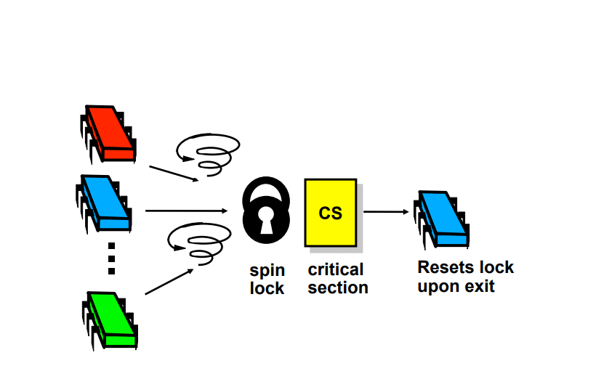
Critical section and hardware support: Read-Modify-Write (RMW) instructions
TestAndSet (aka TAS) Instruction Definition:
boolean TestAndSet (boolean *target){
boolean rv = *target;
*target := true;
return rv} // Executed atomically by the HW
Shared Boolean var lock; initialized to false
repeat while(TestAndSet(&lock)) do [nothing];
[critical section]
lock := false;
[remainder section]
forever
TAS
variable
Is set
TAS variable
Homework training: argue as we did for Peterson’s algo regarding correctness (mutual exclusion, progress) ; what about fairness?
Notes:
Something better is provided by Read-Modify-Write (RMW) operations. In this case we are not talking of individual atomic reads or writes, but of an atomic operation that performs both a read and a write.
Examples of these operations are TestAndSet, FetchAndAdd, CompareAndSwap, and so on. We will look at some of these next.
Let's try with the TestAndSet (TAS) instruction.
As shown in the slide, the function gets a boolean variable, sets it to true and returns the previous value. As I said, this instruction is executed atomically, so it either runs in its entirety or it does not. Under the hood, the hardware is either disabling interrupts if the system is uniprocessor or locking the system bus if the system is a multiprocessor one.
Now, if you think about it, you will agree with me that if the target variable is set to false and N concurrent threads invoke the TAS, then only one will get false in return. If you agree with this, then probably you can see how we can use the TAS in the entry section as shown in the example. A thread can enter its critical section only if the TAS returns false. If there are concurrent invocations, the TAS will only return false to one thread, and no other thread will be able to enter its critical section until another thread exits its own and sets lock to false.
Please, take a moment and try to reason formally about whether this solution meets the mutual exclusion, progress and fairness properties.

Slide 32
Critical section and hardware support: Read-Modify-Write (RMW) instructions
TestAndSet (aka TAS) Instruction Definition:
boolean TestAndSet (boolean *target){
boolean rv = *target;
*target := true;
return rv} // Executed atomically by the HW
CompareAndSwap (aka CAS) Instruction Definition:
int CompareAndSwap(int *V, int expected, int new_value) {
int temp := *V;
if (temp == expected) then *V := new_value;
return temp} // Executed atomically by the HW
Shared Boolean var lock; initialized to false
repeat while(TestAndSet(&lock)) do [nothing];
[critical section]
lock := false;
[remainder section]
forever
Shared int var lock; initialized to 0;
repeat{
while CompareAndSwap(&lock,0,1)!=0) do nothing;
[critical section]
lock := 0 ;
[remainder section]
forever
Notes:
An alternative instruction we could use is the CompareAndSwap (CAS). In this case, the instructions that are run atomically will set a given value to a given variable only if the current value of such variable is the expected one. If you look at this alternative formulation of the critical section, you will see it's equivalent to the one using the TAS.

Slide 33
A reflection about busy-waiting
Rather simple, convenient; BUT:
Busy-waiting consumes processor time unnecessarily
Starvation is possible when using methods as in the previous slides
Even Deadlock possible if spinning in non-preemptive priority-based scheduling: example scenario: threads/processes on the same CPU and:
low priority thread LP executes in critical section
higher priority thread HP needs to access its CS
the higher priority thread HP is dispatched (i.e., occupies the processor) and busy-waits for the LP to exit from its critical section…
Notes:
Something worth noticing about these solutions is that they are busy waiting / spinning.
[c] Each thread will keep consuming CPU cycles until it manages to enter its critical section, which is a waste of resources.
[c] If you have tried to argue yourself about whether these are valid solutions to the critical section problem, you probably have reached the conclusion that from the fairness perspective, they are also not optimal.
More concretely, they can lead to starvation, with the same thread being the one that keeps entering its critical section and other threads not managing to do so.
[c] The third point to think about is the underlying OS scheduling mechanism. Even if in this lecture we have not really made any assumption on the scheduling mechanism the underlying OS is using, you should not think we do not need to make assumptions when looking at a specific solution. For instance, if we assume the OS is running a non-preemptive priority-based scheduler and the thread that is spinning in its entry section is the one with the highest priority, then the solution can lead to a deadlock and no thread is actually able to make any progess.

Slide 34
Critical section + bounded waiting with TaS + busy-waiting for n threads
Shared var lock: boolean // init false;
Shared var waiting[0..n-1]: array of boolean // init all false;
do
waiting[i] := TRUE;
while (waiting[i] && TestAndSet(&lock) ) do [nothing]; //busywait
waiting[i] := FALSE;
[critical section ]
j = (i + 1) % n;
while ((j != i) && !waiting[j]) do // find next one waiting, to help it (handover the “lock” )
j := (j + 1) % n;
if (j == i) then
lock := false; // completed one round without handing over; release “lock”
else
waiting[j] := false; // hand-over “lock”
[remainder section ]
forever;
Notes:
If we now go back to the observation about starvation, let's look at an alternative formulation that can help us achieve better fairness.
Let's assume the entry and exit sections are as shown in this slide.
Besides a shared lock variable initially set to false, we have a shared array of boolean values called waiting. The array has one boolean per thread, initially set to false.
In its entry section, before entering the while loop, each thread shares its will of entering the critical section by setting its entry in the waiting array to true.
The thread will stay in the loop until it manages to run TAS (as before) and while its waiting entry remains true. After exiting the while loop and before entering its critical section, the thread sets its entry in waiting to false.
Now let's look at what happens after the thread exits its critical section.
The thread circles over the waiting array, starting from the next thread in the array (as if the buffer is circular) and then stops as soon as it finds one entry for which waiting is true or if completes the circle.
If no other thread is waiting in its loop inside its entry section, then this thread sets lock to false, so some other thread that wants to enter its critical section later on can do so. Notice that the thread that enters its critical section next could be the thread that just set lock to false, but this cannot happen for an unbounded number of times (if another thread is waiting), since if another thread also wants to enter the critical section, then its entry in waiting will be true and the thread that manages to enter its critical section will then hand over the lock in its exit section, as shown in line 14.
As before, try to formally reason about whether this solution is valid or not by yourselves.

Slide 35
Agenda
Motivation
The Critical Section problem
Check-competition approach
The check-order / after-you approach
Peterson’s Algorithm
Synchronization and hardware support
Read-Modify-Write instructions
Semaphores
Other techniques

Slide 36
Synchronization with semaphores
Special variables/data-objects used for signaling
Accessible via (i.e., API) atomic Wait and Signal operations
If a process is waiting for a signal, it is blocked until that signal is “sent”
Definition of the wait() operation
wait(S) {
while (S == 0) do;
S--;
} // Executed atomically
Definition of the signal() operation
signal(S) {
S++; // and unblock from queue if applicable
} // Executed atomically
Binary semaphore – value can be only 0 or 1
Counting semaphore – value can vary
Notes:
In this video, we are going to look at another synchronization primitive: semaphores.
A semaphore is a special variable/data object that can be used for signaling.
It is handled via 2 atomic operations: wait and signal. If a thread is waiting for a signal, it will remain blocked until that signal is sent.
We have seen such a behavior in the lecture about multi-threaded processes and pthreads.
[c] Here we have the description of how signal and wait work.
When invoking signal on variable S, the variable is atomically incremented.
When invoking wait on S, the thread invoking the function will loop or remain blocked until S value is 0. After that, it will exit after decreasing the value of S.
[c] S can take only values 0 and 1 if it is a binary semaphore or also greater than one if it is a counting semaphore.

Slide 37
Critical section of n threads using semaphores
Shared var mutex_sem : binary semaphore // init = 1
Thread I
repeat
wait(mutex_sem);
[critical section]
signal(mutex_sem);
[remainder section]
forever
Notes:
At this point, you can hopefully see semaphores can be used as shown in this pseudocode to handle the critical section problem (but please try to reason formally by yourself!)

Slide 38
Semaphores as General Synchronization Tools
Q: how to execute code segment B in T_{B} only after code segment A has been executed in T_{A}:
A: use semaphore flag, initialized to 0
T_{A} T_{B}
 
opA wait(flag)
signal(flag) opB
T_{B} will be able to proceed from wait(flag) only after signal(flag) is executed by T_{A}
Notes:
Something worth noticing about semaphores is that they can be used to create an order in the execution of two threads. If we want to execute code segment opB from TB only after code segment opA has been executed in Ta, we can do it as shown in the slide. Since B waits for a signal from A, and A sends a signal after opA, then opB will be executed after opA.

Slide 39
Agenda
Motivation
The Critical Section problem
Check-competition approach
The check-order / after-you approach
Peterson’s Algorithm
Synchronization and hardware support
Read-Modify-Write instructions
Semaphores
Other techniques

Slide 40
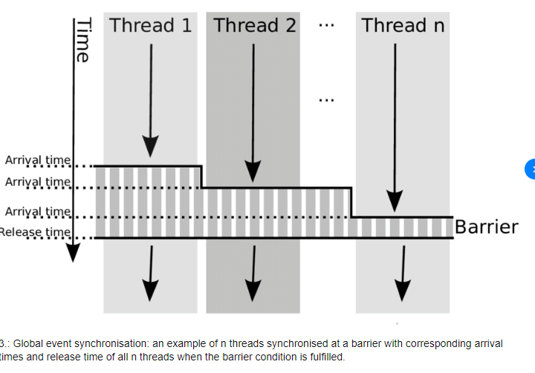
Other synchronization operations/constructs:
Tools for programmers to solve critical section and synchronization problems (can be implemented using hardware atomic instructions or algorithms such as Peterson’s or other such tools
mutex lock x; API :
x.acquire() wait/block if x is not available; else make x not available
x.release() unblock a waiting/blocked process; else make x available
If implemented with busy waiting, called spinlock
Condition Variables: condition x; API:
x.wait () – a process that invokes the operation is blocked.
x.signal () – unblocks one of processes that invoked x.wait () (if any; else, does nothing)
Other high-level synchronization constructs
Monitors (combination of mutex locks and condition variables)
Barriers
Notes:
Notice that besides RMW instructions and semaphores, there are more available synchronization mechanisms.
Linux for instance offers synchronization primitives like mutex, condition variables, monitors, and barriers, among others.
Mutex and semaphores are not exactly the same thing. Semaphore can be binary but also have values greater than 1. It’s not really important who decrements the semaphore, while the mutex needs to be released by the one that acquires it

Slide 41
Linux Synchronization provides system calls for:
semaphores
spin locks for multiprocessors (for short critical sections): why?
[hint: wastes CPU time and can cause deadlocks if used with strict priority scheduling on uniprocessor]
futex
try_lock through 1 invocation of RMW instruction; if already locked, then process enters blocked queue; why?
[Balance the cost of entering a queue directly with the cost of spinning on the RMW instruction]
https://man7.org/linux/man-pages/man2/futex.2.html
Notes:
Which one to use is something that depends on the application. For instance, if you have to choose between an entry section that relies on spinning or one that uses a Linux futex (which tries to acquire a lock in the entry section but instead of spinning puts the thread in the waiting queue), you might want to consider how long the critical section is. It might be OK to spin and "waste" CPU for a relatively short critical section that happens sporadically, but maybe not for a long one that is executed frequently...

Slide 42
Windows XP Synchronization
processor-specific interrupt masks to protect access to global resources on uniprocessors
busy-wait spinlocks on multiprocessors
why not on uniprocessors?
[hint: can cause deadlocks if used with strict priority scheduling]
dispatcher objects
may act as mutexes, semaphores, or provide events (similar to condition variables)
Notes:
Windows too offers synchronization primitives, for instance interrupt masks to protect access to global resources on uniprocessors and busy-wait spinlocks for multiprocessors (we have discussed before why disabling interrupts on a single processor might be not enough to have valid solutions to the critical section problem). Finally, it also offers objects like mutexes, semaphores or to provide events (similar to condition variables).

Slide 43
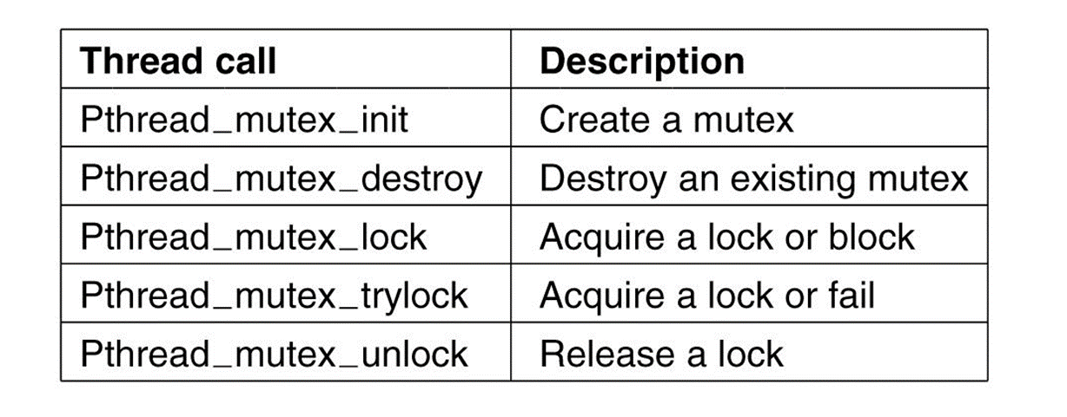
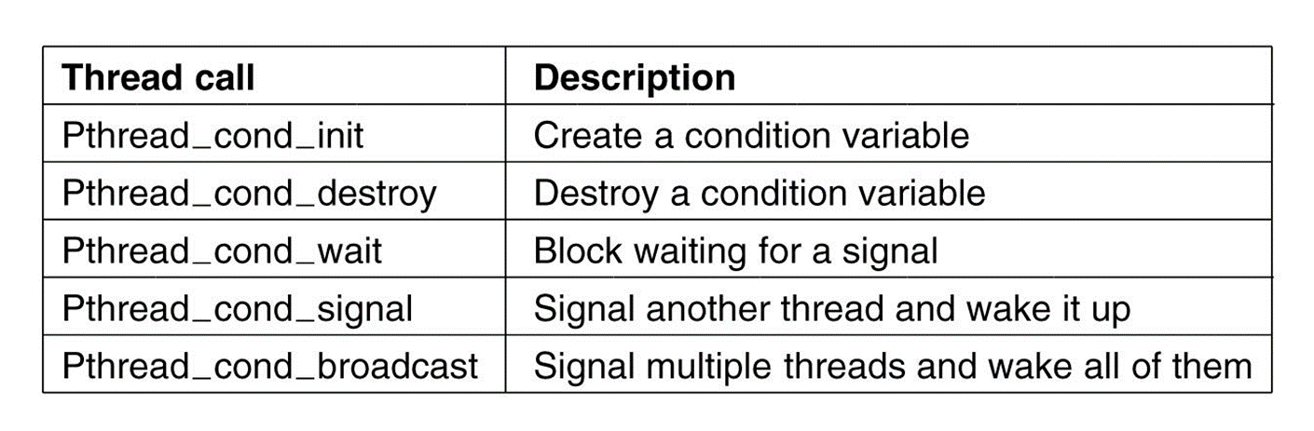
Pthreads Synchronization
OS-independent; provides:
mutex locks with blocking queues (also fairness in mind)
condition variables
Non-portable extensions include:
read-write locks (we will discuss these in upcoming lectures)
spin locks
Notes:
If we look at pthreads, you will see it also offers synchronization mechanisms like mutex locks with blocking queues, which can also support fairness, condition variables, and other non-portable extensions.
Notice that an OS that defines and offers such synchronization primitives usually needs such synchronization primitives itself, to protect its shared variables when multiple concurrent/parallel threads run the OS code!

Slide 44
Questions

Slide 45
Question
Consider the following semaphore setup:
semA = 1;
semB = 0;
semC = 0;
Is opY → opX → opZ valid?
THREAD X
wait(semA);
opX;
signal(semB);
THREAD Y
wait(semB);
opY;
signal(semC);
THREAD Z
wait(semC);
opZ;
signal(semA);
Notes:
no

Slide 46
Question
Consider the following semaphore setup:
semA = 1;
semB = 0;
semC = 0;
Is sequence is valid?
THREAD X
wait(semA);
opX;
signal(semB);
THREAD Y
wait(semB);
opY;
signal(semC);
THREAD Z
wait(semC);
opZ;
signal(semA);
Notes:
a b c a b c

Slide 47
Question
Consider the following semaphore setup:
semA = 1;
semB = 1;
semC = 0;
Are opY & opX → opZ and opX & opY → opZ valid?
THREAD X
wait(semA);
opX;
signal(semB);
THREAD Y
wait(semB);
opY;
signal(semC);
THREAD Z
wait(semC);
opZ;
signal(semA);
Notes:
Yes

Slide 48
If two threads share memory, one thread with high priority wants to enter the critical section but another thread with lower priority was in the CS before, and the scheduling is non-preemptive priority based, that could lead to:
Unfair sharing of CPU time
Deadlock
Violation of mutual exclusion
Notes:
2

Slide 49
Is mutual exclusion guaranteed by this approach?
Notes:
No

