Slide 1


Virtual Memory
Operating Systems – EDA093/DIT401
Vincenzo Gulisano
vincenzo.gulisano@chalmers.se

Slide 2
Reading instructions
Chapter 3.3 to 3.6
(optional additional reading: 9.1-9.4.5, 9.5 to 9.7.1 from Silberschatz Operating System Concepts)

Slide 3
Objectives
To describe the benefits of a virtual memory system
To explain the concepts of demand paging, page-replacement algorithms, and allocation of page frames
To discuss the principle of the working-set model

Slide 4
Agenda
Recap / Introduction
Demand Paging
Copy-on-Write
Page Replacement
Allocation of Frames
Thrashing
Memory-mapped files [Self-reading]

Slide 5
Agenda
Recap / Introduction
Demand Paging
Copy-on-Write
Page Replacement
Allocation of Frames
Thrashing
Memory-mapped files [Self-reading]

Slide 6


… we discussed paging!
Divide the logical address space into fixed-size pages
Divide physical memory into equal-size frames.
Page size = Frame size!
Logical and physical memory decoupling
Less fragmentation (better memory utilization)
Protection
Faster loading / swapping
Notes:
Say: external fragmentation / Internal Fragmentation and so on
pages power of 2

Slide 7
The intuition behind Virtual Memory
What would happen if the OS does not load page 3 in frame 7?
(does not load at all, not in a different frame)
Notes:
Question, wait for answers

Slide 8
The intuition behind Virtual Memory
What would happen if the OS does not load page 3 in frame 7?
(does not load at all, not in a different frame)
When would that be a problem?
Notes:
Question, wait for answers

Slide 9
The intuition behind Virtual Memory
What would happen if the OS does not load page 3 in frame 7?
(does not load at all, not in a different frame)
When would that be a problem?
Let’s wait until the process tries to access page 3… If it does, then we will load it into frame 7 (or another one, that will be decided later on)!
Notes:
Question, wait for answers

Slide 10
Virtual Memory in a Nutshell (i)
Code needs to be in memory to execute, but a process rarely needs all its code and data at the same time.
If we manage to execute partially-loaded programs:
  Program no longer constrained by limits of physical memory
  Each program takes less memory while running -> more programs run at the same time
  Less I/O needed to load or swap programs into memory -> programs may start sooner because fewer pages are loaded initially (but later page faults add overhead!)
  Unusual routines
  Error code

Slide 11
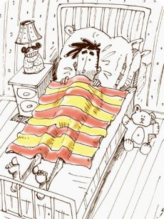
Virtual Memory in a Nutshell (ii)
What are the costs / trade-offs / complications when executing partially-loaded programs:
Need a mechanism to check if a page is in the frame or not (track page residency)
Because of this mechanism, sometimes accessing a page might require more time than expected
Servicing page faults
Choosing victim pages
Transferring pages to or from backing storage

Slide 12
Agenda
Recap / Introduction
Demand Paging
Copy-on-Write
Page Replacement
Allocation of Frames
Thrashing
Memory-mapped files [Self-reading]

Slide 13
Demand Paging
Could bring entire process into memory at load time
Or bring a page into memory only when it is needed
  Less I/O needed
  Less resident memory per process can allow more processes to remain active
Page is needed ⇒ reference to it
  not-in-memory ⇒ bring to memory
Lazy swapper / pager – never swaps a page into memory until the process first references it

Slide 14
Basic Concepts
Pager brings in only those pages into memory
Need new MMU functionality to implement demand paging (transparently to the application)
If pages needed are already memory resident
  No difference from non-demand paging
If page needed and not memory resident
  Need to detect and load the page into memory from storage
    Without changing program behavior
    Without programmer needing to change code

Slide 15
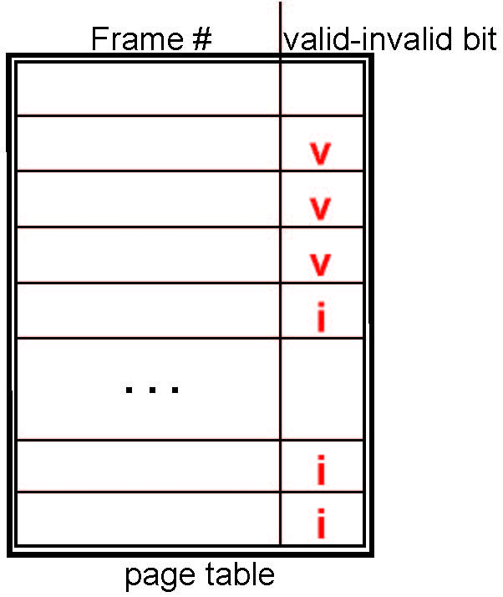
Valid-Invalid Bit
With each page table entry, a valid–invalid bit is associated
(v ⇒ in-memory – memory resident, i ⇒ not-in-memory)
Initially valid–invalid bit is set to i on all entries
Example of a page table snapshot:
During MMU address translation, if valid–invalid bit in page table entry is i ⇒ page fault
Notes:
Clarify Invalid could be also because the page does not belong to the process, valid/invalid is a simplification here

Slide 16
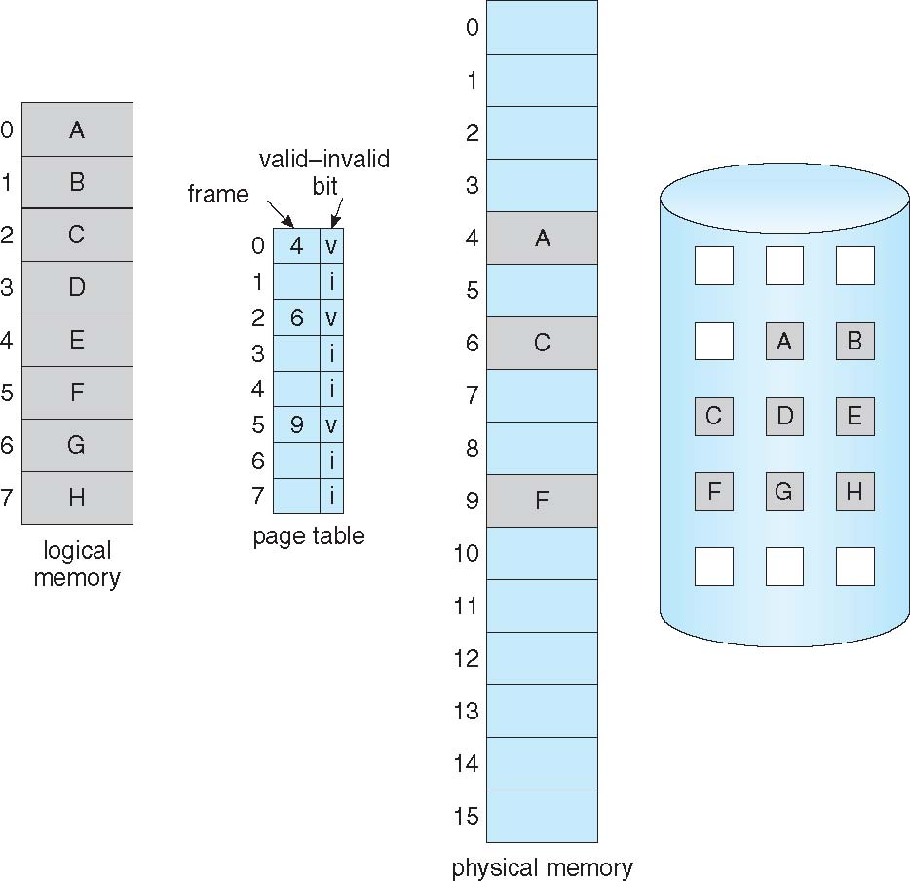
Page Table When Some Pages Are Not in Main Memory

Slide 17
Page Fault
If there is a reference to a page, first reference to that page will trap to operating system if the page is not resident:
page fault
Operating system looks at another table to decide:
  Invalid reference ⇒ abort
  Just not in memory
Find free frame (or select a victim one)
Swap page into frame via scheduled disk operation
  Might need to swap out what is in the frame if it was not free
Reset tables to indicate page now in memory
Set valid bit = v
Restart the instruction that caused the page fault
Notes:
Invalid reference (as I understand) is because the OS only knows there was an invalid reference, it still has to check in the table to see what it is exactly

Slide 18
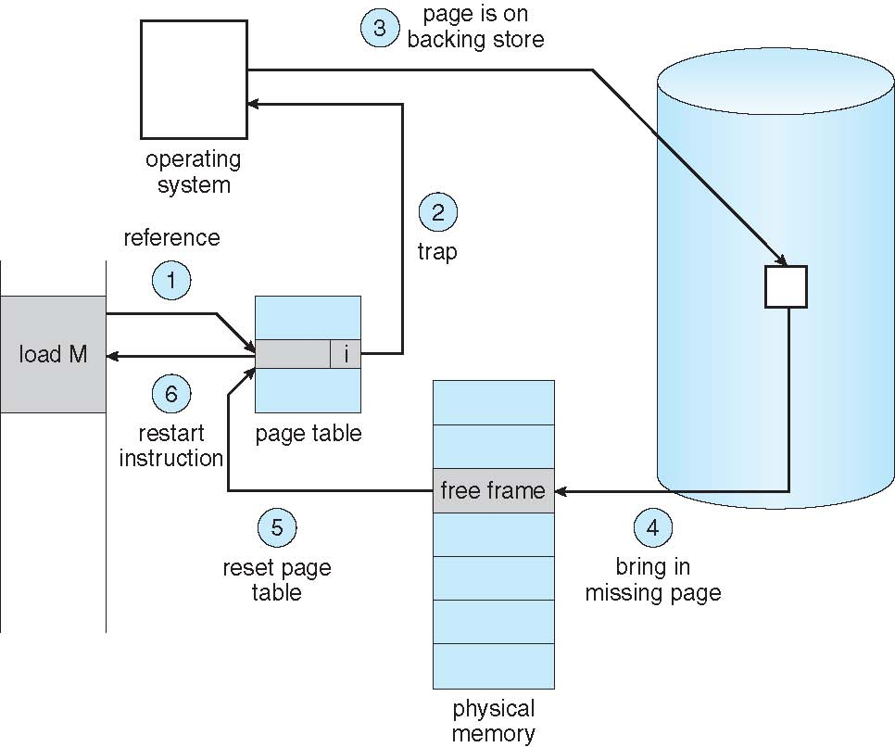
Steps in Handling a Page Fault

Slide 19
Aspects of Demand Paging
  Pure demand paging – start process with no pages in memory
  OS sets instruction pointer to first instruction of process, non-memory-resident -> page fault
  The same happens for every other process page on first access
Hardware support needed for demand paging
  Page table with valid / invalid bit
  Secondary memory (swap device with swap space)
  Instruction restart
Notes:
Do we need this page?

Slide 20
Performance of Demand Paging
Stages in Demand Paging (worst case)
Trap to the operating system
Save the user registers and process state
Determine that the trap was a page fault
Check that the page reference was legal and determine the location of the page on the disk
Issue a read from the disk to a free frame:
  Wait in a queue for this device until the read request is serviced
  Begin the transfer of the page to a free frame
While waiting, allocate the CPU to some other process / thread / user
Receive an interrupt from the disk I/O subsystem (I/O completed)
Save the registers and process state for the other user
Determine that the interrupt was from the disk
Correct the page table and other tables to show page is now in memory
Wait for the CPU to be allocated to this process again
Restore the user registers, process state, and then resume the interrupted instruction
Notes:
trap / interrupt difference

Slide 21
Performance of Demand Paging (Cont.)
Three major activities
  Service the interrupt – careful coding means just several hundred instructions needed
  Read the page – lots of time
  Restart the process – again just a small amount of time
Page Fault Rate 0 ≤ p ≤ 1
  if p = 0 no page faults
  if p = 1, every reference is a fault
Effective Access Time (EAT)
EAT = (1 – p) x memory access
+ p (page fault overhead
+ swap page out [potentially 0]
+ swap page in )

Slide 22
Agenda
Recap / Introduction
Demand Paging
Copy-on-Write
Page Replacement
Allocation of Frames
Thrashing
Memory-mapped files [Self-reading]

Slide 23
Copy-on-Write
Example of optimization enabled by separation of Logical from Physical memory and by demand paging
Copy-on-Write (COW) allows both parent and child processes to initially share the same pages in memory
  If either process modifies a shared page, only then is the page copied
COW allows more efficient process creation as only modified pages are copied
fork() is commonly implemented using copy-on-write: parent and child initially share physical pages, and a page is copied when either process writes it.
vfork() avoids creating a separate address space: the child temporarily runs in the parent’s address space while the parent is suspended, so the child must promptly call exec() or _exit().
Notes:
Fast creation? Copy on write
Fast creation + exec? Vfork()

Slide 24
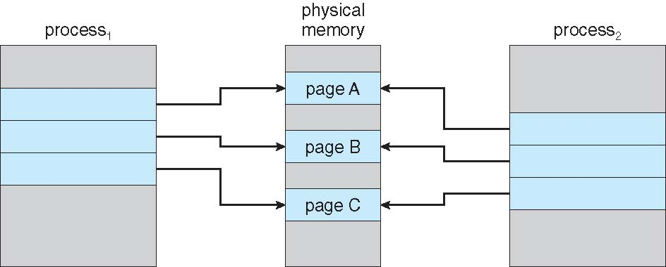
Before Process 1 Modifies Page C

Slide 25
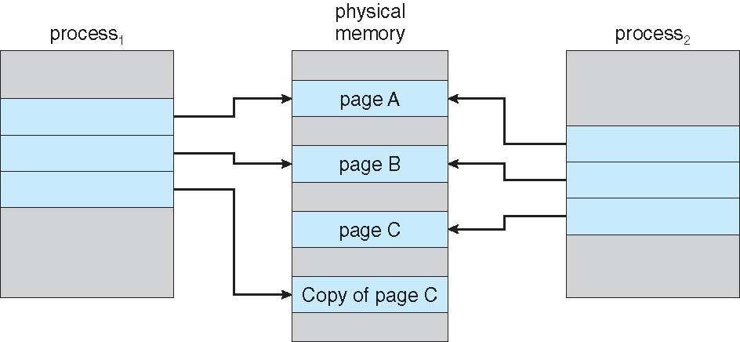
After Process 1 Modifies Page C

Slide 26
Dirty COW (CVE-2016-5195) was a Linux kernel race condition in copy-on-write handling that could allow an unprivileged process to modify read-only mappings and escalate privileges

Slide 27
Agenda
Recap / Introduction
Demand Paging
Copy-on-Write
Page Replacement
Allocation of Frames
Thrashing
Memory-mapped files [Self-reading]

Slide 28
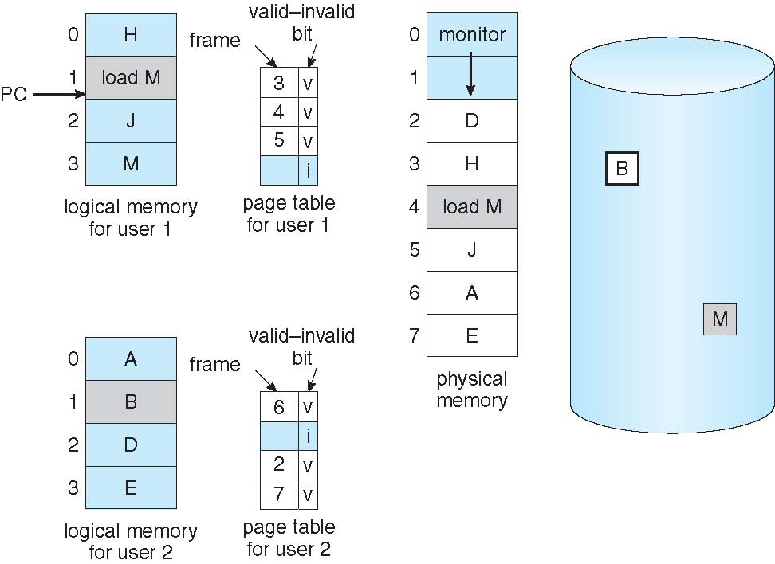
Suppose we end up in a situation like the following one
What to do now?
Can we replace an existing page?
Should it be from process 1 or can it also be from process 2?
Is there any page that can be swapped out without writing it to disk?
Is there any page that has lower probability of being needed later on?
Could we have prevented this situation?
How many pages should we have allocated to the OS and to processes 1 and 2 to prevent this?
…
process 1
process 1
process 2
Process 2
Process 1 needs a free frame (but 0 available!)
Notes:
About the page that is faster to swap out, possible question is how? They have all the same size…

Slide 29
Page and Frame Replacement Algorithms
What to do now?
Can we replace an existing page?
Should it be from process 1 or can it also be from process 2?
Is there any page that can be swapped out without writing it to disk?
Is there any page that has lower probability of being needed later on?
Could we have prevented this situation?
How many pages should we have allocated to the OS and to processes 1 and 2 to prevent this?
…
Frame-allocation algorithm
determines how many frames to give each process
Page-replacement algorithm
Which page to replace? Want lowest page-fault rate on both first access and re-access

Slide 30
Page Replacement
When no free frame exists, the page-fault handler selects a victim page, evicts it (writing it first if dirty), and reuses its frame
Use modify (dirty) bit to reduce overhead of page transfers – only modified pages are written to disk
Page replacement completes separation between logical memory and physical memory – large virtual memory can be provided on a smaller physical memory
Notes:
If we need a frame but there’s no free one, which one do we free?

Slide 31
Basic Page Replacement
Find the location of the desired page on disk
Find a free frame:
  If there is a free frame, use it
  If there is no free frame, use a page replacement algorithm to select a victim frame
    Write victim frame to disk if dirty
Bring the desired page into the (newly) free frame; update the page and frame tables
Continue the process by restarting the instruction that caused the trap
Note now potentially 2 page transfers for page fault – increasing EAT
Notes:
Note now potentially 2 page transfers for page fault – increasing EAT
Actually, dirty bit is to reduce EAT (effective access time)

Slide 32
Page replacement algorithms
We are going to look at:
FIFO (First-In-First-Out)
Optimal algorithm
Least Recently Used (LRU)
Approximated LRU

Slide 33
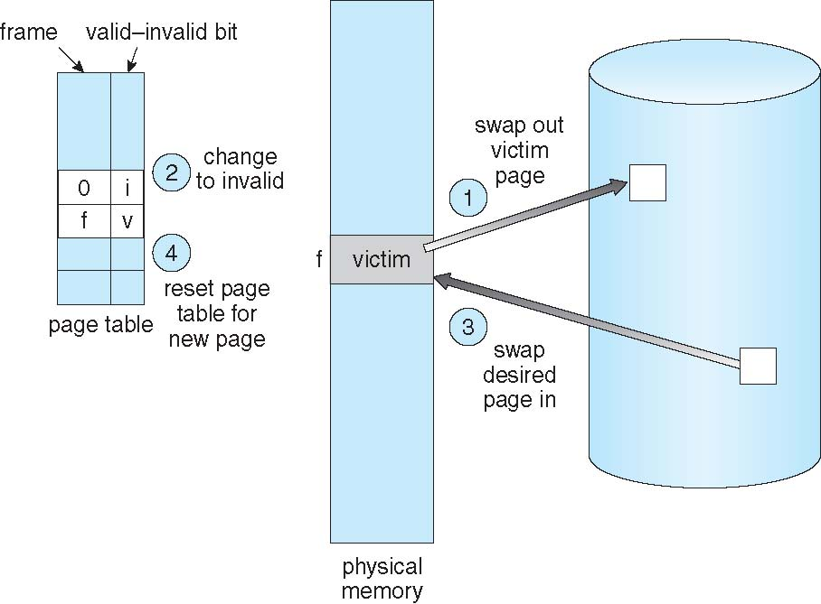
Page Replacement

Slide 34
How to evaluate a page replacement algorithm?
Run it on a particular string of memory references (reference string) and computing the number of page faults on that string
  String is just page numbers, not full addresses
  Repeated access to the same page does not cause a page fault (if the page is still resident)
  Results depend on number of frames available
In all our examples, the reference string of referenced page numbers is
7,0,1,2,0,3,0,4,2,3,0,3,0,3,2,1,2,0,1,7,0,1

Slide 35
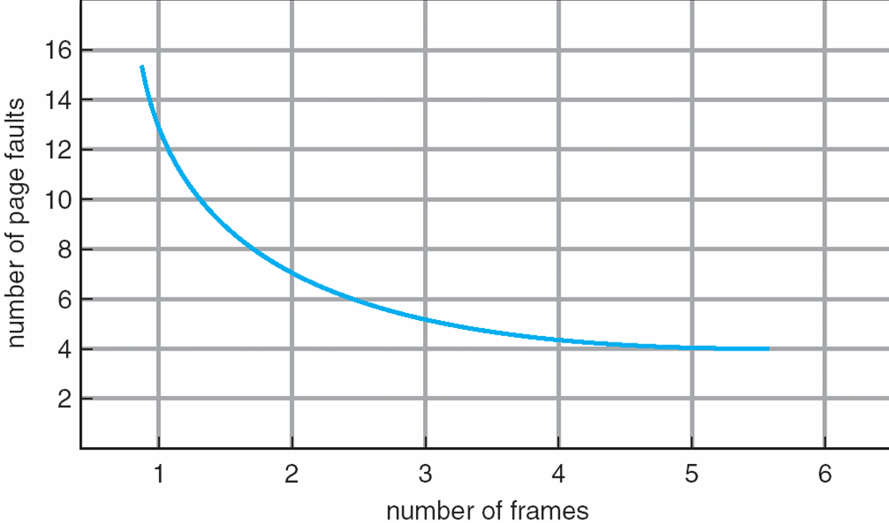
What do we expect?
(Graph of Page Faults Versus The Number of Frames)
Notes:
This is what we expect

Slide 36
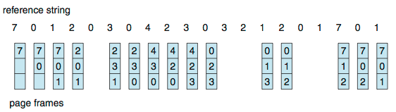
First-In-First-Out (FIFO) Algorithm
If all frames are used, free the one with the page that has been resident the longest
Reference string: 7,0,1,2,0,3,0,4,2,3,0,3,0,3,2,1,2,0,1,7,0,1
3 frames (3 pages can be in memory at a time per process)
Page needed: 7
Status of frames:
Is it there? NO
Do we have a free frame? YES
If YES, load the page
+1 page fault
Page faults: 0

Slide 37
First-In-First-Out (FIFO) Algorithm
If all frames are used, free the one with the page that has been resident the longest
Reference string: 7,0,1,2,0,3,0,4,2,3,0,3,0,3,2,1,2,0,1,7,0,1
3 frames (3 pages can be in memory at a time per process)
Page needed: 0
Status of frames:
Is it there? NO
Do we have a free frame? YES
If YES, load the page
+1 page fault
Page faults: 1
7

Slide 38
First-In-First-Out (FIFO) Algorithm
If all frames are used, free the one with the page that has been resident the longest
Reference string: 7,0,1,2,0,3,0,4,2,3,0,3,0,3,2,1,2,0,1,7,0,1
3 frames (3 pages can be in memory at a time per process)
Page needed: 1
Status of frames:
Is it there? NO
Do we have a free frame? YES
If YES, load the page
+1 page fault
Page faults: 2
7
0

Slide 39
First-In-First-Out (FIFO) Algorithm
If all frames are used, free the one with the page that has been resident the longest
Reference string: 7,0,1,2,0,3,0,4,2,3,0,3,0,3,2,1,2,0,1,7,0,1
3 frames (3 pages can be in memory at a time per process)
Page faults: 3
Page needed: 2
Status of frames:
Is it there? NO
Do we have a free frame? NO
If NO, evict the page loaded more time ago (7)
+1 page fault
7
0
1
Notes:
Could say the first 3 are faults because we are just starting

Slide 40
First-In-First-Out (FIFO) Algorithm
If all frames are used, free the one with the page that has been resident the longest
Reference string: 7,0,1,2,0,3,0,4,2,3,0,3,0,3,2,1,2,0,1,7,0,1
3 frames (3 pages can be in memory at a time per process)
Page needed: 0
Status of frames:
Is it there? YES
Page faults: 4
2
0
1

Slide 41
First-In-First-Out (FIFO) Algorithm
Reference string: 7,0,1,2,0,3,0,4,2,3,0,3,0,3,2,1,2,0,1,7,0,1
3 frames (3 pages can be in memory at a time per process)
Can vary by reference string: consider 1,2,3,4,1,2,5,1,2,3,4,5
Adding more frames can cause more page faults!
  Belady’s Anomaly
How to track arrival order of pages?
  Just use a FIFO queue
15 page faults

Slide 42
FIFO Illustrating Belady’s Anomaly

Slide 43
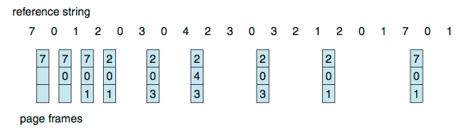
Optimal Algorithm
Replace the page whose next use is farthest in the future
  OPT produces 9 page faults for this reference string
How do you know this?
  Can’t read the future
OPT is useful as a benchmark but cannot be implemented exactly online because future references are unknown
Notes:
This one does not suffer the Belady’s anomaly

Slide 44
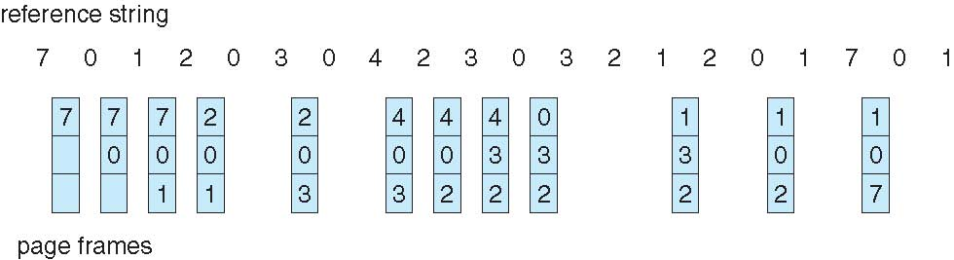
Least Recently Used (LRU) Algorithm
Use past knowledge rather than future
Replace page that has not been used in the longest time
Associate time of last use with each page
12 faults – better than FIFO but worse than OPT
Generally good algorithm and frequently used (with approximations)
But how to implement?

Slide 45
LRU Algorithm (Cont.)
Counter implementation
  Every page-table entry has a counter; every time page is referenced through this entry, copy the clock into the counter
  When a page needs to be changed, look at the counters to find smallest value
    Search through table needed
Stack implementation
  Keep a stack of page numbers in a doubly-linked list:
  Page referenced → move it to the top
  Each update more expensive
  No search for replacement (page to replace at the bottom of the stack)

Slide 46
Use Of A Stack to Record Most Recent Page References

Slide 47
LRU Approximation Algorithms
LRU needs special hardware and still slow
Reference bit
  With each page associate a bit, initially = 0
  Hardware sets a page’s reference bit when the page is accessed; the OS periodically clears it
  Replace any with reference bit = 0 (if one exists)
    We do not know the order, however
Second-chance algorithm
  Generally FIFO, plus hardware-provided reference bit
  Clock replacement
  If page to be replaced has
    Reference bit = 0 -> replace it
    reference bit = 1 then:
      set reference bit 0, leave page in memory
      replace next page, subject to same rules
Notes:
If a page is used a lot, it does not get replaced

Slide 48
Second-Chance (clock) Page-Replacement Algorithm

Slide 49
Agenda
Recap / Introduction
Demand Paging
Copy-on-Write
Page Replacement
Allocation of Frames
Thrashing
Memory-mapped files [Self-reading]

Slide 50
Page and Frame Replacement Algorithms
What to do now?
Can we replace an existing page?
Should it be from process 1 or can it also be from process 2?
Is there any page that can be swapped out without writing it to disk?
Is there any page that has lower probability of being needed later on?
Could we have prevented this situation?
How many pages should we have allocated to the OS and to processes 1 and 2 to prevent this?
…
Frame-allocation algorithm
determines how many frames to give each process
Page-replacement algorithm
Which page to replace? Want lowest page-fault rate on both first access and re-access

Slide 51
Allocation of Frames
Each process needs minimum number of frames
Maximum of course is total frames in the system (but remember the OS and other processes need frames too)
Two major allocation schemes
  fixed allocation
  priority allocation
Many variations

Slide 52
Fixed Allocation
Equal allocation – For example, if there are 100 frames (after allocating frames for the OS) and 5 processes, give each process 18 frames
  Keep some as free frame buffer pool
Proportional allocation – Allocate according to the size of process
  Dynamic as degree of multiprogramming, process sizes change

Slide 53
Priority Allocation
Use a proportional allocation scheme using priorities rather than size
If process P_{i} generates a page fault,
  select for replacement one of its frames (Local replacement)
  select for replacement a frame from a process with lower priority process (Global replacement)

Slide 54
Global vs. Local Allocation
Global replacement – process selects a replacement frame from the set of all frames; one process can take a frame from another
  Global replacement can improve utilization or throughput, but it makes each process’s performance less predictable. The preferred policy depends on the OS and workload.
Local replacement – each process selects from only its own set of allocated frames
  More consistent per-process performance
  But possibly underutilized memory
Notes:
But then process execution time can vary greatly BECAUSE OF EXTERNAL REASONS

Slide 55

Agenda
Recap / Introduction
Demand Paging
Copy-on-Write
Page Replacement
Allocation of Frames
Thrashing
Memory-mapped files [Self-reading]

Slide 56
Thrashing
If a process does not have “enough” pages, the page-fault rate is very high
  Page fault to get page
  Replace existing frame
  But quickly need replaced frame back
  This leads to:
    Low CPU utilization
    Operating system thinking that it needs to increase the degree of multiprogramming
    Another process added to the system
Thrashing ≡ a process or system spends most of its time servicing page faults
Notes:
A higher degree of multiprogramming means more processes are resident/active, so each may receive fewer frames

Slide 57
Thrashing (cont.)
Process needs frames (global page replacement)
“steals” frames from other processes
Paging-I/O device queue grows
Ready queue decreases
OS increases degree of multiprogramming

Slide 58
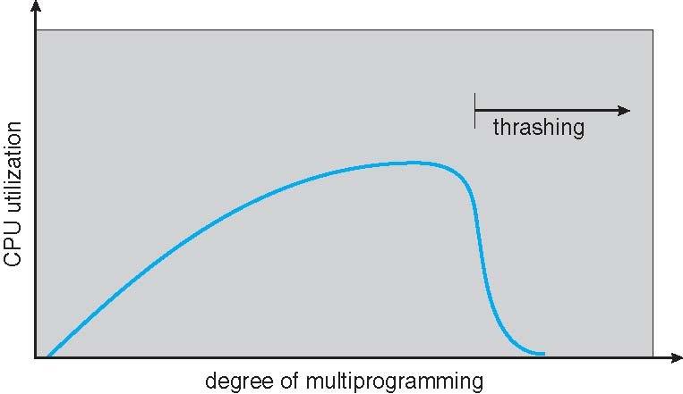
Thrashing (Cont.)
Sometimes the OS needs to reduce degree of multiprogramming to increase (restore) CPU utilization

Slide 59
Demand Paging and Thrashing
Why does demand paging work?
Locality model
  Process migrates from one locality to another
  Localities may overlap
Why does thrashing occur?
Σ size of locality > frames available to the active processes
  Limit effects by using local or priority page replacement

Slide 60
Locality In A Memory-Reference Pattern

Slide 61
How could the OS avoid thrashing?

Slide 62
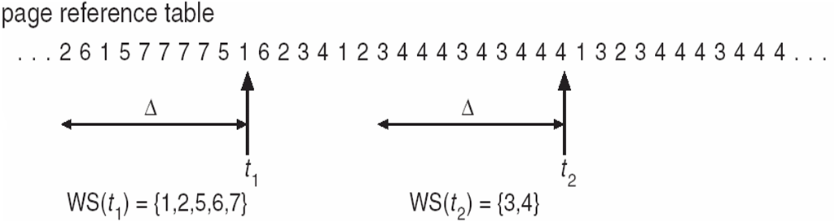
Working-Set Model
Δ ≡ working-set window ≡ a fixed number of page references
Example: 10,000 page references
WSS_{i} (Working Set Size of Process i) =
total number of pages referenced by Process i in the most recent Δ (varies in time)
  if Δ too small will not encompass entire locality
  if Δ too large will encompass several localities
  if Δ = ∞ ⇒ will encompass entire program
D (Total demand for frames) = Σ WSSi
  Approximation of locality
if D > available frames m ⇒ Thrashing
Policy: if D > m, then suspend or swap out one of the processes
How to keep track of the Working Set?
Notes:
How could we avoid trashing

Slide 63
Page-Fault Frequency
More direct approach than WSS
Establish “acceptable” page-fault frequency (PFF) rate and use local replacement policy
  If actual rate too low, process loses frame
  If actual rate too high, process gains frame

Slide 64
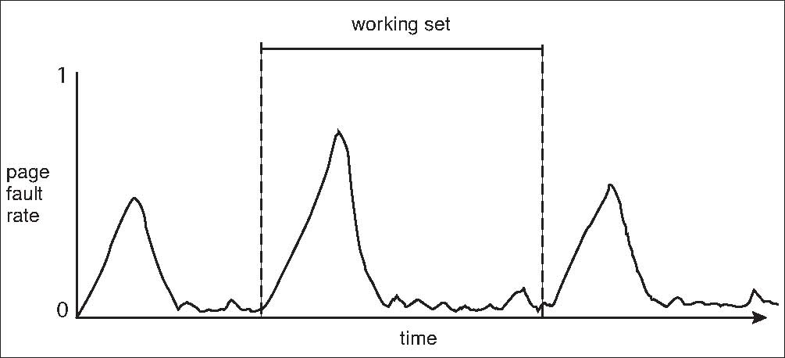
Working Sets and Page Fault Rates
The page-fault rate generally rises when a process has too few frames for its current working set and falls once enough frames are available.
Working set changes over time
Peaks and valleys over time
By looking at the Page Fault Rate you can observe the working set variations over time

Slide 65
Agenda
Recap / Introduction
Demand Paging
Copy-on-Write
Page Replacement
Allocation of Frames
Thrashing
Memory-mapped files [Self-reading]

Slide 66
Memory-Mapped Files
Memory-mapped file I/O allows file I/O to be treated as routine memory access by mapping a disk block to a page in memory
A file is initially read using demand paging
  A page-sized portion of the file is read from the file system into a physical page
  Subsequent reads/writes to/from the file are treated as ordinary memory accesses
Simplifies and speeds file access by driving file I/O through memory rather than read() and write() system calls
Also allows several processes to map the same file allowing the pages in memory to be shared
But when does written data make it to disk?
  Periodically and / or at file close() time
  For example, when the pager scans for dirty pages

Slide 67
Memory Mapped Files

Slide 68
Shared Memory via Memory-Mapped I/O

Slide 69
Some clarifications
Are programs written to disk divided into pages? No (except swapped out pages)
Can processes require extra pages? Yes, different portions of a page table can be loaded into the MMU during the execution of a process
Are swapped pages written to disk? Yes, but sometimes dedicated portions of RAM can also be used (compressed pages)

Slide 70
Questions

Slide 71
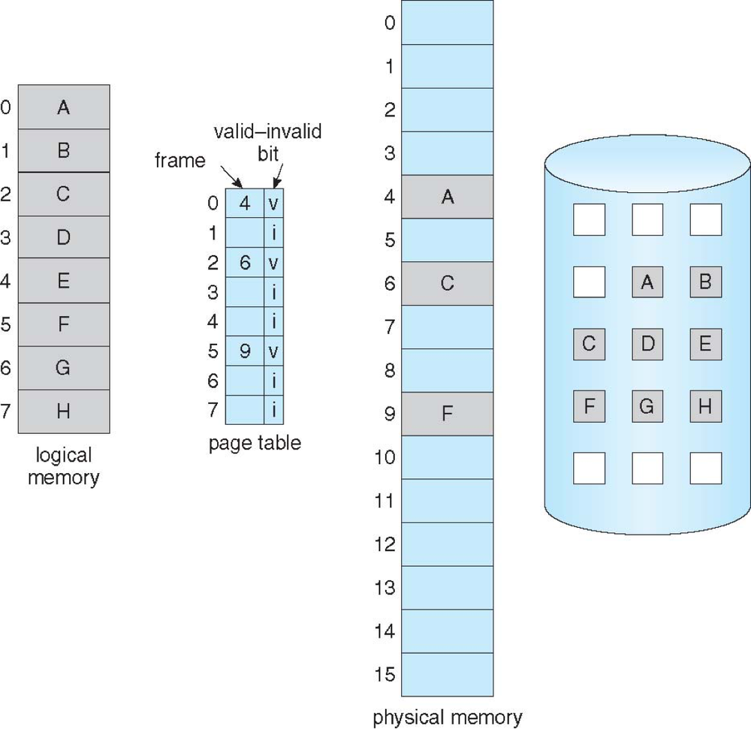
Access to page 3 generates a page fault
I agree
I don't think so...
Notes:
1

Slide 72
When using Virtual Memory, if there are 4 free frames and a process spans 5 pages...
The process cannot run
The process can run
Whether it can run depends on its concurrent execution
Whether it can run depends on its parallel execution
Notes:
2

Slide 73
Access to pages 3,4,3 and 5 generates ...
2 page faults
4 page faults
at least 2 page faults
at least 4 page faults
Notes:
1 & 3

Slide 74
If the invalid bit of a frame is set to 1, the page contained in the referenced frame does not belong to the process
Correct
Not correct
Notes:
2

Slide 75
reducing the degree of multiprogramming can increase CPU utilization
Correct
Not correct
Notes:
1

Slide 76
Having less available frames can reduce the number of page faults
Correct
Not correct
Notes:
1

Slide 77
Exercise
Jake and Finn have a computer whose memory access time is 150 nanoseconds and whose page-fault service time is 5 milliseconds. A process previously run in an operating system without virtual memory was 2 times faster than the same process run by the actualized operating system (the latter having virtual memory). Every how many page accesses are Jake and Finn experiencing a page fault on average? Would buying a new disk able to bring the page-fault service time to 2 milliseconds make the process no more than 1.5 times slower in the new operating system (compared to the previous one)?
Notes:
EAT = (1 – p) x (150 nanoseconds) + p (5 milliseconds)
= (150 – p x 150 + p x 5,000,000)
= 150 + p x 4,999,850
Question 1
Without virtual memory p = 0 → EAT = 150
With virtual memory 150 + p x 4,999,850 = 2 x 150
p = 0.00003
1 page fault every 1/p (33333) on average
Question 2
150 + 0.00005 x 1,999,850 < 1.5 x 150 ?
250 < 225? → NO

Slide 78
Exercise
Given the following reference string
and assuming 4 frames are available, find:
  The minimum number of page faults we can observe
  The extra page faults caused by the FIFO replacement algorithm
  The extra page faults caused by the LRU replacement algorithm
7 | 2 | 1 | 2 | 0 | 1 | 1 | 4 | 2 | 3 | 0 | 7 | 0 | 1 | 2 | 7 | 7 | 3 | 0 | 0 | 3 | 0 | 3
Notes:
Minimum is 8
FIFO is +3
LRU is +4

Slide 79
Solution
 | OPTIMAL
7 | 2 | 1 | 2 | 0 | 1 | 1 | 4 | 2 | 3 | 0 | 7 | 0 | 1 | 2 | 7 | 7 | 3 | 0 | 0 | 3 | 0 | 3
7 | 7 | 7 | 7 | 7 | 7 | 7 | 7 | 7 | 7 | 7 | 7 | 7 | 7 | 7 | 7 | 7 | 7 | 0 | 0 | 0 | 0 | 0
 | 2 | 2 | 2 | 2 | 2 | 2 | 2 | 2 | 2 | 2 | 2 | 2 | 2 | 2 | 2 | 2 | 2 | 2 | 2 | 2 | 2 | 2
 |  | 1 | 1 | 1 | 1 | 1 | 4 | 4 | 3 | 3 | 3 | 3 | 3 | 3 | 3 | 3 | 3 | 3 | 3 | 3 | 3 | 3
 |  |  |  | 0 | 0 | 0 | 0 | 0 | 0 | 0 | 0 | 0 | 1 | 1 | 1 | 1 | 1 | 1 | 1 | 1 | 1 | 1
Page faults
1 | 1 | 1 | 0 | 1 | 0 | 0 | 1 | 0 | 1 | 0 | 0 | 0 | 1 | 0 | 0 | 0 | 0 | 1 | 0 | 0 | 0 | 0 |  | 8

Slide 80
Solution
 | FIFO
7 | 2 | 1 | 2 | 0 | 1 | 1 | 4 | 2 | 3 | 0 | 7 | 0 | 1 | 2 | 7 | 7 | 3 | 0 | 0 | 3 | 0 | 3
7 | 7 | 7 | 7 | 7 | 7 | 7 | 4 | 4 | 4 | 4 | 4 | 4 | 4 | 2 | 2 | 2 | 2 | 2 | 2 | 2 | 2 | 2
 | 2 | 2 | 2 | 2 | 2 | 2 | 2 | 2 | 3 | 3 | 3 | 3 | 3 | 3 | 3 | 3 | 3 | 3 | 3 | 3 | 3 | 3
 |  | 1 | 1 | 1 | 1 | 1 | 1 | 1 | 1 | 1 | 7 | 7 | 7 | 7 | 7 | 7 | 7 | 0 | 0 | 0 | 0 | 0
 |  |  |  | 0 | 0 | 0 | 0 | 0 | 0 | 0 | 0 | 0 | 1 | 1 | 1 | 1 | 1 | 1 | 1 | 1 | 1 | 1
Page faults
1 | 1 | 1 | 0 | 1 | 0 | 0 | 1 | 0 | 1 | 0 | 1 | 0 | 1 | 1 | 0 | 0 | 1 | 1 | 0 | 0 | 0 | 0 |  | 11

Slide 81
Solution
 | LRU
7 | 2 | 1 | 2 | 0 | 1 | 1 | 4 | 2 | 3 | 0 | 7 | 0 | 1 | 2 | 7 | 7 | 3 | 0 | 0 | 3 | 0 | 3
7 | 7 | 7 | 7 | 7 | 7 | 7 | 4 | 4 | 4 | 4 | 7 | 7 | 7 | 7 | 7 | 7 | 7 | 7 | 7 | 7 | 7 | 7
 | 2 | 2 | 2 | 2 | 2 | 2 | 2 | 2 | 2 | 2 | 2 | 2 | 1 | 1 | 1 | 1 | 1 | 0 | 0 | 0 | 0 | 0
 |  | 1 | 1 | 1 | 1 | 1 | 1 | 1 | 1 | 0 | 0 | 0 | 0 | 0 | 0 | 0 | 3 | 3 | 3 | 3 | 3 | 3
 |  |  |  | 0 | 0 | 0 | 0 | 0 | 3 | 3 | 3 | 3 | 3 | 2 | 2 | 2 | 2 | 2 | 2 | 2 | 2 | 2
Page faults
1 | 1 | 1 | 0 | 1 | 0 | 0 | 1 | 0 | 1 | 1 | 1 | 0 | 1 | 1 | 0 | 0 | 1 | 1 | 0 | 0 | 0 | 0 |  | 12

Slide 82
Exercise
Given processes P₁,P₂,P₃ and P₄ having sizes of 20, 25, 50 and 4 pages and given a total number of frames equal to 80 (10% of which reserved to the OS), compute the number of frames allocated to each process if frames are allocated proportionally to the size of each program
Notes:
Frames for P₁: 20/99*72 = 14
Frames for P₂: 25/99*72 = 18
Frames for P₃: 50/99*72 = 36
Frames for P₄: 4/99*72 = 2
Notice that I’m rounding down instead of up otherwise I will violate the assumption that 8 pages should be devoted to the OS!

Slide 83
Exercise
Suppose a process P has size of 100 bytes. Compute (1) the number of wasted bytes caused by internal fragmentation if the page and frame sizes are set to 2^4 bytes and (2) the size in bits of the page table (assume each frame entry requires 1 byte and that dirty bits are also use to speed the swap out of pages).
Notes:
Page size = 16 bytes
Number of pages required = ceil(100/16) = 7
Wasted bytes because of internal fragmentation 16 –100%16 = 12 bytes
Page table = 7 * (8 + 1 + 1) = 70 bits
8 bits → frame entry
1 bit → valid/invalid bit
1 bit → dirty bit

