Slide 1


Threads Operating Systems – EDA093/DIT401 Vincenzo Gulisano vincenzo.gulisano@chalmers.se

Slide 2
What to read (main textbook)
Chapter 2.2, 10.3.3*
*Some concepts will be covered later on (e.g., Copy-on-Write)
(extra facultative reading: 4.1-4.3, 4.4.1, 4.5-4.6 from Silberschatz Operating System Concepts)

Slide 3
Objectives
To introduce the notion of a thread—a fundamental unit of CPU utilization that forms the basis of multithreaded computer systems
To discuss the APIs for the Pthreads, Windows, and Java thread libraries
To explore several strategies that provide implicit threading
To examine issues related to multithreaded programming

Slide 4
AGENDA
Threads (Introduction)
Multithreading models
Implicit threading
Threading issues

Slide 5
AGENDA
Threads (Introduction)
Multithreading models
Implicit threading
Threading issues

Slide 6
We run several programs at the same time
One CPU can only run one program at a time

Slide 7
Concurrent vs Parallel execution
We run several programs at the same time
One CPU can only run one program at a time
We feel several programs run at the same time
Each CPU core can only run one program at the time
(Previous lecture)
(This lecture)

Slide 8
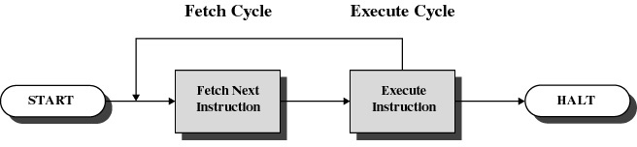
The basic CPU cycle

Slide 9
...

Slide 10

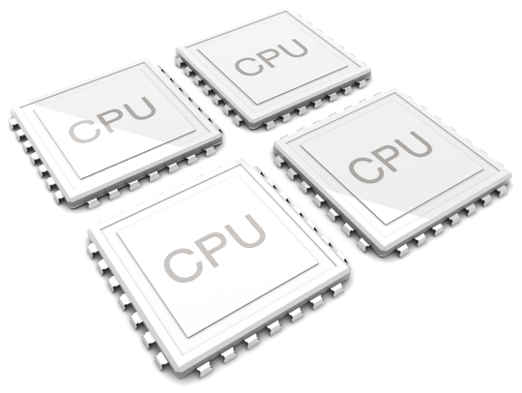
Discussion: parallel/concurrent execution of processes
Process keyboard input…
Spell checker…
Printing a document…
Important: only 1 process can be running on any logical processor / CPU core at any instant.
Notes:
1 process monolithic bad --> 1 core
multiple processes inefficient (e.g., spell checker and text being input are shared)

Slide 11
Threads
One process → multiple threads of execution
Consider having multiple program counters per process
Multiple locations can execute at once
Multiple threads of control -> threads
Must then have storage for thread details, multiple program counters in PCB
Notes:
thread state lives in per-thread TCBs, not literally in the PCB. Technically loose → But I am keeping it simple and talking about PCB

Slide 12
Single and Multithreaded Processes

Slide 13
Motivation
Most modern applications are multithreaded
Threads run within application
Multiple tasks within the application can be implemented by separate threads
Update display
Fetch data
Spell checking
Answer a network request
Process creation is heavy-weight while thread creation is light-weight
Can simplify code, increase efficiency
Kernels are generally multithreaded

Slide 14
Multithreaded Server Architecture

Slide 15
Benefits
Responsiveness – may allow continued execution if part of process is blocked, especially important for user interfaces
Resource Sharing – threads share resources of process, easier than shared memory or message passing
Economy – cheaper than process creation, thread switching lower overhead than context switching
Scalability – process can take advantage of multiprocessor architectures
Notes:
Example of responsiveness: click button

Slide 16
Multicore Programming
Multicore or multiprocessor systems put pressure on programmers, challenges include:
Dividing activities
Balance
Data splitting
Data dependency
Testing and debugging
Parallelism implies a system can perform more than one task simultaneously
Concurrency supports more than one task making progress
Single processor / core, scheduler providing concurrency
Notes:
example of SUM vs median

Slide 17
Concurrency vs. Parallelism
Concurrent execution on single-core system:
Parallelism on a multi-core system:
Notes:
******* HERE FOR KAHOOT

Slide 18
Multicore Programming (Cont.)
Types of parallelism
Data parallelism – distributes subsets of the same data across multiple cores, same operation on each
Task parallelism – distributing threads across cores, each thread performing unique operation
As # of threads grows, so does architectural support for threading
CPUs have cores as well as hardware threads
Notes:
task parallelism --> back to word

Slide 19
Question
We have a program:
How many times (X) faster?
1<X≤10
10<X≤30
30<X≤60
60<X≤100
Serial portion S (25% of the program)
1 core → 100 cores
Notes:
serial portion --> get back to example with array
3.88

Slide 20
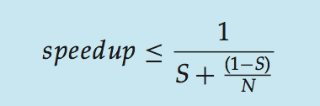
Amdahl’s Law
Identifies performance gains from adding additional cores to an application that has both serial and parallel components
S is serial portion
N processing cores
That is, if application is 75% parallel / 25% serial, moving from 1 to 2 cores results in speedup of 1.6 times
As N approaches infinity, speedup approaches 1 / S
Serial portion of an application has disproportionate effect on performance gained by adding additional cores
Notes:
joke about the company

Slide 21
AGENDA
Threads (Introduction)
Multithreading models
Implicit threading
Threading issues

Slide 22
User Threads and Kernel Threads
User threads - management done by user-level threads library
Three primary thread libraries:
POSIX Pthreads
Windows threads
Java threads
Kernel threads - Supported by the Kernel
Examples – virtually all general purpose operating systems, including:
Windows
Solaris
Linux
Tru64 UNIX
Mac OS X
Notes:
User-threads means there’s a library that manages the threads above the kernel, the kernel sees a single process. It can be good but also might be useless depending on the system call being called.
Kernel threads is the kernel that manages.
Ready queue could have entries that are queues themselves about ready threads

Slide 23
Multithreading Models
Many-to-One
One-to-One
Many-to-Many

Slide 24
Many-to-One
Many user-level threads mapped to single kernel thread
One thread blocking causes all to block
Multiple threads may not run in parallel on multicore system because only one may be in kernel at a time
Few systems currently use this model
Examples:
Solaris Green Threads
GNU Portable Threads

Slide 25
One-to-One
Each user-level thread maps to kernel thread
Creating a user-level thread creates a kernel thread
More concurrency than many-to-one
Number of threads per process sometimes restricted due to overhead
Examples
Windows
Linux
Solaris 9 and later

Slide 26
Many-to-Many Model
Allows many user level threads to be mapped to many kernel threads
Allows the operating system to create a sufficient number of kernel threads
Solaris prior to version 9
Windows with the ThreadFiber package

Slide 27
Two-level Model
Similar to M:M, except that it allows a user thread to be bound to kernel thread
Examples
IRIX
HP-UX
Tru64 UNIX
Solaris 8 and earlier

Slide 28
Thread Libraries
Thread library provides programmer with API for creating and managing threads
Two primary ways of implementing
Library entirely in user space
Kernel-level library supported by the OS

Slide 29
Pthreads
May be provided either as user-level or kernel-level
A POSIX standard (IEEE 1003.1c) API for thread creation and synchronization
Specification, not implementation
API specifies behavior of the thread library, implementation is up to development of the library
Common in UNIX operating systems (Solaris, Linux, Mac OS X)
Notes:
Application Programming Interface

Slide 30
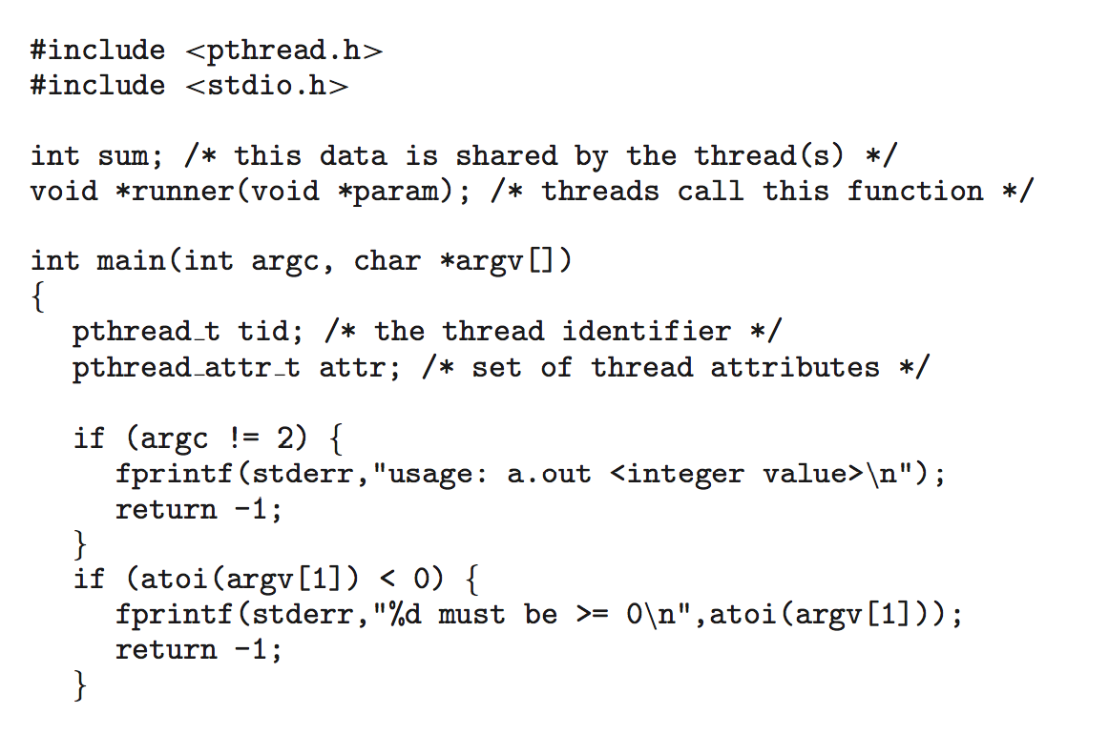
Pthreads Example
Summing 0 … n
Notes:
Thread attribute: stack size, scheduling info…

Slide 31
Pthreads Example (Cont.)

Slide 32
Pthreads Code for Joining 10 Threads

Slide 33
AGENDA
Threads (Introduction)
Multithreading models
Implicit threading
Threading issues

Slide 34
Implicit Threading
Growing in popularity as numbers of threads increase, program correctness more difficult with explicit threads
Creation and management of threads done by compilers and run-time libraries rather than programmers
Two methods explored
Thread Pools
OpenMP

Slide 35
Thread Pools
Create a number of threads in a pool where they await work
Advantages:
Usually slightly faster to service a request with an existing thread than create a new thread
Allows the number of threads in the application(s) to be bound to the size of the pool
Separating task to be performed from mechanics of creating task allows different strategies for running task
e.g., tasks could be scheduled to run periodically

Slide 36
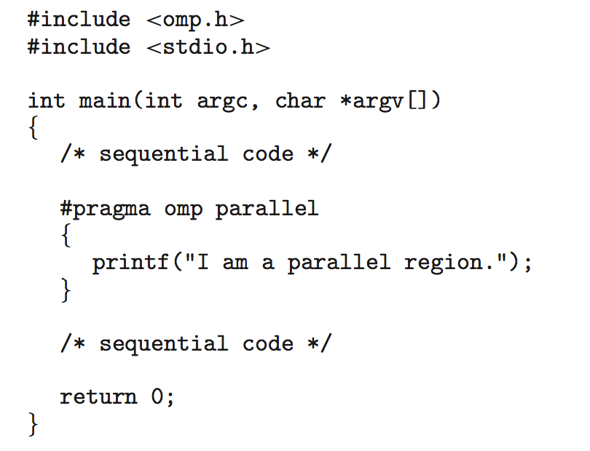
OpenMP
Set of compiler directives and an API for C, C++, FORTRAN
Provides support for parallel programming in shared-memory environments
Identifies parallel regions – blocks of code that can run in parallel
#pragma omp parallel
Create as many threads as there are cores
#pragma omp parallel for for(i=0;i<N;i++) {
c[i] = a[i] + b[i];
}
Run for loop in parallel
Notes:
Make drawing here

Slide 37
AGENDA
Threads (Introduction)
Multithreading models
Implicit threading
Threading issues

Slide 38
Threading Issues
Semantics of fork() and exec() system calls
Signal handling
Synchronous and asynchronous
Thread cancellation of target thread
Asynchronous or deferred

Slide 39

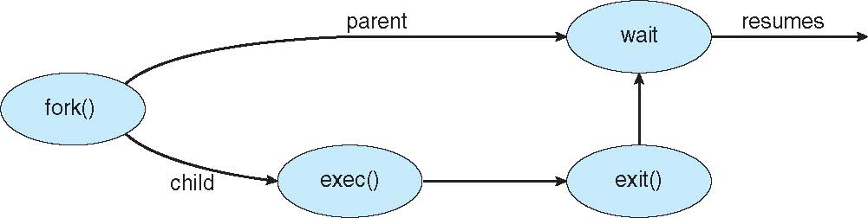
C Program Forking Separate Process

Slide 40
Semantics of fork() and exec()
Does fork()duplicate only the calling thread or all threads?
Some UNIXes have two versions of fork
exec() usually works as normal – replace the running process including all threads
Notes:
Which combination does not really make a lot of sense?

Slide 41
Signal Handling
Signals are used in UNIX systems to notify a process that a particular event has occurred.
A signal handler is used to process signals
Signal is generated by particular event
Signal is delivered to a process
Signal is handled by one of two signal handlers:
default
user-defined
Every signal has default handler that kernel runs when handling signal
User-defined signal handler can override default
For single-threaded, signal delivered to process
Notes:
Interrupts can be viewed as a mean of communication between the CPU and the OS kernel. Signals can be viewed as a mean of communication between the OS kernel and OS processes.
Interrupts may be initiated by the CPU (exceptions - e.g.: divide by zero, page fault), devices (hardware interrupts - e.g: input available), or by a CPU instruction (traps - e.g: syscalls, breakpoints). They are eventually managed by the CPU, which "interrupts" the current task, and invokes an OS-kernel provided ISR/interrupt handler.
Signals may be initiated by the OS kernel (e.g: SIGFPE, SIGSEGV, SIGIO), or by a process(kill()). They are eventually managed by the OS kernel, which delivers them to the target thread/process, invoking either a generic action (ignore, terminate, terminate and dump core) or a process-provided signal handler.

Slide 42
Signal Handling (Cont.)
Where should a signal be delivered for multi-threaded processes?
Deliver the signal to the thread to which the signal applies
Deliver the signal to every thread in the process
Deliver the signal to certain threads in the process
Assign a specific thread to receive all signals for the process
Notes:
Example: ctrl + c

Slide 43
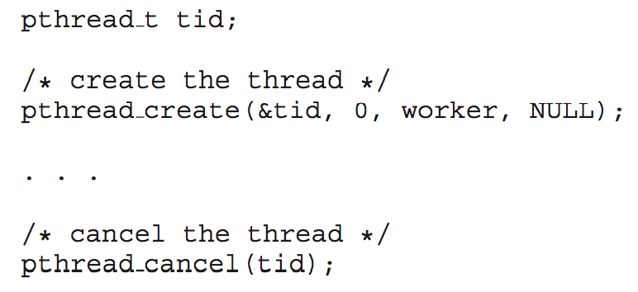
Thread Cancellation
Terminating a thread before it has finished
Thread to be cancelled is target thread
Two general approaches:
Asynchronous cancellation terminates the target thread immediately
Deferred cancellation allows the target thread to periodically check if it should be cancelled
Pthread code to create and cancel a thread:

Slide 44
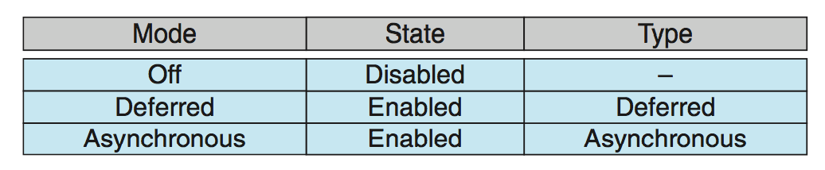
Thread Cancellation (Cont.)
Invoking thread cancellation requests cancellation, but actual cancellation depends on thread state
If thread has cancellation disabled, cancellation remains pending until thread enables it
Default type is deferred
Cancellation only occurs when thread reaches cancellation point
I.e. pthread_testcancel()
Then cleanup handler is invoked
On Linux systems, thread cancellation is handled through signals

Slide 45
Questions

Slide 46
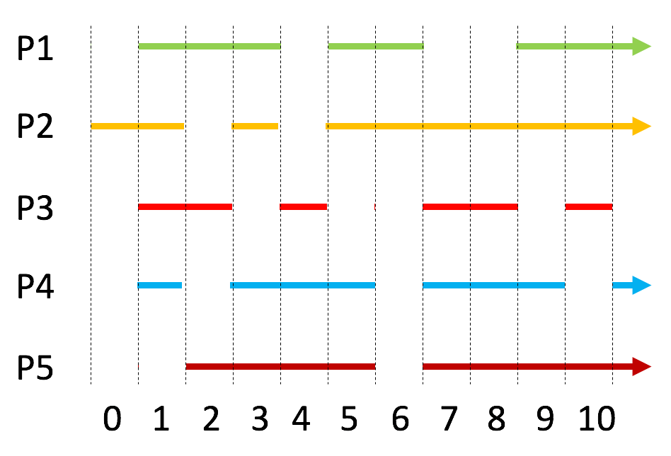
Given the processes running in the figure, how many cores does the CPU have?
exactly 4
at least 4
no more than 4
cannot say
Notes:
1~, 2

Slide 47
Given the processes running in the figure, why does P2 get switched at slot 2?
To run another process
cannot say
Notes:
2

Slide 48
Given the processes running in the figure, why does P3 get switched at slot 5?
To run another process
cannot say
Notes:
2

Slide 49
Given the processes running in the figure, do P2 and P3 run in parallel?
Yes
No
Cannot say
Notes:
1

Slide 50
Given the processes running in the figure, do P2 and P3 run concurrently?
Yes
No
Cannot say
Notes:
1 or 3

Slide 51
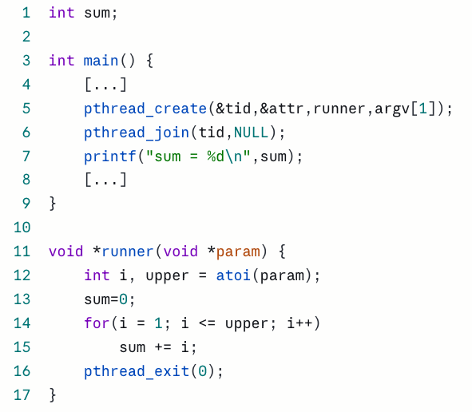
Given the code, the variable sum is not shared between threads.
True
False
cannot say
Notes:
2

Slide 52
Given the code, the main function can complete before the created thread completes.
False
True
Notes:
1

Slide 53
Given the code, pthread_join might find the created thread has already completed when run.
True
False
Notes:
1

Slide 54
Given the code, the final value of sum can change at different executions.
Yes
No
The question is ambiguous
Notes:
1, 2, 3

Slide 55
Assume several threads are created using the many-to-one threading model. Discuss whether they can execute concurrently, in parallel or both.
Notes:
Only concurrently, in parallel requires distinct kernel threads (many-to-one means threads stay in user space)

Slide 56
What is the pthread_join function used for? Write a small sample code to support your discussion.
Notes:
To stop a thread execution until another thread has completed, to join a thread.
What the students should show through their code is that they are aware that each thread has an id, that you need to keep track of it to call join, that you need to pass parameters when you create a thread about its attributes, as well as the function to be run and that you need to join, especially if you are then trying to operate on a shared variable.

Slide 57
Explain why concurrent and parallel execution can be achieved by a program by means of both multiple processes and multiple threads
Notes:
Here the point is that if you want to use multiple cores to run a program, you can design the program to have multiple processes that communicate with IPC. Might be not as efficient as threads, but it works (and is modular, good from fault tolerance perspective). Multithreaded processes are not the only way to enable the leveraging of multi-core architectures.

