Slide 1


Virtualization Operating Systems – EDA093/DIT401 Vincenzo Gulisano vincenzo.gulisano@chalmers.se

Slide 2
Reading instructions
Chapter 7, 7.1-7.10 (included)

Slide 3
Agenda
Introduction
Requirement for virtualization
Type 1 and type 2 hypervisors
Techniques for Efficient Virtualization
Memory virtualization
I/O virtualization
Other benefits of virtualization
Clouds
Containers

Slide 4
Agenda
Introduction
Requirement for virtualization
Type 1 and type 2 hypervisors
Techniques for Efficient Virtualization
Memory virtualization
I/O virtualization
Other benefits of virtualization
Clouds
Containers

Slide 5
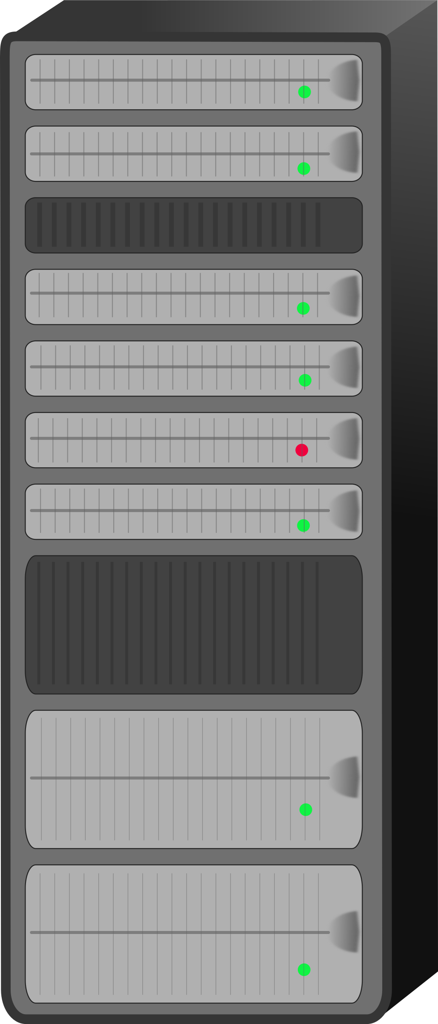


With virtualization (discussed since the 60s…)
Without virtualization
Email server
Web server
FTP server
E-commerce service
Email server
Web server
FTP server
E-commerce service
Hypervisor / Virtual Machine Monitor (VMM)

Slide 6
With virtualization
Without virtualization
If one machine cannot handle the entire load, it works
Reliability (1 server crash does not imply all services are down)
Better for security (sandboxing) – if an intruder compromises web server, does not have access to mails
Run different OSes
…
If the failures are at software/OS level, still reliable
Run different OSes
Hypervisor code (which need to be the one you can really trust) is smaller than OS and easier to maintain
Costs less
Cheaper to try out applications/services/… (good in software development, to test with different OSes) and provide virtual appliances
Legacy applications
Easier to migrate services/OSes
PROS
CONS
Costs money and time
Hardware failure can have catastrophic consequences
As you can imagine, the Cloud starts from this idea and takes it to that of using a server located somewhere else, which further reduces costs…

Slide 7
Agenda
Introduction
Requirement for virtualization
Type 1 and type 2 hypervisors
Techniques for Efficient Virtualization
Memory virtualization
I/O virtualization
Other benefits of virtualization
Clouds
Containers

Slide 8
Aside from “acting like a physical machine”, what are actually the requirements?
Safety (hypervisor should have full control of the virtualized resources)
Fidelity (program running on bare hardware = program running on a VM)
Efficiency

Slide 9



Why can’t we ”just” use an interpreter?
Wrap each instruction
Execute if safe (e.g., INC instruction)
Simulate otherwise (e.g., disable interrupts)
Theoretically it works, but
Safety
Fidelity
Efficiency
VMMs should execute most of the code directly…
Notes:
virtualization by interception — privileged operations are trapped and emulated safely so that the guest believes it has full control of the machine.

Slide 10
What is required for VMMs to run code directly (in traditional trap-and-emulate)?
Sensitive instructions: can be run both in user mode and kernel mode
Their behavior might change depending on the case
Priviledged instructions: will result in an interrupt if not in kernel mode
This machine is virtualizable
These are not
Priviledged
Priviledged
Priviledged
Sensitive
Sensitive
Sensitive
Notes:
If the guest OS runs as user and can run sensitive as user instead of kernel, it does not work
BE CLEAR BEFORE THE GUEST OS RUNS AS USER
Example: command to push flags from the CPU to the stack. If kernel all flags, if user only some.
Another example: reading from specific in port. Some devices can have direct communication with user, others cannot
POPF (Pop Flags), which restores the CPU flags register from the stack. Among those flags is the interrupt flag (IF), which controls whether hardware interrupts are enabled. When executed in kernel mode, POPF will actually change the interrupt flag bit — enabling or disabling hardware interrupts as requested.
When executed in user mode, POPF will not change the interrupt flag, even though it appears to execute successfully. It just silently ignores attempts to modify that privileged bit.
This instruction is sensitive because it depends on and affects CPU state (interrupt handling). But it’s not privileged on older x86 CPUs — it doesn’t trap when run in user mode.
That’s a problem for virtualization: a guest OS running in user mode could execute POPF thinking it disabled interrupts, but the host CPU won’t actually do so, and no trap is generated — so the hypervisor can’t emulate the correct behavior.
NOTICE
No, modern hardware does not require every sensitive instruction to be privileged according to the traditional user/kernel definition.
Yes, the underlying requirement remains: the guest must not perform a sensitive operation outside the control of either the hypervisor or virtualization-aware hardware.
So your concern is valid: the wording describes the historical requirement for virtualization without hardware assistance, not the ordinary modern implementation.

Slide 11

This has been taken into account since 2005
Hardware and OSes collaborating, again…
Both from Intel and AMD
VT technology:
The guest OS runs directly on the hardware until it generates an interrupt
Which is delivered to the hypervisor
The hypervisor sets a hardware bitmap to specify all interrupts it wants to be alerted about (trap-and-emulate approach)
The technique used before that was binary translation:
Simply put: replace all unsafe I/O with a trap
Notes:
They allow each virtual machine to act as if it has its own dedicated processor and memory, even though they share the same physical hardware.

Slide 12
Agenda
Introduction
Requirement for virtualization
Type 1 and type 2 hypervisors
Techniques for Efficient Virtualization
Memory virtualization
I/O virtualization
Other benefits of virtualization
Clouds
Containers

Slide 13
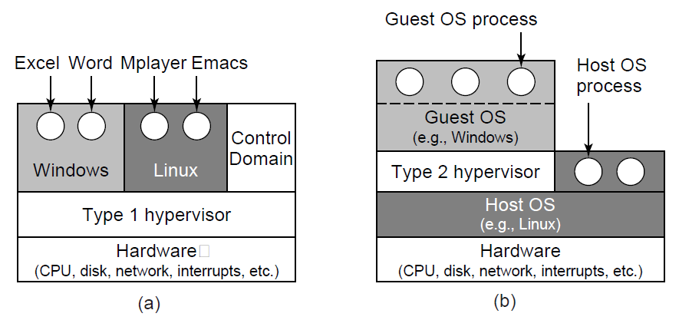
Type 1 and Type 2 Hypervisors
Notes:
Say we mostly talk of type 1 here

Slide 14
Agenda
Introduction
Requirement for virtualization
Type 1 and type 2 hypervisors
Techniques for Efficient Virtualization
Memory virtualization
I/O virtualization
Other benefits of virtualization
Clouds
Containers

Slide 15
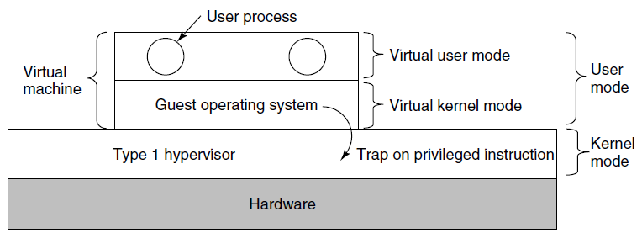
Hypervisor type 1, with VT
Notes:
This slide is to differentiate between kernel/user mode and virtual kernel/user mode
I THINK the reason why they do not mention sensitive/priviledge here is because if the Guest OS gets direct access to the hardware then it sorts of work as always, it not really executing as a virtualizd unit

Slide 16
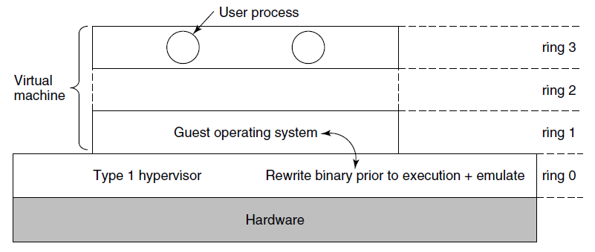
Hypervisor type 1, before/without VT
Before VT, x86 architectures supported 4 protection modes/rings.
Without virtualization, OS runs in ring 0, user processes in ring 3
With virtualization, as shown in figure
OS privileged instructions will trap, but what about sensitive ones?
Notes:
But what if there’s no VT? How was it done before

Slide 17
Hypervisor type 1, before/without VT
Sensitive instructions are removed by rewriting the code
Before executing each basic block (a straight sequence of instructions that ends with a branch), the hypervisor scans the block and replaces sensitive instructions
Notes:
But what if there’s no VT? How was it done before

Slide 18
The cost of virtualization
Traps are expensive
Because of that, sometimes VT + trap-and-emulate performs worst than binary translation
In fact, some hypervisor might use binary translation even for privileged instructions
A small example: Suppose you want to disable interrupts for a while
VT: set registers in the hardware
Binary translation: rewrite code with an extra if statement

Slide 19
Agenda
Introduction
Requirement for virtualization
Type 1 and type 2 hypervisors
Techniques for Efficient Virtualization
Memory virtualization
I/O virtualization
Other benefits of virtualization
Clouds
Containers

Slide 20


Why do we need to virtualize memory too?
VM1
Hypervisor / Virtual Machine Monitor (VMM)
VM2

Slide 21
Shadow page table
The hypervisor maintains a shadow page table, to translate each VM’s believed “frame” into the real physical frame
It is complicated, though:
Guest OS page tables and the Hypervisor shadow page table must always be in synch,
But the OS can change its page table by simply writing to memory…
So, how does the Hypervisor detect a change?
Option 1: mark as read-only the VM pages that contain the page table
Option 2: do nothing and wait for page faults to happen
but this requires extra care of mappings that are removed by the guest OS, because those do not generate page-faults
Notes:
The hypervisor is keeping it's own page tables, and those are not the shadow page table, the shadow page table is what it maintains for the guests to be able to translate correctly.
The guest OS page table maps guest virtual addresses → guest physical frames. These frames are virtualized, not necessarily actual RAM frames.
The hypervisor maps guest physical frames → machine physical frames.
With shadow paging, the hypervisor maintains a shadow page table mapping guest virtual addresses → machine physical frames directly.
The CPU uses the shadow page table while running the guest; the guest does not know it exists.
The hypervisor also has its own page tables for mapping its own virtual addresses to machine memory. These are separate from the shadow page tables.
When the guest changes its page tables, the hypervisor detects the change and updates the shadow tables accordingly.

Slide 22
Page faults
Guest-induced page faults
This are detected by the hypervisor
But need to be reinjected to the guest OS
Example: OS trying to access a page that has been swapped out of RAM
Hypervisor-induced page faults
Used to keep the shadow page table in synch with the guest OS page table
When a page faults results in the hypervisor gaining control, we use the term VM exit

Slide 23
Reclaiming memory
If the hypervisor “lies” to the guest OSes pretending it has way more frames it has,
and then needs to reclaim some of them from OS A and give them to OS B,
how can it do that?
If it simply takes them away, it needs to update the OS page tables, but, where are they? When can that be done safely?...

Slide 24
Ballooning
A small module is loaded in each VM (a balloon) as a pseudo device driver connected to the hypervisor
The hypervisor can inflate is requested space to force the guest OS in releasing pages from other processes and give them to this module
So that the hypervisor can then use them…

Slide 25
Agenda
Introduction
Requirement for virtualization
Type 1 and type 2 hypervisors
Techniques for Efficient Virtualization
Memory virtualization
I/O virtualization
Other benefits of virtualization
Clouds
Containers

Slide 26
I/O virtualization
The hypervisor probes devices at startup and
reports them to the guest OSes.
When the latter try to use them,
they will interrupt and the hypervisor can intervene
BUT: each OS cannot really hold the entire device (e.g., a disk)
Possible solutions
Emulate a disk by means of a file managed by the Hypervisor
Emulate network by having the Hypervisor actually behaving as a switch

Slide 27
Single Root I/O Virtualization (SR-IOV)
For performance, a hypervisor-in-the-middle virtualization approach might not always be optimal
Modern hardware supports virtualization, which allows for devices to be directly controlled by a guest VM (bypassing the hypervisor)
Devices with SR-IOV usually have
Independent memory space, interrupts and DMA streams for each VM
Each VM can map in is own memory its corresponding memory areas
Notes:
Yet another example of cooperation between OS and hardware…
Example: NIC Network Interface Card
The NIC exposes:
One Physical Function (PF): the full-featured PCIe function managed by the hypervisor or host OS.
Multiple Virtual Functions (VFs): lightweight “virtual” PCIe devices that share the same physical hardware but appear as independent NICs to the VMs.

Slide 28
Agenda
Introduction
Requirement for virtualization
Type 1 and type 2 hypervisors
Techniques for Efficient Virtualization
Memory virtualization
I/O virtualization
Other benefits of virtualization
Clouds
Containers

Slide 29
Other benefits of virtualization - 1
When a multi-CPU / multi-core machine is used,
each VM can be assigned a specific subset of cores
This has an important implication:
You could be able to write programs that have a parallelism degree (i.e., number of threads or co-operating processes) that fits the actual number of physical cores the VM you are going to use has access to

Slide 30
Other benefits of virtualization - 2
Different VMs share memory, and they could potentially be duplicating a lot of (read-only) information
Think for instance at having many VMs running the same OS in parallel…
Deduplication techniques (also referred to as transparent page sharing or content-based page sharing) which are usually used for disks, can be used for memory too!
It should not come as a surprise, the physical / logical separation behind VM that is beneficial for running several processes at the same time efficiently can be also beneficial to run several OSes at the same time
At the end of the day, the OS runs a collection of processes too

Slide 31
Agenda
Introduction
Requirement for virtualization
Type 1 and type 2 hypervisors
Techniques for Efficient Virtualization
Memory virtualization
I/O virtualization
Other benefits of virtualization
Clouds
Containers

Slide 32
What exactly is the cloud?
Public vs private…
Access to physical hardware, access to virtual OSes, access to specific software
Big machines / small machines
Desired characteristics
On-demand self-service
Broad network access (available via network with standard mechanisms)
Resource pooling
Elasticity
Measured service (also in connection to $)

Slide 33
Types of services
IAAS (Infrastructure as a Service)
Direct access to a specific VM, the user does what (s)he wants
PASS (Platform as a Service)
Specific environment, with given OS, DataBase, WebServer, …
SAAS (Software as a Service)
Offers specific software

Slide 34
Virtual Machine Migration
What is the server running a bunch of VMs needs maintenance?
Intuition: move the VM to a different server…
Simple approach / but not liked by customers who pay
Turn off the VM, move the data to a different server, turn on the VM
Long downtime… also, turn off when? Ask the user?
Live migration
Keep copy pages in the back, making the transition from one server to another not noticeable (seamless live migration)
As you probably imagine, this is everything but simple…

Slide 35
Checkpointing/Snapshotting
An advantage of VMs is that they can be paused and copied
If something bad happens, you can then revert the VM to the previous save
Incremental snapshotting with mechanisms like copy on write can then allow for lightweight checkpointing
Which can be also used in combination with migration

Slide 36
Agenda
Introduction
Requirement for virtualization
Type 1 and type 2 hypervisors
Techniques for Efficient Virtualization
Memory virtualization
I/O virtualization
Other benefits of virtualization
Clouds
Containers

Slide 37
Containers (motivation/intuition)
VMs virtualize hardware
Containers provide OS-level virtualization
Each process / set of processes believes it’s running in its own OS
Note, under the hood:
Processes share the same OS and hardware. Processes are isolated, but the performance of a set of processes is always somehow affected by what other processes do
All processes / sets of processes need to share OS
Notes:
Containers became widely popular around 2013–2015, following Docker’s launch in 2013 and Kubernetes’ introduction in 2014. We can say that if a VM virtualizes hardware and runs a complete guest OS, then a container isolates one or more processes while sharing the host OS kernel. These processes are isolated from other processes, but their performance can still be affected by other workloads, as with VMs. The key difference is that containers also share the same kernel.

Slide 38
Containers – What are the ingredients for a container / a virtualized OS?
File system
Process identifiers
User identifiers
Network interfaces and IP addresses
Inter-Process Communication (IPC) endpoints (e.g., pipes)
Memory limits
CPU limits
I/O limits
…
Notes:
To isolate a set of processes, we must isolate resources and system views such as the filesystem, process IDs, user IDs, network interfaces, and IPC endpoints. That, as an example, allows for processes in different containers to have the same process ID. We may also define limits, quotas, or priorities for memory, CPU, and I/O. To do all this, we either use namespaces or cgroups. Namespaces isolate what processes can see, while cgroups control or account for the resources they use.

Slide 39
Containers – What are the ingredients for a container / a virtualized OS?
File system
Process identifiers
User identifiers
Network interfaces and IP addresses
Inter-Process Communication (IPC) endpoints (e.g., pipes)
Memory limits
CPU limits
I/O limits
…
Can be managed through namespaces
Of a different nature, they require some active monitoring
Notes:
More concretely, if we focus on namespaces, a namespace is a kernel feature that limits or isolates what a process can see and access. A process belongs to one namespace of each type. New namespaces can be created when a process starts. As an example, I might want to start a process and associate it with a new mount namespace, so that the process gets a restricted view of the filesystem, for example only a specific folder and its subfolders. In that case, I can create a new mount namespace and start the process in that namespace. A process can also join an existing namespace, of course, we do not need to create a new namespace for each new process.
Nonetheless, as said before, for memory, CPU, and I/O a namespace is not enough because we need a mechanism for the kernel to account for resource usage and enforce limits or priorities.

Slide 40
Example of namespace: Mount namespace
Gives a process its own view of the filesystem mount hierarchy
Processes in different mount namespaces can see different mounted filesystems
Created or managed using mechanisms such as clone(), unshare(), and setns()
Container runtimes combine mount namespaces with mounts and mechanisms such as pivot_root() or chroot() to provide an isolated root filesystem
Notes:
Going back to the file system example, a mount namespace isolates the set of filesystem mounts visible to a process. Two processes in different mount namespaces may see different filesystems or different directory trees, even though they run on the same host. Container runtimes use mount namespaces together with other filesystem mechanisms to give each container its own root filesystem.

Slide 41
What about resources that need to be monitored? → cgroups
One controller per resource type:
Resource 1 → cgroups (in a tree) specify “restrictions”
Resource 2 → cgroups (in a tree) specify “restrictions”
…
Each process belongs to exactly one cgroup for each resource of interest, and each resource is managed by a controller
Example:
CPU: c1:50%
Memory: m1:2GB
Processes A and B should use 50% of CPU: A → c1 in CPU / B → c1 in CPU
Process B should not use more than 2GB of memory: B → m1 in Memory
Notes:
If we focus now on resources that require monitoring, what we have is that the kernel provides controllers for resource types such as CPU, memory, and I/O. For each resource, cgroups are organized in a tree and specify restrictions. A process can belong to one cgroup for each resource.
For example, we could have a CPU controller with a cgroup called c1 representing a 50% CPU limit—I am using percentages here only as a simplification—and a memory controller with a cgroup called m1 limiting usage to 2 GB. To limit processes A and B together to 50% of the CPU, we place both A and B in cgroup c1. To also limit process B to 2 GB of memory, we place B in memory cgroup m1.

Slide 42
Why are cgroups organized in a tree data structure for a given controller? Why multiple controllers?
Processes A and B should use 50% of CPU
But what if we want specific quotas for them?
Also, assume we have a CPU with 4 cores
Pinning A and B to 2 cores→ Processes A and B cannot use more than 50% of CPU
Notes:
So, why are cgroups hierarchical, and why are there multiple controllers?
The hierarchy allows limits and resource distribution to be defined at several levels. Multiple controllers exist because CPU time, CPU placement, memory, I/O, and process counts require different accounting and enforcement mechanisms.
In the previous example, A and B together received 50% of the CPU. To divide that allocation further—for example, 80% for A and 20% for B—we can create two child cgroups below the 50% group.
Note that some controllers affect aspects of execution that are related. For instance, the CPU controller manages CPU time, while the cpuset controller determines which CPUs a process may use. On a four-core system, restricting A and B to two cores prevents them from using more than two cores simultaneously, so in a sense, that also limits A and B to maximum 50% of the CPU.

Slide 43
Note: there can be different ways of enforcing a restriction, and they might also conflict…
Cgroup for cpuset controller: use only core 1
Affinity of a thread in that cgroup: use only core 2
The OS will enforce the intersection of the two
The thread is effectively blocked
Notes:
Note also that different restrictions may conflict. For example, a process may belong to a cpuset cgroup that permits only core 1, while one of its threads is pinned to core 2. The OS enforces the intersection of these restrictions. Since the thread has no eligible CPU, it cannot be scheduled until one of the restrictions changes.

Slide 44
cgroups are organized by controller (subsystem)
cpu → CPU bandwidth or relative CPU weight
cpuset → which CPU/NUMA part
memory → memory usage
io/blkio → disk I/O
pids → limits the number of processes/tasks
devices → access to devices
Notes:
As we said, different controllers manage different resources. For example, the CPU controller manages CPU bandwidth or relative weight, cpuset controls CPU and NUMA placement, memory controls memory usage, and pids limits the number of processes or tasks. The devices controller manages device access.

Slide 45
cgroup v1 and cgroup v2
Please note, the following examples mix v1 and v2 of cgroup
cgroup v1
Separate hierarchies may be used for different controllers
A process can belong to different cgroups for different controllers
cgroup v2
One unified cgroup hierarchy
A process belongs to one cgroup in that hierarchy
Controllers are enabled within the hierarchy
Notes:
Please note that Linux supports two main versions of the cgroup interface.
In cgroup v1, controllers can use separate hierarchies, so a process may belong to one cgroup for CPU control and another for memory control.
Cgroup v2 uses one unified hierarchy. A process belongs to one cgroup in that hierarchy, and the relevant controllers are enabled for that part of the tree. This provides a more consistent relationship between processes, parent groups, and resource limits.
The following examples mix both versions because their purpose is to illustrate what cgroups can do rather than the exact configuration interface.

Slide 46
cgroups are organized by controller (subsystem)
cpu
system.slice: 100
user.slice: 100
machine.slice: 100
memory
G1: 100
G1.A: 1000
G1.B: 10000
...
cpu is defined by means of shares
Usually:
system.slice for system services
user.slice for user processes
machine.slice for VMs/Containers
In the example, under full contention, G1 receives approximately 0.25 of the CPU time, G1.A gets 1/11*0.25=0.02 of resources
Notes:
Let’s look at a more thorough example for the CPU controller. Each cgroup is assigned a number of shares. Typically, system.slice contains system services, user.slice contains user processes, and machine.slice contains VMs and containers.
In this example, these three groups and G1 have equal shares. Note that shares matter only during contention, because they define relative fairness, not fixed limits. Under contention, G1 therefore receives approximately one quarter of the available CPU time.
Within G1, G1.A has 1,000 shares and G1.B has 10,000. G1.A therefore receives approximately one eleventh of G1’s allocation, or about 1/44— so around 2.3%—of the total CPU capacity under full contention.
If you want to enforce a strict max, you can do that instead with cpu.max in cgroup v2.

Slide 47
cgroups are organized by controller (subsystem)
cpu
memory
G2: 2GB
G3: 3GB
...
G2.1: 1GB
G2.2: 1.5GB
memory is defined in absolute value
Processes in G2.1 cannot use more than 1 GB
Processes in G2.2 cannot use more than 1.5 GB
Processes in G2.1 together with processes in G2.2 cannot use more than 2GB
Notes:
Different controllers use different types of thresholds. Memory limits, for example, are commonly expressed as absolute byte values.
Here, G2.1 is limited to 1 GB and G2.2 to 1.5 GB. Together, however, they cannot use more than the 2 GB limit of their parent, G2.
A child cgroup is constrained by both its own limit and its ancestors’ limits.

Slide 48
Each process belongs to one cgroup in each hierarchy
cat /proc/4042126/cgroup
12:cpuset:/ → cpuset controller, in the root group (/)
11:perf_event:/ → performance monitoring events, root group
10:devices:/user.slice → limited by device access rules of user.slice
9:memory:/user.slice/user-1009.slice/session-9277.scope → memory limits per user/session
8:cpu,cpuacct:/user.slice → CPU shares/usage accounting under user.slice
7:blkio:/user.slice → block I/O controller, user.slice group
6:rdma:/ → RDMA resources, unrestricted (root)
5:pids:/user.slice/user-1009.slice/session-9277.scope → PID count limits per session
4:hugetlb:/ → hugepage allocation control, root group
3:net_cls,net_prio:/ → network classification, root
2:freezer:/ → process freezing, root
1:name=systemd:/user.slice/user-1009.slice/session-9277.scope → systemd bookkeeping
0::/user.slice/user-1009.slice/session-9277.scope → cgroup v2 unified hierarchy
Notes:
If you want, you can check the membership of each process.
This file shows the cgroup membership of process 4042126. Each line identifies a cgroup hierarchy or controller and the path of the cgroup to which the process belongs.

Slide 49
You can find information about each controller
ls -la /sys/fs/cgroup/blkio/user.slice/
total 0
drwxr-xr-x 2 root root 0 Oct 10 14:20 .
dr-xr-xr-x 5 root root 0 Jul 18 21:47 ..
--w------- 1 root root 0 Oct 14 06:22 blkio.reset_stats
-r--r--r-- 1 root root 0 Oct 14 06:22 blkio.throttle.io_service_bytes
-r--r--r-- 1 root root 0 Oct 14 06:22 blkio.throttle.io_service_bytes_recursive
-r--r--r-- 1 root root 0 Oct 14 06:22 blkio.throttle.io_serviced
-r--r--r-- 1 root root 0 Oct 14 06:22 blkio.throttle.io_serviced_recursive
-rw-r--r-- 1 root root 0 Oct 14 06:22 blkio.throttle.read_bps_device
-rw-r--r-- 1 root root 0 Oct 14 06:22 blkio.throttle.read_iops_device
-rw-r--r-- 1 root root 0 Oct 14 06:22 blkio.throttle.write_bps_device
-rw-r--r-- 1 root root 0 Oct 14 06:22 blkio.throttle.write_iops_device
-rw-r--r-- 1 root root 0 Oct 14 06:22 cgroup.clone_children
-rw-r--r-- 1 root root 0 Oct 10 16:53 cgroup.procs
-rw-r--r-- 1 root root 0 Oct 14 06:22 notify_on_release
-rw-r--r-- 1 root root 0 Oct 14 06:22 tasks
cat /sys/fs/cgroup/blkio/user.slice/blkio.throttle.io_service_bytes would show the accumulated bytes read/written by this cgroup.
Notes:
If you want to check the cgroup user-slice for blkio, then this directory contains the cgroup v1 blkio controller files for user.slice. For example, reading the highlighted file shows the accumulated bytes transferred by devices for this cgroup.

Slide 50
Questions

Slide 51
For classic trap-and-emulate virtualization, why must every sensitive instruction also be privileged?
Otherwise, the guest OS cannot determine which process issued the instruction.
Otherwise, a guest OS could execute a sensitive instruction without trapping, so the hypervisor might not regain control.
Otherwise, the hardware cannot distinguish a host OS from a guest OS.
Notes:
2

Slide 52
What hypervisor type is shown in the figure?
Type 1
Type 2
Cannot say
Notes:
2

Slide 53
Which statement correctly describes a shadow page table?
It is the ordinary page table used by the hypervisor when the hypervisor executes its own code.
It is maintained by the hypervisor on behalf of a VM and maps the VM's view of memory to real physical frames.
It is maintained entirely by the guest OS and is never updated by the hypervisor.
Notes:
2

Slide 54
A hypervisor can map the same physical memory page containing identical read-only operating-system code into two different guest VMs.
True
False
Notes:
1

Slide 55
Which mechanisms are used by Containers to control process identifiers?
Namespaces
Cgroups
Both namespaces and cgroups
Notes:
3

