Slide 1


Processes Operating Systems – EDA093/DIT401 Vincenzo Gulisano vincenzo.gulisano@chalmers.se

Slide 2
What to read (Main textbook)
Chapter 2.1 (optional additional reading: 3.1-3.4, 3.5.3, 3.6.3 from Silberschatz Operating System Concepts)

Slide 3
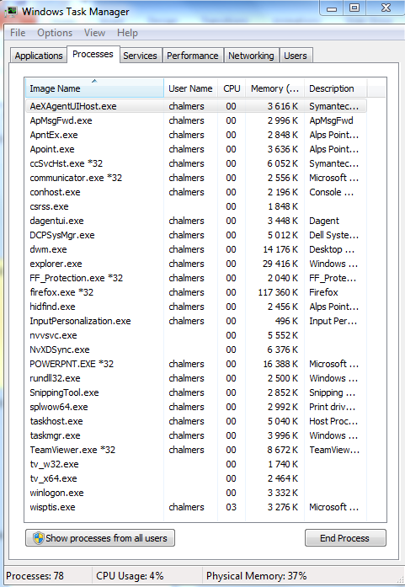
Objectives
To introduce the notion of a process: a program in execution, which forms the basis of all computation
To describe the various features of processes, including scheduling, creation and termination, and communication
To explore interprocess communication using shared memory and message passing
Notes:
While executing different user programs at the same time, how does the OS take care of system tasks too?
OS processes and User processes

Slide 4
AGENDA
Processes (Introduction)
Process Scheduling
Operations on Processes
Interprocess Communication (contains self-reading part)

Slide 5
AGENDA
Processes (Introduction)
Process Scheduling
Operations on Processes
Interprocess Communication (contains self-reading part)

Slide 6
We run several programs at the same time
One CPU can only run one program at a time
Notes:
who think 1 is false?
who think 2 is false?
who think 1 and 2 are false?
ask why

Slide 7
Concurrent vs Parallel execution
We run several programs at the same time
One CPU can only run one program at a time
We feel several programs run at the same time
Each CPU core can only run one program at the time
(Next lecture)
Notes:
Let's assume for now one CPU / one core. No parallelism

Slide 8

Process, not program
A process can be in different states, how many?
There are periods of time during which no process is running! Overheads should be minimal
Notes:
Do not get scared! we will see this now
Actually, write down what PCB means
The OS is an oracle in the beginning, then I explain
The pasta example

Slide 9
Process Concept
Process (or job, task) – a program in execution; process execution must progress in sequential fashion
A program is passive entity stored on disk (executable file), process is active
A program becomes process when executable file loaded into memory
The execution of a program is started via GUI mouse clicks, command line entry of its name, …
One program can have several process instances (consider multiple users executing the same program)
A process can be the execution environment for other code (e.g., Java Virtual Machine)
Notes:
Example of process: mail client. Sequential fashion: open, load interface, receive mail (connect …)

Slide 10
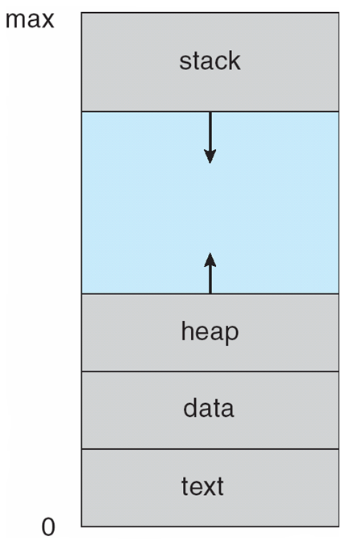
Process in Memory
Multiple parts:
The program code, also called text section
Data section containing global variables
Heap containing memory dynamically allocated during run time
Stack containing temporary data
Function parameters, return addresses, local variables
Notes:
Clarify: Program counter (and other registers) are in the PCB
Stack: thread specific / LIFO. Heap: one-per-process, no specific access pattern
Stack vs. Heap
Stack
Used for automatic storage: function call frames, local variables, return addresses.
Managed implicitly by the compiler and CPU: grows and shrinks as functions are called and return.
Very fast, but limited in size.
Heap
Used for dynamic storage: objects and data whose lifetime is not tied to a function call.
Managed explicitly by the programmer (e.g. malloc/free, new/delete).
More flexible, but slower and more prone to fragmentation.
Growing in Different Directions
In many system architectures, the stack grows downward: it starts at a high virtual memory address and grows toward lower addresses as more frames are pushed.
The heap grows upward: it starts at a low virtual memory address (just above the global data segment) and grows toward higher addresses as more memory is allocated.
Why
This convention helps maximize the efficient use of the process’s address space.
By letting stack and heap grow toward each other, the OS can use the same contiguous region of virtual memory for both, reducing waste.
If the stack grows down from the top and the heap grows up from the bottom, they only collide if the process exhausts its address space, which is easy for the OS to detect.
Yes. In C, local variables with automatic storage duration (the default) are stored on the stack.
Each time a function is called, the compiler generates code to allocate a stack frame.
That frame holds:
the function’s local variables,
bookkeeping info (like the return address and saved registers).
When the function returns, the frame is popped and those variables cease to exist.
Exceptions
If you declare a local variable as static, it is not on the stack. Instead, it lives in the data segment and persists across function calls.
If you use malloc/calloc/realloc, the storage is allocated in the heap, not on the stack, even if the pointer to it is a local variable.
Compiler optimizations may sometimes keep variables in CPU registers instead of on the stack.

Slide 11

Diagram of Process State
As a process executes, it changes state
new: The process is being created
ready: The process is waiting to be assigned to a processor
running: Instructions are being executed
waiting: The process is waiting for some event to occur
terminated: The process has finished execution
Important: only 1 process can be running on any CPU core / logical processor at any instant.
Notes:
process-state models and names vary between operating systems

Slide 12
Context Switch
When CPU switches to another process, the system must save the state of the old process and load the saved state for the new process via a context switch
Context of a process represented in the PCB
Context-switch time is overhead; the system does no useful work while switching
The more complex the OS and the PCB ➔ the longer the context-switch time
Time dependent on hardware support
Some hardware provides multiple sets of registers per CPU ➔ multiple contexts loaded at once

Slide 13
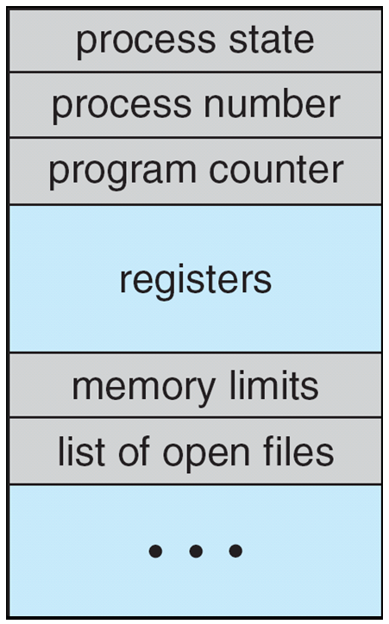
Process Control Block (PCB)
Information associated with each process in the OS
Process state: running, waiting, etc.
Program counter: location of next instruction to execute
CPU registers: contents of all process-centric registers
CPU scheduling information: priorities, scheduling queue pointers
Memory-management information: memory allocated to the process
Accounting information: CPU time used, clock time elapsed since start, time limits
I/O status information: I/O devices allocated to the process, list of open files
Notes:
PCB serves as the repository for any information that may vary from process to process

Slide 14
AGENDA
Processes (Introduction)
Process Scheduling
Operations on Processes
Interprocess Communication (contains self-reading part)

Slide 15
Process Scheduling
Maximize CPU use, quickly switch processes onto CPU for time sharing
Process scheduler selects among available processes for the next execution on CPU
Maintains scheduling queues of processes
Job queue – set of all processes in the system
Ready queue – set of all processes residing in main memory, ready and waiting to execute
Device queues – set of processes waiting for an I/O device
Processes migrate among the various queues

Slide 16
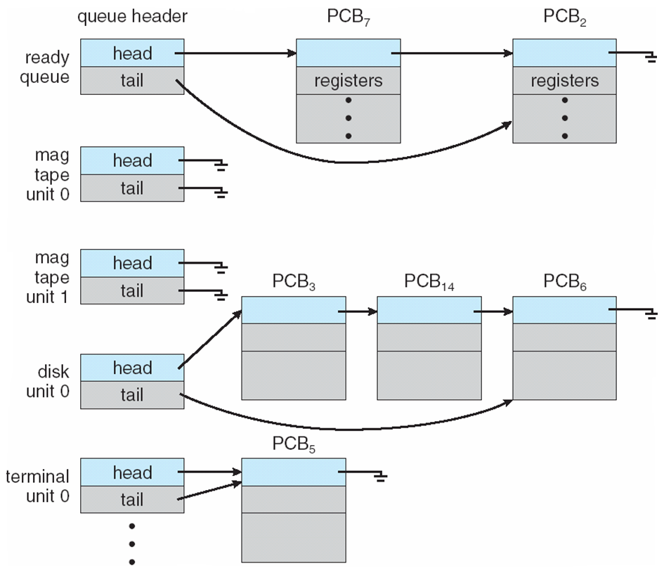
Ready Queue And Various I/O Device Queues
Notes:
Each device has its device queue – Here you can use the blackboard
bags example, instead of one big bag, many bags with similar processes

Slide 17
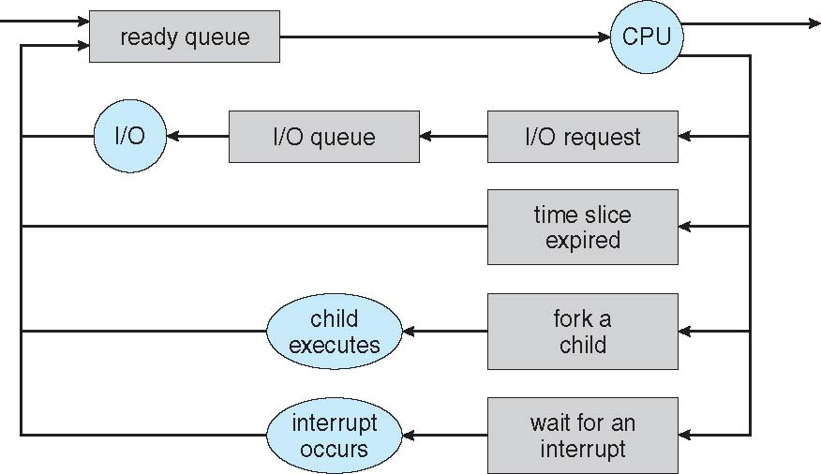
Representation of Process Scheduling
Queueing diagram represents queues, resources, flows
Notes:
Rectangular boxes represent queues. 2 types of queues: ready queue and device queues
Circles represent resources serving the queues
Arrows represent flows
If needed: clarify interrupt here can mean several things hardware/software signal / high-priority event

Slide 18
Schedulers
Short-term scheduler (or CPU scheduler) – selects which process should be executed next and allocates the CPU
Sometimes the only scheduler in a system
Short-term scheduler is invoked frequently (milliseconds) ⇒ (must be fast)
Long-term scheduler (or job scheduler) – selects which processes should be brought into the ready queue
Long-term scheduler is invoked infrequently (seconds, minutes) ⇒ (may be slow)
The long-term scheduler controls the degree of multiprogramming

Slide 19
AGENDA
Processes (Introduction)
Process Scheduling
Operations on Processes
Interprocess Communication (contains self-reading part)

Slide 20
Operations on Processes
The system must provide mechanisms for:
process creation, and
process termination (as detailed in the following slides).

Slide 21
Process Creation
A parent process creates children processes, which, in turn, create other processes, forming a tree of processes
Generally, a process is identified and managed via a process identifier (pid)
Resource sharing options
Parent and children share all resources
Children share a subset of parent’s resources
Parent and child share no resources
Execution options
Parent and children execute concurrently
Parent waits until children terminate
Notes:
You double-click something for a process. Hence, there’s a process waiting for the double-click
Resources: memory, files, devices
Address space: same program and data

Slide 22
A Tree of Processes in Linux
init process, always has pid=1
manages ssh connections
manages clients logging into the system
User process

Slide 23
pstree -pl
XXXXXXXXXX:~$ pstree -pl
init(1)-+-NetworkManager(1215)-+-dhclient(3386)
| |-dnsmasq(3390)
| |-{NetworkManager}(1224)
| `-{NetworkManager}(2164)
|-accounts-daemon(1527)---{accounts-daemon}(1530)
|-acpid(1360)
|-apache2(16861)-+-apache2(2458)
| |-apache2(2460)
| |-apache2(2461)
| |-apache2(2462)
| |-apache2(2463)
| |-apache2(2464)
| |-apache2(4079)
| |-apache2(4082)
| |-apache2(5464)
| |-apache2(5465)
| `-apache2(5466)
|-at-spi-bus-laun(3570)-+-dbus-daemon(3576)
...
Notes:
pstree - display a tree of processes
-p Show PIDs. PIDs are shown as decimal numbers in parentheses after each process name. -p implicitly disables compaction.
-l Display long lines. By default, lines are truncated to either the COLUMNS environment variable or the display width. If neither of these methods work, the default of 132 columns is used.

Slide 24
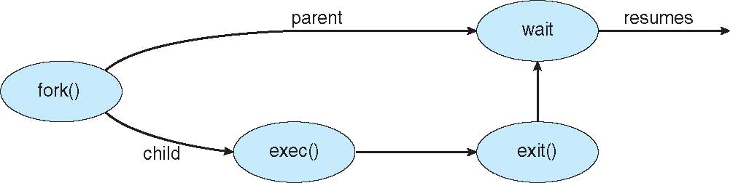
Process Creation (Cont.)
Address space
The child is a duplicate of parent
The child has a program loaded into it
UNIX examples
fork() system call creates new process
exec() system call used after a fork() to replace the process’ memory space with a new program
Notes:
fork() gives the new process a complete, valid starting environment for free, while allowing that environment to be modified before another program is loaded.
A system call that directly creates a completely new process is also possible. Windows uses this style with CreateProcess(), and POSIX provides posix_spawn(). The fork()–exec() design is mainly the traditional UNIX approach, not a universal requirement.
Think also about permissions / scope → all this can be inherited from the parent process easily.

Slide 25

C Program Forking Separate Process
Notes:
Use the blackboard

Slide 26
Process Termination
Process executes last statement and then asks the operating system to delete it using the exit() system call.
The system call allows to return status data from the child to the parent (if parent used wait())
The process’resources are deallocated by the operating system
Parent may terminate the execution of children process using the kill() system call. Some reasons for doing so:
Child has exceeded allocated resources
Task assigned to child is no longer required
The parent is exiting and the operating systems does not allow a child to continue if its parent terminates

Slide 27
Process Termination
Some operating systems do not allow a child to exist if its parent has terminated. If a process terminates, then all its children must also be terminated.
Cascading termination. All children, grandchildren, etc. are terminated.
The termination is initiated by the operating system.
The parent process may wait for termination of a child process by using the wait() system call. The call returns status information and the pid of the terminated process
pid = wait(&status);
A terminated child becomes a zombie when its status has not yet been collected by its parent
If the parent has terminated without invoking wait, the process is an orphan
Notes:
orphan processes are assigned to init
Take a breath here, next slide is about having different processes running within the same program
Key point: Zombie = terminated process still waiting to be reaped. It’s the parent who is late with wait / reaping
Key point: Orphan = still alive, but parent is gone.

Slide 28

Multiprocess Architecture – Chrome Browser
Many web browsers ran as single process (some still do)
If one website causes trouble, the entire browser can hang or crash
Google Chrome Browser is multiprocess, with 3 different types of processes:
Browser process manages user interface, disk and network I/O
Renderer process renders web pages, deals with HTML, JavaScript. A new renderer is created for each website opened
Runs in a sandbox to restrict disk and network I/O and minimize risks of security exploits
Plug-in process for each type of plug-in

Slide 29
AGENDA
Processes (Introduction)
Process Scheduling
Operations on Processes
Interprocess Communication (contains self-reading part)
Notes:
Now, if two processes are distinct entities, how do they communicate?

Slide 30
Interprocess Communication
Processes within a system may be independent or cooperating
Cooperating processes can affect or be affected by other processes, including sharing data
Reasons for cooperating processes:
Information sharing
Computation speedup
Modularity
Cooperating processes need interprocess communication (IPC)
Two models of IPC
Shared memory
Message passing
Notes:
Information sharing: same file accessed by multiple processes
Modularity: design system in modular fashion
MP better for smaller amounts of data, also better in a distributed system
SM is faster because less/fewer system calls, just access to the memory

Slide 31
Communication Models
(a) Message passing. (b) Shared memory.

Slide 32
Cooperating processes: Producer-Consumer Problem
Paradigm for cooperating processes: a producer process produces information that is consumed by a consumer process
Unbounded-buffer: places no practical limit on the size of the buffer
Bounded-buffer: assumes that there is a fixed buffer size

Slide 33
Interprocess Communication – Shared Memory
The major issue is to provide a mechanism that will allow the user processes to synchronize their actions when they access shared memory.
Synchronization is discussed in detail in the following lessons
Notes:
Processes need to agree on sharing memory
Here drawing if needed.

Slide 34
Interprocess Communication – Message Passing
If processes P and Q wish to communicate, they need to:
Establish a communication link between them
Exchange messages via send/receive
Implementation issues:
How are links established?
Can a link be associated with more than two processes?
How many links can there be between every pair of communicating processes?
What is the capacity of a link?
Is the size of a message that the link can accommodate fixed or variable?
Is a link unidirectional or bidirectional?
Notes:
discuss the logical implementation, not the physical one

Slide 35
Logical implementation – Issues [Self-reading section]
Naming, Direct or indirect communication
Synchronous or asynchronous communication
Automatic or explicit buffering
Notes:
Issues / challenges related to the logical implementation of message passing systems (discussion)

Slide 36
Logical implementation – Issues
Naming: direct or indirect communication
Synchronous or asynchronous communication
Automatic or explicit buffering

Slide 37
Direct Communication
Processes must name each other explicitly:
send (P, message) – send a message to process P
receive(Q, message) – receive a message from process Q
Properties of communication link
Links are established automatically
A link is associated with exactly one pair of communicating processes
Between each pair there exists exactly one link
The link may be unidirectional, but is usually bidirectional

Slide 38
Indirect Communication
Messages are sent to and received from mailboxes (also referred to as ports)
Each mailbox has a unique ID
Processes can communicate only if they share a mailbox
Properties of a communication link
A link is established only if processes share a common mailbox
A link may be associated with many processes
Each pair of processes may share several communication links
A link may be unidirectional or bidirectional

Slide 39
Indirect Communication
Operations
create a new mailbox (port)
send and receive messages through mailbox
destroy a mailbox
Primitives are defined as:
send(A, message) – send a message to mailbox A
receive(A, message) – receive a message from mailbox A

Slide 40
Logical implementation – Issues
Naming: direct or indirect communication
Synchronous or asynchronous communication
Automatic or explicit buffering

Slide 41
Synchronization
Message passing may be either blocking or non-blocking
Blocking is considered synchronous
Blocking send - the sender is blocked until the message is received
Blocking receive - the receiver is blocked until a message is available
Non-blocking is considered asynchronous
Non-blocking send - the sender sends the message and continues
Non-blocking receive - the receiver receives:
A valid message, or
A Null message
Different combinations possible
If both send and receive are blocking, we have a rendezvous

Slide 42
Synchronization (Cont.)
Producer-consumer becomes trivial for blocking send/receive:
message next_produced;
while (true) { /* produce an item in next produced */
send(next_produced);
}
message next_consumed;
while (true) {
receive(next_consumed);
/* consume the item in next consumed */
}

Slide 43
Logical implementation – Issues
Naming: direct or indirect communication
Synchronous or asynchronous communication
Automatic or explicit buffering

Slide 44
Buffering
A queue of messages is attached to the link, and is implemented in one of three ways:
Zero capacity – no messages are queued on a link: the sender must wait for receiver (rendezvous)
Bounded capacity – finite length of n messages: the sender must wait if the link is full
Unbounded capacity – infinite length: the sender never waits

Slide 45
Examples of IPC Systems – Windows
Message-passing centric via advanced local procedure call (ALPC) facility
Only works between processes on the same system
Uses ports (like mailboxes) to establish and maintain communication channels

Slide 46
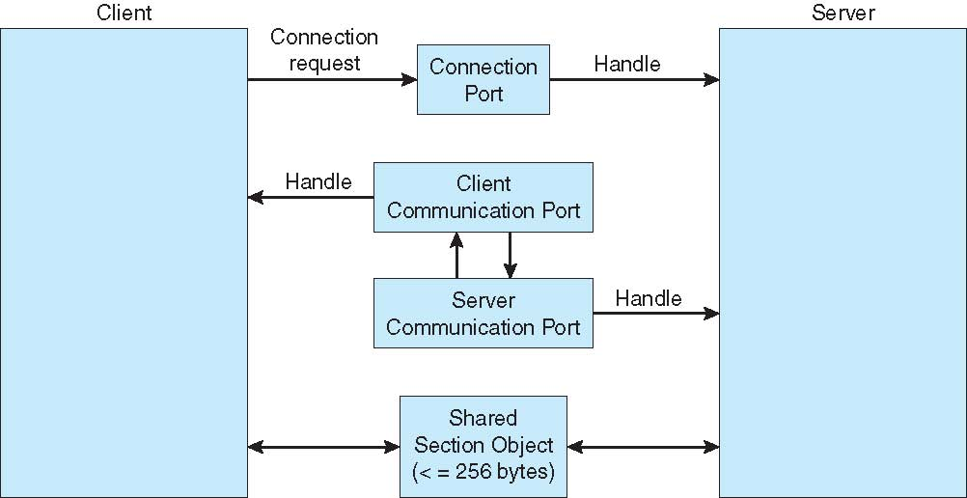
Local Procedure Calls in Windows
Notes:
Server publishes connection-port for all processes
client sends connection request
Server creates channel (two private communication ports) and shares it with the client.
Mixed communication, also section object for larger messages

Slide 47
Pipes
Pipes act as a conduit allowing two processes to communicate
Ordinary pipes – usually used by a parent process to communicate with a child process that it created.
They can also be shared with grandchildren or other related processes that inherit those descriptors. On UNIX, a process may also pass a pipe file descriptor to another process through a UNIX-domain socket.
Named pipes – can be accessed in cases not covered by ordinary pipes (by name).
Notes:
half duplex data traverses one direction at time, full duplex both

Slide 48
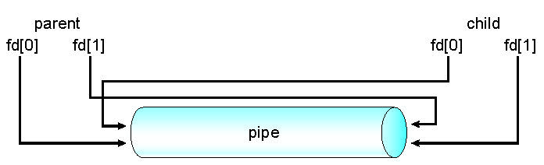
Ordinary Pipes
Ordinary Pipes allow communication in standard producer-consumer style
Producer writes to one end (the write-end of the pipe)
Consumer reads from the other end (the read-end of the pipe)
Ordinary pipes are therefore unidirectional
Require parent-child relationship between communicating processes
Windows calls these anonymous pipes
See Unix and Windows code samples in textbook

Slide 49
Named Pipes
Named Pipes are more powerful than ordinary pipes
Communication is bidirectional
No parent-child relationship is necessary between the communicating processes
Several processes can use the named pipe for communication
Named pipes are provided on both UNIX and Windows systems

Slide 50
Pipes in UNIX
Send the output of one command to the input of another command
use a long listing format
pipe
ls -la | grep <pattern>
list directory contents
print lines matching a pattern
do not ignore entries starting with .
Notes:
Look at the pipe manual (unidirectional pipe in this case)
Step by step
Shell parses the command and sees the |.
The shell calls the system call pipe(), which creates a pair of file descriptors:
fd[0] = read end
fd[1] = write end These are linked in the kernel’s memory; no filename is involved → unnamed pipe.
Fork #1: the shell forks a child to run ls -la.
In that child, standard output (stdout, file descriptor 1) is redirected to the write end of the pipe (fd[1]).
Fork #2: the shell forks a child to run grep <pattern>.
In that child, standard input (stdin, file descriptor 0) is redirected from the read end of the pipe (fd[0]).
The shell closes the unused ends of the pipe in each process.
Now:
ls -la writes its output → goes into the pipe (kernel buffer).
grep reads from the pipe as if it were reading from standard input.

Slide 51
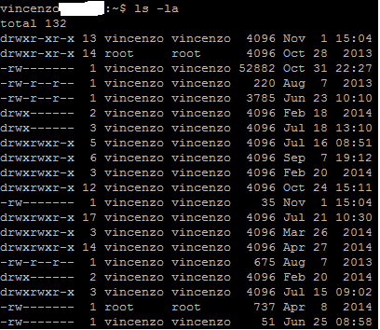

Pipes in UNIX
ls -la
ls -la | grep Apr

Slide 52
Ordinary Pipes - example
#include <stdio.h>
#include <unistd.h>
#include <sys/types.h>
#include <string.h>
#define BUFFER_SIZE 25
#define READ_END 0
#define WRITE_END 1

Slide 53
Ordinary Pipes - example
int main(void)
{
char write_msg[BUFFER_SIZE] = "Greetings";
char read_msg[BUFFER_SIZE];
pid_t pid;
int fd[2];
/* create the pipe */
if (pipe(fd) == -1) {
fprintf(stderr,"Pipe failed");
return 1;
}
/* now fork a child process */
pid = fork();

Slide 54
if (pid < 0) {
fprintf(stderr, "Fork failed");
return 1;
}
if (pid > 0) { /* parent process */
/* close the unused end of the pipe */
close(fd[READ_END]);
/* write to the pipe */
write(fd[WRITE_END], write_msg, strlen(write_msg)+1);
/* close the write end of the pipe */
close(fd[WRITE_END]);
}
else { /* child process */
/* close the unused end of the pipe */
close(fd[WRITE_END]);
/* read from the pipe */
read(fd[READ_END], read_msg, BUFFER_SIZE);
printf("child read %s\n",read_msg);
/* close the read end of the pipe */
close(fd[READ_END]);
}
return 0;
}
Notes:
close(fd[WRITE_END]) is needed to detect the end of the file! (question)

Slide 55
Questions

Slide 56
The instruction to be run next when process X is scheduled is maintained in ...
its text section
its data section
its process control block
Notes:
1 and 3. 2 too if you want (global variable used to decide which instruction to run next)

Slide 57
Which of the following state transitions is not valid?
ready --> running
running --> ready
running --> waiting
ready --> waiting
Notes:
4

Slide 58
During a context switch, what is saved by the OS (to be later re-loaded) is ...
the CPU context into the PCB of the process
the CPU context into the PCB of the process + the memory of the process
the memory of the process
Notes:
1

Slide 59
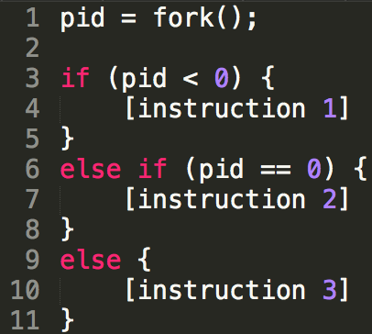
Which of the following statements is false?
Line 4 can be executed by the parent AND the child process
Line 7 is executed by the parent process
Line 7 is executed by the child process
Notes:
1 and 2

Slide 60
Which type of pipes require a parent-child relationship between two processes?
Ordinary
Named
None of the above
Notes:
1 and 3

Slide 61
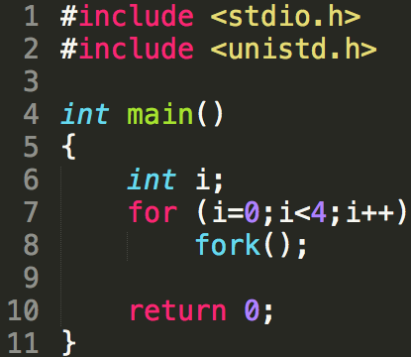
Including the initial parent process, how many processes are created by this code?
4
5
16
31
Notes:
3

Slide 62
Question 2
What is printed by this program?
Notes:
The parent and child do not share variables.
CHILD 0
CHILD -1
CHILD -4
CHILD -9
CHILD -16
PARENT 0
PARENT 1
PARENT 2
PARENT 3
PARENT 4

Slide 63
Question 3
What is printed by this program?
Notes:
child: pid = 0
child: pid1 = X
parent: pid = X
parent: pid1 = Y
Notice:
X is the same for child and parent
Y is different from X
X > 1
Y > 1
The parent is not waiting for the child to print. Messages can be printed in different order...

Slide 64
Question 4
Consider a multiprogrammed system with a degree of multiprogramming of 5 (i.e., five processes are present in memory and competing for CPU time). If each process spends 40% of its time waiting for I/O (independently of others), what will the CPU utilization be?
Notes:
CPU utilization = 1 – p^{n} = 1 – 0.4⁵ = 0.99
where p is the probability for a process to be waiting for I/O.

