Slide 1


I/O Systems
Operating Systems – EDA093/DIT401
Vincenzo Gulisano
vincenzo.gulisano@chalmers.se

Slide 2
Reading instructions
  Chapter 5.1 to 5.3

Slide 3
Agenda
Introduction
I/O Hardware
Application I/O Interface
Kernel I/O Subsystem
Performance

Slide 4
Agenda
Introduction
I/O Hardware
Application I/O Interface
Kernel I/O Subsystem
Performance

Slide 5
Introduction
Main jobs of a computer: I/O & processing.
Role of OS: manage & control I/O operations & I/O devices
OBJECTIVES:
Explore the structure of an OS’s I/O subsystem
Describe the principles and complexities of I/O hardware
Explain performance aspects of I/O hardware and software

Slide 6

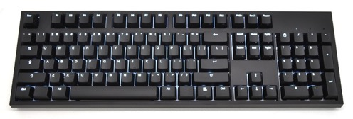
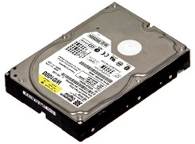

Introduction
I/O challenge: control the devices in a given architecture as effectively as possible
Why is it a challenge?
Variability of I/O devices (in their function & speed)
  Varied methods are needed to control them.
Software and hardware interfaces are becoming more standardized, while the variety of devices continues to increase
Different details & oddities of devices
How does the OS address the challenge?
  dedicated I/O subsystem in the kernel
  device drivers that provide a device access interface to the I/O subsystem
Notes:
The challenge is how to control devices, since we have completely different types (each with different functions)
On one hand, we would like to increase standardization, on the other we have increasing types of devices
In order to deal with different details / oddities the OS uses device drivers.

Slide 7
Agenda
Introduction
I/O Hardware
Application I/O Interface
Kernel I/O Subsystem
Performance

Slide 8


I/O Hardware
We have different types of hardware usually available in a computer:
Storage devices (disks)
Transmission devices (network cards)
Human-interface devices (screen, keyboard, mouse)
All of them exchange information by sending signals (via cable or air)
How do they communicate with the CPU, then?
Notes:
We have different types of hardware (now let’s focus on a standard computer…) we have storage devices (disks) / Transmission devices (network cards) and human-interface devices (screen / keyboard / mouse).
All of them exchange information sending signals (cable or air). So, the question is: how do they communicate?

Slide 9
I/O Hardware
Common concepts:
Port: the connection point (e.g., serial port)
Bus: a set of wires & a protocol that specifies a set of messages that can be sent on the wires.
  Messages conveyed by patterns of electrical voltages with different timings.
  Buses vary in signaling methods, speed, throughput & connection methods.
When device A connects to device B and device B connects to device C... We say A,B,C,… form a daisy chain
  In some systems, daisy-chained devices share a bus or pass bus signals from one device to the next
Notes:
Let’s introduce some common concepts. We have ports (the physical connection), we have bus (the communication channel). Notice that a set of devices plugged one on top of the other can also act as a bus, in this case we call it daisy chain.

Slide 10
Typical PC bus structure (legacy)
Important concepts:
PCI bus: connects the processor-memory subsystem to the fast devices.
Expansion bus: connects relatively slow devices.
Controller: a collection of electronics that can operate a port, a bus or a device.
  Example 1: Serial-port controller
  A single chip (on the host) that controls the signals on the wires of a serial port.
  Example 2: SCSI controller
  It may contain a processor, microcode, and private memory for processing SCSI protocol messages. It may be implemented on an adapter card or integrated into a device or motherboard.
Notes:
When looking at the bus, we actually have different types of buses (PCI and expansion buses) and interfaces to specific types of devices (Controllers)
PCI : Peripheral Component Interconnect
SCSI: Small Computer System Interface

Slide 11
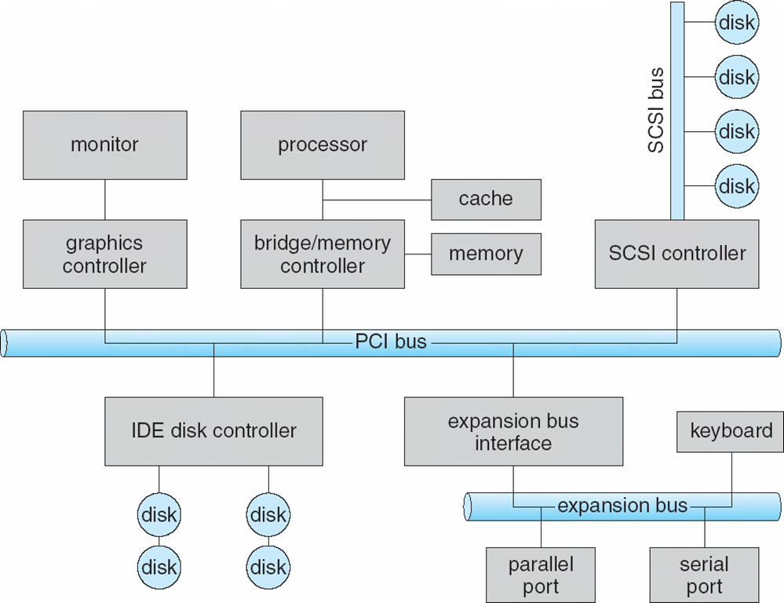
Example of a legacy PC bus structure
Notes:
So this is how it actually looks, you see we have controllers, we have the PCI bus and the expansion bus
IDE Integrated Drive Electronics
Say again each controller is a “small computer”

Slide 12
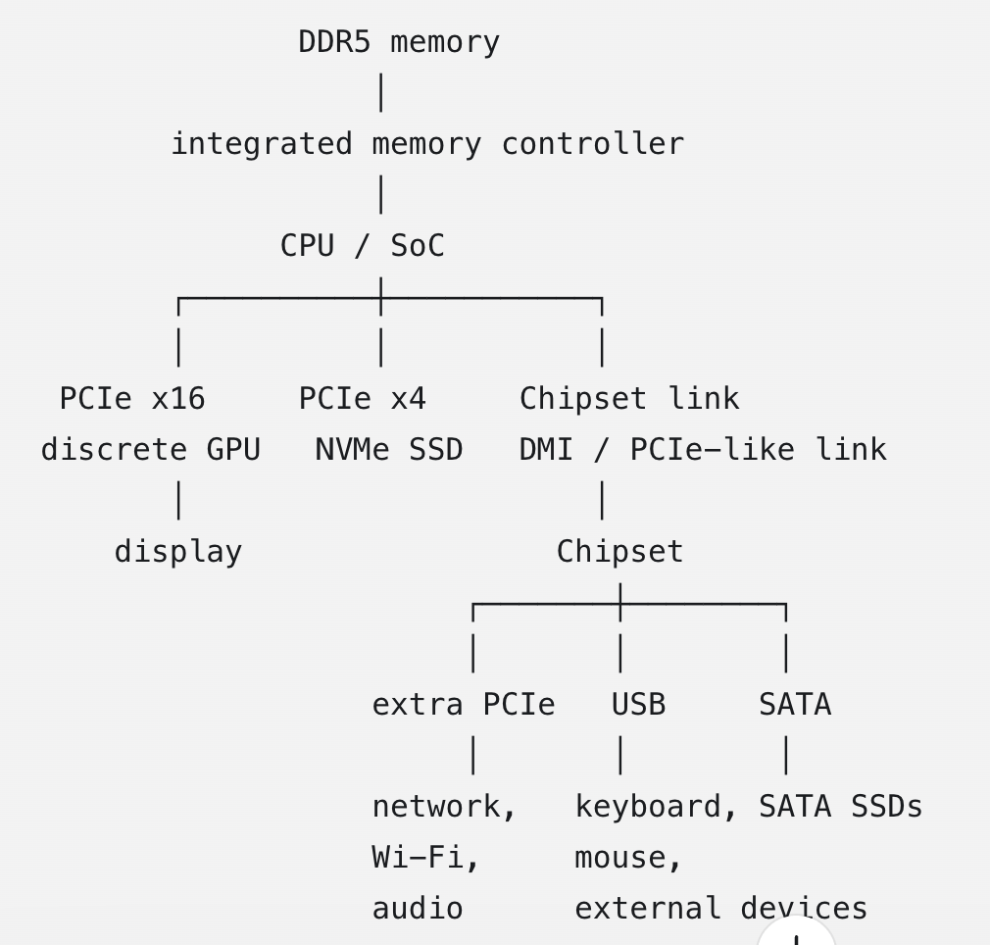
How it looks now
Notes:
SoC — System on a Chip: A chip that integrates CPU cores with other components that were traditionally separate, such as the memory controller, PCIe controller, integrated GPU, and sometimes additional I/O controllers. In the figure, “CPU / SoC” means that a modern processor often contains much more than only CPU cores.
NVMe — Non-Volatile Memory Express: A protocol designed for communicating with fast solid-state storage over PCI Express. The NVMe SSD in the figure connects directly to the processor using four PCIe lanes (PCIe ×4).

Slide 13
I/O Hardware
How can the processor give commands & data to a controller to accomplish an I/O transfer?
1st Way of Communication
Processor reads & writes bit patterns in the controllers’ registers.
  Use of special I/O instructions that specify the transfer of a byte or word to an I/O port address.
  I/O instruction triggers bus lines to select the proper device & move bits into or out of a device register.
2nd Way of Communication: Memory-mapped I/O
Device-control registers are mapped into the address space of the processor.
CPU executes I/O requests using the standard data transfer instructions to read and write the device-control registers.
→ Some systems use both ways of communication.
Notes:
Now, let’s suppose the CPU wants to talk with the disk, how can they do this?
One way for the CPU is to use the registers of the controller, the CPU talks directly with the controller
The second one is to agree with the disk that a certain portion of memory is reserved for the disk, and dedicated hardware can take care of sharing information.
Of course, we can have hybrid systems.

Slide 14
Processor reads & writes bit patterns in the controllers’ registers
RAM
CPU
I use dedicated I/O instructions and I/O-port addresses to access controller registers; ordinary load/store instructions access memory.
SCSI Controller
SCSI Disk

Slide 15
Memory-mapped I/O
RAM
SCSI Controller
CPU
motherboard
When I want to write a byte to a register of a certain controller I use an ordinary load or store instruction. Address-decoding hardware routes the access to RAM or to a device according to the addressed region.
SCSI Disk
Notes:
CLARIFY WE DO NOT REALLY WRITE TO MEMORY, STUFF GETS REDIRETED, BUT THOSE ADDRESSES ARE GONE!!!

Slide 16
Example of Memory-mapped I/O: graphics controller
CPU
motherboard
Graphics controller
Graphics controller: has large memory-mapped region to hold screen contents.
Process sends output to the screen by writing data into the memory-mapped region.
Controller generates screen image based on the contents of the memory.

Slide 17
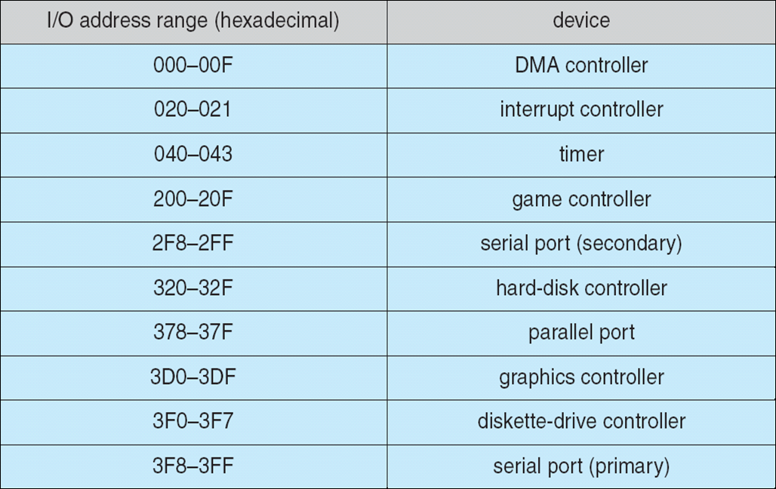
Device I/O Port Locations on PCs
Example legacy x86 I/O-port address ranges
A few fixed I/O-port ranges remain for compatibility, but modern devices generally use dynamically assigned memory-mapped I/O regions.
Notes:
The graphic controller example makes more sense before, then we can put the addresses…
When the CPU decides to write/read registers from devices / controllers there are fixed addresses representing fixed devices.

Slide 18
I/O Hardware
I/O port typically consists of:
Data-in register is read by the host to get input (e.g. 1 to 4 bytes in size)
Data-out register is written by the host to send output
Status register: contains bits that can be read by the host. Indicates states such as:
  whether the current command has completed
  whether a byte is available to be read
  whether a device error has occurred
Control register: to start a command or to change the mode of a device.
Example 1: a certain bit in the control register of a serial port chooses between full-duplex & half-duplex communication.
Example 2: another bit sets the word length to 7 or 8 bits. Other bits select one of the speeds supported by the serial port
Notes:
Each I/O port usually consists of different registers: in / out / status and control
For example…

Slide 19
Interaction between host and controller
Complete interaction protocol between the host & a controller can be intricate.
  busy-waiting / polling: the host repeatedly reads the controller’s status register until the required condition holds
  interrupt: the controller notifies the CPU of an event such as input availability, operation completion, or an error

Slide 20
Polling – Handshaking procedure
  2 bits are used to coordinate the producer-consumer relationship between the controller & the host.
  Controller indicates its state through the busy bit in the status register.
  Host signals its wishes via the command-ready bit in the command register.
  Command ready bit: if it is set, a command is available for the controller
  busy-waiting / polling: it is a loop, reading the status register over and over until the busy bit becomes clear.
  Reasonable when the device and its controller respond quickly
  Inefficient when the CPU repeatedly polls while the device remains busy
  In such cases: hardware controller should notify the CPU when the device becomes ready for service → this hardware mechanism is called interrupt.
Notes:
Now, let’s say the CPU wants to coordinate with a certain device and we can use the registers of the device (directly or memory-mapped).
How can we interact with the device?
You should be familiar with the interrupt model, but there can be different ways in which we can do this, the first one is polling.
On one hand, the CPU can be actively checking if a device can be used (or is finished) on the other hand, it can wait for an interrupt

Slide 21
Interrupts
Basic mechanism (simplified)
  The interrupt mechanism delivers an interrupt request to the CPU, for example through an interrupt line/controller or a message-signaled interrupt.
  CPU senses the interrupt request line after executing every instruction.
  If yes, CPU performs a save state & jumps to the interrupt handler routine at a fixed address in memory.
  Interrupt handler (IH): What was the cause of the interrupt?
  The handler performs the necessary processing, restores the saved state, and executes a return-from-interrupt instruction.

Slide 22
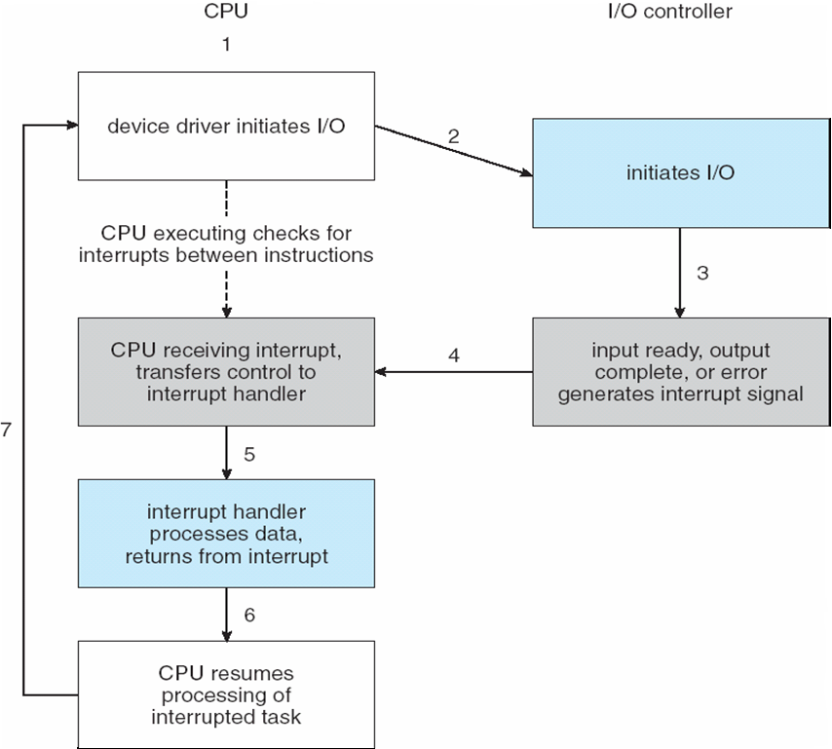
Interrupts

Slide 23
Interrupts - Dictionary
The device controller raises an interrupt
....by asserting a signal on the interrupt request line
CPU takes/accepts the interrupt
CPU dispatches it to the interrupt handler
Handler clears the interrupt by servicing the device
Notes:
Some dictionary about interrupts

Slide 24
Interrupts
Sophisticated Interrupt Handling
In a modern OS: we need sophisticated interrupt handling features
  Ability to defer interrupt handling during critical processing
  Efficient way to locate the proper interrupt handler for a device without asking all devices to see which one raised the interrupt
  Multiple interrupt-priority levels allow higher-priority events to be handled before lower-priority events
In modern OS these facilities are provided by CPU & interrupt controller hardware

Slide 25
Interrupts
Two interrupt request lines (this is actually architecture specific):
Nonmaskable interrupt: reserved for events such as unrecoverable memory errors.
Maskable interrupt: may be temporarily masked by the CPU or interrupt controller while a short critical section is executed.
Interrupt mechanism accepts an address: a number that selects a specific interrupt-handling routine from a small set.
This address is an offset in a table called interrupt vector
This vector contains the memory addresses of specialized interrupt handlers.
Notes:
As we once mentioned, it might not be a good idea if the CPU gets interrupted continuously. For this reason, we actually have 2 types of interrupts (2 different lines)

Slide 26
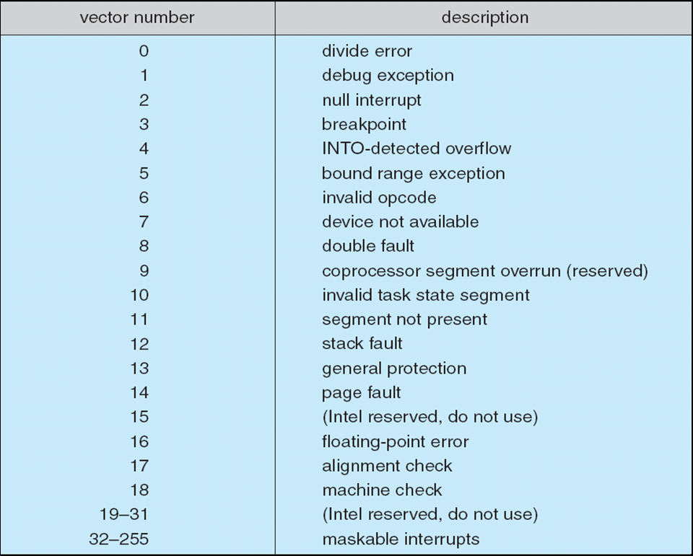
Interrupts – Intel Pentium processor event-vector table
Processor-defined exceptions
Notes:
As you can see in the processor-defined ones we have some interrupts we should be familiar with at this point (like page fault for instance)
Example of maskable is mouse click

Slide 27
Interrupts
OS & interrupts interaction
A modern OS interacts with the interrupt mechanism in several ways.
At boot time, probes the buses to see which devices are present and installs/configures the corresponding interrupt handlers.
During I/O, device controllers raise interrupts when they are ready for service. These interrupts may mean:
  output has completed
  input data is available
  or a failure has been detected
Notes:
The OS interacts with the interrupt mechanism in several ways.
How do we load the routines for the different interrupts?
For instance at boot time…
UP TO HERE FOR KAHOOT

Slide 28
Direct Memory Access
Direct Memory Access
Devices with large transfers (e.g., disk drive).
Not a good idea to use an expensive general-purpose processor to watch status bits & feed data into a controller register → programmed I/O process.
Use a DMA controller instead
After the CPU/driver configures the operation, the DMA engine transfers the block between the device and memory without CPU instructions moving each byte or word.
DMA transfer
To initiate a DMA transfer, host writes a DMA command block into memory.
Block contains:
  a pointer to the source of the transfer
  a pointer to the destination of the transfer
  a count of the number of bytes to be transferred.
Notes:
As we mentioned, we can have Direct Memory Access and this is also a way of reducing the interrupts that could “disturb” the CPU.
We can have dedicated hardware that “talks/interacts” with certain types of devices (the ones that usually transfer considerable amount of data)
Then, CPU writes address of the command block to the DMA controller

Slide 29
Direct Memory Access
Simplified Handshaking between DMA controller & device controller
Performed via a pair of wires: DMA request & DMA-acknowledge.
A word of data available for transfer → device controller places a signal on the DMA-request wire
DMA controller:
  places the desired memory address on the memory-address wires.
  places a signal on the DMA-acknowledge wire.
Device controller receives the DMA-acknowledge signal & transfers the word of data to memory & removes the DMA-request signal.

Slide 30
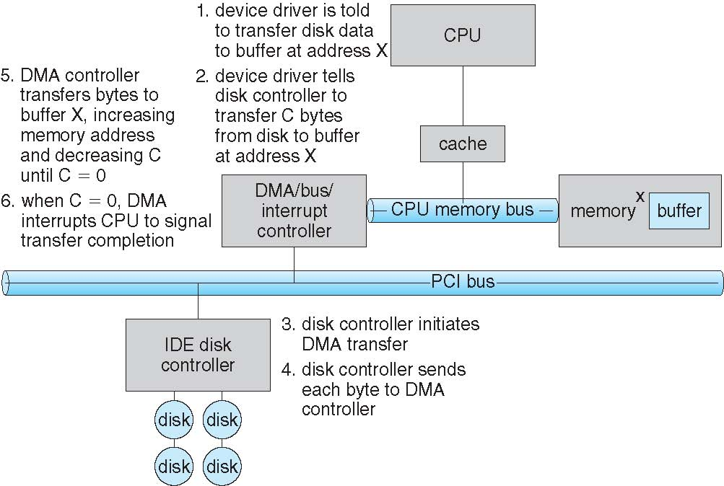
Six Step Process to Perform DMA Transfer
Notes:
Here the important thing is that this is done without the CPU (Once the CPU has configured the transfer).

Slide 31
Agenda
Introduction
I/O Hardware
Application I/O Interface
Kernel I/O Subsystem
Performance

Slide 32
Application I/O Interface
Goals:
  Abstract away the detailed differences in I/O devices by identifying a few general kinds.
  Provide general interfaces that encapsulate common device behaviors
Device-driver layer hides differences among I/O controllers from from the generic kernel I/O subsystem.
Make I/O subsystem independent of the hardware:
  Simplifies the job of the OS.
  Benefits the hardware manufacturers
  Standard interfaces allow a compatible peripheral to be attached without changing the generic I/O subsystem, provided that an appropriate driver already exists
  BUT: each OS has its own standards for the device-driver interface.

Slide 33
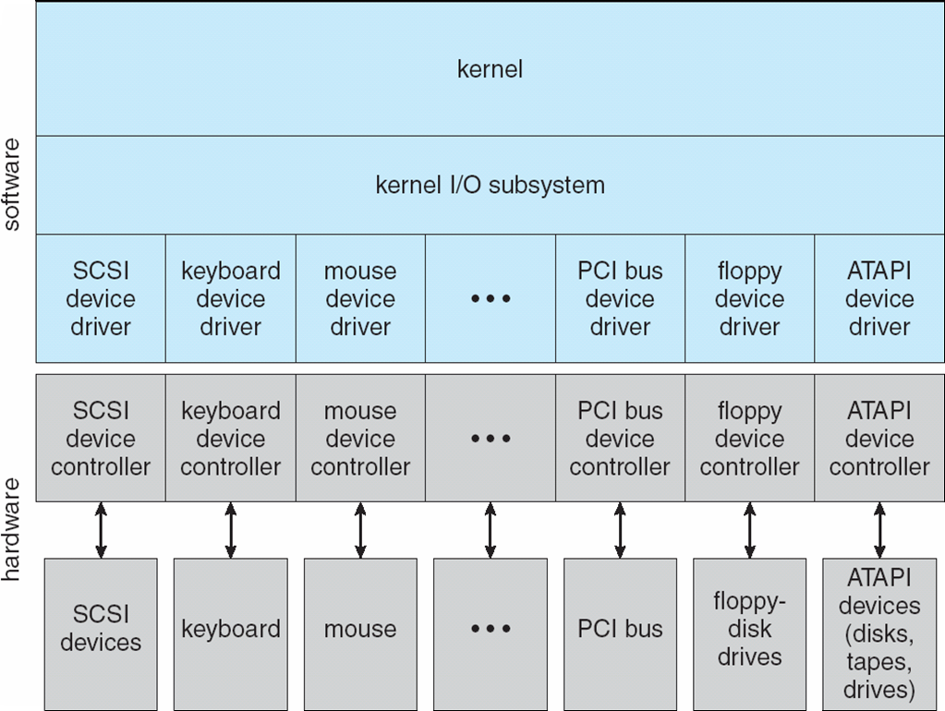
Application I/O Interface

Slide 34
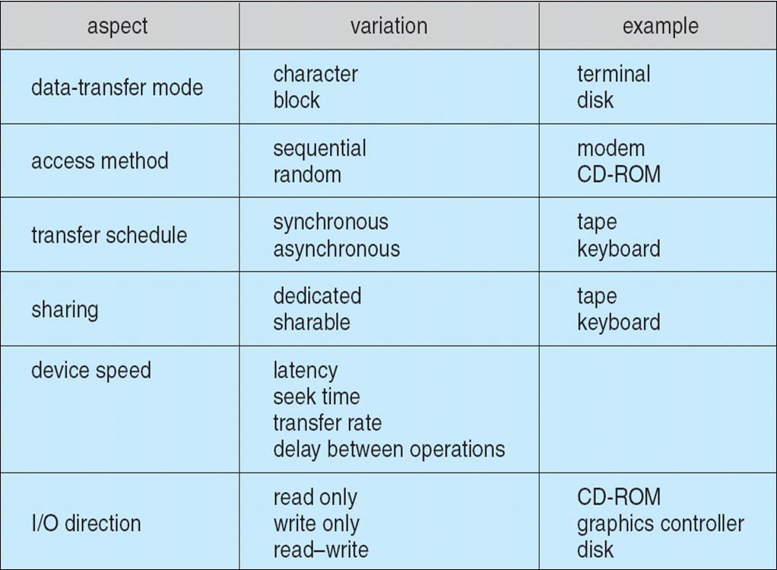
Application I/O Interface
Devices vary in many dimensions:
Character-stream or block: bytes one by one or blocks of bytes
Sequential or random access: fixed order or random
Synchronous or asynchronous: data transfers with predictable response times or not
Sharable or dedicated: used concurrently by several processes or not
Speed of operation: speeds range from a few bytes to gigabytes per sec
I/O direction: some devices support both reading and writing; others support only one direction.
Notes:
Why is it challenging?
Because we have a lot of different dimensions for each device
Let’s have a look at different interfaces we can have depending on the behavior / type of device

Slide 35
Block and Character Devices
Block devices include disk drives
Block-device interface provides the operations needed to access disks and other block-oriented devices
Commands include read(), write(), seek()
Memory-mapped file access possible
Character devices
Include keyboards, mouse, serial ports
Commands include get(), put()
Libraries layered on top allow line editing
Notes:
Each device will implement read write seek as it likes

Slide 36
Network Devices
Network Devices
Network I/O differs significantly from disks
Network communication uses the socket interface. On Unix-like systems, sockets can read()/write(), but they additionally require specific operations: bind, listen, accept, connect, send, and receive; seek is not meaningful
Unix & Windows include socket interface
System calls in the socket interface enable an application to
  Create a socket
  Connect to a remote socket
Socket Interface
Connect local socket to a remote address
Listen for connection requests and accept a connection from a remote application
Send & receive packets over the connection
select() → return which sockets have a packet waiting to be received

Slide 37
Clocks & Timers
Give current time.
Give elapsed time.
Set a timer to trigger operation X at time T.
Programmable hardware interval timer: hardware to measure elapsed time & trigger operations
Example: wait a certain amount of time & then generate an interrupt
Cancel operations proceeding too slowly
Usual interrupt rate (historically): between 18 & 60 ticks per sec.
Hardware clock constructed from a high-frequency counter.

Slide 38
Blocking & Nonblocking I/O
Blocking
  Process suspended until I/O completed
  Moved from running to wait queue
  Later moved back to ready queue & resumes
  Easy to use & understand
  Insufficient for some needs
Nonblocking
  Example: a user interface that receives keyboard & mouse input while processing & displaying data on screen.
  With nonblocking I/O, the descriptor or operation is configured not to wait. The system call returns immediately with transferred data, a partial result, or an indication that the operation cannot currently proceed.
    The application may retry later or wait for readiness using an event mechanism.
  Returns quickly with a return value indicating how many bytes were transferred.
Notes:
This is about system calls that can be provided by the OS
The difference lies in how the kernel and process interact during I/O operations — specifically when the process is allowed to continue execution relative to the I/O completion.
Here’s a concise breakdown:
Type Description Process behavior Example Blocking I/O The system call does not return until the I/O operation is fully complete. The process is put to sleep and cannot run until the data is ready or written. read(fd, buf, n) on a regular file — the process blocks until n bytes are read. Nonblocking I/O The system call returns immediately, even if the I/O cannot proceed. The process continues executing; it must poll or retry later to see if the I/O is done. Setting a socket to nonblocking (fcntl(fd, F_SETFL, O_NONBLOCK)) — read() returns EAGAIN if no data yet. Asynchronous I/O (AIO) The system call initiates the I/O and returns immediately. The kernel performs the I/O in the background and notifies the process upon completion (via signal, callback, or event). The process does not need to poll; it’s notified when I/O completes. POSIX aio_read(), Linux io_uring, Windows OVERLAPPED I/O.
Summary:
Blocking: process waits for completion.
Nonblocking: process checks repeatedly.
Asynchronous: kernel notifies when done.
In short: blocking waits, nonblocking polls, asynchronous is event-driven.

Slide 39
Blocking & Nonblocking I/O
Asynchronous
  The process may continue running while the I/O operation executes
  Returns immediately without waiting for I/O to complete
  Difficult to use
  The I/O subsystem notifies the process when the I/O operation completes
  Unlike nonblocking readiness-based I/O, an asynchronous operation is submitted once and completion is reported later through a signal, callback, event, or completion queue

Slide 40
Agenda
Introduction
I/O Hardware
Application I/O Interface
Kernel I/O Subsystem
Performance

Slide 41
Kernel I/O subsystem
Provides many services related to I/O, including:
  I/O scheduling
  Buffering / Caching / Spooling
  Error handling
  I/O protection

Slide 42
I/O Scheduling
Goal: schedule I/O requests in a good order before executing them
  Improve overall performance
  Share device access fairly among processes
  Reduce the average waiting time for I/O to complete
Some OSes maintain a wait queue of requests for each device
Some OSes try fairness
Example
Application 1 needs a block near the end of a disk
Application 2 needs a block near the beginning
Application 3 needs a block near the middle of the disk
Best Scheduling: 2,3,1
This is for rotating disks, SSDs do not have mechanical seek costs

Slide 43
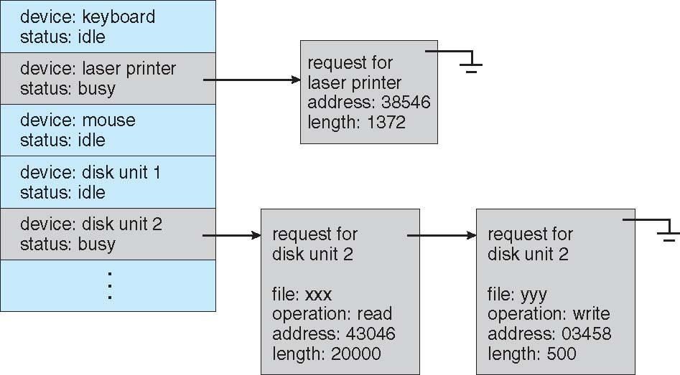
Device status table
When a kernel supports asynchronous I/O and might schedule requests in different orders, it must be able to keep track of many I/O requests

Slide 44
Buffering
Another way to improve performance → Use storage space in main memory or on disk via buffering, caching, spooling
Buffering
Buffer: memory area that stores data being transferred between two devices or between a device & an application.
Example:
  File received via modem for storage on the hard disk.
  Buffer created in main memory to accumulate the bytes received from the modem.
  Buffer full → write data on the disk
  Disk write not instantaneous: two buffers are needed → Double buffering

Slide 45
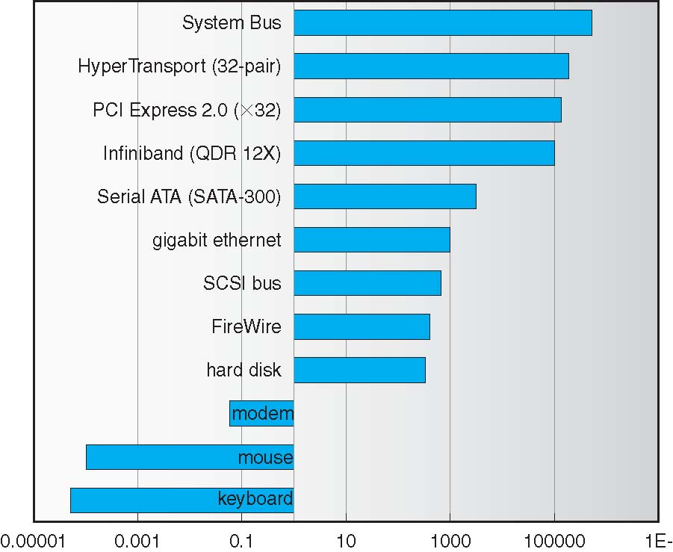
Buffering – Differences in device speeds
Enormous differences in device speeds for typical hardware!
Sun Enterprise 6000 device-transfer rates (logarithmic)

Slide 46
Caching – Spooling
Caching
Cache: holds a copy on faster storage of an item that resides elsewhere
Easier access → Key to performance
Spooling
Hold output for a device
If device can serve only one request at a time (e.g. printing)
Devices that cannot accept interleaved data streams.

Slide 47
Error Handling
Error Handling
Devices and I/O transfers can fail in many ways.
  Transient reasons: a network becomes overloaded
  Permanent reasons: a disk controller becomes defective
OS can recover from disk read, device unavailable, transient write failures
Most return an error number or code when I/O request fails
System error logs hold problem reports

Slide 48
I/O Protection
Necessary: User access may attempt to disrupt normal operation via illegal I/O instructions.
All I/O instructions defined to be privileged → Users cannot issue them directly
To do I/O a user program executes a system call
OS checks if request is valid
If yes it is executed.
Memory-mapped & I/O port memory locations must be protected
Notes:
Can say that this should sound familiar…
This is familiar, priviledged instructions are something related to I/O too… for protection / fairness and also for performance (indirectly)

Slide 49
Agenda
Introduction
I/O Hardware
Application I/O Interface
Kernel I/O Subsystem
Performance

Slide 50
Performance
I/O has a major impact in system performance:
Why?
  Places heavy demands on CPU to execute device-driver code
  I/O completion and blocking interact with process scheduling
  Interrupt handling and kernel entry/exit add overhead; an interrupt may also lead to a process context switch if it causes the scheduler to run and select a different process.
  …

Slide 51
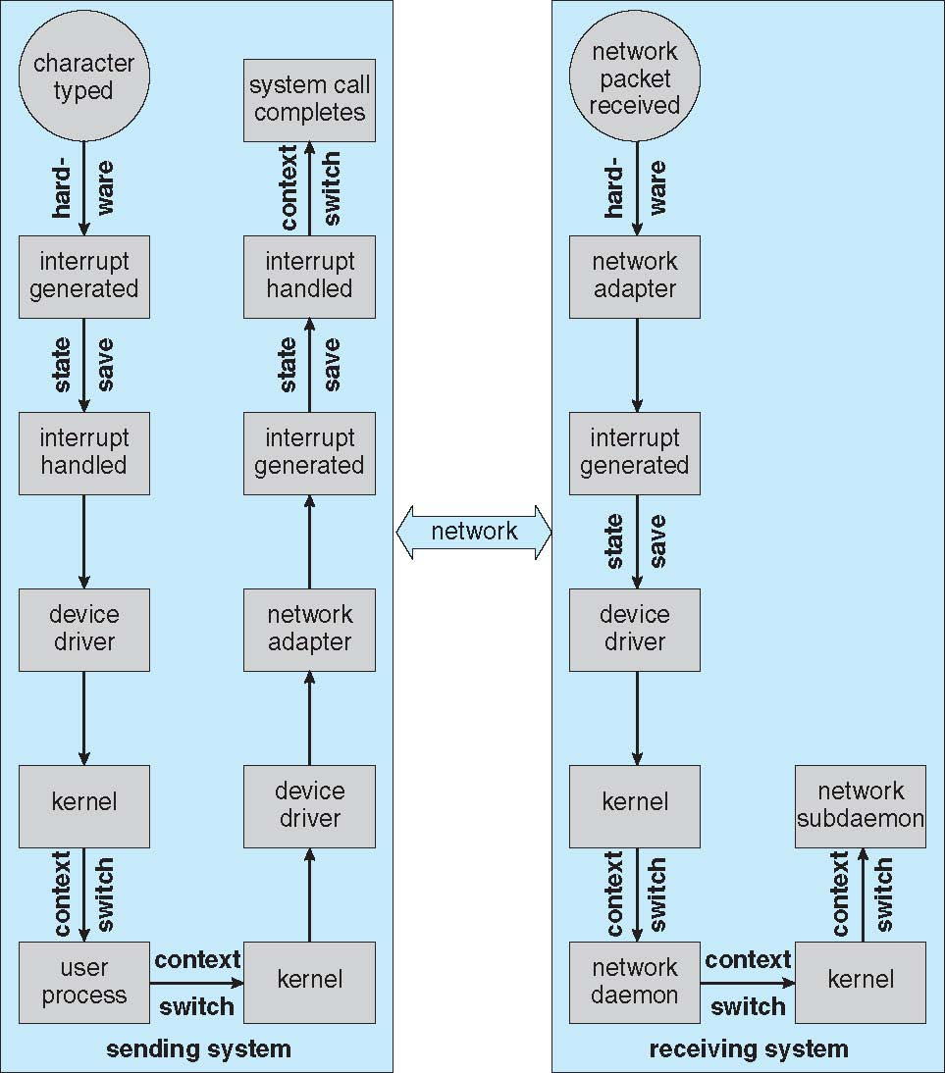
Example of performance: remote login

Slide 52
How to improve performance?
Reduce the number of process context switches
Reduce the number of times data must be copied in memory (between device & application)
Reduce frequency of interrupts
Use large transfers, smart controllers
Use DMA
Balance CPU, memory, bus and I/O performance for highest throughput

Slide 53
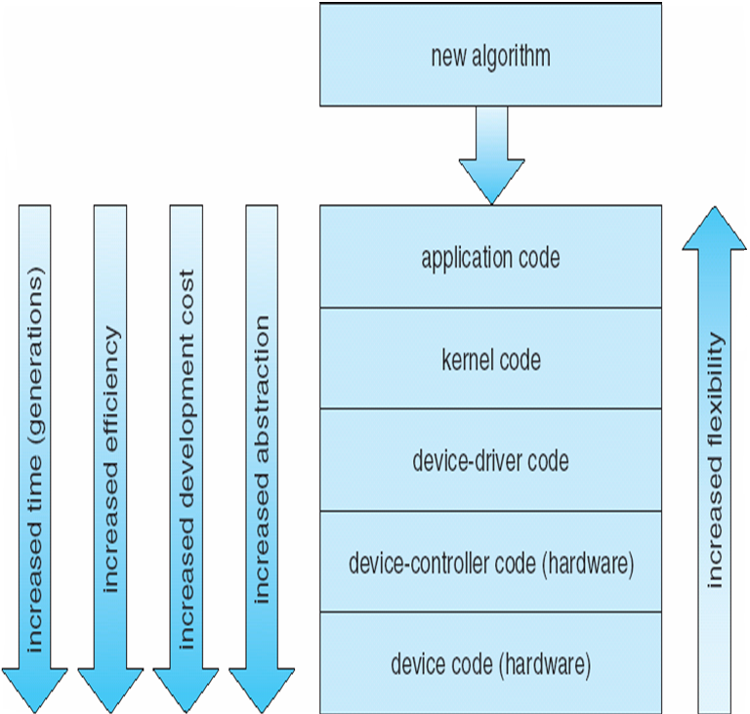
Performance
Notes:
Imagine what happens if you find a bug in the hardware
We can start with application code and then go into lower and lower levels… although it will always take more time and become more challenging (and dangerous in case of errors)

Slide 54
Questions

Slide 55
When using memory-mapped I/O...
The same address can be shared for RAM and I/O device
The same address cannot be shared for RAM and I/O device
Notes:
1 and 2, depends on the interpretation of the question

Slide 56
The address of an interrupt is used to...
Detect if the interrupt is maskable or not
select its interrupt-handling routine
Notes:
2

Slide 57
2 page faults interrupts can be served in parallel by the same interrupt-handling routine
Yes
No
Notes:
1
The answer in the notes (“Yes”) is not unconditionally correct. On one CPU, two handlers cannot literally execute in parallel. On a multicore system, the same reentrant handler code may execute concurrently on different CPUs using separate stacks/state.
NOTE: THE QUESTION ASK PARALLEL! CONCURRENTLY IS DIFFERENT (AND THEY CAN)

Slide 58
Direct memory access (DMA)...
reduces the number of interrupts
allows for data transfer without the need of interrupts
Notes:
1
The intended answer is 1, but option 2 can also be true in a system that polls for DMA completion instead of using an interrupt.

Slide 59
A page fault could be directly handled by the MMU via DMA. What do you think?
why not?
not really...
Notes:
2

Slide 60
The I/O completion order for device D can differ from how PCBs are sorted in D waiting queue
Yes
no
Notes:
1
NOTICE THIS IS A SIMPLIFICATION, THERE CAN BE TWO REQUESTS FROM THE SAME PROCESS, SO JUST 1 PCB IS NOT ENOUGH, WE ARE SIMPLIFYING

