Slide 1


Operating Systems – EDA093/DIT401
Course Introduction
Vincenzo Gulisano vincenzo.gulisano@chalmers.se

Slide 2
Agenda
Main textbook
Why study Operating Systems?
What is this course about?
What is this course NOT about?
Best practices

Slide 3
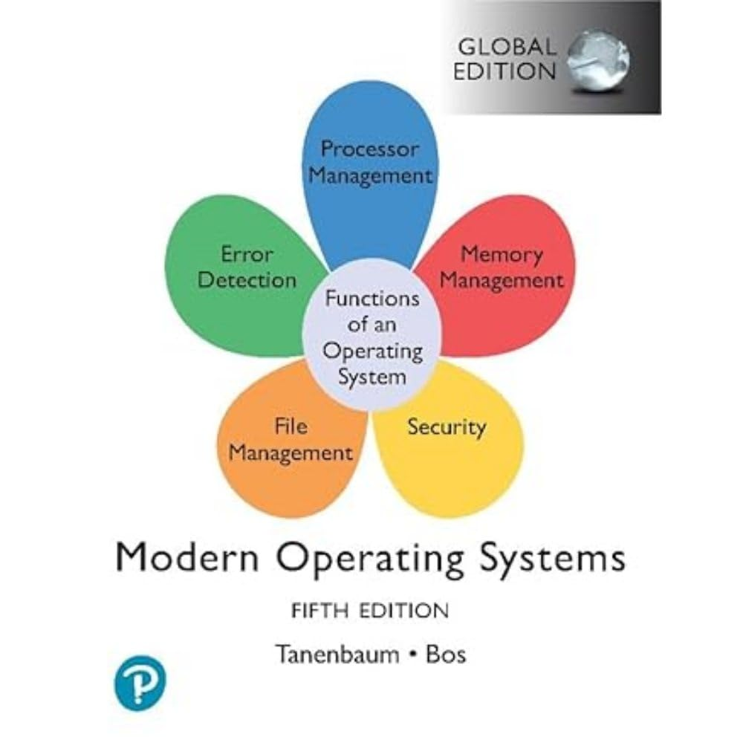
Main textbook
Modern Operating Systems by Andrew S. Tanenbaum (fifth edition)

Slide 4
Agenda
Main textbook
Why study Operating Systems?
What is this course about?
What is this course NOT about?
Best practices

Slide 5
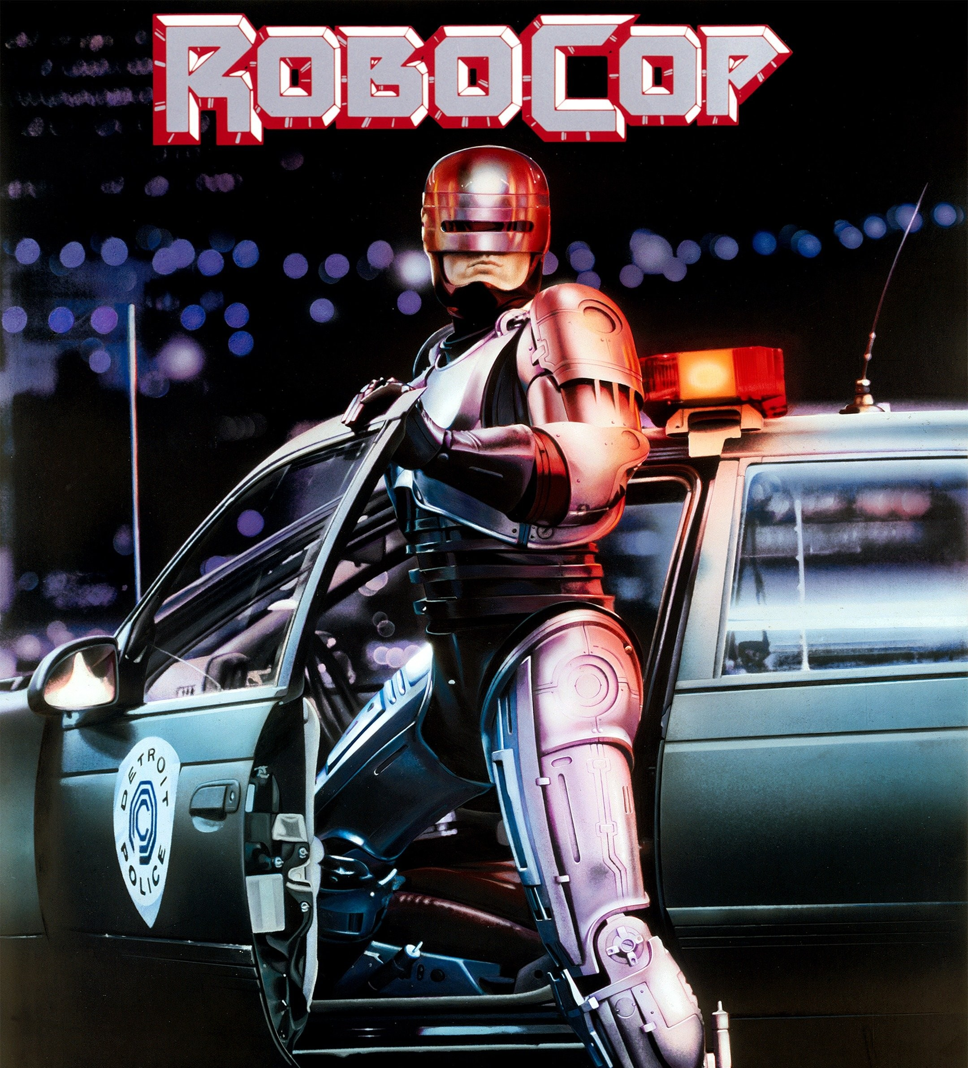
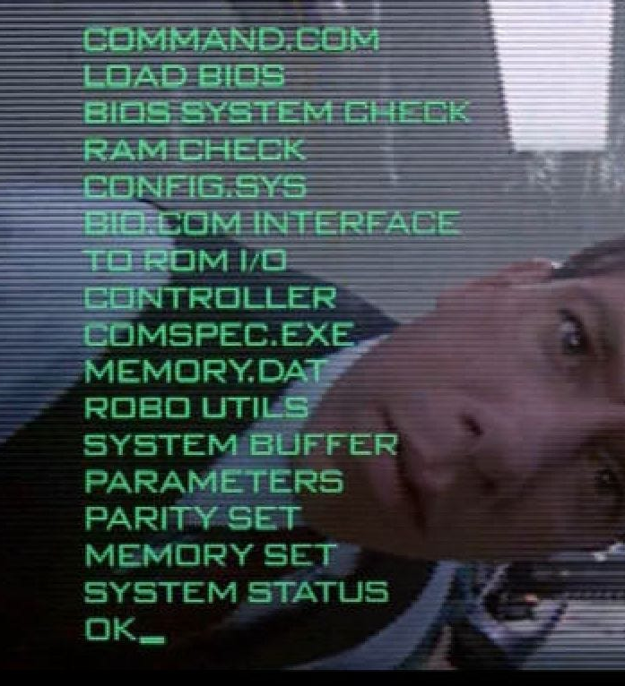
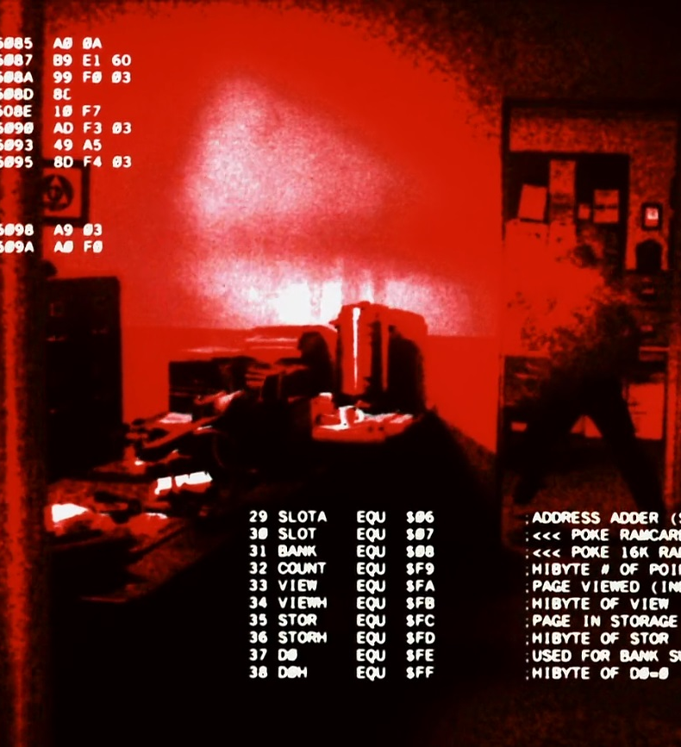
Why study Operating Systems?
Where there are computers, there are operating systems…
Notes:
Probably one of the first courses in which you can see how many things exist and interconnect in large pieces of software.
And that many times these interconnected modules create interesting trade-offs

Slide 6
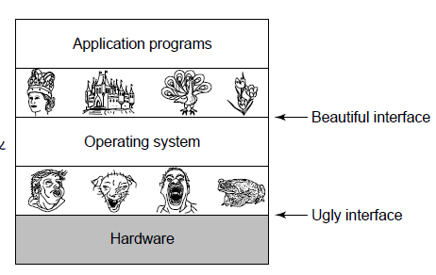
Why study Operating Systems?
Provides services to system users
“Shields” the user from the hardware
Resource manager:
CPU(s)
memory
I/O devices
….
Picture source: Modern OS, by A. Tanenbaum

Slide 7

Why study Operating Systems?
To learn about system functionality and design
performance vs. simplicity, HW vs. SW, etc.
To learn how to manage complexity through appropriate abstractions
again: Because computers and OSs are everywhere!

Slide 8
Agenda
Main textbook
Why study Operating Systems?
What is this course about?
What is this course NOT about?
Best practices

Slide 9
What is this course not about?

Slide 10

What is this course not about?
Learn how to use Windows
Learn how to use Linux
Learn how to use OS X
Learn how to program in C

Slide 11
What is this course about, then?

Slide 12
Content of the course:
Introduction / System Structures
Processes / Threads
Multithreaded Programming
Process scheduling
Synchronization
Deadlocks
Memory Management
Virtual Memory
File Systems
I/O Systems
Security / Protection
Virtualization
Notes:
Do not get scared! I will just go quickly over these things… and we will look at them again then the course finishes, then you will see everything makes sense

Slide 13
Agenda
Main textbook
Why study Operating Systems?
What is this course about?
What is this course NOT about?
Best practices

Slide 14
Best Practices
Participate to lectures, exercise sessions and labs
Ask when something is not clear
Ask when you have some doubt about what is being discussed
Study at pace with classes, do the labs in time
Use the book and other material
Read the book
Try the exercises in the book
Be nice to future generations
Provide feedback
Evaluate the course!!!
Check the updates in the Canvas page
Look at messages in Canvas
FAMILIARIZE YOURSELF WITH UNIX – WITH GIT – WITH GITHUB

Slide 15
Best Practices
Do you know what this is?
ls
mv filename1 filename2
chmod options filename
man commandname
ls -l | grep "Aug" | sort -n
Install a virtual machine (e.g., Virtual Box) → Install Unix OS (e.g., Ubuntu) → start playing with commands and system calls

Slide 16
Thank you for your attention!
Questions?

