Slide 1


Synchronization - Part 2 Operating Systems – EDA093/DIT401 Vincenzo Gulisano vincenzo.gulisano@chalmers.se

Slide 2
What to read (Main textbook) - Both for part 1 and part 2
Chapter 2.4.1-2.4.6, 6.1-6.2, 6.5-6.6, 6.7.3-6.7.4;
Quicker reading, for awareness, of sections 2.3.7-2.3.9, 2.3.11, 6.3

Slide 3
Agenda
Bounded-buffer producer/consumer
Resource allocation, deadlocks, and necessary conditions for deadlocks
Dining philosophers
without circular wait
without no-preemption
without hold-and-wait
Lamport’s bakery algorithm
Readers/Writers problem
OS as arbitrator for deadlock avoidance/recovery
Notes:
Bounded-buffer producer/consumer → can connect to pipes, to glue a bit things together

Slide 4
Agenda
Bounded-buffer producer/consumer
Resource allocation, deadlocks, and necessary conditions for deadlocks
Dining philosophers
without circular wait
without no-preemption
without hold-and-wait
Lamport’s bakery algorithm
Readers/Writers problem
OS as arbitrator for deadlock avoidance/recovery

Slide 5


the Bounded buffer producer-consumer problem
Using: primitives
R/W variables
RMW variables
Semaphores, etc.
…
Construct: objects / solve specific synchronization problems
2 thread CS, n-thread-CS
Producer-consumer (bounded buffer)
Dining philosophers
Transactions
…
Notes:
Starting with this lecture, we are going to discuss classic synchronization problems.
The first such problem is the bounded-buffer producer/consumer problem.
[c] Just a reminder: what we are trying to do here is to study/discuss how we can use basic building blocks, synchronization primitives in this case, to compose applications that have certain semantics.

Slide 6
the Bounded buffer producer-consumer problem
Buffer with space for N items; accessing common entries is a critical section
Producer inserts items;
must wait if buffer full
Consumer removes items;
must wait if buffer empty
1 2 … N
P
A
X
B
Y
@
C
Solve this synch problem using semaphores
Notes:
So, for the bounded producer-consumer buffer, it looks like this.
We have one producer that wants to add items in a queue and a consumer that reads them.
As you can imagine, the queue itself is what we need to handle with care, inside the critical section. Why is that? because the producer must be sure there's space in the buffer before adding an element (it is a bounded buffer), and the consumer must be sure there's something in the buffer before reading it.
[c] Let’s try to find a solution for this critical section using semaphores

Slide 7
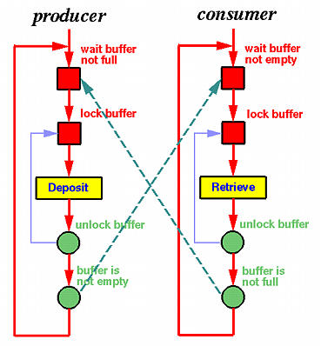
What synchronization do we need?
Producer inserts items; must wait if buffer full
Consumer removes items; must wait if buffer empty
Accessing the buffer is a critical section
Wait until buffer
has space;
Wait until buffer
has items;
buffer
has items;
buffer
has space;
Notes:
A way to put down such ideas is to draw a diagram like the following one. As you can see, each critical section of a thread is "wrapped" in a lock (this is just what we discussed before). The unlocking of the critical section of a thread precedes the locking of the critical section of any of the two threads.
For the producer, an extra wait should precede the locking of its critical section, because if the queue is full the thread has to wait.
For the consumer thread, a while loop should precede the locking of its critical section to make sure there are actually elements in the queue.
When can the producer exit the while? after the consumer removed an element. This can be signaled for sure after the consumer exits its critical section.
When can the consumer exit the while? after the producer added an element. This can be signaled for sure after the producer exits its critical section.

Slide 8
a solution to the Bounded buffer producer-consumer problem
Synchronization variables:
Binary semaphore mutex_sem initialized to 1
General semaphore buffer-has-items initialized to 0
General semaphore buffer-has-space initialized to N
Wait until buffer
has space;
Wait until buffer
has items;
producer
do {
// produce item
wait(buffer-has-space);
wait(mutex_sem);
// add item to buffer
signal(mutex_sem);
signal(buffer-has-items);
} while (TRUE);
consumer
do {
wait(buffer-has-items)
wait(mutex_sem);
// remove item from buffer
signal(mutex_sem);
signal(buffer-has-space);
// use the item
} while (TRUE);
buffer
has items;
buffer
has space;
Notes:
If you draw such a scheme, is then easier to come up with pseudocode like the following one. As for the previous lecture, take a moment later on and think about how to formally reason about the validity of this solution.

Slide 9
Agenda
Bounded-buffer producer/consumer
Resource allocation, deadlocks, and necessary conditions for deadlocks
Dining philosophers
without circular wait
without no-preemption
without hold-and-wait
Lamport’s bakery algorithm
Readers/Writers problem
OS as arbitrator for deadlock avoidance/recovery

Slide 10


Resource allocation
Structure of process/thread P
Repeat
Request resources (entry section)
critical section
Release resources (exit section)
remainder section
Forever
Processes/threads need resources (e.g., memory pages, printer, access to parts of shared data structure, etc.)
Our focus: reusable resources
a human analogy: process = go fishing; needed resources: boat, fishing-rod
A
B
Problem formulation:
A solution must provide the entry and exit sections
It must ensure:
Acquire/Release all the needed resources
Mutual Exclusion.
Progress: no deadlock
Fairness (e.g., Bounded Waiting , no starvation)
Notes:
After discussing the bounded buffer producer/consumer problem, let's move to resource allocation.
We are going to make a small, yet important change to our problem definition. In this new model, threads need to acquire multiple resources to complete a task.
[c] The new pseudocode for the model is shown in the slide.
[c] We still want to ensure mutual exclusion, progress, and fairness.
Pay attention to 2 aspects, though:
First, each thread needs to acquire all the resources it needs to proceed, not just part of them.
Second, to ensure progress we need to ensure threads cannot enter a deadlock state.
So, what is a deadlock?

Slide 11
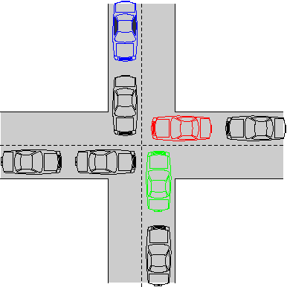
What is a deadlock?
A set of processes/threads blocking each-other so that none of them can proceed:
How can it occur?
Notes:
A set of processes/threads blocking each other so that none of them can proceed.

Slide 12
4 necessary conditions for Deadlock [Coffman et al 1971]
Theorem: all 4 conditions hold simultaneously when a deadlock occurs:
Boat ok, I
need the
rod
Mutual exclusion: only one process at a time can use a resource.
Hold and wait: a process holding some resource can request additional resources and wait for them if they are held by other processes.
No preemption: a resource can only be released by the process holding it, after that process has completed its task.
Circular wait: there exists a circular chain of 2 or more blocked processes, each waiting for a resource held by the next proc. in the chain
Rod ok; I
need the
boat
A
B
Notes:
Can we have some formal reasoning about what could cause a deadlock? Luckily yes. Coffman, back in 1971, proved that for a deadlock to happen, all the following conditions need to hold simultaneously:
mutual exclusion is enforced.
A process or thread that already holds one resource can ask for a second resource and wait for it without releasing the resource it already holds (this is called hold and wait)
There is no preemption: a resource can only be released by the process/thread that holds it
and there is a circular wait: a circular chain of 2 or more blocked processes/threads each waiting for a resource held by the next process/thread in the chain

Slide 13
4 necessary conditions for Deadlock [Coffman et al 1971]
Theorem: all 4 conditions hold simultaneously when a deadlock occurs:
Boat ok, I
need the
rod
Mutual exclusion: only one process at a time can use a resource.
Hold and wait: a process holding some resource can request additional resources and wait for them if they are held by other processes. → GET ALL RESOURCES AT ONCE
No preemption: a resource can only be released by the process holding it, after that process has completed its task. → THREADS RELEASE RESOURCES IF THEY MANAGE TO GET SOME BUT NOT ALL
Circular wait: there exists a circular chain of 2 or more blocked processes, each waiting for a resource held by the next proc. in the chain. → ACQUIRE RESOURCES IN A CERTAIN ORDER
Rod ok; I
need the
boat
A
B
Notes:
Knowing that these 4 conditions need to hold simultaneously implies that by removing one of them, then we can prevent deadlocks.
Of course, we cannot remove the mutual exclusion, ensuring it is our goal, but we can eliminate one of the other 3.
We can eliminate the circular wait by making sure that resources are acquired in a certain order.
We can eliminate the non-preemption, by having a thread releasing a resource if it cannot get the next one.
Or, we can eliminate the hold and wait, making sure a thread either gets all its resources at once or none of it.

Slide 14
Agenda
Bounded-buffer producer/consumer
Resource allocation, deadlocks, and necessary conditions for deadlocks
Dining philosophers
without circular wait
without no-preemption
without hold-and-wait
Lamport’s bakery algorithm
Readers/Writers problem
OS as arbitrator for deadlock avoidance/recovery

Slide 15
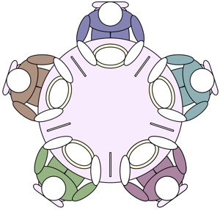
Dining philosophers [Dijkstra65]
n philosophers (processes); each philosopher P_{i}, when hungry, needs both left & right chopstick, in order to eat
Structure of process/thread P
Repeat
Request resources (left + right chopstick)
eat
Release resources (left + right chopstick)
think
Forever
Notes:
Now that we have discussed deadlocks, let's look at a classic problem that, if not properly handled, can lead to deadlocks.
I'm calling this the chopstick-variation of the dining philosophers' problem; the original problem has been introduced by Dijkstra.
[c] Suppose we have n philosophers (they represent our threads) and n chopsticks.
Each philosopher would like to eat, but to do so he/she needs 2 chopsticks, the one on their left side and the one on their right side.
Once a philosopher gets both chopsticks, others of course cannot use the same chopsticks used by the philosopher.
If you reflect about it, you will see that if we have 2 philosophers only one can eat at a time, if we have 3 philosophers only 1 can eat at a time, if we have 4 philosophers than 2 can eat in parallel (but they cannot be adjacent ones), and so on.
So, can this setup lead to deadlock if our algorithm is poorly designed?

Slide 16
Dining philosophers: pick-left-then-right approach
Shared var c[0..n-1]: bin-semaphore // one for each chopstick; init all 1
P_{i}:
do
Wait c[i]; // pick left chopstick
Wait c[(i+1) mod n]; // pick right chopstick
// Eat
Signal c[i]; // leave left chopstick
Signal c[(i+1) mod n]; leave right chopstick
// Think
forever
Recall the requirements:
Mutual exclusion: each resource is used by only one process at a time
Progress: no deadlock
Fairness: FCFS, or no starvation, or other fairness formulation
Notes:
Let's have a look and let us consider the following solution, which we call pick-left-and-then-pick-right.
[c] The first thing we have to do is to check if the mutual exclusion property is satisfied or not. I leave this to you as a homework (again, reason formally about whether the property is satisfied or not).

Slide 17
Dining philosophers: pick-left-then-right approach
Shared var c[0..n-1]: bin-semaphore // one for each chopstick; init all 1
P_{i}:
do
Wait c[i]; // pick left chopstick
Wait c[(i+1) mod n]; // pick right chopstick
// Eat
Signal c[i]; // leave left chopstick
Signal c[(i+1) mod n]; leave right chopstick
// Think
forever
Hold and wait
No preemption
Notes:
The second thing we want to check is whether deadlocks can occur.
From our previous discussion, if mutual exclusion, hold and wait, no preemption and circular wait can happen simultanously, then deadlocks can occur.
Hopefully, you have found out that mutual exclusion is satisfied.
[c] Do we have hold and wait? Yes, if a philosopher manages to get the left chopstick, then the philosopher will not release it until he/she manages to get the right chopstick too.
[c] Do we have no preemption? Yes, 2 chopsticks are released by the same philosopher that manages to get them once the philosopher completes its critical section.

Slide 18

Dining philosophers: pick-left-then-right approach
Shared var c[0..n-1]: bin-semaphore // one for each chopstick; init all 1
P_{i}:
do
Wait c[i]; // pick left chopstick
Wait c[(i+1) mod n]; // pick right chopstick
// Eat
Signal c[i]; // leave left chopstick
Signal c[(i+1) mod n]; leave right chopstick
// Think
forever
c[0]
I got c[1],
I want c[0]
Hold and wait
A
B
I got c[0],
I want c[1]
No preemption
c[1]
Notes:
Do we have circular waits? Indeed, as shown in this slide.
Hence, this solution is not valid, it can lead to a deadlock.
In this slide the arrow from the philosopher to the chopstick means the philosopher is waiting for the chopstick. The arrow from the chopstick to the philosopher means the philosopher got the chopstick.

Slide 19
Agenda
Bounded-buffer producer/consumer
Resource allocation, deadlocks, and necessary conditions for deadlocks
Dining philosophers
without circular wait
without no-preemption
without hold-and-wait
Lamport’s bakery algorithm
Readers/Writers problem
OS as arbitrator for deadlock avoidance/recovery

Slide 20
Dining philosophers: pick-one-at-a-time without circular wait
Shared var c[0..n-1]: bin-semaphore // one for each chopstick; init all 1
P_{i} (except P_{n-1}):
do
Wait c[i]; // pick left chopstick
Wait c[(i+1) mod n]; // pick right chopstick
// Eat
Signal c[(i+1) mod n]; leave right chopstick
Signal c[i]; // leave left chopstick
// Think
forever
Shared var c[0..n-1]: bin-semaphore // one for each chopstick; init all 1
P_{n-1}:
do
Wait c[(i+1) mod n]; // pick right chopstick
Wait c[i]; // pick left chopstick
// Eat
Signal c[i]; // leave left chopstick
Signal c[(i+1) mod n]; leave right chopstick
// Think
forever
Notes:
So, let's try then to modify our solution so that we can avoid deadlocks.
As we discussed before, as long as we make sure one of the following things cannot happen: hold and wait, no preemption or circular wait (I am of course excluding mutual exclusion!) then we are done.
Can we prevent circular wait from happening?
[c] This is not difficult, let's look at a solution we call the request-resource-in-order.
The idea is simple, we only change the code executed by the last philosopher, so that he/she tries to take the right chopstick first and the left chopstick after that.
Let's argument why we cannot have a circular wait in this case.

Slide 21
Dining philosophers: pick-one-at-a-time without circular wait
c[0]
Shared var c[0..n-1]: bin-semaphore // one for each chopstick; init all 1
P_{i} (except P_{n-1}):
do
Wait c[i]; // pick left chopstick
Wait c[(i+1) mod n]; // pick right chopstick
// Eat
Signal c[(i+1) mod n]; leave right chopstick
Signal c[i]; // leave left chopstick
// Think
forever
Shared var c[0..n-1]: bin-semaphore // one for each chopstick; init all 1
P_{n-1}:
do
Wait c[(i+1) mod n]; // pick right chopstick
Wait c[i]; // pick left chopstick
// Eat
Signal c[i]; // leave left chopstick
Signal c[(i+1) mod n]; leave right chopstick
// Think
forever
P₀
P₁
c[1]
Notes:
I am for simplicity assuming we only have 2 philosophers here, but you can extend this reasoning to 3 or more philosophers.
Philosopher 0 takes chopstick 0 and then 1, Philosopher 1 takes chopstick 0 and then 1.
[c] Let's say Philosopher 0 waits for chopstick 0, because [c] philosopher 1 has it. If philosopher 1 has chopstick 0 and Philosopher 0 also waits for chopstick 0, [c] then Philosopher 1 can get chopstick 1 and eat.

Slide 22
Dining philosophers: pick-one-at-a-time without circular wait
c[0]
Shared var c[0..n-1]: bin-semaphore // one for each chopstick; init all 1
P_{i} (except P_{n-1}):
do
Wait c[i]; // pick left chopstick
Wait c[(i+1) mod n]; // pick right chopstick
// Eat
Signal c[(i+1) mod n]; leave right chopstick
Signal c[i]; // leave left chopstick
// Think
forever
Shared var c[0..n-1]: bin-semaphore // one for each chopstick; init all 1
P_{n-1}:
do
Wait c[(i+1) mod n]; // pick right chopstick
Wait c[i]; // pick left chopstick
// Eat
Signal c[i]; // leave left chopstick
Signal c[(i+1) mod n]; leave right chopstick
// Think
forever
P₀
P₁
c[1]
Notes:
Let's say Philosopher 1 waits for chopstick 1[c], then it managed to get chopstick 0[c] . [c] But if it has chopstick 0 then philosopher 1 cannot have chopstick 1, which means philosopher 1 can eat.
Once we have proven this solution cannot lead to a deadlock, the next step is to reason about fairness.
Here, it is probably easy to see that the solution might lead to the same philosopher being the one that manages to get both chopsticks over and over... (as before, try to reason formally about this!). A solution to this problem could be given by having the semaphores implementing some fairness mechanism, delivering the signals to both philosophers.

Slide 23
Agenda
Bounded-buffer producer/consumer
Resource allocation, deadlocks, and necessary conditions for deadlocks
Dining philosophers
without circular wait
without no-preemption
without hold-and-wait
Lamport’s bakery algorithm
Readers/Writers problem
OS as arbitrator for deadlock avoidance/recovery

Slide 24

Idea: when the second resource is not available, release the first one and retry
Dining philosophers: Fight the no-preemption
shared var c[0..n-1]: of type chopstick_struct { // one for each chopstick
s: bin-semaphore // init 1
available: boolean //init true
}
trylock(c: chopstick_structure):
wait(c.s)
if c.available then {
c.available := false
ret:= true }
else
ret:= false;
signal(c.s)
return(ret)
P_{i}:
local var holding_both_chopsticks: boolean;
repeat
while (not holding_both_chopsticks) {
lock(c[i])
if !trylock(c[(i+1)%n]) then release(c[i])
else holding_both_chopsticks := true }
// Eat
release(c[i])
release(c[(i+1)%n])
holding_both_chopsticks := false
// Think
forever
lock(c : chopstick_structure):
repeat
until (trylock(c))
release(c : chopstick_structure):
wait(c.s)
c.available := true
signal(c.s)
Notes:
Let's try now to modify our solution by taking down the no preemption case.
The idea behind what we are going to see next can be summarized as follows: If a philosopher does not manage to get the chopstick on the right, then he/she releases the chopstick on the left.
This is how the solution looks like. Let's first introduce some data structures and methods.
[c] We define the type chopstick_structure so that it contains a binary semaphore initialized to 1 and a boolean variable called available initialized to true (which means that at the very beginning of the execution each chopstick_structure is available).
[c] We then define the trylock method so that, when passed a chopstick_structure the first thing it does is to wait on its binary semaphore.
[c] After the wait, if the chopstick is available, it sets the variable to false and stores true as return value, otherwise it stores false as return value. Finally, it sends a signal on the chopstick's binary semaphore and returns the return value.
[c] The lock method simply enters a loop in which it stays until trylock returns true (i.e., when it finds the chopstick to be available).
[c] The release waits on the binary semaphore. Then, it sets the available variable to true and signals the binary semaphore.
[c]
We can now look at the solution as a whole. In their entry section, the threads define a while loop. The loop goes on as long as a local variable called holding_both_chopsticks is false.
Inside the loop, the thread tries to lock the first chopstick. Based on the method we have introduced, it means it keeps running trylock as longs as it does not find the available variable of the chopstick it is trying to lock set to true.
After that, it runs trylock on the second chopstick. If try lock returns true, then the chopstick available variable was true, and the thread sets holding_both_chopsticks to true, exits the loop, and enters the critical section.
Otherwise, the thread releases the other chopstick.
After the critical section, each thread/philosopher runs release on both chopsticks and sets holding_both_chopsticks to false.
Then, the thread/philosopher enters the remainder section, in which he/she can think instead of eating.
If you look at this solution carefully, you can see a thread enters its critical section only if both chopsticks are available and, when a thread finds the first chopstick to be availalbe but not the second one, the first is set to available again, which means in the next iteration of loop the thread will try again to get both chopsticks.

Slide 25
Dining philosophers: Fight the no-preemption
P_{i}:
local var holding_both_chopsticks: boolean;
repeat
while (not holding_both_chopsticks) {
lock(c[i])
if !trylock(c[(i+1)%n]) then release(c[i])
else holding_both_chopsticks := true }
// Eat
release(c[i])
release(c[(i+1)%n])
holding_both_chopsticks := false
// Think
forever
Mutual exclusion: ok
Progress: no deadlock … but livelock is possible!
Fairness: a process can starve…
Notes:
This solution is valid when it comes to mutual exclusion, and it also avoids deadlocks.
It has 2 downsides, still. One is that a process can starve, since one process X could be the one that is always managing to get both chopsticks.
The other downside is that, while preventing deadlocks, this algorithm does not prevent livelocks.
We have not discussed livelocks in details, but I just want to draw your attention on the fact that if there are two processes and if both processes do not manage to get the second chopstick it might happen that in some execution order (imagine the two processes are concurrently being executed on the same CPU) they both release the other chopstick and try again, and this try and retry can go on for an unbounded number of times.

Slide 26
Agenda
Bounded-buffer producer/consumer
Resource allocation, deadlocks, and necessary conditions for deadlocks
Dining philosophers
without circular wait
without no-preemption
without hold-and-wait
Lamport’s bakery algorithm
Readers/Writers problem
OS as arbitrator for deadlock avoidance/recovery

Slide 27
Idea: philosophers agree on who eats next instead of who gets a chopstick
Dining philosophers: Fight the hold-and-wait
shared var semaphore S[0 .. n-1] // init all 0
shared var semaphore mutex // init 1
shared var state[0 .. n-1] in {HUNGRY, THINKING,EATING}
P_{i}:
do
// think
enterCS(i) // i.e., get both chopsticks
// eat
exitCS(i) // i.e., leave chopsticks
forever
help(k)
if state[k] ==HUNGRY &&
state[(k-1) mod n] != EATING &&
state[(k+1) mod n] != EATING
then {state(k) := EATING ; signal(S[k]) }
enterCS(i)
wait(mutex)
state(i) := HUNGRY
help(i)
signal(mutex)
wait(S[i])
exitCS(i)
wait(mutex)
state(i) := THINKING
help((i-1) mod n)
help((i+1) mod n)
signal(mutex)
Notes:
The third way to fight deadlocks that is left is to avoid the hold and wait.
Simply put, we can devise a solution in which philosophers agree on who is going to eat next rather than on who gets a certain chopstick.
You have such an approach presented here: we have one semaphore per philosopher, an extra semaphore called mutex, and an array of size n of states. One state can either be HUNGRY, THINKING, or EATING.
To enter and exit the critical section we have two methods: enterCS and exitCS.
In the enterCS method, each philosopher waits on the shared mutex variable. In other words, only one philosopher at a time can run the following two instructions, which change his/her state to HUNGRY and call the help method.
After calling signal on mutex, the philosopher running the entryCS method starts waiting for a signal on its entry of the S array.
So, how does the help function work? Only if the philosopher invoking it is hungry and his/her neighbors are not eating, then it changes the state of the philosopher invoking it to eating and sends a signal to it.
Notice that since help runs in between a wait and signal on the shared variable mutex, if multiple neighboring philosophers try to change their state from HUNGRY to EATING, only one manages to do so.
Once a philosopher is done eating, then he/she runs the exitCS method. Again, the relevant instructions are run inside a wait/signal on the shared variable mutex.
In this case, the philosopher sets his/her state to THINKING and then helps his/her neighbors, trying to send them a signal they can use to enter their critical section (assuming they indeed want to).

Slide 28
Dining philosophers: Fight the no-preemption
Mutual exclusion: ok
Progress: no deadlock
Fairness: a process can starve…
If you are interested in a solution with fairness too: https://dl.acm.org/doi/pdf/10.1145/62546.62567?casa_token=4uO24jxkwEAAAAAA:jJlAILeISZe5Uu2ERv6O-dTq_0LbSmRpv0beOZ_3vDi50otRS-_HqB30GoWDib1zVQ9jjrhx4w0
Notes:
This solution is valid when it comes to mutual exclusion, and it also avoids deadlocks.
nonetheless, a process can starve.
As done before, try to reason formally about these properties.
If you are interested in a solution that also ensures fairness, you can find a paper discussing it in the attached link.

Slide 29
Agenda
Bounded-buffer producer/consumer
Resource allocation, deadlocks, and necessary conditions for deadlocks
Dining philosophers
without circular wait
without no-preemption
without hold-and-wait
Lamport’s bakery algorithm
Readers/Writers problem
OS as arbitrator for deadlock avoidance/recovery

Slide 30

Critical section for n threads:
Lamport’s bakery algorithm
Idea: before entering its critical section, each thread gets a number. Holder of the smallest number enters the critical section.
Note: the decentralized scheme generates numbers in non-decreasing order; e.g., 1, 2, 3, 3, 4, 5, 5, 5, 6
If threads P_{i} and P_{j} choose the same number:
if i<j, then P_{i} goes first; else P_{j} goes first.
I.e., we use threads’ ids to break ties
Notes:
At this point we have seen that the critical section problem can be solved in several different ways. We are going to look into one more solution which has some extra nice property: the Lamport's Bakery algorithm.
Lamport is one of the recipients of the Turing award and came up with the following idea. Simply put: all the threads who want to enter a critical section need to get a number. The thread with the smallest number is the one that can enter. Imagine a take-a-number system, basically.
We assume the numbers given by the take-a-number system are non-decreasing. Non-decreasing means that two or more consecutive numbers can be the same. If we also assume each thread has a unique id, we can break ties saying that if two or more threads have the same number, the one with the smallest id can enter its critical section.

Slide 31
Lamport’s bakery algorithm
Shared var choosing: array [0..n – 1] of boolean (init fasle);
number: array [0..n – 1] of integer (init 0);
repeat
choosing[i] := true;
number[i] := max(number[0], number[1], …, number [n – 1])+1;
choosing[i] := false;
for j := 0 to n – 1 do begin
while choosing[j] do [nothing]; // spin
while number[j] ≠ 0 and (number[j],j) < (number[i], i) do [nothing]; // spin
end;
// critical section
number[i] := 0;
// remainder section
until false;
Why does it satisfy the 3 conditions:
Mutex (no 2 threads A and B in CS concurrently): Consider the time between A’s decision step and A’s entry to CS; A decided to move because:
B had higher number: when B checks , it will wait for A since A has smaller number
or B was not interested; when B gets interested, it will choose a number > A’s number, hence it will wait
Progress: the thread with the smaller number can proceed
Fairness: If A waits for B and B exits and wants to enter CS again, if A still waits, B will choose a number > A’s, number, hence B cannot bypass A
This is a more decentralized method than e.g., Peterson’s: no variable is “writable” by all threads
Notes:
Let's look at the complete example.
We have two shared arrays each with n elements (n is the number of threads).
The first array, choosing, contains booleans initialized to false.
The second array, number, contains integers initialized to 0.
In its entry section, thread i starts by setting true to its entry in choosing.
Then, it computes the max value for all entries in number plus 1 and stores it in its number entry.
Finally, it sets false to its entry in choosing.
Then, it does a complete pass over the n entries of the arrays, but it spins on each entry j if such an entry is choosing or if such an entry has a lower number,j combination but the number is not 0 (number,j combination because we use threads' ids to break ties).
Then it enters the section.
Once the critical section is over, the thread simply sets its number back to 0.
Before discussing why this solution is valid, please notice that each thread is only modifying its own entry in the array.
I ask you to formally reason about why this solution is valid, I am only doing a rapid discussion. For mutual exclusion, you can conclude that if a thread enters its critical section, then that thread is sure no other thread has a lower number. When the thread is in, can another thread obtain a lower number and enter the critical section? No, beacuse the number is always the max of all threads + 1, so it will be at least +1 compared to the thread that is running its critical section.
When it comes to progress, the thread with the smallest number can always proceed.
When it comes to fairness, notice that once a thread starts waiting and another enters its critical section, the next number the latter will get is higher than that of the waiting thread.

Slide 32
Agenda
Bounded-buffer producer/consumer
Resource allocation, deadlocks, and necessary conditions for deadlocks
Dining philosophers
without circular wait
without no-preemption
without hold-and-wait
Lamport’s bakery algorithm
Readers/Writers problem
OS as arbitrator for deadlock avoidance/recovery

Slide 33

Readers/Writers problem
Writers write; must wait if some writer or reader is accessing the shared data object (i.e., only one writer is allowed to write at a time)
Readers read; must wait if some writer is accessing the shared data object (i.e., multiple readers are allowed to read at a time but not concurrently with any writer)
W₁
R₁
Shared data object, e.g., a file
…
…
W_{m}
R_{n}
Solve this synch problem using semaphores; we require 1. the safety properties mentioned here; 2. progress
Notes:
After looking at Lamport's bakery algorithm, let's move to a slightly different problem, that of the readers and writers. In this case, we have multiple entities accessing a shared resource, but such entities are of different types and we have different safety properties associated with them.
Both writers and readers are trying to access a shared resource, for instance, a file.
Only one writer at the time can write to such a resource.
Multiple readers are allowed to read at the same time, but not concurrently with writers.
We are going to look at how we can solve this synchronization problem using semaphores.

Slide 34
Readers/Writers problem
R_{j}
Reader
if I am first in a batch of readers to check
wait until no one accesses the object (else others read, hence go on)
// READ
inform: no longer accessing the object
(… + if I am last in a batch of readers who read, tell that no one accesses the object …)
W_{i}
Writer
wait until no one accesses the object
// WRITE
no longer / no one accessing the object
Notes:
If we try to visualize the dependencies between the entry and exit sections of writers and readers, it looks like this.
For the writer, the entry section needs to wait until no one accesses the shared object.
Once the critical section is over (i.e., the portion in which the writer writes to the shared resource), the exit section can send a signal about the fact that no one is accessing the object anymore, and such a signal can be consumed by both a writer or a reader.
For the reader, the entry section should first check if the reader is the first reader of a batch of readers that tries to access the shared resource. If that is the case, then the reader should wait. If other readers are already accessing the resource, then the reader can simply enter its critical section.
For the exit section, the reader should of course inform others it is done with its critical section. If the reader was the only one / the last one completing its critical section, then a signal should be sent for writers or for another batch of readers to enter their critical section.

Slide 35
Readers/Writers problem
W_{i}
R_{j}
shared var:
noone_accesses, protect_check: binary semaphore; // initially 1
rc: int ; // active readers counter, init 0
W_{i}
R_{j}
Writer
Repeat
wait(noone_accesses);
// WRITE
signal(noone_accesses)
forever
Reader
repeat
wait(protect_check); // CS to change and check rc variable
if rc++ == 1 then wait(noone_accesses) // “first” reader: block writers or wait if some of them writes
signal(protect_check);
// READ
wait(protect_check); // CS to change and check rc
if rc-- == 0 then signal(noone_accesses) fi // “last” reader: signals
signal(protect_check)
forever
Notes:
Let's now look at the pseudocode that uses semaphores according to these dependencies.
We have writers and readers sharing the following variables:
- two binary semaphores, noone_accesses and protect_check (notice that both are initially 1), and
- rc, readers counter, which is initially set to 0.
The writers simply protect their critical section by waiting on the noone_accesses variable (entry section) and sending a signal on the same variable (exit section).
The readers use the protect_check variable to make sure they consistently update the rc value.
In the entry section, the first reader that manages to increase it to 1 (i.e., the first reader of a batch) also waits on the noone_accesses variable (to synchronize with the writers).
In the exit section, the reader that sets rc to 0 (notice access to rc is also synchronized here using the protect_check variable among readers) also signals on the noone_accesses variable, so that a writer or another batch of readers can then enter the critical section.
As before, I suggest you try to have some formal reasoning about how this solution is correct, at least in terms of mutual exclusion and progress.
If you think about fairness, you can probably see that here readers are privileged over writers. Once a reader increases rc to 1, other readers can keep accessing their critical section an unbounded number of times. As long as rc is not set back to 0, writers cannot access the shared resource.

Slide 36
Agenda
Bounded-buffer producer/consumer
Resource allocation, deadlocks, and necessary conditions for deadlocks
Dining philosophers
without circular wait
without no-preemption
without hold-and-wait
Lamport’s bakery algorithm
Readers/Writers problem
OS as arbitrator for deadlock avoidance/recovery

Slide 37
Deadlock avoidance using the OS as arbitrator
Resource request & allocation is managed by the OS
Deadlock avoidance:
deadlock might be possible if resources are granted arbitrarily,
but OS uses extra info to grant requests and schedule processes so that it avoids deadlock
Banker’s algorithm[Dijkstra]
Notes:
In this last part of the lecture, let's focus on how the OS itself can act as an arbitrator to avoid deadlocks.
In the examples we have seen so far, all the threads trying to access shared resources sort of know each other, they share variables, they have clear roles (e.g., readers and writers), and so on. But the threads accessing resources on a computer might be unaware of which other threads are running, what resources the latter want to access, and so on...
In this sense, the OS needs to monitor everything that is happening and, if it detects that the requests of a thread could lead to a deadlock, do something about it, for instance, decide to schedule the execution of such a thread for later on.
We are going to introduce a model for this setup and also mention the Banker's algorithm (introduced by Dijkstra).

Slide 38
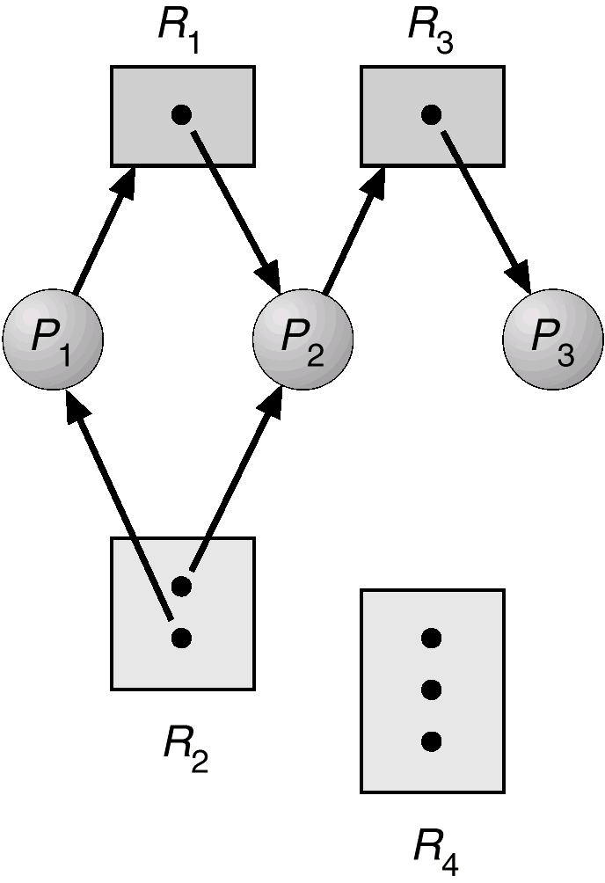
Deadlock avoidance by the OS: system model
Resource types R₁, R₂, . . ., R_{m}
e.g., CPU, memory space, I/O devices, files
each resource type R_{i} has W_{i} instances.
Resource-Allocation Bipartite Graph G(V,E)
nodes:
P = {P₁, P₂, …, P_{n}} the set of processes
R = {R₁, R₂, …, R_{m}} the set of resources types
edges:
request edge: P_{i} → R_{j}
If dotted: potential request
assignment edge: R_{j} → P_{i}
Notes:
Let's begin with the system model, which in this case relies on a graph.
In this graph, we have two types of vertexes: resources and processes (this is a bipartite graph).
A resource can refer to CPU, memory, I/O devices, and so on.
Each resource Ri has Wi instances
Since this is a graph, we also have edges. Each edge connects a Resource with a Process. If the edge/arrow starts at the process and ends at a Resource, it means the process is requesting the resource. If the edge/arrow starts at a resource and ends at a process, it means the resource is assigned to the process.
In the case of a request edge, we use a dashed line to differentiate an actual request from a potential request (i.e., a dashed line implies the process might request the resource but has not done yet).
In our model, besides knowing which resources and processes we have, and how many instances we have, we also know the maximum number of instances each process may need for a given resource.

Slide 39
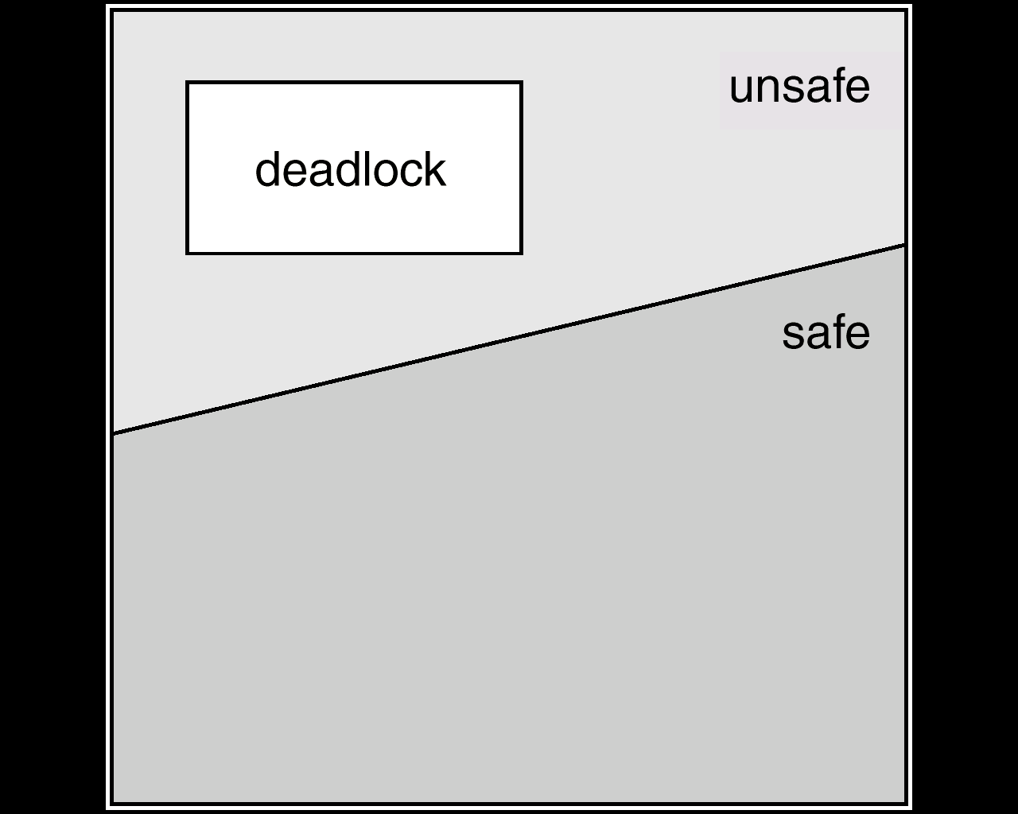
Deadlock avoidance using the OS as arbitrator
Deadlock-avoidance algo, run by OS:
examines the resource-allocation state…
Available, allocated resources
maximum possible demands of the processes.
…to ensure there is no potential deadlock:
unsafe state ⇒ deadlock might occur (i.e., later, if all procs request their maximum and no-one can be granted)
Avoidance = ensure that system will not enter an unsafe state, by suspending processes with risky requests, until enough resources are freed.
Notes:
When it comes to the OS, the idea is that the OS should be able to distinguish which portion of its decision space is safe and which is not (in other words, which decisions might lead to a deadlock). If, by deciding to give control to a certain process, the OS allows for such a process to request a resource instance that can lead to a deadlock, then what the OS can do is to instead suspend such a process, until enough resources are freed.

Slide 40
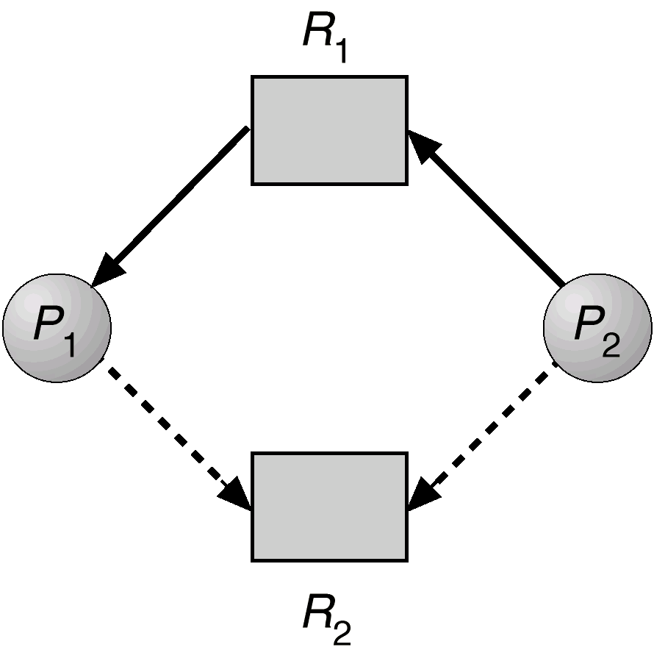
Deadlock avoidance by the OS: example
Example Safe State
Safe State
Example Unsafe State:
i.e., granting the P2-R2 request should not be made until P1 finishes
Notes:
Suppose for instance we are in this situation: processes P1 and P2 could be executed next. Currently, R1 has been given to P1 and P2 has requested R1. The OS also knows that both P1 and P2 might request R2. Which process is safe to run next? P1 or P2?
[c] If the OS decides to run P1, P1 might request and get R2, which is not leading to any deadlock (so from a safe state the OS switches to another safe state).
[c] If the OS decides to run P2, P2 might request and get R2, which in this case creates a circular loop, and this might mean deadlock (so from a safe state the OS switches to an unsafe state)
Based on these observations, the OS can decide to run P1 and maybe suspend P2 until such a situation can no longer happen.
So the order in which processes/threads are scheduled might also depend on possible deadlocks

Slide 41

Deadlock avoidance by the OS: banker’s algorithm
Avoidance = ensure that system will not enter an unsafe state.
Idea:
If potentially satisfying a request can result in an unsafe state // i.e., bank will have not enough to let its customers finish and return their loans in case someone requests its max needs
then the requesting process is suspended
until enough resources are free-ed // by processes that will terminate in the meanwhile
How to do the safety check efficiently?
Banker’s algo gives criterion that can be checked in linear time using the Max, Allocation, Available matrices
Max [i,j] = k:
P_{i} may request max k instances of R_{j}.
Allocation[i,j] = k:
Pi holds k instances of Rj
Available [j] = k:
k instances of Rj are still available.
Notes:
For the model we introduced, Dijkstra introduced an algorithm for resource allocation that can avoid deadlocks.
The idea is to maintain three data structures:
a matrix called max, that in each position i j contains the maximum number of instances process i can request for resource j
a matrix called allocation, that in each position i j contains the number of instances already allocated to process i of resource j
an array called available, that in position j contains the number of instances that are still available for resource j.
As mentioned before, the idea is to check whether potentially satisfying a request can lead to an unsafe state. How is the check done? By checking whether, by satisfying a request, the other processes can still obtain all the resources they might request or not. If that is the case, the request can be satisfied, otherwise, the requesting process is suspended until enough resources are free-ed.

Slide 42
Deadlock detection and recovery
If OS grants requests without checking safety upon every request
It can allow a deadlock state and when detected (e.g., through detection of cyclical waits), recover
Process Termination: Abort all or some deadlocked processes until deadlock is eliminated.
(2) Resource Preemption: Select victim and rollback – return to some safe state, restart process from that state
Must decide on selection criteria (cost, starvation risks, …)
Recovery is pretty expensive as a method ….
Notes:
Please notice that the OS has an alternative to prevent a deadlock from happening: that of being able to detect a deadlock as happened and then resolve it. In other words, the OS can decide to be reactive rather than proactive.
In that case, there can be two ways out. The first one is to terminate the process that has caused a deadlock. Eventually, once one or more processes are terminated, enough resources will be available and the remaining processes will be able to continue.
The second option is to select victim processes and rollback their execution, basically go back in their execution to a point in which the requests made by them did not result in a deadlock and start again their execution later on when more resources are available.
Usually, process recovery is a costly operation, which should be avoided to the extent possible. As always, nonetheless, the exact costs of each alternative (including both proactive and reactive ones) will depend on the specific case taken into account!

