Slide 1


Operating Systems – EDA093/DIT401 Concluding remarks
Vincenzo Gulisano vincenzo.gulisano@chalmers.se

Slide 2
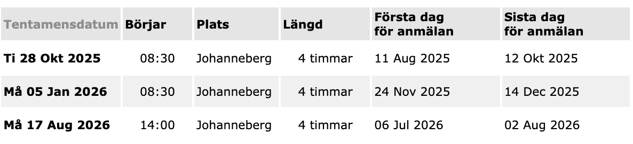
Important before the exam
You may only have a dictionary (English - Swedish – English)

Slide 3
Important before the exam
Summary study:
accompany your summary study with the notes received, exercises (those solved in class and others, incl. those in the hard-copy notes) and summary questions at the end of each book chapter
keep a critical eye in your overview study:
why is this so? how does it work?
How do the puzzle pieces fit together?
later: check OS web-page for news

Slide 4
Important before the exam
Check the reading instructions for the various parts

Slide 5
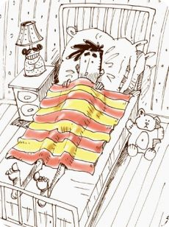
How do we address a challenge?
Like this!
Like this!
Or this!
Or this!
Maybe also like this…
Why not like this… mmm…

Slide 6
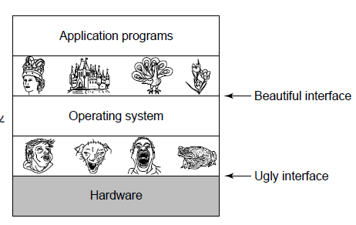
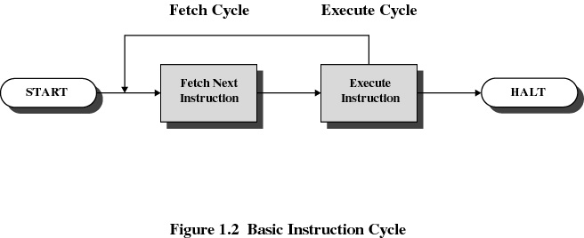
Introduction / System Structures
Processes / Threads
Multithreaded Programming
Process scheduling
Synchronization
Deadlocks
Memory Management
Virtual Memory
File Systems
I/O Systems
Security / Protection
Virtualization
Need to decouple Applications/Users from Hardware
… need to build upon a basic instruction cycle

Slide 7

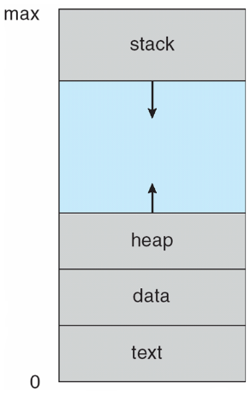
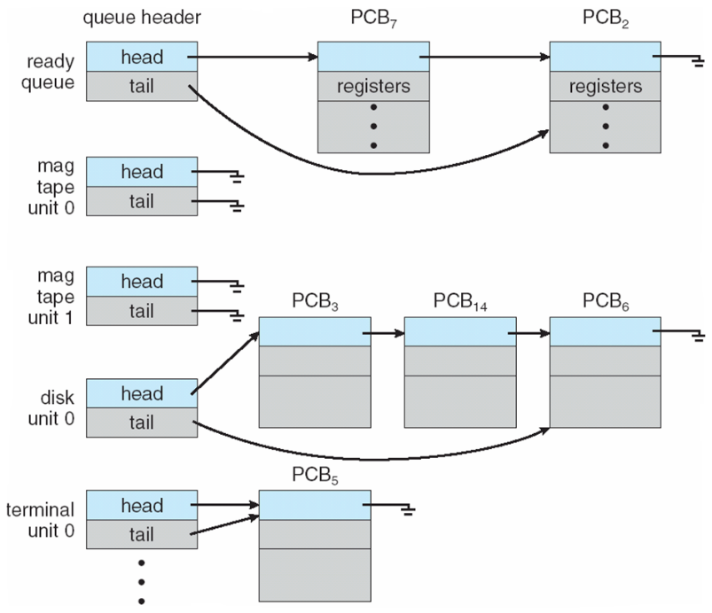
Need to maintain information about processes running in the OS
Need to switch between processes…
Introduction / System Structures
Processes / Threads
Multithreaded Programming
Process scheduling
Synchronization
Deadlocks
Memory Management
Virtual Memory
File Systems
I/O Systems
Security / Protection
Virtualization
Need to organize processes and devices

Slide 8
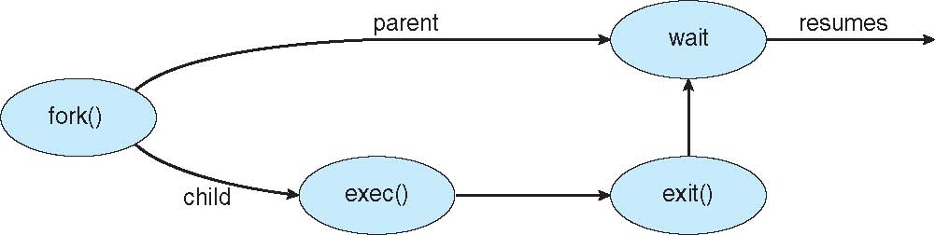
Introduction / System Structures
Processes / Threads
Multithreaded Programming
Process scheduling
Synchronization
Deadlocks
Memory Management
Virtual Memory
File Systems
I/O Systems
Security / Protection
Virtualization
Need mechanisms to improve processes performance / take advantage of hardware
Need to maintain more information…
…and synchronize threads and processes

Slide 9
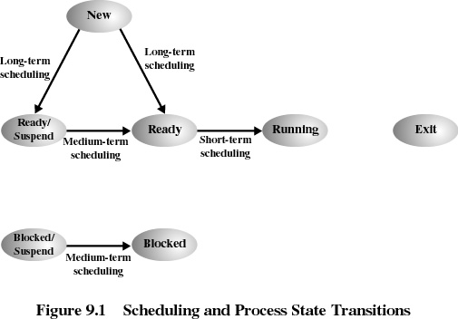
Introduction / System Structures
Processes / Threads
Multithreaded Programming
Process scheduling
Synchronization
Deadlocks
Memory Management
Virtual Memory
File Systems
I/O Systems
Security / Protection
Virtualization
Need scheduling at different granularities
Need scheduling criteria
CPU utilization
Throughput
Turnaround/Response time
Fairness
Overhead

Slide 10
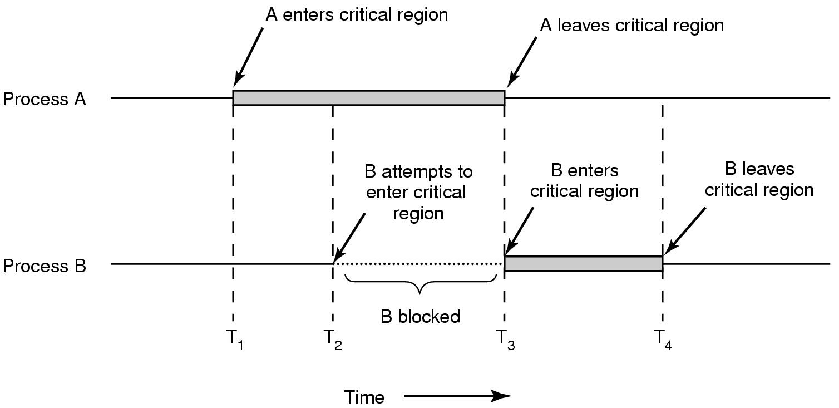
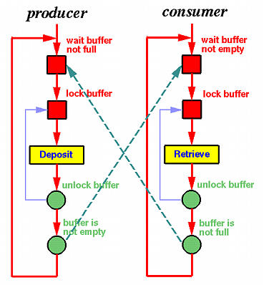
Introduction / System Structures
Processes / Threads
Multithreaded Programming
Process scheduling
Synchronization
Deadlocks
Memory Management
Virtual Memory
File Systems
I/O Systems
Security / Protection
Virtualization
Need to prevent overlapping execution of critical sections
Need to synchronize threads communication

Slide 11
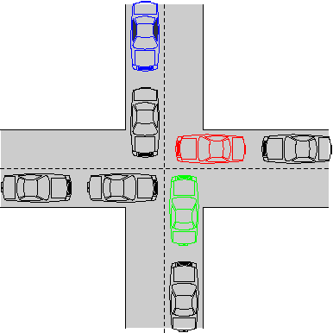
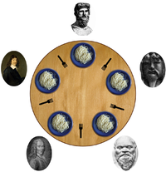
Introduction / System Structures
Processes / Threads
Multithreaded Programming
Process scheduling
Synchronization
Deadlocks
Memory Management
Virtual Memory
File Systems
I/O Systems
Security / Protection
Virtualization
Need to avoid deadlocks
… which can be challenging

Slide 12
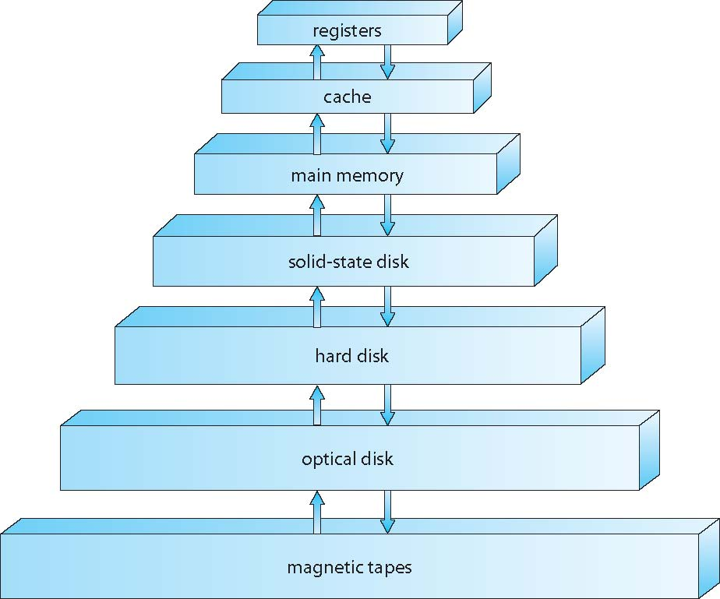

Introduction / System Structures
Processes / Threads
Multithreaded Programming
Process scheduling
Synchronization
Deadlocks
Memory Management
Virtual Memory
File Systems
I/O Systems
Security / Protection
Virtualization
Need to manage information (read / write) based on the available hierarchy
E.g., by swapping processes…

Slide 13
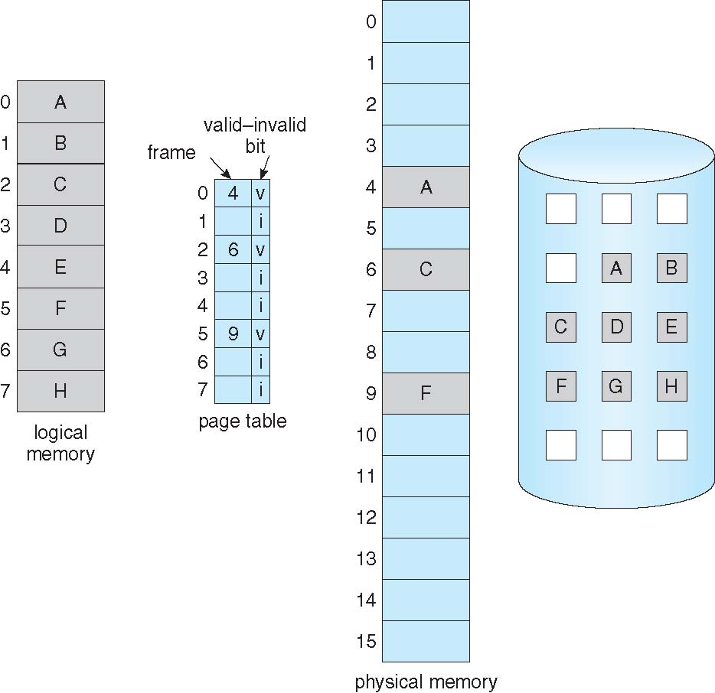

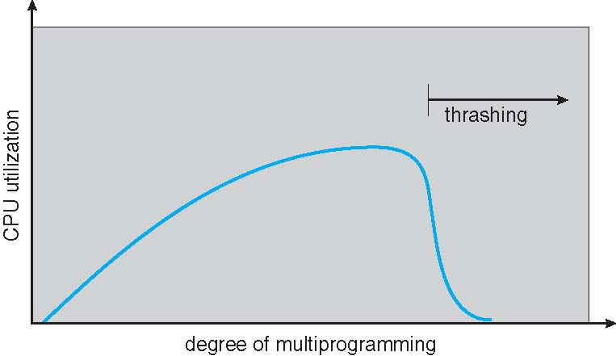
Introduction / System Structures
Processes / Threads
Multithreaded Programming
Process scheduling
Synchronization
Deadlocks
Memory Management
Virtual Memory
File Systems
I/O Systems
Security / Protection
Virtualization
Need to provide more (virtual) memory than available
Need extra overhead to provide that…
Sometimes (hidden?) complexity leads to unexpected behavior…

Slide 14
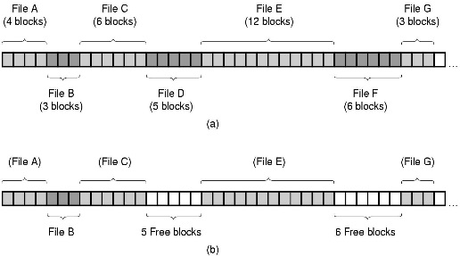
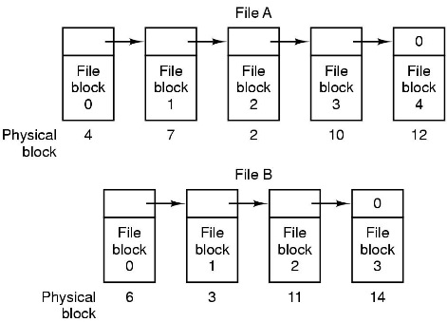
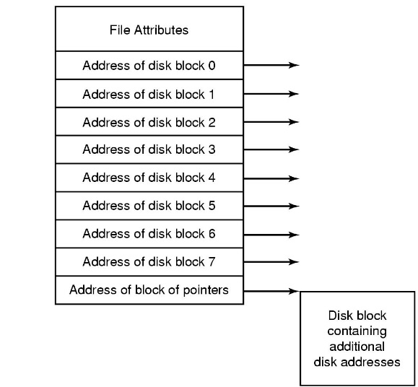
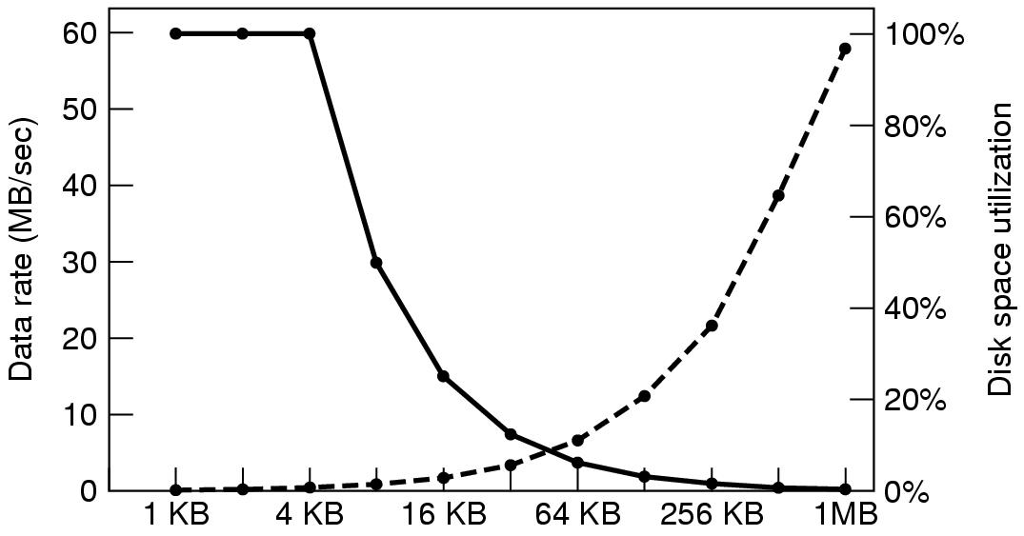
Need to keep track of where files are
Introduction / System Structures
Processes / Threads
Multithreaded Programming
Process scheduling
Synchronization
Deadlocks
Memory Management
Virtual Memory
File Systems
I/O Systems
Security / Protection
Virtualization
Fig. Tanenbaum, Modern Operating Systems
Need to keep track of free space
Need to decide how to use secondary storage

Slide 15
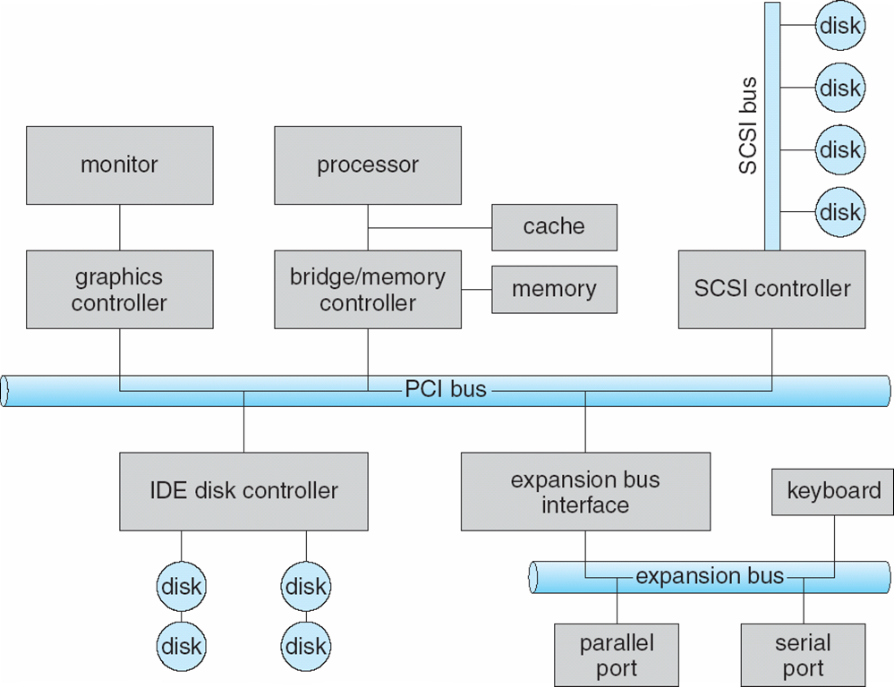
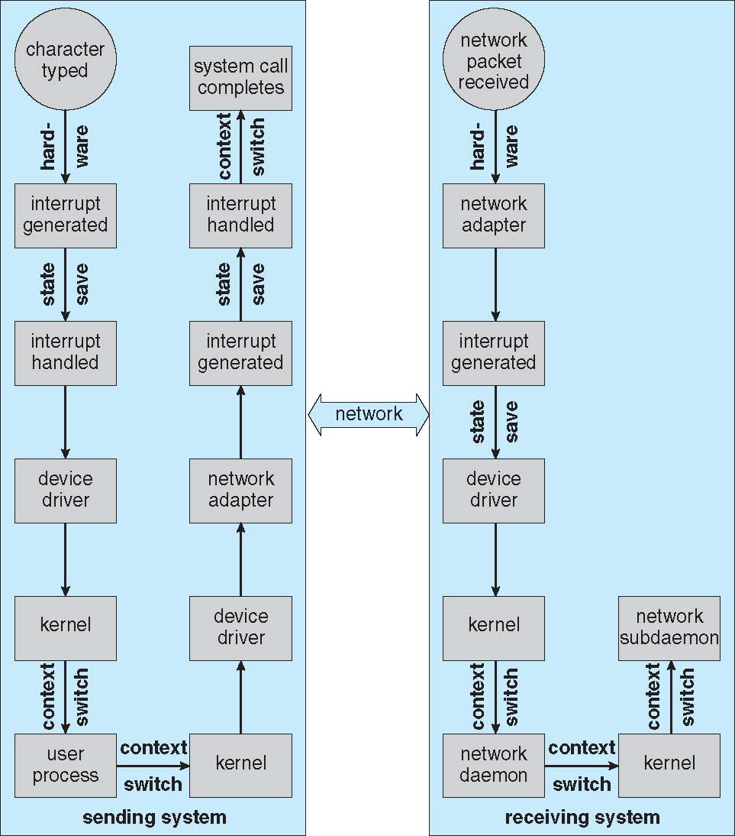
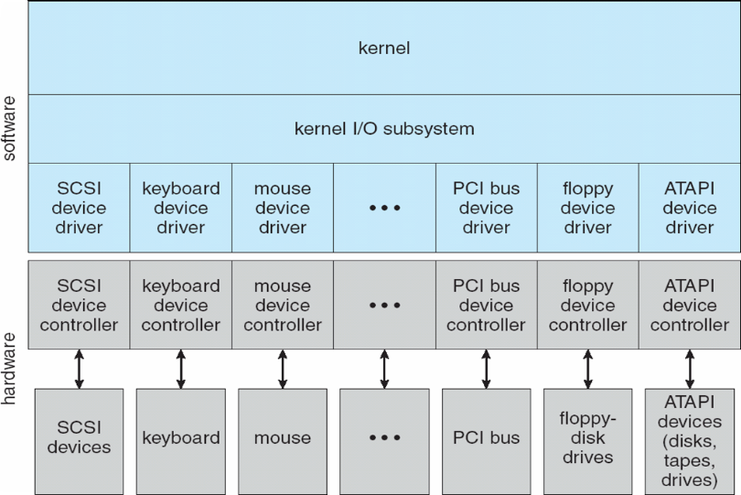
Introduction / System Structures
Processes / Threads
Multithreaded Programming
Process scheduling
Synchronization
Deadlocks
Memory Management
Virtual Memory
File Systems
I/O Systems
Security / Protection
Virtualization
Need to communicate / exchange information with devices
Need good design to increase performance
Need to separate applications’ and hardware’s logic

Slide 16
Introduction / System Structures
Processes / Threads
Multithreaded Programming
Process scheduling
Synchronization
Deadlocks
Memory Management
Virtual Memory
File Systems
I/O Systems
Security / Protection
Virtualization
We need mechanisms to protect and share data…
… from programs’ vulnerabilities (e.g., buffer overflows)
Data
Confidentiality
204
return result
Data
Integrity
203
202
getURL
201
200
Data
Availability
104
103
IE
102
call getURL
101
100
Notes:
Prevent unauthorized users from gaining access to a resource
Prevent authorized users from accessing a resource in an unauthorized manner
Enable legitimate users to access resources in an authorized manner

Slide 17
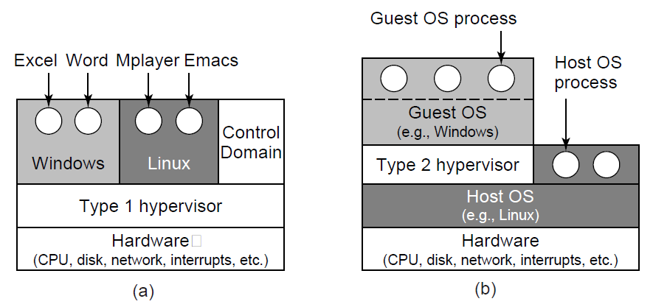
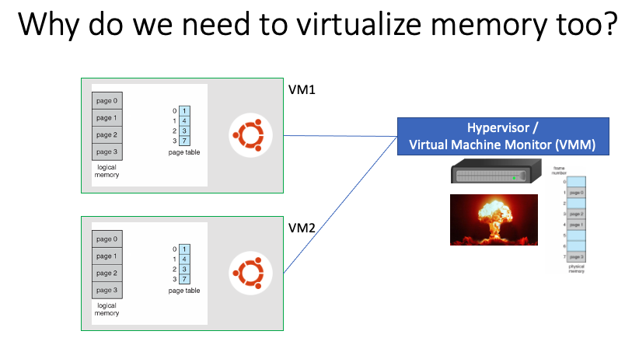
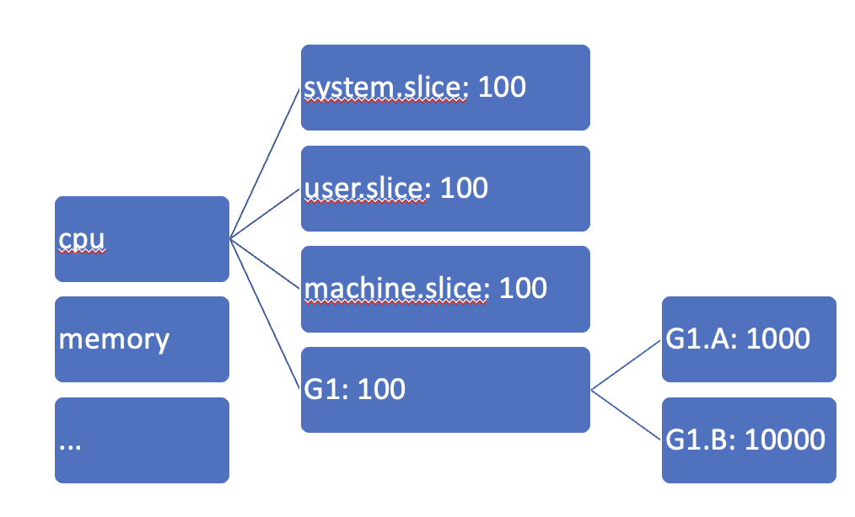
Introduction / System Structures
Processes / Threads
Multithreaded Programming
Process scheduling
Synchronization
Deadlocks
Memory Management
Virtual Memory
File Systems
I/O Systems
Security / Protection
Virtualization
Types of Hypervisors
Notes:
Prevent unauthorized users from gaining access to a resource
Prevent authorized users from accessing a resource in an unauthorized manner
Enable legitimate users to access resources in an authorized manner

