Slide 1
About Me
Vincenzo Coia
January 2021

Slide 2
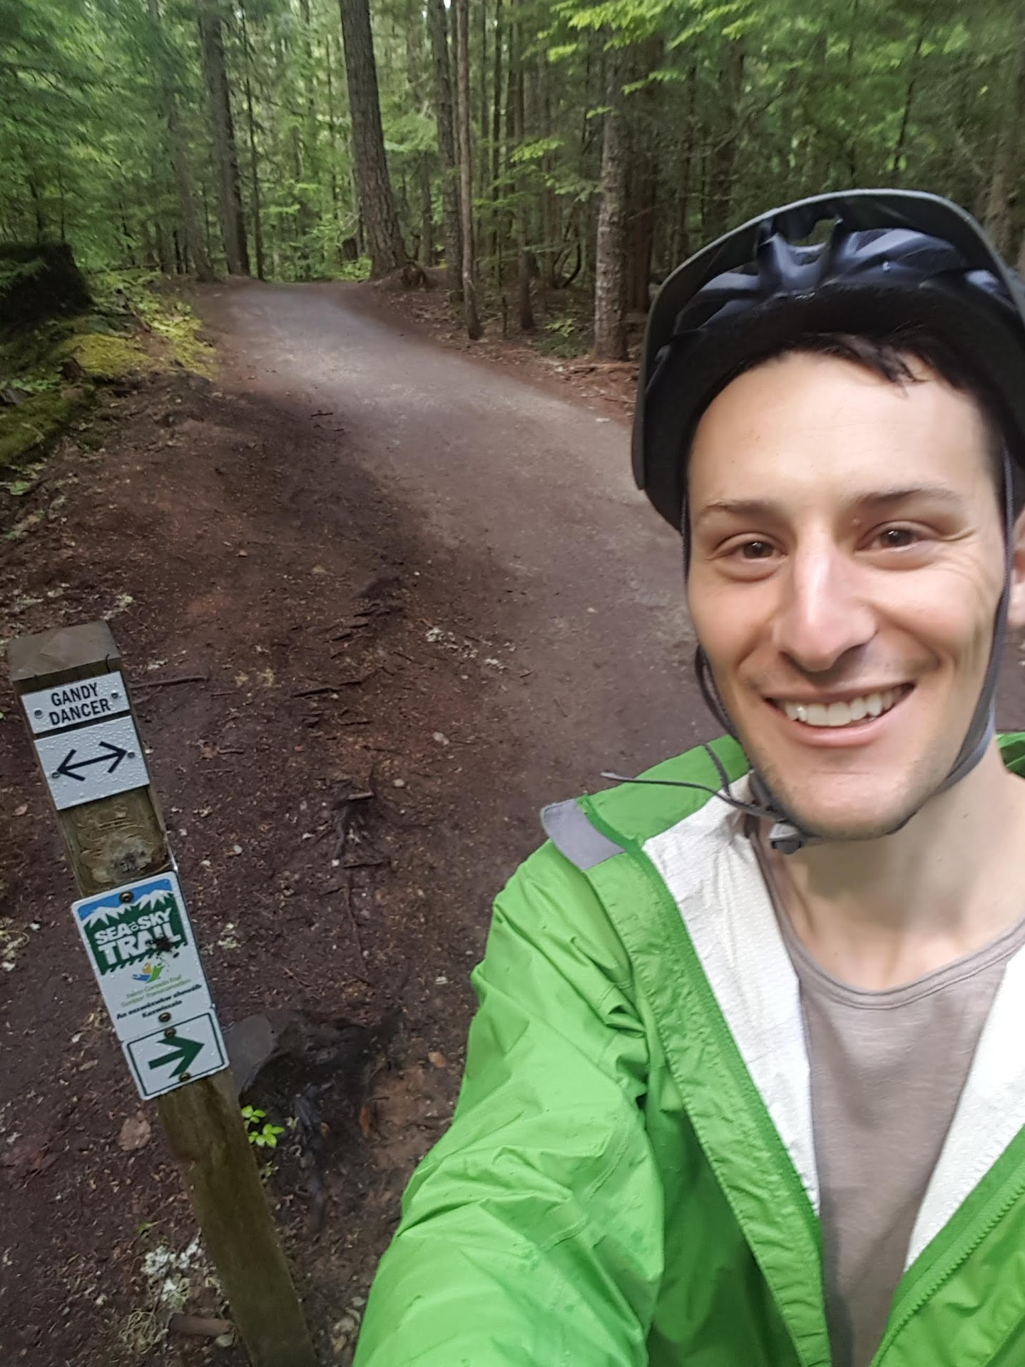
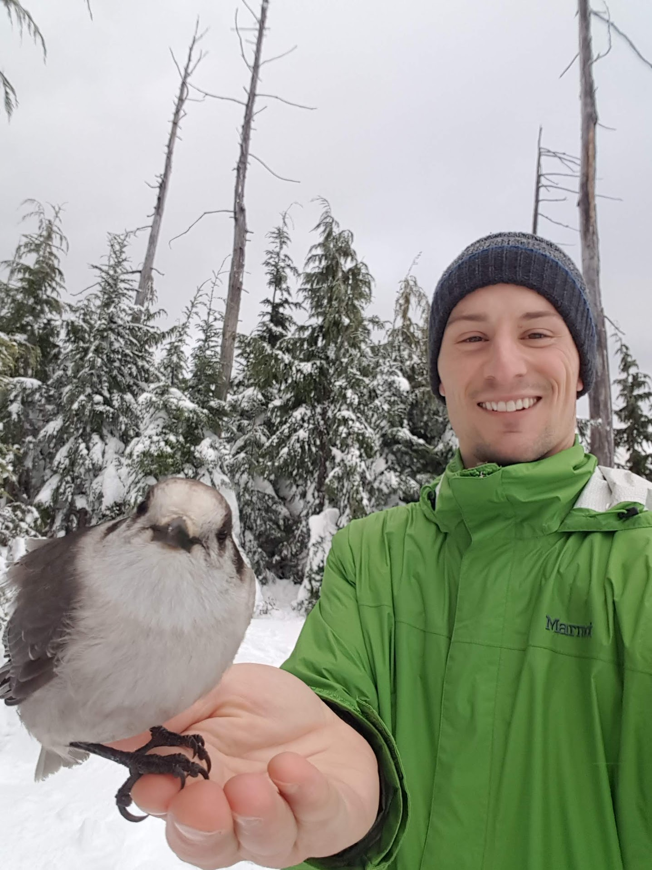
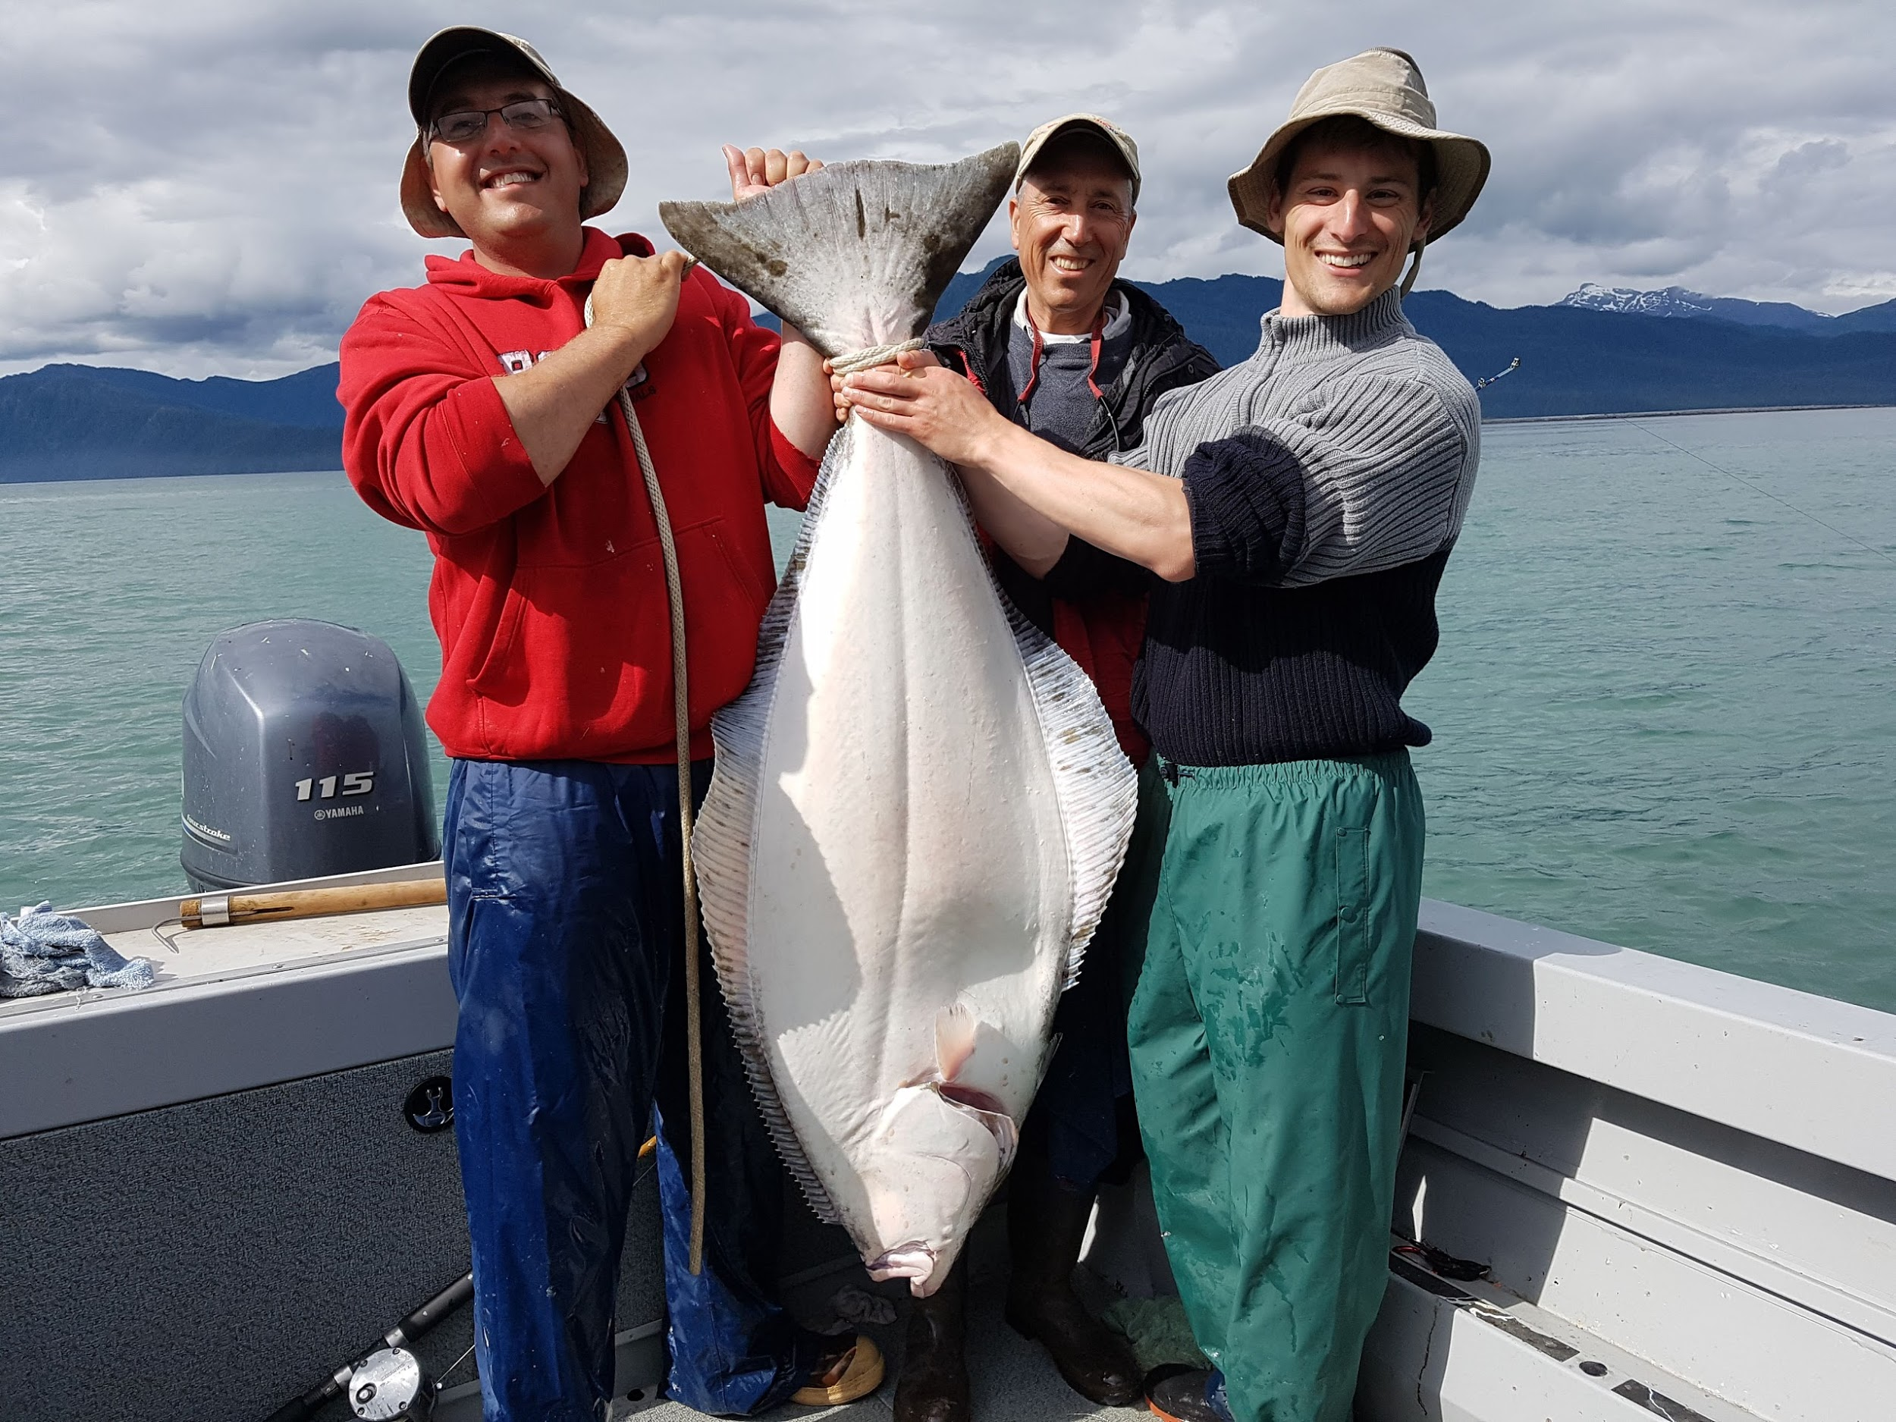
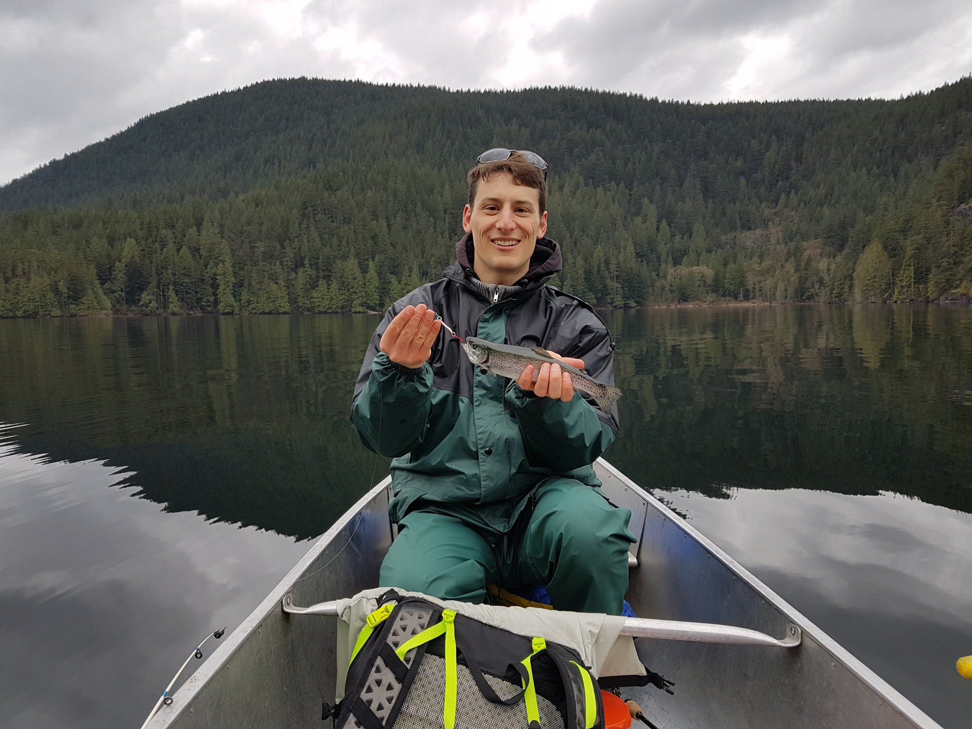
- PhD in Statistics from UBC
- I'm into biology and earth science, too: BSc from Brock.
- Assistant Professor of Teaching at UBC, dept of Statistics
- I love the outdoors!

Slide 3
Career “Mission”
I'm currently seeking to build frameworks and help others use probabilistic thinking when solving problems with data, allowing for a more complete picture of the world so that we can make more informed decisions.
And, do so in a "clean and modern" way!
distplyr R package
YouTube channel
Probability for Data Science “book”
STAT 545 resource

Slide 4
Inclusivity
You belong here.

Slide 5
Inclusivity
It's important to me that I promote an inclusive environment both in and outside of the classroom, both in person and online. To promote this, I like to challenge myself by asking myself, "would I respond differently if this person was a different gender? race? looked a different way?" -- this helps me avoid unconscious preferential treatment of some people over others. Despite my efforts, if I ever do discriminate against someone, or make an uncalled for assumption, I welcome being called out on it, and I sincerely apologize and would like to right the mistake.
I hope you feel that I can provide a safe space for you to open up about any difficulties that you may be experiencing, or any concerns. I like to make time for my students, so please do reach out.

