Slide 1


Fighting Fake News Image Splice Detection via Learned Self - Consistency
Adriano Puglisi (1743285)
Galli Mattia (1753274)
Vincenzo Colella(1748193)
Vision and Perception project- A.Y. 2020-2021

Slide 2
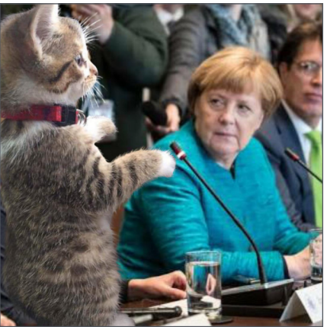
Introduction
Advances in photo editing and manipulation tools have made it significantly easier to create fake imagery
On the other hand, there is a lack of powerful techniques for detecting fakes
Space of manipulated images too vast → lack of sufficient amounts of manipulated training data
We need a method that does not require any manipulated training data at all but can work in an unsupervised/self-supervised regime

Slide 3
State of the Art
Color Filter Array (CFA): detects artifacts in color pattern interpolation
JPEG (DCT): detects inconsistencies over JPEG coefficients
Noise Variance (NOI): detects anomalous noise patterns using wavelets
E-MFCN: Given a dataset of spliced images and masks as training data, they use a supervised fully convolutional network (FCN) to predict splice masks and boundaries in test images

Slide 4
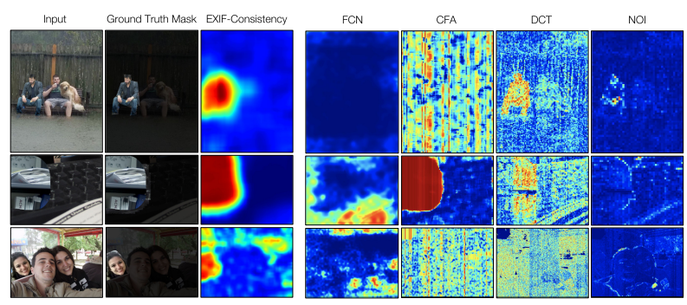
State of the Art

Slide 5
Image EXIF metadata
EXIF tags are camera specifications that are digitally engraved into an image file at the moment of capture
Considering two photos, we could compare their EXIF metadata looking for differences in the imaging pipelines
It is possible to detect spliced images because they are composed of regions that were captured with different imaging pipelines
Paper approach: use the EXIF metadata as a supervisory signal for training a classification model to determine whether an image is self-consistent

Slide 6
Image EXIF metadata extraction
In order to extract the metadata from the dataset we created a dictionary in which each key is an EXIF that has as value a list of lists.
Each of these lists has a value and a list of all the images with that EXIF value.
key : [ [value1,[imageA1,..imageZ1] ], [value2,[imageB2,..imageZ2]], ...]
Once we have filled our dictionary, we remove all the values that has less than 100 or more than 2000 images associated.
After this preprocessing step we create the batch samples and the list of labels for each pair.

Slide 7
Generating Labels and batches
For each pair of images, we generate the corresponding label comparing their metadata
Considering an EXIF tag, if the pair shares the same value for that tag, then we put 1 in the label, otherwise we put 0
In our first attempt we tried to use as input, a pair of random images taken from the dataset, generating labels, but we obtained unaccettable results because of unbalanced batches
In order to solve this probelm, we consider a pairwise re-balancing: pairs of training images within a mini-batch are selected such that for a given EXIF attribute, half of the batch share that value and half do not.

Slide 8
Model: Self-consistency
The model works by predicting whether a pair of image patches are consistent with each other
It estimates the probabilities that they share the same value for each of n metadata attributes
Then it estimates the patches’ overall consistency by combining these n observations of metadata consistency
At evaluation time, the model takes a potentially manipulated test image and measures the consistency between many different pairs of patches
A low consistency score indicates that the patches were likely produced by two distinct imaging systems

Slide 9
Predicting EXIF Attribute Consistency
Siamese network: predict the probability that a pair of 128 × 128 image patches shares the same value for each EXIF metadata attribute
It uses shared ResNet50 sub-networks which each produce 4096-dim. feature vectors
These are concatenated and passed through four-layer MLP with 4096, 2048, 1024 units, followed by the final output layer
The network predicts the probability that the images share the same value for each of the n metadata attributes.

Slide 10
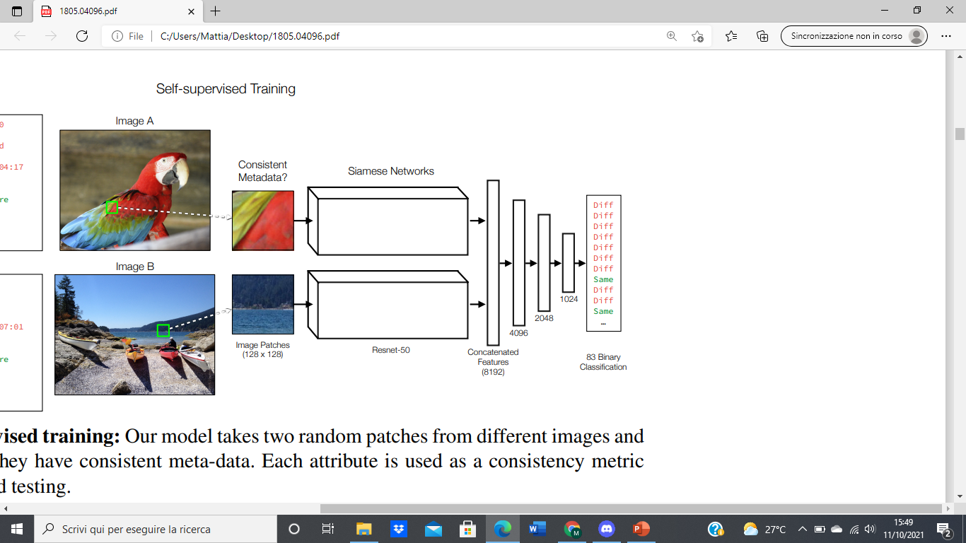
The Network scheme

Slide 11
Combining Consistency Predictions
We want to estimate the pairs’ overall consistency
We train a simple classifier to predict, from the EXIF consistency predictions, whether the patches come from the same image
Consider the n-dimensional vector of EXIF consistency predictions for a pair of patches, we estimate the overall consistency between the patches using a two-layer MLP with 512 hidden units

Slide 12
Setup
Because of the nature of the training process and the big amount of power needed to complete it, we used Google Colab (with a GPU Nvidia K80/T4) to train and save our model.
We consider the following datasets:
Training: https://lesc.dinfo.unifi.it/VISION/
Test: online dataset
Prediction: «In-the-Wild Image Splice Dataset»

Slide 13
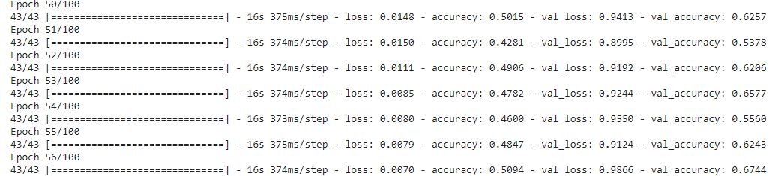
Training: Predicting EXIF Attribute Consistency
We train the first net (Siamese+MLP) considering 100 epochs.
The accuracy was around 60%

Slide 14
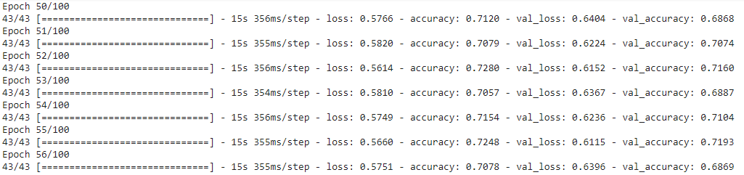
Training: Combining Consistency Predictions
The second net (MLP) was trained for 100 epochs
The approximate accuracy value in this case is around 70%

Slide 15
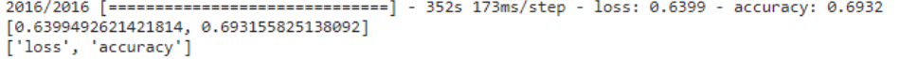
Test
We evaluate our model considering another dataset, obtaining the following results:

Slide 16
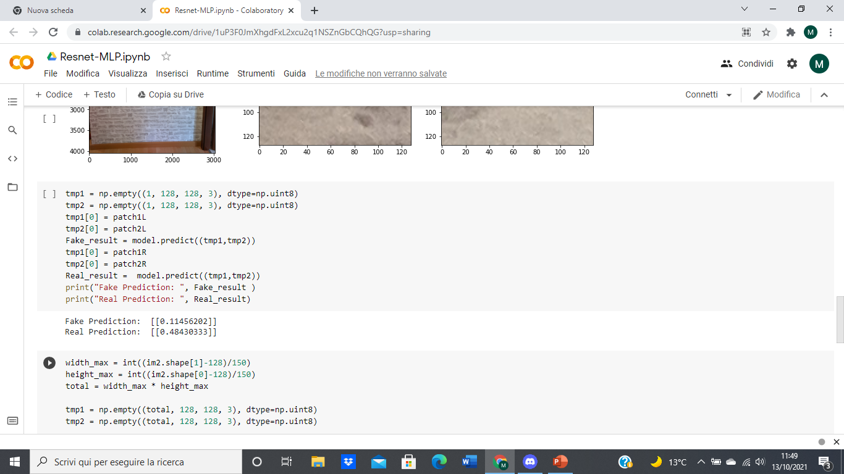
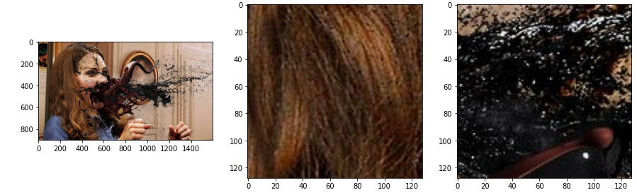
Prediction: Fake image
We made a prediction on a fake image considering 2 patches
Here we expect a low consistency value:
INPUT IMAGE
PATCH 1
PATCH 2

Slide 17
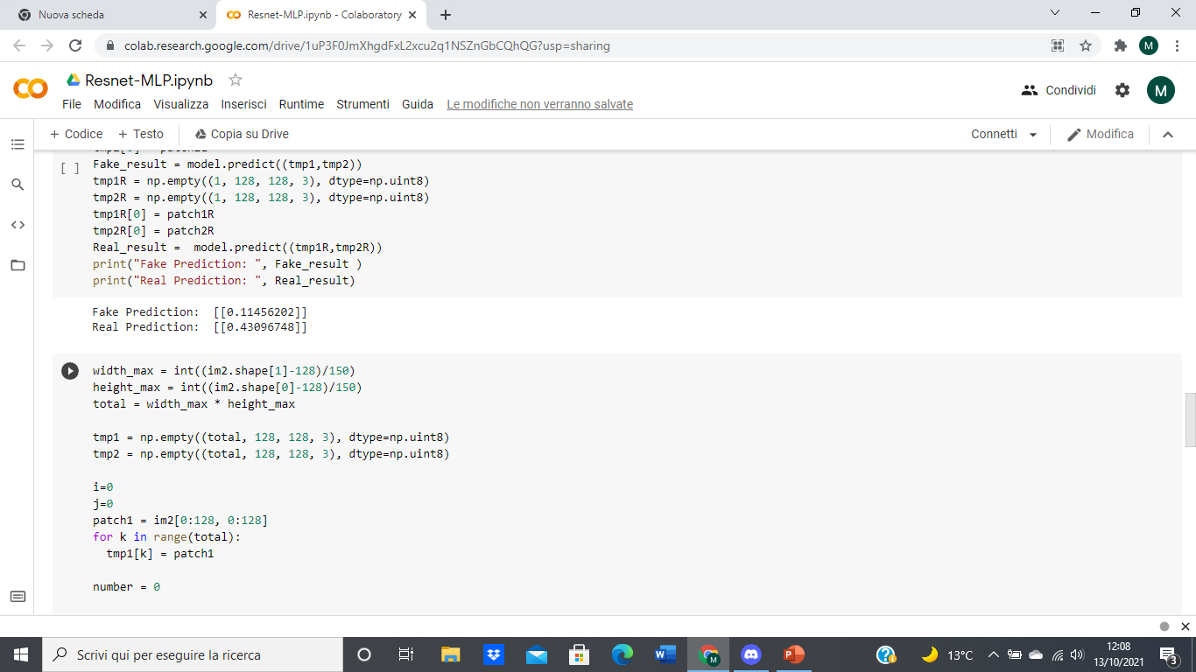
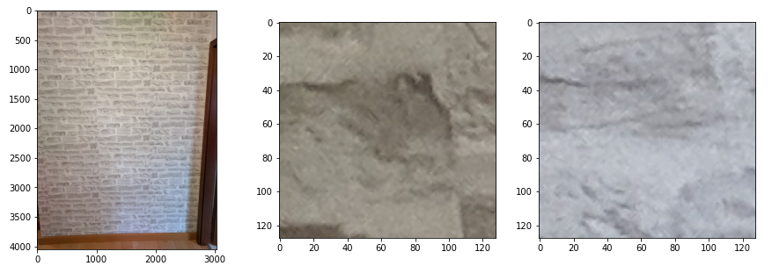
Prediction: Real image
We also made a prediction on a real image to compare the consistency value with the previous one:
INPUT IMAGE
PATCH 1
PATCH 2

Slide 18
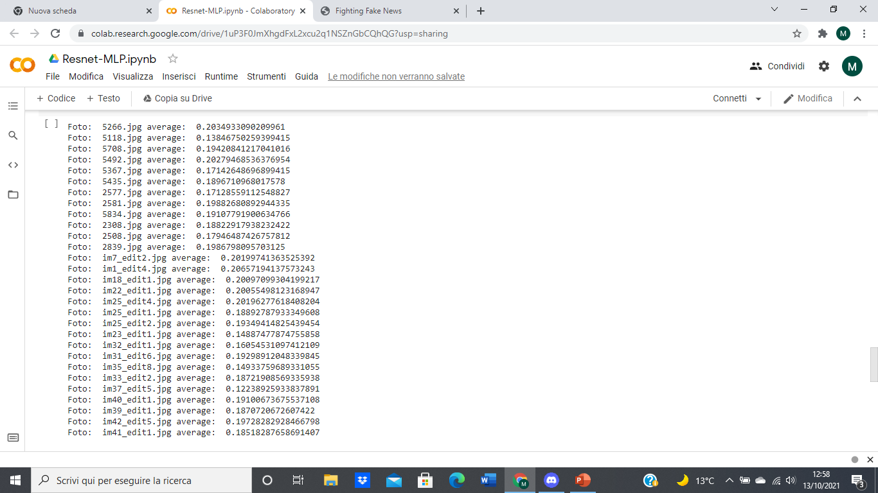
Fake image predictions
We considered the «In-the-Wild Image Splice Dataset»
We compute the average prediction for each image of the dataset, considering as input for the network the pair composed by the first patch of the image and all the others consequently
For each image we consider 400 patches

Slide 19
Conclusions
Our project demonstrates the effectiveness of the approach implemented in the paper
Our results are of course worst with respect the ones obtained in the paper, due to the smaller dataset that we have considered
The model fails in some cases:
Small spliced regions
over- and underexposed regions are sometimes flagged to be inconsistent because they lack any meta-data signal
Notice that the main feature of this model is that it tries to detect manipulations without seeing examples of manipulated image

