Slide 1
CDA 3103
Project Details

Slide 2
Project overview
Simulate a MIPS processor in C
You have a skeleton of how the simulator should function
Just fill in the functions.

Slide 3
Misconceptions
Do not have to make any changes to spimcore.c or spimcore.h
Do not have to worry about input/output
Do not have to convert between HEX and/or DEC

Slide 4
Development Environment Options
MUST compile with gcc
Visual Studio
compile as a commandline executed program
Cygwin
www.cygwin.com
emulates linux in windows
Linux (Virtual Machine or otherwise)
$ gcc -o spimcore spimcore.c project.c
$ ./spimcore <filename>.asc

Slide 5
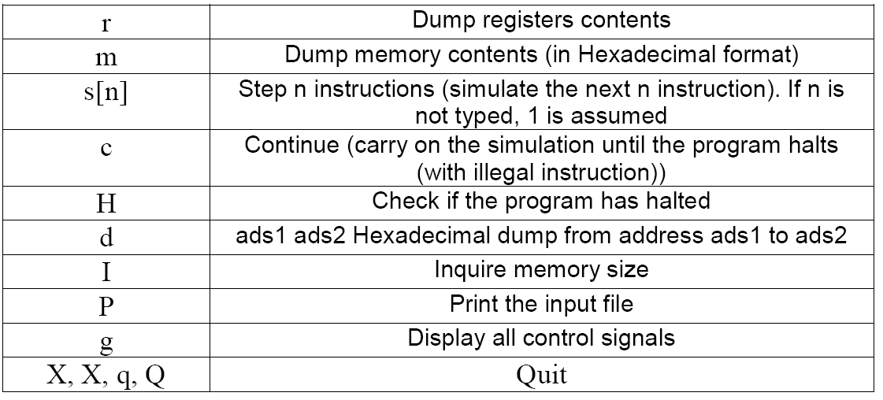
Controls

Slide 6
How to start
Implement functions in order so that you can check each functions output…
IF – Instruction Fetch
IP – Instruction Partition
ID – Instruction Decode

Slide 7
IF
int instruction_fetch(unsigned PC, unsigned *Mem, unsigned *instruction)
As mentioned before, Mem has already been populated, and PC should be the starting address
Check for word alignment
Use PC >> 2 to get the actual location

Slide 8
IP
void instruction_partition(unsigned instruction, unsigned *op, unsigned *r1,unsigned *r2, unsigned *r3, unsigned *funct, unsigned *offset, unsigned *jsec)
unsigned op, // instruction [31-26]
r1, // instruction [25-21]
r2, // instruction [20-16]
r3, // instruction [15-11]
funct, // instruction [5-0]
offset, // instruction [15-0]
jsec; // instruction [25-0]
Remember the bit ordering for a binary number
31,30, 29,….,2,1,0
Make sure to implement it accordingly

Slide 9
ID
int instruction_decode(unsigned op, struct_controls *controls)
Fill in the following structure based on the value of op
typedef struct
{
char RegDst;
char Jump;
char Branch;
char MemRead;
char MemtoReg;
char ALUOp;
char MemWrite;
char ALUSrc;
char RegWrite;
} struct_controls;

Slide 10
Read register
void read_register(unsigned r1,unsigned r2,unsigned *Reg,unsigned *data1,unsigned *data2)
Read the register array Reg to get the values of registers r1 and r2
Fill in data1 and data2 with the values read

Slide 11
Sign Extend
void sign_extend(unsigned offset,unsigned *extended_value)
16th bit is the sign bit
When we partitioned we put all zeros in the first 16 bits…

Slide 12
ALU_operations
int ALU_operations(unsigned data1,unsigned data2,unsigned extended_value,unsigned funct,char ALUOp,char ALUSrc,unsigned *ALUresult,char *Zero)
This function sets parameters for A, B, and ALUControl
Based on value of ALUOp
Test for halt condition
Test for don’t care condition
If R-type instruction, look at funct
In the end, call ALU function

Slide 13
rw_memory
int rw_memory(unsigned ALUresult,unsigned data2,char MemWrite,char MemRead,unsigned *memdata,unsigned *Mem)
If MemWrite = 1, write into memory…
Write data2 to memory based on index calculated from ALUresult
If MemRead = 1, read from memory
Read memory based on index calculated from ALUresult
Don’t forget to test for bad addresses
Bad address = Address which is not word aligned

Slide 14
write_register
void write_register(unsigned r2,unsigned r3,unsigned memdata,unsigned ALUresult,char RegWrite,char RegDst,char MemtoReg,unsigned *Reg)
If RegWrite == 1, and MemtoReg ==1, then data coming from memory…
If RegWrite == 1, and MemtoReg ==0, then data coming from ALU_result
In both cases RegDst value decides the destination register (r2 or r3)

Slide 15
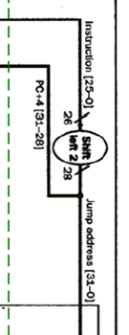
PC_update
void PC_update(unsigned jsec,unsigned extended_value,char Branch,char Jump,char Zero,unsigned *PC)
PC = PC + 4;
Take care of Branch and Jump
Zero – Branch taken or not
If branch taken : PC + offset. Figure out the correct offset value.
Jump: Left shift bits of jsec by 2 and use upper 4 bits of PC

Slide 16
Hints
Accessing memory
Mem[0] is an unsigned int, aka the whole WORD.
This means that given an address, like the PC, you need to shift the address to the RIGHT by 2 to form the index for the Mem structure.
Addresses are byte addresses and each word is 4 bytes.
So divide by 4 (or right shift by 2) to get the correct word index in memory
Notes:
so you would say Mem[PC>>2] to get the word pointed to by the PC.
Use the macro!
This gets annoying which is why there is already a macro provided called MEM. So you can say things like unsigned int instruction = MEM(PC); and the MEM macro takes the arg (PC) and shifts it right by 2 for you. It’ll save your sanity later.

Slide 17
Hints
Isolating bits in an unsigned int via bitwise AND and shift in C. For example:
int op = (inst & 0xFC000000) >> 26;
The input is a series of HEX numbers.
Don’t write anything to parse this file...it is already done for you.
Those numbers are already sitting in the Mem structure at the proper address.
Notes:
so you would say Mem[PC>>2] to get the word pointed to by the PC.
Make a macro!
This gets annoying which is why there is already a macro provided called MEM. So you can say things like unsigned int instruction = MEM(PC); and the MEM macro takes the arg (PC) and shifts it right by 2 for you. I typically encourage everyone to use the macro after explaining this. This will save them later.

Slide 18
Hints
The input is a series of HEX numbers.
Know what unsigned int instruction = MEM(PC) gives you.
It IS the 32 bit instruction. You don’t need to convert it into hex or binary to do things like int op = (inst & 0xFC000000) >> 26.
Notes:
so you would say Mem[PC>>2] to get the word pointed to by the PC.
Make a macro!
This gets annoying which is why there is already a macro provided called MEM. So you can say things like unsigned int instruction = MEM(PC); and the MEM macro takes the arg (PC) and shifts it right by 2 for you. I typically encourage everyone to use the macro after explaining this. This will save them later.

Slide 19
Questions?

