Slide 1

Università degli Studi di Salerno
Dipartimento di Informatica
a.a. 2018/2019
Identification of correlation among
biomedical data through Machine
Learning techniques
Thesis Advisors:
Prof. ssa Tortora Genoveffa
Prof. Risi Michele
Dott. ssa Maria Frasca
Student:
Russo Vincenzo
Matr: 0512104130

Slide 2
Goals
The dataset is made of two categories of patients healthy and affected, is splitted in 19 visits in chronological order
Develop a support system for doctors in order to classify quickly the patients by using the reports written during the visits
Define a process for data correlation based on Information Retrieval techniques such as LSA and M.L. (text2vec) and clustering ones (K-means, Fuzzy)

Slide 3
Techniques
LSA or Latent semantic analysis finds a meaning that is hidden by the use of words for instance synonims
Text2vec is a neural network which computes natural language and maps words in a vocabulary to a corresponding real numbers array doing so it can discover semantic relationships among these words
K-means is a clustering algorithm which divides n objects in k groups based on their attributes (non overlapping)
Fuzzy clustering on the other hand states that an object can belonge to many cluster with a certain percentage (overlapping)

Slide 4




Dataset
Questionnaires
Reworked dataset
pre-processing
pre-processing
Corpus (stemming)
Corpus
LSA
text2vec

Slide 5
Dissimilarity matrix (cosine)
Dissimilarity matrix (cosine)
 | P₁ | P₂ | P₃
P₁ | 0 | 0.412 | 0.165
P₂ | 0.412 | 0 | 0.789
P₃ | 0.165 | 0.789 | 0
 | P₁ | P₂ | P₃
P₁ | 0 | 0.512 | 0.263
P₂ | 0. 512 | 0 | 0.883
P₃ | 0.263 | 0.883 | 0
K-means
Fuzzy
K-means
Fuzzy
PD
GENUN
PD
GENUN
PD
GENUN
PD
GENUN
PD
GENUN
PD
GENUN
PD
GENUN
PD
GENUN
PD
GENUN
PD
GENUN
PD
GENUN
PD
GENUN
median
median
PD
GENUN
PD
GENUN
PD
GENUN
PD
GENUN
PD
GENUN
PD
GENUN

Slide 6
LSA
K-means
Fuzzy

Slide 7
text2vec
K-means
Fuzzy

Slide 8
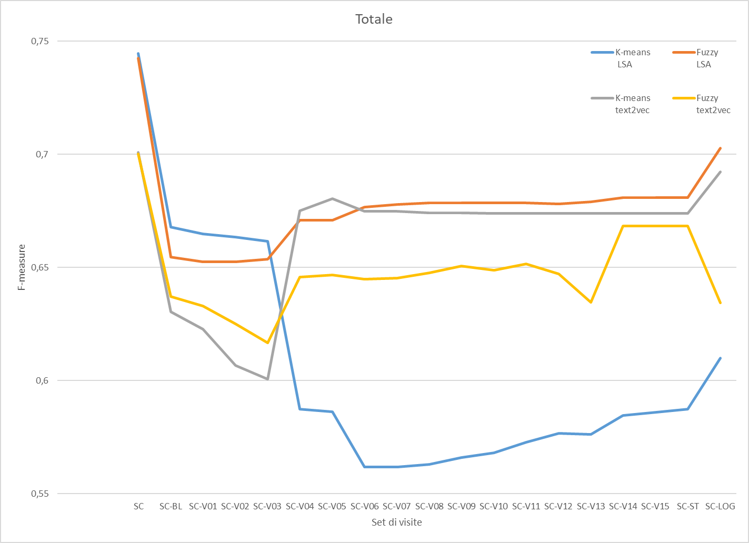
Initially F-measure is high especially for LSA
In SC-V03 LSA K-means decreases and text2vec K-means rises considerably text2vec con Fuzzy discreetly
In SC-LOG LSA Fuzzy and text2Vec K-means obtain the best results. text2vec Fuzzy has significantly decreased LSA K-means has slightly recovered but still has a big gap

Slide 9
Findings and further development
In our case text2vec K-means and LSA Fuzzy gave us the best results
To improve precision:
Describe symptoms in a better way
Extend the analysis and the elaboration process to more tables
Train text2vec neural network using medical dictionaries

