Slide 1
Minimizing Average Cost per Patient for Thyroid Gland Disorder Diagnosis
By Vince Wu and Ryan Liu

Slide 2
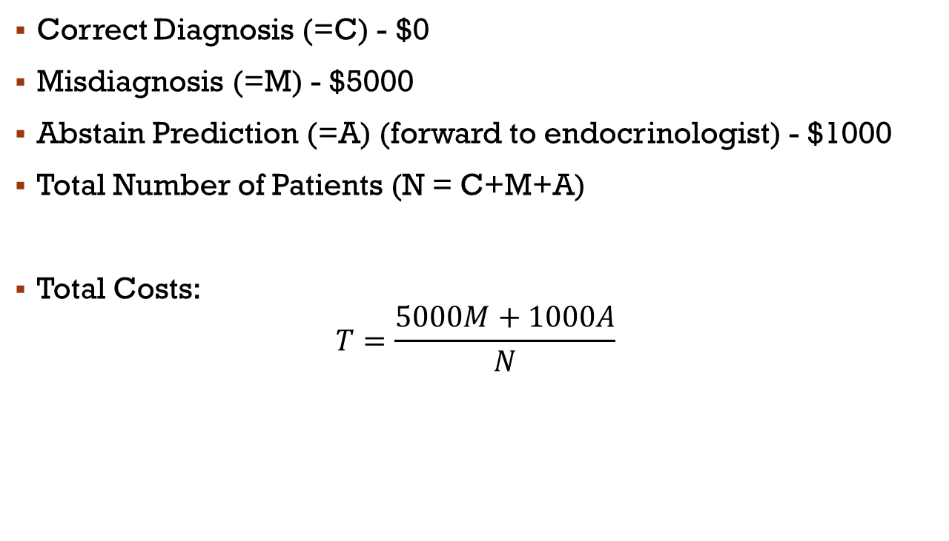
Costs Function
Correct Diagnosis (=C) - $0
Misdiagnosis (=M) - $5000
Abstain Prediction (=A) (forward to endocrinologist) - $1000
Total Number of Patients (N = C+M+A)
Total Costs:
$$T=\frac{5000M+1000A}{N}$$

Slide 3
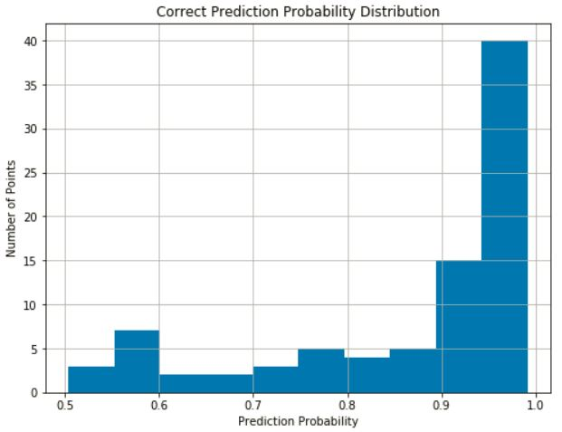
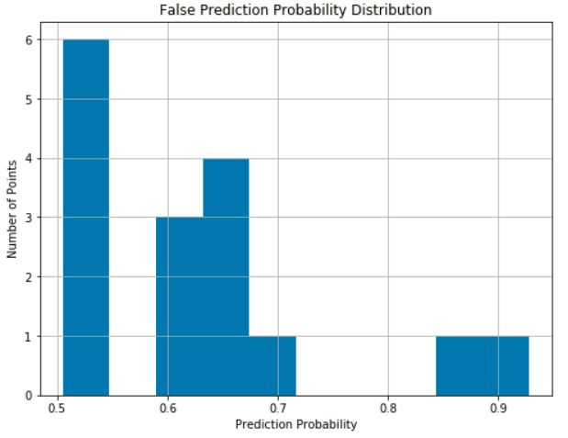

Probability Analysis
OvR (by default threshold) assign classification with p > 0.5
Larger p → Higher chance for correct prediction (diagnosis)
Smaller p → More likely for misdiagnosis

Slide 4
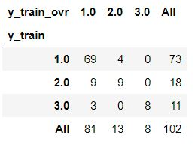
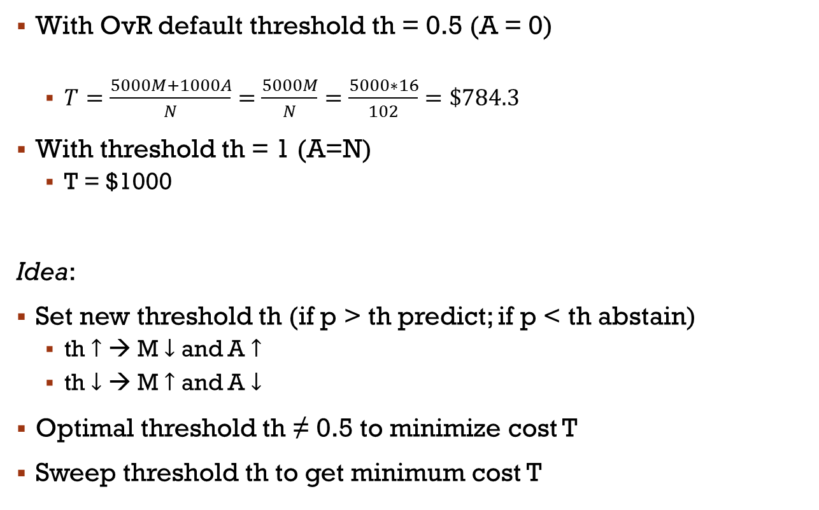
New model
With OvR default threshold th = 0.5 (A = 0)
$T=\frac{5000M+1000A}{N}=$ $\frac{5000M}{N}=$ $\frac{5000∗16}{102}=\$784.3$
With threshold th = 1 (A=N)
T = $1000
Idea:
Set new threshold th (if p > th predict; if p < th abstain)
th $↑$ → M $↓$ and A $↑$
th $↓$ → M $↑$ and A $↓$
Optimal threshold th ≠ 0.5 to minimize cost T
Sweep threshold th to get minimum cost T

Slide 5
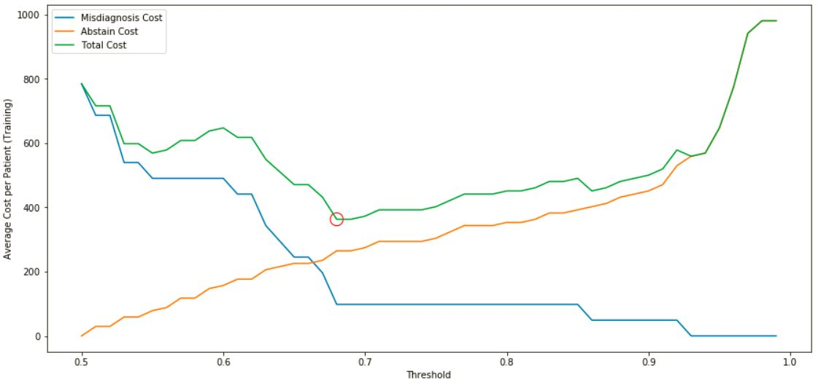
Threshold Analysis
Minimum total cost T = $362.75 (Training Set)
New Threshold th = 0.68 ≠ 0.5 (default)
Minimum total cost T = $575.22 (Testing Set)

Slide 6
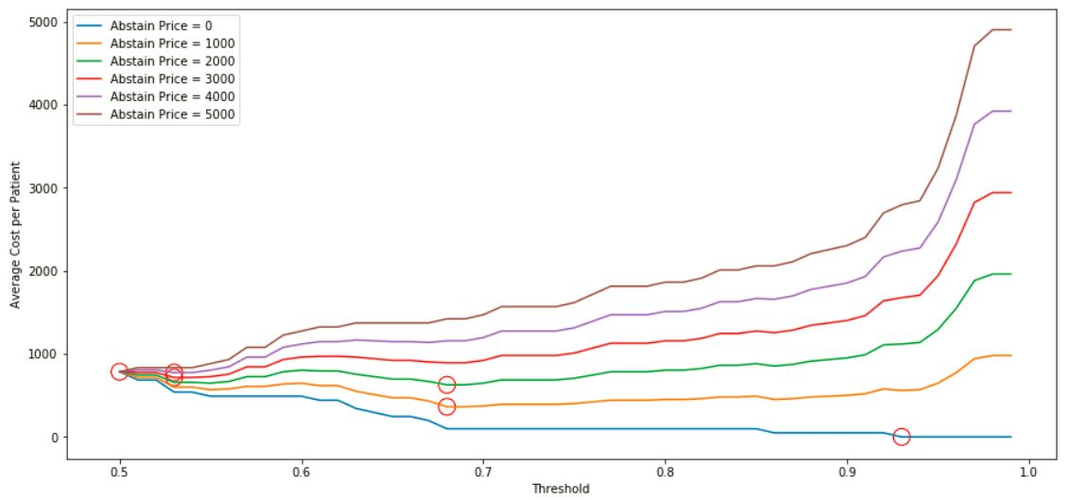
Method Robustness
Always found the optimal threshold
Verification:
When abstain price is low, abstain to predict cost leas – high threshold
When abstain price is high, abstain to predict cost more – low threshold

