Slide 1
AI Fund Performance Review

Slide 2
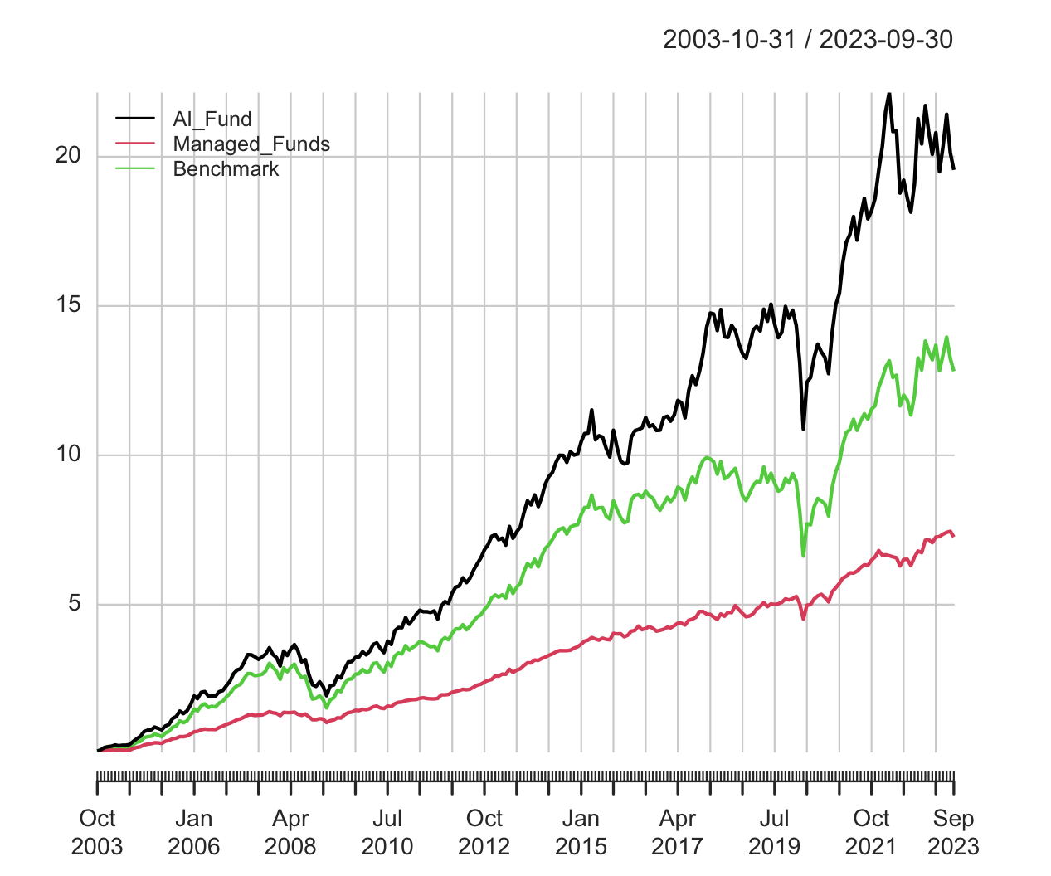
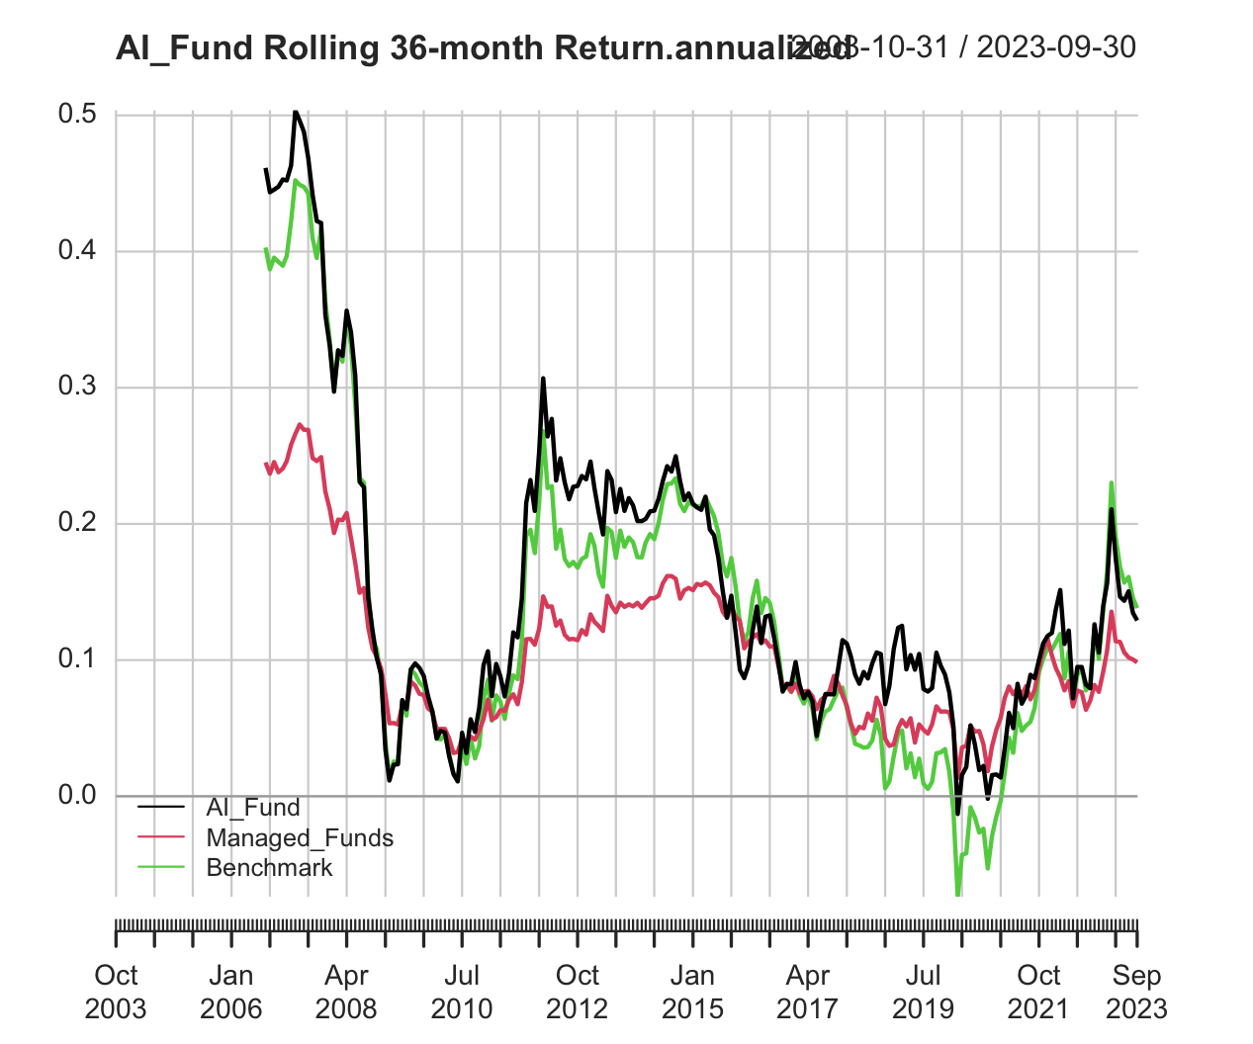
AI Fund outperforms managed funds and benchmark fund

Slide 3
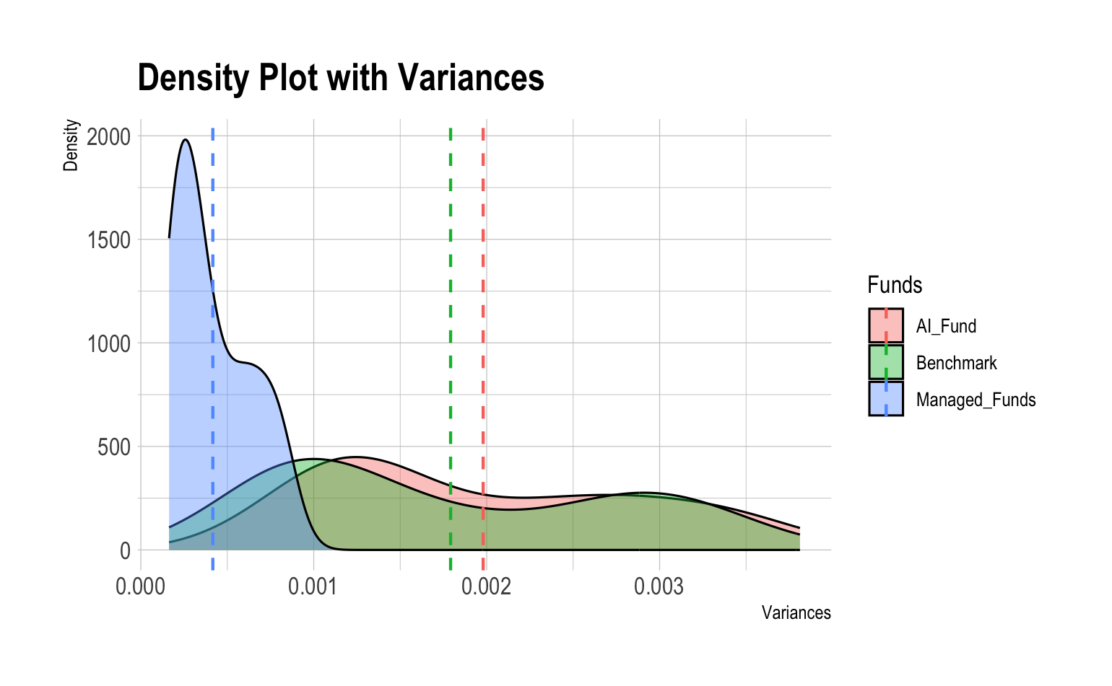
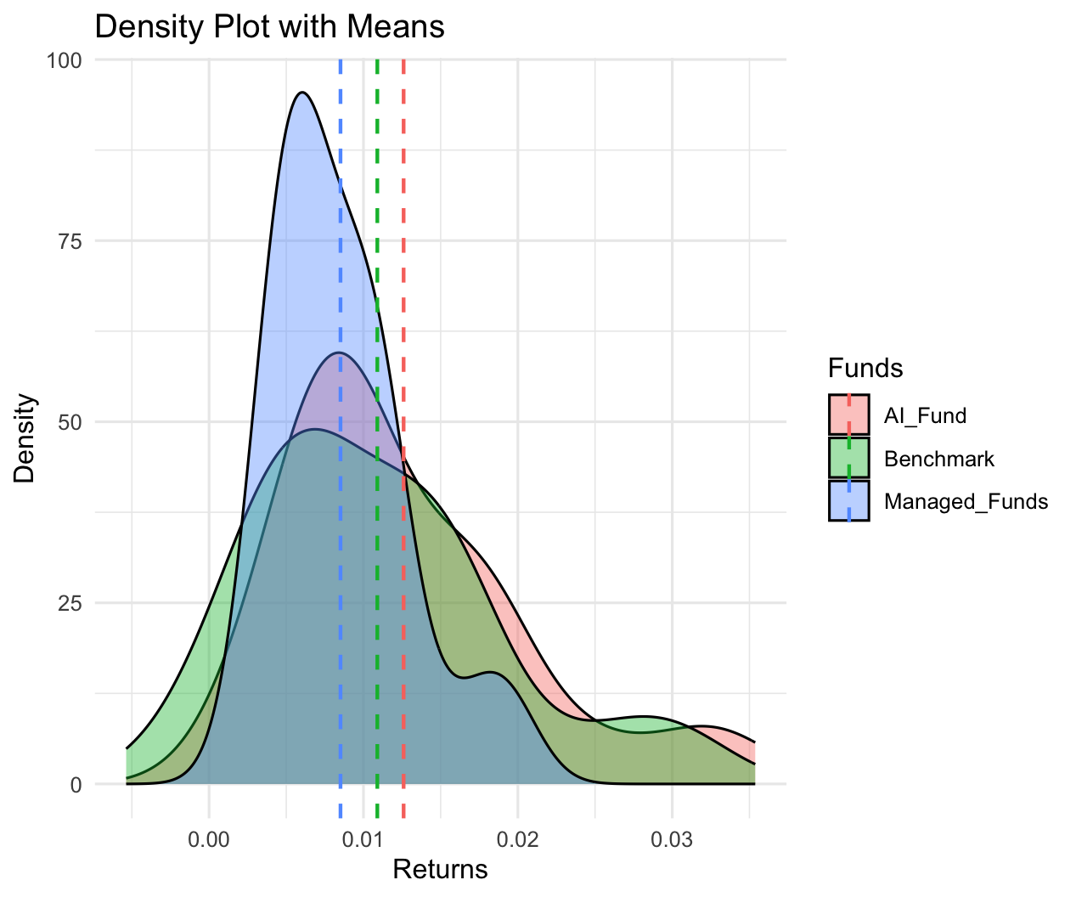
AI Fund is more volatile

Slide 4
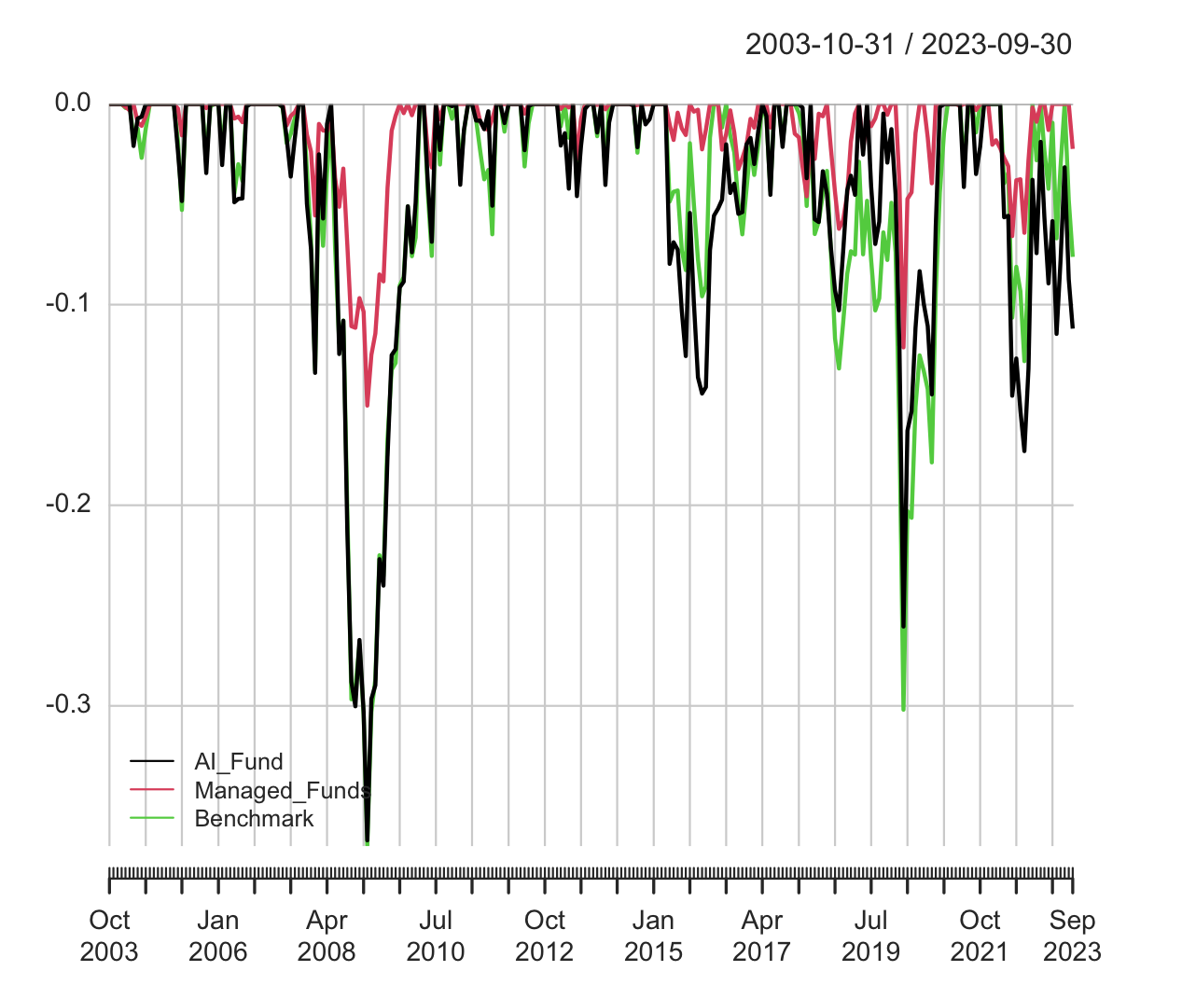
Despite more severe downfalls better overall performance

