Slide 1
Snake Oil Fund

Slide 2
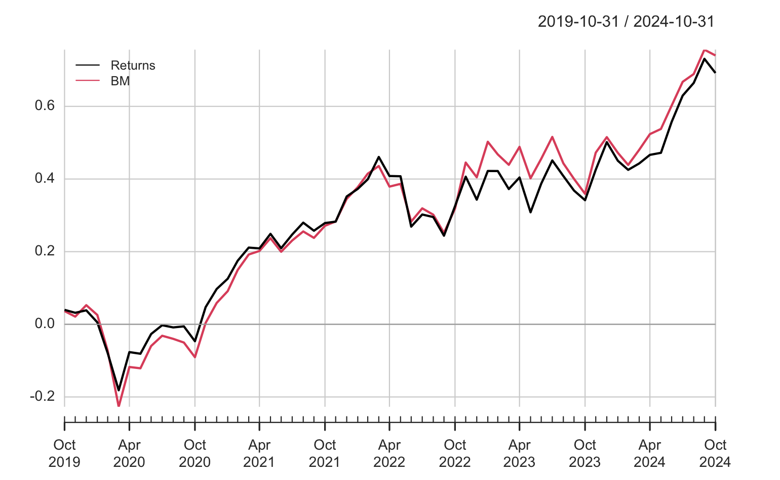
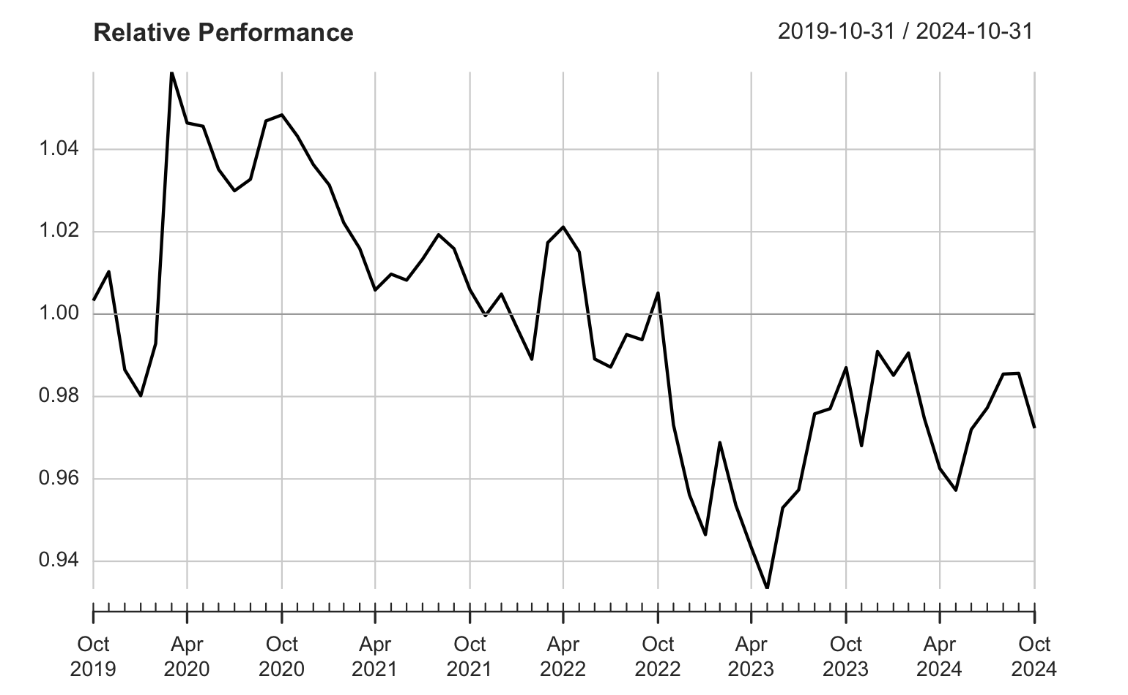
Relative underperformance in recent periods

Slide 3
Summary of statistics
Summary of Statistics from sfm
 | Returns to BM
Alpha | 0.0006
Beta | 0.8789
Beta+ | 0.8427
Beta- | 0.7612
R-squared | 0.9155
Annualized Alpha | 0.0071
Correlation | 0.9568
Correlation p-value | 0.0000
Tracking Error | 0.0498
Active Premium | -0.0061
Information Ratio | -0.1233
Treynor Ratio | 0.1240

