Slide 1
Documenting the code
Victor Ananyev
Taras Shevchenko National University of Kyiv
Faculty of Physics
Quantum Field Theory Department

Slide 2
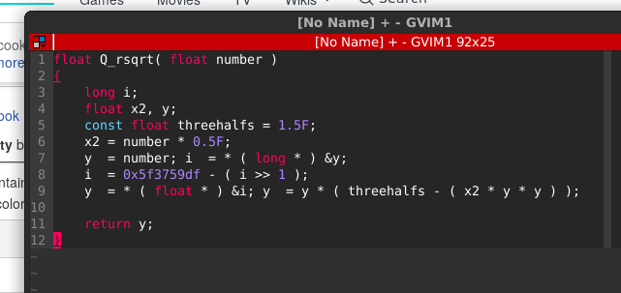
Why documenting code?
What is the application of this function?

Slide 3
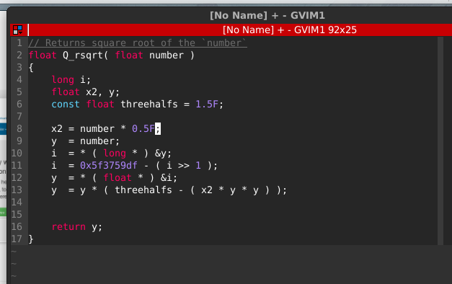
Now it is clear.

Slide 4
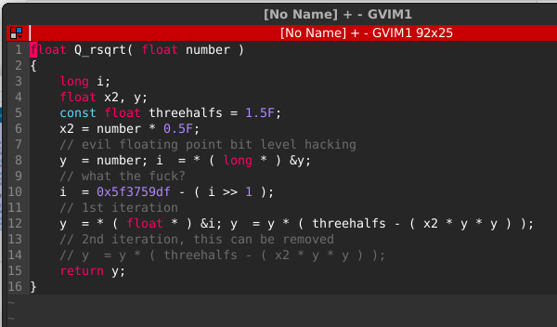
Would you like to see the original?
The code above is the fast inverse square root implementation from Quake III Arena, stripped of C preprocessor directives, but including the exact original comment text
More stuff:
https://www.quora.com/What-is-the-most-complex-line-of-C-code-you-have-created-or-encountered

Slide 5
Approaches
“Documentation schmocumentation...” It does not work for anybody.
“Write a {La}TeX document” school, where the documentation is seen as a standalone product, which is produced independently. This works great for PDF output, and sucks royally for HTML and TXT output.
“Literate programming” school, which abandons readability of both the program source code and the documentation source, which seems to be one of the best access protections one can put on the source code of either.
“DoxyGen” school, which lets a program collect a mindless list of hyperlinked variable, procedure, class and filenames, and call that “documentation”.
OpenOffice, LyX or Word, etc. Anything that uses a fileformat that cannot be put into a version control system, because it is binary and non-diff’able.
Source: https://varnish-cache.org/docs/trunk/phk/sphinx.html

Slide 6
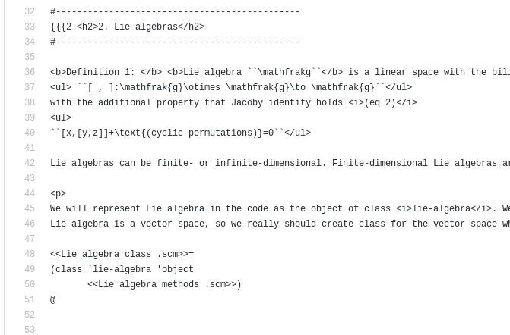
Literate programming example
Source: https://github.com/unixtechie/Literate-Molly

Slide 7
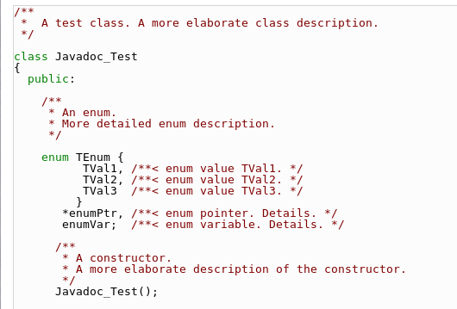
Doxygen. Intro
Source: https://www.stack.nl/~dimitri/doxygen/manual/docblocks.html

Slide 8
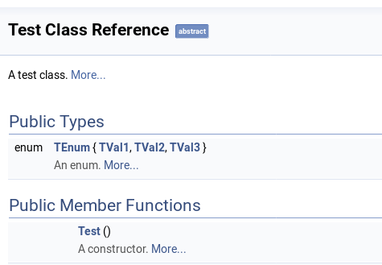
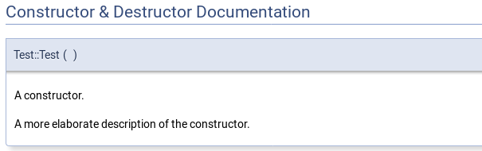
Results into

Slide 9
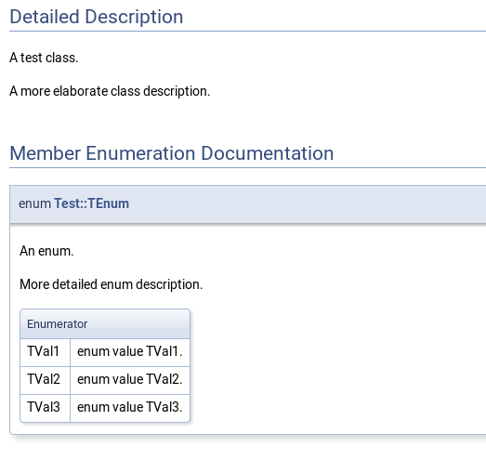
Results into
Source:
https://www.stack.nl/~dimitri/doxygen/manual/examples/jdstyle/html/class_test.html#details

Slide 10
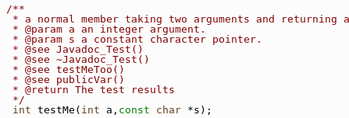
Commenting functions and methods
* Description of parameters and return values are usually placed near the declaration line
** Notice @param, @see, @return commands

Slide 11
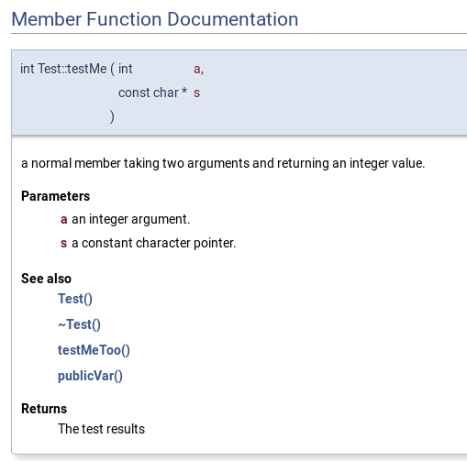
Results in

Slide 12
Formulae
Using inline formulae that appear in the running text. These formulae should be put between a pair of \f$ commands
Results in:

Slide 13
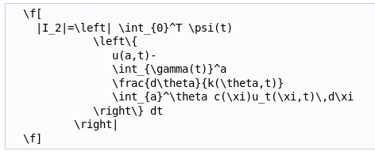

Formulae
Unnumbered displayed formulas that are centered on a separate line. These formulas should be put between \f[ and \f] commands
Results in:

Slide 14
Referencing
Links to functions are created if one of the following patterns is encountered:
<functionName>"("<argument-list>")"
<functionName>"()"
"::"<functionName>
(<className>"::")n<functionName>"("<argument-list>")"
(<className>"::")n<functionName>"("<argument-list>")"<modifiers>
(<className>"::")n<functionName>"()"
(<className>"::")n<functionName>
More: https://www.stack.nl/~dimitri/doxygen/manual/autolink.html

Slide 15
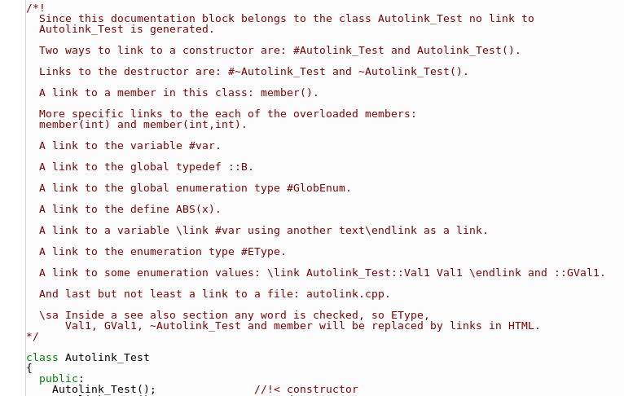
Example of referencing

Slide 16
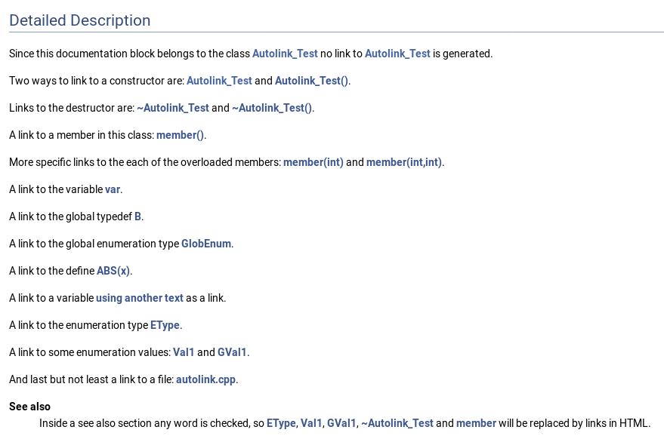
Results in

Slide 17
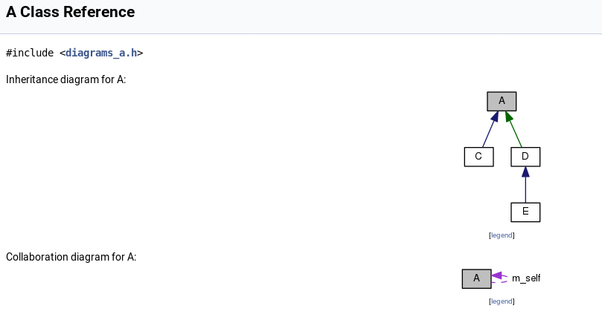
Bonus. Diagramms
If you do it right, Doxygen will generate inheritance diagramms for you automatically:

Slide 18
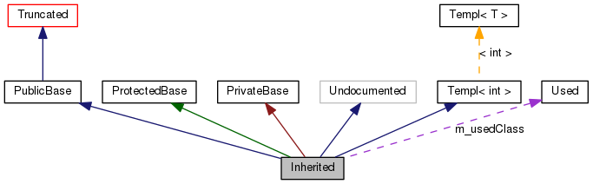
Too many colors?
A filled gray box represents the struct or class for which the graph is generated.
A box with a black border denotes a documented struct or class.
A box with a gray border denotes an undocumented struct or class.
A box with a red border denotes a documented struct or class forwhich not all inheritance/containment relations are shown. A graph is truncated if it does not fit within the specified boundaries.

Slide 19
Too many colors?
A dark blue arrow is used to visualize a public inheritance relation between two classes.
A dark green arrow is used for protected inheritance.
A dark red arrow is used for private inheritance.
A purple dashed arrow is used if a class is contained or used by another class. The arrow is labelled with the variable(s) through which the pointed class or struct is accessible.
A yellow dashed arrow denotes a relation between a template instance and the template class it was instantiated from. The arrow is labelled with the template parameters of the instance.

Slide 20
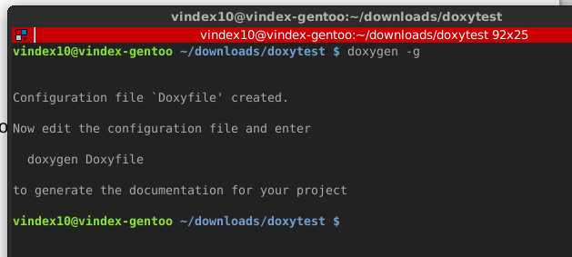
Running Doxygen
Firstly, you should create Doxyfile – configuration file for doxygen engine

Slide 21
Basic directives in Doxyfile
PROJECT_NAME = "My Project" // Project name, it’s clear.
PROJECT_BRIEF = "Brief description of your project" // Together with PROJECT_NAME will be shown in the title of the Doc.
OUTPUT_DIRECTORY = doc // A place to where doxygen will generate all output. For instance, html documentation is under doc/html/index.html
CREATE_SUBDIRS = YES // It forces doxygen to classify files into subdirs. Makes the output more structured.
FILE_PATTERNS = *.py // You can leave it as is, but for readability of your Doxyfile, it is better to leave here only needed extensions to be searched for comments
RECURSIVE = YES // Set it to YES, if you have subdirs in your project structure. Usually you have those.
INLINE_SOURCES = YES // If set to yes, code listings will be included into documentation.
USE_MATHJAX = YES // Use online compilation of LaTeX, but expressions become prettier.
GENERATE_XML = YES // This you will need for thrid-party applications to use your docs
INPUT_FILTER = "doxypypy -a -c” // Command to run on source code before passing it to doxygen. Directive is useful to convert Google Code Style standards for Python into Doxygen compliant. About this further.

Slide 22
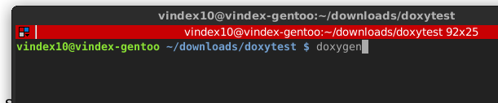
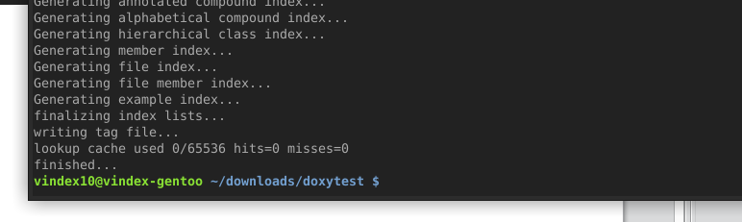
Running
Now simply call doxygen in your project’s root
Results in:

Slide 23
Pros and cons of Doxygen
:-) Doxygen does an excellent job in gathering source code annotations into a database (XML tree structure).
!!! It forces you to mix templating and code description inside your sources.

Slide 24
Why does mixing is wrong?
Let programmer describe his code, and let designer decide how the documentation should look.
Code descriptions should be readable without third-party compilers (like Doxygen engine). Template directives make it worse readable.

Slide 25
Solution
Source Code commented in correspondence to Google Style Guide (or any other standard you like)
Output Filter, to convert neat comments to Doxygen readable format
Doxygen, to get structured XML database of annotations, which mirrors an abstraction of the code
Breathe
Sphinx, to compose big picture overview, examples and tutorials; and combine them together
(using ReStructuredText template language).
Source: librelist.com/browser//breathe/2014/6/19/a-successful-documentation-workflow-using-sphinx-doxygen-and-breathe/

Slide 26
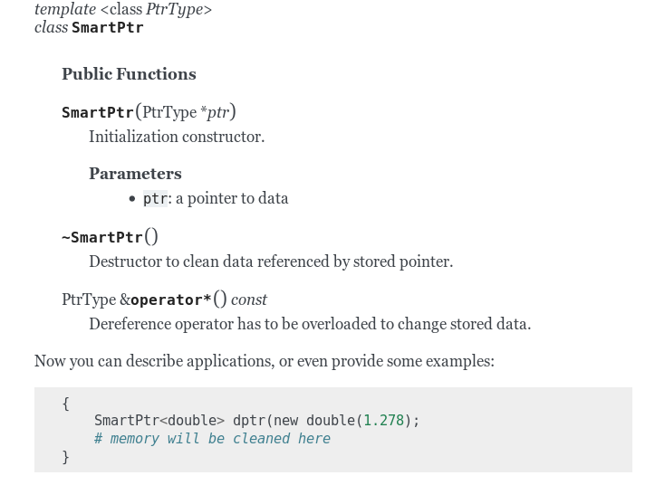
What is Sphinx?
We’ll use Sphinx to glue annotations extracted by Doxygen into Tutorial

Slide 27
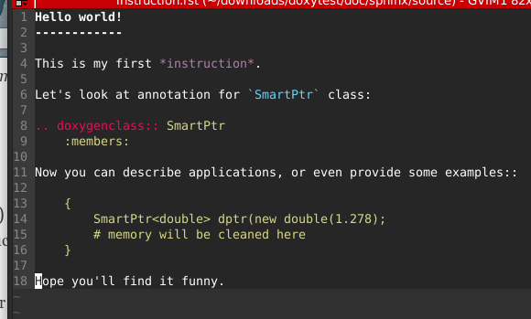
Sphinx’s language is ReST
More about ReST syntax: http://www.sphinx-doc.org/en/1.6.4/rest.html

Slide 28
Where is Doxygen?
More on Doxygen specific commands: http://breathe.readthedocs.io/en/latest/quickstart.html

Slide 29
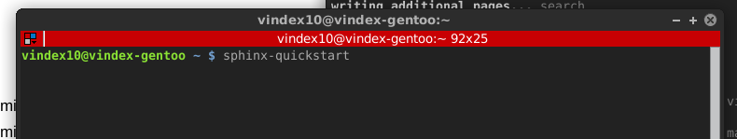
How to breathe? Init Sphinx.
* Assuming, Doxygen has been already configured, and XML output has been generated.
** Assuming, Python packages Sphinx and Breathe have been already installed.
Firstly, we have to initialize Sphinx:
Read more: http://www.sphinx-doc.org/en/1.6.4/tutorial.html

Slide 30
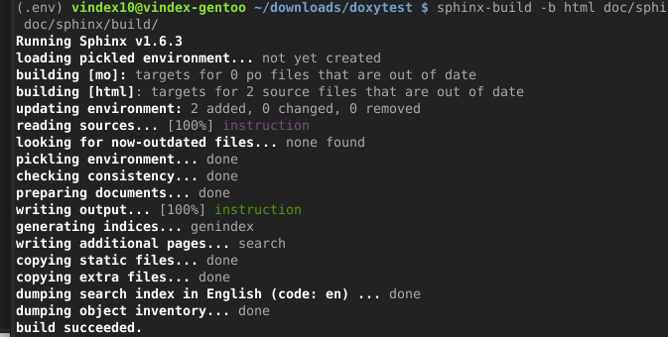
How to breathe? Check Sphinx.
Then, you can try to build basic doumentation, to check if everything is right:

Slide 31
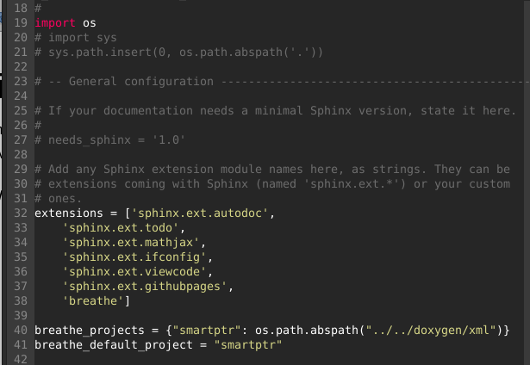
How to breathe? Configure breathe.
Fill some configs at `doc/sphinx/source/conf.py`
Read more: http://breathe.readthedocs.io/en/latest/quickstart.html

Slide 32
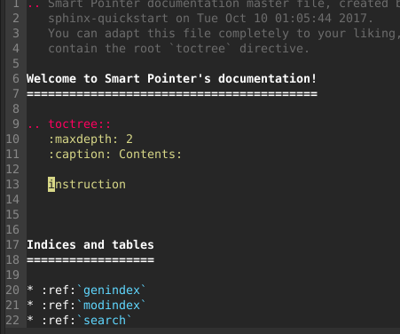
How to breathe? Basic template
Add an entry into Table of Contents at `doc/sphinx/source/index.rst`
Read more: http://www.sphinx-doc.org/en/1.6.4/tutorial.html

Slide 33
How to breathe? Basic template
Create corresponding file `doc/sphinx/source/instruction.rst`
More on ReST: http://www.sphinx-doc.org/en/1.6.4/tutorial.html
More on Doxygen specific commands: http://breathe.readthedocs.io/en/latest/quickstart.html

Slide 34
Deep breathe and Run
Run Sphinx again, now it is able to use Doxygen commands

Slide 35
Results in
See full example on Github: https://github.com/vindex10/codoc

Slide 36
Thanks

