Slide 1
FYS9555 Final project
«Higgs boson production mechanism classification from ATLAS Open Data»
10 June 2020 Victor Ananyev

Slide 2
Outline
Di-photon process
Data acquisition
What’s inside?
Dealing with jagged data in ML
Fighting imbalanced data sets
Fitting baseline ML models

Slide 3
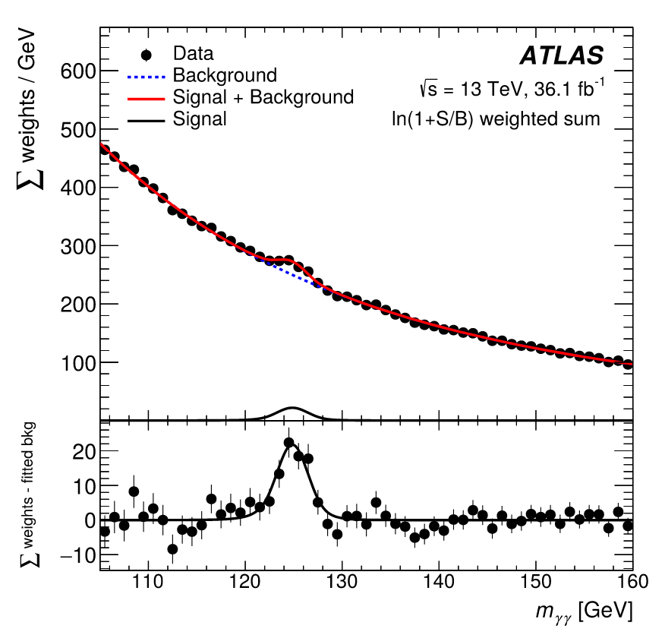
Di-photon process
(borrowed from https://arxiv.org/abs/1806.00242)

Slide 4
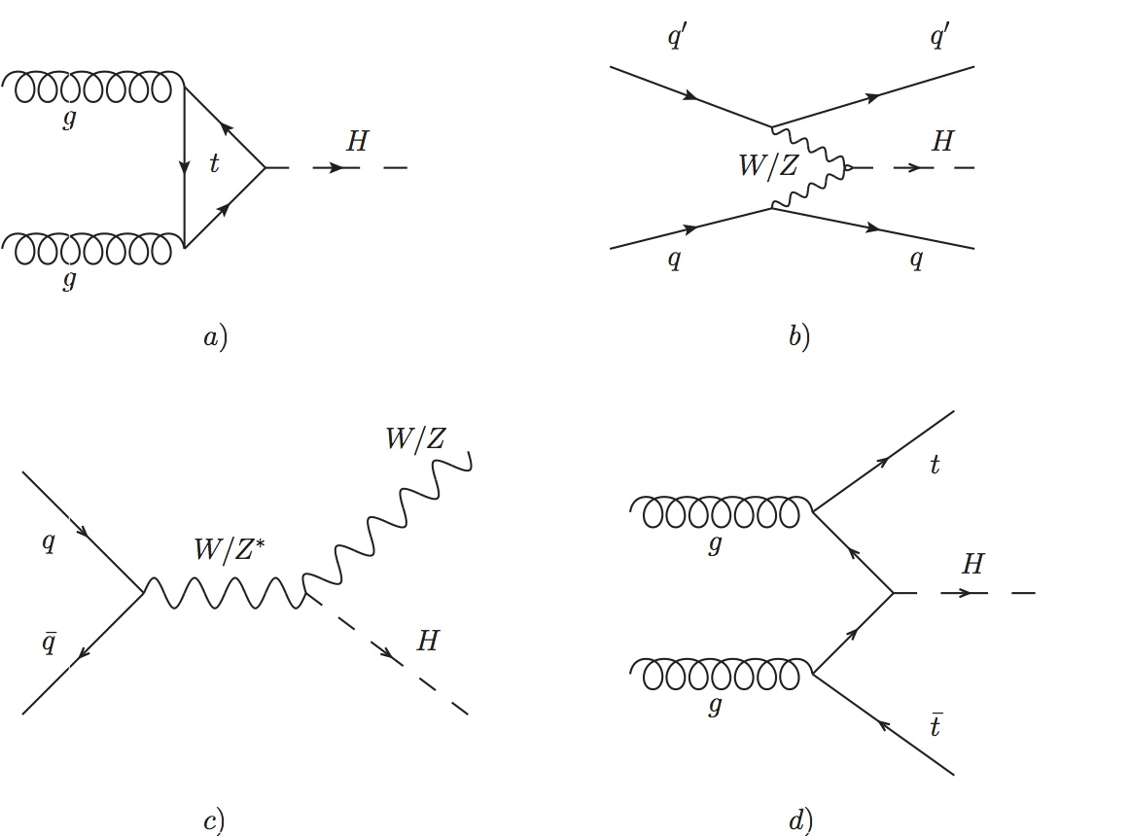
Major production mechanisms
(borrowed from https://grab-group.ethz.ch/research/higgs-boson.html)

Slide 5
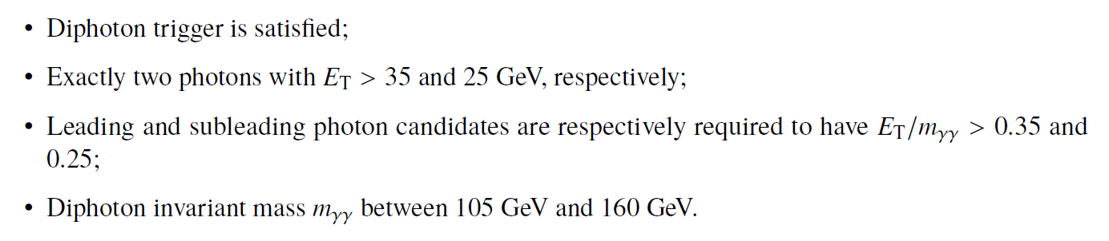
Event selection for Hγγ peak

Slide 6
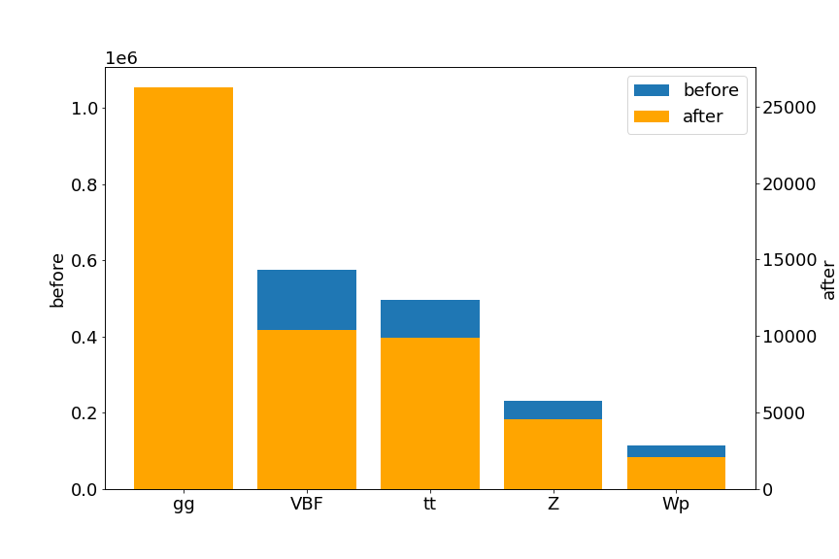
Selection efficiency ~ 1%
MC
Number of events per process

Slide 7
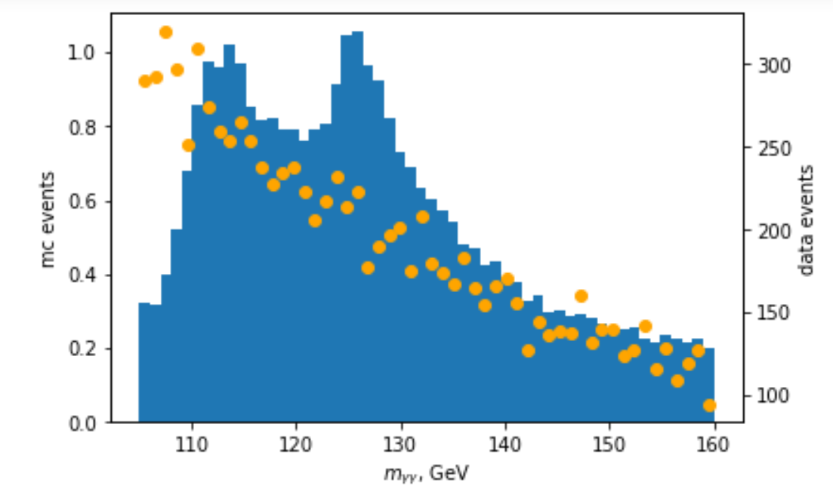
Higgs mass from ATLAS Open Data
8M events in 7 minutes!

Slide 8
Acquire data efficiently
8M events in 7 minutes with Python!

Slide 9

Data pipeline
1TB Root files storage

Slide 10

Data pipeline
Processing power and data traffic
UpRoot (xrootd)
1TB Root files storage
CERN lxplus

Slide 11
Data pipeline
Processing power and data traffic
UpRoot (xrootd)
NumPy
1TB Root files storage
Processed files storage
CERN lxplus

Slide 12

Data pipeline
Processing power and data traffic
UpRoot (xrootd)
NumPy
1TB Root files storage
Processed files storage
CERN lxplus
Jupyter over SSH
User Interface

Slide 13
Data pipeline
Processing power and data traffic
1TB Root files storage
NumPy
UpRoot (xrootd)
CERN lxplus
2GB – 100 GB
Batches 200MB
~ 100 000 events
Store processed
~ 2MB
~1000 events/batch

Slide 14
What’s inside?
XSection
SumWeights
Simulation wide
runNumber
eventNumber
channelNumber
mcWeight
scaleFactor_*
trig*
met_et
met_et_syst
met_phi
ditau_m
Macro features
1 number per event
photon_n
photon_truthMatched
photon_trigMatched
photon_pt
photon_eta
photon_phi
photon_E
photon_isTightID
photon_ptcone30
photon_etcone20
photon_convType
photon_pt_syst
lep_n
lep_truthMatched
lep_trigMatched
lep_pt
lep_eta
lep_phi
lep_E
lep_z0
lep_charge
lep_type
lep_isTightID
lep_ptcone30
lep_etcone20
lep_trackd0pvunbiased
lep_tracksigd0pvunbiased
lep_pt_syst
tau_n
tau_pt
tau_eta
tau_phi
tau_E
tau_isTightID
tau_truthMatched
tau_trigMatched
tau_nTracks
tau_BDTid
tau_pt_syst
tau_charge
jet_n
jet_pt
jet_eta
jet_phi
jet_E
jet_jvt
jet_trueflav
jet_truthMatched
jet_MV2c10
jet_pt_syst
largeRjet_n
largeRjet_pt
largeRjet_eta
largeRjet_phi
largeRjet_E
largeRjet_m
largeRjet_truthMatched
largeRjet_D2
largeRjet_tau32
largeRjet_pt_syst
Micro features
Jagged. List of numbers
per event

Slide 15
Mask bubbling for feature extraction
XSection
SumWeights
Simulation wide
runNumber
eventNumber
channelNumber
mcWeight
scaleFactor_*
trig*
met_et
met_et_syst
met_phi
ditau_m
Macro features
[0, 0, 1, 1, 0, 1 ...]
photon_n
photon_truthMatched
photon_trigMatched
photon_pt
photon_eta
photon_phi
photon_E
photon_isTightID
photon_ptcone30
photon_etcone20
photon_convType
photon_pt_syst
lep_n
lep_truthMatched
lep_trigMatched
lep_pt
lep_eta
lep_phi
lep_E
lep_z0
lep_charge
lep_type
lep_isTightID
lep_ptcone30
lep_etcone20
lep_trackd0pvunbiased
lep_tracksigd0pvunbiased
lep_pt_syst
tau_n
tau_pt
tau_eta
tau_phi
tau_E
tau_isTightID
tau_truthMatched
tau_trigMatched
tau_nTracks
tau_BDTid
tau_pt_syst
tau_charge
jet_n
jet_pt
jet_eta
jet_phi
jet_E
jet_jvt
jet_trueflav
jet_truthMatched
jet_MV2c10
jet_pt_syst
largeRjet_n
largeRjet_pt
largeRjet_eta
largeRjet_phi
largeRjet_E
largeRjet_m
largeRjet_truthMatched
largeRjet_D2
largeRjet_tau32
largeRjet_pt_syst
MASK
1000 events
800
Photon Features
Micro features

Slide 16
Mask bubbling for feature extraction
XSection
SumWeights
Simulation wide
runNumber
eventNumber
channelNumber
mcWeight
scaleFactor_*
trig*
met_et
met_et_syst
met_phi
ditau_m
Macro features
[0, 0, 1, 1, 0, 1 ...]
[0, 0, 0, 1, 0, 1 ...]
>
photon_n
photon_truthMatched
photon_trigMatched
photon_pt
photon_eta
photon_phi
photon_E
photon_isTightID
photon_ptcone30
photon_etcone20
photon_convType
photon_pt_syst
lep_n
lep_truthMatched
lep_trigMatched
lep_pt
lep_eta
lep_phi
lep_E
lep_z0
lep_charge
lep_type
lep_isTightID
lep_ptcone30
lep_etcone20
lep_trackd0pvunbiased
lep_tracksigd0pvunbiased
lep_pt_syst
tau_n
tau_pt
tau_eta
tau_phi
tau_E
tau_isTightID
tau_truthMatched
tau_trigMatched
tau_nTracks
tau_BDTid
tau_pt_syst
tau_charge
jet_n
jet_pt
jet_eta
jet_phi
jet_E
jet_jvt
jet_trueflav
jet_truthMatched
jet_MV2c10
jet_pt_syst
largeRjet_n
largeRjet_pt
largeRjet_eta
largeRjet_phi
largeRjet_E
largeRjet_m
largeRjet_truthMatched
largeRjet_D2
largeRjet_tau32
largeRjet_pt_syst
MASK
MASK
1000 events
800
600
Photon Features
Lepton Features
Micro features

Slide 17
Mask bubbling for feature extraction
XSection
SumWeights
Simulation wide
runNumber
eventNumber
channelNumber
mcWeight
scaleFactor_*
trig*
met_et
met_et_syst
met_phi
ditau_m
Macro features
[0, 0, 1, 1, 0, 1 ...]
[0, 0, 0, 1, 0, 1 ...]
[0, 0, 0, 1, 0, 0 ...]
>
>
photon_n
photon_truthMatched
photon_trigMatched
photon_pt
photon_eta
photon_phi
photon_E
photon_isTightID
photon_ptcone30
photon_etcone20
photon_convType
photon_pt_syst
lep_n
lep_truthMatched
lep_trigMatched
lep_pt
lep_eta
lep_phi
lep_E
lep_z0
lep_charge
lep_type
lep_isTightID
lep_ptcone30
lep_etcone20
lep_trackd0pvunbiased
lep_tracksigd0pvunbiased
lep_pt_syst
tau_n
tau_pt
tau_eta
tau_phi
tau_E
tau_isTightID
tau_truthMatched
tau_trigMatched
tau_nTracks
tau_BDTid
tau_pt_syst
tau_charge
jet_n
jet_pt
jet_eta
jet_phi
jet_E
jet_jvt
jet_trueflav
jet_truthMatched
jet_MV2c10
jet_pt_syst
largeRjet_n
largeRjet_pt
largeRjet_eta
largeRjet_phi
largeRjet_E
largeRjet_m
largeRjet_truthMatched
largeRjet_D2
largeRjet_tau32
largeRjet_pt_syst
MASK
MASK
MASK
1000 events
250 events
800
600
300
Photon Features
Lepton Features
Tau Features
Micro features

Slide 18
Mask bubbling for feature extraction
XSection
SumWeights
Simulation wide
runNumber
eventNumber
channelNumber
mcWeight
scaleFactor_*
trig*
met_et
met_et_syst
met_phi
ditau_m
Macro features
[0, 0, 1, 1, 0, 1 ...]
[0, 0, 0, 1, 0, 1 ...]
[0, 0, 0, 1, 0, 0 ...]
>
>
photon_n
photon_truthMatched
photon_trigMatched
photon_pt
photon_eta
photon_phi
photon_E
photon_isTightID
photon_ptcone30
photon_etcone20
photon_convType
photon_pt_syst
lep_n
lep_truthMatched
lep_trigMatched
lep_pt
lep_eta
lep_phi
lep_E
lep_z0
lep_charge
lep_type
lep_isTightID
lep_ptcone30
lep_etcone20
lep_trackd0pvunbiased
lep_tracksigd0pvunbiased
lep_pt_syst
tau_n
tau_pt
tau_eta
tau_phi
tau_E
tau_isTightID
tau_truthMatched
tau_trigMatched
tau_nTracks
tau_BDTid
tau_pt_syst
tau_charge
jet_n
jet_pt
jet_eta
jet_phi
jet_E
jet_jvt
jet_trueflav
jet_truthMatched
jet_MV2c10
jet_pt_syst
largeRjet_n
largeRjet_pt
largeRjet_eta
largeRjet_phi
largeRjet_E
largeRjet_m
largeRjet_truthMatched
largeRjet_D2
largeRjet_tau32
largeRjet_pt_syst
MASK
MASK
MASK
1000 events
250 events
800
600
250
Photon Features
Lepton Features
Tau Features
Micro features
MASK

Slide 19
Mask bubbling for feature extraction
XSection
SumWeights
Simulation wide
runNumber
eventNumber
channelNumber
mcWeight
scaleFactor_*
trig*
met_et
met_et_syst
met_phi
ditau_m
Macro features
[0, 0, 1, 1, 0, 1 ...]
[0, 0, 0, 1, 0, 1 ...]
[0, 0, 0, 1, 0, 0 ...]
>
>
photon_n
photon_truthMatched
photon_trigMatched
photon_pt
photon_eta
photon_phi
photon_E
photon_isTightID
photon_ptcone30
photon_etcone20
photon_convType
photon_pt_syst
lep_n
lep_truthMatched
lep_trigMatched
lep_pt
lep_eta
lep_phi
lep_E
lep_z0
lep_charge
lep_type
lep_isTightID
lep_ptcone30
lep_etcone20
lep_trackd0pvunbiased
lep_tracksigd0pvunbiased
lep_pt_syst
tau_n
tau_pt
tau_eta
tau_phi
tau_E
tau_isTightID
tau_truthMatched
tau_trigMatched
tau_nTracks
tau_BDTid
tau_pt_syst
tau_charge
jet_n
jet_pt
jet_eta
jet_phi
jet_E
jet_jvt
jet_trueflav
jet_truthMatched
jet_MV2c10
jet_pt_syst
largeRjet_n
largeRjet_pt
largeRjet_eta
largeRjet_phi
largeRjet_E
largeRjet_m
largeRjet_truthMatched
largeRjet_D2
largeRjet_tau32
largeRjet_pt_syst
MASK
MASK
MASK
1000 events
250 events
800
250
250
Photon Features
Lepton Features
Tau Features
Micro features
MASK
MASK

Slide 20
Mask bubbling for feature extraction
XSection
SumWeights
Simulation wide
runNumber
eventNumber
channelNumber
mcWeight
scaleFactor_*
trig*
met_et
met_et_syst
met_phi
ditau_m
Macro features
[0, 0, 1, 1, 0, 1 ...]
[0, 0, 0, 1, 0, 1 ...]
[0, 0, 0, 1, 0, 0 ...]
>
>
photon_n
photon_truthMatched
photon_trigMatched
photon_pt
photon_eta
photon_phi
photon_E
photon_isTightID
photon_ptcone30
photon_etcone20
photon_convType
photon_pt_syst
lep_n
lep_truthMatched
lep_trigMatched
lep_pt
lep_eta
lep_phi
lep_E
lep_z0
lep_charge
lep_type
lep_isTightID
lep_ptcone30
lep_etcone20
lep_trackd0pvunbiased
lep_tracksigd0pvunbiased
lep_pt_syst
tau_n
tau_pt
tau_eta
tau_phi
tau_E
tau_isTightID
tau_truthMatched
tau_trigMatched
tau_nTracks
tau_BDTid
tau_pt_syst
tau_charge
jet_n
jet_pt
jet_eta
jet_phi
jet_E
jet_jvt
jet_trueflav
jet_truthMatched
jet_MV2c10
jet_pt_syst
largeRjet_n
largeRjet_pt
largeRjet_eta
largeRjet_phi
largeRjet_E
largeRjet_m
largeRjet_truthMatched
largeRjet_D2
largeRjet_tau32
largeRjet_pt_syst
MASK
MASK
MASK
1000 events
250 events
250
250
250
Photon Features
Lepton Features
Tau Features
Micro features
MASK
MASK
MASK

Slide 21
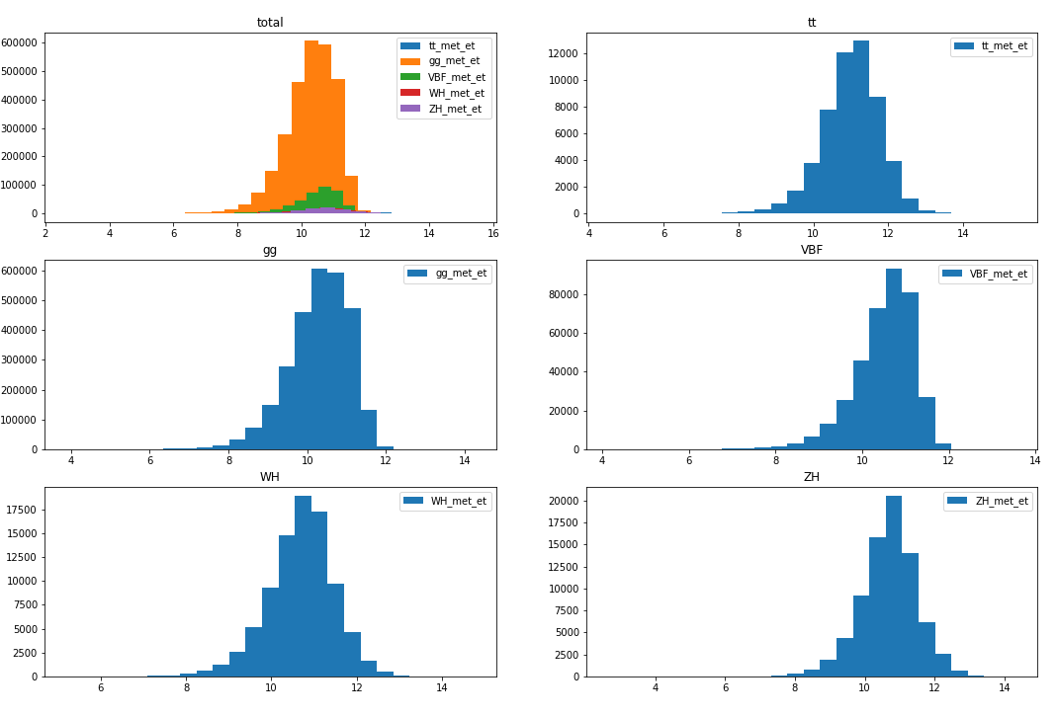
Missing energy Et (log x scale)
Within 100 000 events batch

Slide 22
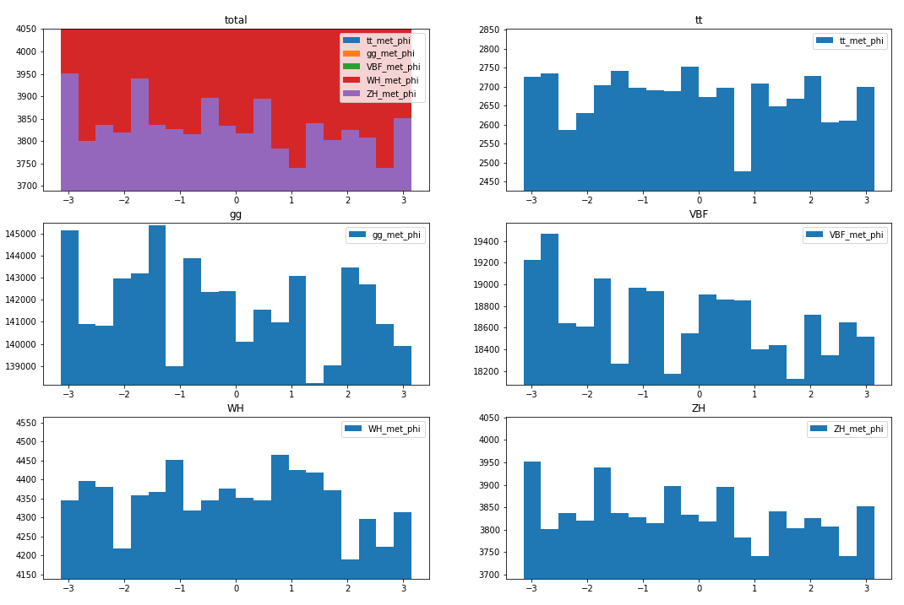
Missing energy Phi
Within 100 000 events batch

Slide 23
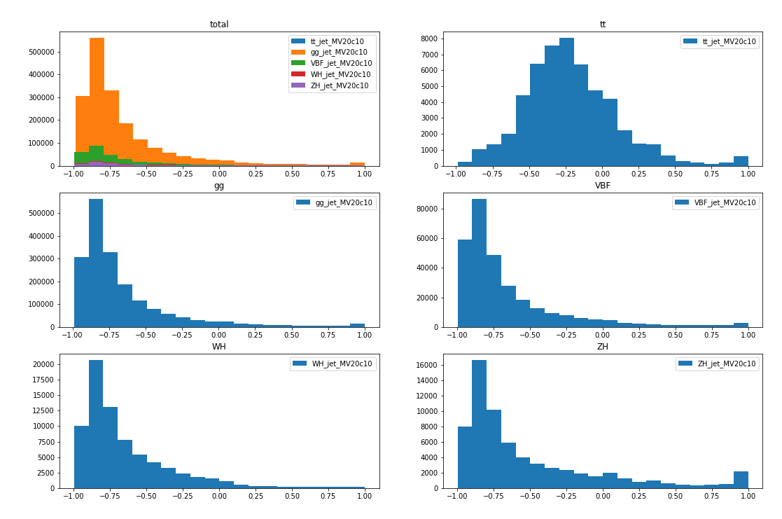
Jet b-tagging score
Within 100 000 events batch

Slide 24
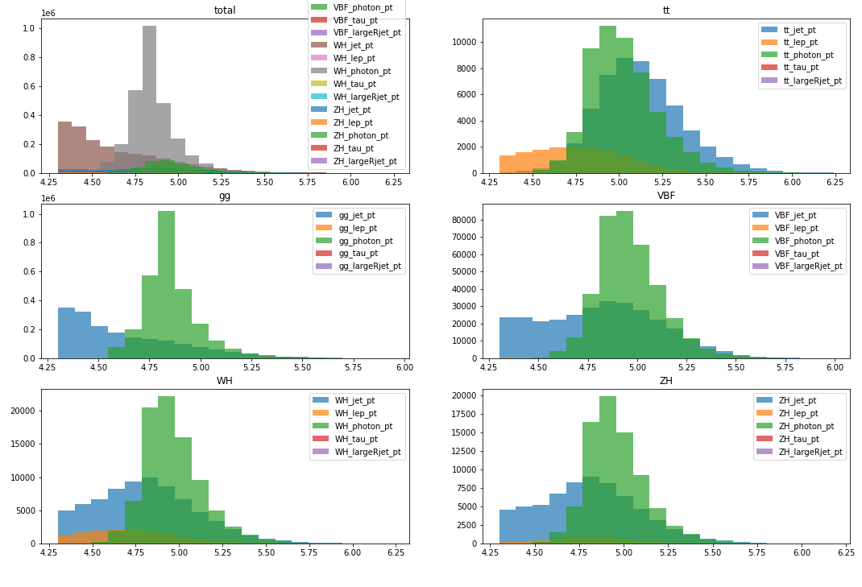
Max pT per particle type (log x scale)
Within 100 000 events batch

Slide 25
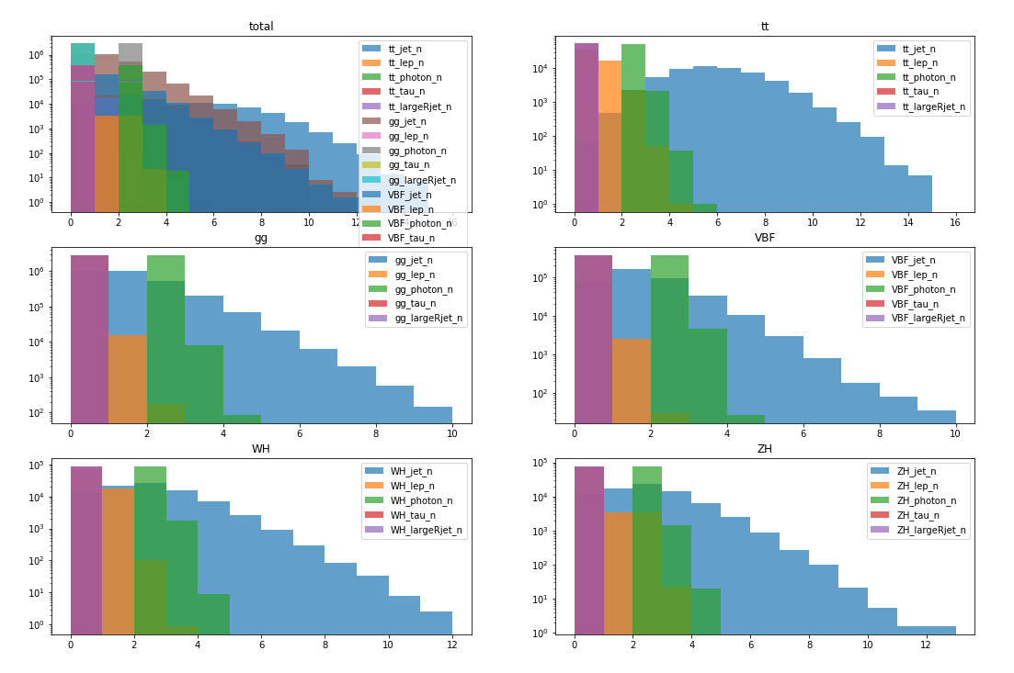
Number of particles (log y scale)
Within 100 000 events batch

Slide 26
Jagged data. Structure of micro features
Photon pT
1.
Photon N = 3
2.
Photon N = 2
3.
Photon N = 1
Events
4.
Photon N = 4
5.
Photon N = 4
6.
Photon N = 3

Slide 27
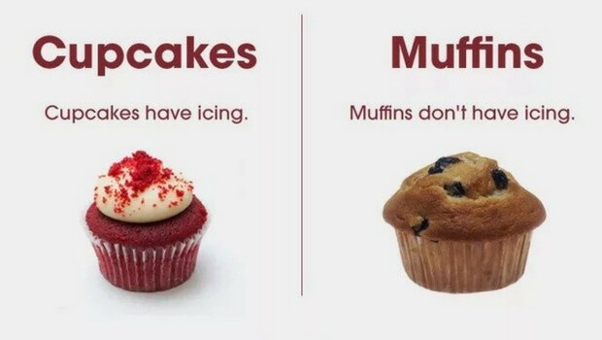
How similar are them?
?

Slide 28

Option: Aggregation
max
avg
min

Slide 29
Option: Aggregation
max
avg
min
?
?
?

Slide 30
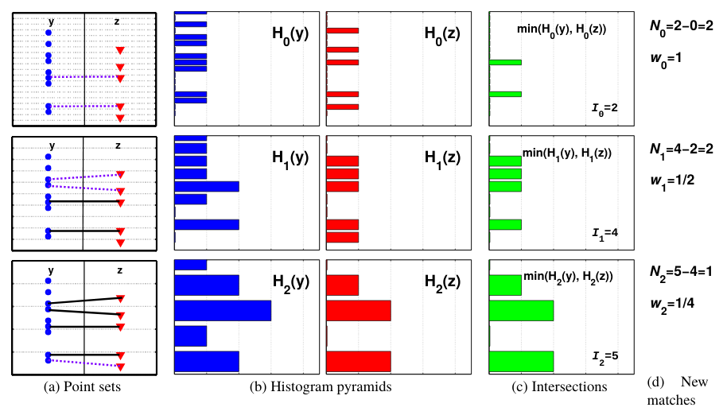

Option: Set Kernels (Pyramid match)
Reference: http://jmlr.csail.mit.edu/papers/volume8/grauman07a/grauman07a.pdf

Slide 31
Option: Set Kernels
+ Operation in non-linearly transformed feature space at no cost (Kernel trick)
Interpretable. Not a black box.
– Compute and store N x N matrix of distances (N – number of training instances)
N² memory consumption
Incremental learning is not easily achievable. 1 extra training point triggers N calls to kernel.
Reference: StackExchange «What are the limitations of kernel methods?»

Slide 32
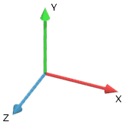
Option: Embedding with NN «DeepSets»
Neural Net
«DeepSets»
Reference: https://arxiv.org/abs/1703.06114

Slide 33
Option: Embedding with NN «DeepSets»
+ Order independence. Treat set of particles as a set
Get feature embedding model in addition to the classifier
– Neural networks are black box
Training requires significant amount of data
Reference: StackExchange «What are the limitations of kernel methods?»

Slide 34
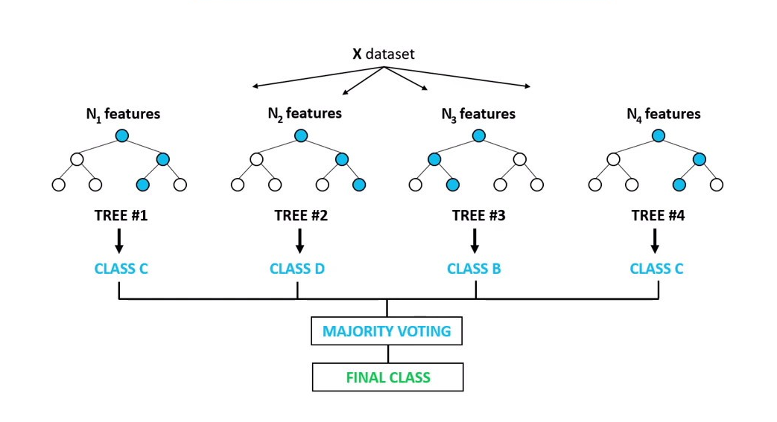
Baseline classifier: Random forest
Reference: https://www.wikiwand.com/en/Random_forest#From_bagging_to_random_forests

Slide 35
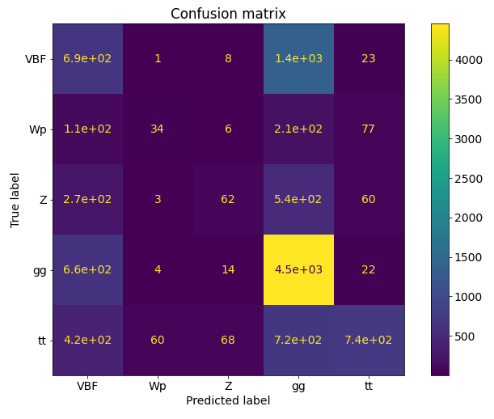
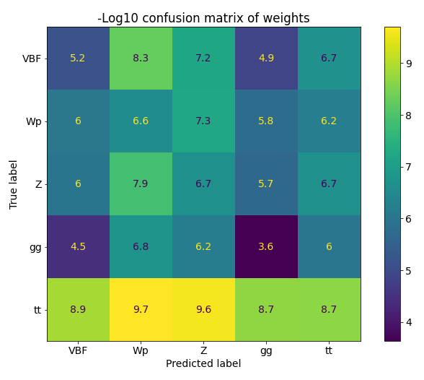
Baseline classifier: Random forest

Slide 36
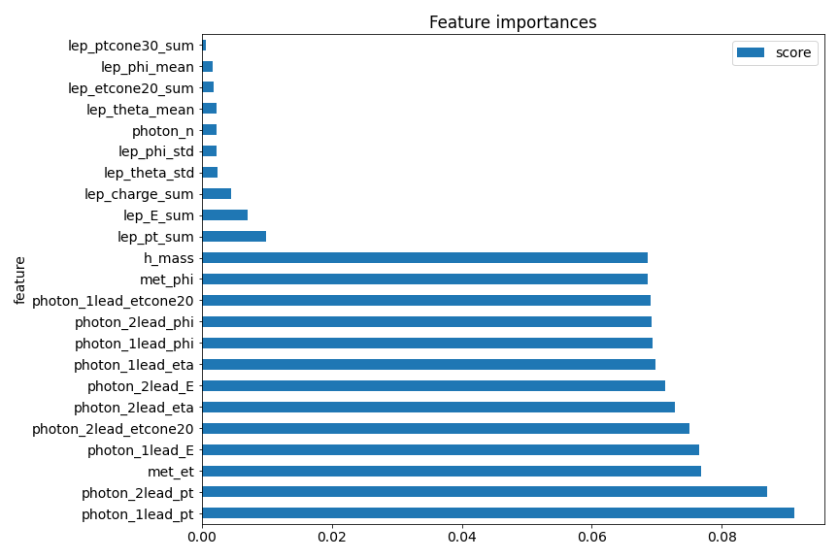
Baseline classifier: Random forest

Slide 37
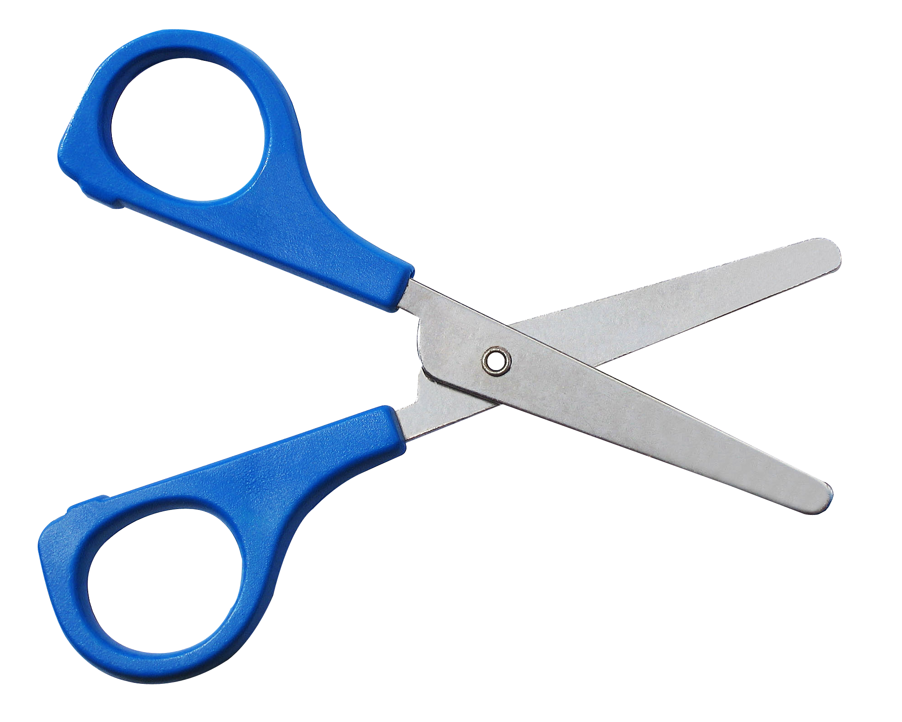
Baseline classifier: Random forest

Slide 38
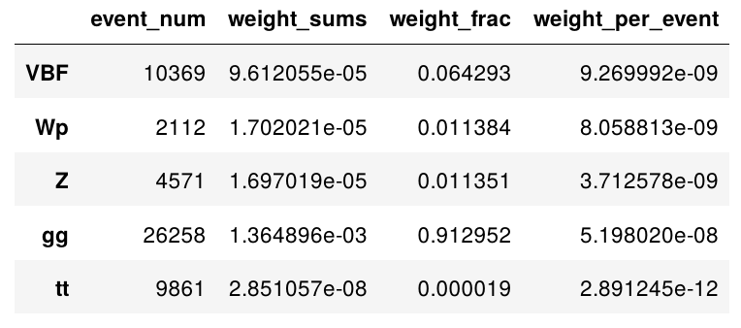
Imbalanced data

Slide 39

Fighting imbalanced data with bagging
Bootstrap sample
Undersampling
Reference: «Bagging and Random forest for imbalanced classification»

Slide 40


Fighting imbalanced data with bagging
Bagging
Reference: «Bagging and Random forest for imbalanced classification»

Slide 41
Fighting imbalanced data with bagging
EasyEnsemble
Reference: «Bagging and Random forest for imbalanced classification»

Slide 42
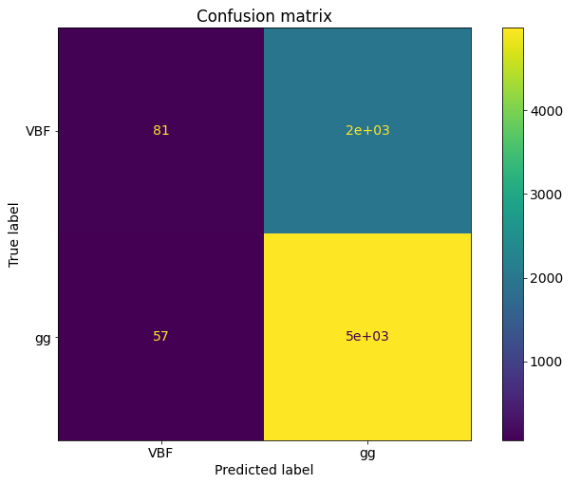
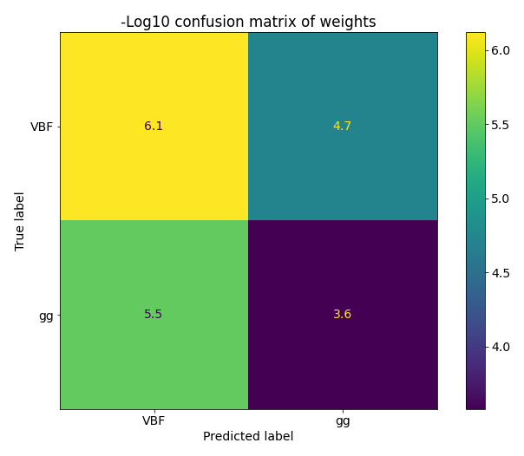
EasyEnsemble model

Slide 43
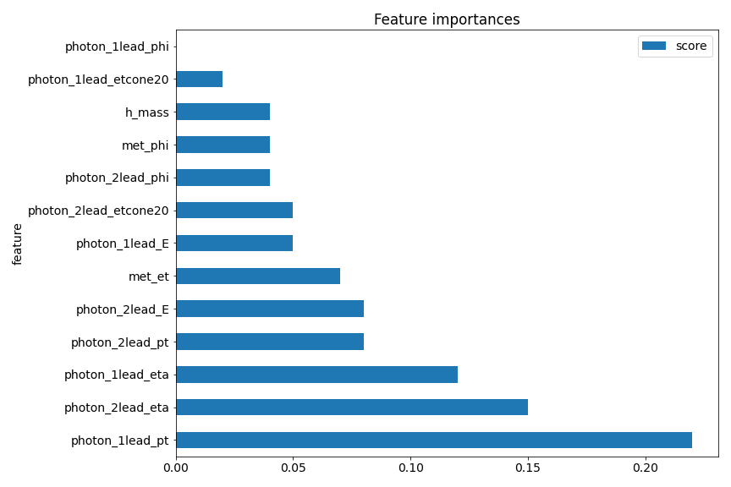
EasyEnsemble model

Slide 44
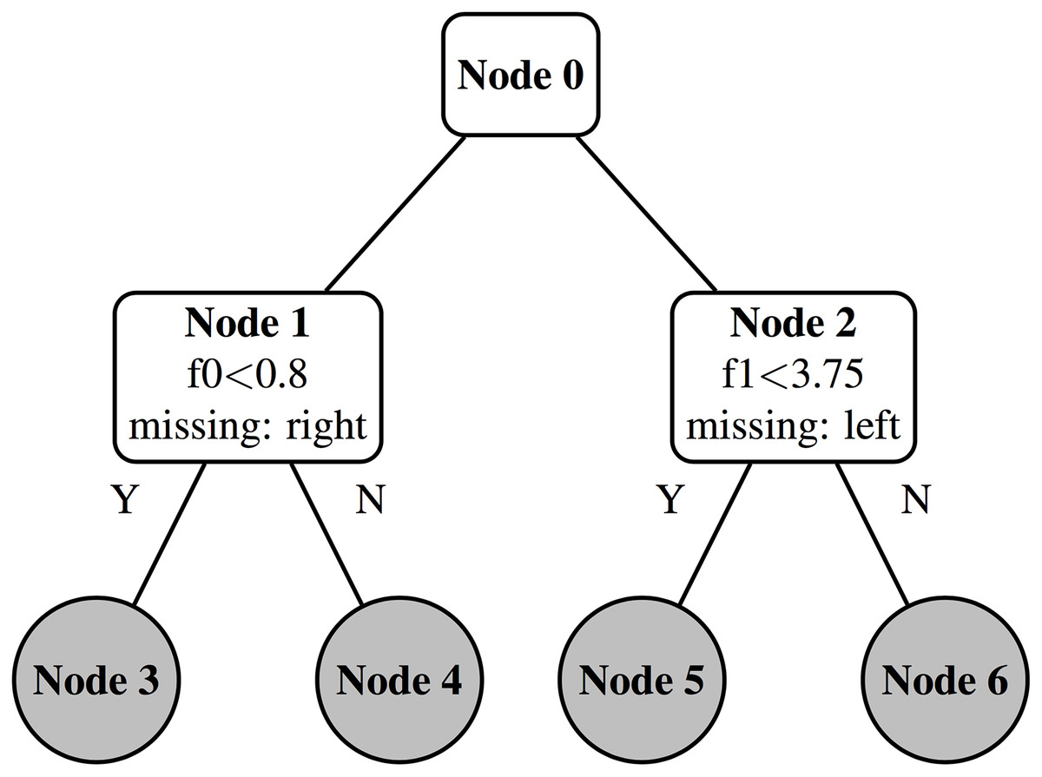
Alternative to downsampling. XGBoost
Decision Tree

Slide 45
Alternative to downsampling. XGBoost
XGBoost Tree

Slide 46
Conclusion
It is possible to analyze HEP data with Python without loss in efficiency (in comparison to C++)
HEP datasets are jagged. Possible solutions include:
feature aggregation
set kernels (Pyramid Match)
feature embedding (DeepSets or alternatives)
HEP datasets are imbalanced. Possible solutions include:
downsampling
oversampling
missing data distribution fit (xgboost)

Slide 47
Backup

Slide 48
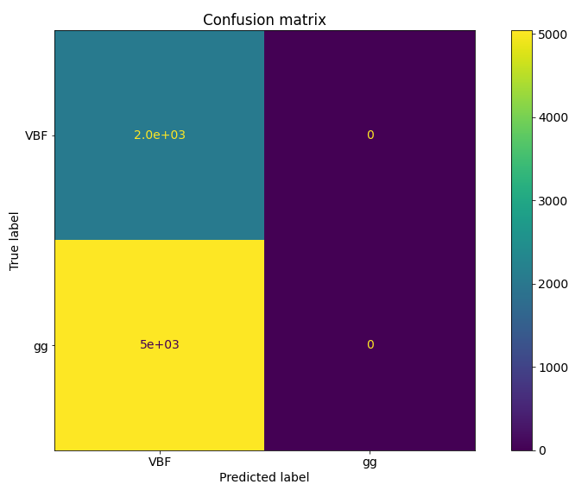
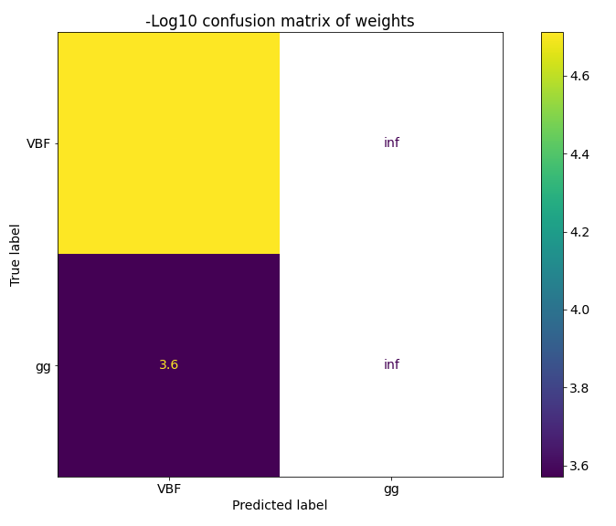
XGBoost

Slide 49
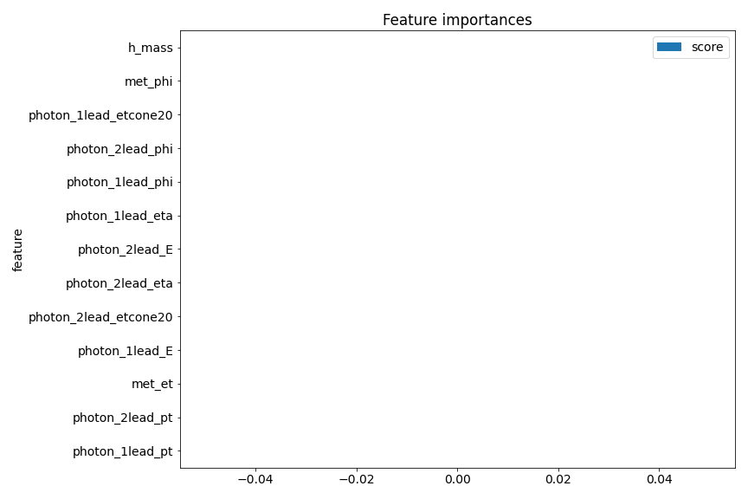
XGBoost

