Slide 1
Social Media Presence Comparison for Topeka’s two biggest healthcare facilities:
Vinecia Haugsness
May, 2018
Capstone Project
MIS670 – Social Media Analytics and Web Mining

Slide 2
BUSINESS PROBLEM & APPROACH
Stormont-Vail is aware of the importance of an online presence to connect with our patients and I am interested in comparing our reach and integration versus our neighbor of University of Kansas Health Systems - St. Francis Campus.
I will extract and analyze both Facebook and Twitter data.
Is there opportunities to improve our presence based on neighbors?

Slide 3

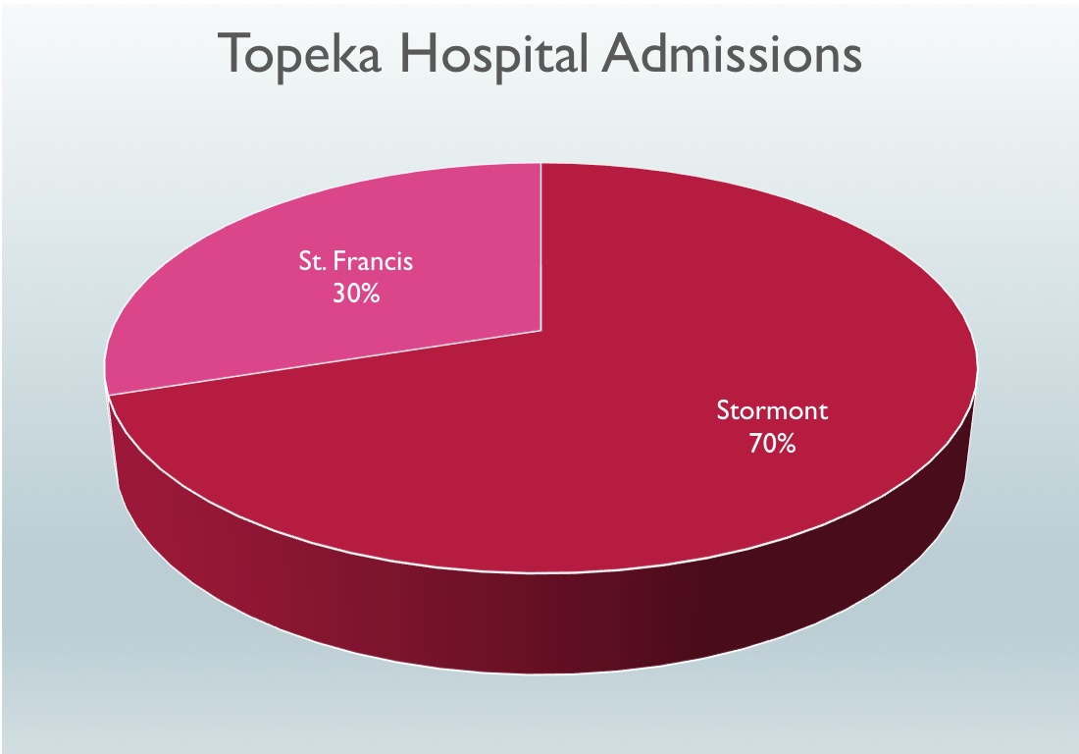
Does Social Media Presence reflect similar?

Slide 4
COMPARISONS FOR LAST 12 MONTHS:
 | Stormont-Vail Health | The University of Kansas Health Systems - St. Francis Campus
 | @stormontvailhealth | @kutopeka
# of Facebook Followers | 9,479 | 6,773
# of Facebook Like-ers | 9,561 | 6,934
Status Updates | 590 | 86

Slide 5
COMPARISONS FOR LAST 12 MONTHS:
 | Stormont-Vail Health | The University of Kansas Health Systems - St. Francis Campus
 | @stormontvailhealth | @kutopeka
Comment Counts | 2,676 | 207
Share Counts | 6882 | 920
Like Counts | 35,854 | 5,179

Slide 6
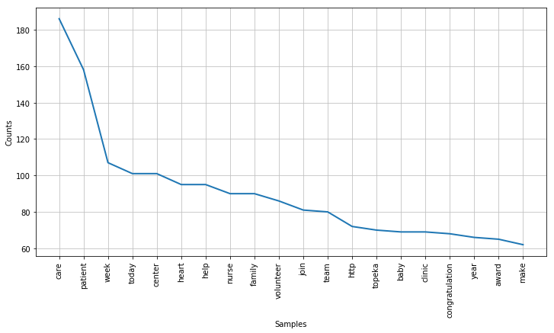
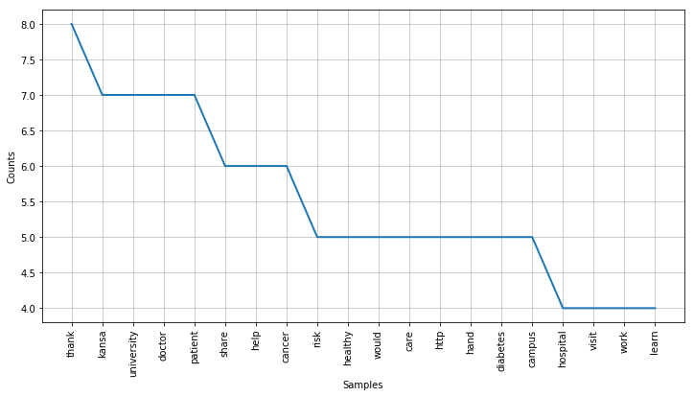
WORD FREQUENCY ANALYSIS:
Stormont-Vail
St. Francis
Stormont you can see repetitive nature of care, patient, WEEK, today. This is indicative of the 550 posts over 12 months.
St. Francis you can see theme of Kansas, University, Thanks, Patient. Focused on the transfer of ownership.

Slide 7
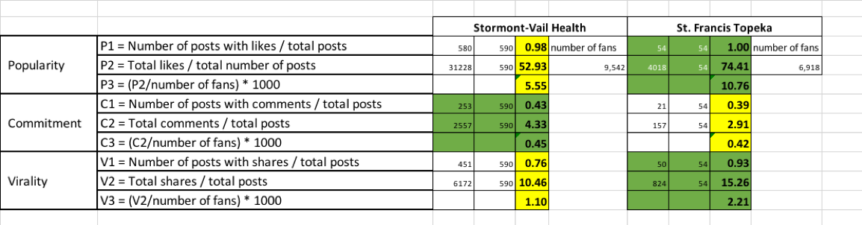
GTM FAN PAGE METRICS:
Stormont-Vail has historically held a 70/30 split of market share and is monitoring closely with St. Francis under new ownership and management.
Stormont-Vail is the strong and steady which is confirmed by its commitment statistics, but SF Topeka is the new exciting game in town which explains the popularity and virality statistics.

Slide 8

COMPARISON: NO DATE LIMITATIONS
 | Stormont-Vail Health | The University of Kansas Health Systems - St. Francis Campus
 | @stormontvail | @stfrancistopeka
Tweets | 1656 | 683
Following | 59 | 359
Followers | 449 | 597
Likes | 107 | 57

Slide 9
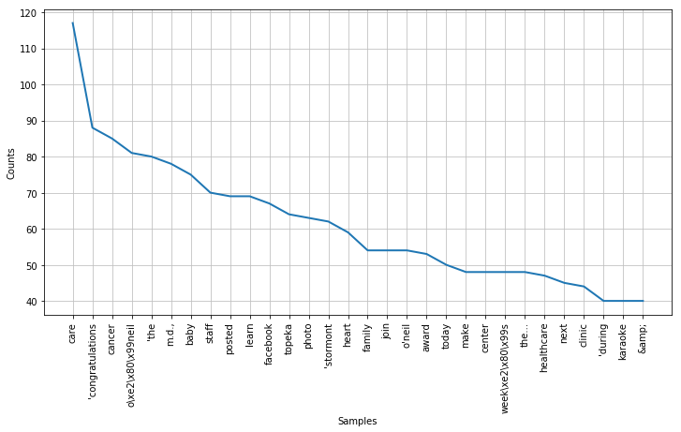
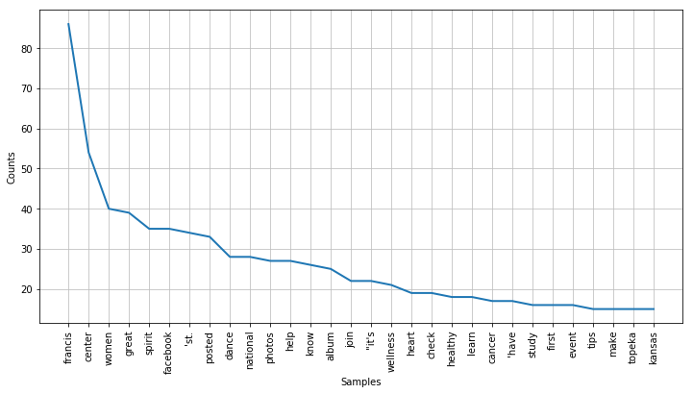
COMPARISON: TWEET WORD ANALYSIS
Stormont-Vail
St. Francis
Stormont is focused on care, congratulations, baby, and also facebook.
Stormont is duplicative of posting the same posts/content on both pages in the same timeframe.
St. Francis is focused on center, women, and facebook is a fairly high mention.
St. Francis has a more active Facebook account – so this correlates.

Slide 10
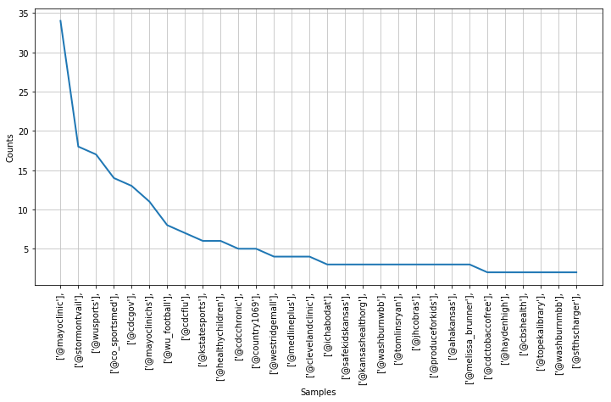
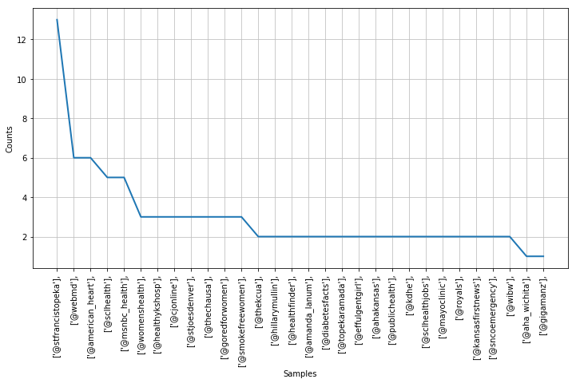
COMPARISON: TAGGING ANALYSIS
Stormont-Vail
St. Francis
Stormont you can see their emphasis on their partnerships with
@mayoclinic, @wusports, and @kstatesports.
St. Francis you can see self mention under both
@stfrancistopeka and @sclhealth and several job related mentions

Slide 11
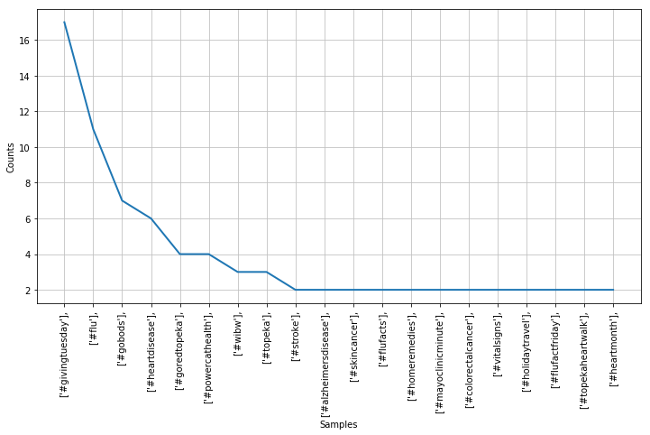
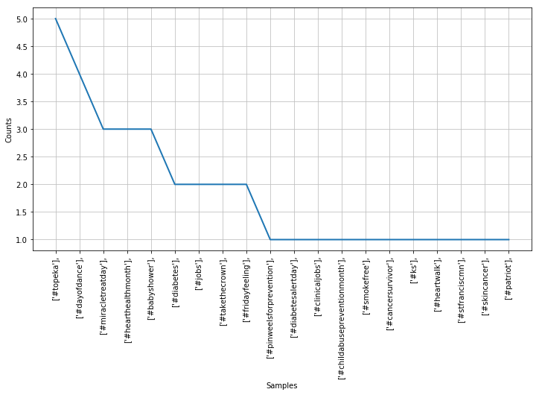
COMPARISON: HASHTAG ANALYSIS
Stormont-Vail
St. Francis
Stormont you can see repetitive nature of #givingtuesday #flu –
indicating the much higher rates of twitter posting.
St. Francis you can see location theme of Topeka and Jobs –
both likely to new ownership.

Slide 12
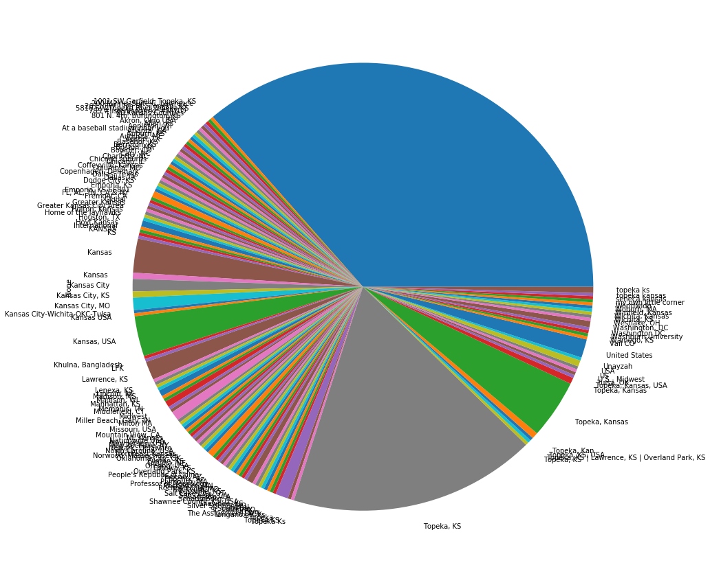
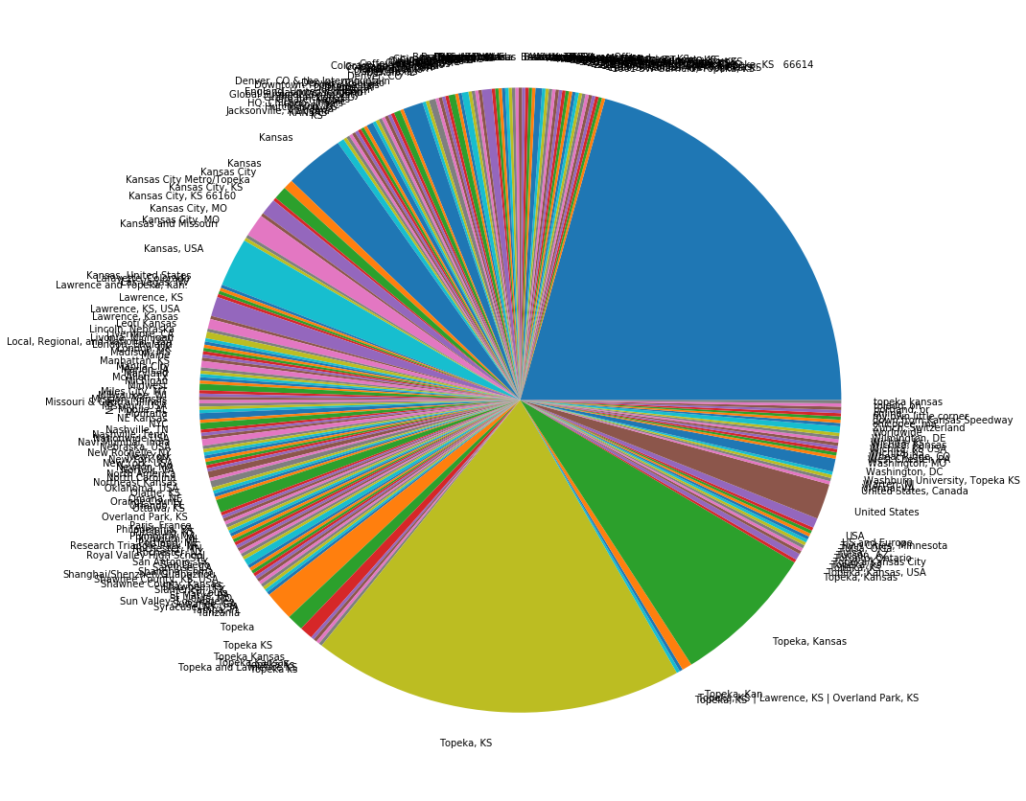
COMPARISON: DEMOGRAPHICS LOCATION
Stormont-Vail
St. Francis
Topeka, Kansas, Kansas City and multiple variations derived >95% of both followers demographics that shared location information. Being a free-text field lacks standardization.

Slide 13
SUMMARY:
Stormont-Vail is the strong and steady facility which is confirmed by its commitment statistics, but SF Topeka is the new exciting game in town which explains the popularity and virality statistics.
Stormont-Vail definitely puts in more resources and efforts with their social media presence. It shows, and it appears to be paying off! Plurality of content as well as instructiveness with its followers. Stormont is many steps ahead of St. Francis in social media presence marketing!

