Slide 1
Grocery Classification:
CNN vs. Vision Transformer
A STUDY OF TRANSFER LEARNING VS. TRAINING FROM SCRATCH
Vineela Goli | CS 5330 | Northeastern University

Slide 2
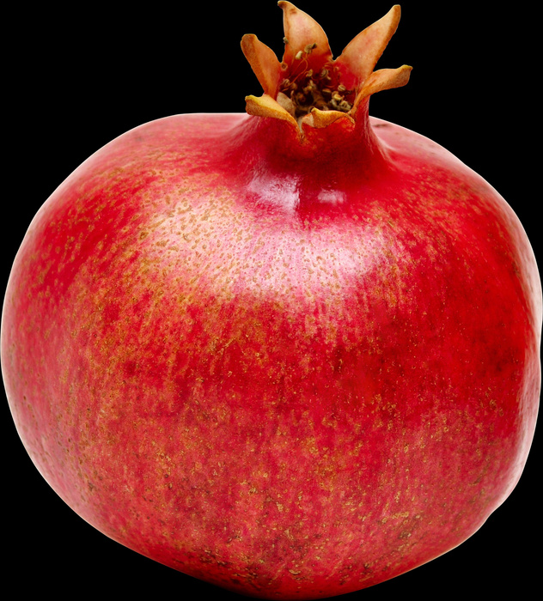
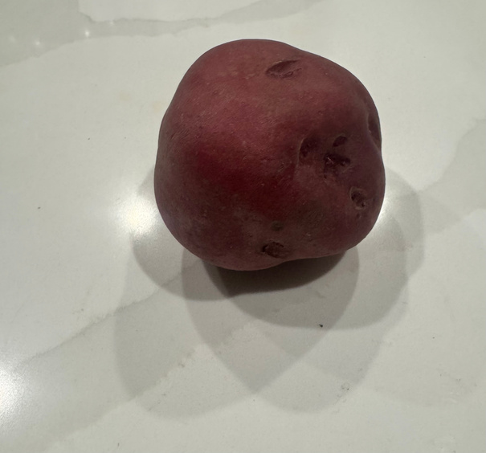
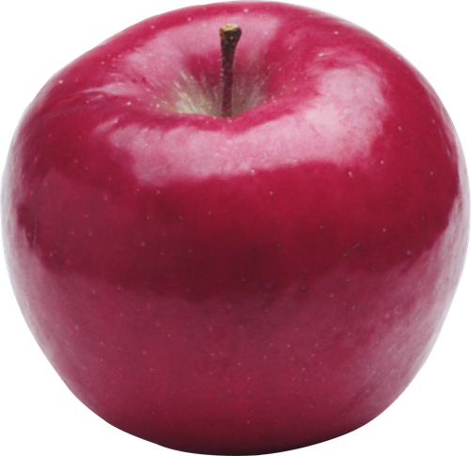
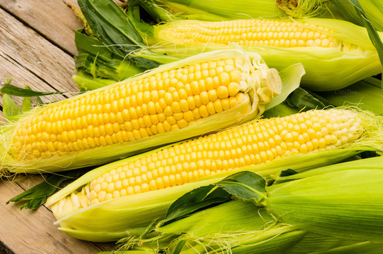
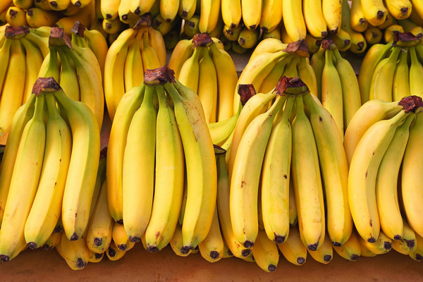
The Problem
Grocery items are visually similar (round red fruits, leafy greens, root vegetables)
Real-world photos add lighting, angles, background clutter
Goal: Classify 36 types of fruits and vegetables from images
Core Question: Can a Vision Transformer trained from scratch compete with a fine-tuned CNN?

Slide 3
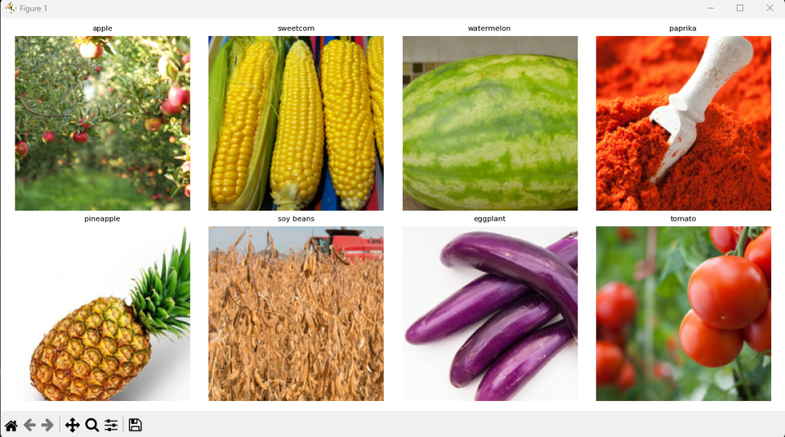
Dataset & Preprocessing
Dataset
Proprocessing Pipeline
Source: Kaggle Fruit & Vegetable Image Recognition dataset by K. Seth
36 Classes
~3136 training images, ~384 test images
Train: Resize (256x256) → RandomCrop (224×224) → RandomHorizontalFlip → Normalize
Test: Resize (256x256) → CenterCrop (224×224) → Normalize
Normalization uses ImageNet mean [0.485, 0.456, 0.406] and std [0.229, 0.224, 0.225]

Slide 4
Model Architecture
ResNet18
Vision Transformer (From Scratch)
Pretrained on ImageNet
Fine-tuned in two phases
Frozen base → replace final layer: 512 → 36 classes
All layers unfrozen and full fine-tuning
Convolution inductive bias built-in
Image split into 196 non-overlapping 16x16 patches
Projected to 192 dim embeddings + learnable positional encoding
6 transformer encoder layers, 6 attention heads
Mean token pooling → LayerNorm → 2-layer MLP (192→384→36) → 36 classes
No pretraining. Learned everything from our 3K images

Slide 5
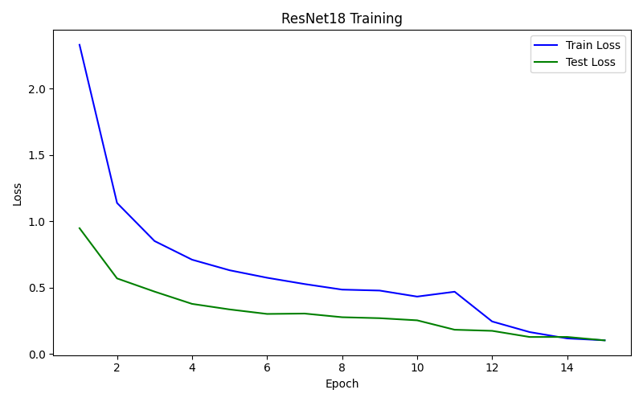
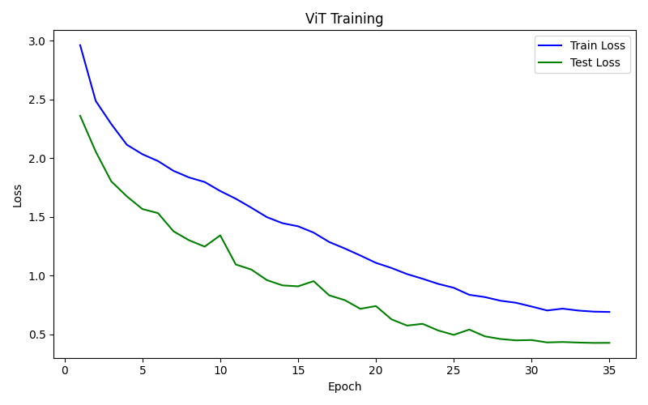
Training Strategy
ResNet18
Vision Transformer (From Scratch)
Two-phase strategy:
10 Epochs → Head Only → 1e-3(Adam) LR
5 Epochs → All layers → 1e-4(Adam) LR
35 epochs (extended from 20 after insufficient convergence)
AdamW optimizer 1e-3, weight_decay 1e-4
Cosine annealing LR scheduler

Slide 6
Results - Benchmark Accuracy
Model | Test Accuracy | Epochs | Training Time
ResNet18 | 97.49% | 15 | Fast
ViT | 90.81% | 35 | 2.3x more epochs
Per-class Highlights:
ResNet18: 29 out of 36 classes at 100% accuracy
ViT: 18 out of 36 classes at 100% accuracy
Hardest classes for both models: apple (50% ViT / 90% ResNet), banana (77.8% ViT / 77.8% ResNet), potato (70% ViT / 80% ResNet)

Slide 7
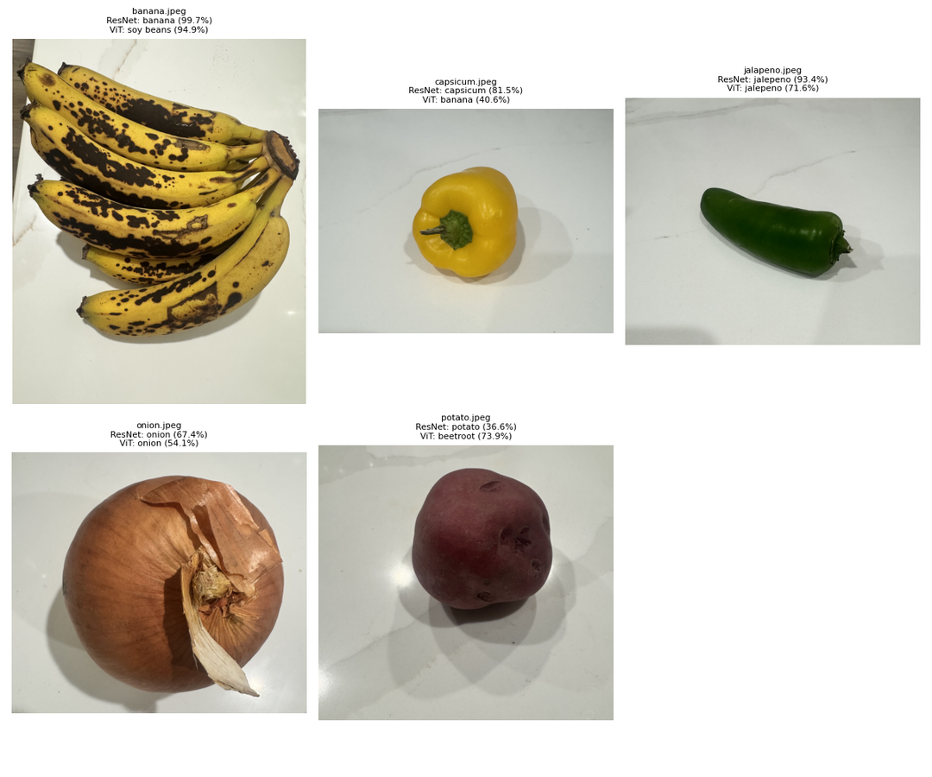
Real-World Performance
Image | True Label | ResNet18 | Confidence | ViT | Confidence
Banana | banana | banana ✅ | 99.7% | soy beans ❌ | 94.9%
capsicum | capsicum | capsicum ✅ | 81.5% | banana ❌ | 40.6%
jalapeno | jalapeno | jalapeno ✅ | 93.4% | jalapeno ✅ | 71.6%
onion | onion | onion ✅ | 67.4% | onion ✅ | 54.1%
potato | potato | potato ✅ | 36.6% | beetroot ❌ | 73.9%
Bottom line:
ResNet18: 5/5 (100%) on unseen real photos
ViT: 2/5 (40%) on unseen real photos

Slide 8
Takeaways
What we learned:
Transfer learning is the clear winner
+6.7% accuracy, 2.3x fewer epochs, 100% real-world robustness
ViTs need large-scale pretraing to compete
Our 3.7k dataset is too small
Both models struggle with visually similar classes (apple, potato, banana)
Future Direction:
Use pretrained ViT weights instead of training from scratch
(ViT-B/16 from ImageNet-21K)
Stronger data augmentation
Mixup, CutMix, Color Jitter
Expand dataset or use few-shot learning

Slide 9
Thank you!
GROCERY CLASSIFICATION: CNN VS. VISION TRANSFORMER
A study of transfer learning vs. training from scratch
Vineela Goli | CS 5330 | Northeastern University

