Slide 1

Big Data based Security Analytics for Virtualized Infrastructure in cloud computing
By
J. Vineela
14121A1231
IV B.Tech (I-Semester)
Department of Information Technology
SREE VIDYANIKETHAN ENGINEERING COLLEGE
(AUTONOMOUS)
(Approved by AICTE, Accredited by NBA and Affiliated to JNTUA, Anantapur)
2017-2018
Guide. Head of the Dept.
Dr. K. Khaja Baseer_{, M. Tech., Ph.D.,} Dr. K. Ramani, _{M .Tech.,Ph.D.,}
Associate Professor Professor and HOD

Slide 2
Contents
Abstract
Introduction
Literature Survey
Limitations
Proposed System
Advantages
Conclusion
References

Slide 3


What is cloud computing?
What is Virtualized infrastructure?

Slide 4
Abstract
Now-a-days, in this world cyber-attacks are becoming more and more and no limit for it.
The cyber attackers have more interest to attack on Virtualized infrastructure.
To attack they use the techniques are Heartbleed, VENOM, Shellshock etc.,
This seminar discusses about the BDSA approach to identify these attacks
The approach firstly determines the attack then extract the attack by using some methods.

Slide 5
cont..
This approach overcomes the cyber-attacks on software code and data
This approach is evaluated using well-known malware with existing techniques.
The BDSA approach is effective in determining attacks than other existing techniques.
This approach consists of 3 steps:
1) Collects the user data from the virtual machine and stores in HDFS.
2) Find the attack features through correlation and MapReduce parser.
3) Extract the attack through logistic regression and belief propagation methods.

Slide 6
Introduction
A Virtualized infrastructure consists of Virtual Machine’s (VM) that rely upon multi-instance resources.
The VM’s consists of large data that has became advantage for the cyber-attackers.
The techniques to attack are:
VENOM
Virtualized Environment Neglected Operations Manipulation.
The attacker break down the VM’s and access the data.

Slide 7
cont..
Heartbleed
This was the most impactful attack.
It allows attackers to read sensitive information such as Username, password, personal data.
Shellshock
It allows the attackers to enter into the Operating System and get the login details to perform attacks.
The below technique is used to extract these attacks.

Slide 8
cont..
BDSA approach
This approach is used to protect Virtualized infrastructure from these attacks.
The basic idea of this approach is to detect real time malware and attacks.
The network logs as well as the user application logs collected from the guest VMs which are stored in a Hadoop Distributed File System (HDFS).

Slide 9
Literature Survey
[1] T.-F. Yen, A. Oprea, K. Onarlioglu, T. Leetham, W. Robertson, A. Juels, and E. Kirda, “Beehive: Large-scale log analysis for detecting suspicious activity in enterprise networks,” in Proceedings of the 29th Annual Computer Security Applications Conference. New Orleans, Lousiana, USA: ACM, 2013, pp. 199–208.
It detect attacks through correlating logs. It consists of 2 steps:
1)Firstly it collects logs of data from different points within the network.
2)then the logs are parsed using known network to extract features.
It is able to detect attacks in even large amounts of data.

Slide 10
cont..
[2] J. Dean and S. Ghemawat, “MapReduce: simplified data processing on large clusters,” Communications of the ACM, vol. 51, no. 1, pp.107–113, 2008.
These parsers are programming model and easily implementation for processing and generating large data sets.
This method is used in BDSA approach.
In this there are two process. Those are:
1) Map process
This function process the key/value pair and generates the intermediate key/value pair.
2) Reduce process
This function merges all intermediate key/value pair with the same intermediate key.

Slide 11
cont..
[3] J. Oberheide, E. Cooke, and F. Jahanian, “Cloudav: N-version antivirus in the network cloud.” in USENIX Security Symposium, San Jose, California, USA, 2008, pp. 91–106.
Antivirus software is one of the most widely used tools for detecting and stopping malicious and unwanted software
The benefits of this approach are better detection of malicious software, enhanced forensics capabilities

Slide 12
cont..
[4] T. Mahmood and U. Afzal, “Security analytics: big data analytics for cyber security: a review of trends, techniques and tools,” in Information assurance (ncia), 2013 2nd national conference on. Rawalpindi, Pakistan: IEEE, 2013, pp. 129–134.
In this the various logs are obtained to determine the attack.
To detect the attack they used the correlation method.

Slide 13
cont..
[5] N.Weaver, J.Amann, J. Beekman, M. Payer et al., “The matter of heartbleed,” in Proceedings of the 2014 Conference on Internet Measurement Conference. Vancouver, BC, Canada: ACM, 2014, pp. 475–488.
The Heartbleed vulnerability was one of the most impactful.
This approach has severe impacts, risks.
It takes the personal data, username, password, etc.,

Slide 14
Limitations
To detect previously undiscovered attacks, this is often not carried out in real-time and current implementations are intrinsically non scalable.
The dependence on a regularly-updated signature database makes it limited in detecting zero-day attacks.
The completed map tasks are again executed because their output is stored on the local disks.
By increasing complexity of antivirus software and services have indirectly results in vulnerabilities.
Difficulty of performing long-running tests on real-world systems.

Slide 15
Proposed System
To overcome those limitations we use the approach called as BDSA approach.
BDSA means Big Data based Security Analytics.
The main aim is to detect attacks in real-time malware. The principles are used in the development of BDSA approach.

Slide 16
Principles
Principle 1
Unsupervised classification
Principle 2
Holistic prediction
Principle 3
Real-time
Principle 4
Efficiency
Principle 5
Deployability

Slide 17
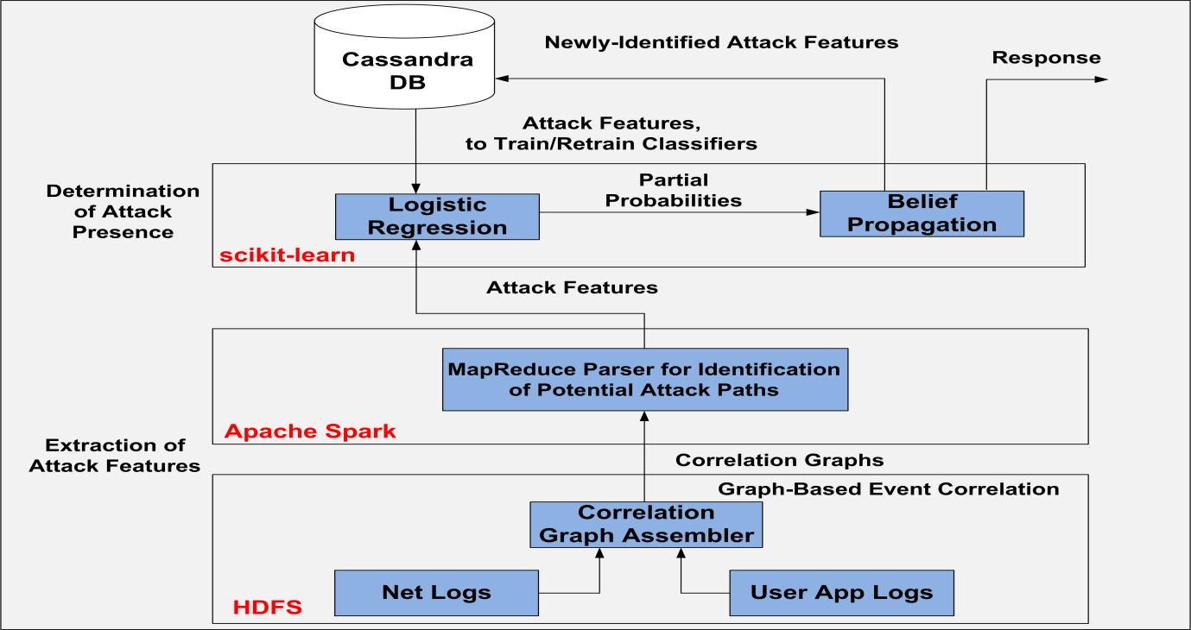
Conceptual framework of BDSA approach

Slide 18
Conceptual framework
In this approach there are two process.
Determination of attack presence.
Extraction of attack features.
1) Determination of attack presence
The stored features are loaded from the Cassandra database to train the data.
This process consists of 2 phases:
1) Logistic Regression
2) Belief Propagation

Slide 19
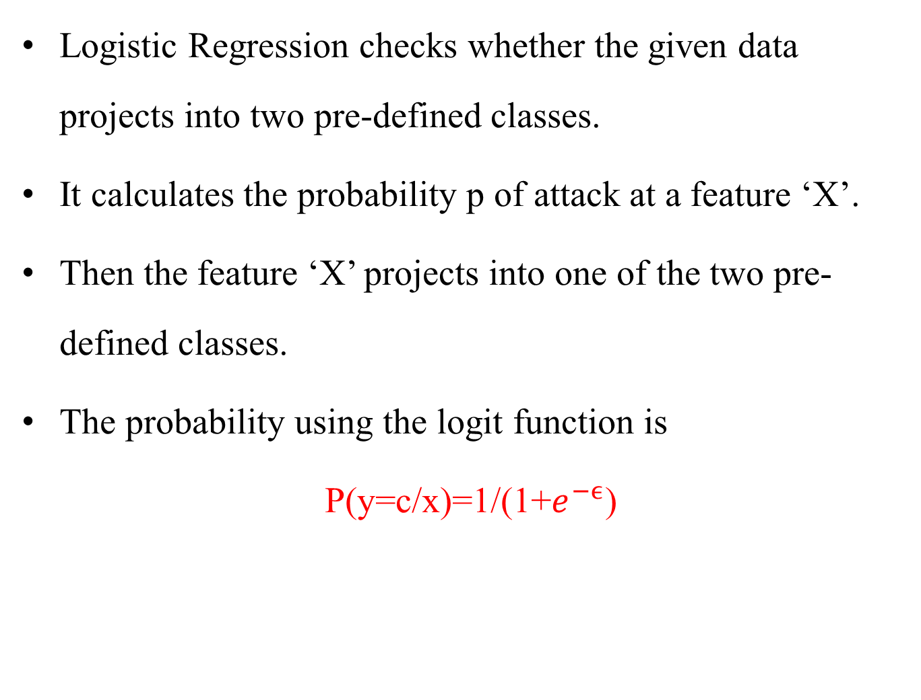
Logistic Regression
Logistic Regression checks whether the given data projects into two pre-defined classes.
It calculates the probability p of attack at a feature ‘X’.
Then the feature ‘X’ projects into one of the two pre-defined classes.
The probability using the logit function is
P(y=c/x)=1/(1+$e^{−ϵ}$)
Conditional probability

Slide 20
Belief Propagation
In this phase the input is conditional probability in order to calculate the attack presence.
To calculate the Belief attack BEL _{attack} .
BEL_{Attack} = P^{port_change} (Attack/ᵡ^{port_change}) * P^{unknown_exect} (Attack/ᵡ^{unknown_exect}) * P^{in_connect}(Attack/ᵡ^{in_connect}_{port}) * P^{out_connect}(Attack/ᵡ^{out_connect}_{port}).
where,
P^{port_change}(Attack/ᵡ^{port_change})=[P^{port_change}_{Attak},P^{port_change}_{Benign}]
P^{unknown_exect}(Attack/ᵡ^{unknown_exect}) =[P^{unknown_exect}_{Attack},P^{unknown_exect}_{Benign}]
P^{in_connect}(Attack/ᵡ^{in_connect} _{port}) =[P^{in_connect} _{Attack}, P^{in_connect} _{Benign}]
P^{out_connect}(Attack/ᵡ^{out_connect}_{port}) =[P^{out_connect} _{Attack}, P^{out_connect} _{Benign} ]

Slide 21
Extraction of Attack Feature
Extracting of attack features are
1) Graph-Based Event Correlation
2) MapReduce parser.
Graph-Based Event Correlation
The data is periodically collects from VM’s.
Each network entry is as follows
net_log:= {IP_{source}, Port_{source}, IP_{destination}, Port_{destination}}
Each application entry is as follows
app_log:={IP_{guest}, APP_{guest}, UserID_{app}, Port_{app}}

Slide 22
cont..
Each correlated entry is as follows:
Correlated_log:={IP_{source}, Port_{source}, IP_{destination}, Port_{destination}, App_{guest}, UserID_{app}}
MapReduce Parser
This function consists of two processes
1) Map process
2) Reduce process
Map process
It has the key/value pair (k_{i},v_{i}) where k_{i} is traffic flow and v_{i} is the occurrence of traffic flow.

Slide 23
cont..
Reduce process
The intermediate key/value pairs are generated from the map process.
The key/value pairs are (k’_{i},v’_{i}) where k’_{i} unified path for a source and the v’_{i} is the occurrence of count.

Slide 24
Algorithm for Belief Propagation
Input: Pport_change, Punknown_exect,Pin_connect, and Pout_connect
Begin
1: Initialize: Create the Bayesian network of attack features using factor graphs.
2: Set the factor graphs Fexe, Fin, Fout, and Fport.
3: while True do
3.1: Update the factor graphs Fexe, Fin, Fout, and Fport with the respective conditional probabilities PAttack and PBenign.
3.2: Calculate μexe->Attack, μin->Attack, μout->Attack, and μport-> Attack
3.3: For unknown_exect and in_connect, calculate Fattack.
3.4: Calculate BELAttack by using the Eq.(1)
3.5: if BELAttack< lower belief then
3.5.1: Alarm “attack presence”.
3.5.2: Update the tables in Cassandra DB with newly identified attack features.
4: End do
End

Slide 25
Algorithm for Security Analysis
Begin
1: Initialize: Obtain benign and malicious parameters of the attack features from Cassandra DB.
2: Train classifiers for monitored features using Logistic Regression.
3: while True do
3.1: Collect network and user application logs from guest VM‟s.
3.2: Filter network log entries using the guest VMs‟ IP addresses.
3.3: Form correlated log.
3.4: Use correlated log to form a correlation graph G.
3.5: Input G into MapReduce parser to identify potential attack paths {attack_paths} which is a sub-set of all graph paths.
3.6: for each attack_path in {attack_paths} do
3.6.1: i<-0.
3.6.2: for each monitored feature tfeature in attack_path do
3.6.2.1: Calculate Pport_change, Punknown_exect, Pin_connect, and Pout_connect
3.6.2.2: Pass Pport_change, Punknown_exect, Pin_connect, and Pout_connect into algorithm 1 as input.
3.6.3: End do
3.7: End do
4: End
End

Slide 26
Advantages
This approach is also implemented by using python environment.
For experiments, this approach is also implemented on running Ubuntu OS.
The ability of the BDSA approach to detect different malware attacks is evaluated by executing the two userspace malware programs as well as the two kernel-level root kits on the guest VMs.
The BDSA approach provides a fastest detection time compared to Livewire threat detection approach.

Slide 27
Conclusion
The effectiveness of the BDSA approach is evaluated by testing it against well-known malware and root kit attacks.
logistic regression enables the fast calculation of attacks conditional probabilities.
BDSA approach incurs less performance overhead in attack detection against Livewire.

Slide 28
References
K. Singh, S. C. Guntuku, A. Thakur, and C. Hota, “Big data analytics framework for peer-to-peer botnet detection using random forests,” Information Sciences, vol. 278, pp. 488–497, 2014.
M. Watson, A. Marnerides, A. Mauthe, D. Hutchison et al., “Malware detection in cloud computing infrastructures,” IEEE Transactions on Dependable and Secure Computing, pp. 192 –205, 2015.
A. Fattori, A. Lanzi, D. Balzarotti, and E. Kirda, “Hypervisor based malware protection with accessminer,” Computers & Security, vol. 52, pp. 33–50, 2015.

Slide 29


